Slide 1
Quality Residency
Capstone Project
Carrie O’Brien BSN, RN, VA-BC

Slide 2
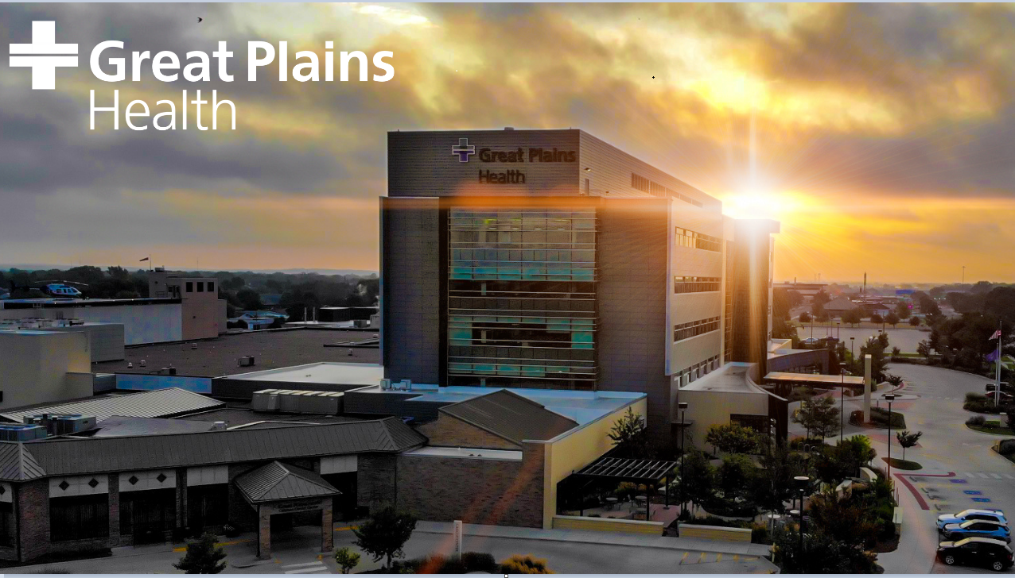
Notes:
I work at Great Plains Health. We are Located almost center in the state, in North Platte, Nebraska, We are a nonprofit, fully accredited, 116-bed regional referral center serving western Nebraska, northern Kansas and northern Colorado. In total, our primary and secondary service areas span 34 counties, 136,000 lives and approximately 67,832 square miles. About the size of the state of Pennsylvania. We have nearly 100 physicians representing 30 medical specialties
In 2022 I started a new role in my nursing career. I am a Clinical Data Specialist in the Quality Department. In that role, I do abstraction for both our Trauma and Stroke programs. While advancing my knowledge in stroke patient cares, I went into in-depth review of all our neuro/vital assessments of our stroke patients. As my knowledge grew I started researching more into the importance of these assessments and how the staff was trained.

Slide 3
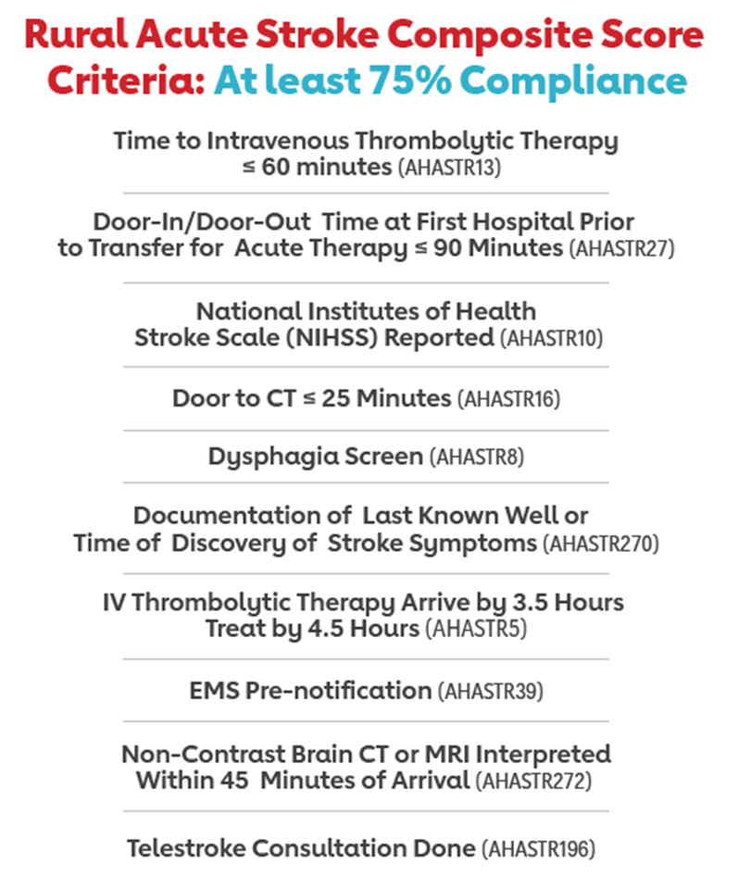
Notes:
In the Abstraction world our data drives changes to improve our patients’ health and well-being. Working along side my Stroke Coordinator we monitor proper cares of the stroke patient. As you can see we monitor a lot of data points.

Slide 4


Team Project
Notes:
One data point we monitor is compliance with Neuro/Vital sign assessments. The reason these assessments are so critical for us as Primary Stroke Center, is that our stroke patients can drastically alter in the 1st 48 hours, post-stroke.
My QI project is how ongoing staff education is directly related to meeting or exceeding, our stroke measures of compliance, for providing best patient care. At Great Plains Health we strive to live our Mission every day. Our Mission is to inspire health and healing by putting our patients first-Always.
For this project my Primary team members include myself and our Stroke Coordinator, Chastity Orr. Other team members include our Chief Quality Officer, Barb Petersen, Chief Nursing Officer, Tina Pate, and our Directors of patient care areas as well as our Nursing Educators.

Slide 5


Goals
Notes:
The goal of this project it to improve nursing compliance in monitoring our Stroke Patients after a TIA event or Stroke.
Our goal is 90% compliance for Neuro/vitals assessments on, all stoke in-patients and all of our ED patients that receive Alteplase
Each month we retrospectively review each stroke patients chart. I will look for orders for neuro checks and vital signs. If no orders are present I follow our policy that is specific to stroke patients. I will then go thru the flowsheets and mark missed and late entries for vitals and neuro checks. I will also check the appropriate neuro checks or NIH scale is charted correctly. Based on how many opportunities to chart timely and comprehensively is how we figure the compliance percentage.

Slide 6
Measuring Success
Notes:
When I started in my new abstractor role, our total compliance was 63%, for the 1st quarter of 2022 . During the 2nd quarter and beginning of the 3rd quarter (2022) I began working closely with my Stroke Coordinator to correlate the relationship between education of the staff and improved compliance of our stroke measures. During this process I pushed to see how can we help within the confines of normal teaching practices as well as outside the confines of normal teaching practices at our facility.
1st, We updated our Policy for In Patient Acute Stroke Care. We changed the verbiage to be clear without possibility of mis-interpretation. This process included our Chief Nursing Officer, nursing floor directors and our education department. (finalized at end of 3rd quarter)
While our stroke policy was being updated, I worked with my Stroke Coordinator to create a Stroke Core Measure Info-gram in a head to toe format which incorporated proper assessment of neuro and vitals. This info-gram was then taught in orientation with handouts and given to current floor nurses at the time it was implemented. (at end of 3rd quarter 2022)
As we continued to improve this process into the 3rd quarter 2022, I noticed several missed assessments were by traveler nurses. After this information was brought to my Stoke Coordinator, she changed her orientation education time to ensure traveling nurses were included in her Stroke care education. (happened in 4th Quarter 2022)
In 2023 our Nursing Directors began taking a more active role in our Stroke measures. Having that support from leadership is crucial to our success. We did experience a dip in the first quarter of 2023 and our Stroke Coordinator attended the floors monthly meetings. As we moved into the 2nd quarter of 2023; more one on one teaching was brought to the nurses. She would randomly ask Nurses if they had a few minutes to play a quick jeopardy game. Our nurses love the game-like atmosphere and don’t feel like they are being put on the spot during these interactions. The nursing floor directors also requested the data on each patient to review with each individual nurse.

Slide 7
Return on Investment (ROI)
Average Hospital Stay for a Stroke Patient – $43,000
Average Stroke Survivor Annual Healthcare for Treatment of just the stroke- $17,000
Average cost of 4 hours of Registered Nurse Education to care for a Stroke Patient- $164
$60,000 - $164 = $59,836 potential revenue for 1 Stroke Patient
Notes:
The Journal of Stroke and Cerebrovascular Diseases states; The average cost of ONE stroke patients hospital stay is $43,000. For that stroke patient the annual healthcare treatment for recovery is $17,000
At GP Health, To train ONE Registered Nurse how to proper monitor and care for a stroke patient is roughly 4 hours or $164
The monetary gain is potentially $59,836 for one stroke patient.
Non-monetary loss---and for our community –loss of quality of life, & possible loss of life from not having the resources to care for Stroke patients. You can’t put a price on someone's’ life

Slide 8


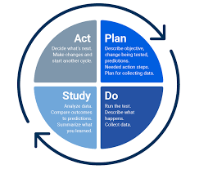
Section subhead.
Notes:
This project continues to be in PDSA cycle. We are monitoring compliance monthly. At the beginning of each month I gather the data and our Coordinator shares these numbers with the Directors of Acute Care, Critical Care and Emergency. Our Directors of Acute Care and Critical Care are rounding with nurses and utilizing this information in their one on ones with staff. . Each month our Stroke Coordinator will do one-on-one teaching with nurses as well as group activities .
As we tweak our PDSA cycle, we are continuously changing how we are presenting education, implementing new processes, and providing new tools to staff. By tracking our changes and comparing them to the data collected we are able to see the improvement in stroke patient cares through out the hospital.

Slide 9


Conclusion
Notes:
One take away I want to impart is that, Not every teaching technique will work with every person, you have to be willing to keep trying. Ultimately we are all here for our patients and we all want to do what is best for them.
Any questions?

