Slide 1
Gender Identity & Sexual Orientation
In The Workplace
Presented by:
Susan Sapp
October 19, 2022

Slide 2
SUSAN SAPP
Practice Areas:
Administrative Litigation
Business Litigation
Employment Litigation
Health Care
Labor and Employment
Personal Injury and Wrongful Death
Professional Liability and Licensing

Slide 3
DID YOU KNOW?
At least 4% of the workforce in Nebraska identifies as LGBTQ

Slide 4
Did You Know?

Slide 5
DID YOU KNOW?
Nearly 1/5 LGBTQ adults have avoided seeking medical care out of fear of discrimination in a healthcare setting

Slide 6
AGENDA
Legal Landscape
Court Decisions
EEOC Guidance
Terminology
Creating an LGBTQ+ Inclusive Workplace
Tips and action steps to implement

Slide 7
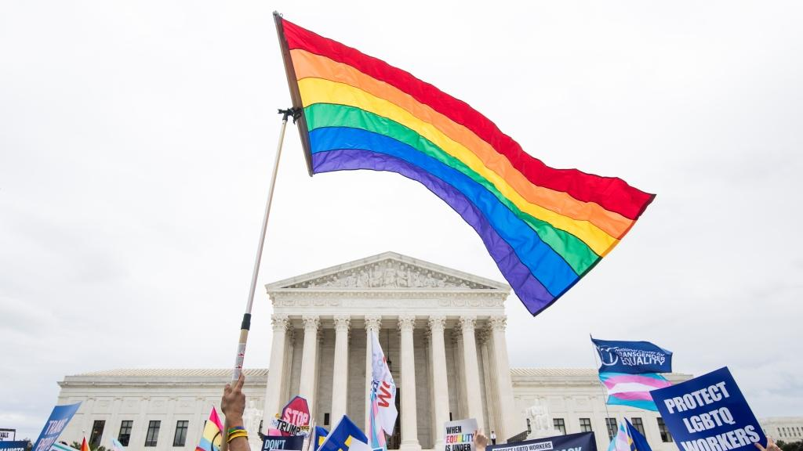
LEGAL LANDSCAPE
Analyzing relevant laws and potential areas for litigation and liability

Slide 8
TITLE VII & LGBTQ DISCRIMINATION
Title VII prohibits employment discrimination on the basis of race, color, religion, sex, and national origin
In 2019, the Supreme Court took up:
Two cases involving sexual orientation discrimination under Title VII
Altitude Express Inc. v. Zarda (Second Circuit, 2018)
Bostock v. Clayton County, Ga. (Eleventh Circuit, 2018)
One case involving gender identity discrimination under Title VII:
R.G. & G.R. Harris Funeral Homes v. Equal Employment Opportunity Commission (Sixth Circuit, 2018)

Slide 9
ALTITUDE EXPRESS
Daniel Zarda alleged he was fired from his job as a skydiving instructor because he was gay. A female customer had voiced concerns about being tightly strapped to Mr. Zarda during a tandem dive. Mr. Zarda, hoping to reassure the customer, told her that he was gay “and had an ex-husband to prove it.”
The customer’s boyfriend complained and Mr. Zarda was fired. Altitude Express argued that Mr. Zarda was fired for “inappropriate behavior.”
The Second Circuit ruled that Title VII prohibits sexual orientation-based discrimination as a subsect of sex discrimination.

Slide 10
BOSTOCK V. CLAYTON COUNTY
Gerald Bostock had worked for Clayton County as a child welfare services coordinator since 2003. In 2013, he began participating in a gay recreational softball league. Shortly thereafter, Mr. Bostock was fired for “conduct unbecoming” of the county’s employees.
The Eleventh Circuit held that Title VII does not prohibit discrimination on the basis of sexual orientation.

Slide 11
HARRIS FUNERAL HOMES
Aimee Stephens (formerly known as Anthony Stephens) was fired from a Michigan funeral home after she informed her employer in 2013 that she identified as a woman and would start wearing women’s clothing to work at the funeral home.
The Sixth Circuit held that discrimination based on gender identity (i.e., Stephens’s transgender status) is barred by Title VII.
“It is analytically impossible to fire an employee based on that employee’s status as a transgender person without being motivated, at least in part, by the employee’s sex.”
“[D]iscrimination ‘because of sex’ inherently includes discrimination against employees because of a change in their sex.”

Slide 12
SCOTUS DECISION
The Supreme Court consolidated Altitude Express, Bostock, and Harris
Questions before the Court:
Whether Title VII’s ban on sex-based discrimination prohibits discrimination based on sexual orientation
Whether Title VII prohibits discrimination based on transgender status or sex stereotyping
Whether the protections of Title VII extend to discrimination based on gender identity
On June 15, 2020, the Court issued a 6-3 decision
Gorsuch authored majority opinion; Kavanaugh, Alito, and Thomas dissented

Slide 13
SCOTUS DECISION
Held: Title VII prohibits discrimination on the basis of sexual orientation
and gender identity
If sex was one but-for cause of the decision, Title VII’s protections are triggered.
It is impossible to discriminate against a person for being gay, lesbian, or transgender without discriminating against that individual based on sex

Slide 14
SCOTUS READING
Definitions of the term “sex” have evolved but “sex” and “discriminate” can be interpreted the same in 1964 as in the present day
Title VII explicitly prohibits discrimination “because of” a protected characteristic → but-for causation standard
Employers violate Title VII when they intentionally fire an employee based in part on sex.
It does not matter if other factors besides the employee’s sex contributed to the decision.
Sex need not be the sole or primary cause of the employer’s adverse action for Title VII to apply.

Slide 15
SCOTUS REASONING
“Consider, for example, an employer with two employees, both of whom are attracted to men. The two individuals are, to the employer's mind, materially identical in all respects, except that one is a man and the other a woman.”
“If the employer fires the male employee for no reason other than the fact he is attracted to men, the employer discriminates against him for traits or actions it tolerates in his female colleague.”

Slide 16
SCOTUS REASONING
“Or take an employer who fires a transgender person who was identified as a male at birth but who now identifies as a female.”
“If the employer retains an otherwise identical employee who was identified as female at birth, the employer intentionally penalizes a person identified as male at birth for traits or actions that it tolerates in an employee identified as female at birth.”

Slide 17
POTENTIAL FUTURE DEVELOPMENTS
Bostock does not explicitly address protecting bisexual or gender non-binary claimants
Bostock does not address sex-segregated bathrooms, locker rooms, or dress codes
Religious exceptions might supersede Title VII in some cases
Housing discrimination (e.g., dormitories) left unaddressed
Title IX implications?
Transgender healthcare coverage

Slide 18
BIDEN EXECUTIVE ORDER
The Biden Administration seeks to expand the scope of Bostock in the federal and public sector
This can influence courts and private employers
January 2021 Executive order: Agencies are to apply Bostock’s interpretation of Title VII to other statutes prohibiting sex discrimination
Title IX, the Fair Housing Act, the Immigration and Nationality Act

Slide 19
EEOC GUIDANCE
Title VII forbids sexual orientation and gender identity discrimination with respect to:
Hiring
Firing, furloughs, or reductions in force
Promotions
Demotions
Discipline
Training
Work assignments
Pay, overtime, or other compensation
Fringe benefits
Other terms, conditions, and privileges of employment

Slide 20
EEOC GUIDANCE
Employers cannot discriminate because customers would prefer to work with people who have a different sexual orientation or gender identity.
Employers cannot prohibit a transgender employee from dressing or presenting consistent with that person’s gender identity
Recall:
Non-LGBTQ+ job applicants and employees are also protected against sexual orientation and gender identity discrimination
Discrimination includes severe or pervasive harassment

Slide 21
HARRASSMENT
It is unlawful to subject an employee to workplace harassment that creates a hostile work environment based on sexual orientation or gender identity.
Hostile work environment elements:
Based on a protected status
Unwelcome conduct
The conduct is severe or pervasive

Slide 22
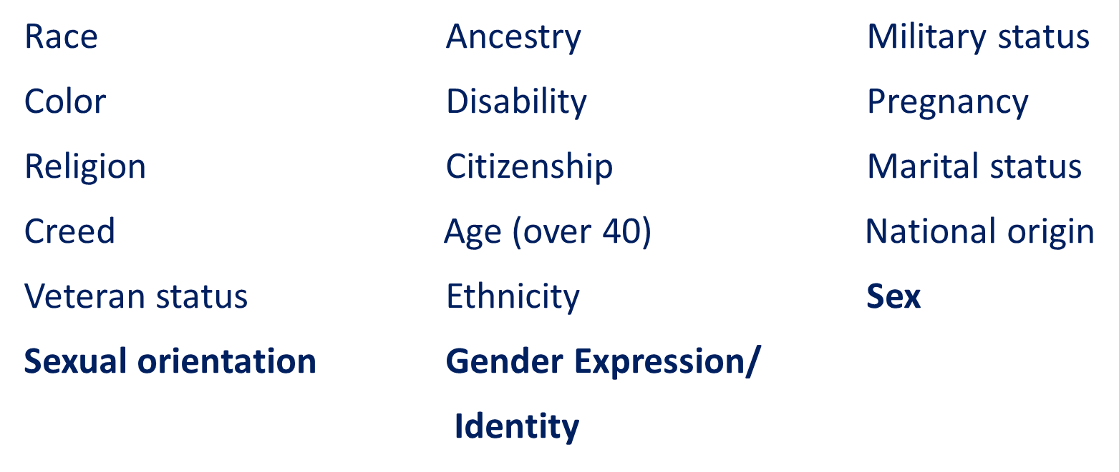
HOSTILE WORK ENVIRONMENT: PROTECTED CATEGORIES UNDER EEO LAWS

Slide 23
EXAMPLES OF PROHIBITED CONDUCT
Harassment can include, for example, offensive or derogatory remarks about sexual orientation or a person's transgender status or gender transition.
Unwelcome or unwanted sexual advances or touching, such as patting, pinching, brushing up against, hugging, cornering, kissing, fondling, sexual flirtations, or any other similar contact.
Verbal harassment or unwelcome kidding of a sexual nature, such as telling “dirty” jokes and comments about body parts, appearance, or clothing, where such comments go beyond mere courtesy or are unwelcome.

Slide 24
EXAMPLES OF PROHIBITED CONDUCT
Too much personal attention, such as repeatedly asking out a
co-worker.
Epithets, racial “jokes,” slurs or negative stereotypes, etc.
Posting or distribution of written or graphic material that denigrates
or shows hostility or aversion to persons of a protected class.
Including social media
Offensive nicknames; identifying someone by a protected characteristic.

Slide 25
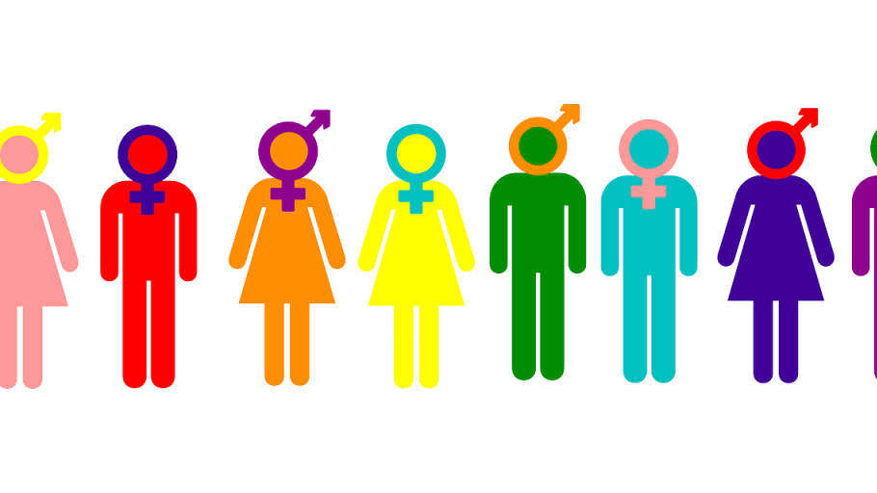
UNDERSTANDING TERMINOLOGY

Slide 26
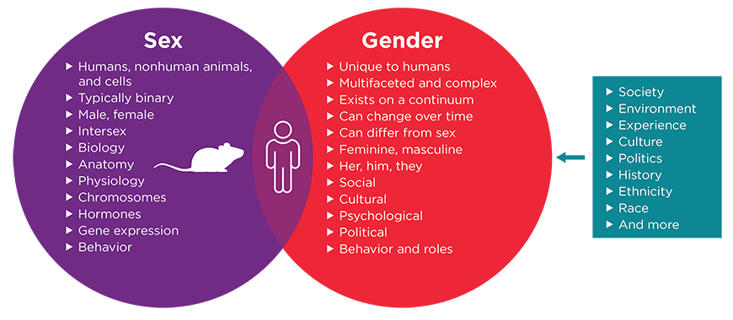
SEXUAL ORIENTATION & GENDER IDENTITY

Slide 27
SEXUAL ORENTATION & GENDER IDENTITY
Sexual orientation: an individual’s physical and/or emotional attraction to the same or a different gender
Cisgender: individuals whose sex assignment at birth corresponds to their gender identity and expression
Transgender: individuals whose gender identity presentation does not fall within stereotypical gender norms and may (but not always) seek to change their physical characteristics through gender affirming surgery or other actions.

Slide 28
GENDER IDENTITY & EXPRESSION
Gender identity: a person’s innate, internal sense of his, her, or their gender
Gender expression: the way in which a person presents his, her, or their gender to the outside world
Gender non-conforming: behavior that does not match social gender stereotypes, often through dress or physical appearance
Non-binary: gender identities that are not exclusively masculine or feminine

Slide 29
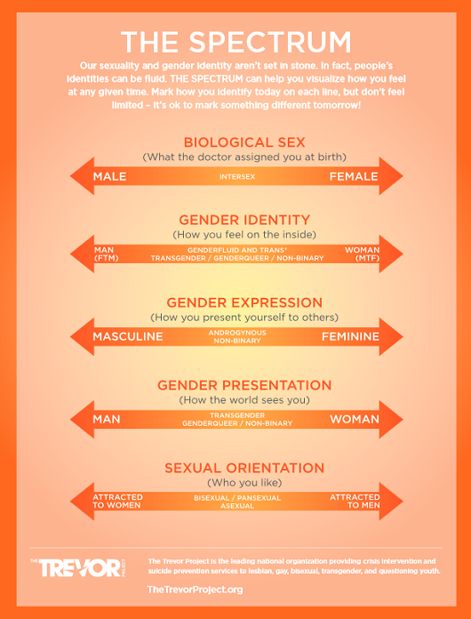
SEXUAL ORIENTATION & GENDER IDENTITY

Slide 30
TERMINOLOGY
Sexual Orientation – The gender to whom an individual is sexually attracted defines one’s orientation.
Queer: Umbrella term to describe individuals who identify as non-heterosexual.
LGB: The terms lesbian, gay, and bisexual describe a person’s sexual orientation and collectively include women and men who are predominantly or sometimes attracted to individuals of the same sex.
Gay: Term used to describe individuals who are primarily emotionally, physically, and/or sexually attracted to members of the same sex.
Asexual: A person who has no sexual feelings or desires.
Demisexual: A person who does not experience sexual attraction unless they form a strong emotional connection with someone.
Pansexual: A person who is not limited in sexual choice with regard to sex, gender, or gender identity.

Slide 31
TERMINOLOGY
Gender Identity- The gender that an individual identifies with, irrespective of biological sex.
* Queer – Umbrella term to describe individuals who identify as non-heterosexual.
Cisgender- An individual whose sex matches their gender expression and identity.
Transgender- An individual whose sex does not match their gender expression and identity.
Agender- The gender that an individual identifies with, irrespective of biological sex.
Bigender- A person whose gender identity is a combination of two genders.
Gender Binary- The idea that there are only two genders , male and female, and that a person must strictly fit into one category or the other.
Genderqueer- Describes a person whose gender identity falls outside the traditional gender binary.
Gender Dysphoria- Distress experienced by some individuals whose gender identity does not correspond with their assigned sex at birth.
Gender Fluid- Describes a person whose gender identify is not fixed

Slide 32
TERMINOLOGY
Heterosexism: discrimination or prejudice against non-heterosexual people on the assumption that heterosexuality is the only normal and/or natural sexual orientation
Misgender: to refer to someone (e.g., a transgender or non-binary person) using a word, especially a pronoun or form of address, that does not correctly reflect the gender with which they identify
Personal gender pronoun: a gender-specific pronoun used by an individual
E.g., singular they/them/their
E.g., “My name is ___ and I use she/her pronouns.”

Slide 33
TERMINOLOGY
Gender affirmation: an interpersonal, interactive process whereby a person receives recognition and support for their gender identity and expression
Individuals may or may not modify their physical characteristics and/or gender expression to be consistent with their gender identity
Social changes: clothing, pronouns, name, mannerisms, voice, etc.
Medical changes: hormone therapy, gender affirmation or other surgery, etc.
Legal changes: changing name and/or gender on birth certificate, driver’s license, etc.

Slide 34
TERMINOLOGY
Transition: altering one’s sex or gender assigned at birth
Process that occurs over time
Can include social, medical, and legal steps
Avoid the term “sex change”

Slide 35
OUTDATED TERMS TO AVOID
Terms to Avoid
Transgenders, transgendered, a transgender, transvestite, tranny
Hermaphrodite
Sexual Preference
Sex change, pre-operative, post-operative
She-male, he-she, it
Terms to Use
Gay, lesbian, bisexual
Sexual Orientation
Transgender person, transgender man, transgender woman
Gender affirmation surgery
Remember: “Transgender” is an adjective, not a noun

Slide 36
CREATING AN LGBTQ+ INCLUSIVE WORKPLACE

Slide 37
CONTEXT
According to a 2021 Gallup poll, 5.6% of adults in the United States identify as LGBT
4% of the workforce in Nebraska is LGBTQ
Americans’ self-identification as LGBTQ is on the rise
1 in 6 Generation Z (born between 1997 and 2015) adults identify as LGBT
1 in 3 LGBTQ Americans report facing discrimination in the last year
36% of LGBTQ Americans report mistreatment in their public, work, and personal lives
62% of transgender individuals report experiencing discrimination in the past year

Slide 38
EXAMPLES OF WORKPLACE DISCRIMINATION
Refusing to hire
Preventing a transgender person from using the restroom that corresponds with their gender identity
Failing to address a person with the proper name and pronoun
Asking invasive questions
Teasing or intimidating, or allowing others to do so
Viewing a person’s sexual orientation as a choice

Slide 39
CREATING AN INCLUSIVE WORKPLACE
Revise nondiscrimination and anti-harassment policies to include gender identity and expression as protected categories
Establish a gender transition plan and policy
Conduct sensitivity trainings and strive to eliminate bias
Avoid outdated terms and microaggressions
Encourage LGBTQ+ employees to be themselves

Slide 40
CREATING AN INCLUSIVE WORKPLACE
Discrimination and harassment on the basis of sexual orientation and gender identity is prohibited.
Help employees to be sensitive to gender identity and expression by incorporating these topics into anti-harassment training programs.
Explain to employees that regardless of their personal beliefs, it is important that employees behave appropriately and continue to work cooperatively and respectfully with their LGBTQ colleagues.
Clearly communicate that failure to behave in this manner towards colleagues could result in discipline, including termination.

Slide 41
ACTION ITEM: COMMUNICATION
Don’t make assumptions.
Use the appropriate pronouns consistent with employees’ gender presentation, expression, and preference.
Respectfully communicate with employees regarding their personal pronouns in a confidential matter.
If there is uncertainty, communicate with employees regarding their personal pronouns in a confidential manner.
Discuss and agree upon a communication plan for notifying coworkers and customers of any change to pronoun or name use.

Slide 42
ACTION ITEM: COMMUNICATION
Respectfully apologize if you accidentally use the wrong name or pronoun.
If employer learns that an employee prefers not to be treated as male or female, ask the employee what assistance they might need to have a professional, comfortable work environment.
Validate when others share.
Goal: make the employee feel comfortable, affirmed, and respected.

Slide 43
ACTION ITEM: REVIEW POLICIES
Review policies, handbooks, work forms, and other documentation to remove specific gender designations, where possible
No need to say “his or her,” or “he or she,” or “him or her.”
Modern English permits you to use “they,” “them,” and “their” as singular, gender-neutral pronouns (AP Stylebook adopted this change in 2017).
Revise dress code policies if they force employees to conform to gender stereotypes
Policies that require professional business attire irrespective of sex or gender are recommended.
If there are “male” and “female” versions of a uniform, employees should be allowed to wear the uniform that comports with their gender identity.

Slide 44
ACTION ITEM: REVIEW POLICIES
Leave Policy: Treat transgender medical procedures like any other medically necessary procedure.
Health Insurance and Benefits: Coordinate with benefit plan administrator and consider these issues:
Removing limitations on gender-specific services (e.g., mammograms) based on gender at birth.
Revising eligibility restrictions for infertility coverage by creating exceptions or otherwise amending provisions that require employees to try to conceive naturally for a period of time before becoming eligible for infertility coverage.
Offering coverage for transgender medical procedures, such as gender affirming surgery.

Slide 45
ACTION ITEM: RESTROOM ACCESS
Employees should be permitted to use the facilities that correspond with their gender identity.
Consider adopting gender neutral or single occupant facilities.
If employers have a single occupancy restroom, employees who object to sharing a common restroom with a transgender employee should be provided with the opportunity to use those facilities

Slide 46
FACILITATING WORKPLACE TRANSISTION
Create a plan and timeline, including time off for medical treatment
Discuss name and pronoun preferences
Express willingness to modify company identification, badges, email, website, etc.
Accommodate employee’s wishes with respect to informing (or not informing) others
Consider training for coworkers
Make a plan for addressing questions
Make sure people feel seen and heard

Slide 47
FACILITATING WORKPLACE TRANSITION
Employee Privacy and Confidentiality: Although a transgender employee’s transition may become a matter of public knowledge in the workplace, personal details about any employee’s transition are private and entitled to confidentiality.
Personnel Records: Be prepared to update or change transgender employees name and gender in certain employee records.
Consider which records must reflect employees’ name and sex at birth, and which records can be modified (e.g., email addresses, name plates, business cards, security badges, etc.).

Slide 49
THANK YOU
Susan Sapp
ssapp@clinewilliams.com
The information is being offered as an outline of general information on the subject to assist in development and implementation of employment practices and policies. It is offered for educational and informational purposes only and is not intended as legal advice.

