Slide 1
Module I
Patient and Family Engagement

Slide 2
Learning Objectives
State key principles of the principle of excellence: creating value for the customer.
Identify strategies for engaging patient and care partners into all levels of a system.

Slide 3
Creating Value for the Customer

Slide 4
Operational Excellence
A mindset that embraces certain principles and tools to create sustainable improvement within an organization.
Source: https://tallyfy.com/guides/operational-excellence/
Notes:
process across your company.

Slide 5
Operational Excellence:
10 Core Principles
Respect Every Individual
Lead with Humility
Seek Perfection
Embrace Scientific Thinking
Focus on the Process
Assure Quality at the Source
Flow and Pull Value
Think Systematically
Create Constancy of Purpose
Create Value for the Customer

Slide 6
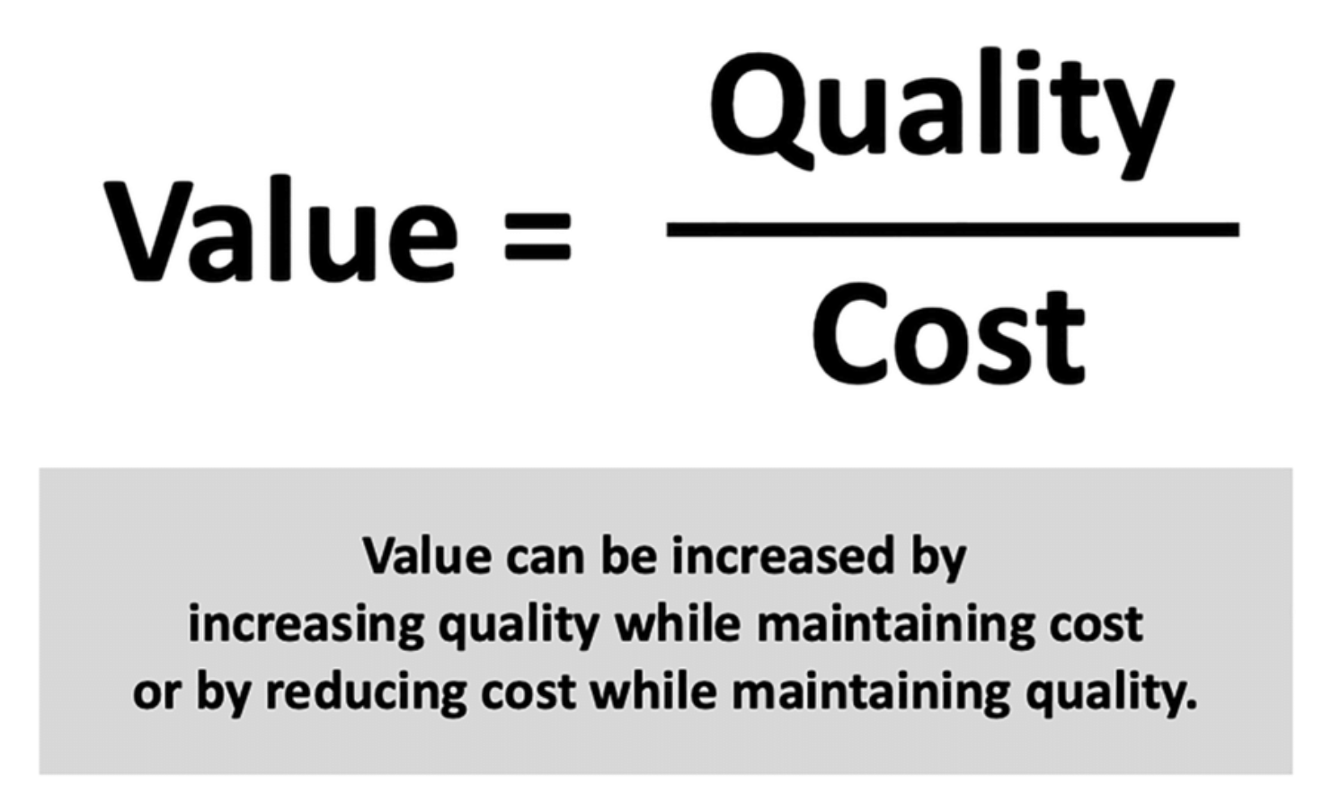
Value Equation

Slide 7
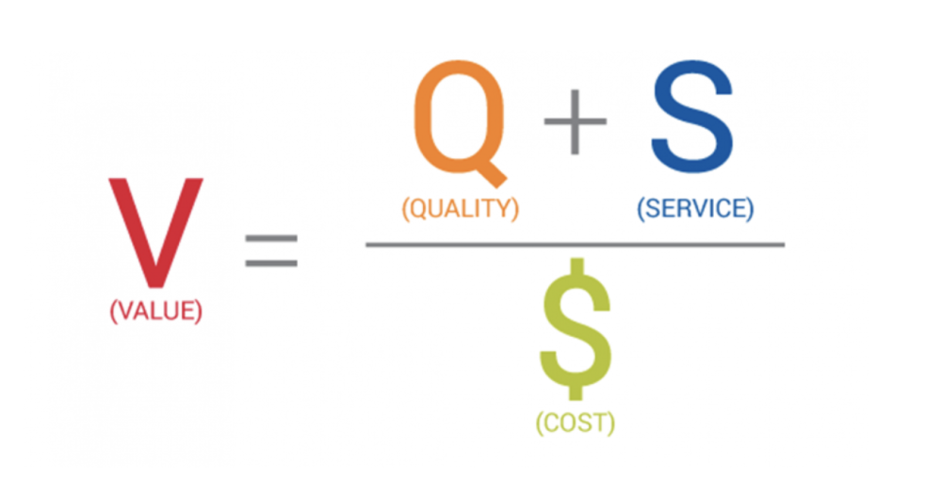
Value Equation

Slide 8
Value “Attributes”
Accessibility: “can I get what I need or want from you?”
Service: “is dealing with you a pleasant experience?”
Effectiveness: “is what you’re providing going to satisfy my need or want?”
Costs: “what’s the cost to me and my family and is it worth it?”

Slide 9
Customer Value Requirements
Understanding the customer’s needs and expectations
Responding to customer feedback
Looking for ways to remove waste and add value to processes

Slide 10
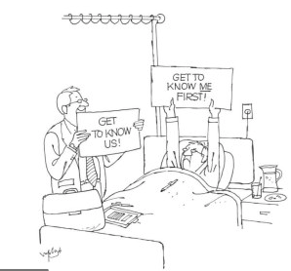

Slide 11
Identifying Value Drivers
Anything that is added to a service that will increase its value to consumers
Help boost its leverage on the marketplace
What differentiates a service from those of a competitor

Slide 12
Voice of the Customer

Slide 13
Examples: Customer Voice
How does your facility ensure that the customer, i.e., your patients, have a voice in expressing their view(s) of what comprises value?

Slide 14
Strategies for
Patient/Family Engagement
Four primary strategies for promoting patient/family engagement:
Encourage patients and family to participate as advisors
Promote better communication
Implement safe continuity of care
Engage patients and family in discharge planning

Slide 15
Patient/Family Engagement Definition
Patients, families, their representatives, and health professionals working in active partnership at various levels across the health care system – direct care, organizational design and governance, and policy making – to improve health and health care.
Source: Health Affairs 32 No. 2 (2013) (223-231)

Slide 16
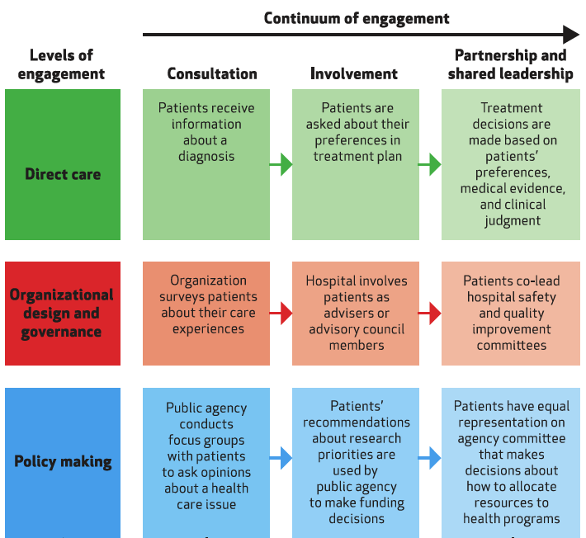
Multidimensional Framework

Slide 17
Direct Care Level
May involve the following:
Interaction with clinicians
Resources and groups to sustain personal health practices

Slide 18
Organizational Design & Governance Level
May involve the following:
Partnering to plan, deliver, and evaluate care
Help design health care facilities
Serve on patient and family advisory councils
Help design and execute quality improvement projects
Assist with staff hiring, training, and development

Slide 19
Policy Making Level
May involve the following:
Collaboration with community leaders and policy makers
Participation in health and clinical research
Speaking on behalf of a general constituency

Slide 20
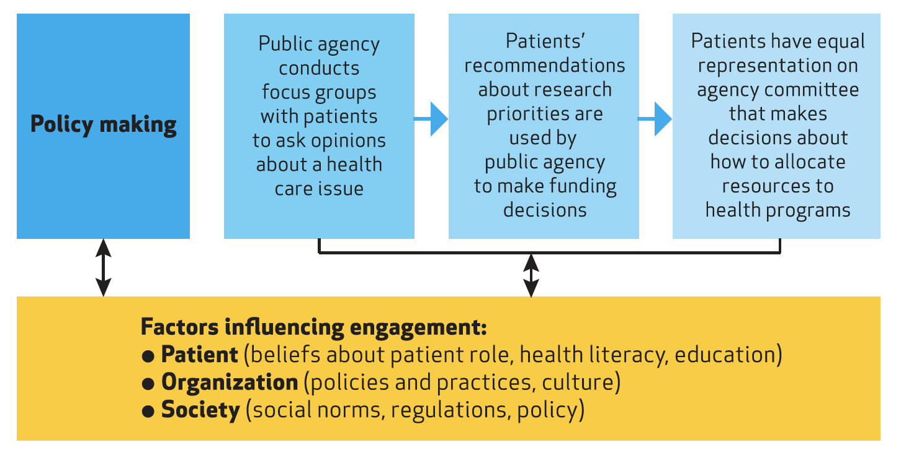
Multidimensional Framework

Slide 21
Tools & Strategies
Patient and Family Advisors
Communicating to Improve
Nurse Bedside Shift Report
Care Transitions from Hospital to Home: IDEAL Discharge Planning

Slide 22
Patient & Family Advisors
Provide feedback on:
Experience(s)
How care is delivered
Materials
Facility design

Slide 23
Patient & Family Advisors
Avenues for advisor involvement:
Short-term projects
Advisory Council members
Hospital Quality and Safety Committee(s)

Slide 24
Communicating to Improve
Help patients and families understand:
Various opportunities that exist for engagement
How to be a partner in their care
Roles of different members of the health care team

Slide 25
Bedside Shift Report
Goal: Ensure a safe handoff of care
Explain:
Benefit(s) of involving patient and family
Process
What to expect

Slide 26
IDEAL Discharge Planning
Include patient and family as partners
Discuss areas to prevent problems at home
Education the patient and family
Assess patient and family knowledge and understanding
Listen and honor patient and family wishes

Slide 27
PFE Measures Toolbox
Existing measures address:
Education and involvement
Motivation and self-efficacy
Behavior change and activation

Slide 28
PFE Measures Toolbox
Future considerations may include:
Data sources and burden
Cultural and linguistic appropriateness
Inclusion of family

Slide 29
Measures of PFE
CAHPS Patient satisfaction
Assesses patient-provider communication, patient education, the discharge process and elements of hospital environment
Retrospective or real-time
Social media
Yelp, Google
Twitter, Facebook

Slide 30
Measures of PFE
Patient Activation Measure (PAM)
Role in activation
Confidence and knowledge
Proactively taking action
Staying the course
Ability to self-manage problems, collaborate with providers, and navigate healthcare system

Slide 31
Measures of PFE
Patient-reported outcomes measures (PROMs)
Impact a procedure had on lifestyle
Comes directly from the patient
Quality of life

Slide 32
Concept to Reality
Hear how a robust Patient Family Advisory Counsel got started at Franciscan Healthcare in West Point.

Slide 33
Franciscan Healthcare’s PFAC Journey
Officially started in 2014
  Led by Sister Joy Rose
  Struggled obtaining support from CEO
  Provided education to Board and Medical Staff
  Obtained our first committee members by asking members of the Medical Staff and Administration for recommendations

Slide 34
Journey continued
First meeting was to educate why they were there and what is expected of them
Followed by a “Walk Around” of the facility
  Asked “what we did well?” and “what we did not so well?”
  Feedback was noted and reviewed with the CEO.
  CEO addressed concerns at the following meeting.

Slide 35
Journey continued
First couple of meetings served as an informal interview of the potential PFAC members.
  Evaluated based on constructive feedback given
  Determined which members would be most valuable on specific organizational committees.
    i.e., Mission, Fall prevention, QPI, Safety, Disaster

Slide 36
Struggles
Obtaining a diverse committee of various generations and backgrounds
Finding members of the Hispanic community that would participate
Finding a time that would work for most on a somewhat regular basis

Slide 37
Breakthrough
Due to the addition of a couple of new Hispanic employees, we were able to convince a group of Hispanic patients they knew to meet with us
  March of 2019
  Continue to meet quarterly
  Never the same group

Slide 38
Hispanic PFAC
Different focus
  Meetings usually more focused on education
    Use of Antibiotics
    Billing statements and collection policies
    COVID vaccination information
      Administered vaccine to those present who wanted one
  Have encouraged more of them to apply for open positions across our organization

Slide 39
Hispanic PFAC
Facilitated English as a second language class through Northeast Community College
Worked with the Chamber office to find ways to help with integration
Send social media posts in Spanish as well as in English

Slide 40
Resources
Additional resources
AHRQ Strategies
  Guide to Patient and Family Engagement in Hospital Quality and Safety
Rural Hospital PFE 2021 Toolkit
Project Patient Care

Slide 41
Report Out
Notes:
Participants to share key takeaways, and one concept or activity that you will take back.

