Slide 1

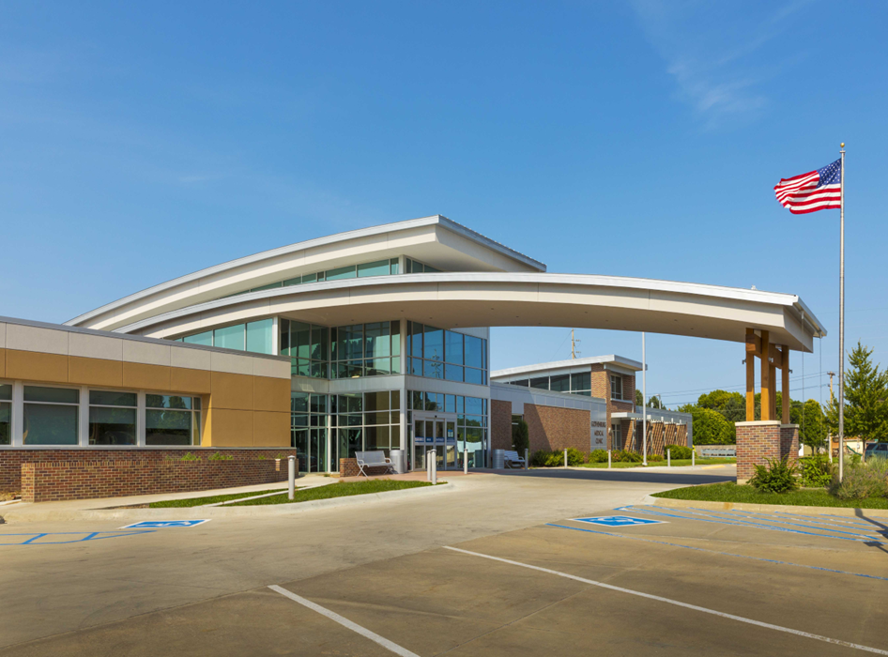
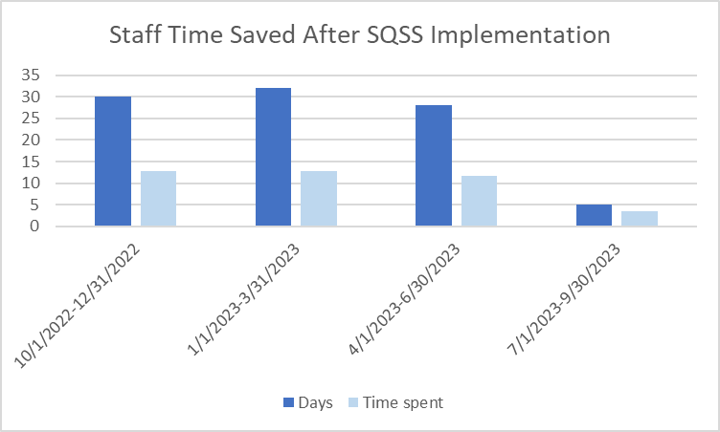
Improving Departmental Quality
Gothenburg Health, Gothenburg Nebraska
Background
Plan
Results
We chose to revamp the quality program, looking at better ways to track occurrence reporting and quality metrics throughout the organization. Prior to this year there had been a lot of turn over in the quality team, metrics were tracked on excel spreadsheets and occurrences were on paper.
We planned to implement an online system to track occurrences and quality metrics. The SQSS system was chosen, and the plan was one module would be implemented at a time. The SQSS system includes videos for training and orientation that would be utilized to orient staff quickly.
With the implementation of SQSS, we were able to decrease the time to close occurrences to 5 days. We decreased the amount of time to trend occurrences to 3.4 hours a month and currently we have 78% in quality data entry compliance in SQSS.
Team
Our team consisted of Kristin Bailey, CQO; Alisa Crown, Director of Population Health and Infection Prevention; Sherry Hughes, Data Analyst; Liz Grisell, Project Manager; and Stacy Flesnar, Informatics.
Measure
For our metrics we used compliance with monthly quality metric tracking for each department, time spent transferring data to excel sheets and number of days to close occurrences within the organization.
Aims
The aim of this project is to increase department compliance of quality metric tracking to 100% and decrease occurrence closing time to less than 21 days by the end of fiscal year 2024.
Next Steps
.
Next Steps include moving all metrics for board over to SQSS, developing physician score cards in system and moving to tasks online.

