Slide 1
Reducing Readmissions- a multidisciplinary Approach

Slide 2
Timeline
10/2022
  New position Discharge Follow-up Advocate
    Role- call all patients discharged using a standardized format and questions
      During the call ensure the patient has follow-up appointment made, is able to attend, connect with experts (pharmacy, coordinators, hospitalist, etc.) for questions about managing their care. All calls are documented in the medical record.
      2 calls for high risk patients and Dr. Deblis patients called on the DC Day 1 and Thursday
2/2023
  Readmission rates increased- Added High Risk Coordination to address patients during their hospitalization
    Unable to find a common trend except 88% had a LACE score greater than 10
      Used the predictive model for high risk for readmission (LACE)
      Multidisciplinary interventions developed by ancillary departments
      Patients at Risk discussed at rounds in the AM
      List of patients given to charge nurses, hospitalists, and MSU manager
      Patient Whiteboard in room updated to allow all members of the care team to see the patient is at risk for admission
      Sticky Note added in patient chart that is visible to all members of the care team

Slide 3
Multidisciplinary approach for addressing high-risk for readmission patients
Discharge foll-up advocates coordinates multidisciplinary actions prior to discharge and ensures
  Patients understand the medical or surgical reasons for their current admission and what transpired during the hospitalization.
  Patients have a clear understanding of their medical conditions (not just admitted condition) and what must be done to continue care as an outpatient. (HF, Wound, DM educators etc.. and the videos can assist with the education)
  Patients receive an explanation of potential warning signs and symptoms that could arise. (HF, Wound, DM educators etc.. and the videos can assist with the education)
  Patients are provided with a 24-hour phone number for emergencies- this is the ED number listed on the DC packet
  Patients should have the name of the provider responsible for their care after discharge (provide written name and phone number). Highlight in packet if needed

Slide 4
Multidisciplinary approach for addressing high-risk for readmission patients
Identify that a patient is at high risk for readmission based on Epic’s risk model
  risk model variables include
    patient age
    clinical diagnoses
    laboratory values
    medication numbers and classes
    order types
    healthcare utilization variables.

Slide 5
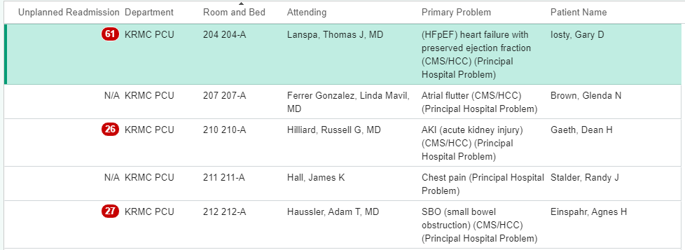
Discharge follow-up advocate ext. 8342
    Announces at Grand Rounds
    List of High-Risk patients is given to the hospitalist (in office by MSU), Charge nurses at PCU/MSU/ICU and MSU Manager
    List emailed to wound care
    Whiteboards in patient Rooms updated (LACE) by the room number on the boards so all departments can see
    Sticky Note added to the chart- recommended DC video will be charted there as well
    Discharge follow-up advocate ensures that Discharge plan has ALL components- appt made, education and numbers to call are on folder once alerted of discharge
    Post discharge- 2 f/u calls for high risk, Deblis patients called on the DC Day 1 and Thursdays
High Risk report Generated
  Discharge follow-up advocate- maintains the list of high-risk patients (Report from Epic)
    Score greater than 17 is considered High Risk

Slide 6
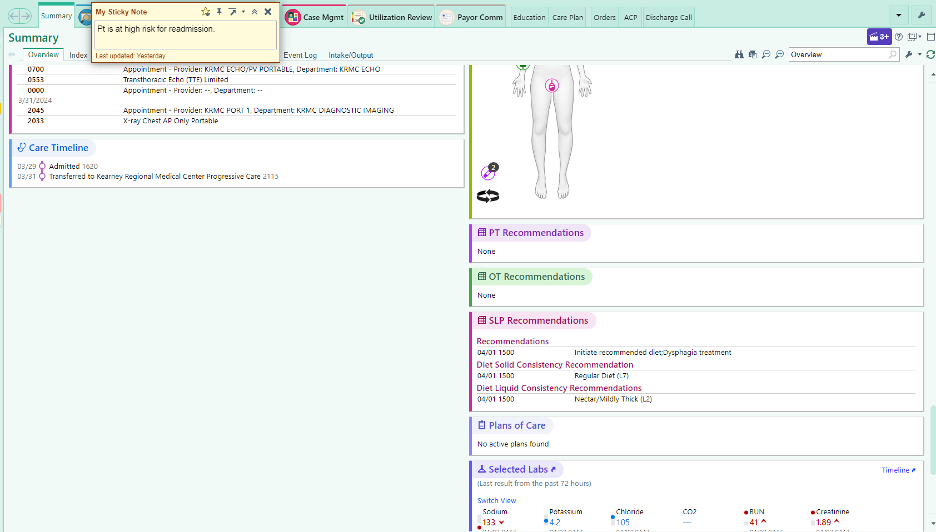
Physical Therapy (ext. 3770)
          Communicate to all staff high risk patients after rounds verbally
          Documentation of Stairs, pain, Ambulation assistance and distance
          Transfer level assistance
          Discharge Recommendation
          Add evening therapy if One person assist, discharge uncertain or home, needs extra education/training
          Communication with CM changes of patient
          DC recommendations will be charted- if no special recommendations this will be stated as well

Slide 7
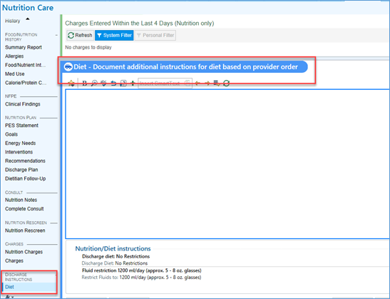
Dietician (ext. 3844)
  Identify patients with malnutrition or at risk of malnutrition, communicate on Rounds and make nutrition recommendations for intervention
    If following patient
      Ensure nutrition education completed
      Communicate patients’ receptiveness/response to education and likelihood of compliance
      If high risk on non-compliance, make recommendations on Rounds to liberalize diet so medications can be adjusted appropriately
      Add any outpatient nutrition recommendations or follow-up to discharge plan

Slide 8
Case Management
        Transition assessment upon admission on high-risk patients
        DME set up
        Referrals for DC made- placement, HH, hospice etc.
        Education to patient that they are at risk for readmission

Slide 9
MSU/PCU/ICU Nursing
        Charge nurse will notify the Primary Care Nurse after rounds that the patient is high risk
        Identify Learning needs on admission- charted in Epic
        begin DC education-add education for the AVS as appropriate during stay i.e.- PICC line, foley etc.
        Include family in education
        Give the patient ability to verbalize questions or write them down
        Discharge packet in room upon admission
        Ensure patient watches education video prior to discharge
        Numbers to call post DC are on the packet- including the ED afterhours number

Slide 10
Pharmacy (ext. 3746)
        Note on our rounds forms any patients at high risk as reported out by physicians in grand rounds.
        Open an intervention (our communication and tracking/documentation platform in pharmacy) for readmission risk patients
        Expectation with the intervention is that at least once during their stay a pharmacist offers to discuss medication therapy.
        Once the patient has been counseled, or at least the offer made, this intervention would be closed.
        We will primarily focus on patients not being dismissed to skilled nursing facilities, with an expectation that the nursing facilities should be continuing (education and administrations, etc..) and assuring compliance…but the second check step would still apply.
        Education (ideally both PRIOR to discharge to discuss and identify potential concerns)
        Recommendation of pill packing or other automation/reminders/etc.. for medications taken at home
        Evaluation of current medication list vs home medication list PRIOR to discharge (as opposed to transitioning certain things or identifying potential treatment gaps when we have historically reviewed only upon discharge).
        Add medication education in chart for new meds, high risk medications

Slide 11
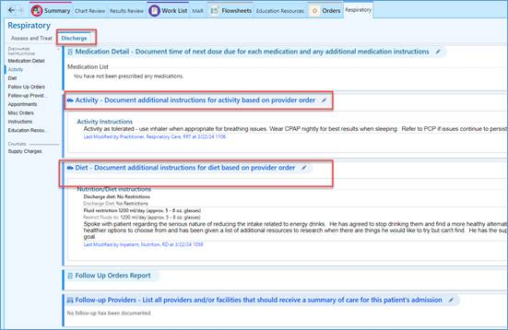
Respiratory (ext. 3809)
    RT attending grand rounds will report out all High-risk patients to Respiratory therapists after rounds.
    Suggest Pulmonary Rehab if patient meets qualifications- sticky note in Epic
    Suggest medication changes if needed
    Qualification for Oxygen (overnight or desaturation assessment) prior to discharge
    Suggest Pulmonary Consult if patient meets qualifications
    Education- COPD video if applicable

Slide 12
Wound Care (ext. 3248) and Heart Failure Coordinators (call 308-440-2944)
    Will consult as needed
    Assist with video prior to DC if indicated
    Receives list of high-risk patients from DC planner

Slide 13
Educational Resources
KRMC Specific Education Video’s
  https://krmcportal.krmc.local/Intranet/Main.aspx?tid=292
    Acute MI
    Catheter Care
    Constipation and Bowels
    COPD
    DVT Prophylaxis
    Heart Failure
    PICC Line
    Pressure Injury
    Total Joints
    Wound Care Management

Slide 14
Post Epic Rates

