Slide 1
Module G
Patient Safety
Gail Brondum, LPN, BS

Slide 2
Objectives
Describe the impact of “To Err is Human” on the modern patient safety movement, including federal and state regulations and the PSO program
Discuss the role of organizational culture and safety culture in quality and patient safety improvement
Discuss the role of leadership in building a culture of safety
Define safety culture in terms of levels, categories, and key components
Explain how and why to conduct a safety culture assessment
Identify four types of interventions that support safety culture
Discuss how knowledge of human factors leads us to use systems thinking and high reliability principles
Describe the hierarchy of the strength of interventions
Discuss pre-work assignment and provide contextual support for patient safety for residency participants
Identify strategies and resources to improve patient safety and quality in healthcare organizations

Slide 3
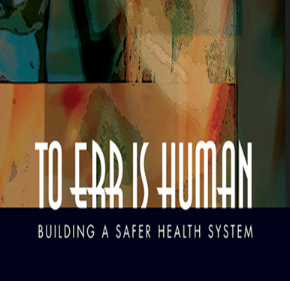
Obj.1 Impact of “To Err is Human”
Patient Safety Movement
Institute of Medicine Report, 1999¹
  Establish national focus and enhance knowledge base about safety
  Encourage health care providers to participate in voluntary reporting systems
  Raise expectations for improvements in safety
  Improve culture and systems in health care organizations for safer healthcare delivery
Notes:
In 1999 the Institute of Medicine published its report To Err is Human. It brought national attention to the problem of preventable medical error in the United States health care system.
From this report and the national attention it received, grew the patient safety movement in the US and important legislation.
The report also outlined 4 strategies for improvement.
The key areas of the strategy relate to
improving knowledge about patient safety, (including establishing a national center for pt safety within AHRQ)
establishing voluntary provider reporting, (called for laws to protect confidentiality of reporting)
raising the bar for what we expect, and (and professional societies should be leaders in encouraging and demanding improvements in patient safety)
improving the safety of health care delivery at the front lines. (through development of culture of safety, focus on reliability and systems improvement.)

Slide 4
Federal Laws and Regulation
Patient Safety and Quality Improvement Act (PSQIA) of 2005³
  Established voluntary reporting system for healthcare providers to enhance data about quality and patient safety issues
  Provides Federal privilege and confidentiality protections for Patient Safety Work Product
  Authorizes AHRQ to list Patient Safety Organizations
Patient Safety Rule published in 2008 implements PSQIA
  Provides the requirements for PSOs to be listed under AHRQ oversight
  Describes privilege and confidentiality protections
  Establishes framework for HHS to monitor compliance with PSO program, confidentiality provisions, impose penalties, etc.
AHRQ does not provide funding to individual PSOs

Slide 5
Nebraska Laws And Regulations
Nebraska legislature passed the Patient Safety Improvement Act in 2005²
Called for formation of a Patient Safety Organization in Nebraska to encourage a culture of safety and quality by providing for:
  Legal protection of information reported
  Aggregation of information about occurrences
  Sharing of information for improvement
Nebraska Coalition for Patient Safety formed in 2006 through collaboration of:
  Nebraska Hospital Association
  Nebraska Medical Association
  Nebraska Academy of Physicians Assistants
  Nebraska Pharmacists Association
  Nebraska Nurses Association
Nebraska Statutes 71-8701-8721 pertain to this act
No funding source for NCPS from state tied to this regulation

Slide 6
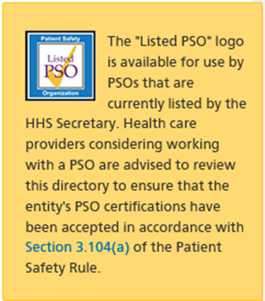

AHRQ PSO Program
https://pso.ahrq.gov/
Notes:
To be listed with AHRQ, a PSO must meet certification for listing requirements initially and every three years. Excellent information about the AHRQ’s PSO program is freely available on their website, including a list of PSOs across the US which meet the listing requirements of AHRQ. There are about 84 listed PSOs.

Slide 7
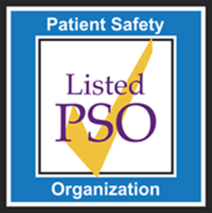
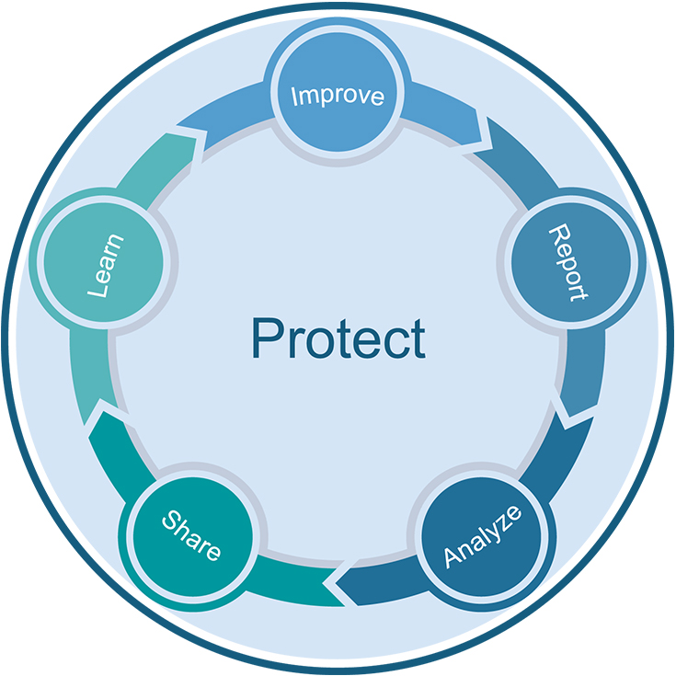
Why work with a PSO?
Working with a PSO provides a safe and protected environment in which to report, analyze, and share information about patient safety events so they can be learned from and improvements can be made to reduce the risk of patient harm.
These privilege and confidentiality protections can only be achieved by working with a federally-listed PSO.
Protect – Report – Analyze – Share – Learn – Improve
Notes:
The value and benefits of working with NCPS come from the federal and state protections that are offered to healthcare providers who work with a PSO.
NCPS provides a safe and protected environment in which to report, analyze, and share information about patient safety events so they can be learned from and improvements can be made to reduce the risk of patient harm.

Slide 8
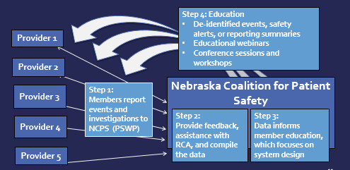
How does a PSO work with providers?
Notes:
This graphic shows the information flow of NCPS PSO. Providers report patient safety events to NCPS and they become privileged as Patient Safety Work Product. NCPS provides feedback, assistance with investigations, and aggregates data from the reports. The data is analyzed and is used to develop shared learning reports, education, and training, which is provided to NCPS members as part of the feedback loop. These Patient Safety Activities are conducted within the confidential and protected Patient Safety Evaluation Systems of both the providers and PSO.

Slide 9

Nebraska Coalition For Patient Safety
PSO
Nebraska’s only federally listed PSO
  Complies with state and federal regulations
  Meets AHRQ listing requirements and is reviewed every 3 years
Non-profit 501C3
Funded by member fees, sponsor contributions, some grants.
Governed by board of directors with representation from parent organizations, other state professional organizations and consumers
Workforce of 2.5 FTEs – Executive Director, Program Director and Health Data Analyst
Located on UNMC campus via a services agreement for facilities, administration, HR, and IT support.
https://www.nepatientsafety.org/
Notes:
The NCPS PSO…

Slide 10





NCPS Founders
Nebraska Coalition for Patient Safety formed in 2006 through collaboration of:
  Nebraska Academy of Physician Assistants
  Nebraska Hospital Association
  Nebraska Medical Association
  Nebraska Nurses Association
  Nebraska Pharmacists Association
Representatives serve on NCPS Board of Directors
Notes:
As a result of the Nebraska Patient Safety Improvement Act, five Nebraska professional organizations came together to form NCPS in 2006, answering IOM’s call to action for professional organizations to be actively engaged in patient safety improvement.

Slide 11
Check-in For Relevance
How many of you were aware of state regulations protecting quality and patient safety improvement information? Where could you look to find that information? Who could help?
How many of you know whether or not you are working with a PSO? What are the benefits? What questions do you have about working with a PSO?
What other questions do you have? What additional information do you need?

Slide 12
Obj.2 Role of Organizational Culture
Organizational Culture…
Shared assumptions learned by a group as they solve problems that originate in external and internal environments
Norms and behaviors that are taught by leaders (designated and situational) that define how to think and feel about those problems
(Schein, 2010)
Notes:
“the way we do things around here” - both learned and taught.

Slide 13
Obj.2 Role of Safety Culture
Shared values, norms, and behaviors related to patient safety among members of an organization (Weaver et al., 2013)
These values, norms, and behaviors reflect
  Relative importance of patient safety as compared to other organizational goals such as productivity (Zohar, 1980)
  Your organization’s willingness to learn from experience (Wiegmann, 2002)

Slide 14
Obj.2 Role of Safety Culture
Four beliefs present in a strong safety culture (IOM, 2004)
  Our processes are designed to prevent failure
  We are committed to detect and learn from error
  We have a just culture that disciplines based on risk taking
  People who work in teams make fewer errors

Slide 15
Obj.2 Safety Culture: A specific type of organizational culture
Organizational Culture
Allows us to make sense of our environment
Reflects common language… is heard and observed
Leaders create/teach culture by how they
  Share information
  Reward, provide feedback
  Hold people accountable
Safety Culture
A cross cutting contextual factor that moderates effectiveness of patient safety interventions (Weaver et al., 2013)
(Schein, 2010)
Notes:
This is the soil that you plant your interventions in. A safety culture is a certain type of organizational culture. This culture impacts your total organizational culture.
1. Schein, E.H. Organizational Leadership and Culture 4th ed. San Francisco: John Wiley & Sons; 2010.
4. Weaver SJ, Lubomski LH, Wilson RF, Pfoh ER, Martinez KA, Dy SM. Promoting a culture of safety as a patient safety strategy: A systematic review. Ann Int Med. 2013;158:369-374.
Methods: We performed multiple regressions to examine the relationships between 15 patient safety culture variables and a composite measure of adverse clinical events based on 8 risk-adjusted PSIs from 179 hospitals, controlling for hospital bed size and ownership. All patient
safety culture data were collected in 2005 and 2006 (except 1 late 2004 hospital), and all PSI data were collected in 2005.

Slide 16
Obj.3 Role of Leadership
Joint Commission Sentinel Event Alert # 57: The essential role of leadership in developing a safety culture
Leadership’s first priority is to be accountable for effective care while protecting the safety of patients, employees, and visitors.
Leadership commitment to creating and maintaining a culture of safety is just as critical as the resources devoted to financial stability, system integration, and productivity.
https://www.jointcommission.org/resources/patient-safety-topics/sentinel-event/sentinel-event-alert-newsletters/sentinel-event-alert-57-the-essential-role-of-leadership-in-developing-a-safety-culture/

Slide 17
Obj.3 Role of Leadership
Joint Commission Sentinel Event Alert # 57: The essential role of leadership in developing a safety culture
Maintaining a safety culture requires leaders to consistently and visibly support and promote everyday safety measures.
Leaders must understand that systemic flaws exist and each step in a care process has the potential for failure simply because humans make mistakes.
https://www.jointcommission.org/resources/patient-safety-topics/sentinel-event/sentinel-event-alert-newsletters/sentinel-event-alert-57-the-essential-role-of-leadership-in-developing-a-safety-culture/

Slide 18
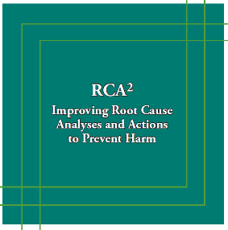
Obj.3 Role of Leadership
Leadership should be actively involved in the RCA² process:
Understand and support the process
Ensure the RCA team has the resources it needs – time, training, tools - to carry out the process
Approve and review action plans for effectiveness
Understand what a thorough RCA² report should include
Act when RCA reviews are not effective and credible
Annually review the RCA process
Establish and foster a culture of trust – a just culture
NPSF/IHI. RCA2: Improving root cause analyses and actions to prevent harm. Boston: 2015
IHI RCA2 guide: http://www.ihi.org/resources/Pages/Tools/RCA2-Improving-Root-Cause-Analyses-and-Actions-to-Prevent-Harm.aspx
Notes:
Gail - (Speaker note: move quickly – point to this resource)
We will talk about RCAs further in a little bit, but I wanted to emphasize that in addition to support for the overall quality and patient safety programs, leaders need to understand and support event investigations and fostering a just and fair culture. The IHI guide for RCA2 is publicly available and is a great resource.
The IHI RCA squared guide outlines leadership responsibilities specifically related to RCAs and we have those summarized here for you..
No matter what size organization you are working in, whether you are in a small rural health clinic, a critical access hospital with 15 beds, or a large healthcare system, these leadership responsibilities with regard to the RCA process will not change.
(Last bullet point) In addition to providing resources for the RCA, a critical role for leadership is to establish a culture of trust, which may also be referred to as a just culture. In the next few slides, we’ll explore this concept a bit more…

Slide 19
Check-in For Relevance
Does your organization have a quality/risk management plan?
Who is ultimately accountable for the quality of care and safety of patients at your organization?
How does leadership demonstrate commitment to patient safety?
How is leadership and the board informed of how you are doing with quality improvement and patient safety? What metrics are reported to the board? How often and by whom?
What success stories can you share? What challenges are you facing?

Slide 20

Obj.4 Three Levels of Organizational Culture
Three levels of organizational culture…
“the way we do things around here”
Observable behavior
Values
Underlying assumptions
(Schein, 2010)
https://www.continuitysa.com/beware-iceberg-business-continuity-important-not-outsource/

Slide 21
Why is it important to recognize the three levels of culture?
A gap often exists between our observed behaviors and our values/beliefs! (Schein, 2010)
Example: We value physical activity and health, we use Fit Bits and Smart Phones to know if we achieve 10,000 steps per day
Teachable, learnable tools and strategies can bridge this gap

Slide 22
Obj.4 Three Levels of Culture
Behaviors
Beliefs & Values
Underlying Assumptions
Behavior consistent with Belief:
50% agree, “Staff feel free to question decisions or actions of those with more authority.”*
Communication Openness Belief:
79% agree, “Staff will freely speak up if they see something that may negatively affect patient care.”*
Assumption: Safety is a system property. Thus, we should voice our concerns about patient safety.
“…in many organizations, values reflect desired behavior but are not reflected in observed behavior.” (Schein, 2010, pp. 24, 27)
*50th percentile response from 630 hospitals reporting to AHRQ 2018 National Database
Notes:
Edgar Schein also helps us to understand culture by identifying three levels of organizational culture
First, the foundation of organizational culture is our underlying assumptions. These unconscious assumptions dictate our beliefs and values….what we say is important, which is the second level of organizational culture.
Finally, we would expect that our observed behaviors—the third level-- would be consistent with what we say our beliefs and values are.
However, as Schein indicates, too often our values reflect the behaviors we would like to see, NOT what we actually see.
Here is an example that we often see in HSOPS results. Let’s say there is an underlying assumption among your staff that safety is a property of the system and that fallible human beings work within that system. If so, then they will value teamwork as a safety net and likely state that they support one another. In fact, data from the HSOPS National Database indicates that on average , 86% of HSOPS respondents agree, “People support one another in this unit.”
However, if we were to observe a unit, we might find that nurses and therapists who experience a sudden increase in their workload try to work faster as individuals and cut corners rather than call for a huddle or ask for task assistance. Data from the HSOPS National Database indicates that on average , 69% of HSOPS respondents agree, “When one area in this unit gets really busy, others help out.” This concept that a gap often exists between beliefs and behaviors is very useful when interpreting HSOPS results.
in the So you would expect that they would use briefs to establish a plan, assign roles and establish expectations; huddles to adjust the plan; and debriefs to learn from what happened.

Slide 23




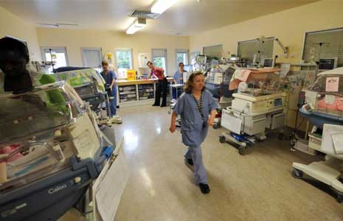
Obj.4 Four Categories of Organizational Culture (Schein, 2010)
Macroculture
Organizational Culture
Professional Subcultures
Unit/Dep’t. Microcultures
Notes:
Who drives your culture? Your most immediate supervisor. That leader either sets out to engineer, create or develop a culture of safety, or the culture runs them. HSOPS (9 f 12) measure culture at dept level. 3 measure organization as a whole.
Edgar Schein defined four overarching categories of culture:
Macroculture
Organizational Culture
Subculture…which reflects the varying culture of different professions
Microculture
Our national culture arises out of values or beliefs while our organizational cultures are primarily shaped by shared practices or behaviors…what we do…Each organizational culture is shaped by the professional subcultures of its personnel…physicians, surgeons, nurses, allied health, managers, and administrators all have different cultures based on their unique beliefs and behaviors. Finally, culture varies among departments and units and even shifts within units. Thus, your organizational culture is really a patchwork quilt made up of unit and department microcultures.

Slide 24
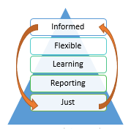
Obj.4 Four Components of Safety Culture (Reason, 1997)
Informed – safe, highly reliable organization
Flexible – the organization changes processes and systems to improve; team communications are optimized; there is psychological safety to speak up about safety related information
Learning – information from reports is used to understand risk in the organization and how systems and processes can be improved (includes RCAs)
Reporting – staff feel safe to freely report errors and unsafe situations; they understand how the information is used
Just –there is a fair, transparent, consistent system of managing events, demonstrating a shared accountability between system design and behavioral choices
Reason, J. Managing the Risks of Organizational Accidents. Hampshire, England: Ashgate Publishing Limited; 1997.
Notes:
Based on James Reason’s work, we can think about safety culture as being made up of four key components.. which are interactive and dynamic
A fair, transparent, and consistent system of workplace justice, or just culture, is a foundational component of a robust culture of safety. In a just culture the focus is on system design and safe choices.
People then feel safe to report events – they know they will be treated in a just and fair manner and they understand how the information is used – that it will be used for learning and improvement– and they trust that system.
Learning - information from reports is used as a window to understand risk in the system. Conducting Root Cause Analysis is one of the methods an organization uses to learn–
Flexible behaviors make an organization adaptable and resilient – the organization changes processes and systems to improve; - this includes RCA action plans
As these components of safety culture are strengthened, the organization moves toward a safe, informed, highly reliable organization. An informed culture is needed to achieve high reliability. High reliability organizations are “mindful” ….they are….
preoccupied with failure
sensitive to how each team member affects a process
allows those who are most knowledgeable about a process to make decisions, and
resists the temptation to blame individuals for errors within complex processes

Slide 25
Check-in For Relevance
Have you heard of Just Culture? Do you have any experience with this concept?
What kind of event reporting system do you have? How are event reports used?
Have you been involved in a Root Cause Analysis? How did it go?
Why is it important to learn from events? Why is it important to share the learning with staff?

Slide 26
Obj.5 Why assess safety culture
Safety culture as measured by the Hospital Survey on Patient Safety Culture (HSOPS) is associated with
  adverse events…the more positive your safety culture the lower is the incidence of adverse events (Mardon et al., 2010)
  patient satisfaction…the more positive your safety culture the more satisfied are your patients (Sorra et al., 2012)
Notes:
Also add joint commission citation about more adverse events in organizations with weak safety culture.

Slide 27
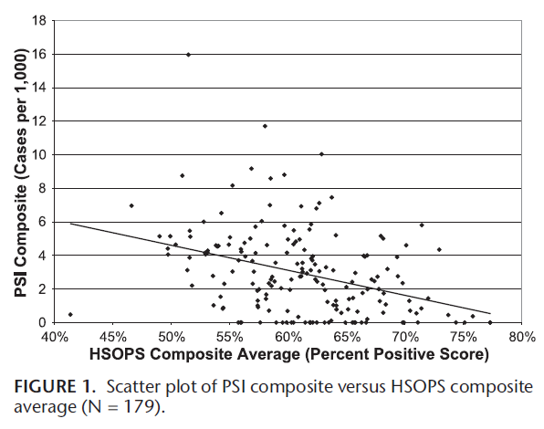
HSOPS and Patient Safety Events (Mardon et al., 2010)
Higher HSOPS scores are associated with fewer adverse events, which validates patient safety culture assessment as a meaningful indication of the safety of patients.
Notes:
HSOPS composite (avg of 12 composite scores)
More positive patient safety culture associated with
Fewer adverse events in hospitals
More positive assessments of care from patients
Mardon RE, Khanna K, Sorra J, Dyer N, Famolaro T. Exploring relationships between hospital patient safety
culture and adverse events. J Patient Saf 2010;6: 226-232.

Slide 28
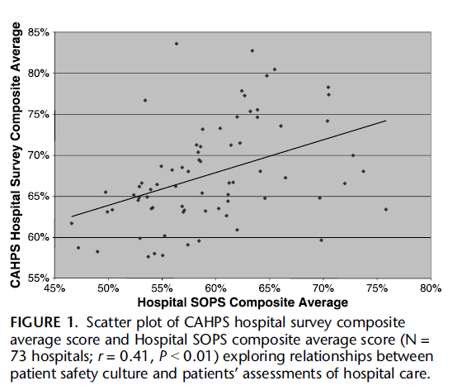
HSOPS and Patient Satisfaction (Sorra et al., 2012)
“….behaviors and attitudes [of hospital employees] can directly affect the pain, discomfort, health, and recovery of patients.”
Notes:
Sorra J, Khanna K, Dyer N, Mardon R, Famolaro T. Exploring relationships between patient safety culture
and patients’ assessments of hospital care. J Patient Saf 2012;8: 131-139.

Slide 29
Obj.5 Plan to Assess Safety Culture
The Joint Commission’s Sentinel Event Database indicates that leadership’s failure to create an effective safety culture is a contributing factor to adverse events
Leaders should ensure your organization
  Establishes a baseline measure of safety culture using the Agency for Healthcare Research and Quality (AHRQ) Hospital Survey on Patient Safety Culture (HSOPS)
  Analyzes and shares results from the survey at the unit and job title level with front-line workers
  Develops and implements action plans to address areas of weakness at organizational and unit-level
  Re-assess safety culture every 18 – 24 months
  (Joint Commission, 2017)
Notes:
The HSOPS was developed by AHRQ to provide healthcare organizations with a valid tool to measure safety culture. AHRQ supports a national comparative database of HSOPS results that allows benchmarking of results by hospital size, type of unit and profession.
Joint Commission reference available at: https://www.jointcommission.org/sea_issue_57/

Slide 30
Obj.5 Resources to Assess Safety Culture
AHRQ Hospital Survey on Patient Safety Culture (HSOPS) Toolkit available at:
  https://www.ahrq.gov/sops/quality-patient-safety/patientsafetyculture/hospital/index.html
AHRQ National Comparative Database of HSOPS results for Benchmarking available at:
  https://www.ahrq.gov/sops/quality-patient-safety/patientsafetyculture/hospital/hosp-reports.html
  630 hospitals; 382,834 respondents in 2018 database
Notes:
The HSOPS was developed by AHRQ to provide healthcare organizations with a valid tool to measure safety culture. AHRQ supports a national comparative database of HSOPS results that allows benchmarking of results by hospital size, type of unit and profession. The 2012 database contains results from 1,128 hospital and 567,703 respondents.
The HSOPS consists of 42 items that are categorized in 12 dimensions or composites. Each dimension consists of three or four items that measure slightly different constructs. Often we can differentiate between an item that asks respondents their perceptions of a belief or value and an item that asks respondents their perceptions of a behavior or practice.
9 of the 12 dimensions ask respondents to think about the dept or work area where they spend the majority of their time. Thus, the majority of the results reflect perceptions of unit-level culture and not the hospitals as a whole.
https://www.jointcommission.org/sea_issue_57/

Slide 31
Goals of Safety Culture Assessment
Identify areas of culture in need of improvement
  Identify impairments in organizational learning
  Create road map for improvement of infrastructure that supports all safety and quality initiatives
Increase awareness of patient safety concepts
Evaluate effectiveness of patient safety interventions over time
Conduct internal and external benchmarking
Meet regulatory requirements
Identify gaps between observed behaviors and values/beliefs within subcultures and microcultures
  (Schein, 2010; Jones et al., 2008; Nieva & Sorra, 2003)

Slide 32
HSOPS
42 items categorized in 12 composites/dimensions
  2 dimensions measure outcomes at dept/unit level
  7 dimensions measure culture at dept/unit level
  3 dimensions measure culture at hospital level
2 additional outcome measures at dept/unit level
Open-ended comments about patient safety
Additional items available to evaluate impact of interventions on safety culture (e.g. TeamSTEPPS, Just Culture, Health IT)
  Extent of training
  Knowledge of intervention
  Adoption of intervention
Notes:
Refer to the survey pdf

Slide 33
Crosswalk Reason’s Components
Reason’s Components⁷ | HSOPS Dimension or Outcome Measure
Reporting Culture - a safe organization is dependent on the willingness of front-line workers to report their errors and near-misses | Frequency of Events Reported (U) Number of Events Reported (O)
Just Culture - management will support and reward reporting; discipline occurs based on risk-taking | Nonpunitive Response to Error (U)
O=Outcome Measure, U=Unit, H=Hospital
Notes:
Let’s see how Reason’s components of culture are measured by the AHRQ survey….

Slide 34
Crosswalk Reason’s Components
Reason’s Components⁷ | HSOPS Dimension or Outcome Measure
Flexible Culture - authority patterns relax when safety information is exchanged because those with authority respect the knowledge of front-line | Teamwork w/in Units (U) Staffing (U) Communication Openness (U) Teamwork ax Units (H) Hospital Handoffs (H)
Learning Culture - organization will analyze reported information and then implement appropriate change | Hospital Mgt Support (H) Manager Actions (U) Feedback & Communication (U) Organizational Learning (U) Overall Perceptions (U) Patient Safety Grade (O)

Slide 35
How to Conduct SOPS
AHRQ resources to help you conduct the survey directly in your organization: https://www.ahrq.gov/sops/surveys/index.html
Use a vendor to help you conduct the survey

Slide 36
Conduct HSOPS with NCPS
NCPS uses principles of survey research to
  Ensure adequate response rate > 50%
  Accurately determine response rate
  Ensure confidentiality of respondents
  Correctly code reverse-worded survey items
NCPS will customize survey demographics to ensure accurate assessment at level of Work Area (microcultures) and Job Title (subcultures)
NCPS provides a reports to assist in understanding results and implementing strong action plans for improvement based on evidence-based interventions

Slide 37
Check-in For Relevance
Why would an organization assess their safety culture?
What would conducting SOPS tell you?
What resources are available to you to conduct SOPS?
Has your organization conducted SOPS? Do you have access to the results? What did you find?
Share your experience and thoughts. What challenges do you face?

Slide 38
Obj.6 Four Types of Interventions to Support Safety Culture
1. Just Culture
“The Just Culture program teaches hospital leadership to address safety concerns by offering a strategy so that employees are not punished for decisions taken in good faith. The Just Culture Algorithm™ is a structured approach that encourages hospitals to look at system factors instead of individual blame yet teaches an organization how to detect and manage disruptive and unprofessional behavior that puts patients at risk… Each manager has the Just Culture Algorithm posted in their office so that it is visible to all staﬀ.” (Campione et al., 2018, p. 28)

Slide 39
Just Culture
Algorithm-based decision-making to manage behavior: human error, at-risk, reckless
Shared accountability: employees accountable for their behavior; management accountable for systems
Human
Error
At-Risk
Behavior
Reckless
Behavior
Inadvertently doing other than what was intended: a slip, lapse, mistake
Choice that increases risk where risk is not recognized or believed to be justified
Choice to consciously disregard a substantial and unjustifiable risk
Console
Coach
Punish
(Marx, 2001; Outcome Engenuity)
Notes:
When we talk about just culture we are really talking about a system of workplace justice. One that is transparent, consistent, and fair. It holds the organization (leaders) accountable for the systems it puts into place and the employees for making safe choices within those systems. The management of the behaviors within the system must be consistent and objective (as possible). It uses tools, such as the just culture algorithm and structured methods of event investigation to support the consistent approach across the organization.

Slide 40
Obj.6 Four Types of Interventions to Support Safety Culture
2. Event Reporting
“The reporting of safety events can be facilitated through a well-developed error reporting system that is easy to use and can track improvement in reducing both errors and near misses. Hospital leaders can promote reporting by providing sufficient feedback and engaging those who take the time to report errors.” (Campione et al., 2018, p. 29)
Notes:
In 2018, Campione and Famolare conducted a study to gain knowledge about promising best practices used by hospitals to improve patient safety culture hospitalwide.
They used HSOPS results in the AHRQ database to identify top improving hospitals and conducted semistructured interviews with 6 top performing hospitals. The goal was to identify common theses and best practices among the hospitals.
The mean change in the all-composite percent positive culture score was a 1.7 percentage point increase. The six
hospitals interviewed had an average increase of 8.6 percentage points (range, 6.5–10.6) in their culture score. The three
most common practices for improving culture as described by the hospital quality leaders from the six hospitals were (1)
goal setting and strong action planning for quality improvement, (2) implementation of well-known patient safety initiatives
and programs, and (3) rigorous survey administration methods.
Among six large hospitals that improved their hospitalwide culture score, the common best practices were the
implementation of routine culture measurement with a wide dissemination of results, strong action planning for improvement
that includes leadership support and involvement from all staff levels, and multifaceted patient safety programs and education
Background: Patient safety culture has a positive influence on the effectiveness of patient safety and quality improvement
interventions. A study was conducted to gain knowledge about promising best practices used by hospitals to improve
patient safety culture hospitalwide.
Methods: Agency for Healthcare Research and Quality (AHRQ) Surveys on Patient Safety Culture™ (SOPS) Hospital
Survey longitudinal results from 536 hospitals that submitted data to the Hospital SOPS database from 2007 to 2014 were
analyzed. Composite-level and aggregate improvement was measured, resulting in the identification of “top-improving,” large
hospitals (400 + beds). Semistructured interviews were conducted with one to three interviewees (for example, Vice President
of Clinical Quality, Patient Safety Officer, Chief Medical Officer) from six top-improving hospitals. The transcripts of
the interviews were analyzed to identify common themes and best practices among the hospitals.
Results: The mean change in the all-composite percent positive culture score was a 1.7 percentage point increase. The six
hospitals interviewed had an average increase of 8.6 percentage points (range, 6.5–10.6) in their culture score. The three
most common practices for improving culture as described by the hospital quality leaders from the six hospitals were (1)
goal setting and strong action planning for quality improvement, (2) implementation of well-known patient safety initiatives
and programs, and (3) rigorous survey administration methods.
Conclusion: Among six large hospitals that improved their hospitalwide culture score, the common best practices were the
implementation of routine culture measurement with a wide dissemination of results, strong action planning for improvement
that includes leadership support and involvement from all staff levels, and multifaceted patient safety programs and education.

Slide 41
Reporting Interventions
Formal Reporting of adverse events with standardized taxonomies (e.g. NCC-MERP A – I Error Severity Taxonomy; medication errors by type and phase of origin; assisted and unassisted falls)
Near misses and non-harmful errors are frequently reported, valued, and learned from
Informal Reporting – Safety Briefings and Leadership WalkRounds to leverage frontline expertise
(Institute for Healthcare Improvement, Singer et al., 2013)
Successful Reporting Systems
Nonpunitive
Confidential
Independent
Expert analysis
Timely
Systems-oriented
Responsive
(Leape, 2002)
Notes:
Reporting, obtaining information about the processes and outcomes of care, is the foundation of a safe, informed culture. Psychologist James Reason states, “Any safety information system depends crucially on the willing participation of the workforce, the people in direct contact with the hazards.” To achieve this, it is necessary to engineer a reporting culture—an organization in which people are prepared to report their errors and near-misses.” The practices that support a reporting culture include formal reporting systems that are nonpunitive, independent of other systems (HR), timely,

Slide 42
Obj.6 Four Types of Interventions to Support Safety Culture
3. Learning Interventions
“Ultimately, the willingness of workers to report depends on their belief that the organization will analyze reported information and then implement appropriate change—organizational practices support a learning culture.” (Reason, 1997)
Notes:
7 Feedback loop – what happens to reports? What is done with them? Are they used for learning? (or punishment)? Are meaningful changes made? If not, why report?

Slide 43
Learning Interventions
Team-based meetings (briefs, huddles, debriefs)
Process Mapping (Colligan et al., 2010)
Individual Root Cause Analysis (Institute for Healthcare Improvement)
Aggregate Root Cause Analysis (Neilly et al., 2003)
Failure Modes and Effect Analysis (VA National Center for Patient Safety)
Safety Briefings and Leadership WalkRounds (Institute for Healthcare Improvement)
Leveraging Frontline Expertise (Singer et al., 2013)
Close the loop with reporting… provide feedback to frontline
Notes:
A learning culture takes action based on information about its systems. A learning culture is driven to improve through constant feedback about the successes and failures of its processes. The foundation of a learning culture is information systems…reporting. Ultimately, the willingness of workers to report depends on their belief that the organization will analyze reported information and then implement appropriate change—organizational practices support a learning culture. Root cause analysis, individual and aggregate, FMEA, Safety Briefings, and Leadership WalkRounds are the tools that organizations use to learn from their experience.

Slide 44
Leveraging Frontline Expertise
The foundation of all safety culture interventions
The Leveraging Frontline Expertise (LFLE) Cycle
Information Gathering
Prioritization
Follow-Up
Feedback Communication
Leaders engage the frontline to learn from and with them about system problems
Leaders hold frontline accountable for implementing and sustaining mutually agreed upon change
(Singer et al., 2013)
Notes:
Learning from the frontline is the foundation of patient safety culture. Open communication between frontline and leadership.
Add Deming philosophy – those who are doing the work know best how the work is done.

Slide 45
Obj.6 Four Types of Interventions to Support Safety Culture
4. Team Strategies and Tools to Enhance Performance and Patient Safety
“TeamSTEPPS is an evidence-based team training program to enhance teamwork, communication, and problem solving that has shown to improve hospital patient safety culture and teamwork attitudes. TeamSTEPPS oﬀers a comprehensive set of ready-to-use materials and a training curriculum.” (Campione et al., 2018, p. 27)
Notes:
7. TeamSTEPPS support the flexible culture - The knowledge, skills, attitudes, language and coordinating mechanisms inherent in teamwork5 create the flexibility team members need to manage complexity6 and learn from experience. (Jones, et. Al)

Slide 46
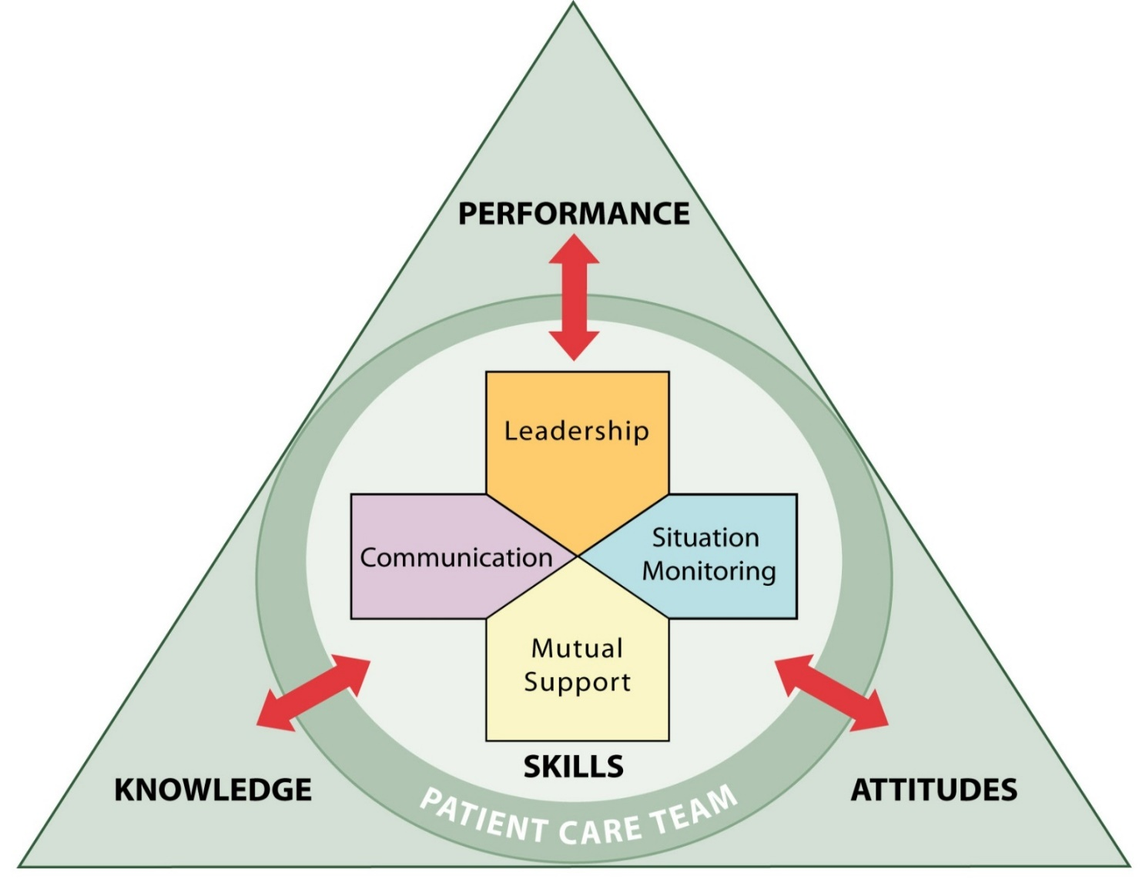
TeamSTEPPS
Adopting team behaviors positively impacts all components of safety culture because teamwork supports learning. (Jones et al., 2013)
http://teamstepps.ahrq.gov
Notes:
Psychologist James Reason states, “A flexible culture takes a number of forms, but in many cases it involves shifting from the conventional hierarchical mode to a flatter professional structure, where control passes to task experts on the spot, and then reverts back to the traditional bureaucratic mode once the emergency has passed.”
TeamSTEPPS stands for Team Strategies and Tools to Enhance Performance and Patient Safety. TeamSTEPPS is an evidence-based team training program developed by the Department of Defense and the Agency for Healthcare Research and Quality. It builds on 30 years of research on teams and team performance in high-risk areas such as aviation, the military, nuclear power, and healthcare in which poor performance may lead to serious consequences or death. TeamSTEPPS is designed to optimize team performance across the healthcare delivery system by focusing on specific skills supporting team performance that empowers ‘experts on the spot’ to ensure all have a shared mental model.
Provides healthcare teams the capacity for resilience to adapt to ever-changing environments and needs – deference to expertise, regardless of title.

Slide 47
Safety Culture Summary
Safety culture is the learned, shared beliefs and behaviors that reflect willingness to learn
Why is it important to devote resources to safety culture?
  Improving safety culture increases likelihood of success of all other patient safety interventions
  Safety culture is associated with adverse events and patient satisfaction
  Use sound survey research methods to ensure your assessments of safety culture are valid
    “If I had an hour to solve a problem I'd spend 55 minutes thinking about the problem and 5 minutes thinking about solutions.” ― Albert Einstein

Slide 48
Safety Culture Summary
  Implement evidence-based interventions within each key component of safety culture
    Just culture
    Effective reporting systems that capture near misses
    Root cause analysis, Leveraging Frontline Expertise
    Team training, implementation, and sustainment
  Keep in mind the end goal…to understand and use what the frontline knows about the system to plan, implement, and sustain change
Notes:
Finally, remember we can often identify whether an item within a dimension is asking about a belief/value or a behavior/practice. We want to look for gaps between beliefs and behaviors within dimensions. We will identify evidence-based practices that can bridge those gaps and “engineer a culture of safety.”

Slide 49
Check-in For Relevance
Do the four components of a safety culture make sense?
How do the components interact?
What can you tell me about the culture of your organization (whether or not you have conducted a SOPS)?
  Just and fair?
  Reporting?
  Learning?
  Flexible?
What opportunities for improvement have you identified so far? What resources do you need?

Slide 50
Obj.7 High reliability, systems thinking and human factors
High reliability - consistent performance at high levels of safety over long periods of time
Used in high risk organizations that manage extreme hazards in complex situation with success
Healthcare is a high risk industry that can use High Reliability Organization (HRO) principles
Systems thinking and human factors engineering are inherent in HROs
Chassin, Loeb, 2011
Notes:
commercial aviation, nuclear power and military aircraft carriers are examples of HROs
A classic example is that of the military aircraft carrier: despite significant production pressures (aircrafts take off and land every 48–60 seconds), constantly changing conditions, and hierarchical organizational structure, all personnel consistently prioritize safety and have both the authority and the responsibility to make real-time operational adjustments to maintain safe operations as the top priority https://psnet.ahrq.gov/primers/primer/31/high-reliability

Slide 51
HRO Principles
Preoccupation with Failure
Reluctance to Simplify
Sensitivity to Operations
Deference to Expertise
Commitment to Resilience
AHRQ Patient Safety Network, 2019

Slide 52
Preoccupation With Failure
Everyone is alert and on the lookout for potential failures.
New threats arise unexpectedly and often.
The absence of errors or accidents does not lead to complacency.
Near misses are seen as opportunities to learn about systems issues and potential improvements, rather than as evidence of safety.
People feel safe to report small problems so they won’t become big ones.
AHRQ Patient Safety Network, 2019
Notes:
How does this fit into what we’ve learning about a just culture and reporting culture?

Slide 53
Reluctance to Simplify
People resist looking for a simple answer or excuse for a problem.
People understand that the systems they work in are complex and dynamic.
Problems are analyzed for underlying explanations, rather than surface ones.
Curiosity and questioning of the status quo is encouraged.
AHRQ Patient Safety Network, 2019
Notes:
How does this fit into a learning culture? How does it fit into a just culture? How about a flexible/team culture?

Slide 54
Sensitivity to Operations
There is “situational awareness” – people have an understanding of what is going on around them and how the current state may threaten safety.
People understand the “big picture” – the context of their work in relation to the unit, process flow or organization.
Resources are available for unexpected situations, changes in workload, etc.
AHRQ Patient Safety Network, 2019
Notes:
How does this fit into a flexible culture?

Slide 55
Deference to Expertise
People closest to the work are the most knowledgeable about the work.
In a crisis or emergency, the person with greatest knowledge of the situation might not be the person with the highest status and seniority.
If something unexpected occurs, the most highly qualified people, regardless of rank, make the decision.
The organizational culture is such that all staff members are comfortable speaking up about potential safety problems.
AHRQ Patient Safety Network, 2019
Notes:
How does this fit into a flexible culture? A just culture?

Slide 56
Commitment to Resilience
People understand that system failures are often unpredictable.
People prepare for and practice assessing and responding to challenging situations.
Teams are cultivated through team training in skills such as situation assessment and cross monitoring so that potential safety threats can be identified and responded to quickly.
Events and potential threats are learned from to improve systems and processes so future problems and harm can be prevented.
AHRQ Patient Safety Network, 2019
Notes:
How does this fit into flexible culture? Learning culture?

Slide 57
Roadmap to HRO
Requirements to achieve high reliability:
Leadership commitment
Development of a culture of safety
Robust and ongoing improvement
Chassin, Loeb, 2011
Notes:
Looks simple, but we know that it isn’t. It starts with leadership commitment (or at the very least, support)! It is like any other performance improvement project in this way – measure, assess, action planning - continuous improvement. PDCA applied to patient safety.

Slide 58
Human Factors and Systems Thinking
The proposition is this: framed by the right systems of learning, the right systems of justice, we can design systems, and help humans make choices in those systems, to produce better outcomes at the individual, local, and societal level.
David Marx, Founder of
Outcome Engenuity

Slide 59
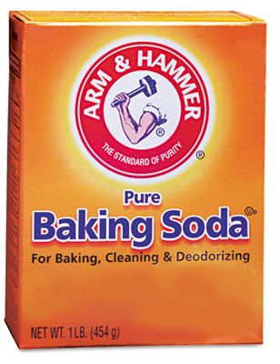
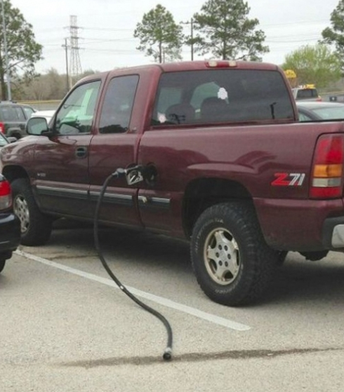
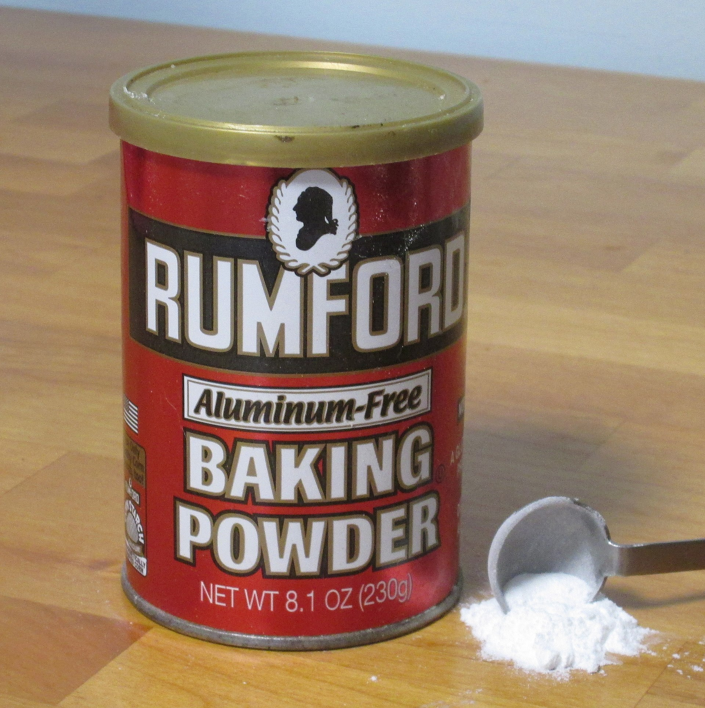
To Err is Human
This Photo by Unknown Author is licensed under CC BY-SA
Notes:
SECTION B
Objective(s): To Err is Human.
Guidance to Instructor(s): To Err is Human (p. 14).
Did not intend the consequence of any damage to the gas station.
Did not intend the action of driving away with the gas nozzle.
This is a human error, a genuine slip lapse or mistake. And most gas stations are ready for this relatively common human error. Either they have learned the hard way, or they learned from others to anticipate this human error. Where are we one human error away from an outcome we cannot tolerate? Let’s find those weak spots and if we can…fix them before the bad outcomes.
Tip(s) for Instructor(s): You could have some fun with this; there is usually at least someone who has either driven away with or almost driven away with the gas nozzle. Also an option here is to discuss system design strategies to help prevent human errors. A second option is to foster a discussion of where are we one human error away from an intolerable outcome.
Instructor(s) Notes:

Slide 60



To Drift is Human
Notes:
SECTION B
You are invited to change this graphic to your preferred example of drift. This example must demonstrate a person who does intend their action but does not see the substantial and unjustifiable risk of their action.
Synchronize this example with the example used twice in Skill 5, Duty to Avoid Causing Unjustifiable Harm plus Repetitive At-Risk Behaviors.
Objective(s): To Drift is Human.
Guidance to Instructor(s): To Drift is Human (p. 14).
Did Steve intend the possible consequence of harm to his son? No.
Did he intend the action of bringing his son into the arena? Yes.
Steve Irwin was doing a crocodile demonstration when he paused half way, went to the side of the arena and his wife handed him his baby son. He then continued the demonstration while holding his son in one arm. Later investigation reveals this is a family tradition. Is this an unsafe act? (1) Is the risk substantial? (2) Is the risk justifiable? If yes & no are your answers, then this is an unsafe act. But does Steve see the risk? No, he feels safe. Even the best of us will drift as we gain comfort in a task. This is drift.
Tip(s) for Instructor(s): It helps to identify for this exercise that we are the network (Steve’s boss).
Instructor(s) Notes:

Slide 61

The P.I.D.A. Model
Decision-Making
Sight
Standard interpretation
(heuristics, mission focused)
Unconscious,
Automatic
Conscious,
Thoughtful
Sound
Smell
The
“Risk Monitor”
(background process, harm focused)
Taste
Touch
Level of Mental Effort
Low
High
Perception
Interpretation
Decision-Making
Action
Notes:
SECTION B
Objective(s): Introduction to the P.I.D.A. Model (Perception, Interpretation, Decision, Action)…how we perceive what is going on around us, interpret the signals and make a decision as to how to respond.
Guidance to Instructor(s): Guidance on how to put yourself in someone else’s shoes and determine intentions. This will be revisited in the Reasonable Person Standard and when using the Algorithm.
Tip(s) for Instructor(s): N/A.
Instructor(s) Notes:

Slide 62
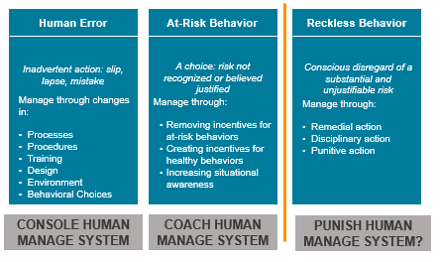
Three Core Human Behaviors

Slide 63
Human Performance Shaping Factors
Internal | External
Physical Attributes Psychological Attributes Knowledge/Skill/Experience Attention Bias | Systems Procedures Resources Staffing/Load/Stressors Time Environment Supervision Communication Culture

Slide 64
Human Performance Shaping Factors - Examples
Alertness | Human- computer interface design | Task Saturation | Emotional state
Anxiety | Illness/injury | Task Complexity | Tool design
Attentiveness - concentration | Language | Medications | Training
Color contrast – color blindness | Lighting | Organizational Pressure | Weather
Communication – verbal instructions | Monotony | Overconfidence | Written Information
Distraction | Noise | Peer Pressure | Workplace layout
Fatigue | Situational Awareness | Culture | Values
Knowledge of task, process, system, rules | Skill | Fear | Visibility
Hearing ability | Stress | Schedule Pressure | Team Coordination
Outcome Engenuity, 2018

Slide 65
Systems Thinking
What is a “System”?
An organized, purposeful structure that consists of interrelated and interdependent elements (components, entities, factors, members, parts) that continually influence one another (directly or indirectly) to maintain their activity and the existence of the system, in order to achieve the goal of the system.
A set of detailed methods, procedures and routines created to carry out a specific activity, perform a duty, or solve a problem.
http://www.businessdictionary.com/definition/system.html

Slide 66
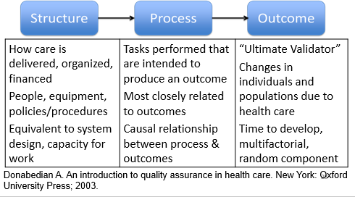
Systems Thinking
Outcomes are produced through the design and operation of structures and processes.

Slide 67
Humans + Systems
Human Factors Engineering:
A discipline that strives to design systems that optimize safety and minimize risk of error in complex environments, by focusing on how systems work in actual practice - with fallible human beings interacting with tools, technology, systems and the environment.
Specific activities are examined in terms of component tasks for the physical and skill demands, mental workload, team dynamics, and environmental conditions and device design needed for optimal performance of the work.
https://psnet.ahrq.gov/primers/primer/20/Human-Factors-Engineering

Slide 68
Human Factors Engineering in System Design
Tool/Technique | Example
Usability Testing: prevent problems or workarounds by testing tools, techniques and technology in real world conditions | Testing a change to the electronic medical record with users before implementation. Doing a pilot of a new process with a few workers before implementing across the whole unit or testing on a unit before implementing organization-wide.
Forcing Functions: prevents unintended action or allows only if required action performed first | Medications cannot be ordered in CPOE until the allergies section is completed Patient ID must be scanned and match the medication dispensing system before medication can be removed
Standardization: ensuring safety steps are performed in correct order, reducing reliance on human vigilance | Using code carts with standard types of and locations for emergency drugs and supplies on every cart Checklist for central line insertion steps to prevent infections
https://psnet.ahrq.gov/primers/primer/20/Human-Factors-Engineering

Slide 69
Human Factors Engineering in System Design
Tool/Technique | Example
Environment: Change the precursors to human error and at-risk behavior | Housekeeping responsible for ensuring a clean gait belt is on hook at the head of the bed in each room Needle disposal bin design and placement
Barriers: Prevent individual errors | Smart infusion pumps that contain pre-programmed libraries with standardized dosing for commonly used intravenous medications
Recovery: Catch errors downstream | Bar Code Medication Administration at bedside using 7 rights of medication administration (right…patient, drug, dose, route, time, reason, documentation) Surgical Safety Check List Sponges with radiopaque marker
Redundancy: Add parallel elements | Independent double check of high alert medications Independent double check of calculations for weight-based dosing
Notes:
SECTION C
Objective(s): N/A.
Guidance to Instructor(s): See The Role of System Design (pp. 19-27) for examples and talking points.
Tip(s) for Instructor(s): N/A.
Instructor(s) Notes:

Slide 70
Hierarchy of Risk Controls/Interventions
Strong
Physical, environmental, architectural, system or process simplification
Moderate
Cognitive aids, checklists, redundancy, standardization
Weak
Administrative, policy change, education, reminders, warnings, supplies
Effectiveness and Sustainability
Hettinger et al., 2013; Liberati et al., 2018
Notes:
How can we support humans in making safe choices?

Slide 71
Learning About How Systems are Operating
Team-based meetings (briefs, huddles, debriefs)
Process Mapping (Colligan et al., 2010)
Individual Root Cause Analysis (Institute for Healthcare Improvement)
Aggregate Root Cause Analysis (Neilly et al., 2003)
Failure Modes and Effect Analysis (VA National Center for Patient Safety)
Safety Briefings and Leadership WalkRounds (Institute for Healthcare Improvement)
Leveraging Frontline Expertise (Singer et al., 2013)
Notes:
A learning culture takes action based on information about its systems. A learning culture is driven to improve through constant feedback about the successes and failures of its processes. The foundation of a learning culture is information systems…reporting. Ultimately, the willingness of workers to report depends on their belief that the organization will analyze reported information and then implement appropriate change—organizational practices support a learning culture. Root cause analysis, individual and aggregate, FMEA, Safety Briefings, and Leadership WalkRounds are the tools that organizations use to learn from their experience.

Slide 72
Looking for System Causes
Outcome
Human Error
Why?
Why?
Behavioral Choice
Why?
Mechanical Failure
Why?
Notes:
A root cause analysis is one method of learning about how systems are operating, after an event.
We start with the undesirable outcome on the right side of the page.
Then we build the diagram from right to left – identifying causal factors and linking the causal chain. We look for causes for every human error, behavioral choice and mechanical failure. We keep asking why until we have an underlying system cause that we can address, or the cause is out of our control.
This helps you see how the proximal causes (middle column) and the preceding causes or contributing factors (left column) line up to produce the outcome. How the holes in the Swiss cheese line up.

Slide 73
Check-in For Relevance
How does knowledge of the four components of a safety culture help an organization work toward becoming a high reliability organization?
Why is knowledge of how systems and humans interact important to improving patient safety?
Are humans ever a component of a system?
Is human error a choice?
How can we help humans make safe choices?

Slide 74
Obj.8 Hierarchy of Interventions
Interventions for improvement vary in effectiveness and sustainability
Stronger interventions:
  Are aimed at eliminating or mitigating root causes of undesired outcomes
  Are aimed at improving systems and processes
  Take human factors engineering into consideration
  Include input from front line experts
  May need to be made incrementally, especially if they are large scale system design improvements
Hettinger et al., 2013

Slide 75
Hierarchy of Risk Controls/Interventions
Strong
Physical, environmental, architectural, software, system or process simplification
Moderate
Cognitive aids, checklists, redundancy, standardization, policy change
Weak
Training, reminders, warnings
Effectiveness and Sustainability
Hettinger et al., 2013; Liberati et al., 2018

Slide 76
Hierarchy of Interventions
STRONG | Example
Institutional (large facility-wide investment) | Implementing unit-based pharmacists
IT Structure (change in software/interface) | Usability evaluation, forcing functions (e.g. to prevent wt-based dosing errors in CPOE)
Architectural/ Environmental (change in physical environment) | Signage, relocating equipment (e.g. gait belt on hook next to bed)
Standardize Equipment | Surgical instrument trays, IV pumps
Leadership Involvement | Clinical champions assigned to relevant interventions
Simplify processes | Revise criteria for admission to Observation unit
Commonwealth of Massachusetts, 2012; Hibbert et al., 2018; Hettinger et al., 2013
Notes:
This is in your toolbox.
Strong things are things that the environment takes care of. Doesn’t rely on human vigilance. Performance shaping factors are changed. Forcing functions, hard stops.
Corrective actions often include education and training.
National Center for Patient Safety’s “Hierarchy of Actions” classifies corrective actions as
Strong: actions that do not depend on staff to remember to do the right thing; the action may not totally eliminate the vulnerability but provide very strong controls
Examples: Engineering controls (forcing functions) Edits on electronic medical record that won’t let you exit until a field is filled, IV tubing that will not allow you to connect certain types of piggy backs, tangible involvement/action by leadership in support of resident and staff safety, and leadership checks in with staff during rounds on how a new process is going, and follows up if issues are identified
Strongest may include: Physical plant changes—e.g., moving a grab bar, Simplfiication of the process—remove unnecessary steps or steps that no longer make sense
Standardize equipment or process to reduce variation and/or conducting usability testing before purchasing new devices—will it really do what you need?

Slide 77
Hierarchy of Interventions
Moderate | Example
Policy/Procedure change or implementation | Patients at high risk for falls not to be left alone while toileting
Audit/Feedback | Appropriate fall risk interventions in place according to policy
Redundancy | Have an additional person assist
Enhanced documentation/ forms | Making hourly rounding and measures easier to document.
Checklists/Cognitive Aids | Fall Risk Signage with picture of required assist device (i.e., walker)
Standardize communication tools | Shift report form with specific space for fall risk and interventions
Training with practice and competency assessment | Falls skills fair. Personnel file documentation of skills competence
Commonwealth of Massachusetts, 2012; Hibbert et al., 2018; Hettinger et al., 2013
Notes:
Cognitive aids, checklists, procedures that are pervasive – standard and in wide use
Intermediate: actions are somewhat dependent on staff remembering to do the right thing, but they provide tools to help staff to remember or to promote clear communication
Examples: Redundancy—everyone entering room looks for “x”, elimination of /reduction of distractions, checklists, cognitive aids, elimination of look-alikes and sound-a-likes, read back—verbal orders, software enhancements/modifications, increase staffing; decrease workload, and enhanced documentation/communication

Slide 78
Hierarchy of Interventions
Weak | Example
Counseling / Discipline | Discussion with individual employee and note in personnel file
Discussions in meetings | General mention in monthly staff meeting (*daily safety huddle reminders might be more helpful)
Notifications (email, communication book) | Notice to “do better.” Decreased opportunity for it to be personalized or have questions answered.
Warnings | Punitive discussion and file note
Double-checks | Double checks of medication dosage prior to administration
Training without practice or competency assessment | Float staff expected to “see one, do one”
Commonwealth of Massachusetts, 2012; Hibbert et al., 2018; Hettinger et al., 2013
Notes:
Try harder.
Weaker: actions that depend on staff to remember their training or remember what is written in the policy
Examples: Double checks (risk for human error), posters or signs on the new equipment, new procedure, policy, memo, training alone and additional study/analysis.

Slide 79




Priority Payoff Matrix
HIGH
LOW
 | EASY/INEXPENSIVE | DIFFICULT/EXPENSIVE
Payoff/ Benefit
(strength of intervention)
Rank your proposed actions on this matrix to help with selection and timing
Use sticky notes with action items on them
Works well with a team
Could you use this tool with your core team in a small organization?
Share your thoughts in chat
Ease/Cost of Implementation
Adapted from GE Medical Systems
Notes:
Gail – The priority/Payoff matrix is a tool that can help you select action items to implement – where to start. Where will you get the biggest bang for the buck??
Vertical axis is benefit – horizontal axis is difficulty or cost.
This is a simple tool to use and works well with a team (or even to use individually). Draw out the matrix on a white board - use sticky notes with action items on them and place them in the quadrants.
Could you use a tool like this in your organization with a small team to help build an action plan?
Examples of each category:
High payoff/Easy implementation : (discontinue stocking two strengths of a certain medication to avoid wrong dose)
High payoff/difficult implementation: (Architectural changes, EMR implementation, )
Low payoff/difficult implementation: (why go here?)
Low payoff/easy implementation: (you would have to consider the bang for the buck – these will probably be weak interventions – poster, email reminder, memo)

Slide 80
Check-in For Relevance
How does knowledge of human factors and systems help us create strong action plans for improvement?
Are strong actions more difficult to implement?
Are weaker actions easier to implement?
When are weaker actions appropriate to use?
Which type of actions to you use most often in your action plans?
Could the hierarchy and priority matrix help you create stronger action plans?

Slide 81
Obj. 9 Homework Assignment
Homework with mentor
How does the mentor’s organization tie patient safety culture to organizational culture and make it a priority?
What patient safety metrics does the mentor’s organization track? How are they reported to the Board of directors? What education is the Board given about patient safety?
How does the mentor’s organization use the SOPS results? What interventions are they implementing to improve their culture of safety?
How does the mentor encourage reporting? How are near misses reported? When is an RCA done at the mentor’s organization and how do they conduct it? Suggestions and lessons learned?

Slide 82
Obj. 10 Strategies and Resources
Identify strategies and resources to improve patient safety and quality in healthcare organizations

Slide 83


https://www.nepatientsafety.org/
Notes:
Patient Safety Alerts, De-identified Events, Patient Safety Briefs, Reporting Committee Summaries, Recorded Webinars and Slides, Tools, are available on the members-only page of our website. If you need a log in to access, please contact me.

Slide 84

NCPS Mission
Continuously improve
the safety and quality of
healthcare delivery

Slide 85
NCPS Goals
Provide protection for reporting
Event investigations that meet the definition of Patient Safety Work Product are made privileged and confidential when reported to a PSO.
Learn from reported events
Learning from event review and data aggregation informs the development of feedback, training, and education.
Share learning
As an integral component of the patient safety learning system, products such as de-identified events, patient safety alerts, and reporting summaries are provided to members.
Offer resources
Members receive feedback on events, root cause analysis support, information about evidence-based best practices, and patient safety culture development.
Provide education and training
Offerings include quarterly member education, annual RCA training, and conference sessions specific to patient safety.

Slide 86
Membership is Voluntary
Currently 63 hospital and ambulatory surgery center members in Nebraska and Iowa
All physicians, osteopathic physicians and physician assistants licensed in Nebraska
As a federally listed PSO, NCPS can serve all types of providers in any state
Notes:
Since we are federally listed, we can serve providers in other states. Our main focus is on Nebraska, but we can work at a regional and national level.

Slide 87
Member Education
The Benefits of Belonging to a Patient Safety Organization
Creating Second Victim Resilience through Peer Support
Using Surveys on Patient Safety Culture to Evaluate and Improve Safety Culture
Medical Human Factors: How to Improve Human- System Interactions for Safer Healthcare Delivery
Stories of Silence, or Speaking Up? Psychological Safety in Healthcare Teams and Organizations

Slide 88
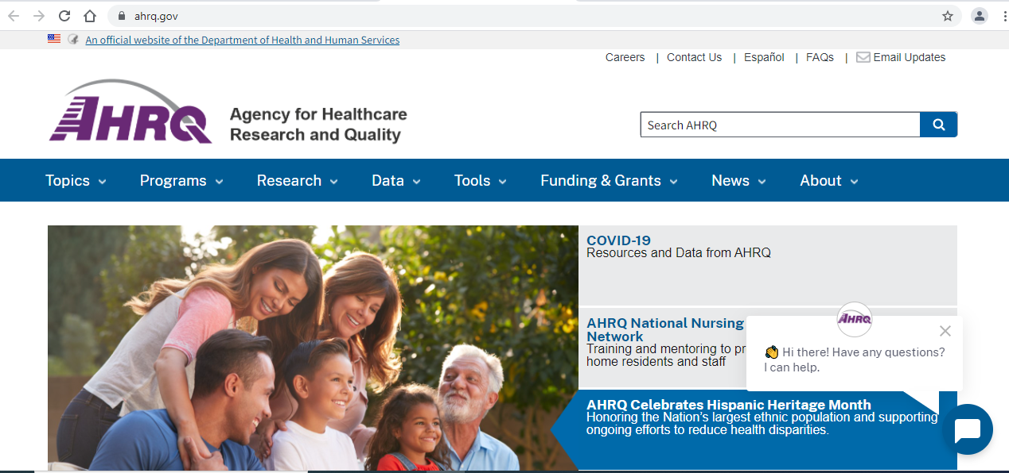
Agency for Healthcare Research and Quality (AHRQ)
https://www.ahrq.gov/
Notes:
AHRQ is a division of the Department of Health and Human Services. FREE resources that are evidence based.

Slide 89
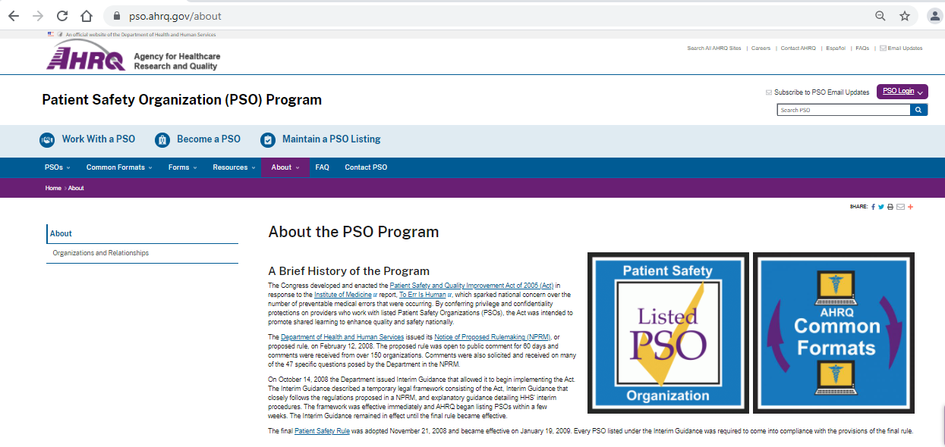
AHRQ PSO Program
https://pso.ahrq.gov/about

Slide 90

Institute for Healthcare Improvement (IHI)
http://www.ihi.org/Pages/default.aspx

Slide 91

IHI RCA2 Resources
http://www.ihi.org/education/WebTraining/Webinars/rca2/Pages/default.aspx

Slide 92

Additional RCA Training Resource
https://www.thinkreliability.com/

Slide 93

Just Culture Training Resource
https://justculture.com/

Slide 94
Check-in For Relevance
Have you identified opportunities to improve your patient safety program?
What are your next steps to improve your program and culture?
What resources might you use to help you?
What challenges will you face?
What help do you need?

Slide 95
References
Agency for Healthcare Research and Quality. Patient safety primer: human factors engineering. Patient Safety Network. January 2019. Available at: https://psnet.ahrq.gov/primers/primer/20/Human-Factors-Engineering
Agency for Healthcare Research and Quality. Patient safety primer: High reliability. Patient Safety Network. January 2019. Available at: https://psnet.ahrq.gov/primers/primer/31/high-reliability
Alliger GM, Tannenbaum SI, Bennett W, et al. A meta-analysis of the relations among training criteria. Pers Psychol 1997;50:341–58.
Battles et al. (2006). Sensemaking of patient safety risks and hazards. HSR, 41(4 Pt 2), 1555-1575.
Campione J, Famolaro T. Promising practices for improving hospital patient safety culture. Jt Comm J Qual Patient Saf. 2018;44(1):23-32.
Chassin MR, Loeb JM. The ongoing quality improvement journey: next stop, high reliability. Health Affairs. 2011; 559-568. Project HOPE— The People-to-People Health Foundation, Inc. Available at: https://doi.org/10.1377/hlthaff.2011.0076
Colligan L, Anderson JE, Potts HWW, Berman J. Does the process map influence the outcome of quality improvement work? A comparison of a sequential flow diagram and a hierarchical task analysis diagram. BMC Health Serv Res. 2010; 10: 7. Available at: http://www.ncbi.nlm.nih.gov/pmc/articles/PMC2822834/pdf/1472-6963-10-7.pdf

Slide 96
References
Grossman R, Salas E. The transfer of training: what really matters. Int J Train Dev 2011;15:103–20.
Institute of Medicine. Patient safety: Achieving a new standard of care. Washington, DC: The National Academies Press; 2004.
Institute for Healthcare Improvement. Conduct Safety Briefings. Available at: http://www.ihi.org/resources/Pages/Tools/SafetyBriefings.aspx
Institute for Healthcare Improvement. Leadership WalkRounds. Available at: http://www.ihi.org/resources/Pages/Tools/PatientSafetyLeadershipWalkRounds.aspx
InstituteRCA2: Improving Root Cause Analyses and Actions to Prevent Harm for Healthcare Improvement. Available at: http://www.ihi.org/resources/Pages/Tools/RCA2-Improving-Root-Cause-Analyses-and-Actions-to-Prevent-Harm.aspx
Joint Commission. The essential role of leadership in developing a safety culture. Sentinel Event Alert. Issue 57. March 1, 2017. Available at: https://www.jointcommission.org/sea_issue_57/
Jones, Skinner, Xu, Sun, Mueller. (2008). The AHRQ Hospital Survey on Patient Safety Culture: a tool to plan and evaluate patient safety programs. Advances in Patient Safety: New Directions and Alternative Approaches http://www.ncbi.nlm.nih.gov/books/NBK43699/

Slide 97
References
Kirkpatrick DL, Kirkpatrick JD. Evaluating training programs: the four levels, 3rd edn. San Francisco: Berrett-Koehler Publishers, Inc., 2006.
Leape, L.L. (2002) Reporting adverse events. The New England Journal of Medicine, 347, 1633-1638 Institute for Healthcare Improvement.
Liberati EG, Peerally MF, Dixon-Woods M. Learning from high risk industries may not be straightforward: a qualitative study of the hierarchy of risk controls approach in healthcare, International Journal for Quality in Health Care, Volume 30, Issue 1, 1 February 2018, Pages 39–43, https://doi.org/10.1093/intqhc/mzx163
Mardon RE, Khanna K, Sorra J, Dyer N, Famolaro T. Exploring relationships between hospital patient safety culture and adverse events. J Patient Saf 2010;6: 226-232.
Marx D. Patient Safety and the “Just Culture”: A Primer for Health Care Executives. New York, NY: Columbia University; 2001. Available at: http://psnet.ahrq.gov/resource.aspx?resourceID=1582
Neily J, Ogrinc G, Mills P, et al. Using aggregate root cause analysis to improve patient safety. Jt Comm J Qual Saf. 2003;29:434-9.
Nieva VF, Sorra J. Safety culture assessment: A tool for improving patient safety in healthcare organizations. Qual Saf Health Care 2003; 12(Suppl II): ii17-ii23.

Slide 98
References
Outcome Engenuity. Engineering better outcomes through just culture. Available at: https://www.outcome-eng.com/just-culture-training/
Outcome Engenuity. Just Culture Train the Trainer Course Slides. 2018. Outcome Engenuity, LLC.
Outcome Engenuity. Root Cause Analysis Certification Course Workbook. 2018. Outcome Engenuity, LLC.
Reason, J. (1997). Managing the Risks of Organizational Accidents. Hampshire, England: Ashgate Publishing Limited.
Schein, E.H. Organizational Leadership and Culture 4th ed. San Francisco: John Wiley & Sons; 2010.
Singer SJ, Rivard PE, Hayes JE, Shokeen P, Gaba D, Rosen A. Improving patient care through leadership engagement with frontline staff: A Department of Veterans Affairs case study. The Joint Commission Journal on Quality and Patient Safety. 2013;39:349-360.
Sorra J, Khanna K, Dyer N, Mardon R, Famolaro T. Exploring relationships between patient safety culture and patients’ assessments of hospital care. J Patient Saf 2012;8: 131-139.
VA National Center for Patient Safety. Healthcare Failure Mode and Effect Analysis (HFMEA). Available at: https://www.patientsafety.va.gov/professionals/onthejob/hfmea.asp

Slide 99
References
Wiegmann. A synthesis of safety culture and safety climate research; 2002. http://www.humanfactors.uiuc.edu/Reports&PapersPDFs/TechReport/02-03.pdf
Weaver SJ, Lubomski LH, Wilson RF, Pfoh ER, Martinez KA, Dy SM. Promoting a culture of safety as a patient safety strategy: A systematic review. Ann Int Med. 2013;158:369-374.

Slide 100
References for NCPS/PSO Section, Objective 11
Institute of Medicine. To Err Is Human: Building a Safer Health System. Washington, DC: The National Academies Press, 2000
Nebraska Department of Health and Human Services. Statutes Relating To Patient Safety Improvement Act. December 1, 2008. http://dhhs.ne.gov/publichealth/Documents/Patient%20Safety%20Improvement%20Act.pdf
U.S. Department of Health and Human Services. Patient Safety and Quality Improvement Act of 2005 and Rule. https://www.hhs.gov/hipaa/for-professionals/patient-safety/statute-and-rule/index.html
Agency for Healthcare Research and Quality. Patient Safety Organization (PSO) Program. Federally-Listed PSOs. https://www.pso.ahrq.gov/listed
National Patient Safety Foundation. Free from Harm: Accelerating Patient Safety Improvement Fifteen Years after To Err Is Human. Boston, MA: National Patient Safety Foundation; 2015. Available at: http://www.npsf.org/free-from-harm.
2013 Annual Hospital-Acquired Condition Rate and Estimates of Cost Savings and Deaths Averted From 2010 to 2013. Rockville, MD: Agency for Healthcare Research and Quality; October 2015. 2015. AHRQ Publication No. 16-0006-EF. http://www.ahrq.gov/professionals/quality-patient-safety/pfp/index.html.
Makary MA, Daniel M. Medical error-the third leading cause of death in the US. BMJ 2016;353:i2139 doi: 10.1136/bmj.i2139

