Slide 1

Health Systems as Stewards of Health
Leading Partnerships:
Collaboration for Collective Impact

Slide 2

Presented to:
Nebraska Hospital Association
Mark J. Bittle, DrPH, MBA, FACHE
October 16, 2019

Slide 3

Disclosures
I have nothing to disclose
Words of warning*
  DO NOT attempt to operate a motor vehicle or dangerous machinery while reviewing this material.
  If DROWSINESS occurs, it shouldn’t be surprising.
*

Slide 4
ACHE Professional Development Task Force
(2016 Report)
“Focused on core and emerging leadership competencies needed in the quickly evolving healthcare environment….
“T”ransformational Competencies:
  Visionary & Adaptive Leadership skills
  Leading Across the Continuum of Care
  Leading Sustainable Community Partnerships
  Ability to Build and Strengthen Community
“T-shaped” Professional
IDEO Consulting
M. Bittle 2019

Slide 5
Seminar Objectives
Participants in this seminar will by the end be able to:
  Describe the association between health status and health influencing factors (Context)
  Articulate the role for their organization as a member of a community-oriented, “public” health care model in the context of a socially-responsible healthcare system. (Strategic Governance)
  Understand the elements and importance of the Collective Impact framework to foster effective collaboration. (Execution)
  Describe the need for a new leadership mindset in building lasting strategic collaborations with partners outside the “4 walls” of the healthcare system. (Leading)
M. Bittle 2019
Notes:
Organizational forms evolve to better meet the needs of their constituencies. So, too, must leadership styles and methods

Slide 6
Seminar Structure:
Adult-Learning
Peer-to-Peer Learning
Experiential Collaboration
Reflection
The Evidence
Impact on Practice
Adult Education: Malcolm Knowles (1980)
  Readiness to Learn
    Adults become ready to learn something when they experience a need to learn it in order to cope more satisfyingly with real life tasks or problems
  Orientation to Learning
    Adults are performance-centered: see learning as a process of developing competencies today that can be applied to living more effectively tomorrow
Kirkpatrick Model for Training Evaluation (1954, 1975, 1994)
Adults define themselves based on experience, therefore, adults have more to contribute to the learning of others (i.e. peer-to-peer)
New learning takes on greater meaning when it can be related to past experiences (i.e. locus for learning is the learner)
Provide training based on, and targeted to, identified needs of learner and, in proximity to the need
Need to assess Reaction, Learning, Behavior, & Results
M. Bittle 2019

Slide 7
Agenda
0900 - 0930: Welcome & Introductions
0930 - 1030: Health and Health Status
1030 - 1045: Break
1045 - 1200: Collaborating for Impact
1200 - 1300: Networking Lunch
1300 - 1430: Collaboration at Work
1430 - 1445: Break
1445 - 1600: Leading Effective Collaboration
1600 - 1630: Concluding Thoughts and Reflection
M. Bittle 2019

Slide 8

Introductions:
Who’s in the room?
Briefly
  Your name
  Your organization
  Your title and role
1-2 main items you want to take away from this 2-day session
1-2 main goals for the group as a whole
M. Bittle 2019

Slide 9
Healthcare’s Expanding Front
we attempt to tackle more complex issues
at the nexus of
health, environment, economics and equity.
Question: “ How does a Multi-billion dollar health system make decisions based on race, privilege, economic status and access.”
Response: “Basically looking at how the hospitals themselves can address public health problems in their communities.”
M. Bittle 2019

Slide 10
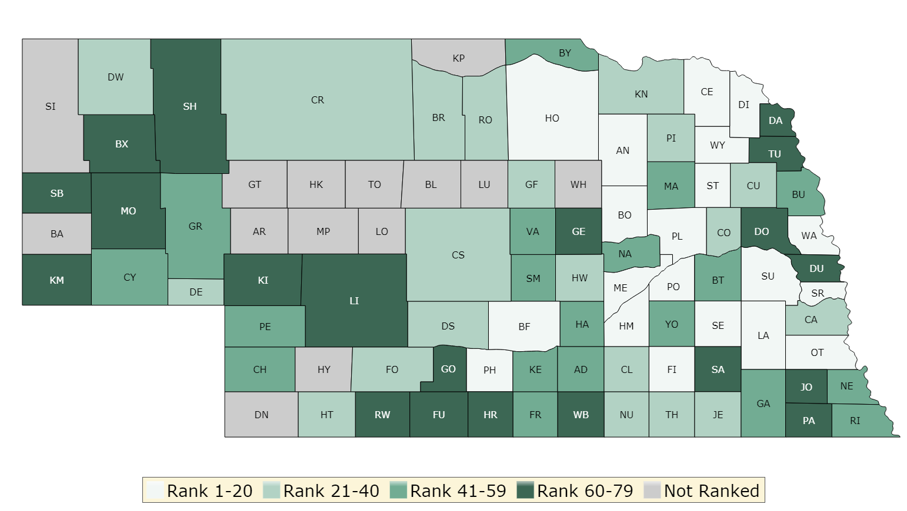
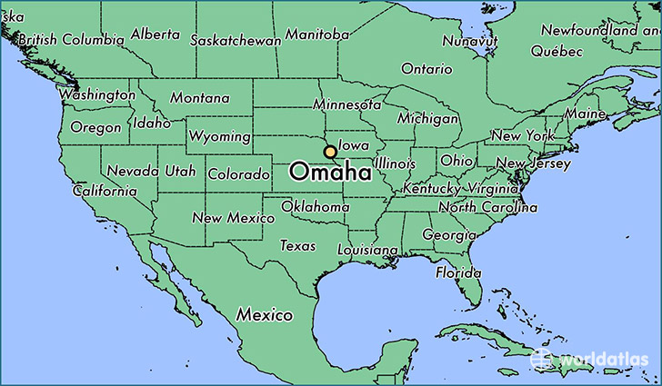
Differences in Health Outcomes within States by Place and Racial/Ethnic Groups – 2019 Report
County Health Rankins and Road Map
A RWJF Project
Dodge = 72
Washington = 6
Douglas = 70
Sarpy = 5
Saunders = 14
How Healthy is Your Community?
Notes:
Create a poll everywhere survey and activate: Type response as single word
Home email
bittleMJB password

Slide 11
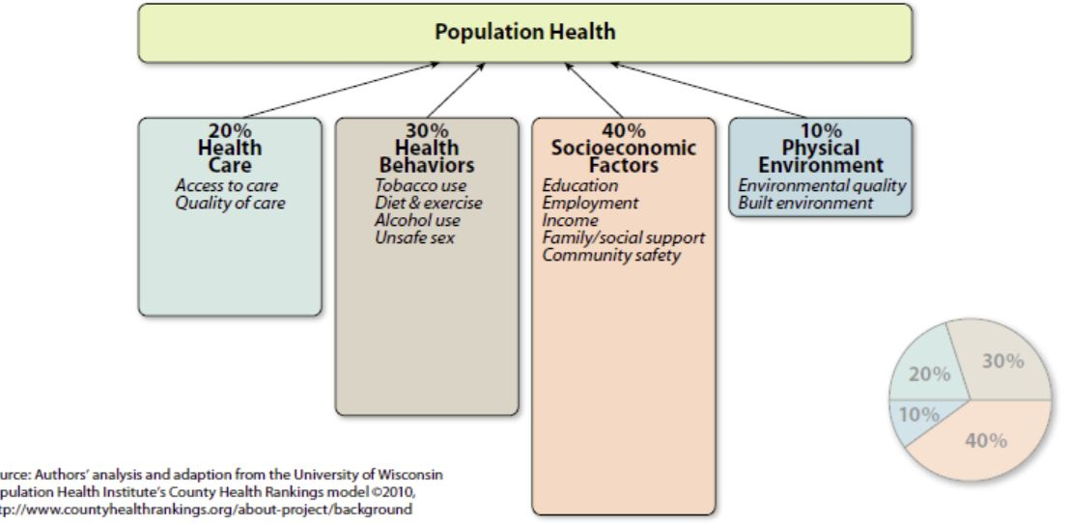
The Determinants of “Population” Health Go Well Beyond Just Medical Care
“Within a couple of years, 80% of health care expenditures will be in response to chronic health conditions”
Epidemic of Care
According to Bunker et al, of the 30-year increase in longevity, only 5 years can be attributed to medical (health) care services.
Source: Minnesota ICSI , based on Univ of Wisc. Analysis in ACO and community health white paper https://www.icsi.org/health_initiatives/accountable_health/
Notes:
Raise your hands if you are familiar with the SDH and their influences on health.
Name some and why they are important.
The above represent determinants of health: The range of personal, social, economic, and environmental factors that influence health status are known as determinants of health.
Determinants of health fall under several broad categories:
Policymaking
Social factors
Health services
Individual behavior
Biology and genetics
It is the interrelationships among these factors that determine individual and population health. Because of this, interventions that target multiple determinants of health are most likely to be effective. Determinants of health reach beyond the boundaries of traditional health care and public health sectors; sectors such as education, housing, transportation, agriculture, and environment can be important allies in improving population health.

Slide 12
Determinants of Health (Refer to Appendix 1) c/o Office of Disease Prevention and Health Promotion – Healthy People 2020.
The range of personal, social, economic, and environmental factors that influence health status.
Determinants of health fall under several broad categories:
  Policymaking; Social factors; Health services; Individual behavior; and, Biology and genetics
It is the interrelationships among these factors that determine individual and population health.
  interventions that target multiple determinants of health are most likely to be effective.
  Education, housing, transportation, agriculture, and environment can be important allies in improving population health.
M. Bittle 2019
https://www.healthypeople.gov/2020/about/foundation-health-measures/Determinants-of-Health

Slide 13
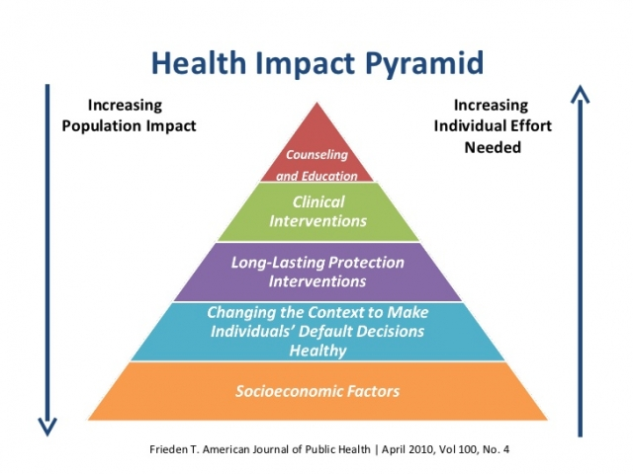
“Today, the biggest threats to the health and
longevity of Americans are preventable diseases”
– Dr. Georges Benjamin, APHA

Slide 14

“Disparate health outcomes are a reality of the American health[care] system and are a result of not only inadequacies in health care, but also the failure to address the social determinants of health.”
Dr. Georges Benjamin, APHA
The Nation’s Health: Medicaid, Medicare making the move toward social determinants
by Lindsey Wahowiak on Sep 2, 2016

Slide 15
Social Responsibility
…..more than Community Benefit
Social responsibility (social responsiveness)
  imply both a new social dimension of care, as well as
  new organizational patterns of hospitals and other health care organizations.
The concept of social responsibility implies
  a shared vision of the common good, that is
  universally accepted among health care professionals, other stakeholders and the overall social matrix
    i.e. a situation or a set of conditions in which something else develops or forms
Brandão, C., Rego, G., Duarte, I., & Nunes, R. (2013). Social Responsibility: A New Paradigm of Hospital Governance? Health Care Analysis, 21(4), 390–402. http://doi.org/10.1007/s10728-012-0206-3
M. Bittle 2019
Notes:
Hospitals and health systems need to think differently in the era of “population-based,” or what I call “community-oriented” health.
They are one piece of a larger puzzle, a seismic change, wouldn’t you agree from the role hospitals have traditionally played.
This is not just the typical community benefit were speaking about, but rather a view that turns the role of the hospital inside out. It implies (read 2nd bullet)

Slide 16
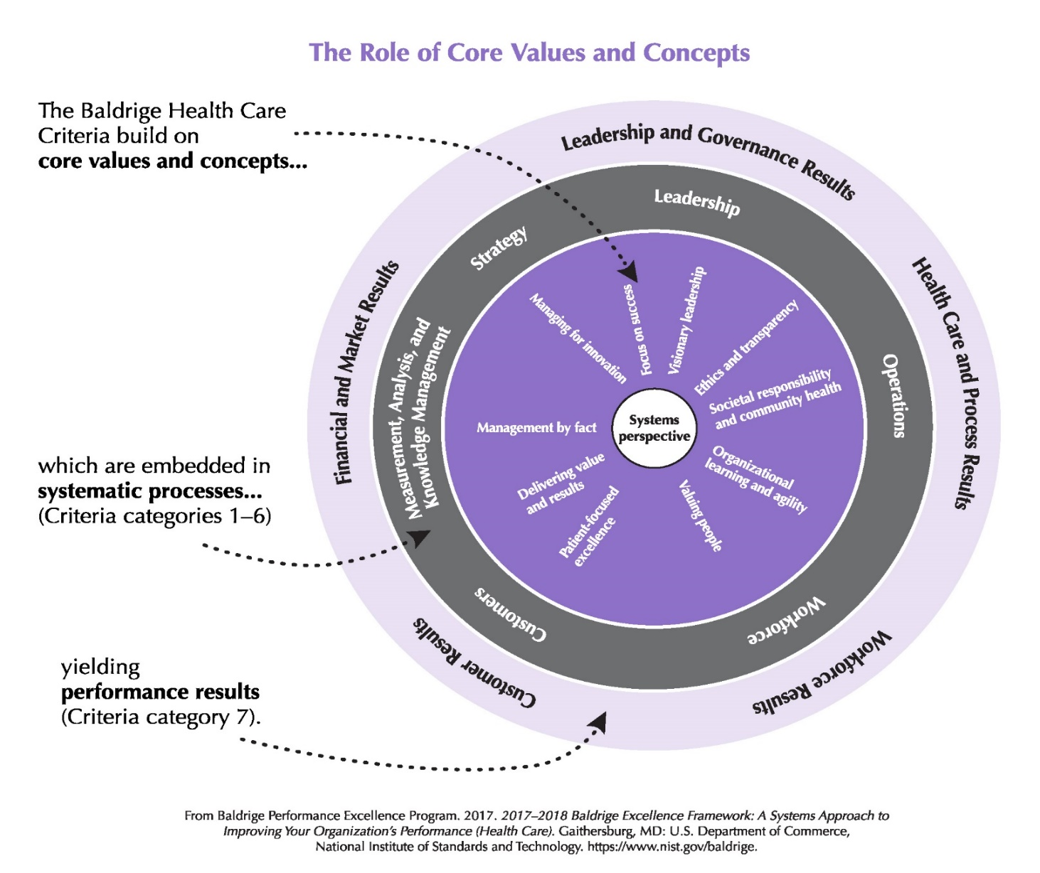
2017-2018 Baldrige Framework
M. Bittle 2019
Notes:
Even the Baldrige framework has evolved to include this notion of social responsibility

Slide 17

Share Organizational Examples of Social Responsibility in Nebraska Hospitals:
- Board Conversations
- Describe an initiative or program
- Community Engagement on needs
0930-0950
Social Values
& Needs
Hospital/HS
Performance
Social
Responsibility
“Re-interpreting the concept of
social responsibility means that an organization should not only fulfill its economic and legal obligations but also actively contribute
to the social good.”
Dr. Weinstein, a spine surgeon and author of Unraveled: Prescriptions to Repair a Broken Health Care System, spoke about how the government, businesses, industry leaders and communities can rethink the current models of healthcare to better focus on equity versus "brick and mortar solutions that don't address the social and economic issues of our times.“ Becker’s Hospital Review. May 23, 2017
M. Bittle 2019
Notes:
Hence the title of this seminar.
What does this mean to you? Do you agree this represents more than our current Community Benefit undertakings?

Slide 18
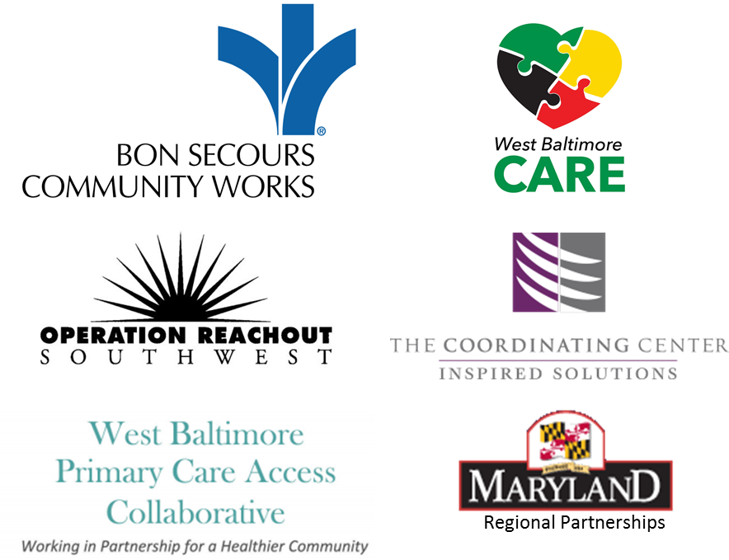
Bon Secours – West Baltimore
See appendix 2
“SOCIAL JUSTICE AND HEALTH =
ACHIEVING
HEALTH EQUITY”
Dr. G. Benjamin, APHA
20% of W. Baltimoreans will experience a mental illness each year; 58% do not receive treatment.
Highest disease burden and shortest life spans in Baltimore City/State.
Social Determinants of Health: Poverty, substance abuse, unemployment, and domestic violence rates significantly exceed Baltimore City rates.
M. Bittle 2019
Notes:
The goal of the assessments is to move hospitals away from just treating the sick, toward addressing population health and prevention.

Slide 19
Systems for Action (2018)
Robert Wood Johnson Foundation (RWJF)
RWJF’s Culture of Health Vision
  Action Framework’s 4 Action Areas
    Making Health A Shared Value
    Fostering Cross-Sector Collaboration to Improve Well-Being
    Creating Healthier, More Equitable Communities
    Strengthening Integration of Health Services and Systems
M. Bittle 2019
Notes:
Better Health and Well-Being for all Americans

Slide 20
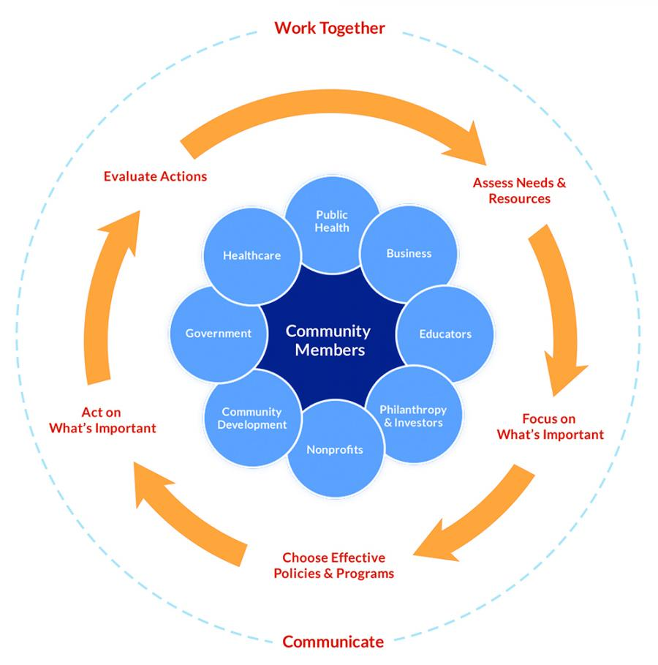
Take Action Cycle
Gather information to assess needs and resources.
Set priorities, so you can focus on what’s important.
Find the most effective approaches to address your priorities, and then …
Get to work on acting on what’s important.
Evaluating throughout the cycle will help you improve your strategies and ensure that what you’re doing is effective
https://www.countyhealthrankings.org/take-action-cycle
M. Bittle 2019

Slide 21


“Achieving the vision of healthy people in healthy communities is a difficult and complex task that cannot be accomplished through a single plan of action or by a single agency or organization – rather broad social action is required at every level.”
IOM. Committee on Assuring the Health of the Public in the 21st Century (2003)
1030 - 1045
M. Bittle 2019

Slide 22
Agenda
0900 - 0930: Welcome & Introductions
0930 - 1030: Health and Health Status
1030 - 1045: Break
1045 - 1200: Collaborating for Impact
1200 - 1300: Networking Lunch
1300 - 1430: Collaboration at Work
1430 - 1445: Break
1445 - 1600: Leading Effective Collaboration
1600 - 1630: Concluding Thoughts and Reflection
M. Bittle 2019

Slide 23

Redefining Health Care. Michael Porter
Redefine the Product
  Illness → Wellness
  Patients → Healthy People
Redefine the Place
  Office/Hospital → Home, School , Community, etc.
Redefine Providers
  Beyond Healthcare Practitioners → Teachers, Urban Planners & Architects, Individuals, Social Workers, etc.
Source: https://hbr.org/resources/images/products/7782_500.png
M. Bittle 2019

Slide 24
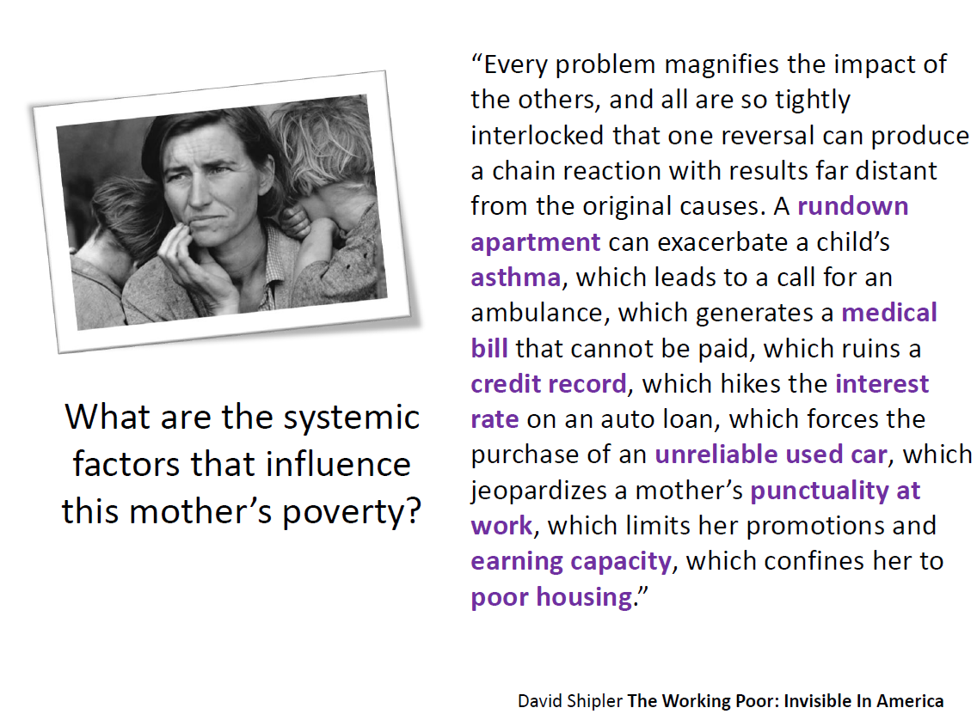
“Every problem magnifies the impact of the others, and all are so tightly interlocked that one reversal can produce a chain reaction with results far distant from the original causes.
A rundown apartment can exacerbate a child’s asthma, which leads to a call for an ambulance, which generates a medical bill that cannot be paid, which ruins a credit record, which hikes the interest rate on an auto loan, which forces the purchase of an unreliable used car, which jeopardizes a mother’s punctuality at work, which limits her promotions and earnings capacity, which confines her to poor housing.”
M. Bittle 2019
Notes:
Why is knowing this important? Its all about Impact!

Slide 25
Complexity & Evaluation is an Uncertain World
Melbourne University, March 2016
Mark Cabaj
Notes:
History shows us, as this graphic depicts from very recent research, that to improve population level outcomes, system-level, rather than programmatic interventions are needed.
The reason, communities are complex adaptive (meaning there is an Act – then a “see what happens” phase, then adapt) systems. Programmatic interventions tend to disrupt, rather than change systems. Think of it this way, systems have built-in defense immune responses, when disturbed they tend to resist change, returning to their original patterns. Since these are adaptive systems, advance planning is difficult and there can be, and often are, intended as well as unintended consequences.

Slide 26
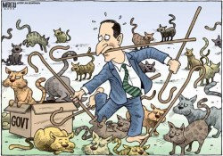
Effort without
Impact
M. Bittle 2019
Notes:
What thoughts are invoked when you see this picture?
Confusion? Independence? Disorganized? If the intent is to get all the cats into the box is this more representative of a programmatic intervention or a system intervention? Can you see the potential for the “immune response?” (i.e. get the cat into the box, but one is already jumping out)

Slide 27

Effort with
Impact
Isolated Impact
Collective Impact
M. Bittle 2019
Notes:
What characteristics or thoughts are invoked by this picture?
Order? Focus? Individual experts focused on a common goal/vision? Collective impact? Is this more representative of a programmatic intervention or a systemic intervention? More or less likely to return to original state?

Slide 28
IOM* Call to Action (2003)
Adopt a population health approach
  Builds on evidence related to the multiple determinants of health
Strengthen public health infrastructure
  The backbone of any public health system
Create new generation partnerships
  Build consensus on health priorities and support
Develop systems of accountability
  To ensure evidence-based population health goals are met
Acknowledge communication as the key
* Institute of Medicine (IOM)
M. Bittle 2019
Notes:
This is what the IOM recommended nearly 2 decades ago. What have you seen in your markets? Has this happened?

Slide 29
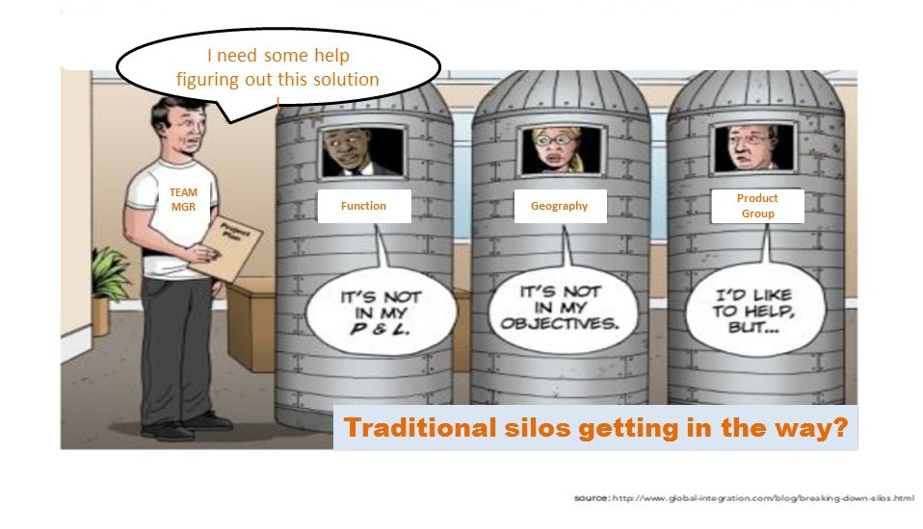
“New Generation” Community Partnership
“Most organizations are traveling on separate but parallel paths…..as a result…..valuable data, information, and resources are often siloed.”
Public Health
Health System
CBO
Source: The Advisory Board (2016) Population Health Advisor
27
We do this already
M. Bittle 2019

Slide 30
Building a Business Case for Community Partnership
“Partnerships among health systems, public health bodies, and community organizations are the most effective ways to address community health.”
Source: The Advisory Board (2016) Population Health Advisor
28
M. Bittle 2019

Slide 31
Preventable Death Rates Fell Where Communities Expanded Population Health Activities Through Multisector Networks
Research suggests a need for greater coordination and alignment across the sectors that deliver medical, public health, and social services.
The results show that deaths due to cardiovascular disease, diabetes, and influenza decline significantly over time among communities that expand multisector networks supporting population health activities.
The findings imply that incentives and infrastructure supporting multisector population health activities may help close geographic and socioeconomic disparities in population health.
By Glen P. Mays, Cezar B. Mamaril, and Lava R. Timsina HEALTH AFFAIRS 35, NO. 11 (2016): 2005–2013
M. Bittle 2019

Slide 34
The Advisory Board (2016)
Population Health Advisor Research and Analysis

Slide 35
Insights Into Collaborative Networks Of Nonprofit, Private, And Public Organizations That Address Complex Health Issues
Despite the increases in the numbers of and funding for cross-sector networks, there are limited data and methods that can be used to assess their effectiveness and analyze their designs.
Traditional types of partners in community health networks such as hospitals, community health centers, and public health agencies were the most trusted and valued by other members of their networks. However, nontraditional partners, such as employer or business groups and colleges or universities, reported contributing relatively high numbers of resources to their networks.
Rachel A. Hogg and Danielle Varda. HEALTH AFFAIRS 35, NO. 11 (2016): 2014–2019
M. Bittle 2019

Slide 36
Growing awareness…
Crete Area Medical Center
Mission
To advance the health of the communities and region we serve, through collaboration, prevention, innovation, and exceptional care.
The Nation’s Health, June 2017
Western Maryland Health System
“Transforming Health Outside of Healthcare”
M. Bittle 2019
Notes:
The goal of the assessments is to move hospitals away from just treating the sick, toward addressing population health and prevention

Slide 37

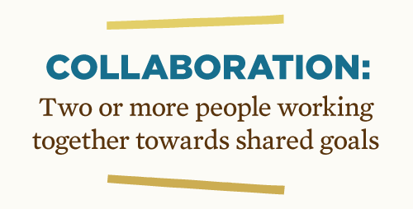
Healthcare’s next evolution:
Expanding Collaboration
Why Now? Complexity, Change, Uncertainty
M. Bittle 2019
Notes:
Start with Floating ring exercise
Relate back to previous slide – why has this not happened? Its hard

Slide 38
“Times and conditions change so rapidly that we must keep our aim constantly focused on the future.”
~ Walt Disney
Connect
Share
ENJOY!
LUNCH
Reflect
NETWORKING
Ideas
Opportunities
1200 – 1300 p.m.
M. Bittle 2019

Slide 39
Agenda
0900 - 0930: Welcome & Introductions
0930 - 1030: Health and Health Status
1030 - 1045: Break
1045 - 1200: Collaborating for Impact
1200 - 1300: Networking Lunch
1300 - 1430: Collaboration at Work
1430 - 1445: Break
1445 - 1600: Leading Effective Collaboration
1600 - 1630: Concluding Thoughts and Reflection
M. Bittle 2019

Slide 40
Systems for Action (2018)
Robert Wood Johnson Foundation (RWJF)
RWJF’s Culture of Health Vision
  Action Framework’s 4 Action Areas
    Making Health A Shared Value
    Fostering Cross-Sector Collaboration to Improve Well-Being
    Creating Healthier, More Equitable Communities
    Strengthening Integration of Health Services and Systems
Activating this framework requires new knowledge about how to mobilize collective actions across diverse sectors and systems
that shape health in American communities.
M. Bittle 2019
Notes:
Better Health and Well-Being for all Americans

Slide 41
Effective Collaboration = Impact
Common Agenda
Common Progress Measures
Mutually Reinforcing Activities
Keeps all parties moving towards the same goal
Measures that get to the true outcome
Each expertise is leveraged as part of the overall
Communications
This facilitates a culture of collaboration
Backbone Organization
Takes on the role of managing collaboration
Collective Impact
  a framework to tackle deeply entrenched and complex social problems.
  an innovative and structured approach to making collaboration work across government, business, philanthropy, non-profit organizations and citizens to achieve significant and lasting social change.
John Kania & Mark Kramer,
Stanford Social Innovation Review (2011)
M. Bittle 2019
Notes:
But of course, times are changing. The ACA created incentives that may soon become full-fledged payment mechanisms that broaden the perspective of the healthcare system to think beyond the four-walls of the traditional network’s responsibilities. The term social determinants, perhaps a term not used in the business before 2-3 years ago, is now on every HS agenda. So how can we move in the direction of improving a complex, socially-based, issue like a population’s health?
If hospitals are to acknowledge this new role, take-on the challenge of social responsibility as part of a broader-reaching effort to improve community health – what fundamentally needs to change within the organization?
Rethink the mission and goals
Collaborate with others, which requires a new chassis or framework, preferably one that has some basis in evidence.
That is where the CI framework, a construct to tackle entrenched social issues, like the SDH, through effective collaborations, can turn the recommendations of the IOM into meaningful, IMPACTFUL, change.

Slide 42
A Common Agenda
Engage broadly and with unusual suspects
Define the problem being tackled
  The need for data
Develop a plan of action
  This takes time
  Do not jump ahead until the agenda is “robust, clear, and agreed.”
Common Agenda
Common Progress Measures
Mutually Reinforcing Activities
Keeps all parties moving towards the same goal
Communications
Backbone Organization
Source: John Kania & Mark Kramer,
Stanford Social Innovation Review (2011)
M. Bittle 2019
Notes:
One of the key criterion in our discussion of collaboration and partnerships in a population health management model was the need to have a common purpose. The collective impact model uses the term common agenda. The model’s authors suggest that all participants have a common agenda for change. Part and parcel to this common agenda as we have heard before from others, is the need for all relevant stakeholders to have a shared understanding of the problem and come to an agreement on a joint approach to solving it through, preferably evidence-based actions. The notion of a shared vision for change is critical if alignment of efforts is to be realized.
Developing the action plan takes time. With the diversity of people around the table and the need to collect and analyze data, it is not surprising to learn that setting a common agenda takes time – sometimes up to 18 months.
Patience is essential and this can be a frustrating experience, which challenges people’s motivation and commitment. Good leadership and facilitation is essential to help steer the group through this part of the process. One means to maintain engagement and motivation is intentionally creating early wins – as the authors point out - even if they are not strategic or highly impactful in nature.
Above all, it is important to stay with the process and resist the temptation to jump ahead to planning or implementation until the common agenda is robust, clear and agreed.
Can you think of an analogy for this step in the process? For me a couple come to mind. Back to the puzzle analogy, if you and some of your classmates decided to work together to put a 500 piece puzzle together, the first thing you might all agree to do is study the box top, so that everyone working on the puzzle had a clear idea of the direction you were heading. Another analogy might be that of a crew boat. Getting all the rowers facing in the same direction would be similar to have a common agenda with a shared vision. Unless all the rowers were facing in the same direction, there would be little chance of getting to where you wanted to go.

Slide 43


A Common Purpose and Shared Vision
(1)
(2)
Source Graphics
(1) https://c1.staticflickr.com/3/2222/2156056072_c83b882862_z.jpg?zz=1
(2) http://www.syossetrowingclub.com/handbook.html
M. Bittle 2019
Notes:
For me a couple come to mind. Back to the puzzle analogy, if you and some of your classmates decided to work together to put a 500 piece puzzle together, the first thing you might all agree to do is study the box top, so that everyone working on the puzzle had a clear idea of the direction you were heading.
Another analogy might be that of a crew and boat (or racing shell). Getting all the rowers facing in the same direction would be similar to have a common agenda with a shared vision. Unless all the rowers were facing in the same direction, there would be little chance of getting to where you wanted to go. This is also a very good analogy for collective impact in general.

Slide 44
Common Progress Measures
Common Agenda
Common Progress Measures
Mutually Reinforcing Activities
Measures that get to the true outcome
Communications
Backbone Organization
“use of a common set of measures to monitor performance, track progress towards outcomes and learn what is and is not working in the group’s collective approach”
There are three phases to developing a shared measurement system.
  Design; Develop; Deploy
Source: John Kania & Mark Kramer,
Stanford Social Innovation Review (2011)
M. Bittle 2019
Notes:
The next element is having common progress (not to be confused with process) measures.
Developing a shared progress measurement system is essential to collective impact as it provides the pathway or means to assess progress towards the common agenda.
Agreement on a common agenda is illusionary without agreement on the ways success will be measured and reported, according to the authors. Collecting data and measuring results consistently on a short list of indicators at the community level and across all participating organizations not only ensures that all efforts remain aligned, it also assures mutual accountability, in other words it enables the participants to hold each other accountable and learn from each other’s successes and failures. Shared measures allow a Collective Impact initiative to: Improve Data Quality; Track Progress Toward a Shared Goal; Enable Coordination and Collaboration; Learn and Course Correct; Catalyze Action.
There are three phases to developing a shared measurement system, which I have listed on the slide. These are (read list). The authors provide a list of key success factors in the development of shared measurement systems and they include:
The first is Broad and open engagement: This refers to the engagement of relevant stakeholders during the design phase, which includes clear expectations about confidentiality and open input and review, or transparency of the process.
The second is Infrastructure for deployment: This refers to the effective use of web-based technology, as well as ongoing staffing for training, facilitation, reviewing data and reporting accuracy.
The third key success factor to development of a shared measurement system is the creation of Pathways for learning and improvement: This refers to how data and information are used for evaluation and continually improving the systems through feedback and a facilitated process for incorporating the feedback into ongoing training for participants to leverage and disseminate best practices.
Common progress measures are like checkpoints along your route of travel. Have a map, or common agenda, can only get you so far. Without checkpoints, you have no real idea of where you are along the journey, when you are likely to get there, or even if you are on the right path in the first place. Common progress measures serve as your means of ensuring efforts are moving in the right direction.

Slide 46
Mutually Reinforcing Activities
Goal: to align the existing resources and effort in the system towards achieving the common agenda and shared measures.
  Influence not Direct Authority
Components include:
  Build upon existing efforts
  Support and leverage each others’ efforts
  Distribute activities; take advantage of existing skills, passion & expertise
  Use data as the foundation for a learning system: continuous improvement
  Use data to determine which innovations should be scaled and which should be stopped
Common Agenda
Common Progress Measures
Mutually Reinforcing Activities
Expertise is leveraged for overall good
Communications
Backbone Organization
Source: John Kania & Mark Kramer,
Stanford Social Innovation Review (2011)
M. Bittle 2019
Notes:
The goal of mutually reinforcing activities is the alignment of existing resources and effort in the system towards achieving the common agenda and shared measures. Mutually reinforcing activities is in many ways the power of collective action. It is not, as the authors say, the result of sheer number of participants or the uniformity of their efforts, but power to achieve the common agenda comes from “the coordination of their differentiated activities through a mutually reinforcing plan of action.” Mutually reinforcing activities commences once common agenda and shared measures have been developed and launched. The focus of this element is to align the existing resources and effort in the system towards achieving the common agenda and shared measures.
This is where the real work takes place and where effective leadership is needed to ensure the basic tenets are followed. These include (read list under 2nd bullet).

Slide 48
Communication
Goals: Build Trust, Address Concerns, Share Ideas
Internal & External
  Listening to the community, and communicating results to the public essential.
All partners to have equal representation and involvement in all interactions, to ensure that decision-making is collaborative and takes into account all members’ point of view.
Common Agenda
Common Progress Measures
Mutually Reinforcing Activities
Communications
This facilitates a culture of collaboration
Backbone Organization
Source: John Kania & Mark Kramer,
Stanford Social Innovation Review (2011)
M. Bittle 2019

Slide 49
Backbone Organization
Six Functions
  Guide Vision and Strategy
  Support (not do) Aligned Activities
  Establish Shared Measurement Practices
  Build/Maintain Public Will (i.e. Social Capital)
  Advance Policy
  Mobilize Funding
Key Concept
  Takes role of managing Collaboration not Managing the collaborative
Common Agenda
Common Progress Measures
Mutually Reinforcing Activities
Communications
Backbone Organization
Takes on the role of managing collaboration
Source: John Kania & Mark Kramer,
Stanford Social Innovation Review (2011)
M. Bittle 2019

Slide 51

Baltimore CONNECT: A Backbone Organization example
http://www.jhsph.edu/research/affiliated-programs/baltimore-connect/
Baltimore CONNECT: originally funded under a 3-year PCORI grant was a pilot partnership between Johns Hopkins and select community organizations in East Baltimore.
  The aim of this of project is to build capacity among the community organizations and improve the health outcomes for East Baltimore and Southeast Baltimore residents.
Baltimore CONNECT is now a 501(c)(3) organization comprised of community-based organizations and the Johns Hopkins Health System to better link social and healthcare services across Baltimore.
COMMUNITY ORGANIZATIONS
  Beans and Bread
  Berea-Eastside Community Assoc.
  Centro de la Communidad
  Dee's Place
  Franciscan Center
  Helping Up Mission
  Maryland New Directions
  Moveable Feast
  Roberta's House
  St. Vincent de Paul Church
M. Bittle 2019

Slide 52
Collective Impact
All participants have a common agenda for change including a shared understanding of the problem and a joint approach to solving it through agreed upon actions.
Collecting data and measuring results consistently across all the participants ensures shared measurement for alignment and accountability.
A plan of action that outlines and coordinates mutually reinforcing activities for each participant.
Open and continuous communication is needed across the many players to build trust, assure mutual objectives, and create common motivation.
A backbone organization(s) goal is to build coalition leadership as opposed to being the coalition leadership – energize the coalition to serve the entire initiative and coordinate participating organizations and agencies.
John Kania & Mark Kramer,
Stanford Social Innovation Review (2011)
M. Bittle 2019

Slide 53

The Power of Collaboration (Part 1)
Infant Mortality in Baltimore
“Our hope is that all of Baltimore's Babies are born at a healthy weight, full term, and ready to thrive in healthy families.”
M. Bittle 2019

Slide 54
Infant Mortality in Baltimore City:
*2009 reflects highest in City’s History
Infant Mortality Rate (IMR) - 2009
  Maryland: 7.2 per 1,000 live births
  Baltimore City: 13.5* per 1,000 live births
    128/541 infants that died that year
Significant disparities based on race in Baltimore City
  IMR (Whites): 3.5
  IMR (Blacks): 18.5
IMR for Baltimore City – 2005-2009
  12.1 per 1,000 live births
    1.3% increase over prior 5 yr. period
Leading causes of IMR in Maryland
  Short Gestation/Unspec. Low Birth Weight
    Born to soon
  Sleep-related Death
    Not necessarily SIDS
Source: http://www.healthybabiesbaltimore.com/uploads/file/Maryland%20State%20IMR%20report%202009.pdf
49
M. Bittle 2019

Slide 55

Consider the following
Discuss, Answer and Prepare to Share
  Why might a Collective Impact approach be appropriate in this case?
  What would a Collective Impact approach look like?
    How can the Collective Impact framework be used to reduce infant mortality in Baltimore? E.g.:
      Potential Partners?
      Potential first steps?
      Approaches to Communications?
      Possible Backbone Organization?
M. Bittle 2019

Slide 56
An Example of Collaboration and a “Collective” Impact
VISION:
“Our hope is that all of Baltimore's Babies are born at a healthy weight, full term, and ready to thrive in healthy families.”
APPROACH:
Champions the voice of community members and clients in program planning.
Builds cross-sector coalitions for strategic planning and implementation.
Strengthens systems and streamlines interventions.
Addresses social, economic and racial inequities that affect health over a lifetime.
Aims for sustainable, evidence-based solutions and funding.
STRATEGY Domains:
Services
Policy/Systems
Communities
Families
Source: http://www.healthybabiesbaltimore.com/home
51
M. Bittle 2019

Slide 57
The Collaborative: Multiple working groups
B’more Fit for Healthy Babies Coalition, to help postpartum women reach a healthy weight.
Teen Pregnancy Prevention Initiative (TPPI), to reduce unintended pregnancies among teens.
Youth Advisory Council, to ensure a youth lens for BHB and allow for their creative voices to be heard through photo-voice and other activities.
Early Entry into Prenatal Care Task Force, to ensure that all women receive early and adequate prenatal care through linkages with hospital emergency departments.
Family Literacy Coalition, to improve school readiness in children and health literacy among adults.
Preventing Substance-Exposed Pregnancy Collaborative, to help women reduce risky behaviors before and during pregnancy.
Equity in Birth Outcomes Coalition, to improve equity and decrease disparities in infant mortality and maternal and infant health.
Housing Task Force, to promote better housing for pregnant women and moms.
Source: http://www.healthybabiesbaltimore.com/about-bhb/task-forces
52
M. Bittle 2019

Slide 58
A Collective Impact!
“BHB brings together communities, organizations, and resources so that every baby might have the best start possible.”
Infant Mortality Rate in Baltimore City
In 2015 the infant mortality rate dropped to its lowest point ever in Baltimore City:
  8.4 deaths per 1,000 live births – a decrease of nearly 40% since BHB’s launch in 2009.
Sleep-related infant deaths in Baltimore City have decreased by more than 50% since 2009
  from 27 deaths in 2009 to 13 deaths in 2015, which has greatly contributed to the decrease in the IMR
In 2015, racial disparities between African American and white infant mortality decreased by nearly half (~50%) from 2009 to 2015.
  A black infant was still twice as likely to die than a white infant.
13.5
(2009)
10.3
(2013)
8.4
(2015)
Per 1,000 Live Births
2017 ~ 8.8 per 1,000 live births
Source: http://www.healthybabiesbaltimore.com/about-bhb
M. Bittle 2019

Slide 59


Larimer County, CO: Dramatic Panorama, BUT….
?
54
Source (Graphic): http://hin.com/blog/wp-content/uploads/2013/03/healthcare_network.jpg
Source: Paul Brodeur. (2008) To Improve Health and Health Care, Vol. XI. Chp. 5. Jossey-Bass. San Francisco, CA.
M. Bittle 2019
Notes:
As Paul Brodeur explains, the fragmented and siloed efforts of the mental health and substance abuse services are no different really from that in communities across the country. Individuals suffering from either, and especially, those suffering from both, do not receive integrated treatment or care that is well-coordinated with other sectors of medical care delivery.
The following true story, as presented by the author, describes just how dysfunctional the system had become in Larimer county. I am going to present this story essentially verbatim so as not to lose the effect. I have tried to represent the story in the graphic shown here.
“At a meeting that took place in 1999, seven case examples written by agencies providing mental health and/or substance abuse services were distributed to and read by members of our steering committee,” she recalled. “To their astonishment and dismay, they realized that four of them had written about the same person. ‘I think some of you are describing the same man I have,’ one of them said. ‘Aren’t we talking about the fellow who has family in New Mexico?’ another asked. Still another member pointed out, ‘This is the guy who wears a tattered brown jacket every day.’”
The committee members were indeed talking about the same man, and they were
shocked to realize that none of them had known he was being cared for by other agencies.
Here’s Joe’s, not his real name, story, considered a fairly common composite picture of what
often happens to people who suffer from mental illness and are also addicted.
Joe is a really nice guy once you get to know him, and he has a great sense of humor. As a kid in grade school, he seemed normal and outgoing, but during his teens he became withdrawn, his grades suffered, and he developed what he describes as ‘a fire in my brain.’ By the age of 16 he had begun to smoke marijuana, which calmed him and made him feel better, but he soon entered a cycle in which he medicated himself not only by smoking pot but also by drinking heavily. By his early twenties, he was suffering from major untreated mental illness and addiction, which resulted in his not being able to keep a job or make new friends.
By the time he was in his 30s, he was living on the street, unable to get a job, and had few if any friends. At the age of 45, he embarked upon a nightmarish two-year ordeal during which he was shuffled from agency to agency with little or no treatment coordination.
“After suffering a mental health crisis, he was taken to the Emergency Department of the Poudre
Valley Hospital, here in Fort Collins.” “From there, he was sent to the Island Grove Regional Treatment Center, a detoxification agency in Greeley, about 30 miles away, and then back
to Fort Collins, to the Hope Counseling Center for outpatient substance abuse counseling.
Following another crisis, he was admitted to the Emergency Department of McKee Hospital, in
Loveland, seven miles south of Fort Collins, and then shipped back here to Mountain Crest, a
psychiatric hospital that treats people with mental illness and substance abuse problems. From there, he was sent to the Colorado State Mental Health Institute, in Pueblo, which is about 120 miles south of Denver. Following a stay at the Institute, where they treat serious mental illness, he came back to Fort Collins, to receive treatment at the Larimer County Mental Health Center. However, after committing several crimes—Joe has had charges brought against him for driving under the influence, carrying a concealed weapon, and contempt of court—he found himself in the Larimer County Detention Center, where he received a mental health assessment that resulted in his being sent to the Circle Program, a long-term residential program operated by the State of Colorado for people with serious co-occurring mental illness and substance abuse disorders.
However, after completing the program, he went off his medication, started drinking again, and committed another crime that landed him back in the Larimer County Detention Center. It is estimated that during his two years of shuttling back and forth between different agencies, more than a quarter of a million taxpayer dollars were spent to treat Joe, only to have him wind up in jail.
What a story, right? The fragmentation and lack of coordination is very evident and sad. The nature of Joe’s health condition, plus his environment, social factors, lack of a support structure all conspire against him, contributing to the ultimate outcome. What is also evident, if the overall lack of accountability and a common vision for how someone like Joe should be treated and cared for.

Slide 60
The Power of Collaboration (Part 2)
1999: Larimer County Mental Health Network was formed
  members of the Network developed a long-term vision and mission statement that called for a coordinated and well-funded continuum of mental health and substance abuse services
Laid the groundwork for changing the system.
  However, members of this early network realized that real change could not be achieved unless top leaders in the community were engaged in the development of a formal process to bring it about.
The Collaborative takes shape
Source: Paul Brodeur. (2008) To Improve Health and Health Care, Vol. XI. Chp. 5. Jossey-Bass. San Francisco, CA.
55
M. Bittle 2019
Notes:
As the story unfolds Paul Brodeur describes the formation of the Larimer County Mental Health Network, a predecessor to the CMHSA Partnership.
This early attempt at linking the fragmented elements of the disintegrated silos of care came about when a man named Jack Ewing, who himself battled with mental illness, and the Poudre Valley Hospital acted as catalysts in the formation of a coalition of people who either had experienced mental illness or had a family member with mental illness, and which included some midlevel managers of agencies that provide mental health services, including the Larimer County Center for Mental Health, the Health and Human Services Department of Larimer County, and the Mountain Crest Behavioral Health Center, a psychiatric hospital affiliated with the Poudre Valley Hospital.”
The group was concerned that people with mental illness were not getting the level of treatment
they needed. The coalition called itself the Larimer County Mental Health Network. Members of the Network developed a long-term vision and mission statement that called for a coordinated and well-funded continuum of mental health and substance abuse services, which was described to be immensely valuable in laying the groundwork for changing the system.
However, members of the network realized that real change could not be achieved unless they could involve top leaders in the community in the development of a formal process to bring about the needed change.

Slide 61
A Collective Approach to Mental Health and Substance Abuse in Larimer County
Engaging relevant stakeholders at all levels
Conducting a formal mental health and substance abuse planning process
  define and understand the problem
Engaged the community through active involvement in planning and reported the findings back to the community
  Builds trust, credibility, and begins engaging individual accountability
Established a prioritized action plan to overhaul the mental health and substance abuse services
Source: Paul Brodeur. (2008) To Improve Health and Health Care, Vol. XI. Chp. 5. Jossey-Bass. San Francisco, CA.
56
M. Bittle 2019
Notes:
Continuing with Paul Brodeur’s story, we move forward with his description of the formation of a collective effort to address this public health problem. As the story unfolds, see if you can identify the critical elements as reflected in the collective impact model.
As discussed a few minutes ago, there was recognition by the members of the network that not all the relevant stakeholders were around the proverbial table. To that end, efforts to engage others resulted in the chief executive officers of the Health District, the Larimer Center for Mental Health, and the Mountain Crest Behavioral Health Center agreeing to become involved in a formal mental health planning process to be called the Communitywide Mental Health and Substance Abuse Planning Project, the goal of which was to assess the nature and extent of the mental health issues facing the community.
A key event in this process took place in August, 1998, when 80 people attended an open forum to talk about their experiences with the mental health system and give advice on how to improve it.
A 13-member steering committee was chosen to discuss information gathered about the scope of the mental health and substance abuse problem in Larimer County, formulate a strategy for dealing with it, and report its findings back to the community.
The steering committee’s search for information culminated in a report entitled Mental Illness and Substance Abuse in Larimer County, dated February 2001, which revealed some disturbing findings, which included, for example,:
it was estimated that more than 60,000 people in the county (~25%) were affected by a mental health disorder or by substance abuse. Of those, approximately 20,000 had significant functional impairment caused by mental illness, and 15,000 were seriously impacted by substance addiction.
Major depression was found to be the number one health burden in the community by a wide margin, outranking cardiovascular disease, cancer, and other illness.
Members of the steering committee identified a number of crucial needs that had to be met to overhaul the mental health and substance abuse system in Larimer County and then recommended its top priorities. Again all of this and more was contained in the 2001 report, which was reported back to the community.
So far, I hope the critical elements presented on the slide here are those that you also recognized as I related the story told by the author. These are (read slide)

Slide 62
A Collective Approach to Mental Health and Substance Abuse in Larimer County - Priorities
To create an improved and integrated mental health and substance abuse information and referral system
To improve the delivery of mental health and substance abuse services to people who did not qualify for Medicaid, as well as those with low incomes who were uninsured
To create a comprehensive education plan that would lessen the stigma of asking for help in dealing with mental illness and substance abuse among the general population
    Also, educate what it called “gatekeepers”—among them school personnel, law enforcement officers, clergy, judges, and employers—in how to identify the signs and symptoms of mental illness and addiction disorders and to make appropriate referrals for treatment.
Source: Paul Brodeur. (2008) To Improve Health and Health Care, Vol. XI. Chp. 5. Jossey-Bass. San Francisco, CA.
57
M. Bittle 2019
Notes:
The recommendations in priority order from the steering committee are listed here. (Read list)

Slide 63
A Collective Approach to Mental Health and Substance Abuse in Larimer County - Priorities
To create and implement an effective infrastructure that would support their broad plan to change the mental health and substance abuse system in Larimer County, the committee, in December 2000, created a consortium of existing agencies, with headquarters adjacent to the Poudre Health Services District, and with funding to be provided by the Health District and Partnership members and through outside grants.
    The consortium was called the Community Mental Health and Substance Abuse Partnership, and among its members—34 organizations and some 80 individuals over time—
      Top executives from all of the major mental health and substance abuse providers in Larimer County, as well as, Leading representatives from Colorado State University, consumer advocates, officials of the justice system, law enforcement officers, public school personnel, and other interested parties.
Source: Paul Brodeur. (2008) To Improve Health and Health Care, Vol. XI. Chp. 5. Jossey-Bass. San Francisco, CA.
58
M. Bittle 2019
Notes:
The fourth and final recommendation from the steering committee is listed here. (Read list)
Note that the steering committee had 4 recommendations (not 44 or 104). This is essential in a collective effort as broad reaching as this. Too many goals distract attention and diffuse efforts. Having a common agenda with a discrete set of clearly articulated goals, which are then used to establish mutually reinforcing activities and partner accountability are critical elements of the collective impact model. The other important comparison to make between what was done in Larimer County and the Collective impact framework was to establish an infrastructure to support (rather than lead) the plan for change. Note the multi-sectoral nature of the supporting infrastructure.
The steering committee also identified a funding model that included direct support from the health district and partner members, as well as grants to help cover currently unfunded services. One topic discussed in the past was the notion of reallocation of resources as part of the role of the backbone organization recommended by the collective impact model. In this case, the Partnership estimated that $18.6 million a year was being spent by 16 major agencies that provided the bulk of funding to care for tens of thousands of residents of Larimer County who were suffering from some degree of mental illness and substance abuse. Understanding what already exists is very helpful in understanding how any changes to the system as part of the redesign may impact allocation of resources.
Both a dedicated infrastructure and the direct funding model help to assure sustainability, enhancing the likelihood for long-term change.

Slide 64

The Partnership and Collective Impact
Community Education
Early Identification
Early Intervention
Follow up and Coordination
Social Support
Mid-2006: Community Mental Health and Substance Abuse Partnership
  Achieved many systems changes
  The story of Joe would have a much different ending
    identifying people with potential mental illness, substance abuse disorders, or both, intervening early and effectively and connecting them to help.
2019: Passed a 0.25% sales and use tax to fund Behavioral and Mental Health Services
  $19M estimated revenue in year 1
Provide preventative, early identification, intervention, support, and treatment services for youth, adults, families and senior citizens, either directly or indirectly, who are residents of Larimer County
59
M. Bittle 2019
Notes:
Imagine it now mid-2006, and while the author does not share specifics in terms of mental health and substance abuse outcomes improvement, he does indicate that the CMHSA Partnership’s efforts have resulted in the development of a far more integrated system. Had this system been in place when Joe was first encountered, members of the Partnership think the results would be quite different. They suggest the system now works something like this:
Imagine a system where the community at large is engaged to understand MH and SA as a serious public health issue and not one to be afraid to disclose or seek help, Where early identification by trained gatekeepers helps to identify signs and symptoms early and connecting those individuals to appropriate help so interventions can be initiated. The system of care is designed, purposely to be integrated to coordination and follow up result in high levels of compliance with care and treatment regimes. In addition, patients like Joe would have a social network designed specifically to support and assure accountability for Joe’s continued improvement over the long-term.

Slide 65
“…we will see improved applications of Collective Impact emerge:
where those most affected by the issues lead the effort and share the decision making and the power;
where the collaborative action is based on an understanding of the social, political, and social justice context in which the issues of the community are embedded, and addresses these issues head on; and
where the Collective Impact work is more thoroughly based on the existing fields of coalition building and community development, learning from the acquired knowledge, experience, and available tools.”
Tom Wolff, Ph.D.
Global Journal of Community Psychology Practice. (2016)
US-based consultant on coalition building and community development.

Slide 66
“My historical perspective, dating back to studies of the Committee on the Costs of Medical Care (1928-1932), convinces me that community coordination is the missing element in moving from our current fragmented health system to an ever more effective system.”
Robert M. Sigmond, FACHE
Back to the future: partnerships and coordination for community health. (1995)
Fron Health Serv Manage. 11(4):5-38
1430 - 1445
M. Bittle 2019

Slide 67
Agenda
0900 - 0930: Welcome & Introductions
0930 - 1030: Health and Health Status
1030 - 1045: Break
1045 - 1200: Collaborating for Impact
1200 - 1300: Networking Lunch
1300 - 1430: Collaboration at Work
1430 - 1445: Break
1445 - 1600: Leading Effective Collaboration
1600 - 1630: Concluding Thoughts and Reflection
M. Bittle 2019

Slide 68

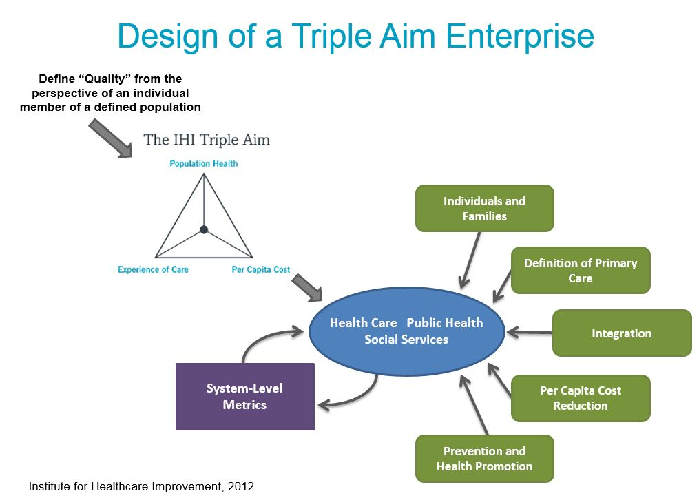
Managing Shared Responsibility
CURRENT, FRAGEMENTED MODEL
HEALTH SYSTEM
HOSPITAL
COMMUNITY RESEOURCES
PUBLIC HEALTH AGENCIES
SAFETY NET
FQHC’S
MEDICAL GROUP
Cross-sector Collaboration
Bittle, MJ. A New Vision and Leadership Challenge:
Implementing the Affordable Care Act to Improve the
Organization and Delivery of Health Care Services.
Journal Public Health Management & Practice. Jan/Feb 2015, 21:1, 59-61.
M. Bittle 2019

Slide 69
The transformation of the traditional organization requires the transformation of the traditional leader
(Ashkenas, Ulrich, Jick, Kerr, 2002)
Flat or matrix structures have increased the complexity of accountability, control, and the exercise of power and influence, so adoption of nonhierarchical leadership models has risen in importance and demand.
(Meisel & Fearon, 1999).
Beyond the four walls, the locus of function, be it production or action, often occurs at the nexus of relationships among a variety of parties that contribute to the function.
(Schilling, 2001)
It is no longer simply a matter of leading within a well-defined hierarchy: It is now necessary to exercise leadership across a network of entities with “interactive, interdependent, and creative processes”
(Prati, Douglas, Ferris, Ammeter, & Buckley, 2003)
M. Bittle 2019

Slide 70
Leadership for Collective Impact
- A Different Leadership Mindset
"mobilizing people to tackle tough problems“
Heifetz. Leadership Without Easy Answers (1994)
Leading through complexity requires an adaptive leadership approach: demonstrate the following three key success factors:
Skills over Content: a successful Collective Impact leader must possess existing relationships with, or an ability to build relationships with, a cross-sectoral range of system players who themselves are issue area experts
Orchestra Conductor: It’s not about the conductor coming in and throwing all the musicians out and starting from scratch. It’s about exploring the great talents that can be built upon, and identifying some gaps where we need other musicians to fill in.
Sufficient Authority: the effective Collective Impact leader must feel comfortable pushing the thinking of senior-level people at a range of partnering agencies and organizations, facilitating difficult conversations, and communicating with a range of stakeholders more broadly.
“that leadership can rise above the walls of organizations – and it may lead to
greater impact”
M. Bittle 2019
Notes:
Thinking about collective impact and socially-responsive health systems, why is adaptive leadership so important?
To build coalition leadership as opposed to being the coalition leader
Involving all key stakeholders, particularly those impacted
Willingness to step-back and let other SMEs lead
Lets think for a minute – what’s happening in our organizations – are we not trading layers of management for self-organizing teams? Are we not asking, or dare I say, challenging employees to find new solutions rather than simply executing orders from above?

Slide 71

Network/Meta-Leadership
“In the world of complex, multi-stakeholder problem-solving, approaches like collective impact and technologies like social media offer useful, concrete structures and tools—but alone, they are insufficient for achieving transformational change.”
Source: https://ssir.org/network_entrepreneurs
Isolated Impact
Collaboration
Collective Impact
Population
Health
Network
Communication
M. Bittle 2019
Notes:
Researchers from Stanford, suggest (read quote).
This quote reflects, as the diagram on this slide depicts, one way to harness the individual impacts of relevant stakeholders around a socially complex issue is through the establishment of a network or collaboration, which serves to align efforts and focus them on a mutually beneficial common agenda, like improving the health of a community.
But whose is leading this change effort?
At the heart of some of the most sophisticated, large-scale solutions to social problems are some of the most accomplished leaders you’ve never heard of, according to authors Jane Wei-Skillern, David Ehrlichman, & David Sawyer. In their 2015 article, The Most Impactful Leaders You’ve Never Heard Of published in the Stanford Social Innovation Review, they describe these individuals as network entrepreneurs.

Slide 72
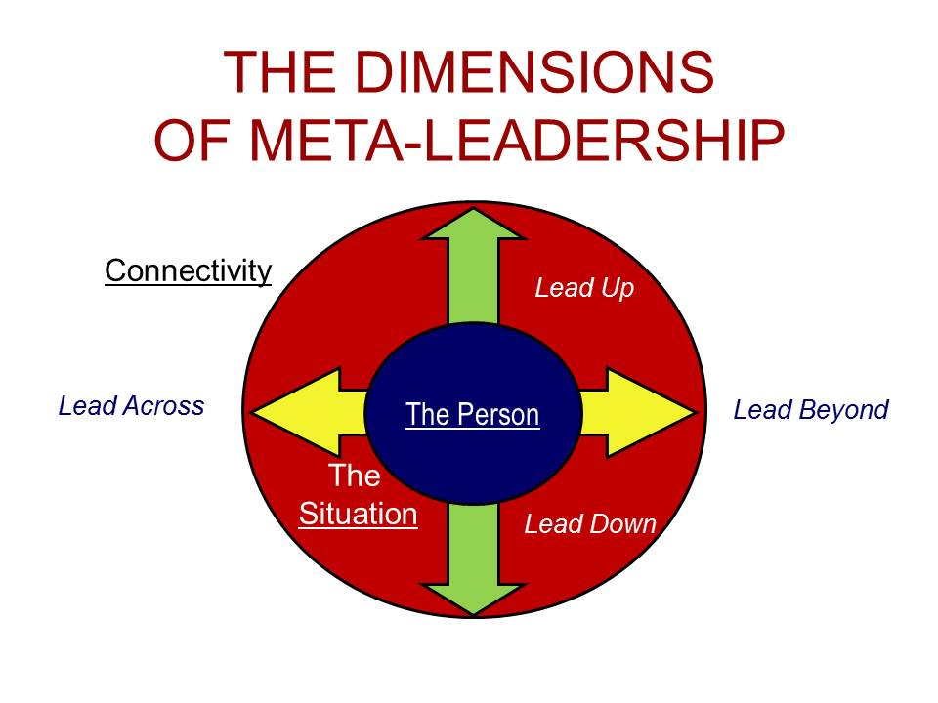
Leonard et al. describe organizations primed for meta-leadership as
“complex, networked and chaotic”
Source: Marcus, LJ, Dorn, BC. (2015). National Preparedness Leadership Initiative. Harvard School of Public Health
77
M. Bittle 2019

Slide 73
Broadly envisioned, integrated and overarching leadership
….leaders today must simultaneously lead down in the traditional sense, up to influence the people or organizations to which they are accountable, across to activate peer groups and others within their organization with whom there is no formal subordinate relationship, and beyond to entities outside of the leader’s organization or chain of command.
This is “meta-leadership”
Source: Marcus, LJ, Dorn, BC. (2015). National Preparedness Leadership Initiative. Harvard School of Public Health
M. Bittle 2019

Slide 74
Network “Leader”: Operating Principles
Trust Not Control
Return on Relationships
Humility Not Brand
Node Not Hub
Mobilize a constellation of resources and skills
Visionary, Stewards
Foster collective leadership; network culture & structure
Mission Not Organization
“Celebrate the change-generating network itself above any single person or institution”
Source: Jane Wei-Skillern, David Ehrlichman, & David Sawyer (2015). The Most Impactful Leaders You’ve Never Heard Of. Stanford Social Innovation Review.
Graphic: Bittle, MJ
86
M. Bittle 2019
Notes:
Dr. Wei-Skillern and colleagues suggest there are 4 operating principles related to network leadership.
The first of the four principles is trust not control. Strong relationships among network partners and a culture in which actors routinely invest resources into building long-term, trust-based relationships—without the expectation of control or even recognition—is critical to collaborative success. Network entrepreneurs emphasize “return on relationships” above all else. Unless they are built on a foundation of mutual respect and integrity, collaborations are unlikely to succeed, regardless of how much formal structure or strategic planning went into them
The second of the 4 principles identified by the authors is humility not brand.
Unlike social entrepreneurs so often held up as hero-like figures, network entrepreneurs are largely anonymous by design.
Early in a network’s development, these leaders are important visionaries, and stewards who help foster a healthy network culture and develop a sustainable structure. But they are deliberate about ceding their power to the collective leadership of the network and developing leadership capacity throughout the network.
The 3rd of the 4 principles the authors describe in their research is node not hub.
Network entrepreneurs are keenly aware that they are few among many working across the larger system, and in this way they embody a special type of system leader.
The authors explain that networks entrepreneurs not only connect to the larger system around them and foster propagative conversation, but also deliberately catalyze and lead action-oriented networks that are aligned around a defined shared purpose and built on the foundation of deep relationship.
They develop a culture where no individual or organization seeks to be the brightest star. Partners and peers mobilize a constellation of resources and skills that enables the achievement of a shared vision, according to the authors research. The network becomes the primary vehicle for delivering mission impact. This bears repeating, the network becomes the primary vehicle for delivering mission impact. Consequently, there is as much focus on engaging trusted peers outside the network entrepreneur’s organization as there is on tasks within the organization.
The final principle that Dr. Wei-Skillern and colleagues identified as common to successful network leaders is mission not organization.
Network leaders are far more motivated, says the authors, to achieve maximum impact than to advance themselves or their organizations. The network entrepreneur acts as a participant, often putting the interests of their peers ahead of their own, in service to the mission. An example of this notion of service to the mission provided by the authors, is the case where a network leader refers potential donors to peers that can better deliver a program or service; rather than simply seeking to maximize their own organization’s budget. When all network participants adhere to this principle, it becomes self-reinforcing; it greases the wheels of current collaborations and opens the doors to future partnerships.

Slide 75
“Meta-Leadership” Principles
Achieving the goals of the Triple Aim requires COLLECTIVE IMPACT facilitated by effective “META-LEADERSHIP” or “NETWORK”:
Essential aspects of “META-LEADERSHIP” (Marcus & Dorn 2010)
A conceptual framework and vocabulary that describes intentional networking and cohesion beyond formal organizational boundaries to connect the purposes and work of different stakeholders.
A purposeful strategy of action designed to advance coordinated planning and activity.
A compelling mission and rallying cry for both leaders and followers that inspires, guides, and instructs, setting a higher standard and expectation for performance and impact.
M. Bittle 2019
Notes:
Meta-leadership is a framework and practice method well-suited to situations that are built on trust and influence more than formal authority.
Three principles of meta leadership are:
conceptual framework and common vocabulary that describes intentional networking and cohesion within, across and beyond formal organizational boundaries to connect the purposes and work of different stakeholders;
a purposeful strategy for action to advance coordinated planning and activity
compelling mission and rallying cry for both leaders and followers that inspires, guides, and instructs, setting a higher standard and expectation for performance and impact.
Write on board:
Three principles of meta leadership are:
The person: high degree of EI: self-awareness, self-regulation, motivation, empathy, and social skills
Clear perception of the situation – situational awareness- most critical in any complex situation, time of change, or moment of crisis - Getting as close as possible to objective reality and conveying it accurately to others is at the heart of this. The purpose is to understand and to integrate the divergent perspectives into a more cohesive view that incorporates what is happening with the identified interests, potential contributions, and objections of each stakeholder, and to characterize both gaps and overlaps in activity. To move stakeholders toward coherence and clarity, the meta-leader draws upon the capacities outlined in Dimension One, distinguishing which priorities are most important to the overall endeavor and calculating both the potential upsides and downsides of each option for the different stakeholders. These calculations are then used to chart a course forward. With this greater understanding, the meta-leader can begin to craft a compelling and mutually agreeable goal that fosters unity of purpose and effort.
-without the first two you can be successful
3) The third then is Connectivity - the dimension of organizational or interpersonal capability: leading down in one’s designated formal purview of authority; up to those to whom one is accountable; across to other departments, units, or teams within the organization; and beyond to the various entities outside of the organization. The work of meta-leadership is in forging a strategic connectivity for coordinated effort among stakeholders, reaching past the usual bounds of isolated organizational thinking, functioning, competition, and conflict. This can only be achieved when the meta-leader can move stakeholders from individual self-interests to shared aligned interests.
What are some of the critical questions one might ask?
How do we define success and encourage it across the organizational spectrum? What are the critical relationships, dependencies, and interdependencies? How will information, resources, and assets flow? How will interests and incentives be optimally aligned? How will risk and rewards be distributed?
Another related notion you may have heard or read about is Collaborative Leadership. Within this are styles of leadership not often seen as needed within many industries.
These are the concepts of Process Catalyst and Process Minder. The former is a style of leadership focused on the ability to make connections, draw participants together based on articulation of a broad vision that is mutually beneficial, and that can only be achieved together. What are the important characteristics that you think define a process catalyst?
- Trustworthy; See the big picture; Articulate and communicate effectively; Influential; Comfortable with risk, ambiguity, allowing others to lead; Reflective
A process minder is a style of leadership that is focused on constant monitoring, reviews collaborator interactions and processes, and provides feedback, encouragement, and advice on the need for change. In this mode, one is always on the look out for toxic participants, fence-sitters, and the need for new ways of thinking about the issues.

Slide 76
Impact:
Collaboration and Leadership
There is value in both the output, the “impact value,” as well as in the experience of the process, the “collaborative value.”
The tangible progress – impact – amplifies the experience and rewards of working together – collaboration – and vice versa making the results mutually reinforcing.
Source: Marcus, LJ, Dorn, BC. (2015). National Preparedness Leadership Initiative. Harvard School of Public Health
96
M. Bittle 2019

Slide 77

Public health is…. “What we as a society do collectively to assure the conditions in which people can be healthy.” IOM 1988
(1)
Aligned, with definable purpose or outcome
(2)
Collective Impact
Collection of individual experts, or resources;
No definable purpose or outcome
Source Graphics
(1) https://c1.staticflickr.com/3/2222/2156056072_c83b882862_z.jpg?zz=1
(2) http://puzzlepalace.com.au/wp-content/uploads/2016/03/Across-the-Sea-1500-PC-Jigsaw-Puzzle.jpg
88
M. Bittle 2019
Notes:
To solve complex, social issues, embedded in complex adaptive communities, relevant stakeholders must come together, aligning resources, people, funding, and efforts around a common purpose. To improve population health, hospitals and health systems must be effective at relinquishing control, redefining their mission and purpose to be that of a participate, one piece in a large puzzle, focused on health.
Only through collective impact can the myriad pieces of the puzzle be aligned in just the right configuration to achieve the desired end result. Following the collective impact model provides a standardized, and reasonably evidence-based approach to assuring the there is a common agenda for change, a well-defined and mutually beneficial approach, where each individual piece of the puzzle understands, or is helped to understand, the role and function they play in achieving the desired, and agreed upon, end-state – for purposes of this discussion is a new social equilibrium in which the health of the population is improved.
Improving population health is very much like assembling a puzzle - there must be a reasonably structured approach, which allows for each meaningful component to come together in a defined way, so as to achieve the desired impact. This is underlying concept of collective impact.

Slide 78
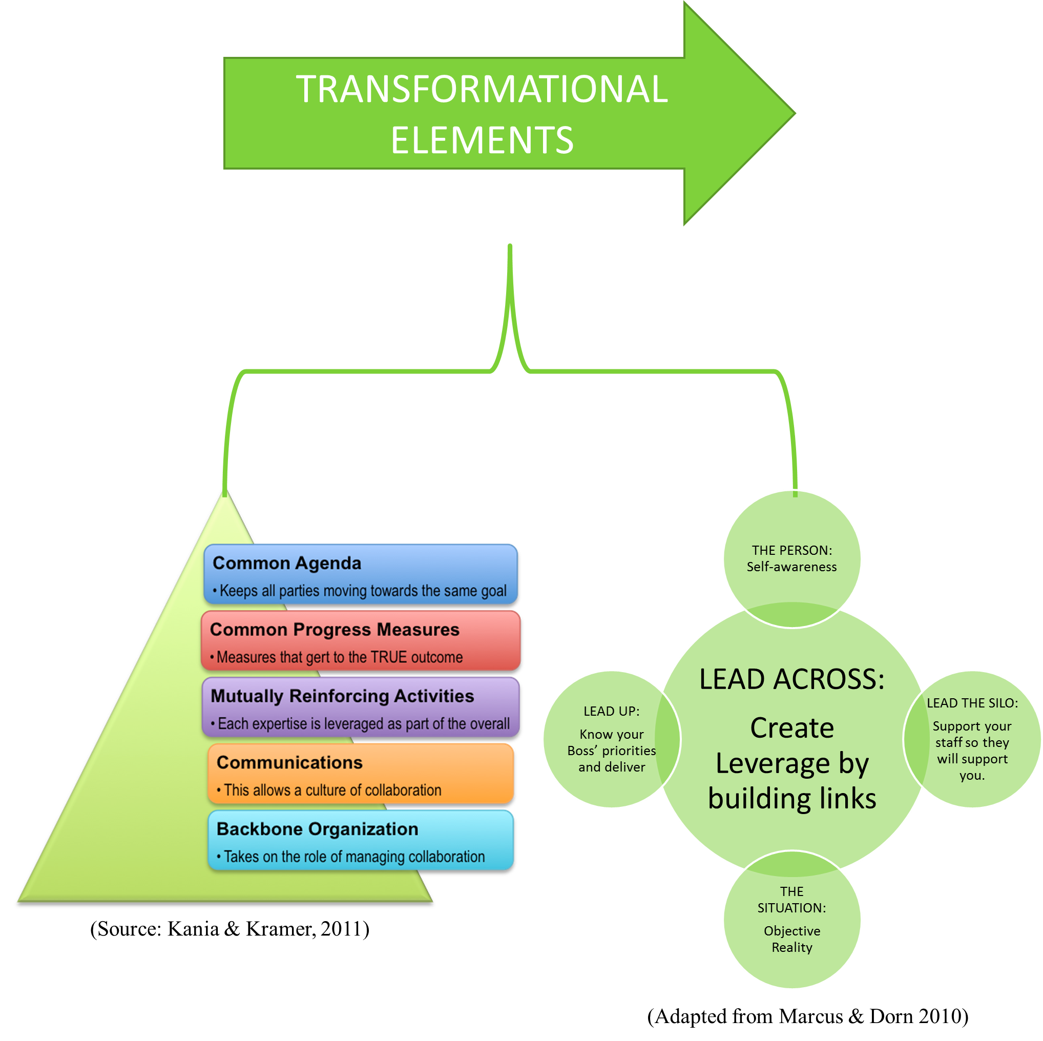
CURRENT, FRAGMENTED MODEL
TRIPLE AIM ENTERPRISE
Bittle, MJ. (2016). Leading for better health in the 21st Century.
Manuscript in process
Notes:
Paul Brodeur, wrote a chapter in the book To Improve Health and Health Care, Vol. XI, published in 2008. He wrote the following quote “responsibility shared among many entities, can quickly become responsibility ignored or abandoned.”
The notion as reflected on this slide, is that in order to create true shared accountability for a communities health, requires a structured approach to collaboration that will assure a collective impact. And, as leaders, we accept our role as but one piece of a large more important puzzle.

Slide 79
Re-envisioning roles:
A COMMUNITY-BASED HEALTH SYSTEM
Resources beyond the traditional boundaries of the hospital and health system need to be ALIGNED and LEVERAGED in order to optimize health care transformation and meet the goals of the Triple Aim.
Using a framework for COLLECTIVE IMPACT, diverse organizations, community agencies, and community members themselves, can move beyond collaboration and partnership to create a formalized population health management system.
The BACKBONE ORGANIZATION bring all stakeholders together under a COMMON VISION and PERFORMANCE MEASURES thus assuring true population-based health accountability.
“META-LEADERS” in this new era must focus on establishing and nurturing sustainable relationships, built on mutual accountability, financial commitment, and trust.
M. Bittle 2019

Slide 80

An Opportunity for Reflection
What?
So What?
Now What?
M. Bittle 2019

Slide 81
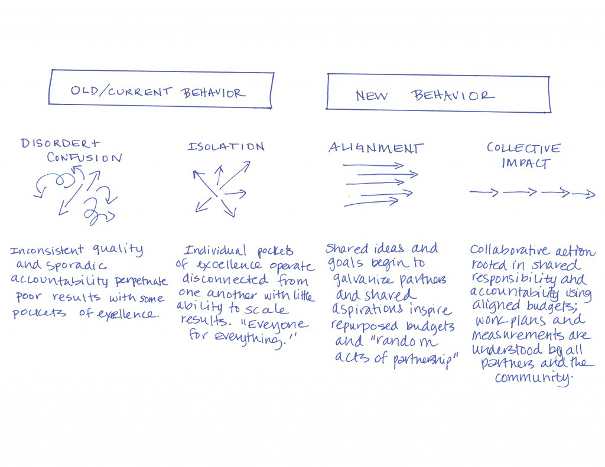
Synthesis and Reflection
John Kania & Mark Kramer,
Stanford Social Innovation Review (2011)
M. Bittle 2019

Slide 82
Questions to ask
YOUR Organization
The Collective Impact approach is an appropriate response for tackling complex social problems – the types of problems that have multiple layers of stakeholders, all with different perspectives and disagreement about the causes and best solutions.
What is our role in Health?
What type of social problem are you trying to solve?
What is your purpose?
Do you have a Collective Impact mindset?
Can you lead adaptively?
Do we aim to effect significant change (i.e., 10% or more) on a community-wide metric?
Are we including those most affected?
Do we believe that a long-term investment (i.e., three to five- plus years) by stakeholders is necessary to achieve success?
Do we believe that cross-sector engagement is essential for community-wide change?
Are we committed to using measurable data to set the agenda and improve over time?
Are we committed to having community members as partners and producers of impact?
John Kania & Mark Kramer,
Stanford Social Innovation Review (2011)
M. Bittle 2019

Slide 83


Knowing is not enough; we must
Apply.
Willing is not enough; we must
Do.
-Goethe

Slide 84
Working in groups
Scenario: Addressing the need for Behavioral Health
Issue
  Mental health is an essential component of overall health. Untreated mental illness can lead to devastating consequences, including homelessness, incarceration, unemployment and drug or alcohol abuse.
Prevalence
  1 out of 5 (110,468) Baltimoreans will experience a mental illness each year.
  1 out of 20 (24,093) adults have a serious mental illness such as major depressive disorder, bipolar disorder, or schizophrenia.
  1 out of 20 (6,955) children have serious emotional impairment.
  1 out of 25 (19,275) adults need both mental health and substance abuse treatment.
Impact
  While Baltimore City represents 11% of the State’s population, it represents 33% of those who utilized public mental health system services.
  Expenditures of over $225 million for Baltimore City account for 35% of total expenditures on public mental health services in Maryland.
  Average expenditures for adult consumers was $5,247, and $126,724 for the top 50 highest cost consumers.
  Average expenditures for child consumers was $5,762, and $184,290 for the top 50 highest cost consumers
M. Bittle 2019

Slide 85
Apply the Collective Impact Model
Develop an approach to this issue:
Create a Common Agenda
  What are the elements?
  Who are the stakeholders?
Consider elemental set of Progress Measures
Define Mutually Reinforcing Activities
  Based on the above, what could these be?
Establish effective Communications
  What are some strategies for this?
Define the backbone structure
  Who? What form?
Common Agenda
Common Progress Measures
Mutually Reinforcing Activities
Keeps all parties moving towards the same goal
Measures that get to the true outcome
Each expertise is leveraged as part of the overall
Communications
This facilitates a culture of collaboration
Backbone Organization
Takes on the role of managing collaboration
M. Bittle 2019

Slide 86
References
Argyris, C. (1999, 1994). On Organizational Learning. Blackwell Publishers. Cambridge, Massachusetts.
Bard, M., Nugent, M. (2011). Accountable Care Organizations: Your Guide to Strategy, Design, and Implementation. Health Administration Press, Chicago, IL.
Bennis, W. & Mische, M. (1995). The 21st Century Organization (Reinventing Through Reengineering). Pfeiffer & Company. San Diego, CA.
Chiellini, R. B. (2006). Influence: The psychology of persuasion. Harper Press/Harper Collins, New York, NY.
Drucker, P.F. (1999). Management Challenges for the 21st Century. McGraw-Hill. New York, NY.
Kouzes, J., Posner, B. (2007). The Leadership Challenge (4th edition). Jossey-Bass, San Francisco, CA.
Larson, B.K., Van Critters, A.D., Kriendler, S.A., Carluzzo, K.L., Gbemudu, J.N., Wu, F.M., Nelson, E.C., Shortell, S.M., Fisher, E.S. (2012) Insights from Transformations Under Way at Four Brookings-Dartmouth Accountable Care Organization Pilot Sites. Health Affairs. Nov, 31(11), 2395-406.
Lukas, C.V., Holmes, S.K., Cohen, A.B., Restuccia, J., Cramer, I.E., Shwartz, M., Charns, M.P. (2007) Transformational Change in Health Care Systems: An Organizational Model. Health Care Manage Rev. Oct-Dec, 32(4), 309-20.
McAlearney, A. (2012). Population Health Management. Strategies to Improve Outcomes. Health Administration Press, Chicago, IL.
Porter, M. Teisburg, E. (2006). Redefining Health Care. Harvard Business School Press, Boston, Massachusetts.
Rath, T., Conchie, B. (2008) Strengths Based Leadership. Gallup Press, New York, NY.
Schein, E.H. (1992). Organizational Culture and Leadership (2nd edition). Jossey-Bass, San Francisco, CA.
Senge, P.R. (1990). The Fifth Discipline: The Art and Practice of the Learning Organization. Doubleday Currency. New York, NY.
Shortell, S., Gillies, R., Anderson, D., Erickson, K., Mitchell, J. (2000). Remaking Health Care in America (2nd edition). Jossey-Bass, San Francisco, CA.
Sibbald, S.L., Wathen, C.N., Kothari, A. (2016). An Empirically Based Model for Knowledge Management in Health Care Organizations. Health Care Manage Rev. 41(1), 64-74.
The Future of the Public's Health in the 21st Century. (2002) Institute of Medicine (US) Committee on Assuring the Health of the Public in the 21st Century. Washington (DC): National Academies Press (US).
M. Bittle 2019

Slide 87
Appendix 1
Social Determinants of Health

Slide 88
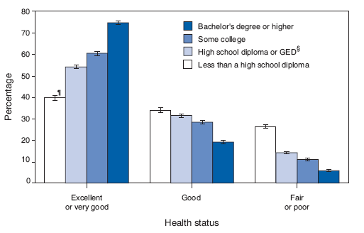
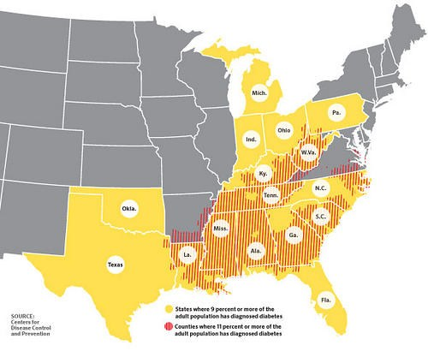
Education
Access to Healthy Foods
https://storify.com/APHA/social-determinants
Notes:
According to Robert Wood Johnson Foundation data, both women and men live longer the more education they attain. And babies born to women who did not complete high school are almost twice as likely to die in their first year than babies born to women who did finish high school.
Where people live has a dramatic effect on their health. Location can mean someone lives far away from grocery stores, and cannot access healthy foods. This is called a food desert, and many Americans live in one. A lack of access to healthy food can mean poorer health outcomes, including a greater chance of being obese and developing Type 2 diabetes or heart disease. +

Slide 89
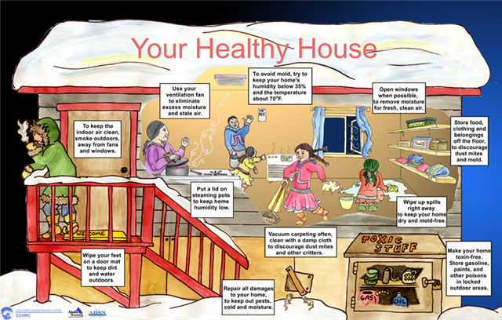
https://storify.com/APHA/social-determinants
Notes:
Even access to affordable housing can affect how healthy a person is.
Safe, healthy, affordable housing can improve health, according to the World Health Organization. People spend most of their time indoors, at home, especially young children, who are especially vulnerable, according to the Robert Wood Johnson Foundation. +
Place can also affect the air you breathe. Residents in many neighborhoods, particularly low-income neighborhoods, are at risk for asthma and other lung diseases because of air pollution.

Slide 90
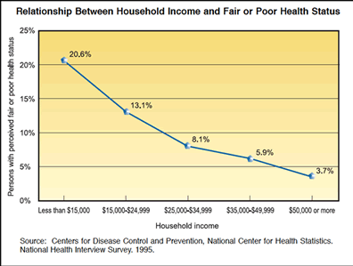
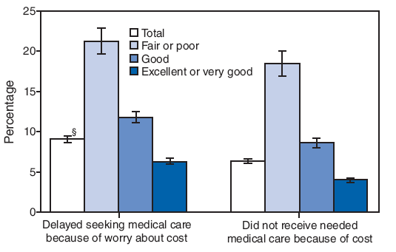
Income
Access to Health Insurance
https://storify.com/APHA/social-determinants
Notes:
The amount of money a person makes also has an effect on how healthy she or he can be. Poverty is a major indicator of poor health, and unsurprisingly, is linked to housing and education as well.
Income can affect someone's access to health insurance, which is often a factor in how often a person gets medical attention — or if they seek care at all. Better coverage means more preventive care.

Slide 91
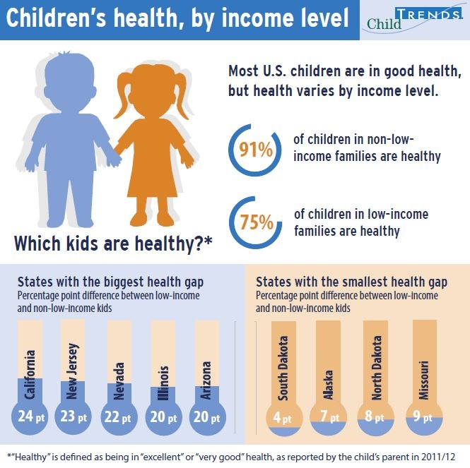
Growing up poor
https://storify.com/APHA/social-determinants
Notes:
In fact, growing up poor sets kids up for a lifetime of health issues

Slide 92
Appendix 2
Bon Secours Baltimore
M. Bittle 2019

Slide 93

Bon Secours Community Works
Programs include:
  Family Support Center
  Women’s Resource Center
  Housing and Neighborhood Revitalization
  Youth Employment and Entrepreneurship
  Career and Workforce Development
  Financial Services - Our Money Place
TOC

Slide 94

Operation ReachOut Southwest
Goal: To make Southwest Baltimore a desirable place to live, work, and play
Coalition of neighborhood associations in Southwest Baltimore
Consists of 250+ residents, business owners, and nonprofit organizations, including BSBHS

Slide 95

West Baltimore Primary Care Access Collaborative
Goal: Expand access to primary care and preventive care and create a community health infrastructure to serve residents of West Baltimore
Supports recruitment of 18 new primary care professionals, 11 community health workers, and build access to community health resources

Slide 96

West Baltimore CARE (Community Assets and Resource Exchange)
Goal: Working in partnership to provide health programs and services to West Baltimore residents in zip codes 21216, 21217, 21223, and 21229 to reduce cardiovascular disease, diabetes, and hypertension.
Partners include hospitals, FQHCs, community-based organizations, academic institutions, and city and state representatives

Slide 97

West Baltimore Readmissions Reduction Collaborative (WBRRC)
A community based care transition program targeting Medicare participants at high risk of hospital readmission
Partners include the Coordinating Center, the University of Maryland Medical Center, University of Maryland Midtown, Bon Secours Hospital, and Baltimore City Aging and Disability Resource Center

Slide 98

West Baltimore Collaborative
Regional Health Partnership for Health System Transformation
Goal: To improve healthcare access and outcomes for patients with chronic conditions identified as high utilizers of hospital services
Partners include the University of Maryland Medical Center, University of Maryland Midtown, Bon Secours Hospital, and St. Agnes Hospital
Regional Partnerships

