Slide 1
Quality Residency Capstone
Community Hospital
Brandi Renner RN, BSN
& Chelsey Hartwell RN, BSN
2022

Slide 2
Team
Our team consists of Brandi Renner Director of Quality and Chelsey Hartwell Clinical Quality Coordinator/Risk Manager.

Slide 3
AIM Statement
AIM Statement
To increase admission and discharge checklist compliance to 80% by Oct. 1, 2022.

Slide 4
Measures
Admission Checklist Compliance
N: Completed Admission Checklists
D:Total number of Admissions
Discharge Checklist Compliance
N: Completed Discharge Checklists
D:Total number of Discharges (Exclusions: transfers, deaths)
Incomplete orders
N: Total number missed orders
D:Total number of Discharges (Exclusions: transfers, deaths)

Slide 5
Selecting Changes
What changes can you make that will result in improvement
Our goal is to improve checklist compliance to at least 80%. In our project we decided that the issue was compliance rather than process so we focused on education and auditing with feedback to individuals.

Slide 6
PDSA
Describe your PDSA cycles
The first step was to audit the incomplete orders. In doing so we found that checking for them was not part of the discharge process but we also found that the discharge checklists, which are part of our standard process, were not being filled out. So we changed our focus to checklist completion and hoped that the incomplete orders –once added to the checklist would improve.
Education was done and expectations were set regarding the process to nursing.
Ward clerks were given education on returning the checklists.
Checklists were audited
Feedback given accordingly

Slide 7
Implementing Change
Describe your PDSA cycles
Auditing admission and discharge checklists as well as incomplete orders.
We empowered the ward clerks to monitor the checklists and hand them back if not complete.
With the swift improvement we decided to continue monitoring and giving feedback as appropriate and that no further changes be made at this time.

Slide 8
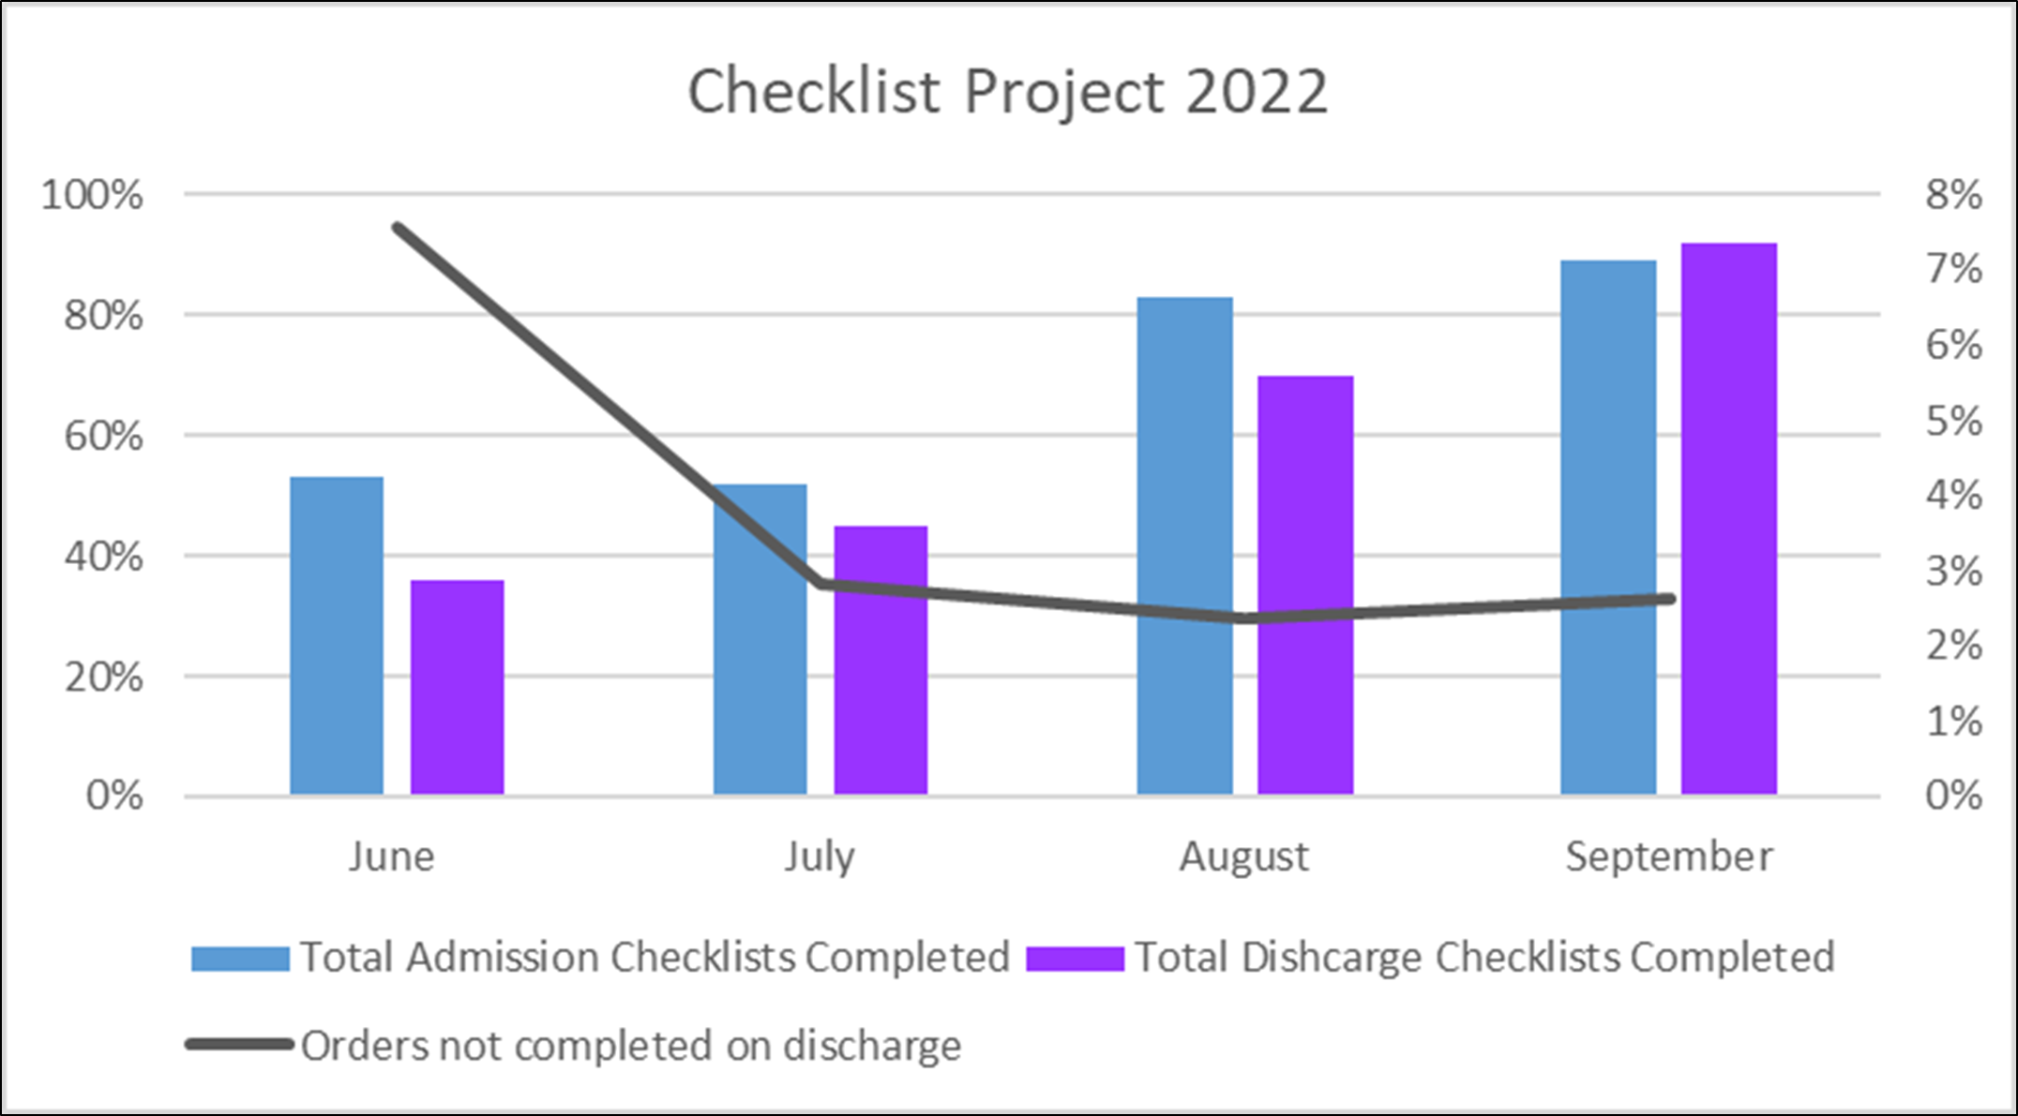
Data

Slide 9
Spreading Changes
Celebration for nursing staff and ward clerks for successful improvement was done

Slide 10
Questions?
Chelsey Hartwell
chartwell@chmccook.org
Brandi Renner
brenner@chmccook.org

Slide 11
References
IHI: The Science of Improvement: How to Improve http://www.ihi.org/resources/Pages/HowtoImprove/ScienceofImprovementHowtoImprove.aspx
Langley GL, Nolan KM, Nolan TW, Norman CL, Provost LP. The Improvement Guide: A Practical Approach to Enhancing Organizational Performance (2nd edition). San Francisco: Jossey-Bass Publishers; 2009.
The Plan-Do-Study-Act (PDSA) cycle was published by W. Edwards Deming in The New Economics for Industry, Government, and Education [Cambridge, MA: The MIT Press; 2000]. For more on the development of the PDSA cycle and how it differs from PDCA, see: Moen RD, Norman CL. Circling back: Clearing up myths about the Deming cycle and seeing how it keeps evolving. Quality Progress. November 2010.

