Slide 1

Age-Friendly Health Systems
August 2023

Slide 2
Objectives
Discuss and understand what an Age-Friendly Health System is, its goals, and why it is important
Review the 4Ms of Age-Friendly and how they affect the elderly patient
  Medication
  Mentation
  Mobility
  What Matters
Outline of the Age-Friendly process within various health settings
  How to Join
  Timeline
  Recognition

Slide 3

Age-Friendly Partners
Age-Friendly Health Systems is an initiative of The John A. Hartford Foundation and the Institute for Healthcare Improvement (IHI) in partnership with the American Hospital Association (AHA) and the Catholic Health Association of the United States (CHA)

Slide 4

What is Age-Friendly?
“Age-Friendly” describes environments that promote access to options, services and opportunities for people as they age, and that promote the inclusion and participation of older adults in all aspects of life (Age Friendly Institute, 2023).
Age Friendly Health Systems use evidence-based measures to provide high-quality patient care and align with the specific health outcomes for the elderly patient.

Slide 5
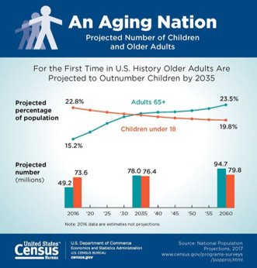
Why Age-Friendly is Important
According to the US Census Bureau, the US population aged 65+ is expected to almost double over the next 30 years to an estimated 83.7 million people by the year

Slide 6
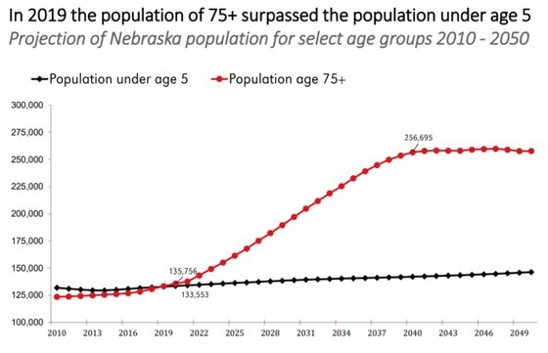
Why Age-Friendly is Important- Nebraska
The State of Nebraska is no different as our 75+ year old population is expected to eclipse 250,000 prior to the year 2040, far surpassing the populations of those under the age of 5.

Slide 7

Goals of an Age-Friendly Health System
The Aim of the Age-Friendly Health System is to:
  Guide by an essential set of evidence-based practices (4Ms)
  Cause no harms
  Align with What Matters to the older adult and their family

Slide 8
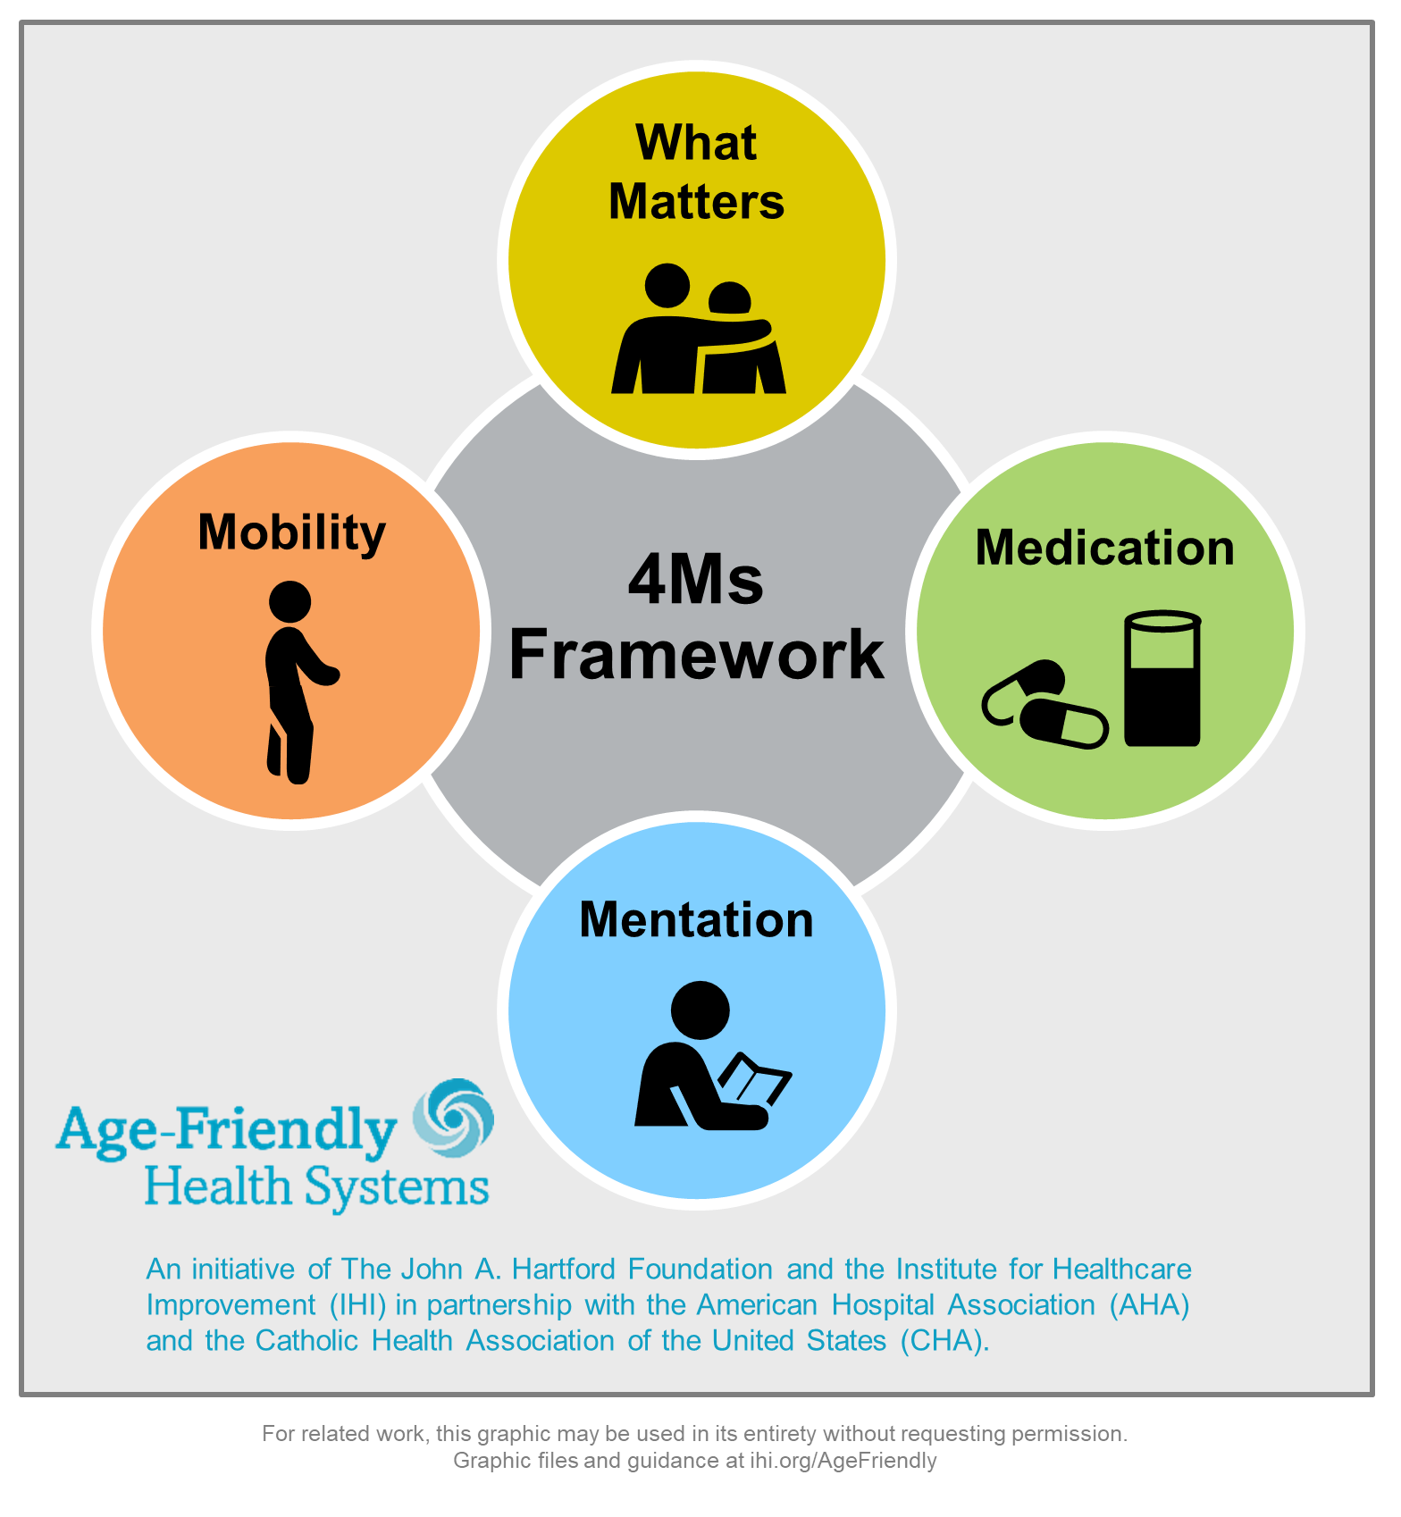
The 4Ms of Age-Friendly
Age-Friendly Health Systems break down the core care into four main areas:
  What Matters
  Medication
  Mentation
  Mobility
These represent core health issues for older adults
They are built on strong evidence base
The process simplifies and reduces implementation and measurement burden on systems while increasing effect
All the core elements are synergistic and reinforce one another
The goal with this process is to progress and implement through out each community.

Slide 9
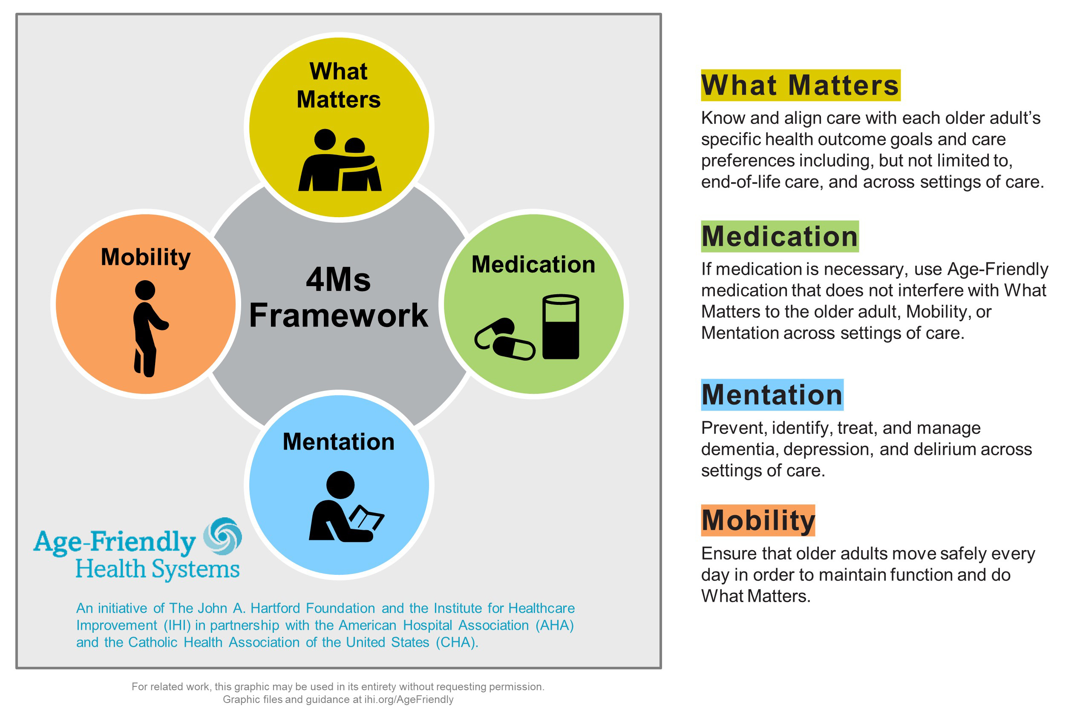
The 4Ms of Age-Friendly

Slide 10

What Matters
Know and align care with each older adult’s specific health outcome goals and care preferences.
What matters involves a wide-array of questions, including but not limited to specific health outcomes, crossing settings of care, end-of-life, financial implications, religious considerations, race, gender, ethnics health out come goals, and health preferences.
Example questions include:
  What Matters most to you for this visit? ​
  What outcome are you most hoping for? ​
  What concerns you most when you think about your health today? ​
  What concerns do you have about your health as you think about the future? ​
  What is something important for us to know about you? What would make tomorrow a good day?​

Slide 11

Mentation
Delirium | Dementia | Depression​
Delirium occurs in up to:​
  25% of Medical Inpatients​
  50% of Surgery Patients​
  75% of Intensive Care Patients, 90% in Dementia​
Delirium & Dementia can lead to long-term function, cognition, and social impairments. Delirium can result in long-term care. ​
  Delirium costs over $152 billion a year​
  Depression occurs in 1/10 in and is under-diagnosed​
  Average hours for caregiving post-hospitalization = 50 hours a week​

Slide 12

Medication
Understanding “What Matters” to the patient​
Partner with patients to co-develop in a shared decision-making approach and a personalized medication treatment plan.​
Ensure safety, quality, and better outcomes​
Ensure access to medications – focus on cost and availability​
Communicate with other healthcare professionals​
Provide appropriate monitoring and coordinate care appropriately

Slide 13

Mobility
Patients spend 95% of time in the bed or chair​
Decrease muscle mass and strength deconditioning most common cause of delay in discharge​
Decrease ADLs and Increased SNF admission adjusting for illness severity​
Linked to pressure ulcers, delirium, decreased function and mobility, increased length of stay, early readmission

Slide 14
Why the 4Ms are Important
What Matters:​
  Asking what matters and developing an integrated systems to address it lowers inpatient utilization (54% decrease), ICU stays (80% decrease), while increasing hospice use (47.2%) and patient satisfaction (AHRQ 2013)​
Medications:​
  Older adults suffering an adverse drug event have higher rates of morbidity, hospital admission and costs (Field 2005)​
  1500 hospitals in HEN 2.0 reduced 15,611 adverse drug events saving $78m across 34 states (HRET 2017)​
Mentation: ​
  Depression in ambulatory care doubles cost of care across the board (Unutzer 2009)​
  16:1 ROI on delirium detection and treatment programs (Rubin 2013)​
Mobility: ​
  Older adults who sustain a serious fall-related injury required an additional $13,316 in hospital operating cost and had an increased LOS of 6.3 days compared to controls (Wong 2011)​
  30+% reduction in direct, indirect, and total hospital costs among patients who receive care to improve mobility (Klein 2015)

Slide 15
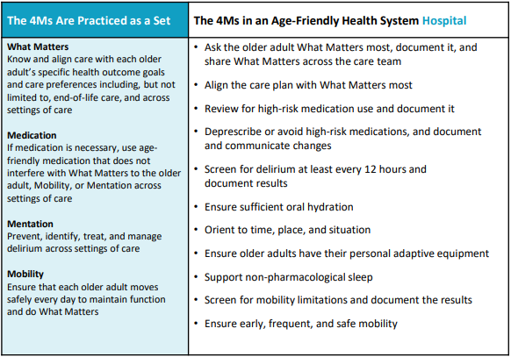
4Ms in the Hospital Setting in Action

Slide 16
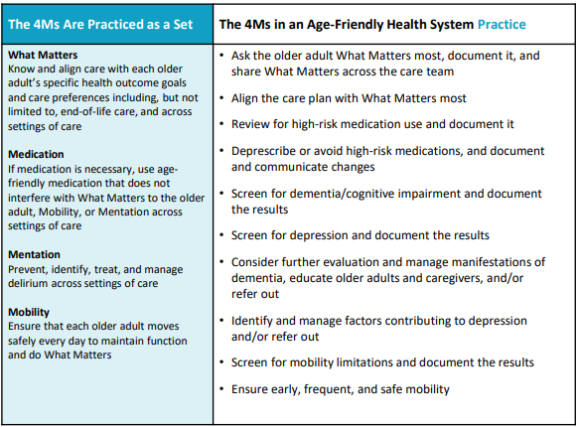
4Ms in the Ambulatory Setting in Action

Slide 17
How Age-Friendly is Implemented
Health care entities can become Age-Friendly certified by either completing the process on their own or using action community
Action Communities enable teams to accelerate reliable practice of the 4Ms in an active community of learners and testers. This 7-month journey to Recognition provides a structure for learning with and from other health systems and expert faculty. Over the course of the Action Community, teams participate in webinars and attend an in-person meeting (when possible) and develop their plan for practicing the 4Ms. ​If your health system or practice is interested in the Action Community,​​ see the upcoming opportunities below.
  The NHA is a facilitator of these action communities, not only using the IHI pathway, but adding supplemental assistance and educational opportunities for all involved.

Slide 18
How Age-Friendly is Implemented
7 Months
Participate in monthly interactive webinars
Monthly content calls focused on 4Ms
Opportunity to share progress and learnings with other teams
Test Age-Friendly Interventions
Test specific changes in your practice using the Guide to Using the 4Ms in the Care of Older Adults
Join monthly peer-to-peer topical learning calls
Join other teams for measurement and testing support in monthly drop-in coaching sessions on various subjects
Leadership track to support system-level scale up
Leaders join monthly C-suite/Board level calls to set-up local conditions for scale up (hosted by IHI)
NHA Age-Friendly Coaching and Support of Community Spread
On-site Consultation/Education
Share Description of 4Ms Care
Submit monthly qualitative feedback on your progress and description of 4Ms Care

Slide 19
Recognition
Facilities who undertake the Age-Friend process can achieve recognition through either level 1 (Participant) or level 2 (Committed to Care Excellence). It’s a distinction based on an evidence-based framework known as the 4Ms.
Level 1 (Participant) teams have successfully developed plans to implement the 4Ms.
Level 2 (Committed to Care Excellence) teams have three months of verified data to demonstrate early impact of using the 4Ms.

Slide 20
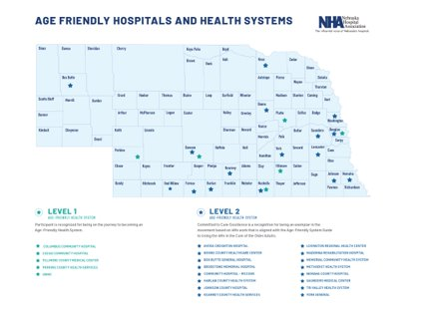
Spreading Age-Friendly
As of June 2023, over 3000 sites of care have earned either level 1 or level 2 distinction. Nationally over 2.8 million lives have been cared fore in an Age-Friendly setting.
The state of Nebraska has successfully implemented the Age-Friendly Health System in over 75+ facilities as of July of 2023.

Slide 21
Why Join Age-Friendly?
Patient Safety
Streamlined implementation
  Many time patient safety initiatives fail due to difficulty to reproduce, may not translate across care settings, or are difficult to disseminate
  The IHI process tries to work within your current processes to coordinate for the most effective elderly patient care.
Return on Investment
Elderly patient care
  81% of older adults would rather go to a hospital that provides age-friendly care than one that does not (John A Hartford Foundation, 2022).
  “I feel like I matter” – Patient at Sharp Healthcare CA USA

Slide 22
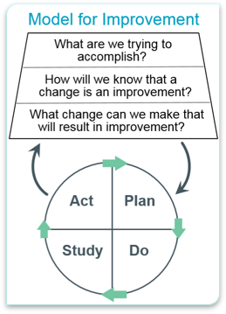
Measuring Success
Know where and how the 4Ms are already in practice and secure leadership support and commitment​
Define what it means to provide care consistent with the 4Ms​
Design/adapt your workflow to deliver care consistent with the 4Ms, including how you will assess, document and act on the 4Ms​
Provide care consistent with the 4Ms​
Study your performance. Measure and share – how reliable is your care? What impact does your care have? Track progress and celebrate successes​
Improve and sustain care consistent with the 4Ms and share learnings with others

Slide 23

Next Steps
Decide to Join
Sign Letter of Intent
Identify Team
Review 4Ms Processes
Complete Description Worksheet
Collect Data ( 3 Months)
Submit Data
Celebrate becoming an Age-Friendly Health System
Begin working with other entities within your community to progress the Age-Friendly health System

Slide 24
Contact Information
Matt Lentz RN, MSN
Quality Consultant
Nebraska Hospital Association
3255 Salt Creek Circle, Suite 100 | Lincoln, NE 68504
(402) 382-8025 (cell)
mlentz@nebraskahospitals.org

Slide 25
References
Age Friendly Institute. (2023). What is age-friendly? Retrieved from: https://www.agefriendly.org/about.
Agency for Healthcare Research and Quality (AHRQ). (2013). System-Integrated Program Coordinates Care for People With
Advanced Illness, Leading to Greater Use of Hospice Services, Lower Utilization and Costs, and High Satisfaction. (n.d.). Retrieved August 9, 2018. from https://innovations.ahrq.gov/profiles/system-integrated-program-coordinates-care-people-advanced-illness-leading-greater-use.
Field, T. S., Gilman, B. H., Subramanian, S., Fuller, J. C., Bates, D. W., & Gurwitz, J. H. (2005). The costs associated with adverse drug events among older adults in the ambulatory setting. Medical Care, 43(12), 1171-1176.
Fulmer, T., & Berman, A. (2016, November 3, 2016). Age-Friendly Health Systems: How Do We Get There? Accessed August 8, 2018, from http://healthaffairs.org/blog/2016/11/03/age-friendly-health-systems-how-do-we-get-there
Health Research & Educational Trust (HRET). (February 2017). Adverse Drug Events Change Package: 2017 Update. Chicago, IL: Health Research & Educational Trust. Accessed August 9, 2018. Retrieved from: www.hret-hiin.org.
Institute for Healthcare Improvement. 2023. Age-friendly health systems. Retrieved from: https://www.ihi.org/Engage/Initiatives/Age-Friendly-Health-Systems/Pages/Join%20the%20Movement.aspx
Klein, K., Mulkey, M., Bena, J. F., & Albert, N. M. (2015). Clinical and psychological effects of early mobilization in patients treated in a neurologic ICU: A comparative study. Critical Care Medicine, 43(4), 865-873.
Mate, K. S., Berman, A., Laderman, M., Kabcenell, A., & Fulmer, T. (2017) Creating Age-friendly health systems: A vision for better care of older adults. Healthcare, 6(1), 4-6. doi: https://doi.org/10.1016/j.hjdsi.2017.05.005
Reuben, D. B., Evertson, L. C., Wenger, N. S., Serrano, K., Chodosh, J., Ercoli, L., & Tan, Z. S. (2013). The University of California at Los Angeles Alzheimer’s and Dementia Care Program for Comprehensive, Coordinated, Patient-Centered Care: Preliminary data. Journal of the American Geriatrics Society, 61(12), 2214-2218.
The State of Aging and Health in America 2013. Atlanta: Centers for Disease Control and Prevention, US Department of Health and Human Services; 2013. https://www.cdc.gov/aging/pdf/State-Aging-Health-in-America-2013.pdf “Fact Sheet: Healthy Aging.” National Council on Aging; 2016. https://www.ncoa.org/resources/fact-sheet-healthy-aging/
Unützer, J., Schoenbaum, M., Katon, W. J., Fan, M. Y., Pincus, H. A., Hogan, D., & Taylor, J. (2009). Healthcare costs associated with depression in medically ill fee-for-service Medicare participants. Journal of the American Geriatrics Society, 57(3), 506-510.
Wong, C. A., Recktenwald, A. J., Jones, M. L., Waterman, B. M., Bollini, M. L., & Dunagan, W. C. (2011). The cost of serious fall-related injuries at three Midwestern hospitals. Joint Commission Journal on Quality and Patient Safety, 37(2), 81-87
John A Hartford Foundation (2022). Age-friendly insights polls: older adults feel good about hospitals but want age friendly care. Retrieved from: https://www.johnahartford.org/dissemination-center/view/age-friendly-insights-poll-older-adults-feel-good-about-hospitals-but-want-age-friendly-care

