Slide 1
Emergency Preparedness
Dari Olson, CHSP, HEM, CHEP, CHOP
Safety Director, Emergency Manager
Community Hospital
Notes:
About me…
35 yrs. at Community Hospital
26 years in Safety and EM
I went from 3 notebooks to having an assistant to adding 5 security staff. Emergency Management has mushroomed over the past years!
EM is my favorite job!

Slide 2
disclaimer
This presentation may contain references or links to statutes, regulations, or other policy materials. The information provided is only intended to be a general summary. It is not intended to take the place of either the written law or regulations. Please review the specific statutes, regulations, and other interpretive materials for a full and accurate statement of their contents.

Slide 3
Agenda
Understanding the CMS Guidelines
Assessment and Implementation
Steps of Emergency Management
Resources

Slide 4
Cms emergency preparedness rule
1st published in the Federal Register for comment in December 2013
Increases patient safety during emergencies
Establishes consistent emergency preparedness requirements across provider and supplier types
Establishes a more coordinated response to natural and man-made disasters
Notes:
Applies to 17 Medicare and Medicaid providers and suppliers.
Final rule was published in the Federal Register in September 16, 2016
Rule was effective as of November 15, 2016
Rule must be implemented November 15, 2017
This is NOT a new rule!

Slide 5
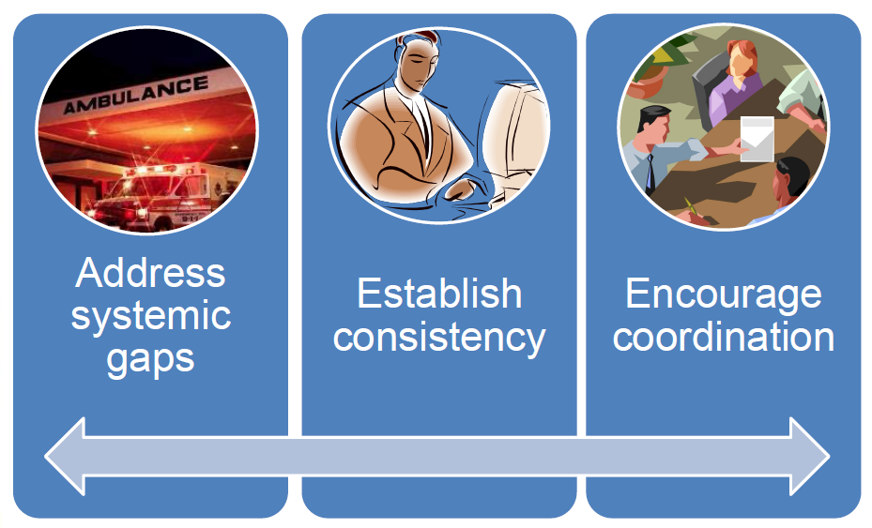
Goals for the rule

Slide 6
Definition of a disaster
A disaster is a serious disruption occurring over a short (mass casualty incident) or long period of time (pandemic) that causes widespread human, material, economic or environmental loss which exceeds the ability of the affected community or society to cope using its own resources.

Slide 7
WHAT KEEPS YOU AWAKE AT NIGHT?
Notes:
Ask the group and discuss

Slide 8
Notes:
Our CAT – her name is Little Girl, we call her something else…bites, is not lovey, walks on us at night…
Many of us are pulled in a lot of difference directions, family, finances, work, work, work…

Slide 9
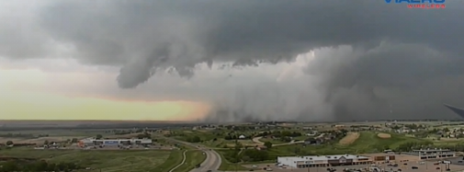
Work Related thoughts, keep me awake…

Slide 10
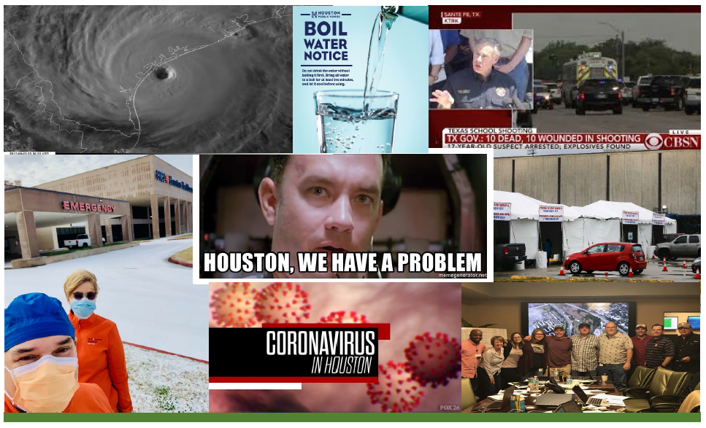
Notes:
Where you live has a lot to do with which disasters you should prepare for. If you live in California, you’ll need to think about earthquakes. Live in a Midwestern state like Oklahoma or Texas? A tornado is the number one emergency.
Knowing which disaster you’ll likely face will help you come up with the best plan.
Do you know if your home is in a flood zone?
What about wildfires? Are you in a high fire hazard zone?
While most of us don’t like to think about scary events, knowing the risks and what you can do to prepare and protect your family can help reduce anxiety.
You can sign up for emergency alerts; do you know your local alert systems? Are they used just for weather?

Slide 11
Types of Disaster events
Internal Incidents
Fire
Cyber-security
Infectious Diseases
Missing Person
Active Shooter
External Incidents
Mass Causality
HazMat
Tornado
Winter Storms
Power Outage
Notes:
Each of these requires a different type of management
An internal emergency is one that directly involves the facility or is a threat to staff and patients that causes damage to the facility.
An external emergency is one that occurs outside of the facility and does not directly threaten the staff, patients and others inside the building. The indirect effect on the facility is the possibility of large numbers of casualties arriving for treatment.
These emergencies may include, but are not limited to, care-related emergencies, equipment and power failures, interruptions in communication, including cyber-attacks, loss of a portion or all of a facility and interruptions in the normal supply of essentials such as water, food, or medical supplies.
A 2019 CMS update specified that emerging infectious diseases such as Ebola and Zika viruses, be considered in the all hazard risk assessment.

Slide 12
Notes:
The CoPs and CfCs are health and safety regulations which must be met by Medicare and Medicaid – participating providers and suppliers.
They serve to protect individuals receiving services from those organizations.
Emergency Preparedness under this Final Rule is just one new COP/CfC of many that providers/supplies must meet for Medicare Participation.
CMS is quite clear that compliance must be met.

Slide 13
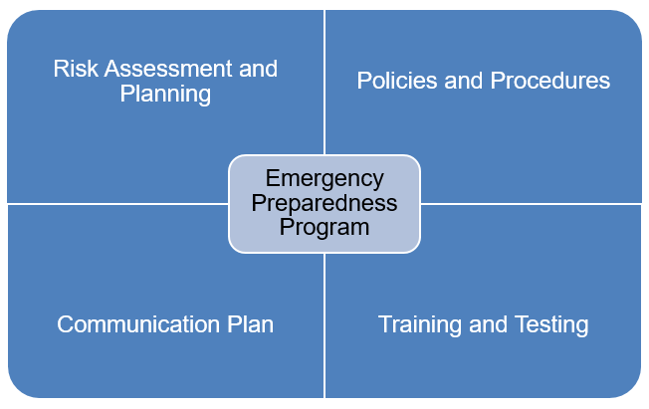
Core Elements of the CMS Emergency Preparedness Rule include:
Notes:
The CMS preparedness rule establishes national emergency preparedness requirements to ensure adequate planning for both natural and man-made disasters and coordination with federal, state, regional and local emergency preparedness systems.
There are four core elements of the Emergency Preparedness Program and element of the plan must be reviewed and updated annually.
RISK ASSESSMENT AND PLANNING – all providers must develop an emergency plan using all hazards approach, plan and identify in advance essential functions and who is responsible in a crisis.
POLICIES AND PROCEDURES – developed based on the plan (e.g. medical documentation, evacuation or shelter in place)
COMMUNICATION PLAN – alternate means of communication, provide info to local authorities sharing medical info, and providing occupancy information and ability to provide assistance to other facilities in the community.
TRAINING AND TESTING PROGRAM – train staff and test the plan through drills

Slide 14
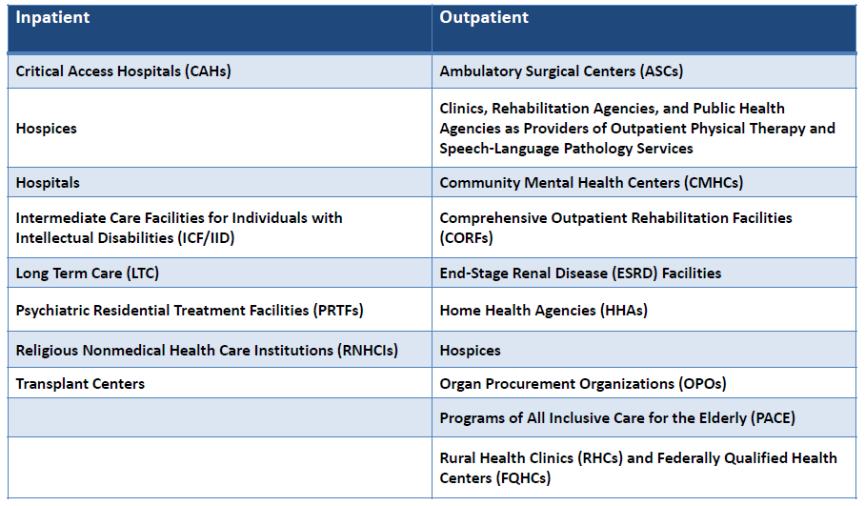
Who is Affected?
Notes:
Requirements vary by provider type.
Outpatient providers would not be required to have policies and procedure for the provision of subsistence needs.
Home Health agencies and Hospices required to inform officials of patients in need of evacuation.
Long-term care and psychiatric residential treatment facilities must share information from the emergency plan with residents and family member or representatives.

Slide 15
Notes:
I will tell you, it takes a team effort to be compliant!
Facilities, EVS, Infection Control, Nursing, Administration…I could list all of those who work in your facility.

Slide 16
Hospital Preparedness program
The Hospital Preparedness Program (HPP) enables the health care system to save lives during emergencies that exceed day-to-day capacity of the health and emergency response systems.
Notes:
This is accomplished through the development of regional healthcare coalitions (HCCs) that incentivize diverse and often competitive health care organizations with differing priorities and objectives to work together.
HPP anticipates that health care entities that have not previously engaged in community preparedness will seek to do so through participation in HCCs.

Slide 17
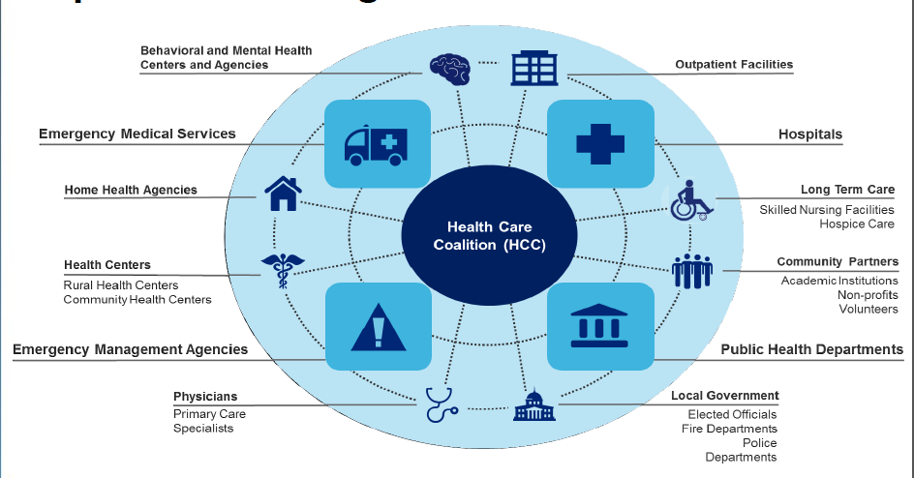
Notes:
Hospital Preparedness Programs invest in regional healthcare preparedness, response and recovery capabilities through Healthcare Coalitions.
The CMS rule offers HCCs and newly engaged providers a tremendous opportunity to achieve greater organizational and community effectiveness and financial sustainability through a more inclusive preparedness community.

Slide 18
Notes:
Although over 26,000 healthcare organizations already engaged in community preparedness through HCCs may already meet or exceed the baseline of preparedness in the CMS rule, HCCs will also function as an accessible source of preparedness and response best practices as newly engaged provider types adapt to the new requirements.
“Health care coalitions (HCCs) are groups of individual healthcare and response organizations – such as hospitals, EMS providers, emergency management organizations, public health agencies, and more – working in a defined geographic location to prepare for and respond to disasters and emergencies.
HCCs collaborate to ensure each member has what it needs to respond to emergencies and planned events, including medical equipment and supplies, real-time information, communication systems, and educated and trained health care personnel.” - U.S. Department of Health and Human Services, Office of the Assistant Secretary for Preparedness and Response

Slide 19
Hospital Incident Command System (HICS)
Notes:
The Incident Command System (ICS) was created in response to a series of destructive wildfires in southern California in 1970. National, state, and local emergency responders required a tool to effectively provide command and control functions while coordinating the efforts of many individual agencies and departments working together to stabilize a disaster, while protecting life, property and the environment.
The Incident Command System has evolved over the years, and has taken on a specific meaning for hospitals and health care systems in the form of the Hospital Incident Command System (HICS). While HICS provides a prescriptive model for implementation, hospitals have tailored the conventional methodology of the Incident Command System in most case to fit their specific needs.
HICS is an incident management system based on principles of the Incident Command System (ICS), which assists hospitals and healthcare organizations in improving their emergency management planning, response, and recovery capabilities for unplanned and planned events.

Slide 20
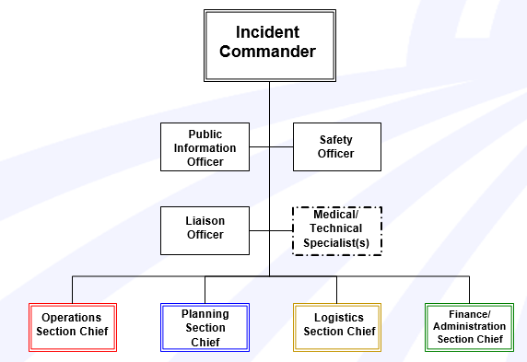
Basic Incident Command Structure
Notes:
Incident Commander is the one position that is always activated. It may be the only position that is activated, as you only need to activate the position(s) needed.
The hospital incident command structure is the only one with the Medical/Technical Specialist
The 4 Chief Sections are considered functional groups.
Only the positions that are needed based on the situation should be activated
Operations section: DOERS – Boots on the ground – Largest group
Planning: Brains – “Thinkers” – they are the keepers of the information, track and document the event.
Logistics: UPS of the organization *get supplies, staff and stuff
Finance: Keep track of all costs of an event (COVID-any expenses from this event were tracked by the CFO/accounting)

Slide 21
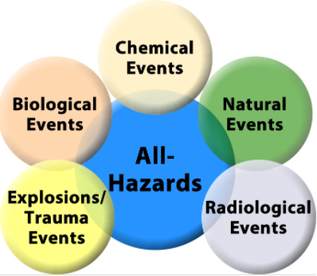
Preparedness – All hazards approach
Notes:
There are many different threats or hazards out there. The probability that a specific hazard will impact your business is hard to determine. That’s why it’s important to consider many different threats and hazards and the likelihood they will occur.
These may include, but are not limited to, care-related emergencies, equipment and power failures, interruptions in communications, including cyber-attacks, loss of a portion or all of a facility, and interruptions in the normal supply of essentials such as water and food.
Facilities should continuously reassess their emergency readiness plans. All facets of planning must be re-examined; most importantly, coordination with local emergency planning agencies in surrounding communities as well as communications with local and state public health should be enhanced.

Slide 22
5 Steps of emergency management
Prevention
Mitigation
Preparedness
Response
Recovery
Notes:
Preparedness: Policies/procedures (based on the HVA), conducting education, training and exercises, community outreach
Mitigation: Education, hazard vulnerability assessment, improved infrastructure
Response: Activation of the Hospital Incident Command, Evacuation (internal [relocation] or evacuation, mass care
Recovery: Returning to normal operations – “all clear”, restock supplies, debris management
Disaster Management does not avert or eliminate the threats; instead, it focuses on creating plans to decrease the effect of disasters.

Slide 23
Hazard Vulnerability Analysis
Natural Occurring Events
Technological
Related
Events
Human Related
Events
HazMat
Related
Events
Notes:
A hazard vulnerability analysis is a process for identifying the hospital's highest vulnerabilities to natural and man-made hazards and the direct and indirect effect these hazards may have on the hospital and community.
Hospitals should develop specific mitigation and event specific response plans for the top 3 to 5 hazards they have identified, and should emphasize training and exercises around responding to those hazards.
Natural
Technological
Human Events
HazMat Events
It is important to note that cities and counties are also required to prepare HVAs; the hospital HVA should consider hazards identified in the community plans that may impact the hospital.

Slide 24
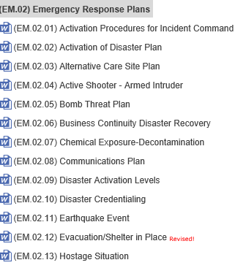
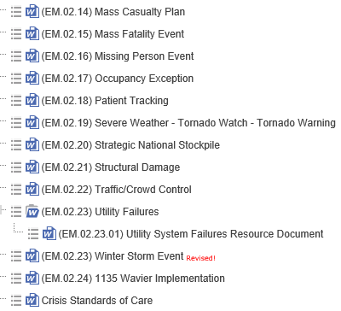
Notes:
Facilities need to develop and implement policies and procedures based on the emergency plan, risk assessment, and communication plan
Policies and procedures must address a range of issues including:
Subsistence needs,
Evacuation and shelter in place plans
Tracking patients and staff during an emergency,
Medical documentation, and;
Processes to develop arrangements with other providers/suppliers.
Policies and procedures should be reviewed and updated at least annually
(Continually reviewed)
25 emergency response plans

Slide 25
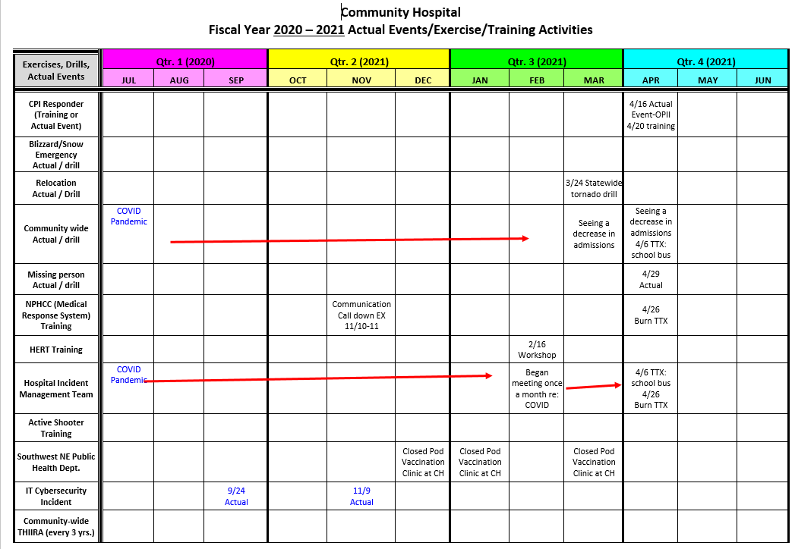
Notes:
Fiscal Year tracking of workshops, functional/TTX or full scale events.

Slide 26
Communication is Critical
Mass Communication
Cell Phones (text messages)
Handheld Radios
HAM Radios
Public
Patients/Families
Staff
Media
First Responders
Vendors
Notes:
This is one of the core areas highlighted for meeting CMS compliance.
In any emergency, the key to an effective response is effective communication; and in a hospital emergency, effective communication is critical because of a number of entities – both internal and external – that have a role to play in response and recovery. These entities need to know if your hospital is available to take patients or if it needs to be evacuated.
Hospital need to remain HIPAA compliant as patients are being transferred, whether patients are incoming or being evacuated. We must have P&Ps regarding a system to track the location of staff and patients in the hospital’s care both during and after an emergency.
At-risk populations are individuals who may need additional response assistance including…from diverse cultures, have limited English proficiency or are non-English speaking.
With the right communication plans & tools in place, hospitals and healthcare providers will not only meet compliance bur they’ll be better prepared should an emergency situation occur in the future.

Slide 27
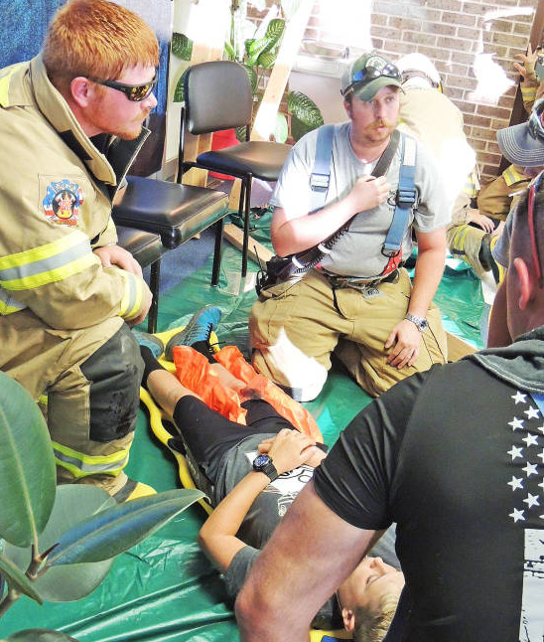
Training and Testing Requirements
Notes:
Post-incident critiques often confirm that experience gained during exercises was the best way to prepare staff to respond effectively to an emergency. Exercises should be designed to engage staff members and get them working together to manage the response to a hypothetical incident. Exercises enhance knowledge of plans, allow staff to improve their own performance and identify opportunities to improve capabilities to respond to real events.
Training and Testing: CMS guidelines – inpatient providers such as hospitals and long term care facilities are required to conduct 2 testing exercises annually, but have the flexibility to conduct 1 test through a method of their choice, such as a workshop or tabletop exercise. The other testing event should still be a full-scale community exercise. One exercise is required for outpatient providers.

Slide 28
Other Key elements
Temperature Controls and Emergency and Standby Power
Higher level of requirements for hospitals, critical access hospitals, and long-term care facilities.
Locate generators in accordance with National Fire Protection Association (NFPA) guidelines.
Conduct generator testing, inspection, and maintenance as required by NFPA.
Maintain sufficient fuel to sustain power during an emergency.
Notes:
Emergency and standby power systems can be fairly simple (for homes) or very complex (for large institutional buildings like hospitals).
Emergency Power Systems provide automatic backup power in the event of normal power loss. They are required by code and shall provide power within 10 seconds to all life safety systems such as egress lighting, smoke evacuation, fire alarm systems, elevators, etc. Simply put, anything that will protect the lives of the building occupants should be on Emergency Power.

Slide 29
Where are we now?
Interpretive Guidelines and State Operations Manual has been developed and published by CMS
In September, 2017, the surveyor training for emergency preparedness requirements was launched. Available at https://surveyortraining.cms.hhs.gov/
Training through the Integrated Surveyor Training website is available for providers and suppliers
As of November 15, 2017, in conjunction with their regularly scheduled survey, these condition of participation will now be assessed.

Slide 31
Compliance
Facilities are expected to be in compliance with these requirements
Surveys for Emergency Preparedness will be in conjunction with the regular survey cycle
In the event facilities are non-compliant, the same general enforcement procedures will occur as is currently in place for any other conditions or requirements cited for non-compliance

Slide 32
Response
Notes:
SHOW VIDEO!
Emergencies are overwhelming and stressful, even for professionals. Your critical thinking skills may deteriorate, especially if you have not previously undergone training for managing the scenario you face. Emergency preparedness ensures you have the right skills and the right state of mind to manage a disaster.
Support Documents:
Mass notification
Building and site maps
Resource Lists
Rigorous testing and training go a long way towards ensuring the emergency preparedness of your organization. Staff will response how they train!!!
Participating in facility training should be an expectation for all staff!

Slide 33
RECOVERY
Notes:
The aim of the Recovery phase is to restore the affected area to its previous state. It differs from the Response phase in its focus: recovery efforts are concerned with issues and decisions that must be made after immediate needs are addressed.
Recovery efforts are primarily concerned with actions that involve rebuilding destroyed property, re-employment, the repair of other essential infrastructure, as well as the re-opening of essential services in the hospital.
Recovery operations are an extremely important phase in the Emergency Management continuum and yet one that is often overlooked. The Incident Command System team is responsible for the implementation of the Recovery phase.

Slide 34
Why all the hype about Emergency preparedness
Disasters
2021 Winter Storms. February 13, 2021.
2020 North American Wildfire Season. December 7, 2020.
2020 Atlantic Hurricane Season. December 1, 2020.
2020 Monsoon Floods. July 17, 2020.
2020 Spring Tornadoes. January 10, 2020.
2019 California Wildfires. October 10, 2019.
2019 Catastrophic River Flooding. March 14, 2019.
2017 Wildfires.
Notes:
The National Incident Management System is a structure for management of large-scale or multi-jurisdictional incidents. It is being phased in at the federal, state and local levels. Eventually, any jurisdiction seeking federal Homeland Security grant money will have to demonstrate that it is NIMS compliant.
REVIEW the slide…
NIMS is designed to provide a framework for interoperability and compatibility among the various members of the response community. The end result is a flexible framework that facilitates governmental and nongovernmental agencies working together at all levels during all phases of an incident, regardless of its size, complexity, or location.

Slide 35
Notes:
Category 4
Aug. 17 – Sep. 2 2017

Slide 36
Notes:
May 18, 2018
Active Shooter event: do you know what to do?

Slide 37
Notes:
What did this do to the healthcare system?
Medical supply shortage
Staffing
O2 and ventilator issues
To our economy?
Business closures
Unemployment
Community?
Vaccinations (those who want it / and those who don’t)
Assisting Health departments
Closed pods

Slide 38
Notes:
Feb. 13-17 2021 Swept across 26 states
57 deaths
A few events that have or are occurring in 2021:
Southern Border Humanitarian Crisis
Volcano Eruption
Tornados
Flooding
Miscellaneous Shootings
Any guess on which state has the least natural disasters? Michigan
Most prone state: Texas

Slide 39
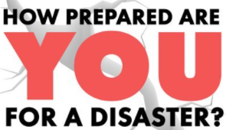
Let’s find out!
Notes:
Do the EM game Afterwards, watch video!
6 pieces of paper
2-3 – favorite possessions
2-3– activities you enjoy doing
2-3 – people you love

Slide 40
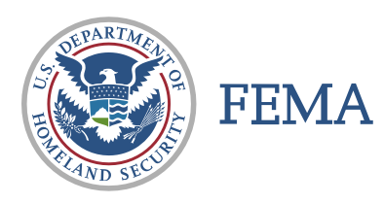
Resources
CMS.GOV
Outline of requirements by provider type
Links to aggregated EP resources
Routinely updated FAQs
CDC
Federal & Accrediting Organizations
Healthcare Ready CMS Knowledge Center
Notes:
CMS
Webinar hosted by CMS on the rule in October
Slides, transcript, and audio recording posted online
Federal & Accrediting Organizations Resources
DNV / Joint Commission / others
FEMA Emergency Management Institute
Independent Study online courses
Healthcare Ready CMS Knowledge Center
Running list of relevant articles
Perspectives from healthcare coalitions
Regulations / Templates / sample Policies and Procedures

Slide 41
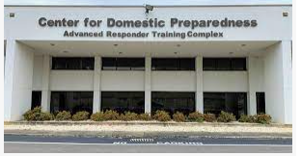
Center for Domestic Preparedness
cdp.dhs.gov
HHS/ASPR Technical Resources, Assistance Center, and Information Exchange (TRACIE)
NFPA, Chapter 12
Google
Notes:
CDP: in-person training held in Anniston AL at a renovated base hospital – at no cost.
The Noble Training Facility is the only hospital facility in the United States dedicated solely to training hospital and healthcare professionals in disaster preparedness and response. The facility includes classrooms, exercise and simulation areas, an emergency operations center, emergency department, clinical ward, and an isolation ward for ‘patients’ with highly infectious diseases.
50 training courses are offered. We have sent several clinical and administrative folks to the “Healthcare Leadership for Mass Casualty Incidents”.
The scope of training includes preparedness, protection, and response. Training and education provide folks with knowledge, skills and abilities needed to help people before, during and after disasters.
ASPR/TRACIE
Web-based resource for healthcare stakeholders
Topic Collections
− General Emergency Management & Provider- and Supplier- Specific
Routinely updated CMS Resources at Your Fingertips
Submit technical assistance requests

Slide 42
What surprised you? What questions do you have?

Slide 43
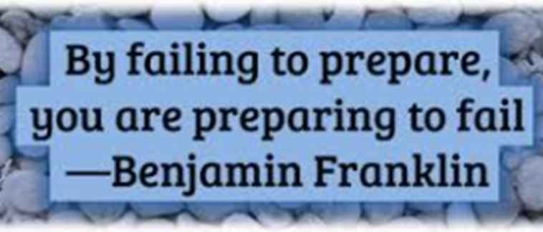
Dari Olson, HEM, CHEP, CHOP, CHSP Safety Director
Community Hospital 308.344.8362 dolson@chmccook.org

