Slide 1
MBQIP: Critical Access Hospitals Reporting and Improving Quality
Sarah Brinkman, MBA, MA, CPHQ
Robyn Carlson, RHIA, CPHQ
Stratis Health
July 8, 2021
Rural QI Residency Program

Slide 2


Sarah Brinkman
Robyn Carlson

Slide 3
Stratis Health
Independent, nonprofit, Minnesota-based organization founded in 1971
  Lead collaboration and innovation in health care quality and safety, and serve as a trusted expert in facilitating improvement for people and communities
Work at intersection of research, policy, and practice
  Long history of working with rural providers, CAHs, and the Flex Program
  Rural Quality Improvement Technical Assistance (RQITA) is a FORHP funded program of Stratis Health

Slide 4
Rural Quality Improvement
Technical Assistance Center (RQITA)
Cooperative agreement awarded to Stratis Health starting September 2015 from the Health Resources and Services Administration Federal Office of Rural Health Policy (HRSA FORHP).
Improve quality and health outcomes in rural communities through TA for FORHP quality initiatives
  Flex/MBQIP
  Small Health Care Provider Quality Improvement Grantees (SCHPQI)
Focus on quality reporting and improvement

Slide 5
Objectives
Articulate the purpose of the Medicare Beneficiary Quality Improvement Program (MBQIP) program and its position in the national quality reporting landscape
Understand requirements of MBQIP and how data is reported
Identify ways to utilize MBQIP data and suggested strategies to drive improvement

Slide 6

Medicare Beneficiary Quality Improvement Project (MBQIP) Overview

Slide 7
MBQIP Overview
Quality improvement (QI) activity under the Medicare Rural Hospital Flexibility (Flex) grant program through the Federal office of Rural
Health Policy (FORHP)
Improve the quality of care in CAHs by increasing quality data reporting and driving improvement activities based on the data
Common set of rural-relevant hospital metrics, technical assistance, encouragement, and support
Ability for FORHP to demonstrate impact of hospital and state-based efforts on a national scale

Slide 8
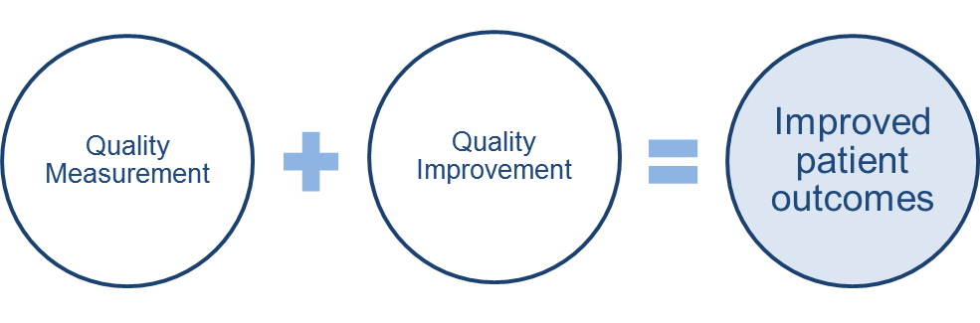
Goals of MBQIP
CAHs report common set of rural-relevant measures
Measure and demonstrate improvement
Prepare CAHs for participation in value-based payment programs
Notes:
One quarter of all US hospitals are CAHs
JAMA Article(s) from 2011 calling out CAHs for poor quality
PPS hospitals paid based on quality performance – expectation that third party payers will follow the lead of CMS and expect value demonstration from CAHs even if Medicare reimbursement for CAHs doesn’t change.

Slide 9
Benefits of MBQIP Participation
Improved patient care and quality outcomes
Increased capacity for participation in Federal reporting programs
Access to full scope of Flex resources

Slide 10
Move to Value: Rural Context
Value-Based Purchasing (VBP) programs have typically launched with ‘reporting’ efforts:
  Progression to CMS Hospital VBP
Continued roll-out across health care sectors:
  Hospitals, ESRD, Home Health, Long Term Care, Physicians…
  Most programs include metrics related to cost/efficiency, including hospital readmissions or admissions
Increasing engagement by rural providers in alternative models
Broad movement across payers
Continued theme spanning across numerous administrations

Slide 11
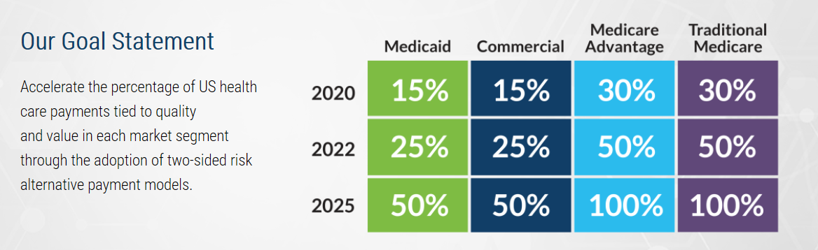
Health Care Payment
Learning & Action Network
https://hcp-lan.org/

Slide 12
MBQIP Current State Assessment
Significant increases in CAH quality reporting (consistency still a challenge)
To date, improvement on individual metrics is mixed
Seeing a shift in conversations - from a focus on reporting to more focus on improvement
Growing set of resources to support reporting and improvement

Slide 13
MBQIP Measures

Slide 14
MBQIP Core Measures
Patient Safety/ Inpatient | Patient Engagement | Care Transitions | Outpatient
HCP/IMM-3 (formerly OP-27) – Healthcare personnel influenza vaccination Antibiotic Stewardship – Implementation of core elements | Hospital Consumer Assessment of Healthcare Providers & Systems (HCAHPS) | Emergency Department Transfer Communication (EDTC)§ | AMI: OP-2 – Fibrinolytic therapy w/in 30 OP-3 – Time to transfer ED Throughput: OP-18 – Time from arrival to departure OP-22 – Left w/o being seen
§ EDTC – Only measure not collected through CMS or NHSN

Slide 15
Reporting Channels for Core MBQIP Measures
Hospital Quality Reporting (HQR)
CMS Outpatient Measures
(Submitted via CART or vendor tool)
OP-2, OP-3, OP-18
CMS Outpatient Measures
(Submitted via HARP)
OP-22
HCAHPS Survey
(Vendor or self-administered)
HCP/IMM-3
(formerly
OP-27)
Antibiotic Stewardship (submitted via Annual Facility
Survey)
NHSN*
State Flex Office
EDTC†
*National Healthcare Safety Network †Emergency Department Transfer Communication

Slide 16
MBQIP Additional Measures
Falls – discussing later today!
Swing Beds – more information to come!

Slide 17
Quality Reporting Resources
MBQIP Quality Reporting Guide
  www.ruralcenter.org/resource-library/mbqip-quality-reporting-guide
MBQIP Measures Fact Sheets
  www.ruralcenter.org/resource-library/mbqip-measures-fact-sheets
MBQIP Data Reporting Reminders
  www.ruralcenter.org/resource-library/mbqip-data-reporting-reminders
Ask Robyn Quarterly Open Office Hours (July 13)
  www.ruralcenter.org/resource-library/ask-robyn-quarterly-open-office-hour-calls-for-mbqip-data-abstractors
Online MBQIP Data Abstraction Training Series
  www.ruralcenter.org/resource-library/online-mbqip-data-abstraction-training-series
Abstracting for Accuracy
  www.ruralcenter.org/resource-library/abstracting-for-accuracy-project

Slide 18
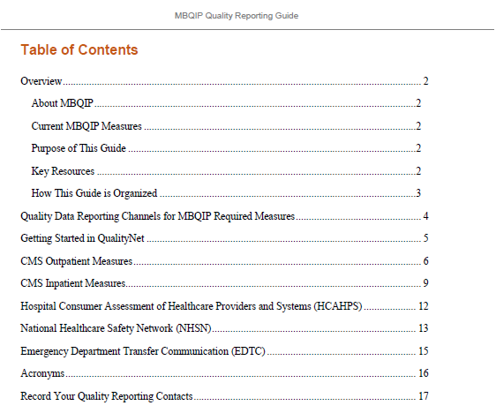
MBIQP Quality Reporting Guide
Focus on MBQIP Measures
Links embedded throughout
Hospital quality reporting contact form
www.ruralcenter.org/resource-library/mbqip-quality-reporting-guide

Slide 19
Abstracting for Accuracy
An opportunity for CAHs to participate in an abstraction review process
Help to increase validity of data collection
Identify opportunities for additional training and clarification related to
chart abstraction
www.ruralcenter.org/resource-library/abstracting-for-accuracy-project

Slide 20
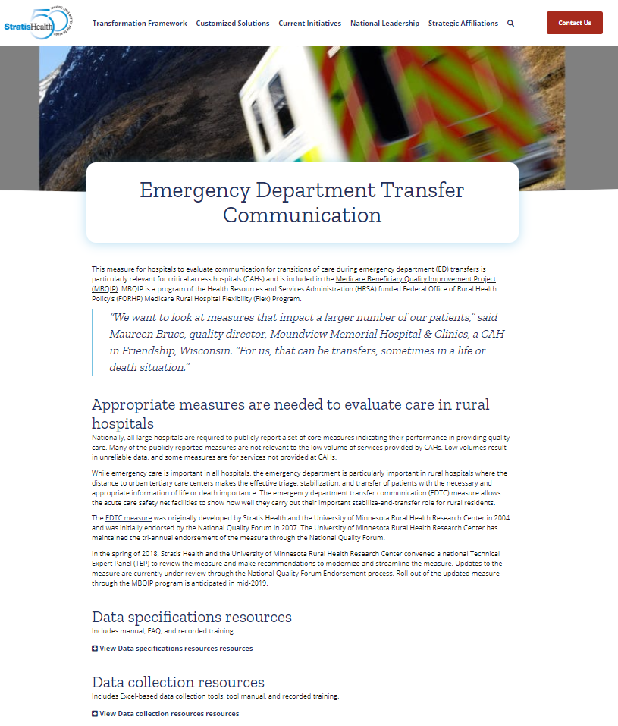
EDTC
Streamlined measure – 8 data elements
Training videos and FAQ available
Started using for Q1 2020 encounters
https://www.ruralcenter.org/resource-library/data-specifications-manual-edtc-measure

Slide 21
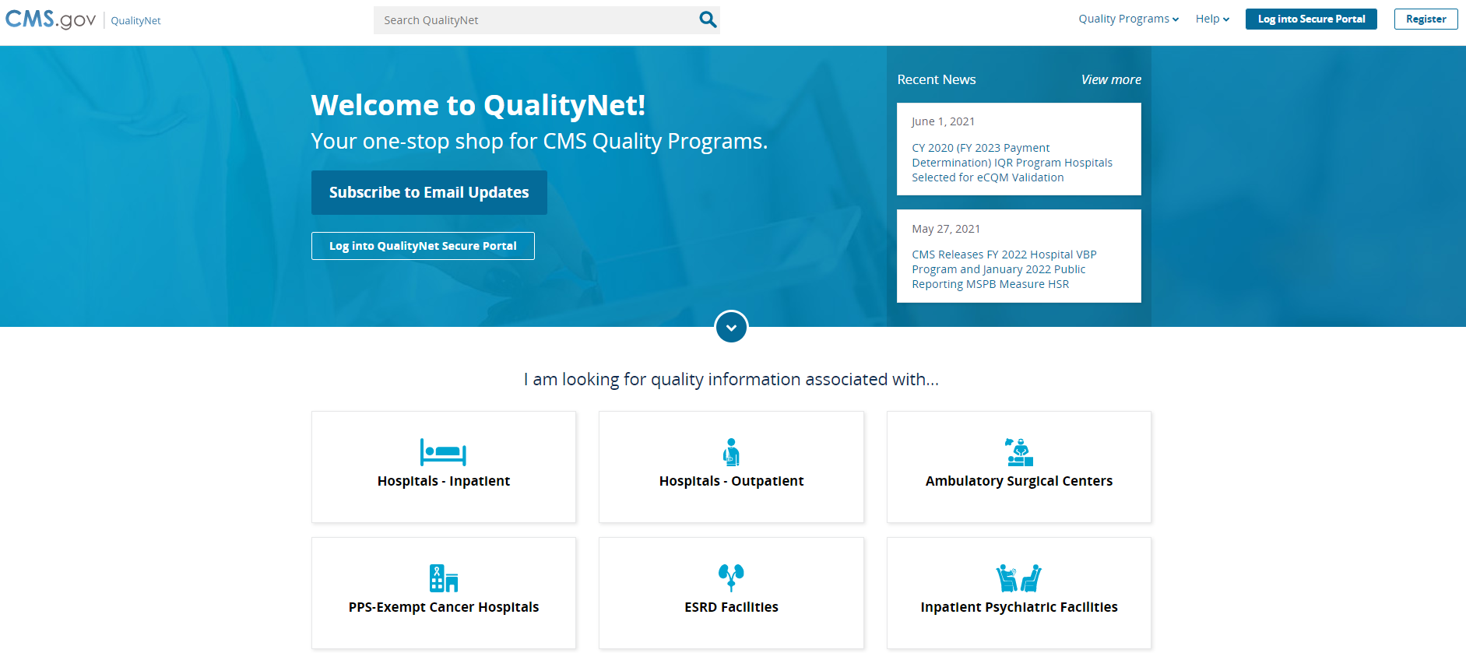
Quality Net
Specifications Manuals
CMS Abstraction & Reporting Tool (CART)
Subscribe for updates
https://qualitynet.cms.gov/

Slide 22
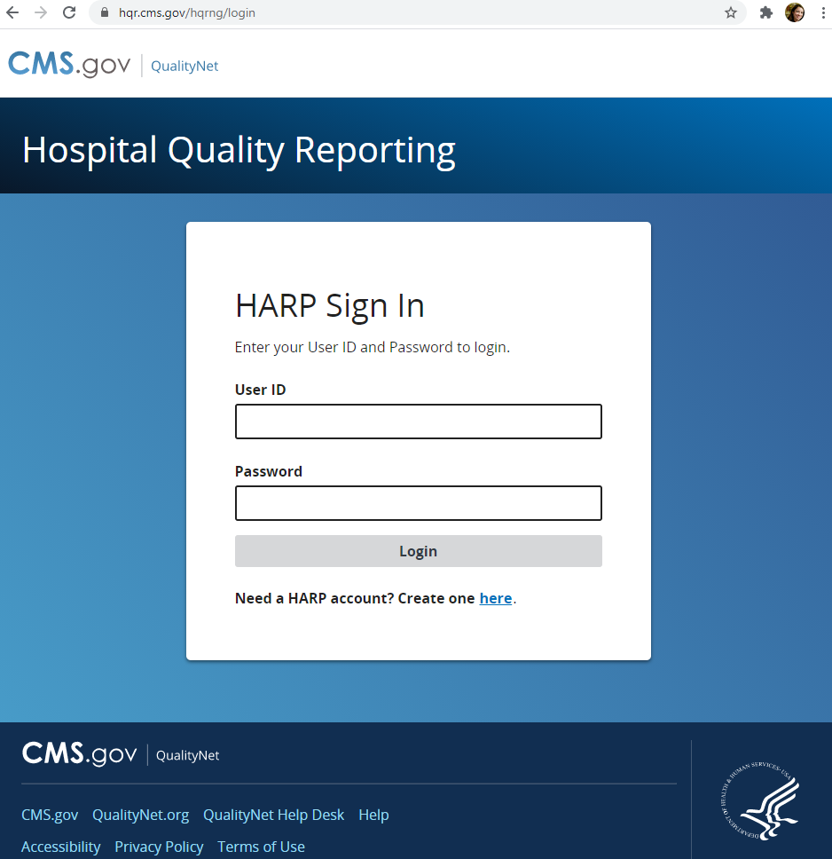
HARP
Login here to submit data:
https://hqr.cms.gov/hqrng/login

Slide 23
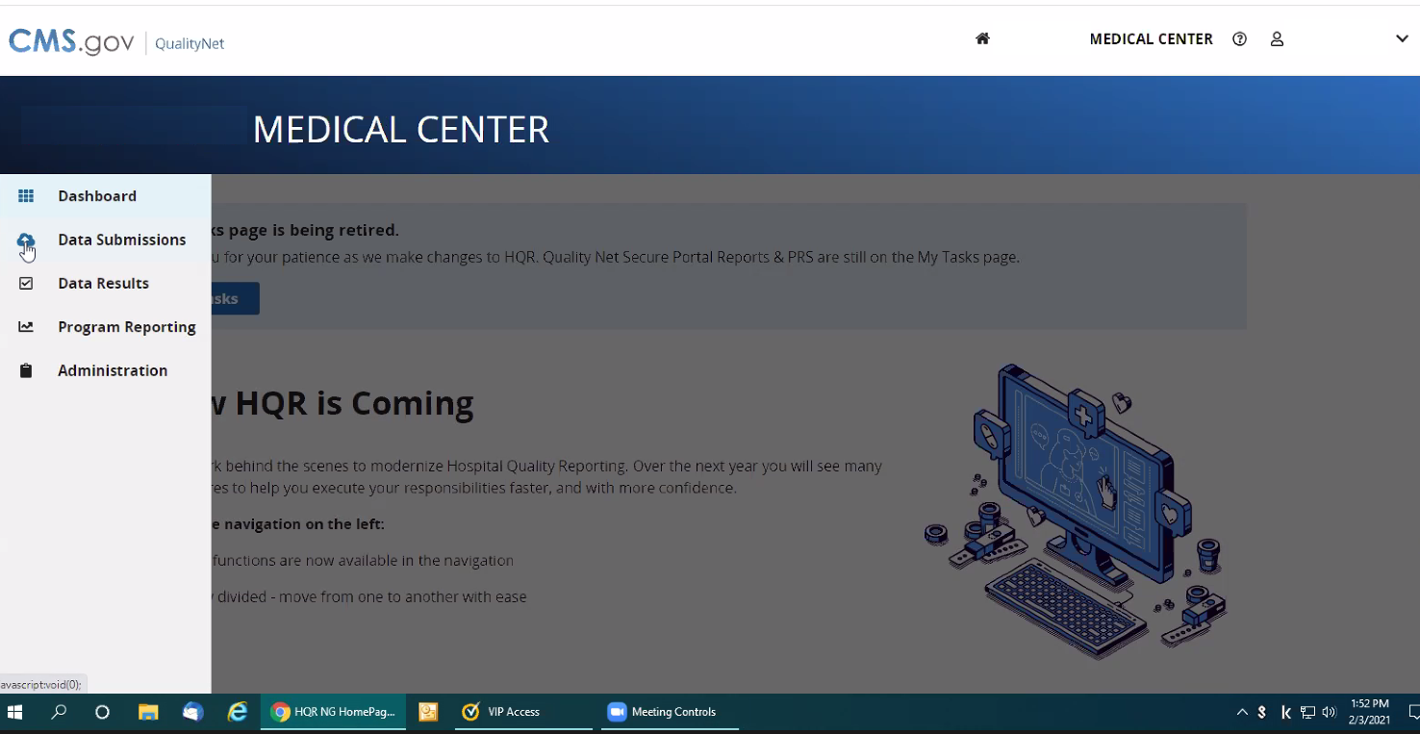
sdfasfasd

Slide 24
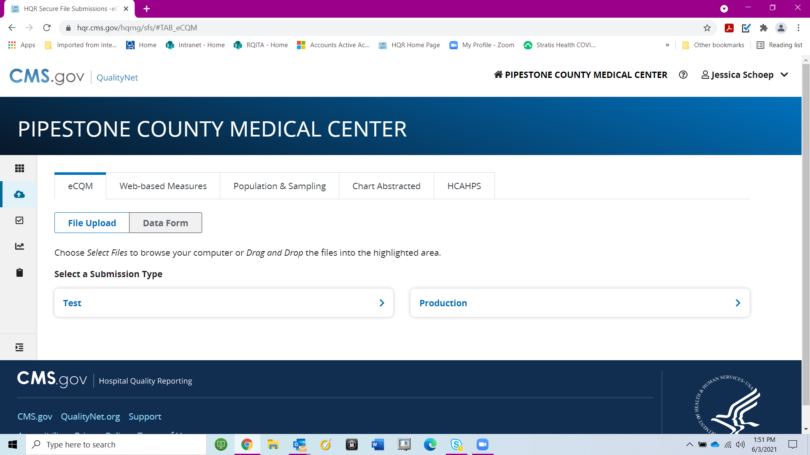

Slide 25
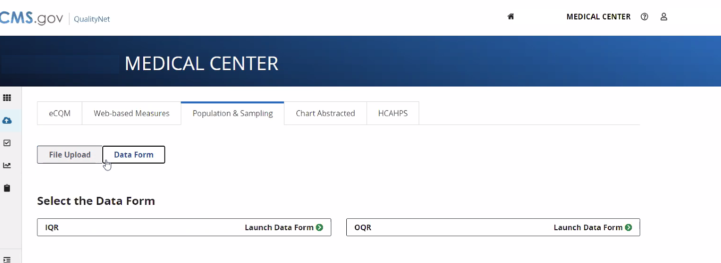
sdfasfasd

Slide 26
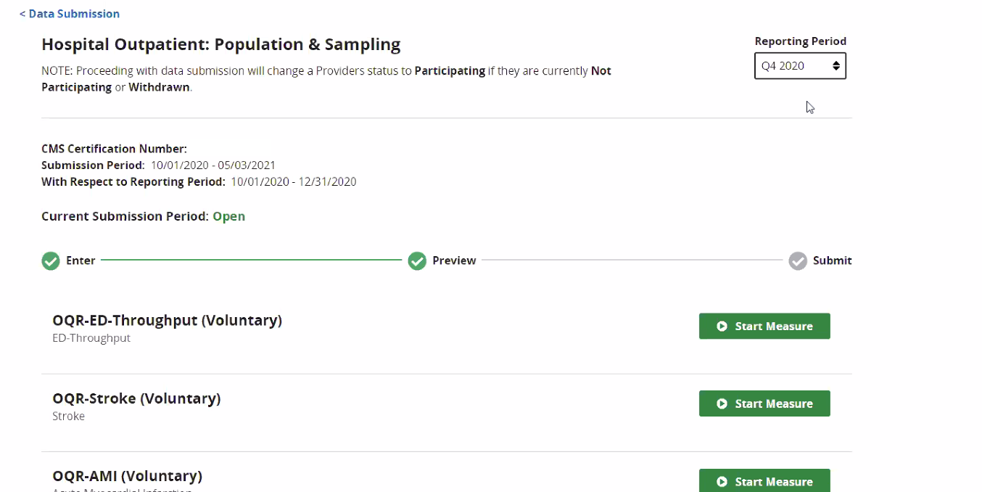
a

Slide 27
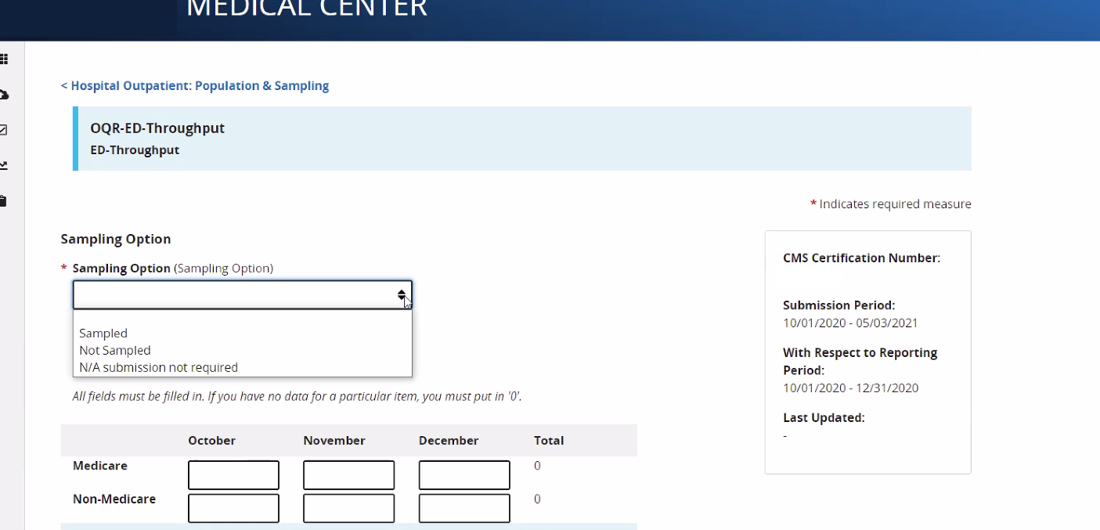
a

Slide 28
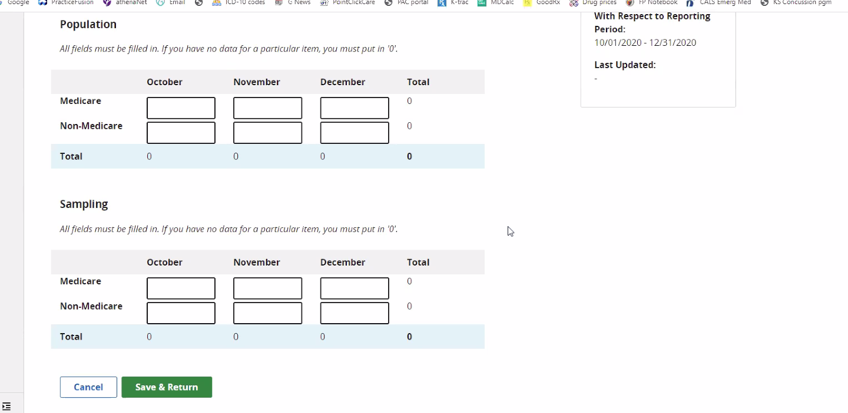
a

Slide 29
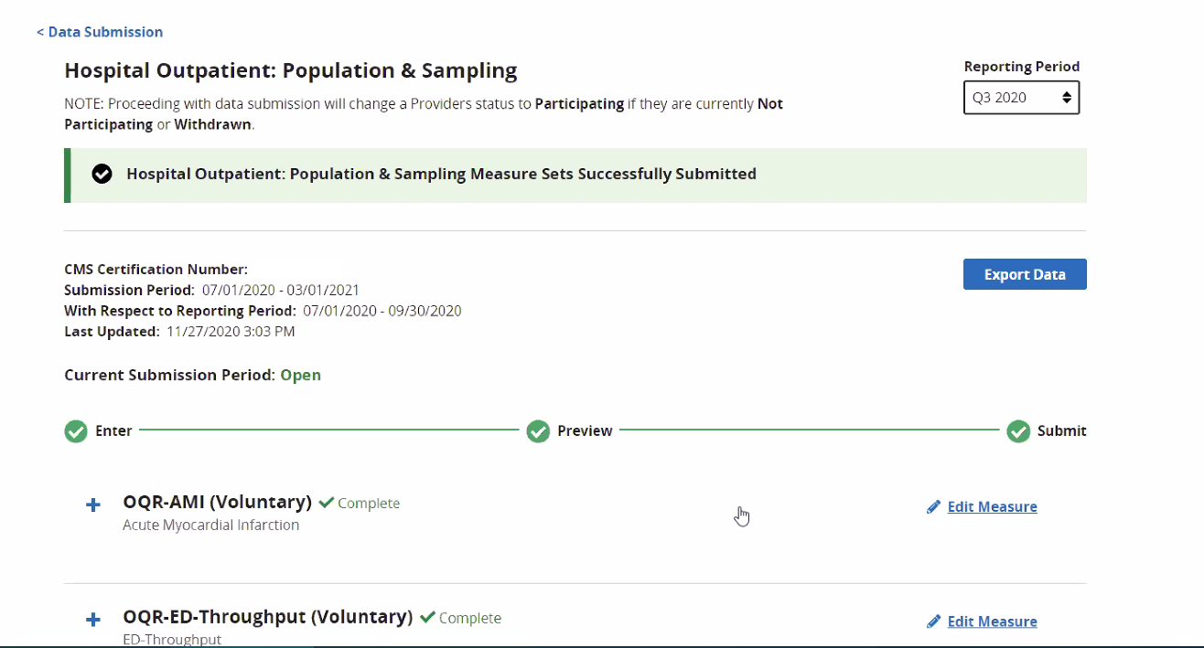
a

Slide 30
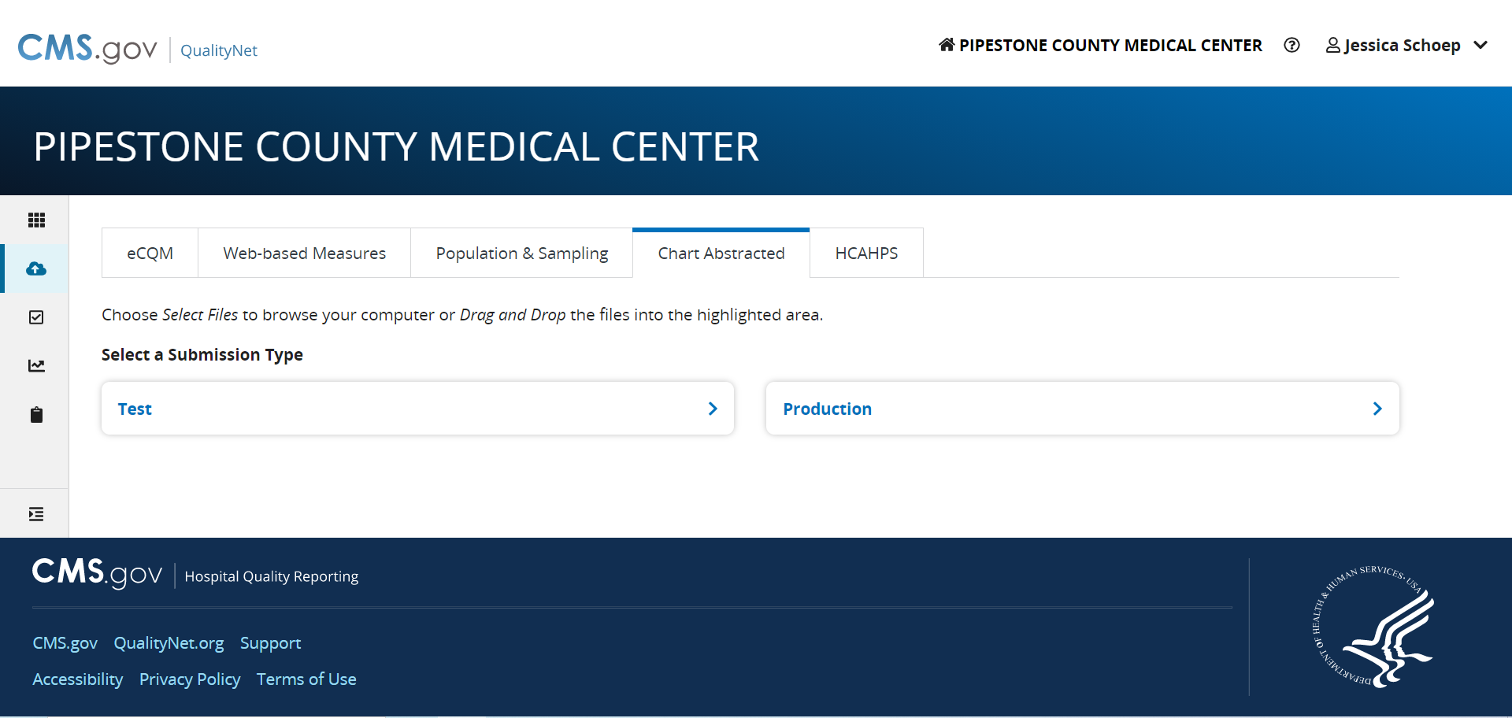

Slide 31
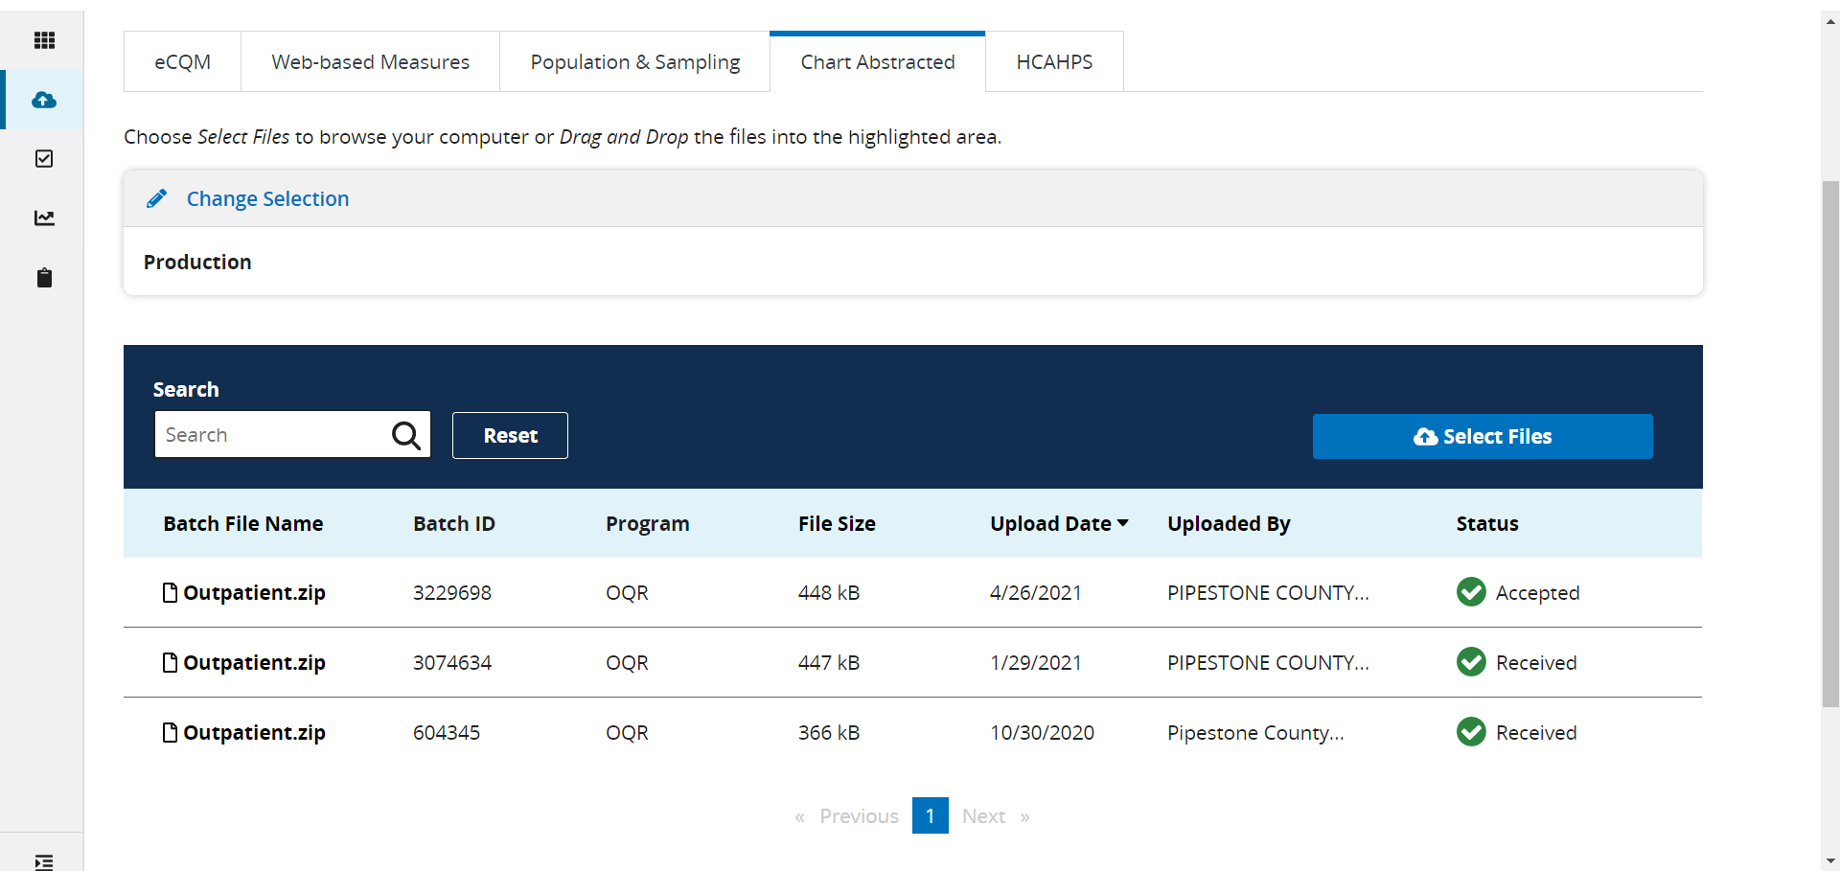

Slide 32
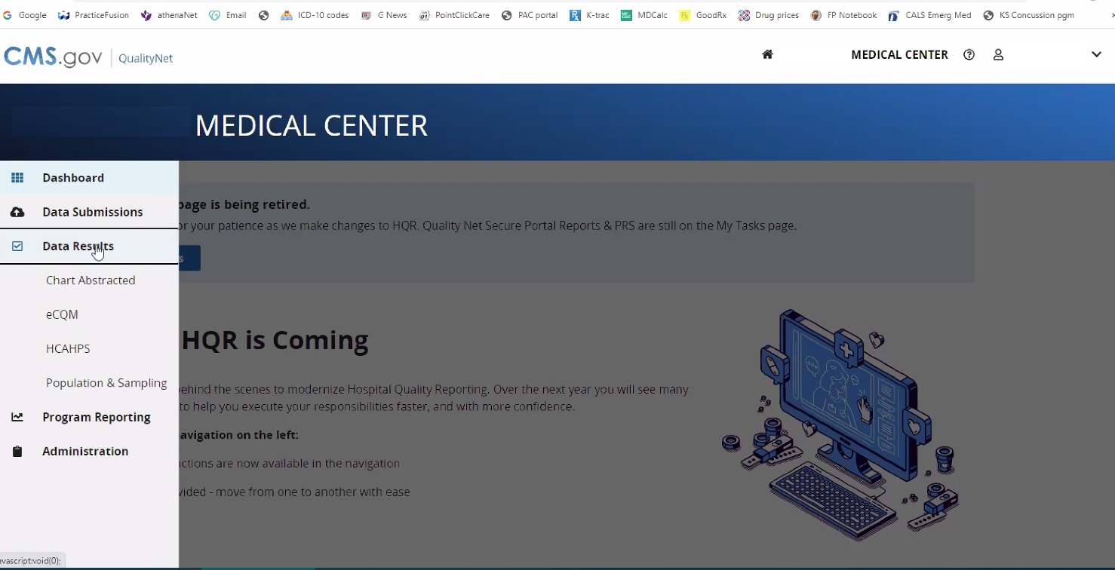
a

Slide 33
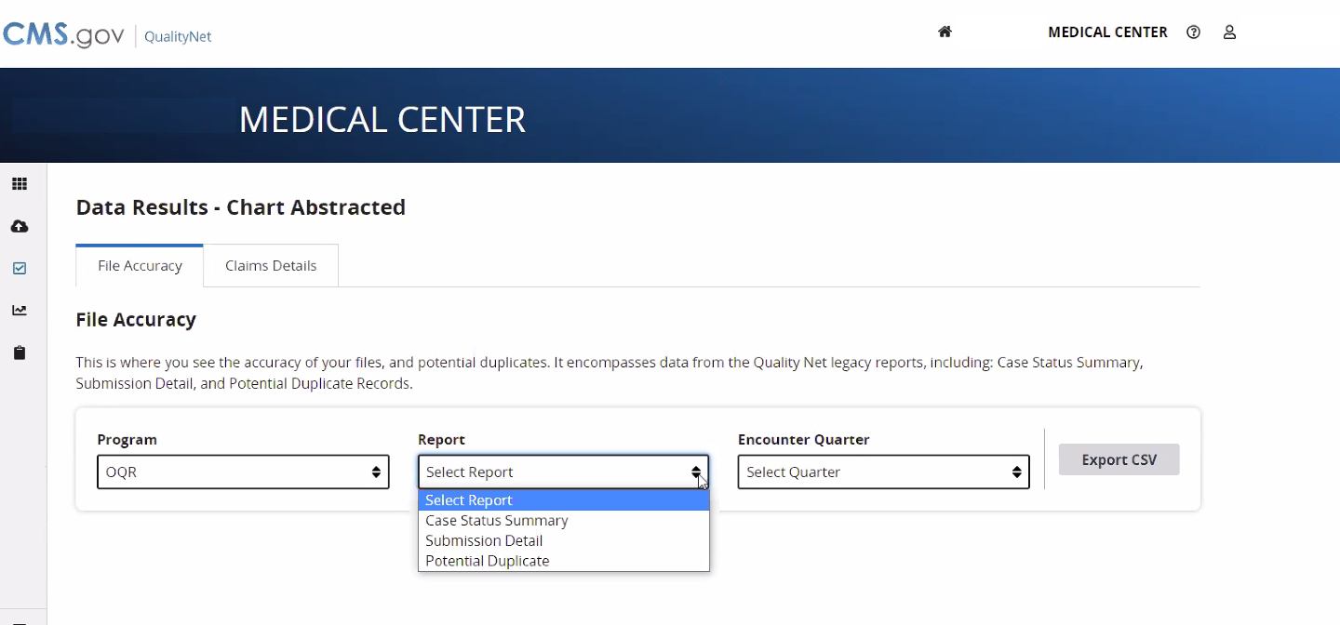
a

Slide 34
Nebraska MBQIP Performance Data

Slide 35
HCP/IMM-3 (OP-27): Immunization among Health Care Personnel
Flu Season | # (%) CAHs Reporting |  | Average |  | 90th Percentile
 | NE CAHs (64) | National CAHs (1,338) | NE CAHs | National CAHs | NE CAHs | National CAHs
2017-2018 | 48 (75%) | 1,030 (77%) | 93% | 89% | 99% | 99%
2018-2019 | 41 (64%) | 985 (74%) | 94% | 90% | 99% | 99%
2019-2020 | 31 (48%) | 718 (54%) | 91% | 92% | 99% | 99%
Notes:
Orient to the table – across the left are the three most recent flu seasons for which we have data
Across the top we have the average performances for the state CAHs that reported and all CAHs that reported nationally – both CAHs and PPS. To the far right we have the 90th percentile performance among State CAHs and CAHs nationally.
2017-2018 season

Slide 36
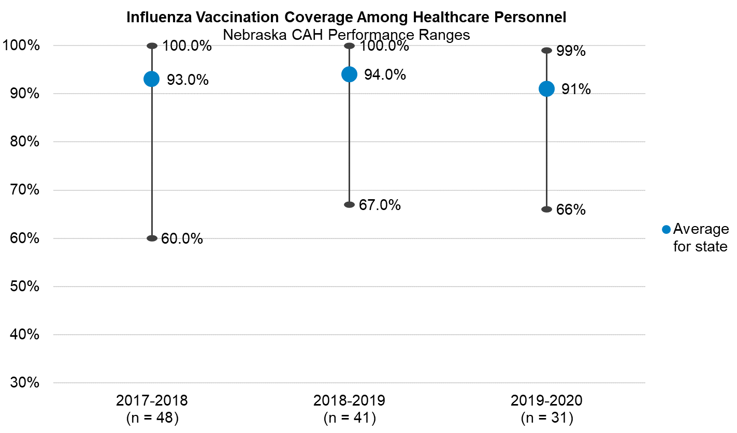
National CAH average for 2019-2020: 92%
National CAH 90th Percentile for 2019-2020: 99%
Notes:
Range of performance in the first year was 60% to 100% - increased to a low of 67% in the second flu season reflected here and dipped just slightly in the third year, which aligns with the lowest average across the three years of 91%.

Slide 37
OP-18: Median time from ED Arrival to Departure (in minutes)
Timeframe | # (%) CAHs Reporting |  | Median |  | 90th Percentile
 | NE CAHs (64) | National CAHs (1,338) | NE CAHs | National CAHs | NE CAHs | National CAHs
4Q 2019 | 56 (88%) | 960 (72%) | 99 | 106 | 77 | 78
1Q 2020 | 48 (75%) | 799 (60%) | 98 | 108 | 82 | 80
2Q 2020 | 35 (55%) | 718 (54%) | 101 | 106 | 81 | 80
3Q 2020 | 48 (75%) | 924 (69%) | 99 | 110 | 80 | 80
Notes:
Similar orientation as the first table, but now we’re looking at a median measure that is reported quarterly so we’re reviewing the last four quarters of available data.
26 of 29 CAHs reported OP-18 in 3rd quarter 2018 which is the most recent period of data we have available. The Median time from arrival to departure for ED patients at AR CAHs was 102 minutes during that time frame. Slightly lower than the national median for CAHs. The 90th percentile performance among AR CAHs is 81 minutes and the national 90th percentile is 78 minutes.

Slide 38
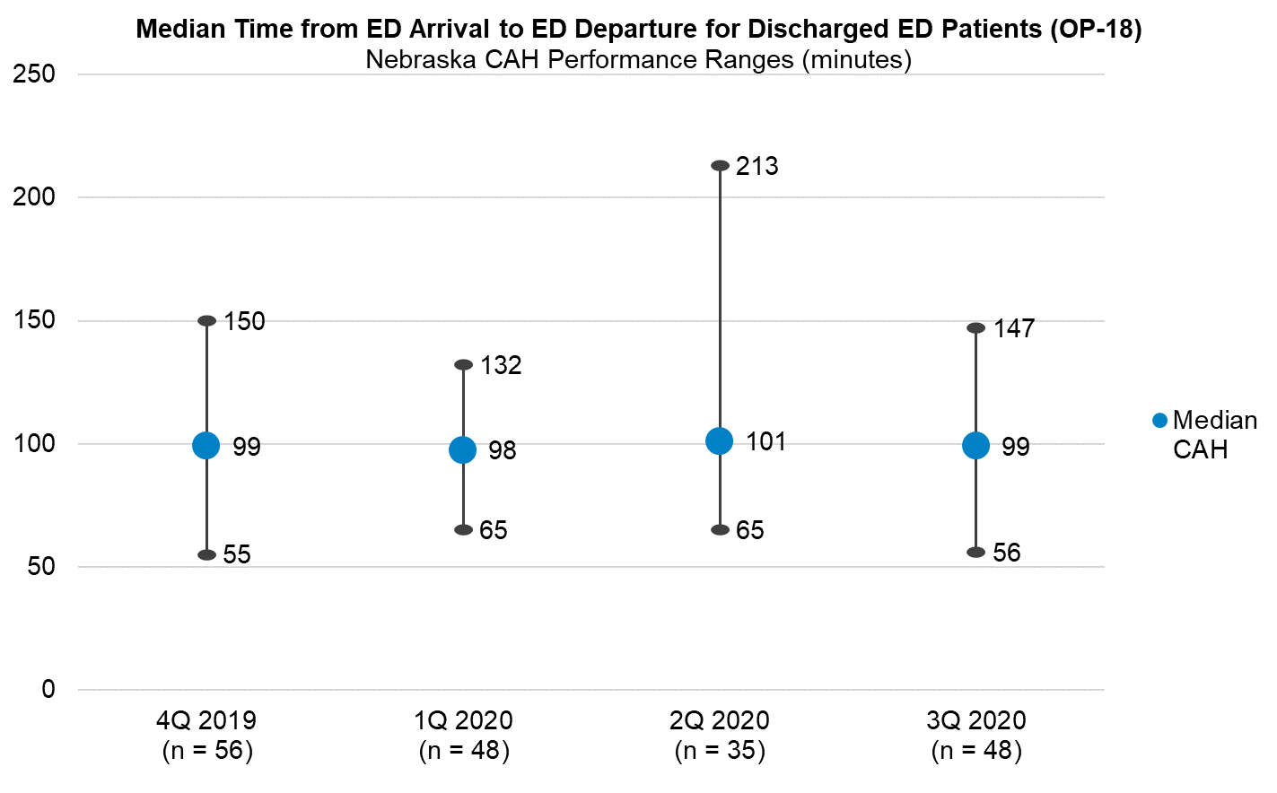
National median CAH in 3Q 2020: 110
National CAH 90th Percentile in Q3 2020: 80
Notes:
Swings in the number of CAHs reporting over the four quarters shown (56-48-35-48). The range of median times has varied over the last four quarters – 55 minutes was the low in quarter 4 2019; 213 minutes was the high in Q2 2020. The blue dot represents the median NE CAH performance (not an average of the medians, but the actual performance of the median CAH).

Slide 39
EDTC-All: Emergency Department Transfer Communication Composite
Timeframe | # (%) CAHs Reporting |  | Average |  | 90th Percentile
 | NE CAHs (64) | National CAHs (1,338) | NE CAHs | National CAHs | NE CAHs | National CAHs
1Q 2020 | 59 (92%) | 1,025 (77%) | 88% | 87% | 100% | 100%
2Q 2020 | 53 (83%) | 1,037 (78%) | 91% | 90% | 100% | 100%
3Q 2020 | 57 (89%) | 1,147 (86%) | 91% | 90% | 100% | 100%
4Q 2020 | 60 (94%) | 1,159 (87%) | 90% | 90% | 100% | 100%
Notes:
94% of Nebraska CAHs reported EDTC data in Q4 2020 – that’s great! Can you tell me a bit about how you have your EDTC reporting set up?
If you’re familiar with EDTC you know that there are data elements that make up sub-measures and those sub-measures roll up into an EDTC all composite measure. In order for a case to count towards the EDTC all composite, every single data element needs to have been met, meaning that all of the patient information identified in the measure was sent to the receiving facility in a timely matter and that communication was documented in the EHR.

Slide 40
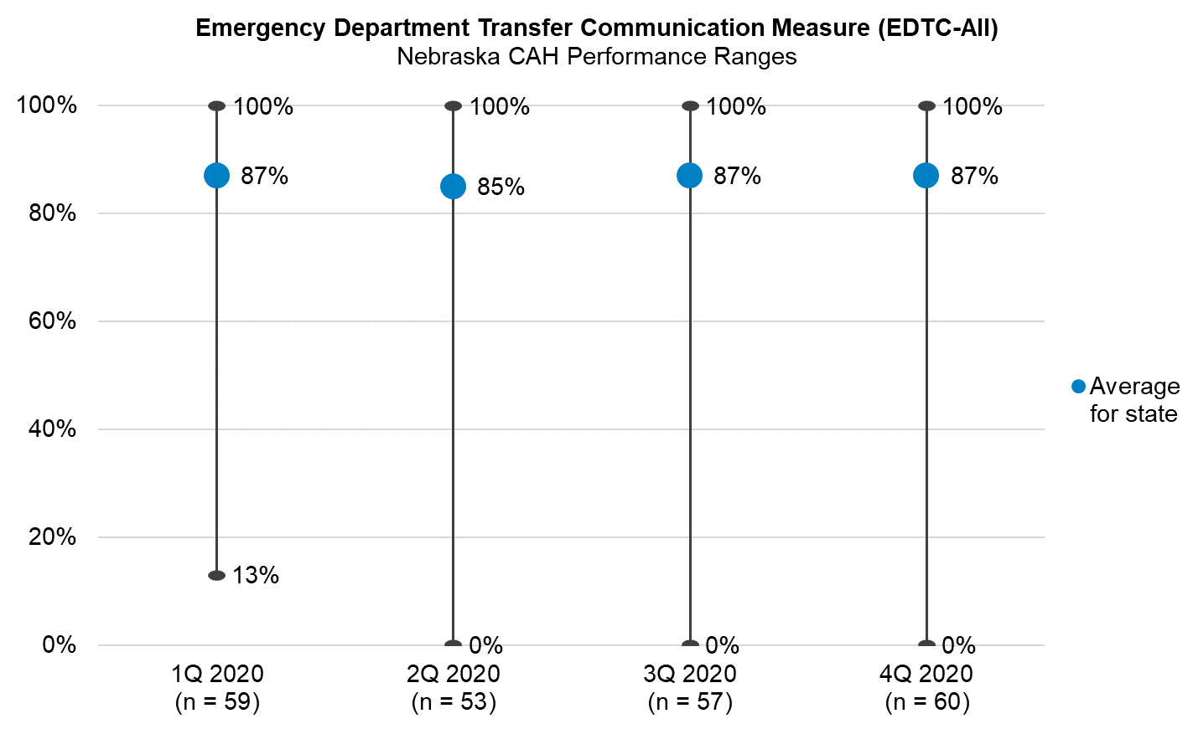
National CAH average for 4Q 2020: 90%
National CAH 90th Percentile in Q4 2020: 100%
Notes:
You can see that there is pretty wide variation among hospitals here regarding performance for EDTC all – in the three most recent performance periods – the range was from 0% to 100%.

Slide 41
HCAHPS
The most recent available HCAHPS data is for the time period of Q1 2019 – Q4 2019 encounters (released in October 2020)
HCAHPS reporting for Q1 2020 and Q2 2020 encounters was optional due to the Public Health Emergency
Next anticipated HCAHPS public reporting update is in July 2021, inclusive of Q4 2019 and Q3 2020 encounters
  Jan2020_Oct2021_ Technical Specifications _HCAHPS Public Reporting (hcahpsonline.org)

Slide 42

Core Elements of Hospital Antibiotic Stewardship
Leadership Commitment
Accountability
Drug Expertise
Action
Tracking
Reporting
Education

Slide 43
Core Elements – 2019
Nationally: 1,074 of 1,338 CAHs (80%) have completed the 2019 survey
Nebraska: 45 of 64 CAHs (70%) have completed the 2019 survey
# of Core Elements Met | % CAHs Nationally | NE CAHs | % NE CAHs
0 | <1% | 0 | -
1 | <1% | 0 | -
2 | <1% | 0 | -
3 | ~1% | 1 | 1.5%
4 | 2% | 1 | 1.5%
5 | 4% | 1 | 1.5%
6 | 8% | 4 | 6.3%
7 | 64% | 38 | 59.4%
Survey not completed | 20% | 19 | 29.7%
Notes:
2019 data updated 8/14/2020
1,338 CAHs obtained from Q4 2019 list of CAHs participating in MBQIP (source: EDTC Q4 2019, since PS-IP-OP Q4 2019 list unavailable at time of slides)

Slide 44
Leadership
Our facility has a formal statement of support for antibiotic stewardship (e.g., a written policy or statement approved by the board).
Facility leadership has demonstrated a commitment to antibiotic stewardship efforts by:
 | Communicating to staff about stewardship activities, via email, newsletters, events, or other avenues
 | Providing opportunities for staff training and development on antibiotic stewardship
 | Allocating information technology resources to support antibiotic stewardship efforts
Our facility has a committee responsible for antibiotic stewardship.
If a physician and/or pharmacist are leading antibiotic stewardship activities, are antibiotic stewardship responsibilities in their contract or job description?
43 NE CAHs
40 NE CAHs
42 NE CAHs
36 NE CAHs
43 NE CAHs
17 NE CAHs
Notes:
2019 data updated 8/14/2020

Slide 45
Accountability
Our facility has a leader (or co-leaders) responsible for antibiotic stewardship outcomes.
43 NE CAHs
Drug Expertise
Our facility has pharmacist lead or co-lead responsible for antibiotic stewardship
Our facility has a physician or other lead responsible for antibiotic stewardship and at least one pharmacist is responsible for improving antibiotic use at the facility.
34 NE CAHs
9 NE CAHs
Notes:
2019 data updated 8/14/2020

Slide 46
Leadership, Accountability, & Drug Expertise
Core Element | State Level (NE) | Nationally
Leadership | 45 out of 64 CAHs (70%) | 1,056 out of 1,338 CAHs (79%)
Accountability | 43 out of 64 CAHs (67%) | 1,014 out of 1,338 CAHs (76%)
Drug Expertise | 43 out of 64 CAHs (67%) | 989 out of 1,338 CAHs (74%)
Who is meeting the Leadership Core Element?
State Level: X out of X CAHs (XX%) are meeting the
Nationally: XXX out of 1345 CAHs (XX%)
Notes:
2019 data updated 8/14/2020

Slide 47
Action
Our facility has a policy or formal procedure for:
 | Required documentation of indication for antibiotic orders
 | Required documentation of duration for antibiotic orders
 | The treating team to review antibiotics 48-72 hours after initial order (i.e., antibiotic time-out)
 | The stewardship team to review courses of therapy for specific antibiotic agents and provide real-time feedback and recommendations to the treatment team (i.e., prospective audit and feedback)
 | Required authorization by the stewardship team before restricted antibiotics on the formulary can be dispensed (i.e., prior authorization)
32 NE CAHs
18 NE CAHs
30 NE CAHs
19 NECAHs
3 NE CAHs
Notes:
2019 data updated 8/14/2020

Slide 48
Action Cont’d
Providers have access to facility- or region-specific treatment guidelines or recommendations for commonly encountered infections.
Our facility targets select diagnoses for active interventions to optimize antibiotic use (e.g., intervening on duration of therapy for patients with community-acquired pneumonia according to clinical response)
44 NE CAHs
36 NE CAHs
Core Element | State Level (NE) | Nationally
Action | 45 out of 64 CAHs (70%) | 1,055 out of 1,338 CAHs (79%)
Notes:
2019 data updated 8/14/2020

Slide 49
Tracking
Our facility has a policy or formal procedure for required documentation of indication for antibiotic orders and our stewardship team monitors adherence to that policy or formal procedure.
Providers have access to facility- or region-specific treatment guidelines or recommendations for commonly encountered infections and our stewardship team monitors adherence to those guidelines or recommendations.
Our stewardship team monitors:
 | Antibiotic resistance patterns
 | Antibiotic use in days of therapy (DOT) per 1000 patient days or days present, at least quarterly
 | Antibiotic use in defined daily doses (DDD) per 1000 patient days, at least quarterly
 | Antibiotic expenditures (i.e., purchasing costs), at least quarterly
29 NE CAHs
36 NE CAHs
35 NE CAHs
23 NE CAHs
9 NE CAHs
8 NE CAHs
Notes:
2019 data updated 8/14/2020

Slide 50
Reporting
Our facility has a policy or formal procedure for the stewardship team to review courses of therapy for specific antibiotic agents and provide real-time feedback and recommendations to the treatment team (i.e., prospective audit and feedback)
If antibiotic use in DOT, DDD, or some other means of monitoring are selected, our stewardship team provides individual-, unit-, or service-specific reports on antibiotic use to prescribers, at least annually.
Our stewardship team provides the following updates or reports, at least annually:
 | Updates to facility leadership on antibiotic use and stewardship efforts
 | Outcomes for antibiotic stewardship interventions to staff
19 NE CAHs
18 NE CAHs
38 NE CAHs
21 NE CAHs
Notes:
2019 data updated 8/14/2020

Slide 51
Tracking & Reporting
Core Elements | State Level (NE) | Nationally
Tracking | 44 out of 64 CAHs (69%) | 1,024 out of 1,338 CAHs (77%)
Reporting | 41 out of 64 CAHs (64%) | 960 out of 1,338 CAHs (72%)
Who is meeting the Leadership Core Element?
State Level: X out of X CAHs (XX%) are meeting the
Nationally: XXX out of 1345 CAHs (XX%)
Notes:
2019 data updated 8/14/2020

Slide 52
Education
Which of the following groups receive education on appropriate antibiotic use at least annually? (Check all that apply)
 | Prescribers
 | Nursing staff
 | Pharmacists
33 NE CAHs
26 NE CAHs
35 NE CAHs
Core Element | State Level (NE) | Nationally
Education | 41 out of 64 CAHs (64%) | 960 out of 1,338 CAHs (72%)
Notes:
2019 data updated 8/14/2020

Slide 53
Using Data and Driving Quality Improvement

Slide 54
MBQIP Data Analysis Resources
Interpreting MBQIP Hospital Data Reports for Quality Improvement
  https://www.ruralcenter.org/tasc/resources/interpreting-mbqip-hospital-data-reports-quality-improvement
How Small is Too Small?
  https://www.ruralcenter.org/resource-library/how-small-is-too-small
Eliminate the Denominator
  https://www.ruralcenter.org/resource-library/eliminate-the-denominator

Slide 55

MBQIP Monthly
https://www.ruralcenter.org/tasc/mbqip/mbqip-monthly
CAHs Can!
Data: CAHs Measure Up
Tip: Robyn Quips
Tools and Resources

Slide 56

Quality Time: Sharing PIE
(performance improvement experience)
https://stratishealth.org/quality-time-sharing-pie/
CAH QI Mentors share lessons learned, strategies, tips, and ideas from their in-the-field performance improvement experience.
Listen online or wherever you get your podcasts.

Slide 57
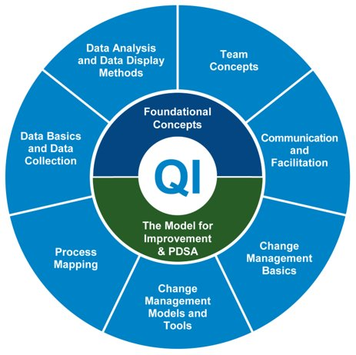
Quality Improvement Basics Course
https://stratishealth.org/quality-improvement-basics/
11 didactic modules including videos, slides, and transcripts
  Can be completed in sequence or stand-alone
Templates and tools
Facilitator Guide and Sample Syllabus also available

Slide 58
Quality Improvement Implementation Guide & Toolkit for CAHs
https://www.ruralcenter.org/resource-library/quality-improvement-implementation-guide-and-toolkit-for-cahs
QI Implementation Guide
QI Measure Summaries
Brainstorming Tool
Internal Quality Monitoring Tool
Project Action Plan Template
Meeting Agenda Template
Rapid Tests of Change Tool
Prioritization Tool
Internal Quality Monitoring Tool
10-Step QI Project Documentation Template

Slide 59

Suggested Strategies for Improving MBQIP Measures
Part of the Quality Improvement Implementation Guide and Toolkit for CAHs
Suggested promising strategies for QI for each of the MBQIP Core Measures
  https://www.ruralcenter.org/resource-library/quality-improvement-implementation-guide-and-toolkit-for-cahs

Slide 60

HCAHPS Best Practices
Best practices for improving HCAHPS as collected from high performing CAHs
Includes strategies for increasing response rates and performance in each of the HCAHPS domain
  https://www.ruralcenter.org/resource-library/study-of-hcahps-best-practices-in-high-performing-cahs

Slide 61
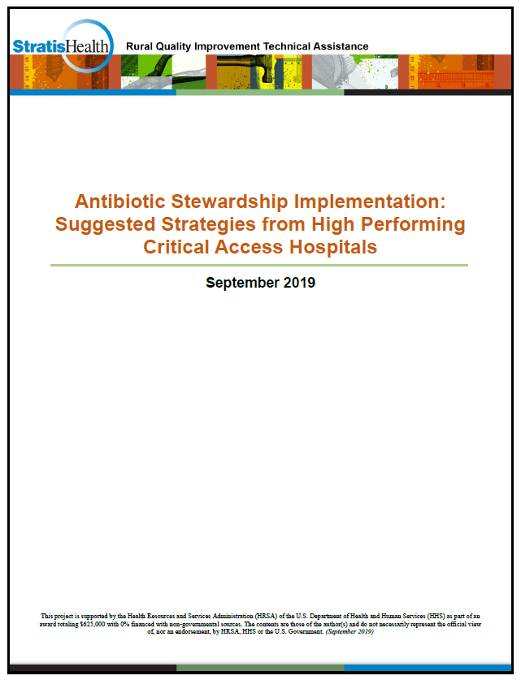
Antibiotic Stewardship Strategies
Best practices for improving implementing AS collected from high performing CAHs
Aligned with the Centers for Disease Control & Prevention 7 core elements of antibiotic stewardship
  https://www.ruralcenter.org/resource-library/antibiotic-stewardship-implementation-suggested-strategies-from-high-performing

Slide 62
Questions & Discussion
What will you take from this presentation?

Slide 63
Questions?
Sarah Brinkman
Program Manager
952-853-8552 sbrinkman@stratishealth.org
www.stratishealth.org
Robyn Carlson
Quality Reporting Specialist
952-853-8587 rcarlson@stratishealth.org

Slide 64
Stratis Health is a nonprofit organization that leads collaboration and innovation in health care quality and safety, and serves as a trusted expert in facilitating improvement for people and communities.
This project is supported by the Health Resources and Services Administration (HRSA) of the U.S. Department of Health and Human Services (HHS) as part of an award totaling $625,000 with 0% financed with non-governmental sources. The contents are those of the author(s) and do not necessarily represent the official view of, nor an endorsement, by HRSA, HHS or the U.S. Government. (07/2021)

