Slide 1
HOUSING IS HEALTH CARE
The primary and essential function of housing, to provide a safe and sheltered space, is absolutely fundamental to the people’s health and well-being.
– Dearbhal Murphy
Notes:
Naomi
*messaging is important
*if our journalists, media, neighbors aren't on the same page as the needed change, we are missing a key component to sustainable impact
*talk about community fundraising effort

Slide 2
Affordable housing is an investment in our health.
Issues such as frequent moves, struggling to pay rent, an eviction or foreclosure, poor conditions—can cause physical and mental health issues, or make existing conditions worse.
Notes:
Naomi
*messaging is important
*if our journalists, media, neighbors aren't on the same page as the needed change, we are missing a key component to sustainable impact
*talk about community fundraising effort

Slide 3
PHYSICAL HEALTH IMPACTS
Physical health impacts of housing are especially pronounced for children, who are in a critical stage of their physical, emotional, and intellectual development.
Children who experience housing instability or homelessness have a 25% greater risk of poor health in adulthood. Stable housing, however, can reduce healthcare costs and improve lifelong health for children and adults. Research consistently documents the impacts of housing instability on our health. It shows direct links between housing instability and childhood nutrition, healthy development, and asthma. For example, children living in poor-quality housing make nearly 60 percent more visits to the emergency room due to asthma.
Also, a child living with housing insecurity is almost 30 percent more likely to be underweight, and nearly 20 percent more likely to have poor nutrition.
Notes:
Naomi
* an example of messaging and marketing comes from an early project
* explain NCS
* talk about media and journalism / #WordsMatter

Slide 4
LOCAL NUMBERS
Approximately 15% of households in the Omaha and Council Bluffs area (21,500 households) pay more than half of their income on housing (45% of renters spend more than 30%, 19% of homeowners spend more than 30%) —a strong risk factor for housing instability.
An estimated 20,000 children live in these households, meaning that these 20,000 children are at higher risk of the health issues associated with unstable housing and poor housing conditions. By providing more stable housing to these families, each of these children would have a better chance at developing into healthy young adults.
Notes:
Naomi
* an example of messaging and marketing comes from an early project
* explain NCS
* talk about media and journalism / #WordsMatter

Slide 5
DECREASED HEALTH RISKS & ECONOMIC BENEFITS
When individuals and families have access to safe, quality, and affordable housing, their correlating health risks decrease. One economic benefit of a focus on safe affordable housing is when households are not required to pay more than 30% of their income on rent or mortgage, and utilities.
By reducing this housing cost burden, households can instead prioritize access and financial resources for health care, foods that are healthy for their individual needs, and transportation to/from physical and mental health care.
Notes:
Naomi
* an example of messaging and marketing comes from an early project
* explain NCS
* talk about media and journalism / #WordsMatter

Slide 6
Notes:
Meridith

Slide 7
Our charge…
to identify housing initiatives for philanthropy to support equitable growth in the community
Notes:
Meridith

Slide 8
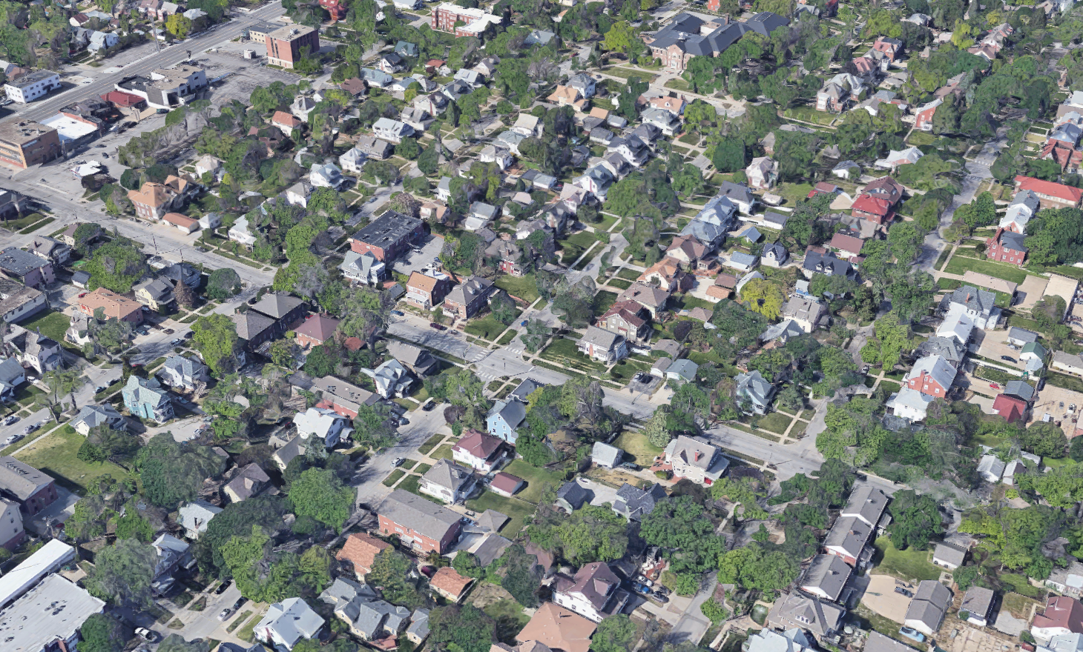
Housing Challenges
Housing cost burden is prevalent in the region, particularly impacting renters, black, indigenous, and people of color, refugee and immigrant neighbors, and it is all escalating amid COVID-19
Some areas—including those that are currently more “affordable”—are experiencing the most rapid rent and/or home value increases, leaving current residents at risk of displacement
Demand for quality affordable and workforce housing is growing far more quickly than the current system produces it
There is a need for dedicated affordable housing in areas that support access to amenities (jobs, transit, education, services)
Thousands of units will lose affordability restrictions without preservation action
Notes:
Meridith

Slide 9
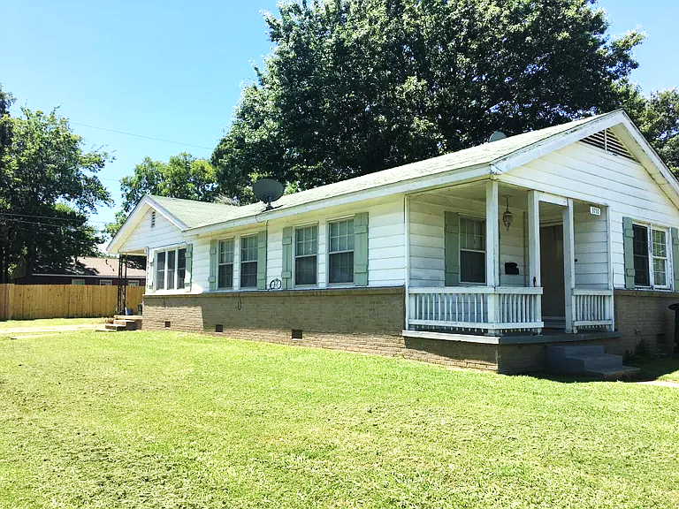
Understanding affordability is a critical starting point for the conversation.
$987
per month
to rent a 2-bedroom unit
of safe and decent quality, including utilities
$19/hr
housing wage
bare minimum to afford a 2-bedroom unit of safe and decent quality plus utilities
Based on FY21 HUD Fair Market Rent for Omaha-Council Bluffs, NE-IA HUD Metro
Calculated based on a $930 FMR (gross rent), assuming 30% of income toward rent and utilities, full-time employment
Notes:
Meridith

Slide 10
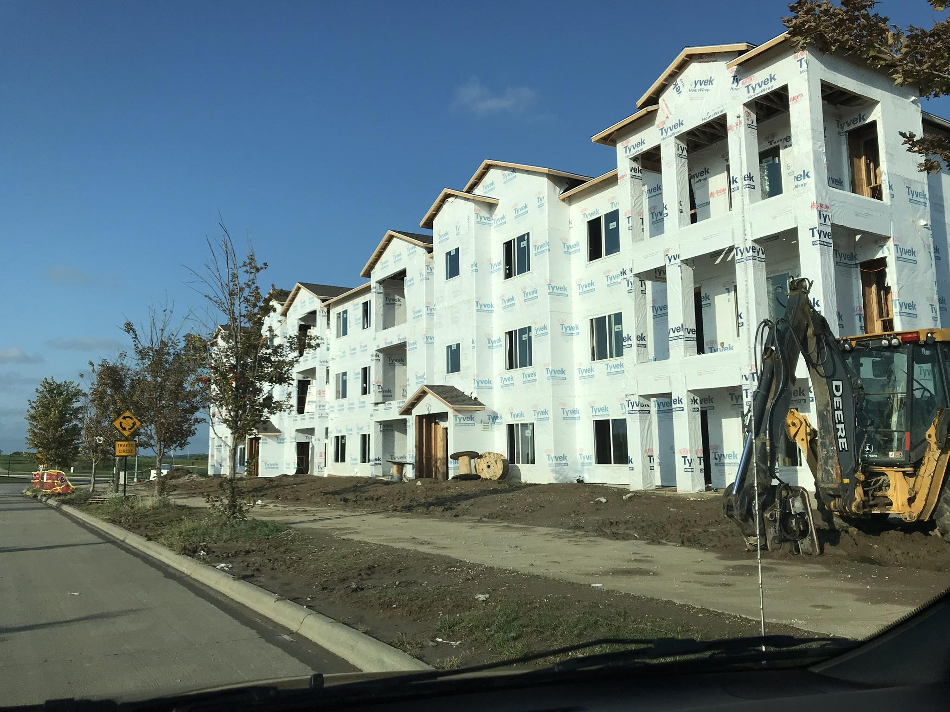
AFFORDABLE HOUSING SUPPLY
IN COMPARISON TO NEED
129,600
HHs qualify
gap of
104k
units
subsidized affordable housing
1.6%
annual growth
98,500
HHs qualify
gap of
78,800 units
subsidized affordable housing
300 units
per year
+6,000
new units
subsidized
households
19,730
2020
2040
Source: production based on past 10 years of LIHTC allocations; demand based on estimate of households with incomes below 60% AMI; growth based on Heartland 2050
Notes:
Meridith

Slide 11
WHAT TYPES OF HOUSING ARE NEEDED?
SUMMARY OF 20-YEAR DEMAND FOR OMAHA & COUNCIL BLUFFS AREA
SUBSIDIZED
LOW-INCOME
AFFORDABLE
WORKFORCE
MODERATE
UPSCALE
< 30% AMI
30 – 50% AMI
50 - 80% AMI
80 – 120% AMI
120 - 150% AMI
150 - 200% AMI
< $22k/YR
$22k - $37k/yr
$37k – 58k/yr
$58k - $88k/yr
$88k - $110k/yr
$110k - $146k/yr
new construction requires subsidy
rental demand (current / future)
for-sale demand (current / future)
Source: ESRI, NOVOCO, definitions established assuming 2.55-person household, the average household size for the study area
Notes:
Meridith

Slide 12
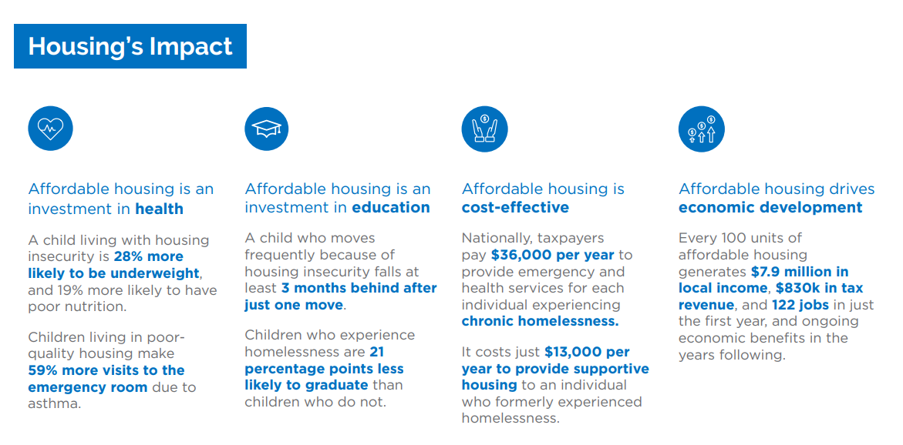
Notes:
Meridith

Slide 13
1
Accelerate the production of quality, dedicated affordable housing
2
Preserve and improve the quality of existing affordable housing
3
Prevent and address housing instability and homelessness
4
Foster innovations that reduce the cost of providing quality affordable housing
5
Provide relief and assistance to residents in neighborhoods experiencing gentrification
Notes:
Meridith

Slide 14
Front Porch Investments was created as a response to the demand for strategic investment and coordinated leadership in the areas of affordable housing and homelessness prevention, including the implementation of the strategic framework and solutions identified in the Assessment of Housing Affordability, Needs, & Priorities report.
Notes:
Meridith

Slide 15
Notes:
Meridith

Slide 16
Notes:
Meridith

Slide 17
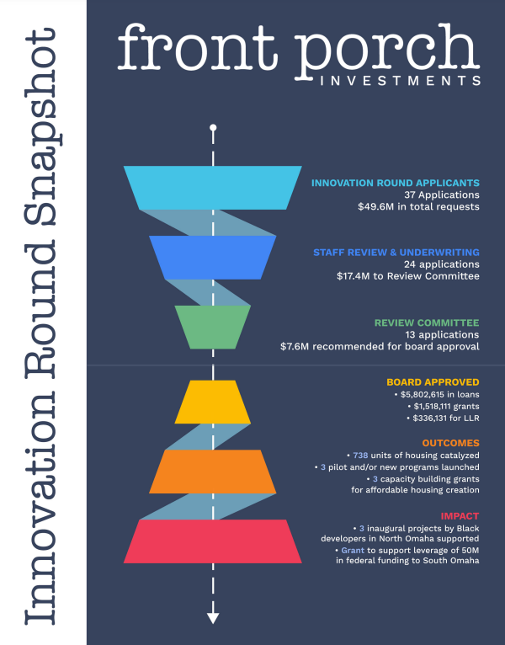
Process & Awards
2 week application cycle
37 applicants
49.6M in requests
Awarded over 7M
5.8M in loans ranging from
18 months to 18 years
1.5M in grants
Outcomes & Impact
Over 700 units of mixed income & affordable housing
3 pilot & new programs launched
Supporting emerging developers
Leveraging public & private partnerships
Innovation Round Successes
Notes:
Meridith

Slide 18
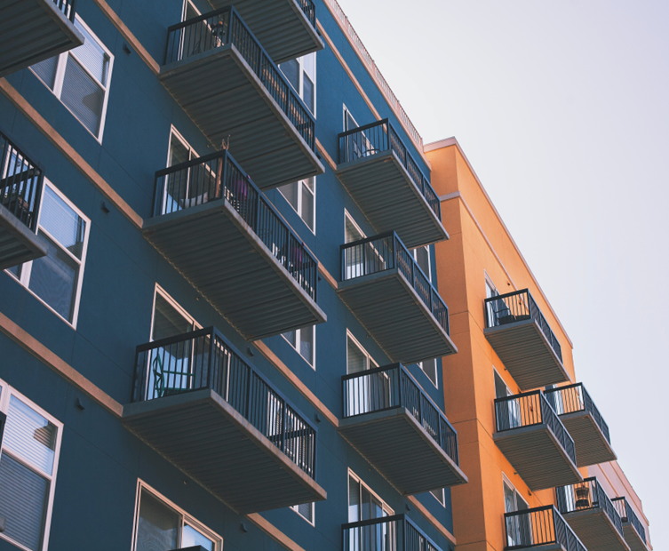
Development & Preservation Fund
The broad goals of the Development and Preservation Fund as identified in the assessment are to:
Fund Launch
City of Omaha ARPA partnership
Fall Funding Round
Future Opportunities
Provide gap financing for the development of new affordable housing, including mixed-income rental housing, the creation of affordable housing in areas near job centers and transit, and transformative “catalyst” projects in neighborhoods undergoing broader revitalization efforts.
Provide needed gap financing to preserve and improve the quality of at-risk dedicated affordable rental housing, as well as “naturally occurring” affordable housing properties in deteriorating condition or at risk of conversion to market-rate.
Notes:
Meridith
With the launch of the Development and Preservation Fund on Monday, we are executing on two of the recommendations contained in the Assessment of Housing Affordability report. This fund is designed to support the development of new affordable housing, the preservation of existing affordable housing, and the programs that help connect low to moderate income renters and homebuyers to these opportunities.

Slide 19
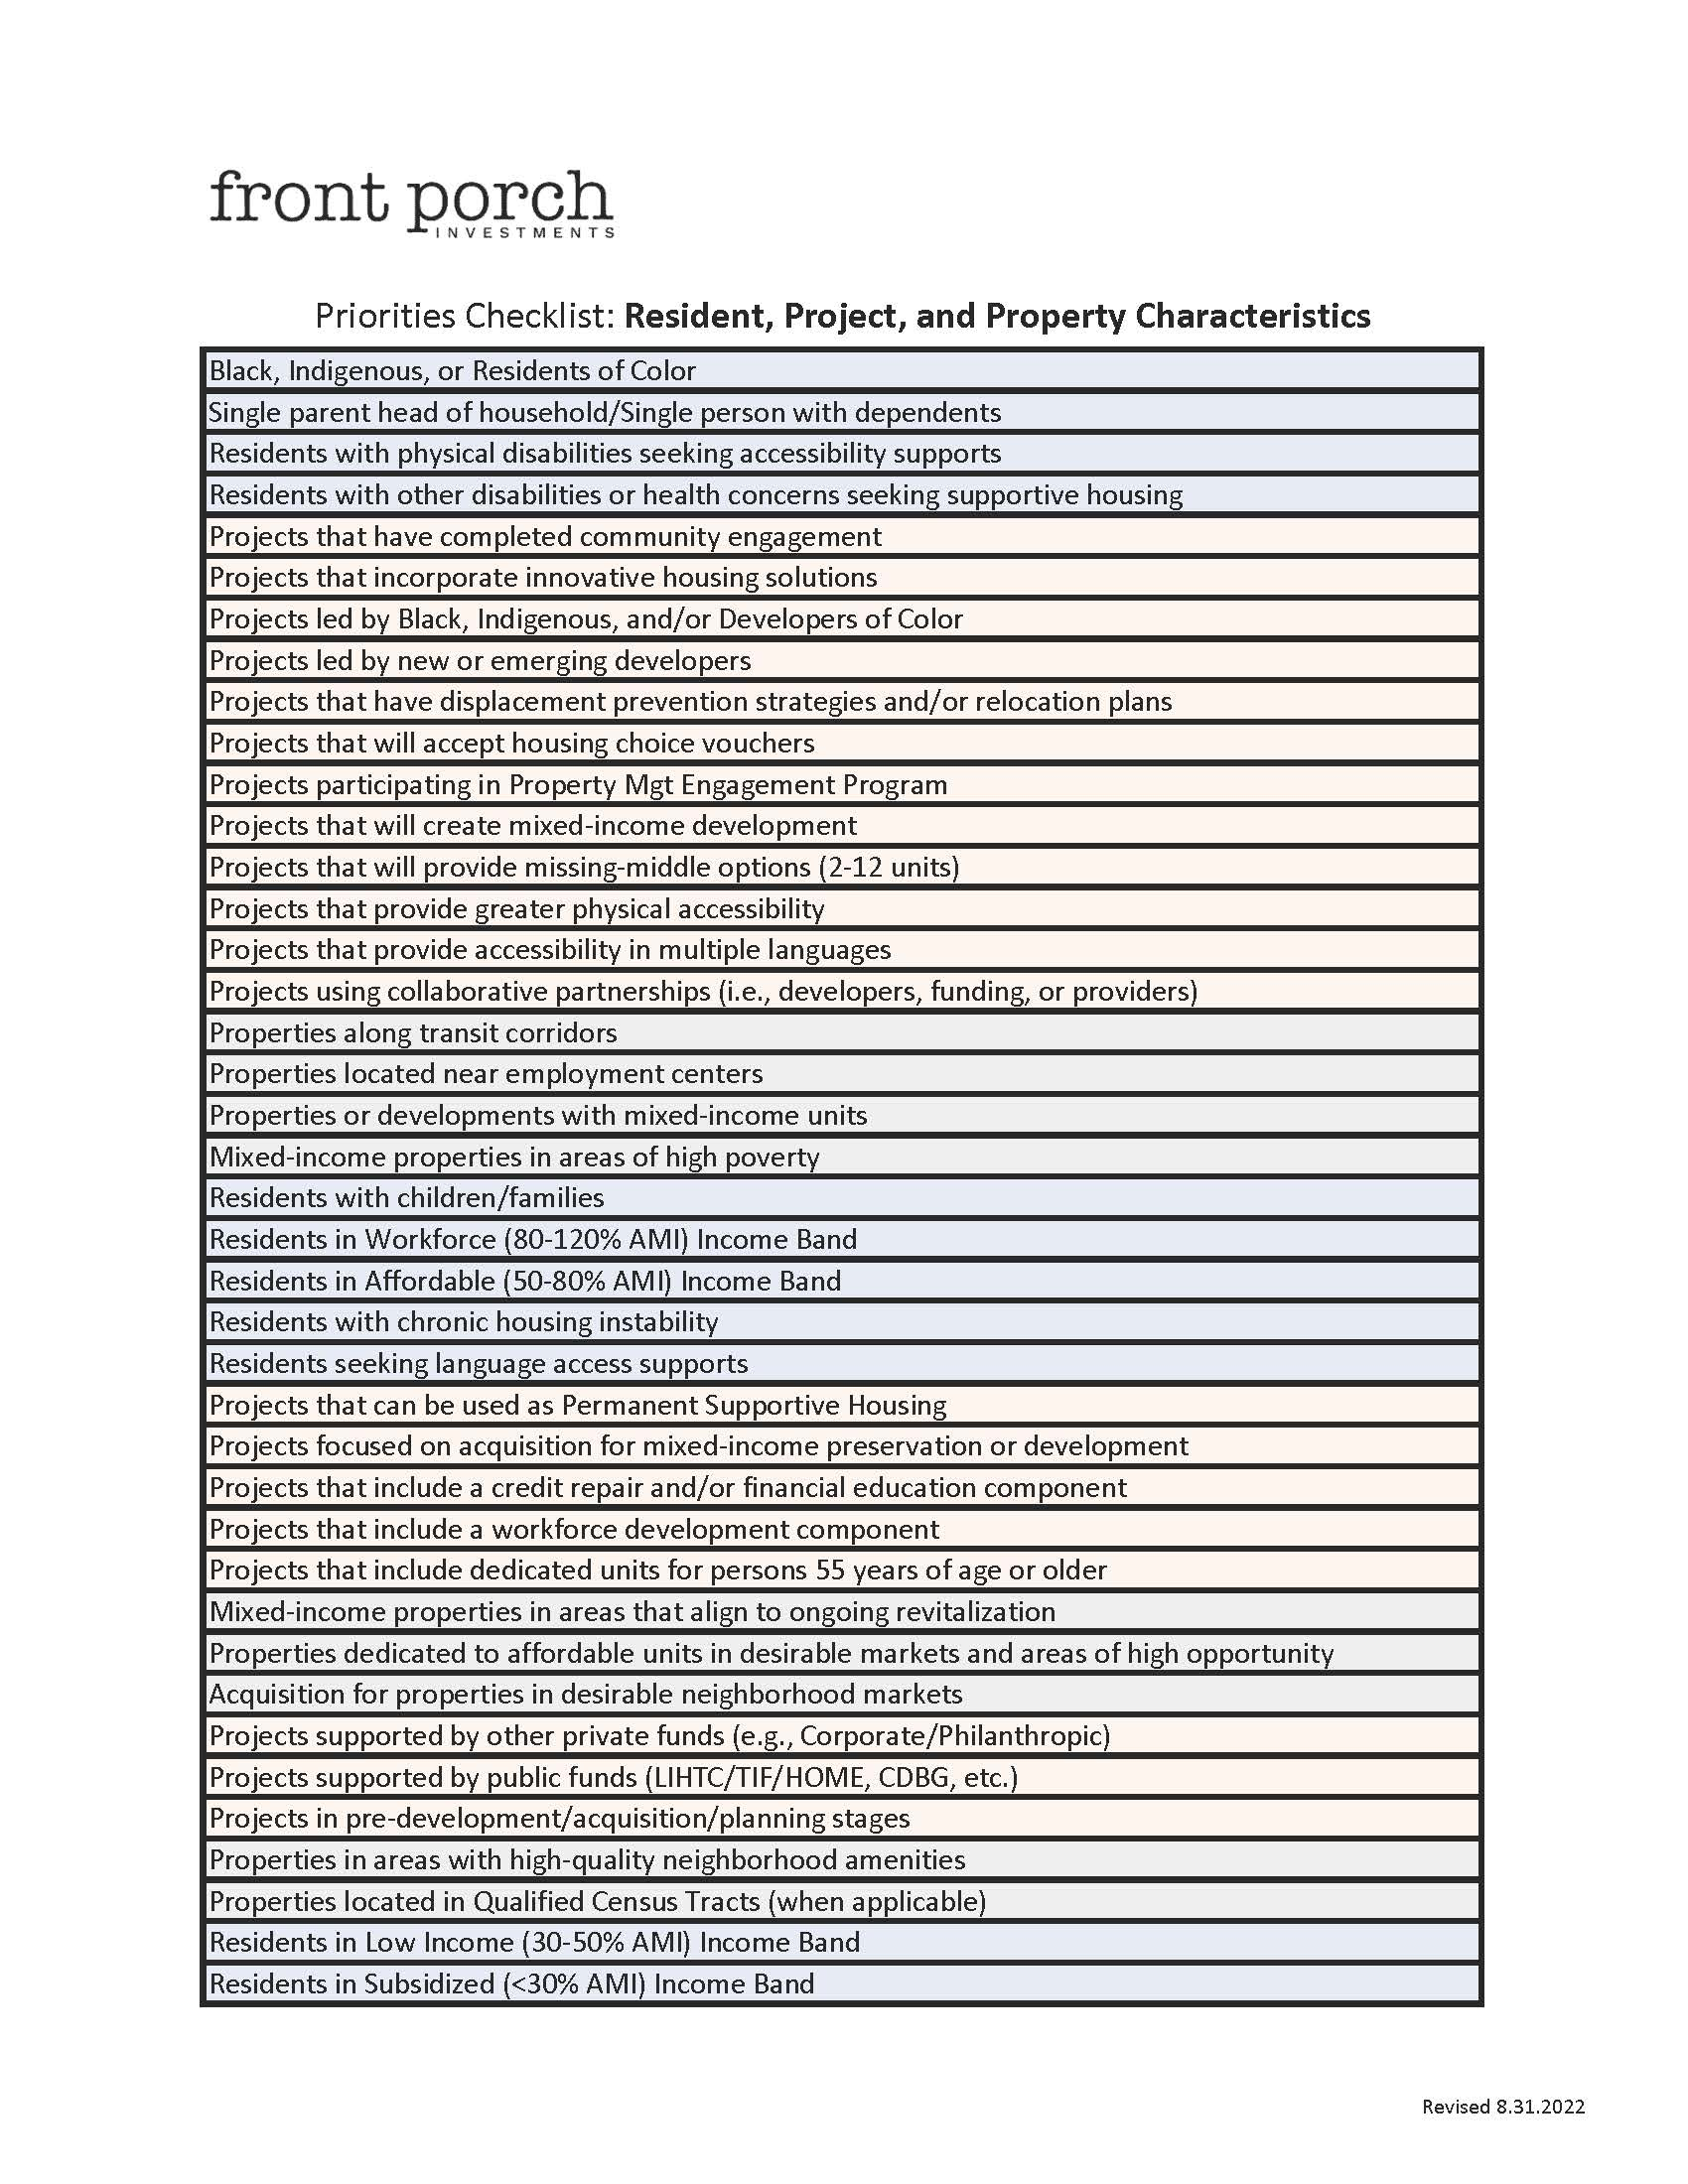
Front Porch Priorities
Notes:
Meridith
With the launch of the Development and Preservation Fund on Monday, we are executing on two of the recommendations contained in the Assessment of Housing Affordability report. This fund is designed to support the development of new affordable housing, the preservation of existing affordable housing, and the programs that help connect low to moderate income renters and homebuyers to these opportunities.

Slide 20
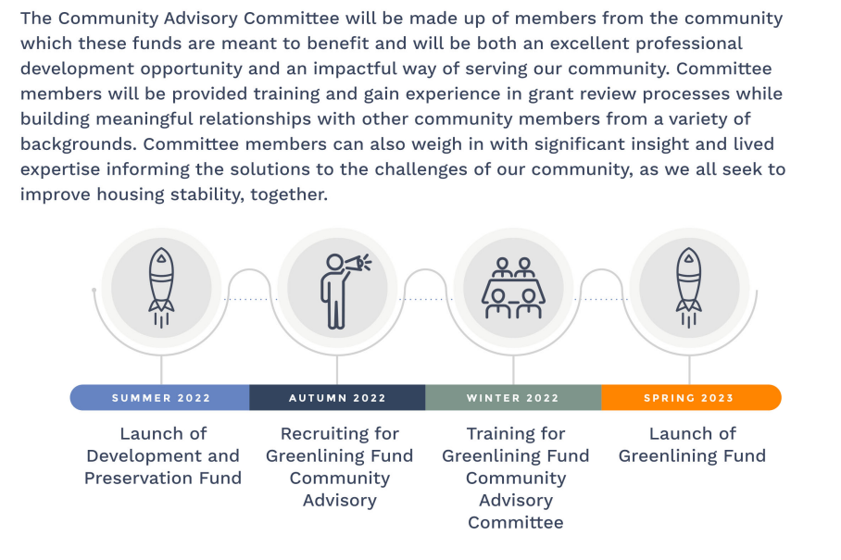
Greenlining Fund
Notes:
Naomi
*intentional investment in formerly redlined census tracts
* CAC
* priorities for investment: down payment assistance, home equity loans, property tax relief fund

Slide 21
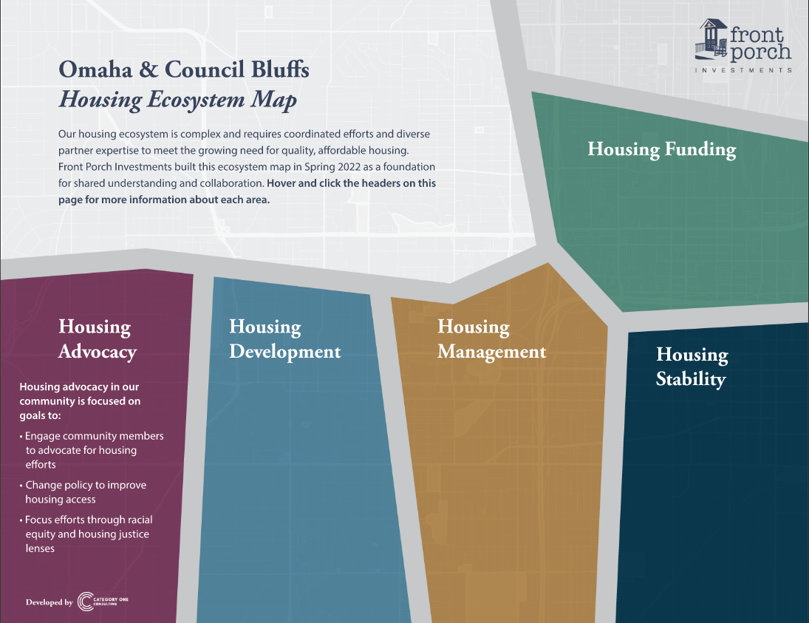
Ecosystem Mapping
The Complexity of Affordable Housing, the Challenge, and How You Can Be a Part of the Solution
Notes:
Naomi
* importance of inviting **everyone** to the table
* to do that, we need to lay out the visual of how it is all connected

Slide 22
Solutions:
* Omaha Medical Respite
A short-term, post-acute care for persons experiencing homelessness who are too ill or frail to recover from a physical illness or injury on the streets or in shelter but are not ill enough to be in a hospital.
* University of Illinois Hospital
Better Health Through Housing, a partnership with the Center for Housing and Health, aims to reduce healthcare costs and provide stability for the chronically homeless by moving individuals directly from hospital emergency rooms into stable, supportive housing, with intensive case management. The UI Health Hospital & Clinics committed funding to help launch the initiative, and it is the only Chicago-area hospital working on this type of healthcare-and-housing enterprise.
What can you do?​
Notes:
Naomi
*messaging is important
*if our journalists, media, neighbors aren't on the same page as the needed change, we are missing a key component to sustainable impact
*talk about community fundraising effort

Slide 23
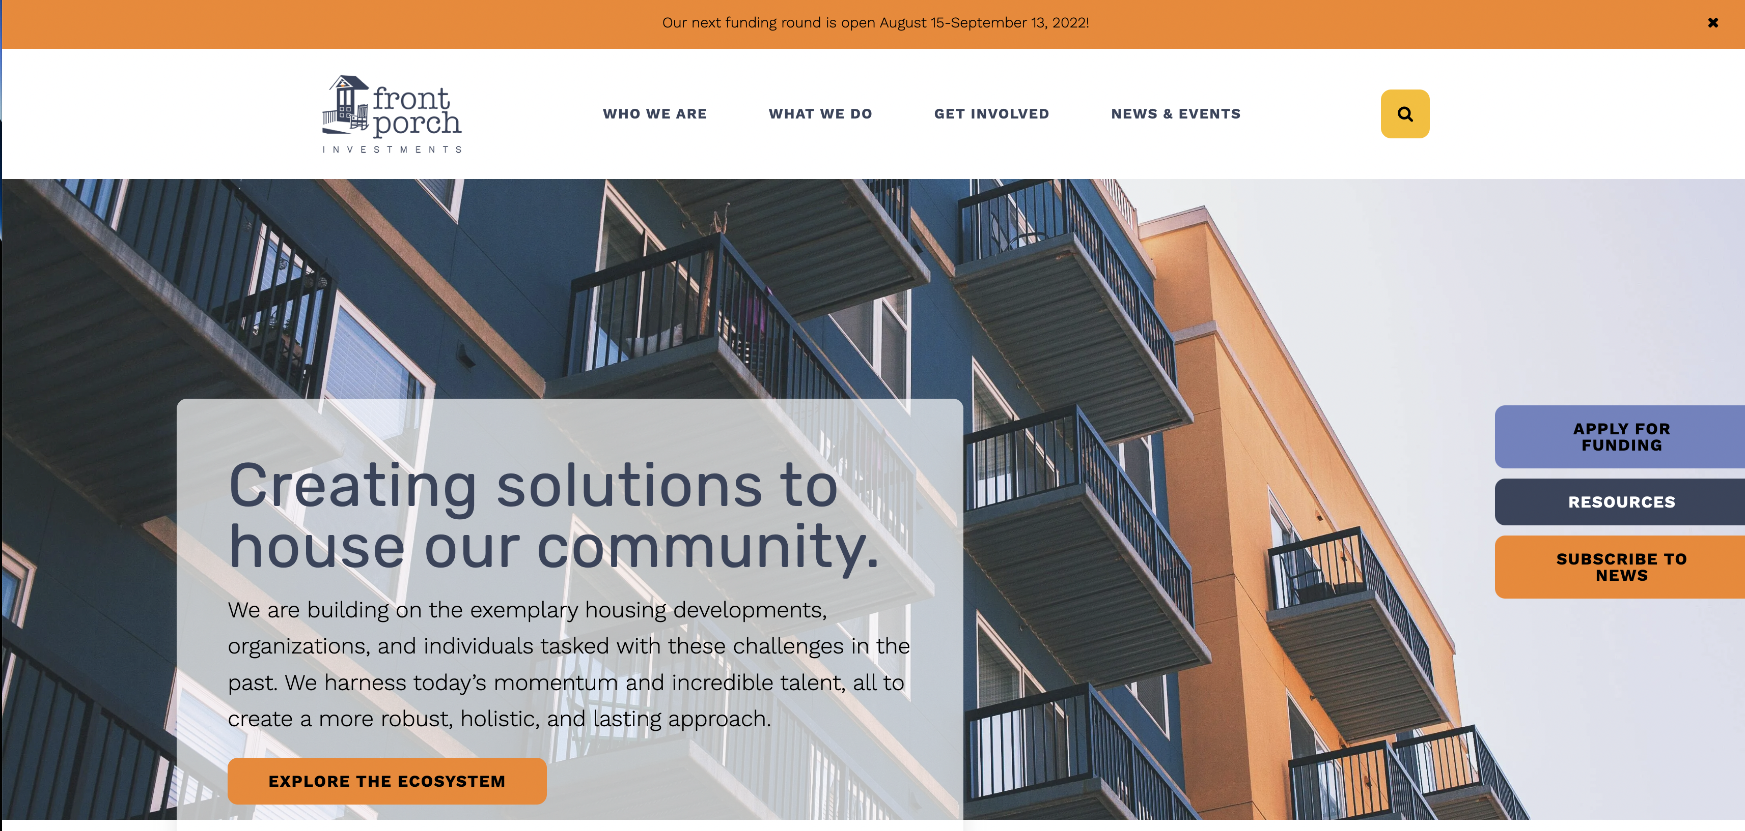
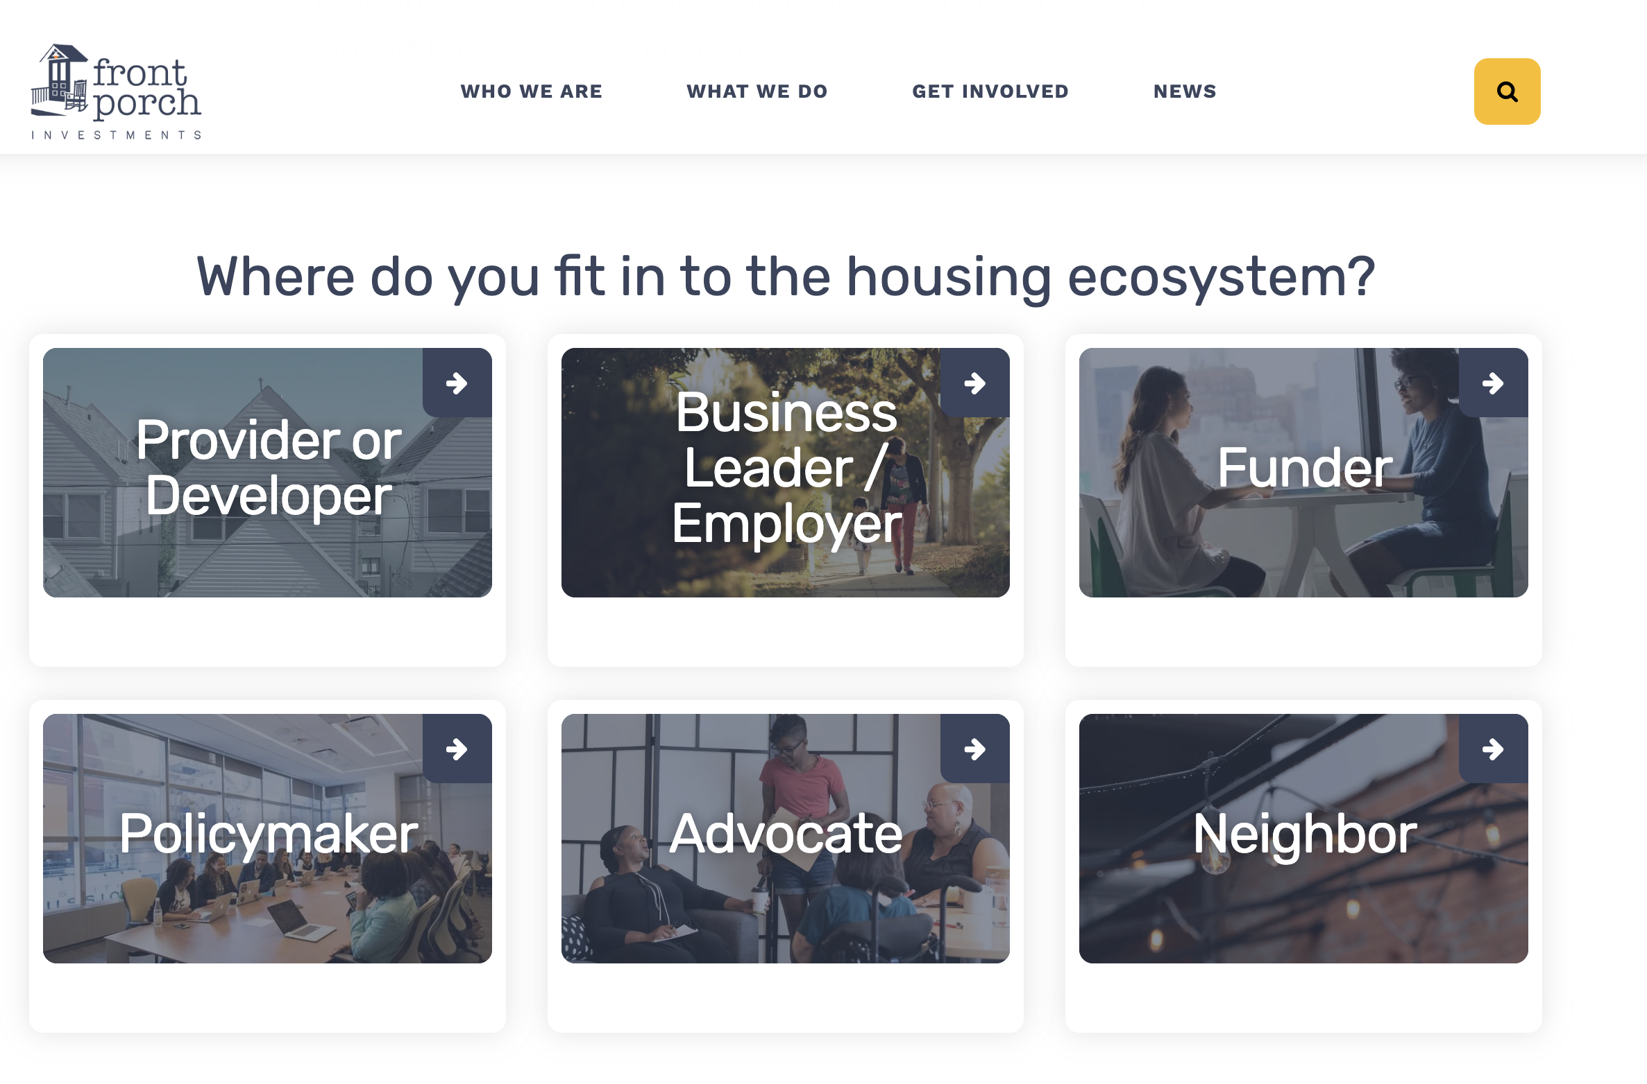
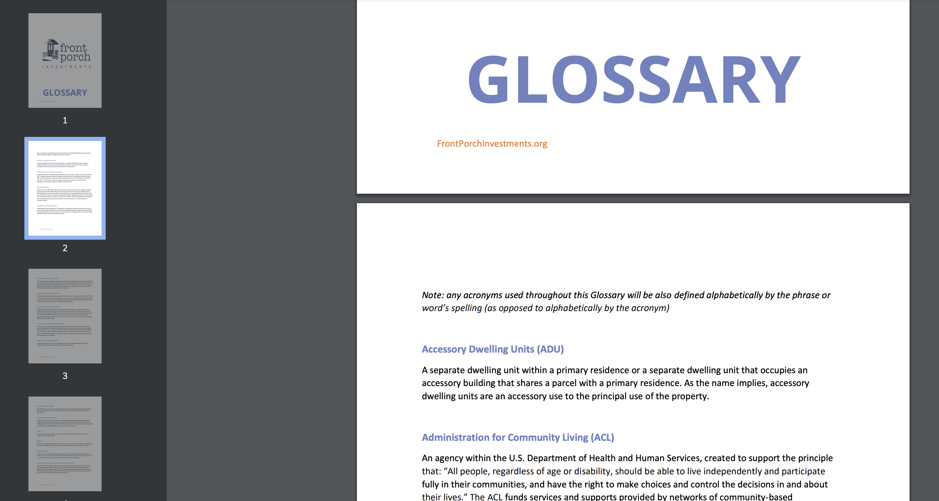
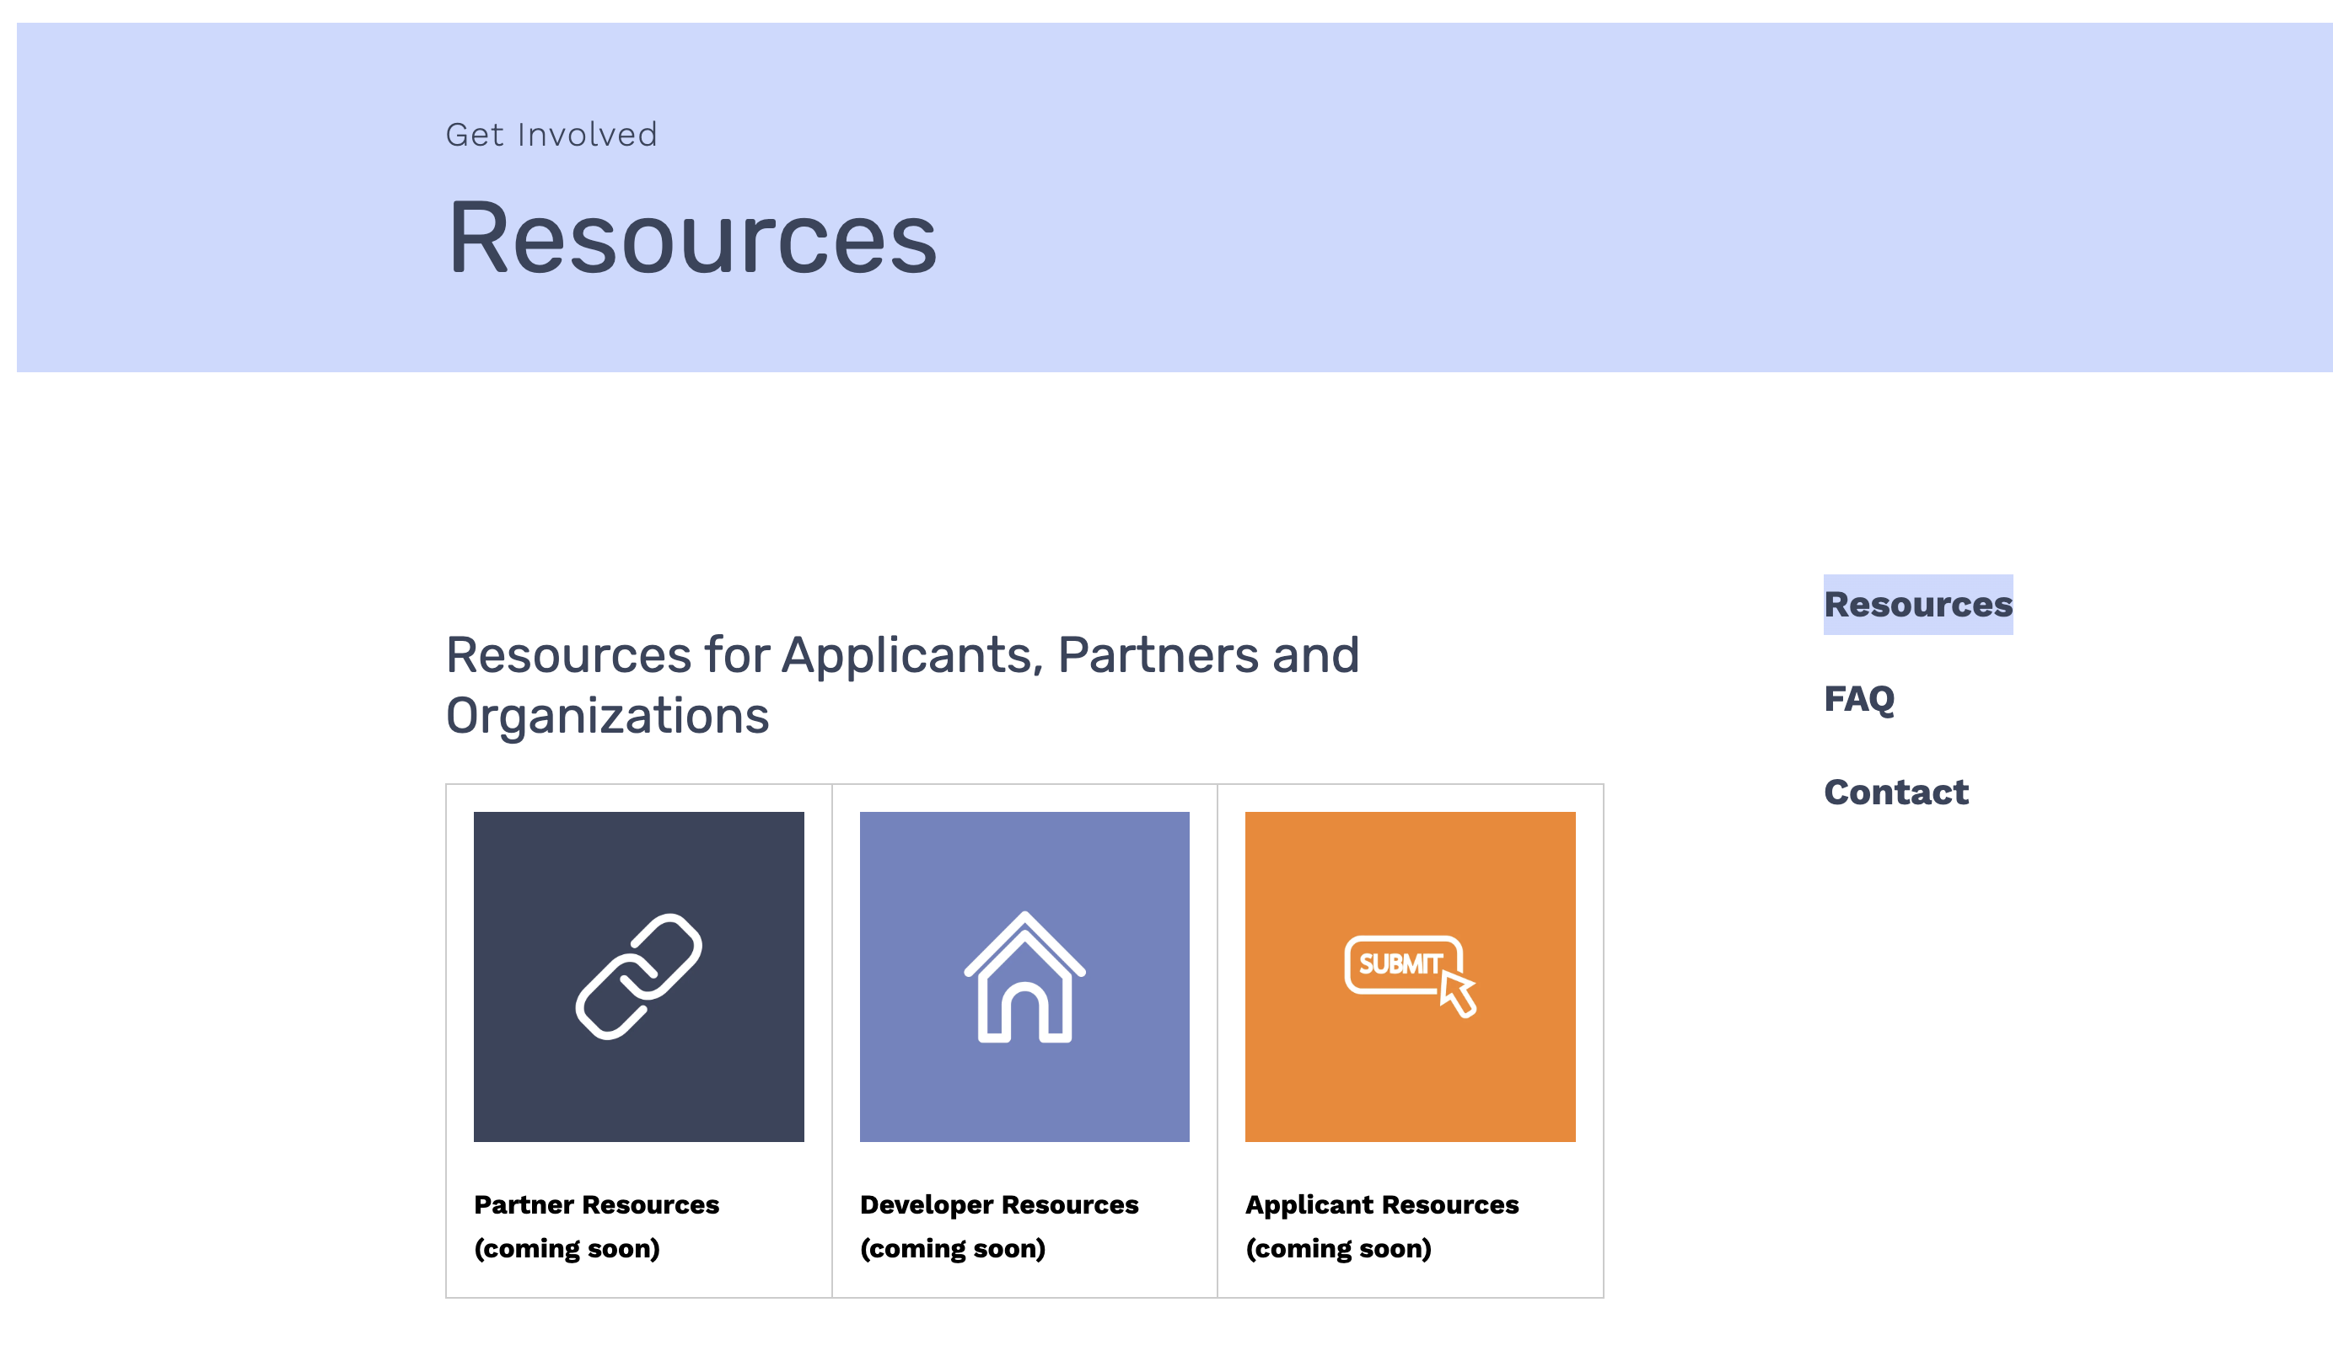
Website
Notes:
Naomi
* Not only did we need to lay out a visual in order to market and promote the ecosystem of affordable housing, we also needed to bring users along for the journey
* showcase the learning paths
* showcase the Glossary and "Affordable Housing – a definition" article
* we knew we needed to change the WORDS folks are using when they talk about affordable housing and homelessness prevention work

Slide 24
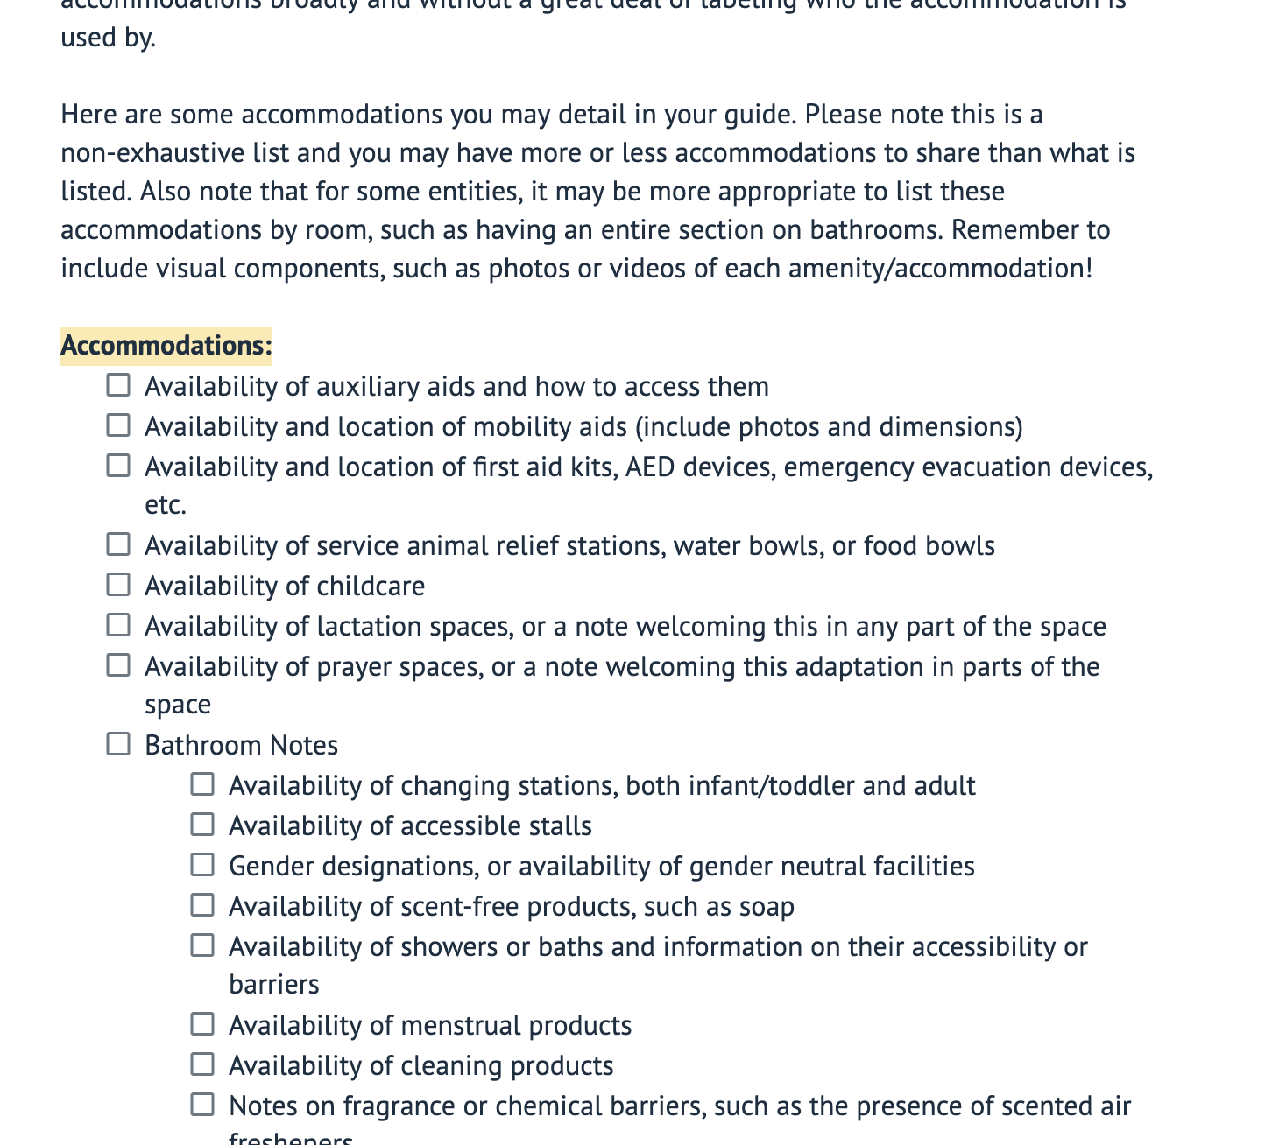
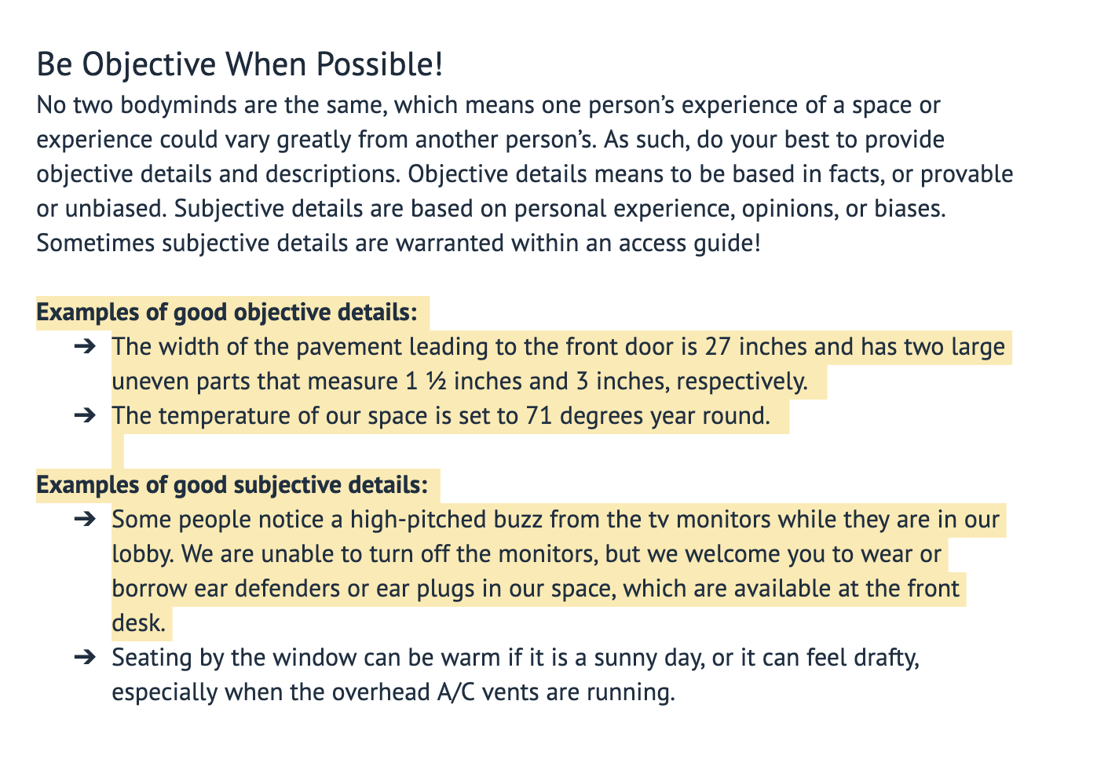
ACCESS GUIDES
A work in progress example at the non congregate site
USER GUIDE
OBJECTIVE DESCRIPTIONS
ACCOMMODATIONS
Notes:
Naomi
*showcase screenshots of the NCS Access Guide
*marketing of services should be for ALL people

Slide 25
Notes:
NAOMI turn it back over to Meridith

