Slide 1
QI Residency Capstone
Reducing Turn Around Time for Head CTs and Improving Documentation for Patients Presenting to Emergency Department with Stroke Symptoms
Presented by: Katie Neujahr, Quality Coordinator

Slide 2
Background
Franciscan Healthcare is a 25-bed critical access hospital with a 6 bed Emergency Department in West Point, NE
In 2022, 22% of patients who met the hospital stroke measure had a CT completed within 45 minutes. 70% of patients that presented to the Emergency Department with stroke like symptoms had a last known well documented.
Hospital measure OP-23 is a measure that our Quality and Radiology departments have been reporting and auditing since 2019. However; have been unable to make sustainable improvements on this measure.
An internal review and discussion with staff demonstrated the need for improvement with the consistency and promptness of transfer to CT and documentation for stroke patients.
Team members: Katie Neujahr-Quality Coordinator, Dave Ridder-ER Manager, Jami Brester-Patient Care Manager, William Hagemann-Patient Care Manager, Danelle Ehrisman-Radiology Manager, Kristine Jahnke-PA-C Physician Champion

Slide 3
AIM Statement
Patients that present with stroke symptoms or altered mental status will have a head CT completed, read, and results to physician within 45 minutes 70% of the time by the end of 2023. The state rate is 63% and national rate is 69%.
By the end of 2023, patients with stroke like symptoms will have last known well properly documented 100% of the time.

Slide 4
Interventions and Improvements
Educate nursing staff on what signs and symptoms to look for when deciding to utilize the stroke protocol.
Educate nursing staff on the importance of documentation of last known well.
Audit if Emergency Medical Services notifies the Emergency Department staff when bringing a patient to the Emergency Department. We have 11 community squads that transport patients to our facility.
Audit the time of arrival to Emergency Department to time CT completed, read, and resulted.
Notes:
Timeline of when Audit was started for EMS and how many times they have not called ahead of time when bringing a patient into the emergency room
Make sure to note that shortly after the audit started there was a trauma review in which the ER manager emphasized the importance of calling ahead of time so they can call in the radiology tech. Do not have radiology in house 24/7

Slide 5
Measuring Success
Nursing staff audits completed monthly by nurse manager as well as two staff nurses. The results from the audit are reported quarterly at the quality meeting and data submitted to American Heart Association: Get with the Guidelines- Stroke.
The audit looks at these 8 areas:
Arrival time
Reason for visit (“Five sudden, severe, symptoms” of stroke)
If the stroke protocol was used upon admission
NIHSS documented score
The time CT head was performed
Patient Diagnosis
The amount of time it took to complete CT- goal is to be within 30 minutes
The arrival time to ED and time CT is resulted and read
Emergency Medical Service (EMS) Audit
Started auditing if EMS was notifying staff before bringing patients to the ED in August.
95% (63/66) of the time EMS or Dispatch notified nursing staff before bringing the patients to the ED
Notes:
Make sure to note that shortly after the audit started there was a trauma review in which the ER manager emphasized the importance of calling ahead of time so they can call in the radiology tech. Do not have radiology in house 24/7

Slide 6
Notes:
Add in previous year data

Slide 7
Notes:
Add in previous year data

Slide 8
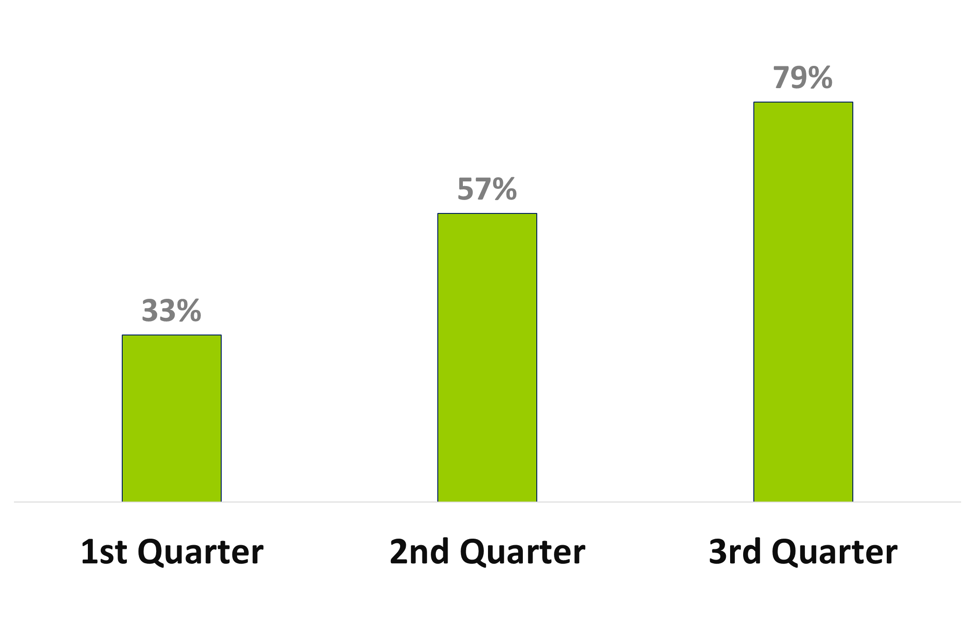
2023: Percentage of Last Known Well documented with stroke like symptoms
n-size 15
n-size 30
n-size 14
Top 10 Percent Benchmark: 100%
Notes:
Add in previous year data

Slide 9
Internal Benchmark- 70%
Notes:
Add in previous year data

Slide 10
2023: CTs for Patients Presenting with Stroke Like Symptoms Interpreted within 45 Minutes of Arrival
n-size 7
n-size 16
n-size 6
n-size 5
n-size 11
n-size 6
Notes:
Add in previous year data

Slide 11
Return on Investment
Weekday Rate
Average Rate | 31.23
Shift Dif 2 | 2.25
Weekday Night Rate | 33.48
Weeknight Hours | 13
Weeknight Wage | 435.24
Weekday | 5
Weekly night pay |  | 2,176.20
Weekend PM Rate
Average Rate | 31.23
PM Shift Differential | 3.75
PM Rate | 34.98
Weekend PM Hours | 30
Weekend PM pay |  | 1,049.40
Total Weekly Pay |  | 3,531.42
Weeks per year |  | 52
Estimated Full Time Radiology Coverage |  | 183,633.84
Current On-Call Pay |  | 76,000.00
Variance |  | 107,633.84
Weekend AM Rate
Average Rate | 31.23
AM Shift Dif | 2.75
AM Rate | 33.98
Weekend AM Hours | 9
Weekend AM pay |  | 305.82

Slide 12
Return on Investment
If we had to hire new (added benefits)
Estimated Full Time Radiology Coverage |  | 183,633.84
Benefit Ratio |  | 30%
Employee costs w/ benefits |  | 238,723.99
Current On-Call Pay |  | 76,000.00
Net Cost to add FT Coverage |  | 162,723.99

Slide 13
Process Improvement Steps
Radiology department will be tracking CT times and present the data monthly to the staff as well as the Radiologist.
Evaluate impact of staff not in house 24/7. Calculate cost of Radiology available 24/7 versus on Call. Currently the call back time is 20 minutes.
Continuing education planned for November and will be presented by Mary Ellen Hook APRN-CNS from Bryan Medical Center. The presentation will focus on Strokes in our Community: Improving Patient Outcomes.

