Slide 1
CAPTURE Falls
Anne Skinner, MS, RHIA
Dawn Venema, PT, PhD
Victoria Kennel, PhD
Jenae Murry, OTS
University of Nebraska Medical Center

Slide 2
Learning Objective
Explain processes and tools available to manage a quality improvement project

Slide 3

Acknowledgements: Funding
This project is supported by:
Medicare Rural Hospital Flexibility Program subgrant contracts #69460-04, #69595-04, #73918-04, #38725-Y3, #45364-Y3, and #50796-Y3 from the Nebraska Department of Health and Human Services, Division of Public Health and the Nebraska Office of Rural Health. (2015 – present)
This project builds from a previous project supported by
grant number R18HS021429 from the Agency for Healthcare Research and Quality. The content is solely the responsibility of the authors and does not necessarily represent the official views of the Agency for Healthcare Research and Quality. (2012 – 2015)

Slide 4
Introductions – UNMC Team
Victoria Kennel, PhD
Industrial/Organizational Psychologist
Anne Skinner, MS, RHIA
Health Informaticist/Data Analyst
Dawn Venema, PT, PhD
Physical Therapist
Expertise in teamwork and patient safety/quality improvement
Expertise in learning from data and patient safety/quality improvement
Expertise in patient fall risk from mobility standpoint
Jenae Murry, OTS
Research Assistant
REDCap Data Coordinator
Notes:
Should we add Jenae? How much longer does she plan to stay on?

Slide 5
CAPTURE Falls
Collaboration and Proactive Teamwork Used to Reduce Falls

Slide 6
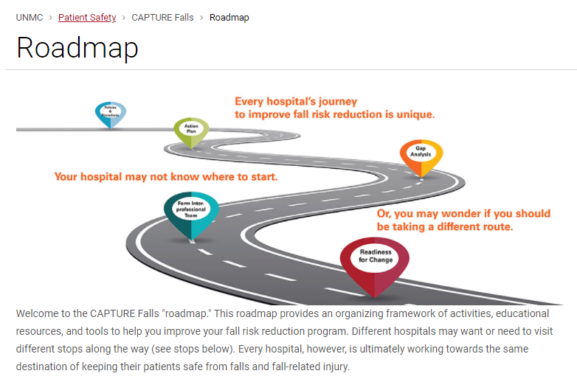
CAPTURE Falls Roadmap Tour
https://www.unmc.edu/patient-safety/capturefalls/roadmap/index.html

Slide 7
Participation in CAPTURE Falls
Join on a rolling basis – contact UNMC team at capture.falls@unmc.edu to discuss participation
Complete the CAPTURE Falls Gap Analysis
Review CAPTURE Falls Gap Analysis with UNMC team and formulate Action Plan
Utilize resources on CAPTURE Falls Roadmap

Slide 8
Participation in CAPTURE Falls
Participate in consultative calls with the UNMC team as desired/needed
Attend quarterly CAPTURE Falls collaborative educational calls
Report fall events and post-fall huddles into Know Falls database on an ongoing basis; fall rates annually to contribute to statewide benchmark

Slide 9
Our expectations for CAPTURE Falls program hospitals
Commitment to taking action and learning to reduce fall risk in your facility
Proactive communication with the UNMC team about implementation progress, successes, barriers, and questions/needs – we are here to help you!

Slide 10
What you can expect from the UNMC team
Accurate reporting of fall events and post-fall huddles in Know Falls system
Expert consultation, guidance as you evaluate and implement your fall risk reduction program
Quarterly analytic reports on reported fall events
Annual fall rate benchmarks from collaborative

Slide 11
What you can expect from the UNMC team
We will challenge you to think
differently about falls!

Slide 12
Wrap Up

