Slide 1

Quality Residency
Capstone Project
nebraskahospitals.org
Kamrie Peterson MSN, MBA, RN
Kim Yungdahl BSN, RN,
November 2, 2023,
Annie Jeffrey Memorial County Health Center

Slide 2
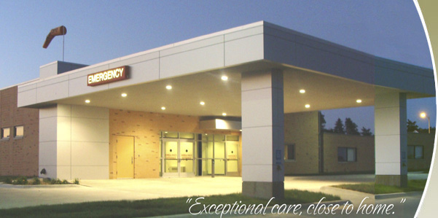
Introduction
16 bed Critical Access Hospital
Only hospital in Polk County
Services include:
  Emergency Department
  Outpatient
  Inpatient
  Obstetrics
  Surgery

Slide 3
Introduction
Identifying Opportunities for Improvement
EMR Transition August 2022
Centriq to Thrive
Emergency Department patients were not being discharged with condition specific education
Goal: to prevent an increase in repeat Emergency Department patients
Building our Team
Kim – QI resident participant, surgery supervisor transitioned to Director of Nursing
Kamrie – QI resident participant, QA/QI Nurse
Lori- Director of Nursing for majority of the project
Chris- Clinical IT
Robin- Chart review
Front Line Staff

Slide 4
AIM Statement
By August 31, 2023 95% of all Emergency Department patients will receive condition specific education upon discharge.

Slide 5
Measuring Success
Monthly audit of all ED patient charts- Completed by Robin
Review of patient education tab and scanned documents
Raw data was collected on paper each month and shared with Kamrie and Kim
  Percentages were calculated and reviewed monthly
  Data was tracked in a shared spreadsheet.
    Numerator: Number of ED charts with condition specific education
    Denominator: Total Number of ED visits that discharged home
AJMCHC Top ICD10 Diagnoses
  RO789: Chest pain
  K0889: Other specified disorders of teeth and supporting structures
  R1013: Epigastric pain
  S63502A: Unspecific sprain of left wrist
  B349: Viral Infection
  I213: ST elevation (STEMI)

Slide 6
Selecting Changes
  Brainstorm change options with team
  Observed current workflow options
  Created most effective workflow
    Discussed at QA
    Discussed at nurses meeting
  How to handle thrive updates
  Working through changing thrive education options

Slide 7
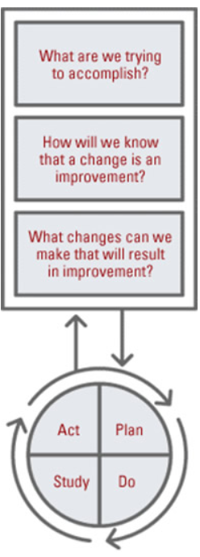
Plan
Do
Observe current workflows
Multiple workflows identified
Study
Discharge process is different depending on the application staff used
Measurement goal was met – More observation time needed
Act
Simplification of workflow identified
Enhance current knowledge of Thrive process
Produce more efficient workflows

Slide 8
Plan
Do
Observe new changes for 2 months
Identified that Thrive update disrupted workflow. Nurses were using different way to discharge patients
Study
There are multiple ways to discharge a patient
Act
More understanding is needed of Thrive functionalities
Discharge patients from ED with condition specific education
Goal: Decrease return ED visits
Educate nurses on a standardized workflow for discharge education
Measurement goal was not met
Changes still needed to define a consistent workflow process

Slide 9
Data and Trends
Discussion began with Nurses in January and February
Began observations in February
Thrive update in April and July

Slide 10
Return on Investment (ROI)
Expenses
  No additional expenses were needed for this project
Savings
  Decreased ED readmissions
  Decreased provider burnout
Total Savings/Revenue – Total Costs/Expenses = Total ROI
Positive ROI = Dollars Earned ~~ Negative ROI = Dollars Lost

Slide 11
Spreading / Sustaining / Maintaining / Replicating
Monthly chart audits will continue
Condition specific education will remain a QI indicator for the ED department throughout 2024.
Unintended Win
This quality improvement project was not meant to be replicated in other areas of the hospital. However, it did generate thoughts and conversations about other nursing processes that could use some help.

Slide 12
THANK YOU/Questions
Kamrie Peterson and Kim Yungdahl
Annie Jeffrey Hospital
402-747-2031
nebraskahospitals.org

