Slide 1
Building a Foundation of Leadership
Dr. Mike Freel
mike.freel@bellevue.edu

Slide 2
Introductions
What is the #1 thing you want to accomplish during the LEADERSHIP INSTITUTE program?

Slide 3
Do THIS.

Slide 4
Go DEVELOP yourself!

Slide 5
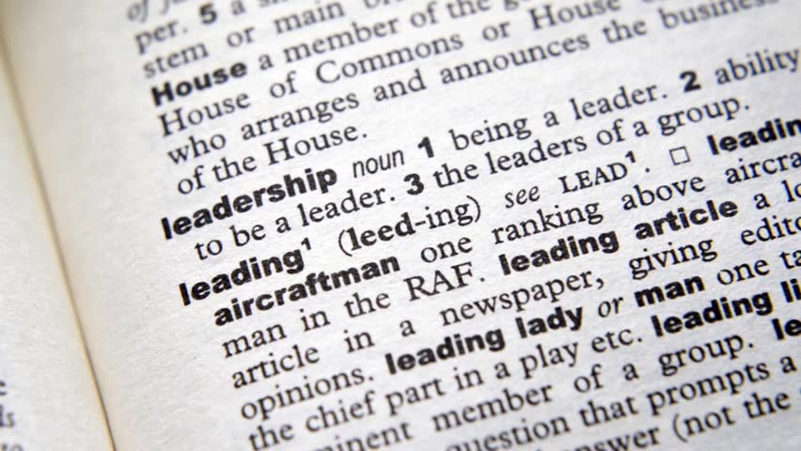

Slide 6
How has LEADERSHIP changed since COVID?

Slide 7
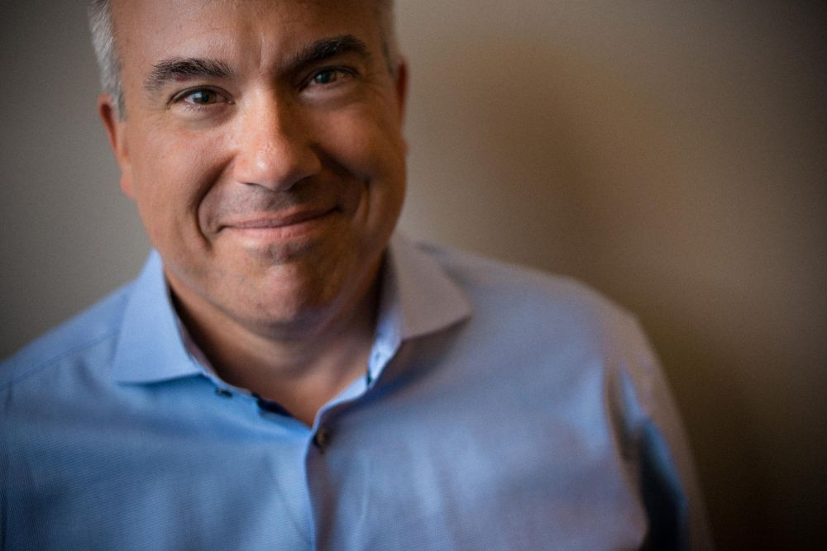
Management vs. Leadership
Planning and budgeting versus setting DIRECTION.
Organizing and staffing versus ALIGNING PEOPLE.
Controlling activities and solving problems versus MOTIVATING and INSPIRING.
Telling versus GET OUT OF THE WAY.

Slide 8
About LEADERSHIP:
The leadership profile inventory.

Slide 9
Leadership Theories

Slide 10
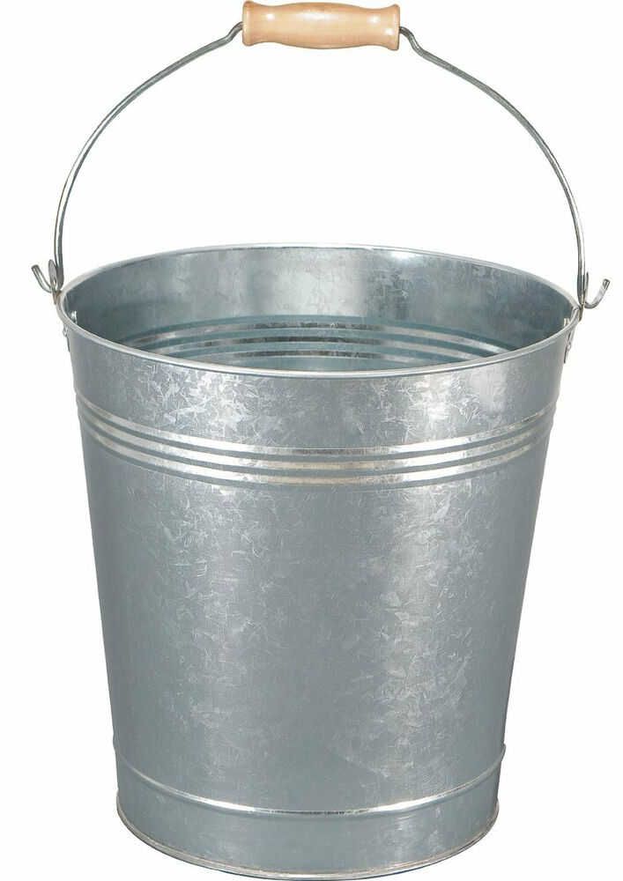
Barack Obama
Mark Zuckerberg
Scott Frost
Effective LEADERSHIP
Abraham Lincoln
Pope Francis
Elon Musk

Slide 11
Leadership
Motivation
Honesty & Integrity
Drive
TRAITS
Knowledge of Business
Self-Confidence
Cognitive Ability

Slide 12
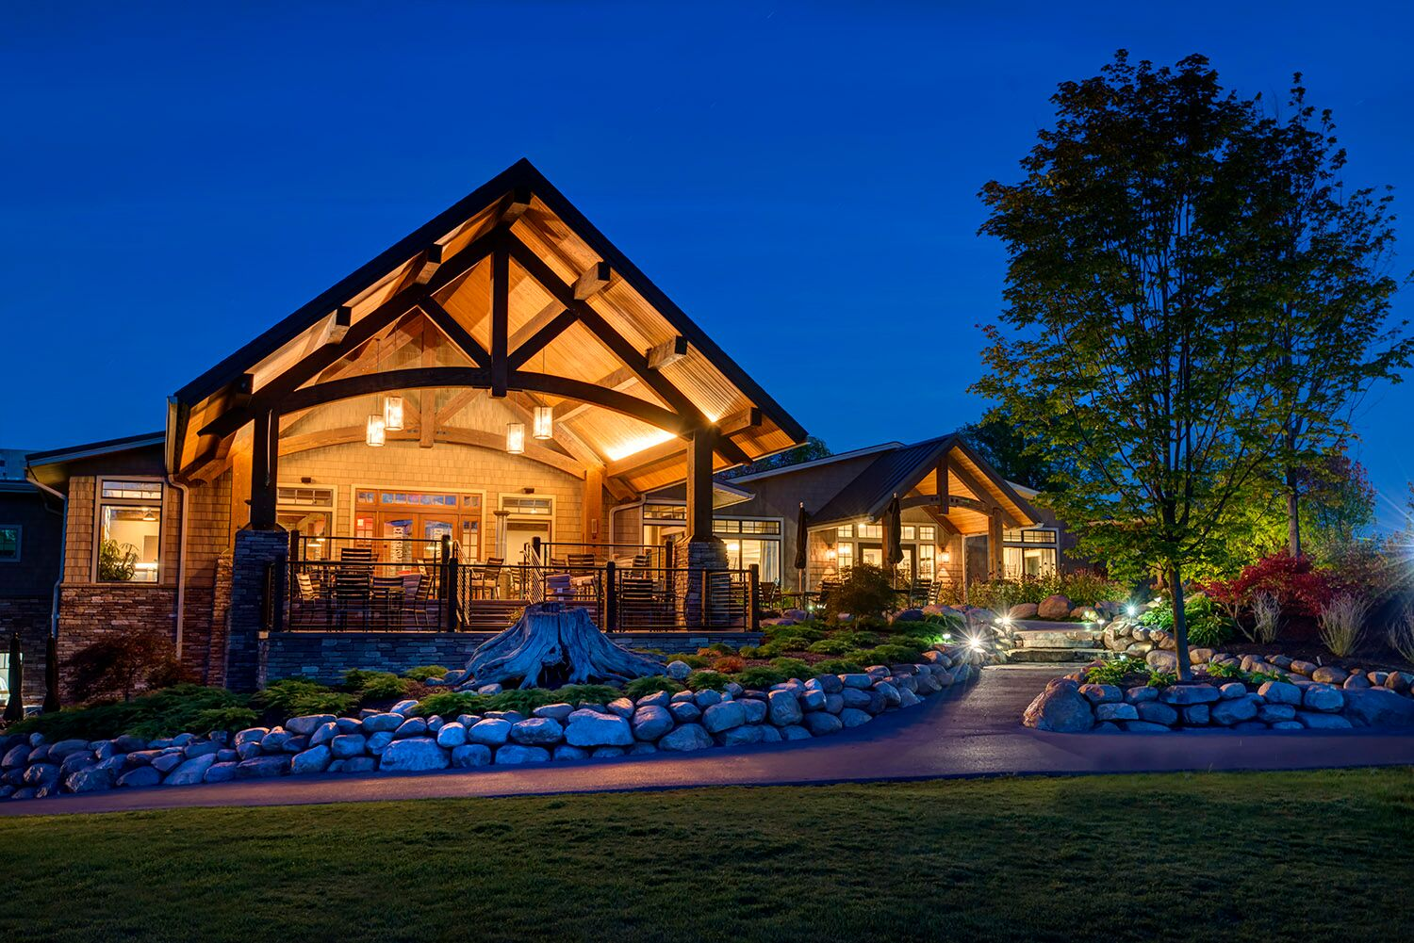
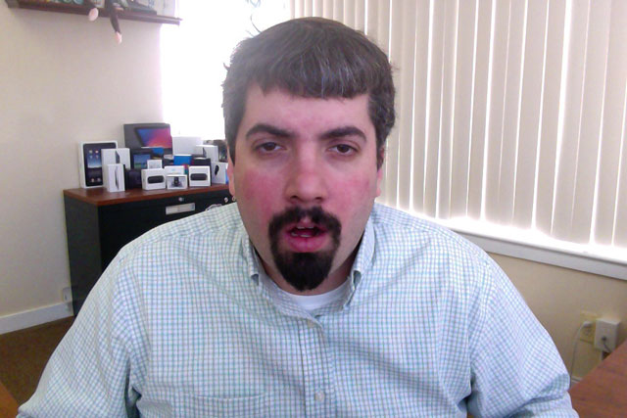
Blake and Mouton Managerial Grid
Behaviors
People
Vs.
Task
Compromising

Slide 13
BEHAVIORAL MODELS
What does it mean to be transactional?
What does it mean to be transformational?
The 4 I’s
Idealized Influence
Inspirational Motivation
Intellectual Stimulation
Individualized Consideration
Charisma
Social
Vision
Transactional
Delegation
Execution

Slide 14
Values and Leading
ADVOCATE for the organization and each other
REINFORCE shared goals
MERITOCRACY
Foster HIGH ethical standards
Values and LEADERSHIP
Value CONGRUENCE
GROUPS – The link between values and leadership
Notes:
Values and leadership.
First, write down your top 5 values.
Second, in a group, prioritize the group’s top 5 values in order.
Whole group – what is the frequency?
How do you support these values?

Slide 15
UNIVERSAL Approach
Given the choice, what is the
SINGLE MOST IMPORTANT TRAIT
to possess as an effective leader?

Slide 16
CONTINGENCY Models
Fill in the blank.
LEADERSHIP
is contingent upon
BLANK

Slide 18
SERVANT Leadership
Listens first
Care about well-being
Walk in their shoes
Awareness
Persuasion, not coercion
Visionary – big picture person
Advocate – follower and the organization
Foresight – eye on the horizon
Developmental toward the follower
Developmental toward the community

Slide 19
SERVANT Leadership
Can a SERVANT leader exist within an ORGANIZATION?

Slide 20
LMX Leader-Member Exchange
In-Group
More attention
More socialization
Challenging tasks
More responsibility
More communication
More satisfaction
Out-Group
Less attention
Redundant tasks
Formal reporting and job structures
Need-to-know
More resistance

Slide 21
SITUATIONAL Leadership
UNWILLING and UNABLE
UNWILLING and ABLE
WILLING and UNABLE
WILLING and ABLE
Decisions are made by the leader and announced, so communication is largely one-way.
TELLING
Decisions remain the leader’s prerogative, but communication is much more 2-way.
COACHING
The leader facilitates the follower’s participation in decisions but control remains with the leader.
PARTICIPATING
The leader is still involved in decisions and problem solving, but control is with the follower.
DELEGATING
READINESS

Slide 22
SITUATIONAL Leadership
The SITUATION
You were just hired to head up the IT implementation team for a new system to be introduced at Nebraska City Healthcare. You have successfully completed several leadership development courses at Bellevue University (shameless plug) and you have a pretty good idea of what it means to be an effective leader. Review the following scenarios and describe how your leadership skills would best address the site’s performance.

Slide 23
SITUATIONAL Leadership
SITUATION 1
Your NCH management team is made up of people who have been with the department for several years. The entire site has enjoyed exceptional success throughout the last 4 quarters. Each department is well-staffed and morale is high. As you meet with each manager, you discover that in the past, they have taken an active role in the development of their teams and each has moved up through the ranks within the department. One of the managers tells you that he would like to grow the department even faster, but there just isn’t enough space for additional growth. Things are good!

Slide 24
SITUATIONAL Leadership
SITUATION 2
You arrive at NCH to a team of relatively new managers. Due to recent structural changes, the existing management team was relocated or quit. Now, you have a group of managers with very little experience working in an IT systems environment. However, each manager is highly motivated to attain departmental goals. These are intelligent managers who have a good sense of leadership, good general knowledge of departmental goals and performance measures, but lack the experience in leading a team.

Slide 25
SITUATIONAL Leadership
SITUATION 3
You arrive to your new job as director of NCH’s IT implementation team. Almost immediately, you find out that 50% of the IT employees and 50% of your management team are currently on a developmental plan for poor performance. Morale is low, turnover is high, and performance standards are nowhere to be found.

Slide 26
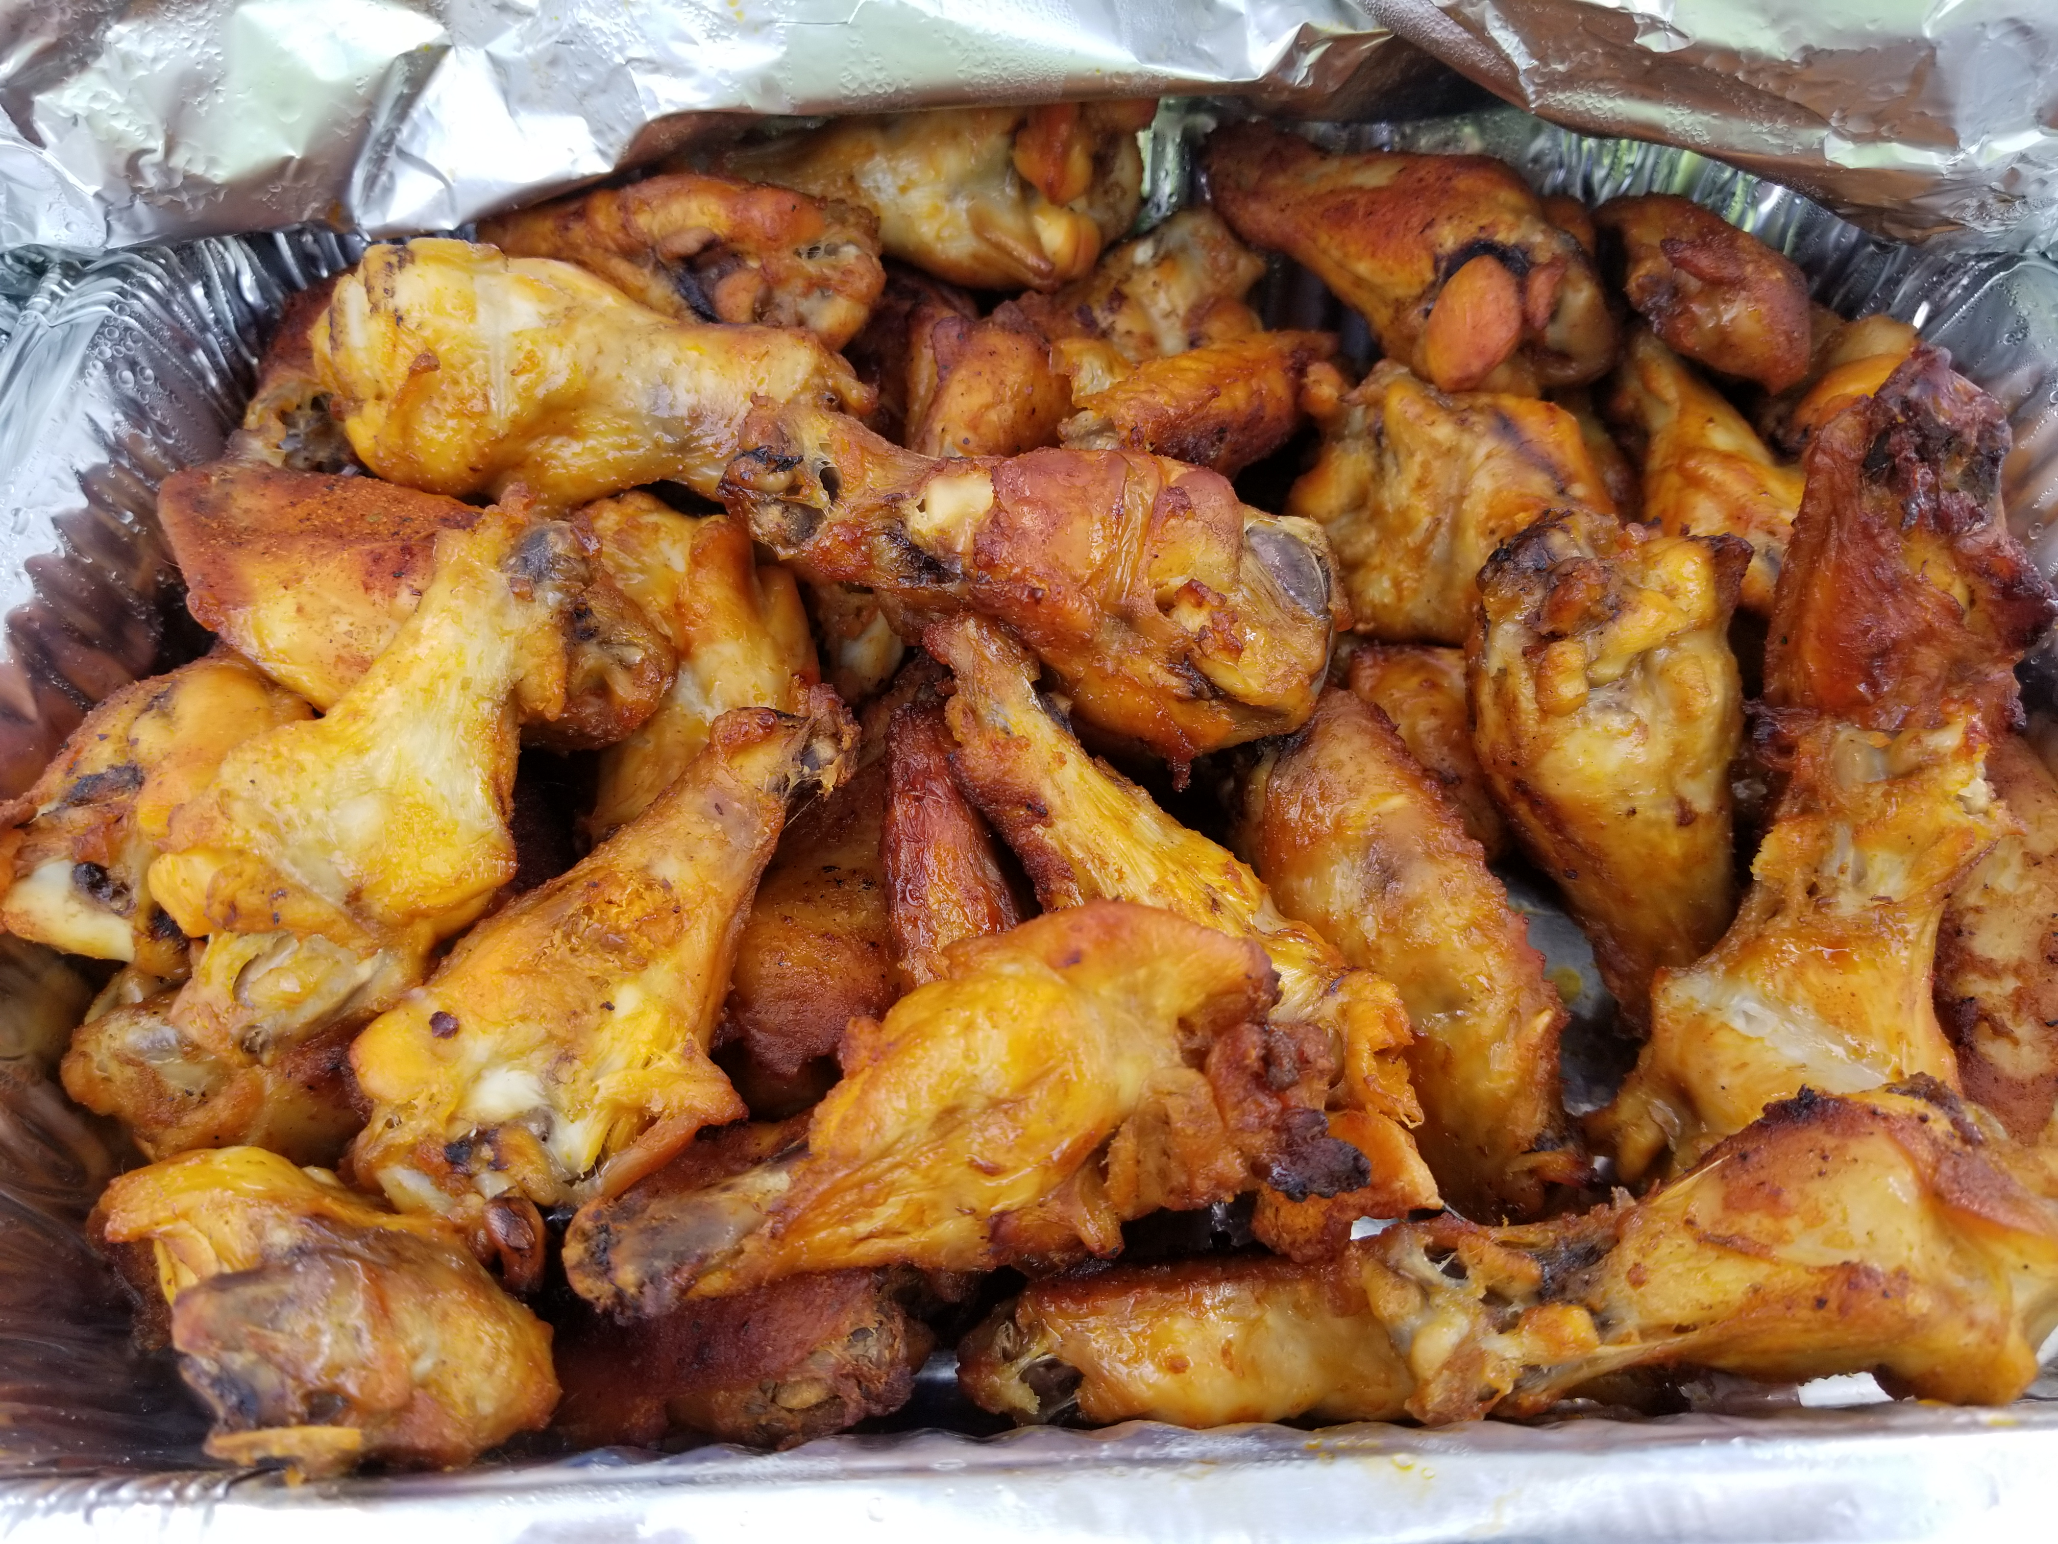
A Quick Assessment
QUESTIONS?
Building a Foundation of Leadership?

Slide 27
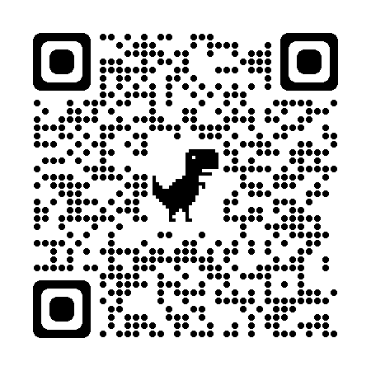
Faculty Phone: 402.557.7121 Faculty Email: mike.freel@bellevue.edu bellevue.edu
Bellevue University is accredited by the Higher Learning Commission (hlcommision.org). Bellevue University is committed to providing an environment that is free from harassment and discrimination based upon race, color, religion, sex, national origin, age, disability, genetic information, military obligations, or status in any other group protected by local, state, or federal law.

