Slide 1
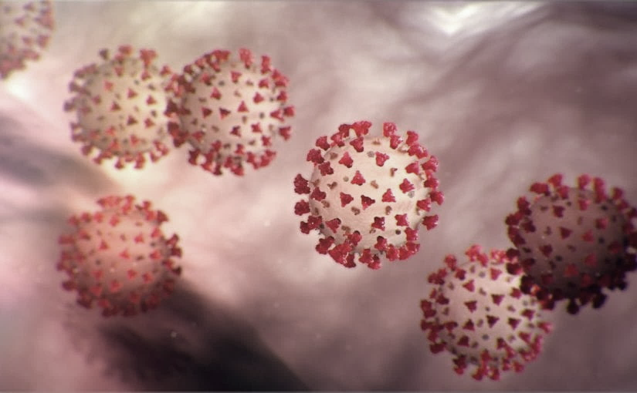
Covid-19 Webex Update on ACH for COVID-19 4-3-20
Maureen Tierney, MD, MSc.
Healthcare Associated Infections Medical Director
Tom Safranek, MD, State Epidemiologist
Matthew Donahue, MD, EIS Officer, NE DHHS

Slide 2
We are one in this fight
Frontline Heroes
Public Health Heroes
First Responder Heroes

Slide 3
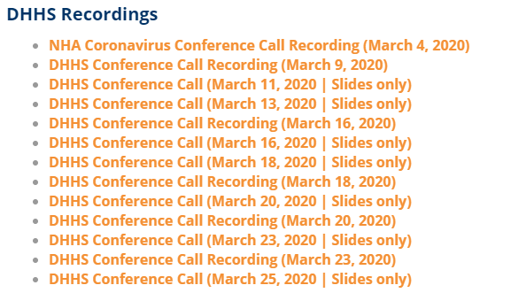
Thank you for joining us!
Slides and recording of today’s presentation will be available at
https://www.nebraskahospitals.org/coronavirus-covid-19-information.html
Scroll to the bottom of the page

Slide 4
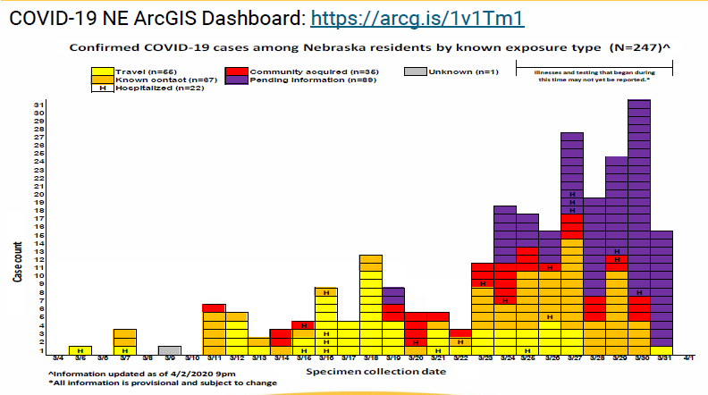

Slide 5
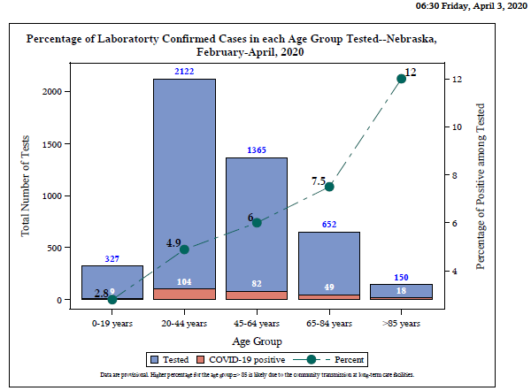

Slide 6
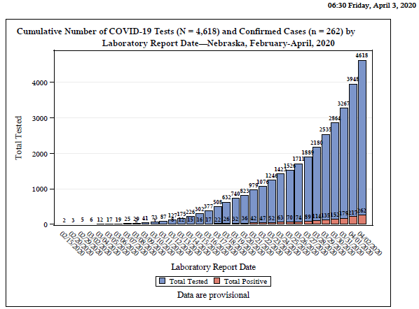

Slide 7
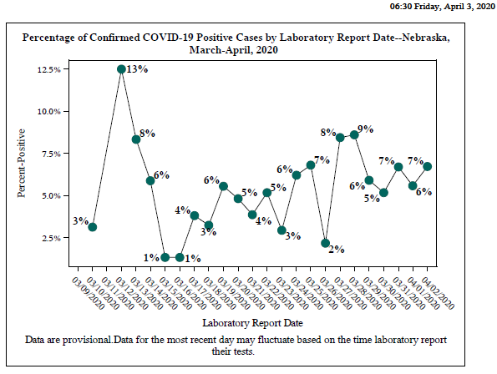

Slide 8
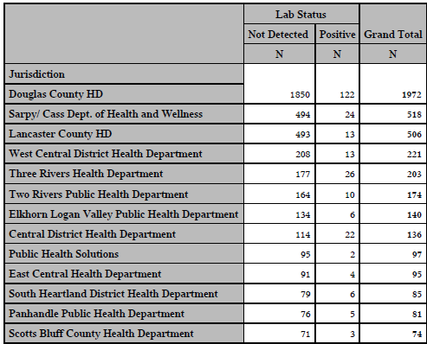
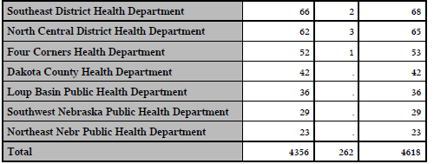

Slide 9
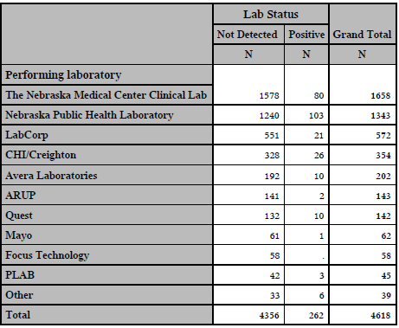

Slide 10
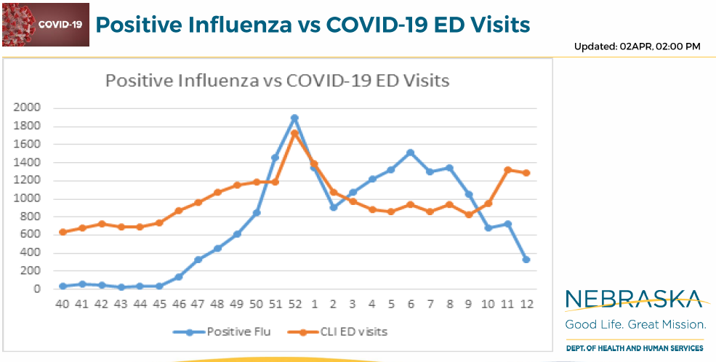

Slide 11
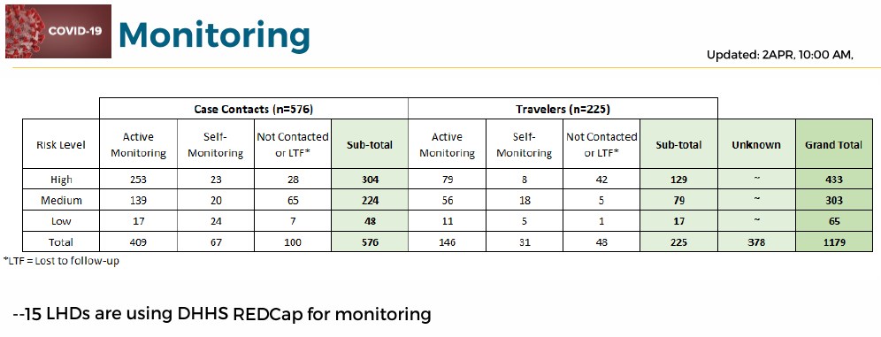

Slide 12
Other Reseources
Nebraska COVID map - https://universityofne.maps.arcgis.com/apps/MapSeries/index.html?appid=d68aec6490f2457a8f0156d9f150e954
Douglas County COVID tracker - https://dogis.maps.arcgis.com/apps/opsdashboard/index.html#/21bec056a9a6449abcca89a329868fd6

Slide 13

Infection Prevention and Control
Office Hours
Monday – Friday
7:30 AM – 9:30 AM Central Time
2:00 PM -4:00 PM Central Time
Call 402-552-2881

Slide 14
Clinical Diagnosis
Given the consequences of widespread transmission, public health authorities nationally are broadening the range of clinical syndromes warranting self-isolation:
• Temperature ≥100.4°F (HCP, elderly, folks entering hospital for other reasons:100.0)
• Cough often dry
• Shortness of breath and/or CP
• +/- Sore throat (more prominent in recent cases)
Fatigue and myalgias; nausea and diarrhea maybe presenting symptoms
? Loss of smell
To limit potential transmission, if any of these symptoms are present, alone or in combination (in the absence of a known alternative diagnosis): patients should self-isolate.
New COVID ICD-9 code

Slide 15
Precautions when evaluating patients for non COVID 19 issues
If the patient is afebrile (temperature is less than 100.0ºF) and otherwise without even mild symptoms* that might be consistent with COVID-19 (e.g., cough, sore throat, shortness of breath, chest pain, myalgias, severe fatigue, diarrhea), then precautions specific to COVID-19 are not required. However, until the patient is determined to be without such symptoms, HCP should wear all recommended PPE for the patient encounter.
Since failure to identify and implement proper precautions in a healthcare setting for persons infected with COVID-19 can contribute to widespread transmission in that facility due to the presence of susceptible patients and healthcare personnel.
For this reason, a lower temperature of 100.0ºF and the inclusion of mild and non-specific symptoms should be used by healthcare settings evaluating these patients to increase the ability to detect even mild cases of COVID-19.

Slide 16
Pregnancy and Breast Feeding-Prelim Data
Pregnancy-immunocompromising to some degree-does this cover increased risk for sever disease-no data has shown this yet and di not appear to be the case in China.
No documented vertical transmission documented
Adverse Outcomes-not clearly shown but really unknown
high fevers in first trimester can be associated with some adverse outcomes
severe respiratory infection can be associated with low birth weight
Breast Feeding Not detected in breast milk yet
transmission from close contact
Guidance for pregnant and breastfeeding mothers
https://www.cdc.gov/coronavirus/2019-ncov/need-extra-precautions/pregnancy-breastfeeding.htmll

Slide 17
New Testing Capacity
CHI Health-Creighton Core Lab (Omaha): •
ABBOTT M2000: 94/tests/run; up to three runs/day
Regional Pathology Service (RPS) Laboratory, affiliated with Nebraska Medicine: •
UDT TEST: 100 tests/ day •
ROCHE COBAS 6800: 180 tests/day • TOTAL: 280 tests/day
Nebraska Public Health Laboratory (NPHL) based at UNMC in Omaha: •
CDC-public health test: up to 400 tests/day
Commercial labs (LabCorp, Quest, Mayo Clinic, ARUP, etc.): •
Currently reporting approximately 100 total tests /day; future capacity, unknown. These labs accept orders for COVID-19 tests without restrictions or prescreening.

Slide 18
New HAN on Testing 4-2-10
In-patients: Any in-patient will be tested.
Out-patients: Persons in these groups with a clinical or rule-out diagnosis of COVID-19 can be tested at NPHL. •
Healthcare workers •
Public Safety/First Responders (EMS, law enforcement, firefighters) •
Residents and staff at nursing homes • Residents and staff at group homes, homeless shelters, and daycare facilities • Individuals > 65 years old, and patient with serious underlying conditions
Providers can seek NPHL testing for patients who fail to meet these requirements based on special circumstances that warrant rapid turnaround time.
Contact a state/local public health authority for telephone pre-authorization. For all other patients, order COVID-19 testing through either in-state or national commercial laboratories.
To maximize throughput at NPHL, the lab is group-testing pooled specimens. Pools are created using five individual specimens. If the pool tests negative, all five contributors are considered negative. If the pool tests positive, the individual contributors to the pool are retested separately. This conserves reagents and allows more persons to be tested. To optimize this method, we request that ordering providers indicate on the order form if the provider believes the likelihood of a positive test to be high or low. The low likelihood specimens will be pooled to help save on scarce kits and reagents used to run the test.

Slide 19
Nulirt Ordering
Ordering providers can utilize their existing account or set up a new account, and order COVID-19 tests themselves directly out of their clinic. This entails collecting the specimen, labeling the specimen, submitting the order into NUlirt, printing out the “completed order” and “batch shipping” documents from NUlirt, and arranging for courier delivery of specimens and associated documents via NPHL client services (402-559-2440).
2) Laboratories can place the order into NUlirt on behalf of an ordering provider. Providers must submit the specimen accompanied by a completed COVID-19 NPHL REQUISITION (attached) to the laboratory placing the order into NUlirt. Laboratories cannot place the order into NUlirt without the signed COVID-19 NPHL REQUISITION. Ordering labs are responsible for getting test results back to the ordering provider.
3) Ordering providers can refer patients to designated COVID-19 specimen collection sites, and fax or e-mail a completed COVID-19 NPHL REQUISITION OR have the patient take the completed form with them to the specimen collection site. COVID-19 specimen collection sites must have a completed, signed COVID-19 NPHL REQUISITION to proceed with specimen collection if referring the specimen to NPHL. COVID-19 specimen collection sites can place the order electronically into NUlirt, or reflex to option #4. Specimen collection sites placing electronic orders are responsible for getting test results back to the ordering provider.
4) Ordering providers, laboratories, and designated COVID-19 specimen collection sites can send the COVID-19 NPHL REQUISITION PLUS the N-P specimen via courier to NPHL where the test will be electronically ordered through NUlirt. Please note the importance of specifying the account on the COVID-19 NPHL REQUISITION to insure delivery of the test result via fax or secure e-mail.

Slide 20
Nulirt
Access NUlirt here (https://nulirt.nebraskamed.com) using your existing NUlirt account. If you are a new user, follow the link to register and create a new account. If you are having issues getting access to NUlirt, reach out to the NUlirt support group via email nulirtsupport@nebraskamed.com. There are also client service representatives available to assist with ordering through the NUlirt system at 402-559-2440; or toll free: 1-866-290-1406.
These recommendations are subject to revision depending on COVID-19 lab testing capacity at NPHL and commercial laboratories.
Specimen Collection Requirements: See Collecting and Handling COVID-19 Laboratory Specimens, http://www.nphl.org/. •
Nasopharyngeal Swab (NP): 1 (one) nasopharyngeal swab should be placed in a single tube of viral transport medium (VTM). •
Lower respiratory specimen: sputum if the patient can produce sputum, do not induce sputum

Slide 21
How to Order COVID-19 Different Testing Options
If currently enrolled with the Omaha CHI-Health laboratory: Alegent Core lab)
  order COVID-19 tests through that pathway. All CHI n-patient facilities along with providers, clinics and other entities with an established relationship with the CHI Health Laboratory.
2) If currently enrolled with RPS (Regional Pathology Services) operated out of UNMC, order COVID-19 tests through RPS.
3) If your reference laboratory services are other than these, follow their recommendations for routine and priority COVID-19 testing.
4) NPHL prioritizes testing statewide for ALL in-patients (except above) with possible COVID-19, HCWs (esp. outside of CHI and RPS networks), and suspected COVID-19-infected patients from group settings and other vulnerable populations (e.g., LTC).
5) On March 20, CEO of NM Jim Linder, M.D., e-mailed an invitation offering COVID-19 testing to several other health systems across the state.
WRITE A FOR ASYMPTOMATIC OR S FOR SYMPTOMATIC ON THE TUBE WHEN COLLECTING SPECIMENS (ALLOWS FOR POOLING OF SPECIMENS)

Slide 22
Testing Priorities
All providers are asked to prioritize testing of:
Revising call in screening forms
Inpatients with a clinical presentation consistent with COVID-19
Residents and staff at nursing homes, group homes, homeless shelters, and other residential facilities
Health care workers who are ill (acute care, LTC and outpatient)
Public safety workers and first responders
Outpatients who are in high risk or vulnerable populations
Individuals > 65 years old and anyone with underlying conditions where a COVID-19 infection could result in increased morbidity/mortality

Slide 23
Testing Performance
Over 90% SE/SPEC\(probably over 95 % in good lab hands-which NPHL, UNMC, and CHI labs are.
Rapid 15 min test-60% sensitivity; difficulty with reagents acc. To local lab experts
Serology now FDA approved-not for use in clinical diagnosis-timing of IgM in the acute setting will be past most infectious period
IgG prior infection-able to go back to work???
How long does immunity last??

Slide 24
Call In Lines; Facility Screening
1. NM-Info hotline and referral -400-922-0000; Evaluated over the phone
referred one of their outpatient clinics, Can do their own test
2. CHI-CHIhealth.com 8am to 8pm; after hours virtual care (for CB, IMM, Lakeside St. Es, St. Francis and Good Sam ) Virtual Screening referred to MD or ANP; free.
Methodist 402-815-7425 24/7
  Doing testing on main campus; some drive through testing by appt
4. Bryan -24/7 hotline-402-481-0500; also website from their Bryan Health homepage
ezVisit-if for coronavirus questions will be provided free of charge
5. Great Plains Health-no hotline-ask people to call their PCP.
6. Crossroads Urgent Care Clinic near 72/Dodge Omaha 402 715 5272 by appointment only

Slide 25
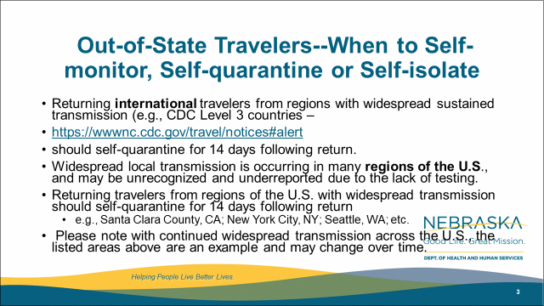
Out-of-State Travelers--When to Self-monitor, Self-quarantine or Self-isolate
Returning international travelers from regions with widespread sustained transmission (e.g., CDC Level 3 countries –
https://wwwnc.cdc.gov/travel/notices#alert
should self-quarantine for 14 days following return.
Widespread local transmission is occurring in many regions of the U.S., and may be unrecognized and underreported due to the lack of testing.
Returning travelers from regions of the U.S. with widespread transmission should self-quarantine for 14 days following return
  e.g., Santa Clara County, CA; New York City, NY; Seattle, WA; etc.
Please note with continued widespread transmission across the U.S., the listed areas above are an example and may change over time.

Slide 26

Identifying high risk domestic travel
https://coronavirus.jhu.edu/map.html
Notes:
As of 3/24

Slide 27
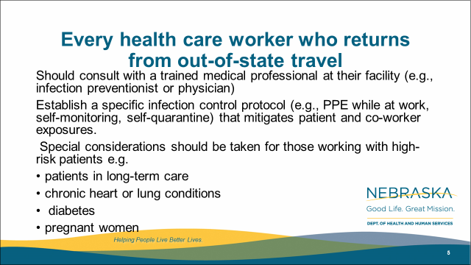
Every health care worker who returns from out-of-state travel
Should consult with a trained medical professional at their facility (e.g., infection preventionist or physician)
Establish a specific infection control protocol (e.g., PPE while at work, self-monitoring, self-quarantine) that mitigates patient and co-worker exposures.
Special considerations should be taken for those working with high-risk patients e.g.
patients in long-term care
chronic heart or lung conditions
diabetes
pregnant women

Slide 28
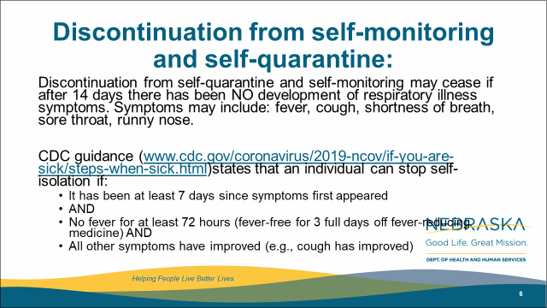
Discontinuation from self-monitoring and self-quarantine:
Discontinuation from self-quarantine and self-monitoring may cease if after 14 days there has been NO development of respiratory illness symptoms. Symptoms may include: fever, cough, shortness of breath, sore throat, runny nose.
CDC guidance (www.cdc.gov/coronavirus/2019-ncov/if-you-are-sick/steps-when-sick.html)states that an individual can stop self-isolation if:
  It has been at least 7 days since symptoms first appeared
  AND
  No fever for at least 72 hours (fever-free for 3 full days off fever-reducing medicine) AND
  All other symptoms have improved (e.g., cough has improved)

Slide 29
Discontinuation of Home Isolation
Time-since-illness-onset and time-since-recovery strategy (non-test-based strategy)*
Persons with COVID-19 who have symptoms and were directed to care for themselves at home may discontinue home isolation under the following conditions:
At least 3 days (72 hours) have passed since recovery defined as resolution of fever without the use of fever-reducing medications and improvement in respiratory symptoms (e.g., cough, shortness of breath); and,
At least 7 days have passed since symptoms first appeared.
(UNMC may recommend longer periods-10/5)
Test based Strategy
Negative results of an FDA Emergency Use Authorized molecular assay for COVID-19 from at least two consecutive nasopharyngeal swab specimens collected ≥24 hours apart** (total of two negative specimens).

Slide 30
Discontinuation of Isolation
Individuals with laboratory-confirmed COVID-19 who have not had any symptoms may discontinue home isolation when at least 7 days have passed since the date of their first positive COVID-19 diagnostic test and have had no subsequent illness.
What about family members quarantined with a COVID-+ family member, when does their quarantine end-14 days after their family member is either documented as being COVID-19 – or 14 days from when the loved one would have been eligible to discontinue isolation
Footnote from CDC
*This recommendation will prevent most, but may not prevent all instances of secondary spread. The risk of transmission after recovery, is likely very substantially less than that during illness.

Slide 31
Outbreaks in Healthcare
HCW worked when ill-16 residents in an ALF
HCW ill 5+ patients in a SNF
PCP worked for 5 days when ill exposed scores of patients
2-3 others
Any signs or symptoms-STAY HOME

Slide 32
Updates-When should HCPs Self Quarantine
Travel-to high risk areas self quarantine if at all possible (and upon returning from any travel if possible); if not possible, consult IP or ID/PH/Med Dir.
Any respiratory symptoms, severe fatigue and myalgias, diarrhea, or fever of greater than 99.9F.
If there is a household member who is positive for COVID-19, or highly suspected of having COVID-19.
They have been caring for a person who was documented as having COVID-19
and were not wearing necessary PPE –please see next slide for what to do based on different exposures.

Slide 33
Managing COVID 19 in LTC
Transfer out of Acute Care Hospitals-stay lengthened-stay in ACH until bed utilization goes up
Patients from LTC-isolated 1-3 cases to Midlands/St Es
Larger Number of cases-creating COVID unit or section
ICAP provides guidance for each LTC that has a case of COVID-19 now.
Creating additional Convalescent Sites
???Work force to assist in LTC-nursing students
staff from surgical ambulatory sites or specialty hospitals
restaurant workers in dietary

Slide 34

Accepting Hospitalized Residents Back to the Nursing Home
Initially admitted for non-COVID-19 illness and Still No COVID concerns:
Can be admitted back to the Nursing Home (consider a transition unit/holding area for 14 days within the facility) with contact/droplet precautions during observation period (AMDA) A COVID test is not required for acceptance back into facility. However, if a COVID test has been performed ,transfer should wait until results are back
Had COVID-19 concerns/ symptoms but now ruled out:
Can be admitted back to the Nursing Home (consider a transition unit/holding area for 14 days within the facility and keep them in
contact/droplet precaution until respiratory symptoms resolves and 14 days have passed)
Was COVID-19 positive and are recovering:
Will either remain in the acute care hospital or be admitted to designated COVID-19 treatment/recovery centers until no longer infectious and then will be transferred back to the nursing home
https://paltc.org/sites/default/files/COVID%2019%20QA%20Community%20Spread%20March%2023.pdf

Slide 35
Gowns for MRSA and VRE
The use of gowns as part of Contact Precautions in the context of MDROs has been implemented primarily to reduce the risk of transmission to other patients rather than to protect healthcare personnel (HCP). Facilities with shortages could consider suspending the use of gowns for the care of patients with endemic MDROs, such as MRSA, VRE, and ESBL-producing Gram-negative bacilli except as required for Standard Precautions. Facilities should assess their local epidemiology to determine which MDROs are considered endemic. Regardless of the use of gowns, HCP at facilities should continue to wear gloves for contact with these patients and their environment. Hand hygiene should continue to be emphasized. Facilities should also attempt to place patients colonized or infected with an MDRO in a private room, if available.

Slide 36
Caring for patients who have highly resistant Gram-negative organisms (e.g., carbapenem-resistant Enterobacteriacae) and other MDROs (e.g., Candida auris) that are not considered endemic: Rather than gowns being donned for every room entry, they should be reserved for use as part of Standard Precautions and also prioritized for high-contact patient care activities that pose highest risk for transfer of pathogens from the patient to HCP. Examples of such high-contact care activities include dressing, bathing/showering, transferring, providing hygiene, changing linens, changing briefs or assisting with toileting, device care or use (central line, urinary catheter, feeding tube, tracheostomy/ventilator), and wound care. To further preserve gowns, HCP are recommended to bundle high-contact care activities as part of individual care encounters. Regardless of the use of gowns, HCP at facilities should continue to wear gloves for contact with these patients and their environment. Hand hygiene should continue to be emphasized. Facilities should also attempt to place patients colonized or infected with an MDRO in a private room, if available.
Caring for patients with Clostridioides difficile infections (CDI): Facilities should continue using Contact Precautions (putting on a gown and gloves upon entry into the patient’s room and placing the patient in a private room) for the care of symptomatic patients with CDI. As part of a supplemental strategy to prevent transmission of CDI,

Slide 37
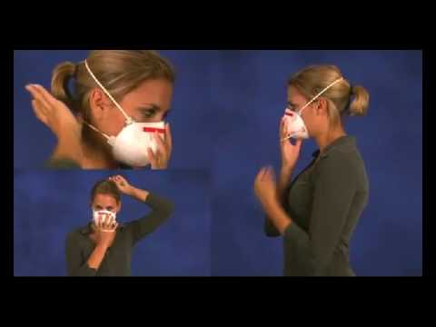
User seal check for N95 respirators
https://www.youtube.com/watch?v=pGXiUyAoEd8.

Slide 38
CDC Updates PPE Optimization Strategies
Alert facilities that updates have been made
Encourage review of guidance at https://www.cdc.gov/coronavirus/2019-ncov/hcp/ppe-strategy/index.html
Highlights:
  Extended use and limited re-use of facemasks
  “When no facemasks are available” guidance
  No resources for Crisis/Alternative Strategies for N95s
  Option for reprocessing eye protection
  Strategies to Allocate Ventilators from Stockpiles to Facilities
  Additional crisis strategies for gowns, including “when no gowns are available”
Notes:
We just want to alert people that the CDC has updated their PPE Optimization Strategies. Some highlights are included here. It is worth reading to see if this gives facilities any new ideas, but frankly catches CDC up to what has been under discussion in Nebraska for awhile- including strategies from NETEC and Nebraska Medicine.

Slide 39
Implement extended use of eye protection.
Extended use of eye protection is the practice of wearing the same eye protection for repeated close contact encounters with several different patients, without removing eye protection between patient encounters. Extended use of eye protection can be applied to disposable and reusable devices.
Eye protection should be removed and reprocessed if it becomes visibly soiled or difficult to see through.
  If a disposable face shield is reprocessed, it should be dedicated to one HCP and reprocessed whenever it is visibly soiled or removed (e.g., when leaving the isolation area) prior to putting it back on. See protocol for removing and reprocessing eye protection below.
Eye protection should be discarded if damaged (e.g., face shield can no longer fasten securely to the provider, if visibility is obscured and reprocessing does not restore visibility).
HCP should take care not to touch their eye protection. If they touch or adjust their eye protection they must immediately perform hand hygiene.
HCP should leave patient care area if they need to remove their eye protection. See protocol for removing and reprocessing eye protection below.

Slide 40
Crisis Level Extended Use Eye Protection
Use eye protection devices beyond the manufacturer-designated shelf life during patient care activities.
If there is no date available on the eye protection device label or packaging, facilities should contact the manufacturer. The user should visually inspect the product prior to use and, if there are concerns (such as degraded materials), discard the product.
Prioritize eye protection for selected activities such as:
During care activities where splashes and sprays are anticipated, which typically includes aerosol generating procedures.
During activities where prolonged face-to-face or close contact with a potentially infectious patient is unavoidable.
Consider using safety glasses (e.g., trauma glasses) that have extensions to cover the side of the eyes.

Slide 41
Resources (as of 8:00am 3/30/20)
Exposure Risk Assessment
https://www.cdc.gov/coronavirus/2019-ncov/hcp/guidance-risk-assesment-hcp.html
Guidance for PPE
https://www.cdc.gov/coronavirus/2019-ncov/hcp/ppe-strategy/index.html
  Regarding use of homemade masks
  https://www.cdc.gov/coronavirus/2019-ncov/hcp/ppe-strategy/face-masks.html

Slide 42
Dr. Wen Hang Zhang Chair Chinese Infectious Disease Society
>50% coinfected with other respiratory bacteria and viruses (flu season)
LDH and D-dimer associated with development of ARDS
Short window of time between CT findings and ARDS
Heart disease was greatest underlying risk factor (myocarditis)
Less lung fibrosis than with SARS
Most did well long term
Extreme social distancing and testing all suspected cases prevented a predicted 1 million cases in Shanghai
All patients admitted to COVID hospitals.
Courtesy notes from Dr. Joann Schaefer

Slide 43
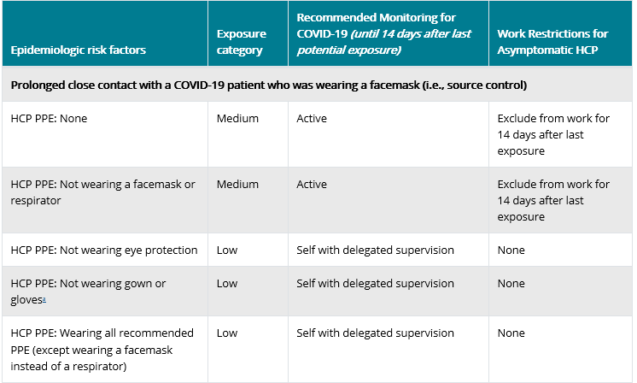
Exposure Risk Assessment
https://www.cdc.gov/coronavirus/2019-ncov/hcp/guidance-risk-assesment-hcp.html

Slide 44

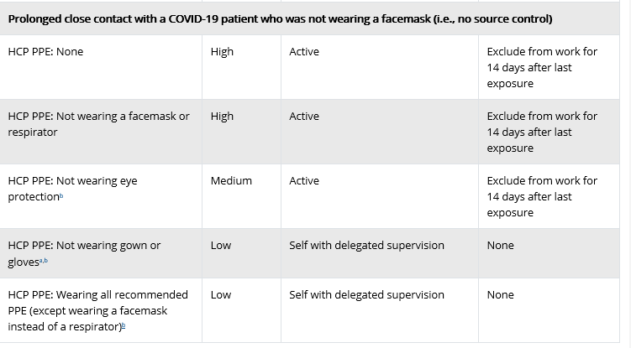
Exposure Risk Assessment
https://www.cdc.gov/coronavirus/2019-ncov/hcp/guidance-risk-assesment-hcp.html

Slide 45
HCP Return to work
Wear a facemask until all symptoms are resolved or 14 days after symptom onset whichever is longer
Be restricted from contact with severely immunocompromised patients
Adhere to HH and respiratory etiquette as recommended for control of COVID-19 in the interim guidance
Self monitor for worsening or recurrence of symptoms and notify employee health/occupational health/supervisor if occurs

Slide 46
EVS Cleaning After COVID 19 patient leaves
Terminal cleaning may be performed by EVS personnel.
Delay entry into the room until a sufficient time has elapsed for enough air changes to remove potentially infectious particles. We do not yet know how long SARS-CoV-2 remains infectious in the air.
See next slide for table on air exchanges-time room will be 99% or 99.9% free of particles
After this time has elapsed, EVS personnel may enter the room and should wear a gown and gloves when performing terminal cleaning.
A facemask and eye protection should be added if splashes or sprays during cleaning and disinfection activities are anticipated or otherwise required based on the selected cleaning products.

Slide 47
Air Exchanges per hour | Time (in minutes) required for removal 99% efficiency | Time (in minutes) required for removal 99.9% efficiency
2 | 138 | 207
4 | 69 | 104
6 | 46 | 69
8 | 35 | 52
10 | 28 | 41
Values apply to an empty room with no aerosol-generating source. With a person present and generating aerosol, this table would not apply. Removal times will be longer in rooms or areas with imperfect mixing or air stagnation. Caution should be exercised in using this table in such situations.
https://www.cdc.gov/infectioncontrol/guidelines/environmental/appendix/air.html#tableb1
Notes:
Values apply to an empty room with no aerosol-generating source. With a person present and generating aerosol, this table would not apply. Removal times will be longer in rooms or areas with imperfect mixing or air stagnation.²¹³ Caution should be exercised in using this table in such situations.
Cleaning could occur during this time, as long as respiratory protection is worn. Room would be blocked for appointments until the specified time has elapsed.

Slide 48
Additional Resources on Air Exchanges
https://www.mintie.com/assets/img/resources/ASHRAE_Article-on-VentilationChanges.pdf
https://www.hfmmagazine.com/articles/2671-planning-and-maintaining-hospital-air-isolation-rooms

Slide 49
UNMC Study on Contamination of Environment near COVID 19 Patients
https://www.unmc.edu/news.cfm?match=25339
IMPORTANT context about this information: Our findings DO NOT confirm that this virus spreads in an airborne fashion. The identification of genetic material from the virus that causes COVID-19 in air samples found in this study provides limited evidence that some potential for airborne transmission exists. More study is underway to determine if live culturable virus was captured in this study and additional evidence is needed to determine the risk of SARS-CoV-2 transmission via the airborne route.
A study by UNMC/Nebraska Medicine/NSRI researchers recently posted on the open pre-publication site BioRxiv, provides new evidence of SARS-CoV-2 environmental contamination in COVID-19 patient care areas. …The study found high levels of the virus contamination by PCR on commonly used surfaces and in the air of rooms of COVID-19 patients. Air samplers from hallways outside of rooms where staff were moving in and out of doors were also positive.
“Air samples that were positive for viral RNA by RT-PCR were examined for viral propagation in Vero E6 cells. Cytopathic effect was not observed in any sample, to date, and immunofluorescence 15 and western blot analysis have not, so far, indicated the presence of viral antigens suggesting viral replication. However, the low concentrations of virus recovered from these samples makes finding infectious virus in these samples difficult. Further experiments are ongoing to determine viral activity in these samples. “
From https://www.medrxiv.org/content/10.1101/2020.03.23.20039446v2

Slide 50
From CDC-Patient Placement
For patients with COVID-19 or other respiratory infections, evaluate need for hospitalization. If hospitalization is not medically necessary, home care is preferable if the individual’s situation allows.
If admitted, place a patient with known or suspected COVID-19 in a single-person room with the door closed. The patient should have a dedicated bathroom.
  Airborne Infection Isolation Rooms (AIIRs) should be reserved for patients who will be undergoing aerosol-generating procedures (intubation, sputum inductionsuctioning, bronchoscopy
  CDC answers to question about nebulizer therapy and negative pressure rooms:
As a measure to limit HCP exposure and conserve PPE, facilities could consider cohorting staff and if possible, designating entire units within the facility, with dedicated HCP, to care for known or suspected COVID-19 patients. Dedicated means that HCP are assigned to care only for these patients during their shift

Slide 51
CDC Recommendations for PPE
Based on local and regional situational analysis of PPE supplies, facemasks are an acceptable alternative when the supply chain of respirators cannot meet the demand. During this time, available respirators should be prioritized for procedures that are likely to generate respiratory aerosols, which would pose the highest exposure risk to HCP.
    Facemasks protect the wearer from splashes and sprays.
    Respirators, which filter inspired air, offer respiratory protection.
    When the supply chain is restored, facilities with a respiratory protection program should return to use of respirators for patients with known or suspected COVID-19Eye protection, gown, and gloves continue to be recommended.
    If there are shortages of gowns, they should be prioritized for aerosol-generating procedures, care activities where splashes and sprays are anticipated, and high-contact patient care activities that provide opportunities for transfer of pathogens

Slide 52
CDC Guidance on Nebulizing Treatments
Yes, nebulization is considered aerosol generating. However, the role it plays in the transmission of SARs-CoV-2 is not absolutely known at this point. In settings like nursing homes, where N95s are not readily available, we have been encouraging the following:
If patient can tolerate, switch to metered-dose inhalers with a dedicated spacer.
  HCW should wear a facemask during the procedure if a respirator is unavailable. Eye protection, gloves, and gowns are also recommended.
  Close patient door when providing nebulizer treatment.
  Upon set-up of nebulizer, have HCW maintain a safe distance (6 feet or greater), possibly outside the door.
  While our guidance does state that AGPs should ideally be conducted in a negative pressure room, given the limit of these rooms conducting all nebs in a negative pressure room is not feasible. would suggest prioritizing negative pressure rooms for other AGPs such as intubation, extubation, open suction, and bronchoscopy.

Slide 53
Masking-Options, with Best Alternatives
    N-95 fitted with eye protection is best-goggles or face-shield (especially for aerosol gen procedures inc. NP swab) if available
    N-95 unfitted (seal checked) with eye protection-face-shield might provide protection better than goggles if available
    Face mask with eye protection may be used if no aerosol generating procedures, if possible face-shield might provide more protection than goggles esp if it necessary to get NP swab or give nebulizers, if available
    All HCWs in LTC should wear surgical facemasks for patient encounters

Slide 54
Strategies for Re-Use of masks
The pathogens on the filter materials of the FFR may be transferred to the wearer upon contact with the FFR during activities such as adjusting the FFR, improper doffing of the FFR, or when performing a user-seal check when redoffing a previously worn FFR. A study evaluating the persistence of SARS-CoV-2 (the virus that causes COVID-19) on plastic, stainless steel, and carboard surfaces showed that the virus is able to survive for up to 72-hours [1]. One strategy to mitigate the contact transfer of pathogens from the FFR to the wearer during reuse is to issue five respirators to each healthcare worker who may care for patients with suspected or confirmed COVID-19.
The healthcare worker will wear one respirator each day and store it in a breathable paper bag at the end of each shift. The order of FFR use should be repeated with a minimum of five days between each FFR use. This will result in each worker requiring a minimum of five FFRs, providing that they put on, take off, care for them and store them properly each day. Healthcare workers should still treat the FFRs as though they are still contaminated and follow the precautions outlined in our reuse recommendations. If supplies are even more constrained and five respirators are not available for each worker who needs them, FFR decontamination may be necessary.

Slide 55
Table 2 Summary of the decontamination method and effect on FFR performance
Table 2 provides a summary of the decontamination methods evaluated in the referenced literature and the reported effect of each method on FFR performance.
Method | Treatment level | FFR filtration performance | FFR fit performance | Other observations | References
Vaporous hydrogen peroxide (VHP) | Battelle report: Bioquell Clarus C HPV generator:. Bergman et. al.: Room Bio-Decontamination Service (RBDS™, BIOQUELL UK Ltd, Andover, UK), which utilizes four portable modules | Passed | FFR fit was shown to be unaffected for up to 20 VHP treatments cycles using a head form | Degradation of straps after 30 cycles (Battelle report) | 3, 4
Ultraviolet germicidal irrad. (UVGI) | 0.5–950 J/cm2 | Passed | 90–100% passing rate after 3 cycles depending on model |  | 2, 3, 7, 8, 9, 10
Microwave generated steam | 1100–1250W microwave models (range: 40 sec to 2 min) | All passed filtration eval for 1 or 20 tr. cycles | 95–100% passing rate after 3 and 20 cycles for all models tested |  | 9, 10, 14
Microwave steam bags | 1100 W, 90 sec (bags filled with 60 mL tap water) | Passed | Not evaluated |  | 15
Moist heat incubation | 15 min–30 min (60°C, 80% RH) | 6 of 6 models passed after 3 cycles of contamination | Passed |  | 3, 9, 10
Liquid hydrogen peroxide | 1 sec to 30 min (range: 3–6%) | Passed | Not evaluated |  | 3, 7
Ethylene oxide | 1 hour at 55°C; conc. range: 725–833/L | Passed | Not evaluated |  | 2, 3, 7

Slide 56
UV Disinfection of PPE
“A team led by John Lowe, PhD, UNMC assistant vice chancellor for inter-professional health security training and education has developed a safe and effective method to decontaminate N95 respirators so they can be used multiple times, instead of just once. It involves using ultraviolet light towers to irradiate high numbers of N95 respirators.
The decontamination of these items works like this: groups of N95s are safely bagged and transported to a room inside Nebraska Medical Center, which is equipped with two ultraviolet light towers. The N95 respirators are hung on wires stretching the length of the room and then decontaminated when the lights are powered on. They are then removed and returned to the original owners for reuse.”
This is public facing now on the NETEC site.
https://repository.netecweb.org/files/original/fe9a813e5643ab774a62b4b1778117e0.pdf

Slide 57
On March 28, 2020, FDA issued an Emergency Use Authorization (EUA) permitting the Battelle Decontamination Systemexternal icon at Battelle Memorial Institute to be authorized for use in decontaminating “compatible N95 respirators.”
Because ultraviolet germicidal irradiation (UVGI), vaporous hydrogen peroxide (VHP), and moist heat showed the most promise as potential methods to decontaminate FFRs, researchers, decontamination companies, healthcare systems, or individual hospitals should focus current efforts on these technologies.

Slide 58
PPE Supply
Previous calls have identified the issues with limited supply
Any new PPE gets distributed to LHDs who distribute based on need in their jurisdictions, aggressive efforts underway to get more PPE-some supplies on the way, including masks
CDC strategies are tier-based and facilities should be utilizing all the listed strategies including:
  Conventional
  Contingency
  Crisis
  https://www.cdc.gov/coronavirus/2019-ncov/hcp/ppe-strategy/index.html
  Regarding use of homemade masks:
  https://www.cdc.gov/coronavirus/2019-ncov/hcp/ppe-strategy/face-masks.html
Notes:
Regarding facemasks- especially- just some caution about the use of homemade masks.
CDC notes regarding the use of homemade masks:
“n settings where facemasks are not available, HCP might use homemade masks (e.g., bandana, scarf) for care of patients with COVID-19 as a last resort. However, homemade masks are not considered PPE, since their capability to protect HCP is unknown. Caution should be exercised when considering this option. Homemade masks should ideally be used in combination with a face shield that covers the entire front (that extends to the chin or below) and sides of the face.”

Slide 59
Special message for rural areas
In communities not yet seeing community spread, please consider these actions
  Inventory all PPE now and begin conservation and use tracking
  Help community members with:
    N-95 respirator fit testing
    N-95 respirator use training, including
      Donning
      Seal check
      Doffing
  Especially important to partner and assist with long term care to facilitate their ability to collect COVID-19 specimens on residents
  Establish referral pattern for LTC patients
  Info about Critical Access Call to happen next Tuesday TBD

Slide 60
Minimizing Spread
The best way to minimize COVID-19 virus introduction/spread in Nebraska is to:
minimize out- of-state travel;
maximize the amount of self-quarantine, social distancing, and non-pharmaceutical interventions among travelers returning to Nebraska.
Maximize the use of social distancing, frequent hand washing or use of hand sanitizer, and covering cough and sneezes
Self isolation of contacts of cases, and family members of those with respiratory illness.
Dr. Adi Pour Press Conference-3.29.20

Slide 61
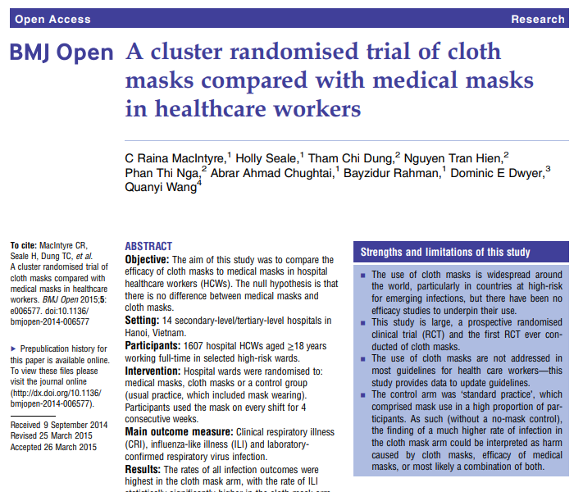
https://bmjopen.bmj.com/content/bmjopen/5/4/e006577.full.pdf
Notes:
This study is from the British Medical Journal, published in 2015.
Conclusion This study is the first RCT of cloth masks, and the results caution against the use of cloth masks… Moisture retention, reuse of cloth masks and poor filtration may result in increased risk of infection. Further research is needed to inform the widespread use of cloth masks globally. However, as a precautionary measure, cloth masks should not be recommended for HCWs, particularly in high-risk situations...
I think we can use this to inform decisions about cloth mask use for HCW- as a stand alone, they are inadequate. Regarding use of cloth masks over N-95, for example, caution should be used to ensure that the wearer can breathe comfortably.

Slide 62
BMJ
Results: The rates of all infection outcomes were highest in the cloth mask arm, with the rate of ILI statistically significantly higher in the cloth mask arm (relative risk (RR)=13.00, 95% CI 1.69 to 100.07) compared with the medical mask arm. Cloth masks also had significantly higher rates of ILI compared with the control arm. An analysis by mask use showed ILI (RR=6.64, 95% CI 1.45 to 28.65) and laboratory confirmed virus (RR=1.72, 95% CI 1.01 to 2.94) were significantly higher in the cloth masks group compared with the medical masks group. Penetration of cloth masks by particles was almost 97% and medical masks 44%. Conclusions: This study is the first RCT of cloth masks, and the results caution against the use of cloth masks. This is an important finding to inform occupational health and safety. Moisture retention, reuse of cloth masks and poor filtration may result in increased risk of infection. Further research is needed to inform the widespread use of cloth masks globally. However, as a precautionary measure, cloth masks should not be recommended for HCWs, particularly in high-risk situations, and guidelines need to be

Slide 63
Updates from Interim Guidance for IP in HC
For care other than aerosol generating procedures a face mask can replace an N-95 if an N-95 is not available
If gowns become scarce gowns should be reserved for
Aerosol generating procedures
Care where splashes and sprays anticipated
High contact care activities
In extreme scarcity-
Moving between patients with same confirmed diagnosis and eye protection and mask
not soiled by spray etc
remove only gloves and gowns and perform HH
replace gowns and gloves for next patient

Slide 64
Reporting to LHD
Reporting to LHD should primarily be by providers not patients. The LHD staff screening for who to test need the providers to have done some clinical screening/evaluating first (which may all be by phone)
Do NOT need to report all tests just positives and any probable cast that is pending (epi link)-
Any general questions by the public can be answered by the general COVID 19 hotlines at various LHDs
Listing of the local health departments and contacts:
http://dhhs.ne.gov/CHPM%20Documents/contacts.pdf

Slide 65
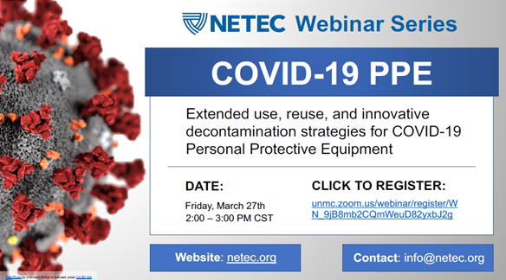
Registration link: https://unmc.zoom.us/webinar/register/WN_9jB8mb2CQmWeuD82yxbJ2g

Slide 66
NETEC series
1135 WEBINAR on Friday 4/3/2020 Click to register: http://ow.ly/TuGk50z1xwW

Slide 67
Infection Prevention and Control
Office Hours
Monday – Friday
7:30 AM – 9:30 AM Central Time
2:00 PM -4:00 PM Central Time
Call 402-552-2881

Slide 68
Strategies for Optimizing the Supply of PPE

Slide 69
Extended Use versus Re-use
Extended use refers to the practice of wearing the same N95 respirator for repeated encounters with several patients, without removing the respirator between the encounters. Extended use may be implemented when multiple patients are infected and patients are placed together in dedicated waiting rooms, clinics or hospital units. o
Eye protection may be left in place with the N95 respirator for extended use. •
Reuse refers to the practice of using the same N95 respirator for multiple encounters with patients but removing it (‘doffing’) between at least some of the encounters. The respirator is stored in between encounters and reused. o
Re-use of full face shields will be permitted.
Face shields will be dedicated for use by individual healthcare personnel.
Disinfection of the face shield will be required between uses.

Slide 70
Extended Use of N-95s
Discard N95 respirators following use during aerosol generating procedures.
Discard N95 respirators contaminated with blood, respiratory or nasal secretions, or other bodily fluids from patients.
Discard N95 respirators following close contact with, or exit from, the care area of any patient co-infected with an infectious disease requiring contact precautions.
Consider use of a cleanable face shield (preferred³) over an N95 respirator and/or other steps (e.g., masking patients, use of engineering controls) to reduce surface contamination.
Perform hand hygiene with soap and water or an alcohol-based hand sanitizer before and after touching or adjusting the respirator (if necessary for comfort or to maintain fit)

Slide 71
Re-use of N-95s
Discard N95 respirators following use during aerosol generating procedures.
Discard N95 respirators contaminated with blood, resp. or nasal secretions, or other bodily fluids
Discard N95 respirators following close contact with any patient co-infected with an infectious disease requiring contact precautions.
Use a cleanable face shield (preferred) or a surgical mask over an N95 respirator and/or other steps (e.g., masking patients, use of engineering controls), when feasible
Hang used respirators in a designated storage area or keep them in a clean, breathable container such as a paper bag between uses. To minimize potential cross-contamination, store respirators so that they do not touch each other and the person using the respirator is clearly identified.
Clean hands with soap and water or an alcohol-based hand sanitizer before and after touching or adjusting the respirator (r to maintain fit). Avoid touching the inside of the respirator.
Use a pair of clean (non-sterile) gloves when donning a used N95 respirator and performing a user seal check. Discard gloves after the N95 respirator is donned and any adjustments are made to ensure the respirator is sitting comfortably on your face with a good seal.

Slide 72
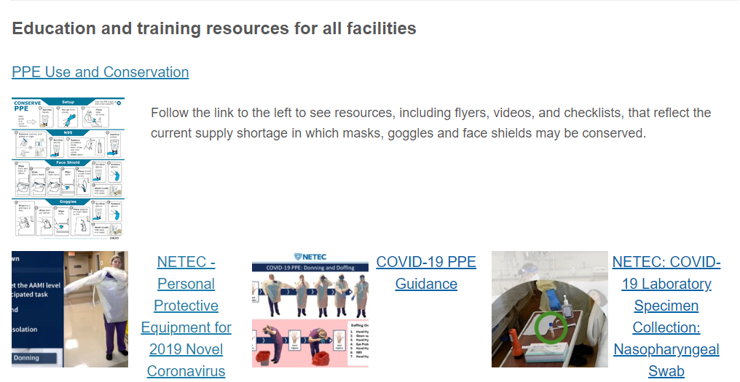
https://repository.netecweb.org/exhibits/show/ncov/ncov
Notes:
NETEC offers excellent training resources on COVID-19 PPE use, as well as conservation

Slide 73


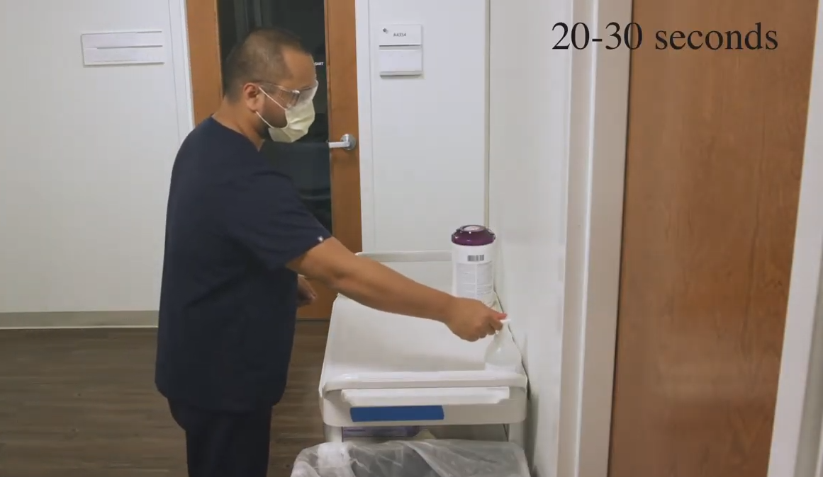
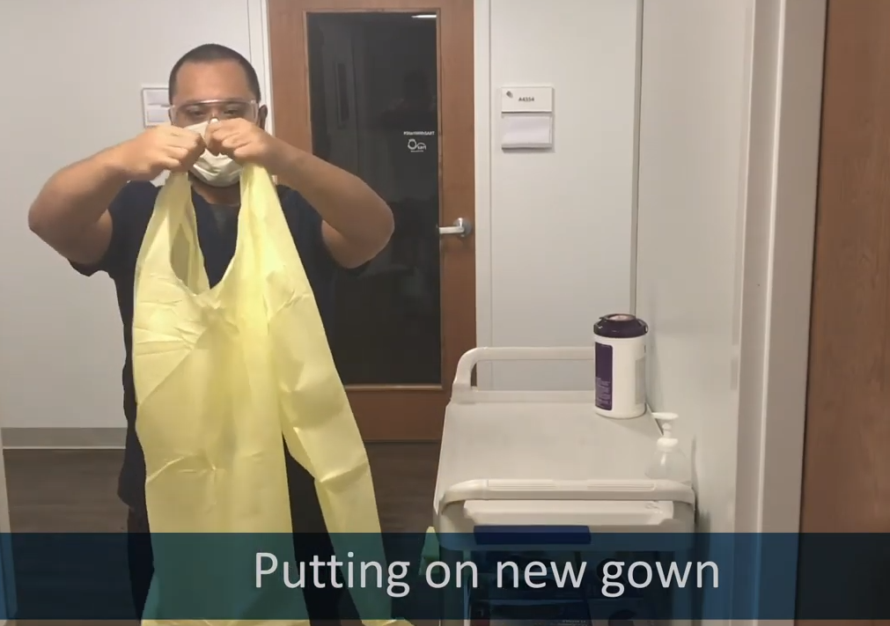
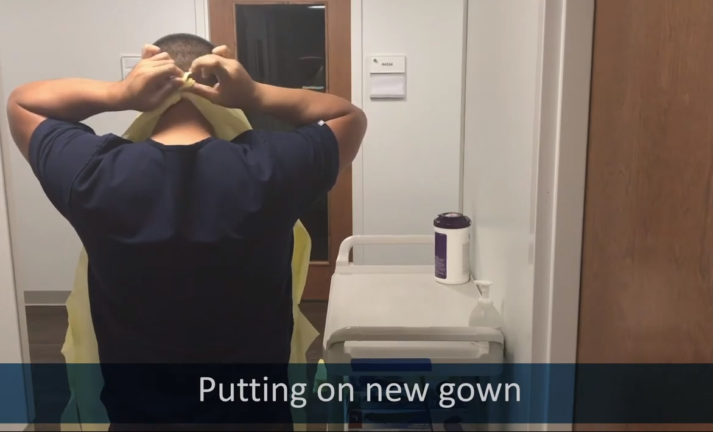
https://med.emory.edu/departments/medicine/divisions/infectious-diseases/serious-communicable-diseases-program/covid-19-resources/conserving-ppe.html
Notes:
The infographics are at the top of this page, but the better place to start is towards the bottom of the page with the instructional video series. In this set clips from the video, you see the HCW donning PPE as part of a conservation strategy to extend the use of eye protection and mask. Highlighted here is the strategy to tear the gown at the neck so that there is no reason to pull the gown over the head/ over the PPE which is still in use.

Slide 74
From the CDC –ABHR Shortages
If “severe shortages of ABHR (and have exhausted supply chain access to efficacious products) may consider local production of formulations as described by the FDA Policy for Compounding of Certain Alcohol-Based Hand Sanitizer Productsexternal icon. This policy remains in effect through April 30, 2020. Formulations included in the FDA guidance are consistent with World Health Organization production guidance. These locally produced products are intended for routine healthcare personnel hand cleaning, must not contain active ingredients other than those specified in the FDA guidance, and should not take the place of other regulated skin antiseptics (e.g. surgical hand rub). To avoid contamination with spore-forming organisms, WHO formulations require a 72-hour post-production quarantine. Organizations should revert to the use of commercially produced, FDA-approved product once such supplies again become available.”
Here is the link to The World Health Organization's hand rub directions:https://www.who.int/gpsc/5may/Guide_to_Local_Production.pdf
Here is the FDA one:https://www.fda.gov/news-events/press-announcements/coronavirus-covid-19-update-fda-provides-guidance-production-alcohol-based-hand-sanitizer-help-boost

Slide 75
Resources (as of 8:00am 3/30/20)
Exposure Risk Assessment
https://www.cdc.gov/coronavirus/2019-ncov/hcp/guidance-risk-assesment-hcp.html
Guidance for pregnant and breastfeeding mothers
https://www.cdc.gov/coronavirus/2019-ncov/need-extra-precautions/pregnancy-breastfeeding.htmll
Guidance for PPE
https://www.cdc.gov/coronavirus/2019-ncov/hcp/ppe-strategy/index.html
  Regarding use of homemade masks
  https://www.cdc.gov/coronavirus/2019-ncov/hcp/ppe-strategy/face-masks.html

Slide 76
PPE Examples: Conserving, Donning and Doffing
Repeat slides from Wednesday 3.25.20

Slide 77

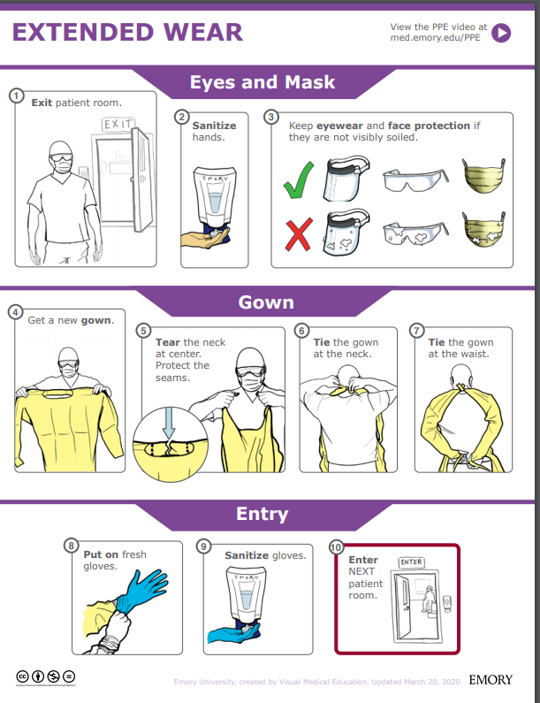
Extended Wear:
Exit room
Sanitize hands
Keep eye wear and face protection if they are not visibly soiled.
Get a new gown
Tear the neck at the center. Protect the seams
Ties the gown at the neck
Ties the gown at the waist
Put on fresh gloves
Sanitize gloves
Enter the next patient room
https://med.emory.edu/departments/medicine/divisions/infectious-diseases/serious-communicable-diseases-program/pdf/extended-wear.pdf
Notes:
This infographic could be posted at the point of PPE Donning. Another infographic is available for doffing, of course.
We think the graphic and the video really need to be paired for clarity- and just want to make you aware of these resources.

Slide 78
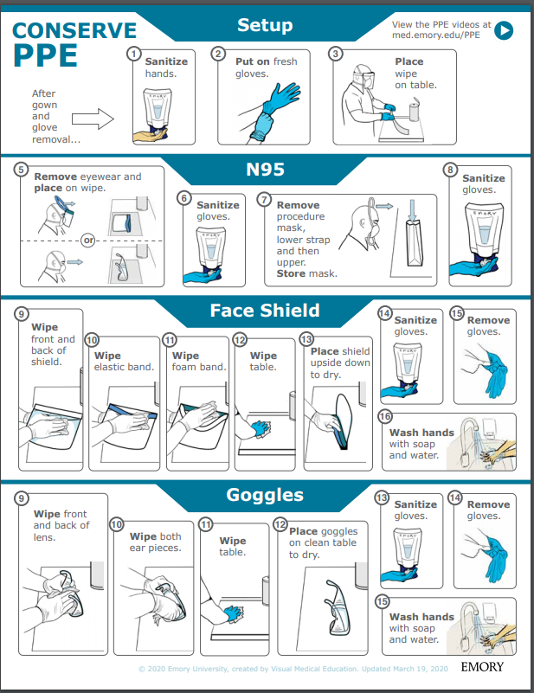
Face shield Re-Use
Sanitize hands
Put on fresh gloves
Place wipe on table
Remove eye wear and place on wipe
Sanitize gloves
Remove procedure mask; Store mask
Sanitize gloves
Wipe front and back of shield
Wipe elastic band
Wipe foam band
Wipe table
Place shield upside down to dry
Sanitize gloves
Remove gloves
Wash hands with soap and water
https://med.emory.edu/departments/medicine/divisions/infectious-diseases/serious-communicable-diseases-program/pdf/ppe-conserve-process-v3.pdf

Slide 79

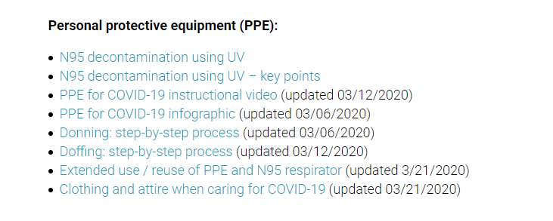
https://www.nebraskamed.com/for-providers/covid19
Notes:
As we’ve noted on previous calls, Nebraska Medicine’s COVID-19 website is public facing, and we encourage users to check out those complete resources and see if those can be implemented or used in conjunction with what your facilities are creating.
Nebraska Medicine has particularly good resources for bagging and processing used PPE.

Slide 80
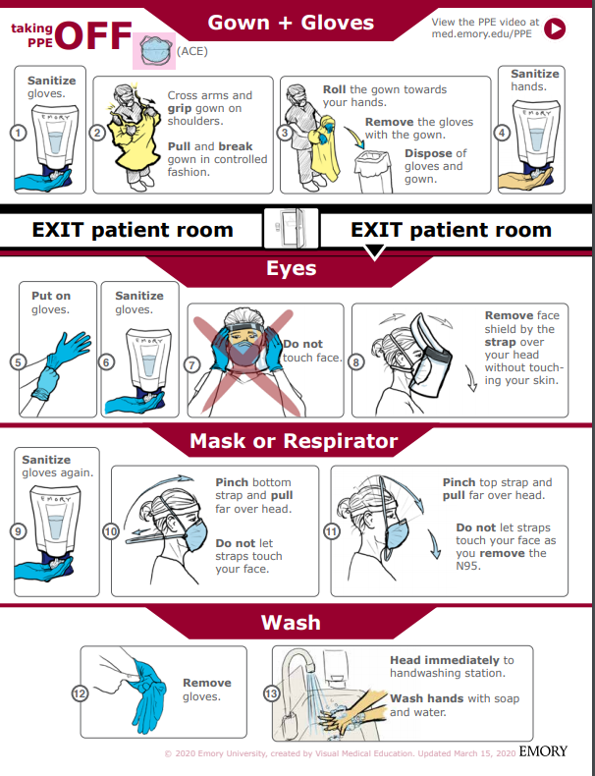
Taking off PPE: Gown
1. Sanitize Gloves
2. Cross arms and grip gown on shoulders. Pull and break gown in a controlled manner
3. Roll the gown towards your hands. Remove the gloves with the gown. Dispose of the gloves and gown.
4. Sanitize hands
https://med.emory.edu/departments/medicine/divisions/infectious-diseases/serious-communicable-diseases-program/pdf/taking-off-ace-conserve-2.pdf
Notes:
We really encourage you to go to the source for both the poster and matching videos. We want to highlight them here. The proper use for your facility, would be to go to the Emory website and use the resources as they have intended. This is just a summary.

Slide 81
Taking off PPE: Eye Protection
  Put on gloves
  Sanitize gloves
  Do NOT touch face
  Rove the face shield by the strap over head without touching our skin
https://med.emory.edu/departments/medicine/divisions/infectious-diseases/serious-communicable-diseases-program/pdf/taking-off-ace-conserve-2.pdf

Slide 82
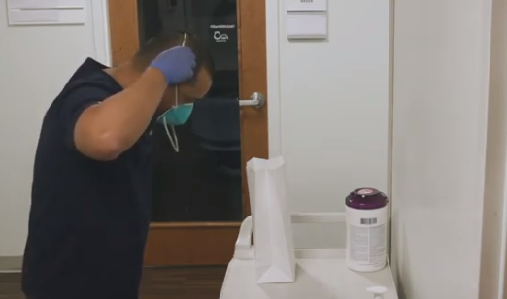
Taking off PPE: Mask
  Sanitize hands
  Pinch loops and pull them back and off your ears.
  Do not let loops touch your face
  Pull loops off without touching your face with them or your hands
  Remove the mask
  WASH
https://med.emory.edu/departments/medicine/divisions/infectious-diseases/serious-communicable-diseases-program/pdf/taking-off-ace-conserve-2.pdf
Notes:
AGAIN, we really encourage you to go to the source for both the poster and matching videos. We want to highlight them here. The proper use for your facility, would be to go to the Emory website and use the resources as they have intended. This is just a summary.

Slide 83
Regarding PPE use
Training must be provided anytime new equipment or new protocols are introduced
Personnel should be required to demonstrate competency: correct technique is observed by a trainer following each training
Posters and educational resources should be readily available; such as posters at the point of PPE donning and doffing
Audits of use with real-time education/feedback are very helpful to ensure proper protection of frontline personnel

Slide 84
https://bmjopen.bmj.com/content/bmjopen/5/4/e006577.full.pdf
Notes:
This study is from the British Medical Journal, published in 2015.
Conclusion This study is the first RCT of cloth masks, and the results caution against the use of cloth masks… Moisture retention, reuse of cloth masks and poor filtration may result in increased risk of infection. Further research is needed to inform the widespread use of cloth masks globally. However, as a precautionary measure, cloth masks should not be recommended for HCWs, particularly in high-risk situations...
I think we can use this to inform decisions about cloth mask use for HCW- as a stand alone, they are inadequate. Regarding use of cloth masks over N-95, for example, caution should be used to ensure that the wearer can breathe comfortably.

Slide 85
Crisis Capacity When N-95s are running low
HCP planned proximity to the case patient during encounter | Facemask or respirator determination
 | Patient masked for entire encounter (i.e., with source control) | Unmasked patient or mask needs to be removed for any period of time during the patient encounter
HCP will remain at greater than 6 feet from symptomatic patient | HCP remaining at this distance from the patient should not need to enter the patient care area; if entry required: no facemask or respirator | HCP remaining at this distance from the patient should not need to enter the patient care area; if entry required: no facemask or respirator
HCP will be within 3 to 6 feet of symptomatic patient | HCP remaining at this distance from the patient should not need to enter the patient care area; if entry required: facemask | HCP remaining at this distance from the patient should not need to enter the patient care area; if entry required: facemask
HCP will be within 3 feet of symptomatic patient, including providing direct patient care | Facemask | N95 respirator/ elastomeric /PAPR, based on availability
HCP will be present in the room during aerosol generating procedures performed on symptomatic persons | N95 respirator/ elastomeric /PAPR, based on availability | N95 respirator/ elastomeric /PAPR, based on availability

Slide 86
PPE Extended and Re-use at NM
Nebraska Medicine has posted how they are extending PPE use on the Nebraska Medicine COVID page- open access.
https://www.nebraskamed.com/sites/default/files/documents/covid-19/COVID-Extended-Use-Reuse-of-PPE-and-N95.pdf?date=03182020

Slide 87

Resources
CDC is updating guidance frequently and should be considered the best authority for most situations
  https://www.cdc.gov/coronavirus/2019-ncov/index.html (main)

Slide 88
Presentation prepared by: Dr. Maureen Tierney and Dr. Tom Safranek; Kate Tyner and Margaret Drake
HAI/AR Epidemiologist
Ishrat.kamal-ahmed@Nebraska.gov
402-471-2937

