Slide 1
Human Trafficking
Anne Boatright MSN,RN SANE-a
State Forensic Nursing Coordinator
Nebraska Attorney General’s Office

Slide 3
“Victim” and “survivor” are used interchangeably to provide consistency with statutory language and cross-agency terminology.
We recognize that individuals who have experienced trafficking are survivors at all stages of their abuse and recovery and are not defined by their victimization.
LANGUAGE MATTERS
Language Caveat

Slide 4
What is human trafficking?
Human trafficking is modern day slavery
Labor Trafficking
Sex Trafficking

Slide 5
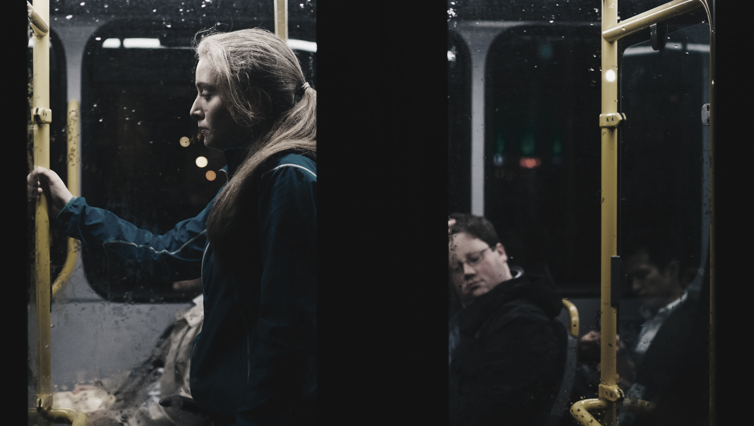
What is Sex Trafficking?
Notes:
Here in the US, in Nebraska, in [local city].

Slide 6
What is Sex Trafficking?
Human trafficking is the 2nd fastest growing criminal industry
$150 billion industry & growing
Children are majority of victims
Public Health Issue – 7 years

Slide 7
Recruitment, harboring, transportation, provision, solicitation or obtaining of a person for the purpose of a commercial sex act, in which the commercial sex act is induced by force, fraud, or coercion
Any minor under the age of 18 years induced into commercial sex is a victim of sex trafficking
What is Sex Trafficking?

Slide 8
Force
Any form of dominance, control, influence, violence or physical pressure.

Slide 9
Beating Others
“He started going off and first time I seen him beat one of his other girls was a 28 year-old girl

Slide 10
Fraud
In the end it will be just you and me.
Everything you earn is for US!
I will make you rich.
I will take care of you.
I love you, baby!
50/50 split

Slide 11
Coercion
Targets vulnerabilities of the victim
1
Financial
2
Psychological
3
PHYSICAL OR NON-PHYSICAL HARM

Slide 12
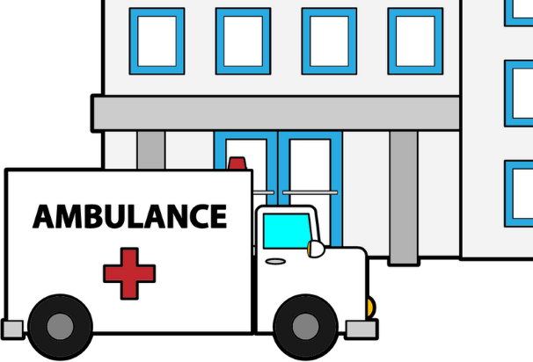
The Landscape of Exploitation
Coercion
Targets vulnerabilities of the victim
1
Financial
2
Psychological
3
Traffickers/Pimps
Family-based
Gang-based
Peer-based
Independent/Survival Sex
* Leslie Briner – Building a Justice Centered Movement
PHYSICAL OR NON-PHYSICAL HARM

Slide 13
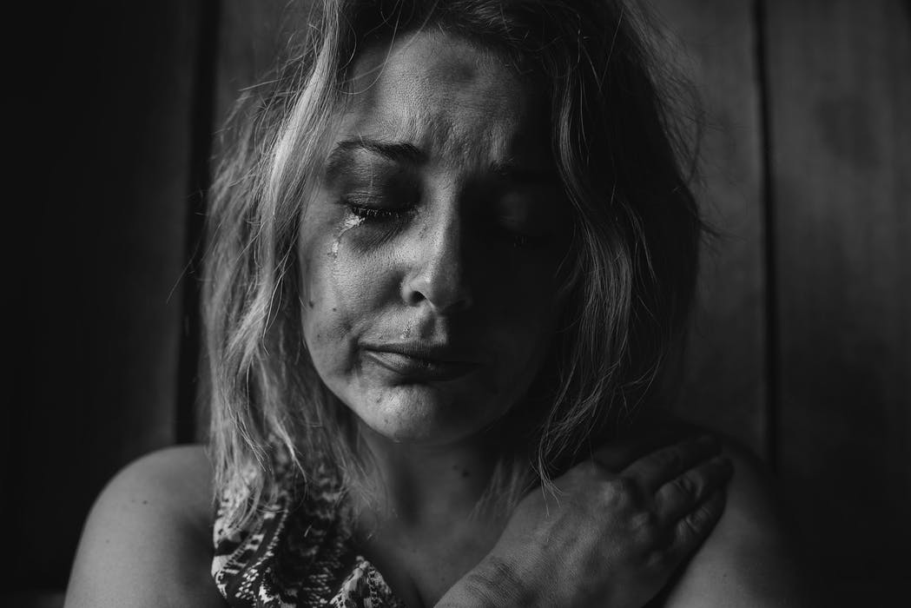
What do
traffickers
look like?

Slide 14
What is Sex Trafficking of a Minor?
Coercion
Targets vulnerabilities of the victim
1
Financial
2
Psychological
3
PHYSICAL OR NON-PHYSICAL HARM
Helping to sell
Trying to buy
Trading anything for value
in exchange for a sex act or pornography with a person

Slide 15
Missing Youth
25,000 youth missing from care were reported to NCMEC in 2017
1 in 7 of these children are likely victims of sex trafficking.
88% were in the care of social services when they went missing
National Center for Missing and Exploited Children, “Child Sex Trafficking Infographic,” 2017

Slide 16
Nebraska’s Missing Foster Youth
Notes:
Nebraska’s foster youth data

Slide 17
DCFS Missing Youth
Point in Time 1 /28/2019
27 DCFS youth missing from care

Slide 18
DCFS Missing Youth
Point in Time 1/28/2019

Slide 19
DCFS Missing Youth
Point in Time 1/28/2019
Notes:
Highest placement # is 34 ☹

Slide 20
DCFS Missing Youth
Point in Time 1/28/2019
Relative Foster Home
No Placement
In Nebraska, youth went missing from…
Parent/Caretaker
Detention Facility
Group Home
Independent Living
Agency-Supported Foster Home
YRTC
Notes:
Agency Supported Foster Home 13
Group Home 4
Kinship is a person who has a past connection to the youth. i.e. A pastor, a teacher, a babysitter, etc.
PRTF- Psychiatric Residential Treatment Facility
YRTC- Youth Residential Treatment Center-Geneva and Kearney
No placement- youth came into the system as living/home location unknown or unable to be located at last known residence

Slide 21
Sex Trafficking in Nebraska
Notes:
Here in the US, in Nebraska, in [local city].

Slide 22
Trafficking Risk
This Nebraska map illustrates the location of reports of human trafficking since 2016.*
Whitney
Chadron
Ainsworth
Atkinson
O’Neill
South Sioux City
Royal
Wayne
Norfolk
Scottsbluff
Bartlett
Schuyler
Fremont
Columbus
Omaha
Area
Kimball
Sidney
Ogallala
Stromsburg
Gothenburg
Grand Island
Seward
Lexington
Lincoln
Kearney
Hastings
Crete
McCook
Beatrice
*All reports are reviewed and investigated but not all are prosecuted.

Slide 23
A Young Market
11% advertised under the age of 21
20% advertised as very young based on keywords
“just turned 18”
“fresh meat”
“virgin”

Slide 24
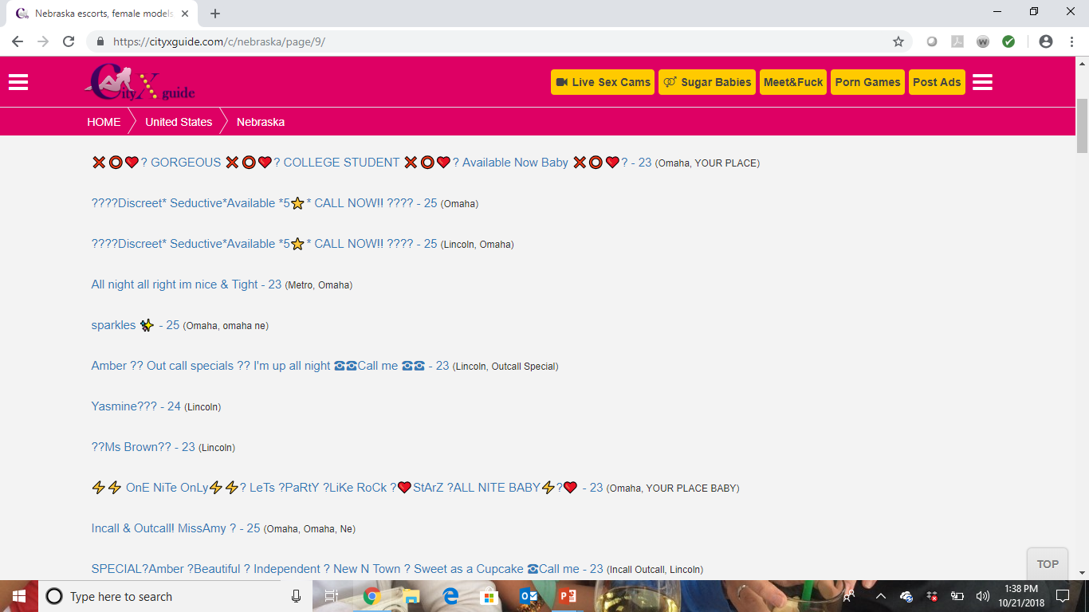

Slide 25
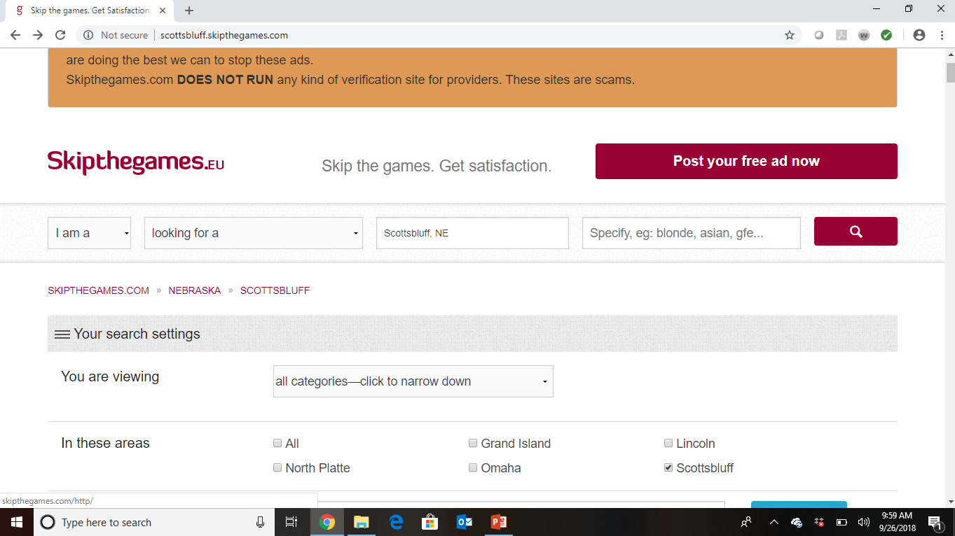

Slide 26
How Traffickers Operate
Notes:
Here in the US, in Nebraska, in [local city].

Slide 27
How Do Traffickers Operate?
Exploit vulnerabilities & marginalized status
Use of technology
Prior trauma
Immigration status
LGBTQ+
Age
Mental health
Poverty & homelessness
Neglect
Child welfare
Substance abuse
Control over these populations through social media often starts with FRAUD and can transition to COERCION and FORCE

Slide 28
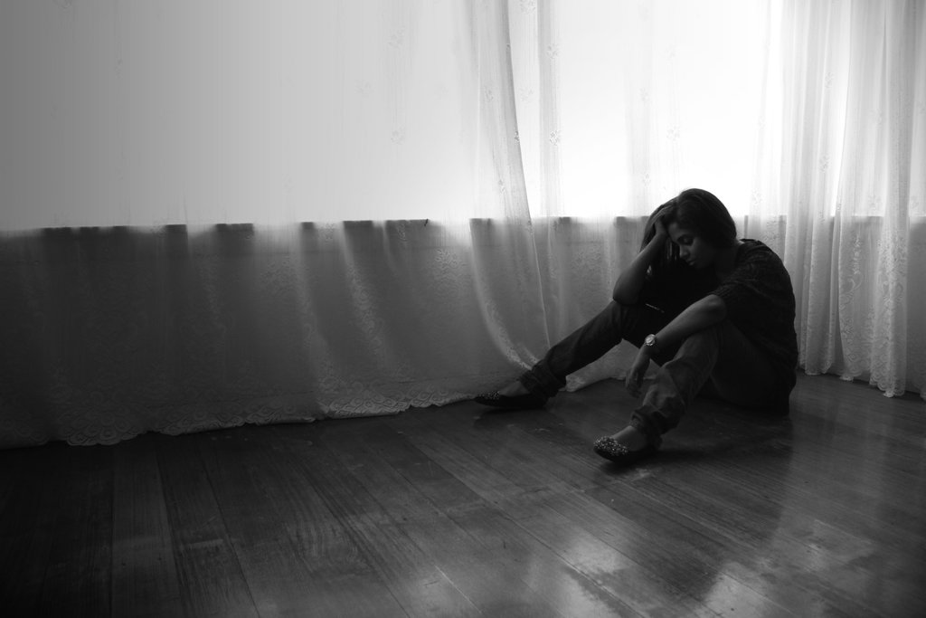
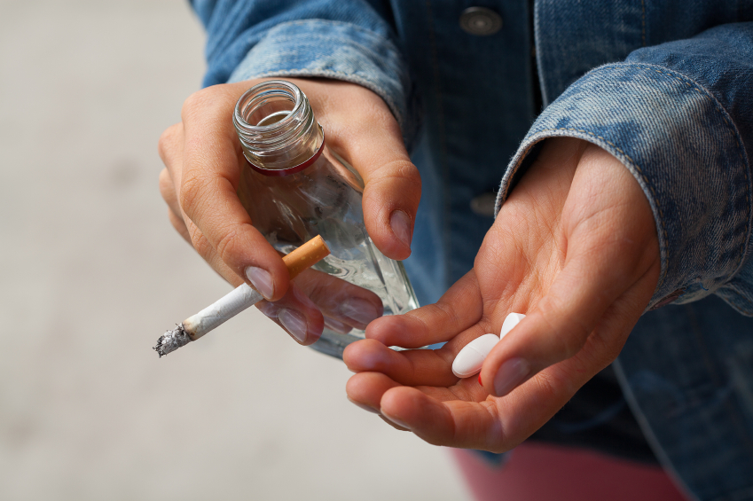
How Do Traffickers Operate?
POWER
and
CONTROL
Isolate victims from friends & family
Appeal to love
Physical, emotional, verbal, sexual abuse
Forced substance use
Appeal to fear
Trick victims

Slide 29
Warning Signs
Unusual tattoos
Several cell phones
No ID/Controlled by others
Large amounts of cash
Possession of hotel keys
Close relationship which raises suspicion
Unkempt and malnourished
Disorientation
Evidence of inflicted injury
Notes:
Nebraska Law: in addition to commercial sex act →
sexually explicit performance or
the production of pornography.
(The last two do not require sexual contact or perhaps commerce.)

Slide 30
Traditional Sexual Abuse Cases Verses Trafficking
Lack of disclosure
Doesn’t see themselves as victim
Will actively deny they are a victim
Behaviors perceived as “naughty or promiscuous” verses victimization.
Consent issues

Slide 31
Healthcare & Trafficking

Slide 32
Beazley Institute for Health Law and Policy:
Annals of Health Law
Any type of clinic 57.1%
Hospital/ER 63.3%
Planned Parenthood 29.6%
Regular doctor 22.5%
Urgent care clinic 21.4%
Women’s Health Clinic 19.4%
Neighborhood clinic 19.4%
On-site doctor 5.1%
Other 13.3%
88%

Slide 33
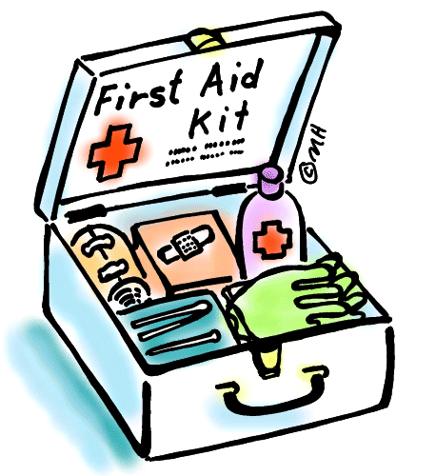
Trafficking Examples in Healthcare
Patients present for a variety of complaints.
Examples include but are not limited to …
Children missing from care present for medical care well check.
Sexual Assault report- statutory etc.
Injuries sustained through assault.
STD treatment
Pregnancy care/ treatment/ abortion services
Psychiatric or mental health needs
Others???

Slide 34
Screening of Suspected Victims…
Engage the victim alone
Ensuring appropriate screening tool
Significant others, friends, relatives could be perpetrators or other members of the stable
Discuss confidentiality and its limits
Assess for acute medical needs first
Safety plan before the conversation ends, if able

Slide 35
HEADSS mnemonic (At-risk youth screen)
Home: Who do you live with? Get along? Can you come & go? Run away
Education/Employment: Grades? Skip school? How make $/ survive?
Activities: Typical day? Do you have a significant other? How did you meet?
Drugs/alcohol: Use to escape? Do something didn’t want to when high/drunk/passed out?
Suicide/Safety: Thought of suicide? Fight w/ significant other?
Sex/Exploitation: How many in sex partners in life? When last time had sex? Ever pregnant/STI? Protection?

Slide 36
Care of Known Victims…
Discuss resources
Engage your community partners
Don’t be an investigator
Do know resources ahead of time

Slide 37
Health Consequences of Sex Trafficking Survivors
Beazley Institute Health Annals

Slide 38
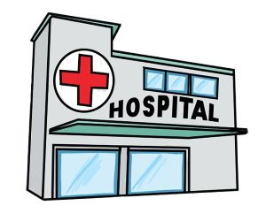
Survivors Reported
Any Physical Health Problem 99.1% (N=106)
Neurological 91.7% (N=106)
General Health 86.0% (N=105)
Injuries 69.2% (N=102)
Cardiovascular/Respiratory 68.5% (N=106)
Gastrointestinal 62.0% (N=106)
Dental 54.3% (N=105)

Slide 39
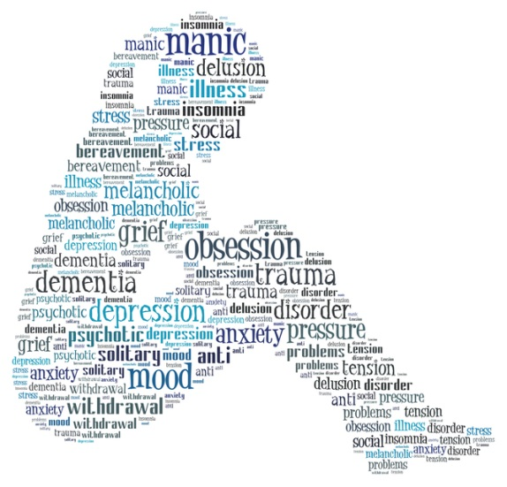
Trafficking Overlaps with Sexual Assault and DV
Strangulation is #1 predictor of IPV homicide.
50% of victims examined within hours have NO SIGNS of injury
50% of rapes include head injuries
60% of injuries occur to the head, face and neck
35% have orbital fractures
50% of victims physically abused are sexually abused
50% of sexual assaults involve strangulation

Slide 40
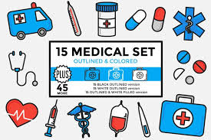
Important Aspects to Consider for Institutions Performing Examinations.
SANE provider outside ED staff or other models
Designated SANE room with specialized supplies
How to accomplish continuing education and training?
On-site medications.
Continual Quality Assurance.

Slide 41
So I Have a Victim, Now What??
Community response team benefits.
Knowing your resources and making the connections.
Who in your area can help?
How should activation of team look?
Know numbers/colleagues to call

Slide 42
Reporting Process
Mandatory reporting
Child Protective Services
Forensic Nurses
Child Advocacy Center
Law enforcement
Others?

Slide 43
Who Promotes Commercial Sex?
Notes:
Here in the US, in Nebraska, in [local city].

Slide 44
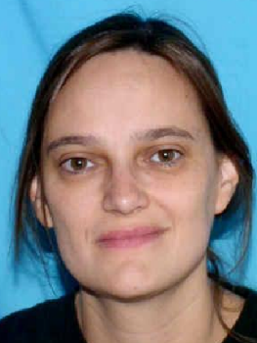
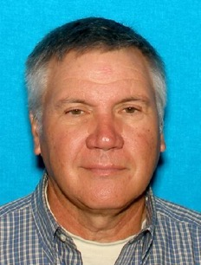
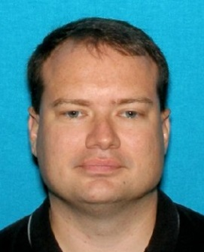
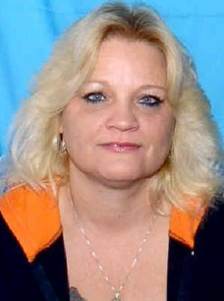
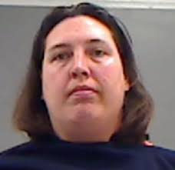
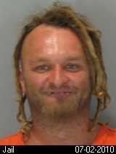
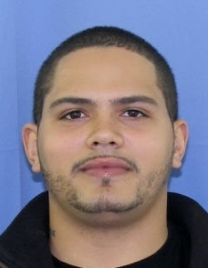
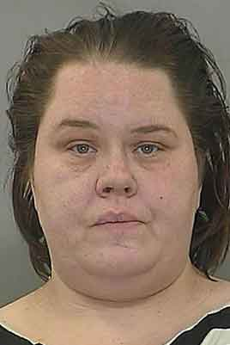
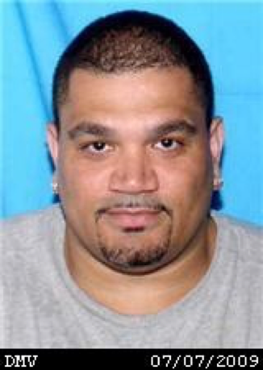
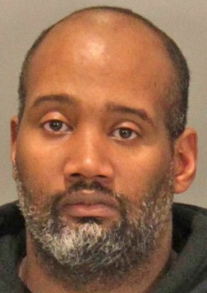
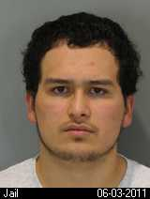
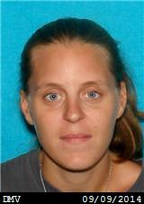
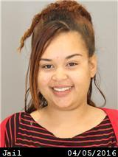
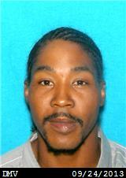
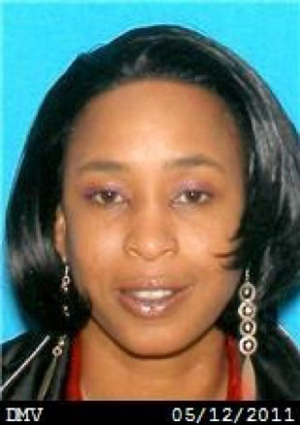
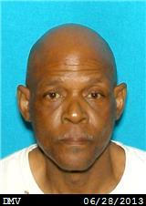
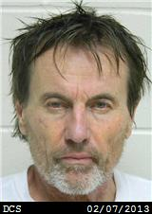
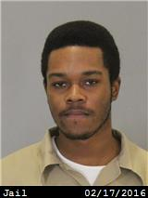
Who Promotes Commercial Sex?

Slide 45
NO BUYERS
NO TRAFFICKING

Slide 46
Who?
No Singular Profile
May not know or care if the person they purchase is trafficked or not
International Study of men who purchased sex reported 75% desire a woman under 25 and 22% desired a female under 18
Sex Buyers regularly inflict multiple forms of violence including but not limited to:
Abductions, Beating, Strangulation
Forced Oral, Anal, and Vaginal RAPE
Coercion to perform and or produce pornography
Mapping the Demand, Sex Buyers In The State of Minnesota, 2017 University of Minnesota

Slide 47
Use of Internet
Direct In Person Solicitation
Word of Mouth Networks
Mapping the Demand, Sex Buyers In The State of Minnesota, 2017 University of Minnesota
How

Slide 48
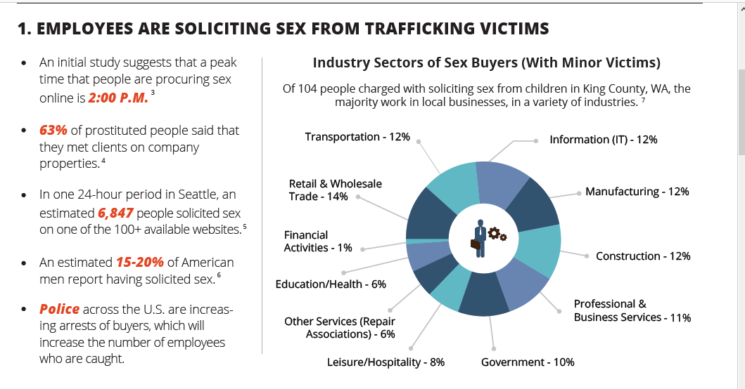

Slide 49
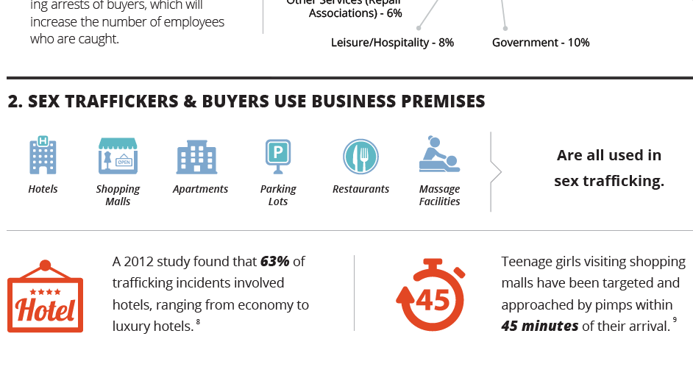

Slide 50
Listen
Be patient.
People who have experienced trauma may not share everything all at once.
Believe
Start by believing.
Build trust first vs focusing on facts.
Disclosure is a big first step.
Respect
Provide services and support …
no matter who it is.
Notes:
No standard set of questions fit every person.
Be sure to use reflective listening.
Be aware that canned stories are common and the true story may not emerge until trust has been built after multiple meetings.
Peel the onion-ask questions differently than expected.
What happens when you don’t do what is being asked of you?

Slide 51
It’s On Us
The system has failed these people many times.
We missed signs, symptoms and the environment.
Naturally test the system when seeking help.
We need to ask questions and be ready for the true answers.
Providers must build an environment of trust for children within our systems.
We need to encourage open communication and to return for help.
We need to empower with options by researching services.

Slide 52
Bringing it all Together
What policies does your institution have?
Who would you call?
What are your next steps?

Slide 53
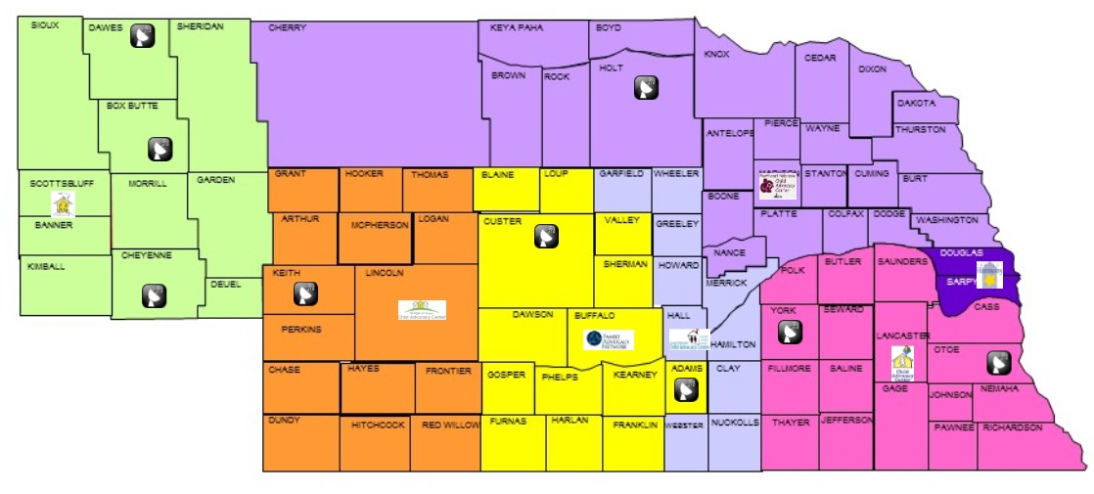
Nebraska Child Advocacy Centers

Slide 54
Know Your Local Contacts
Child Advocacy Center (CAC)
Domestic Violence/Sexual Assault Program
SAFE-T Trafficking Specialist
Nebraska State Patrol
Sexual Assault Nurse Examiner (SANE) Program

Slide 55
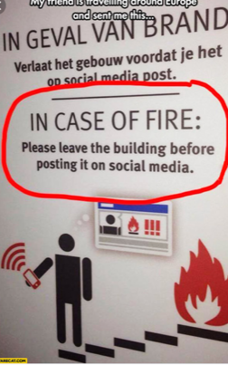
Too much training

Slide 56
We Cannot Do This Alone!!

Slide 57
The Community is advised:
If you suspect human trafficking
Call 911
or
National Human Trafficking Hotline
888-373-7888
or
Text “Help” to 233733

Slide 58
Panel Discussion
Investigator Tony Kavan
Nebraska State Patrol
Tony.Kavan@Nebraska.gov
Jamie Vetter- Executive Director
Family Advocacy Network Kearney
jdirwin@familyadvocacynetwork.org
Anne Boatright MSN, RN SANE-a
Anne.Boatright@Nebraska.gov

