Slide 1
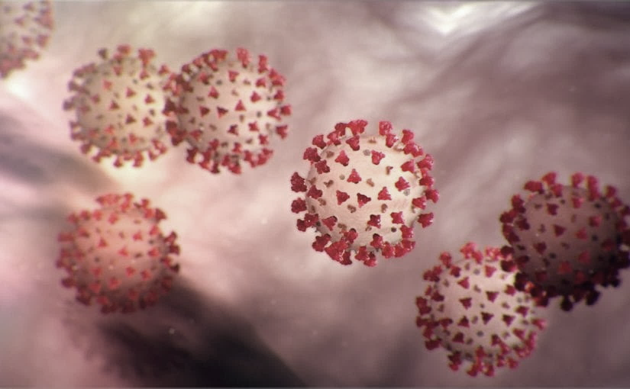
Covid-19 Webinex Update on ACH for COVID-19 3-23-20
Maureen Tierney, MD, MSc.
Healthcare Associated InfectionsMedical Director
Tom Safranek, MD, State Epidemiologist
Matthew Donahue, MD, EIS Officer, NE DHHS

Slide 2
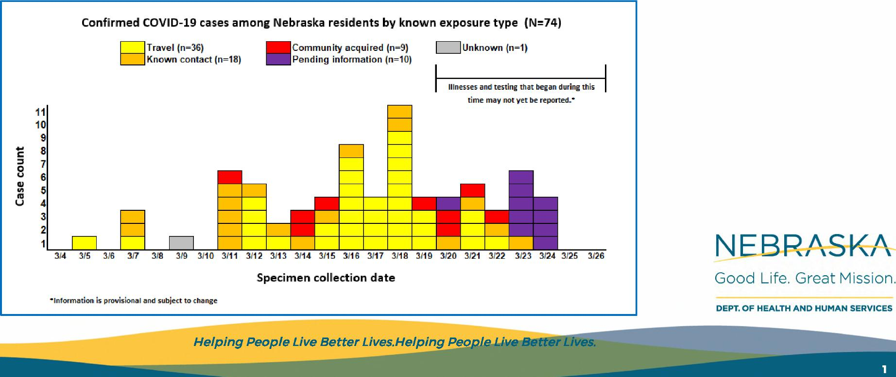
 | Local Health Department Update
GIS Dashboard URL: https://arcg.is/1v1Tm1
Confirmed COVID-19 cases among Nebraska residents by known exposure type (N=74)
Travel (n=36) ■Community acquired .(n=9).
Known contact (n=18) Pending information ;n=10}
Unknown (n=1)
Illnesses and testing that began during this time may not yet be reported.*
11 10 9 8 7 6 5 4 3 2
1
Ca se count
NEBRASKA
314 315 316 317 318 3/9 3110 3111 3112 3113 3114 3115 3116 3117 3118 3119 3120 3121 3122 3123 3124 3125 3126
Specimen collection date
Good Life. Great Mission.
Information is provisional and subject to change
DEPT. OF HEALTH AND HUMAN SERVICES
Helping People Live Better Lives.Helping People Live Better Lives.
Helping• People Live better Lives.
1

Slide 3
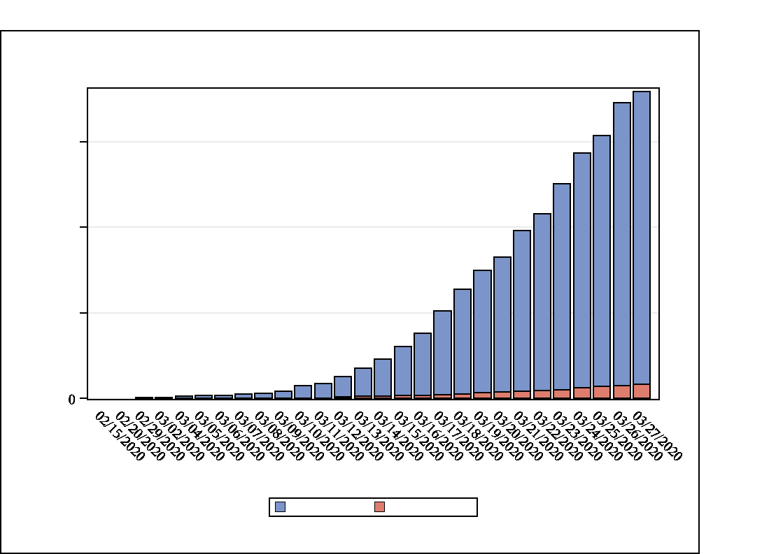
07:21 Friday, March 27, 2020 2
Cumulative Number of COVID-19 Tests and Confirmed Cases by Laboratory Report Date— Nebraska, February-March, 2020
1500
_{d}
_{tsee}
1000
_{lTtaoT}
500
Laboratory Report Date
Total Tested Total Positive
Data are provisional

Slide 4
07:21 Friday, March 27, 2020 4
Number of tests performed on Nebraska residents by local health jurisdiction and result --Nebraska, February-March 2020
 | Lab Status |  |  | Grand Total
 | Not Detected | Positive | Inconclusive
 | N | N | N | N
Jurisdiction | 73 | 7 | 1 | 81
Three Rivers Health Department
Lancaster County HD | 149 | 3 | . | 152
Sarpy/ Cass Dept. of Health and Wellness | 209 | 10 | . | 219
Scotts Bluff County Health Department | 22 | . | . | 22
Douglas County HD | 857 | 47 | 3 | 907
Central District Health Department | 42 | 2 | . | 44
Two Rivers Public Health Department | 49 | 5 | . | 54
Public Health Solutions | 34 | . | . | 34
Loup Basin Public Health Department | 16 | . | . | 16
Elkhorn Logan Valley Public Health Department | 44 | 1 | . | 45
Panhandle Public Health Department | 29 | . | . | 29
North Central District Health Department | 22 | 2 | 1 | 25
Southeast District Health Department | 19 | 1 | . | 20
West Central District Health Department | 49 | 3 | . | 52
Northeast Nebr Public Health Department | 10 | . | . | 10
South Heartland District Health Department | 17 | 2 | . | 19
Southwest Nebraska Public Health Department | 9 | . | . | 9
East Central Health Department | 19 | . | . | 19
Four Corners Health Department | 17 | . | . | 17
Dakota County Health Department | 19 | . | . | 19
Total | 1705 | 83 | 5 | 1793
Data are provisional

Slide 5
07:21 Friday, March 27, 2020 3
Number of tests performed on Nebraska residents by county and result -- Nebraska, February-March 2020
 | Lab Status |  | Grand Total
 | Positive | Inconclusive
 | N | N | N
Patient County | 45 | 3 | 48
Douglas
Cass | 2 |  | 2
Knox | 2 |  | 2
Sarpy | 8 |  | 8
Lincoln | 3 |  | 3
Adams | 2 |  | 2
Nemaha | 1 |  | 1
Buffalo | 4 |  | 4
Lancaster | 3 |  | 3
Dawson | 1 |  | 1
Washington | 5 | 1 | 6
Saunders | 2 |  | 2
Madison | 1 |  | 1
Holt |  | 1 | 1
Hall | 2 |  | 2
Kearney | 1 |  | 1
Not Reported | 1 |  | 1
Total | 83 | 5 | 88
Data are provisional

Slide 6
07:21 Friday, March 27, 2020 5
Number of positive, not detected, and inconclusive tests on Nebraska residents by performing laboratory -- Nebraska, February-March 2020
 | Lab Status |  |  | Grand Total
 | Not Detected | Positive | Inconclusive
 | N | N | N | N
Performing laboratory | 607 | 43 | . | 650
Nebraska Public Health Laboratory
The Nebraska Medical Center Clinical Lab | 599 | 27 | 3 | 629
LabCorp | 178 | 3 | . | 181
South Dakota Public Health Lab | . | 1 | . | 1
Focus Technology | 26 | . | . | 26
Avera McKennan Laboratory | 46 | 1 | . | 47
ARUP | 79 | 2 | 1 | 82
Iowa State Hygeienic Lab | 9 | . | . | 9
Mayo | 108 | 1 | . | 109
Quest | 51 | 4 | 1 | 56
Sanford Reference Laboratory | 1 | . | . | 1
Veterans Affairs Public Health Lab | . | 1 | . | 1
Avera Institute Human Genetics | 1 | . | . | 1
Total | 1705 | 83 | 5 | 1793
Data are provisional

Slide 7
Risk Factors
Travel—50-60%
UK, Italy, Singapore, WA, CA, FL, CO, NY
Contact-25-35%
Community Acquired-4
Selection/Testing Bias
Models from other cities likely 15-20 cases for every positive we see.

Slide 8
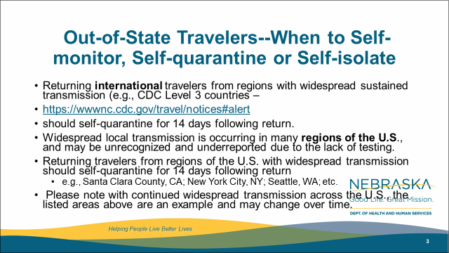
Out-of-State Travelers--When to Self-monitor, Self-quarantine or Self-isolate
Returning international travelers from regions with widespread sustained transmission (e.g., CDC Level 3 countries –
https://wwwnc.cdc.gov/travel/notices#alert
should self-quarantine for 14 days following return.
Widespread local transmission is occurring in many regions of the U.S., and may be unrecognized and underreported due to the lack of testing.
Returning travelers from regions of the U.S. with widespread transmission should self-quarantine for 14 days following return
  e.g., Santa Clara County, CA; New York City, NY; Seattle, WA; etc.
Please note with continued widespread transmission across the U.S., the listed areas above are an example and may change over time.

Slide 9

Identifying high risk domestic travel
https://coronavirus.jhu.edu/map.html
Notes:
As of 3/24

Slide 10
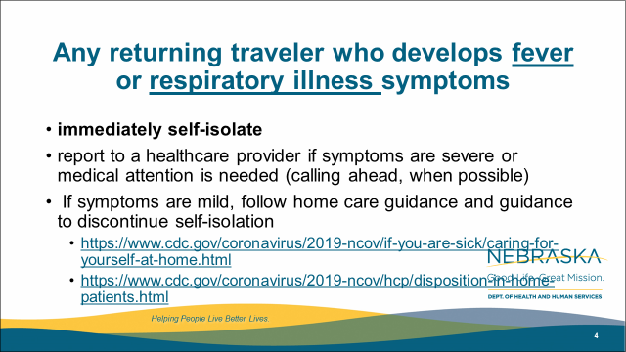
Out-of-State Travelers--When to Self-monitor, Self-quarantine or Self-isolate
Returning international travelers from regions with widespread sustained transmission (e.g., CDC Level 3 countries –
https://wwwnc.cdc.gov/travel/notices#alert
should self-quarantine for 14 days following return.
Widespread local transmission is occurring in many regions of the U.S., and may be unrecognized and underreported due to the lack of testing.
Returning travelers from regions of the U.S. with widespread transmission should self-quarantine for 14 days following return
  e.g., Santa Clara County, CA; New York City, NY; Seattle, WA; etc.
Please note with continued widespread transmission across the U.S., the listed areas above are an example and may change over time.

Slide 11
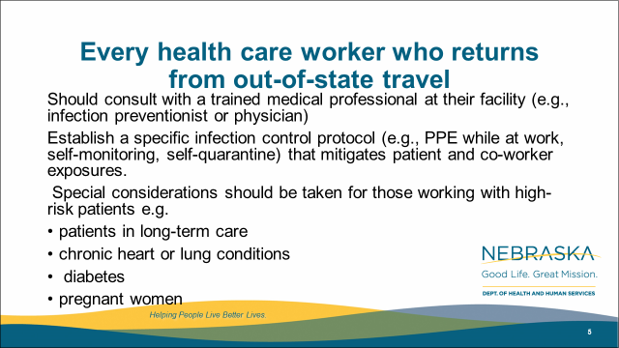
Every health care worker who returns from out-of-state travel
Should consult with a trained medical professional at their facility (e.g., infection preventionist or physician)
Establish a specific infection control protocol (e.g., PPE while at work, self-monitoring, self-quarantine) that mitigates patient and co-worker exposures.
Special considerations should be taken for those working with high-risk patients e.g.
patients in long-term care
chronic heart or lung conditions
diabetes
pregnant women

Slide 12
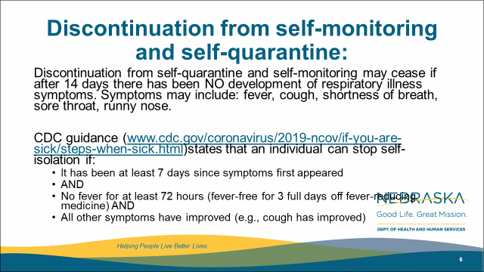
Discontinuation from self-monitoring and self-quarantine:
Discontinuation from self-quarantine and self-monitoring may cease if after 14 days there has been NO development of respiratory illness symptoms. Symptoms may include: fever, cough, shortness of breath, sore throat, runny nose.
CDC guidance (www.cdc.gov/coronavirus/2019-ncov/if-you-are-sick/steps-when-sick.html)states that an individual can stop self-isolation if:
  It has been at least 7 days since symptoms first appeared
  AND
  No fever for at least 72 hours (fever-free for 3 full days off fever-reducing medicine) AND
  All other symptoms have improved (e.g., cough has improved)

Slide 13
Discontinuation of Home Isolation
Time-since-illness-onset and time-since-recovery strategy (non-test-based strategy)*
Persons with COVID-19 who have symptoms and were directed to care for themselves at home may discontinue home isolation under the following conditions:
At least 3 days (72 hours) have passed since recovery defined as resolution of fever without the use of fever-reducing medications and improvement in respiratory symptoms (e.g., cough, shortness of breath); and,
At least 7 days have passed since symptoms first appeared.
(UNMC may recommend longer periods)
Test based Strategy
Negative results of an FDA Emergency Use Authorized molecular assay for COVID-19 from at least two consecutive nasopharyngeal swab specimens collected ≥24 hours apart** (total of two negative specimens).

Slide 14
Discontinuation of Isolation
Individuals with laboratory-confirmed COVID-19 who have not had any symptoms may discontinue home isolation when at least 7 days have passed since the date of their first positive COVID-19 diagnostic test and have had no subsequent illness.
Footnote
*This recommendation will prevent most, but may not prevent all instances of secondary spread. The risk of transmission after recovery, is likely very substantially less than that during illness.

Slide 15
Updates-When should HCPs Self Quarantine
Travel-to high risk areas self quarantine if at all possible (and upon returning from any travel if possible); if not possible, consult IP or ID/PH/Med Dir.
Any respiratory symptoms or fever of greater than 99.9F.
If there is a household member who is positive for COVID-19, or highly suspected of having COVID-19.
They have been caring for a person who was documented as having COVID-19
and were not wearing necessary PPE –please see next slide for what to do based on different exposures.

Slide 16
HCP Return to work
Wear a facemask until all symptoms are resolved or 14 days after symptom onset whichever is longer
Be restricted from contact with severely immunocompromised patietns
Adhere to HH and respiratory etiquette as recommended for control of COVID-19 in the interim guidance
Self monitor for worsening or recurrence of symptoms and notify employee health/occupational health/supervisor if occurs

Slide 17
EVS Cleaning After COVID 19 patient leaves
Terminal cleaning may be performed by EVS personnel.
Delay entry into the room until a sufficient time has elapsed for enough air changes to remove potentially infectious particles. We do not yet know how long SARS-CoV-2 remains infectious in the air.
See next slide for table on air exchanges-time room will be 99% or 99.9% free of particles
After this time has elapsed, EVS personnel may enter the room and should wear a gown and gloves when performing terminal cleaning.
A facemask and eye protection should be added if splashes or sprays during cleaning and disinfection activities are anticipated or otherwise required based on the selected cleaning products.

Slide 18
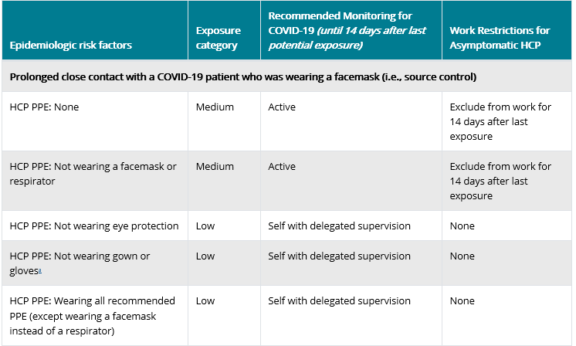
Exposure Risk Assessment
https://www.cdc.gov/coronavirus/2019-ncov/hcp/guidance-risk-assesment-hcp.html

Slide 19

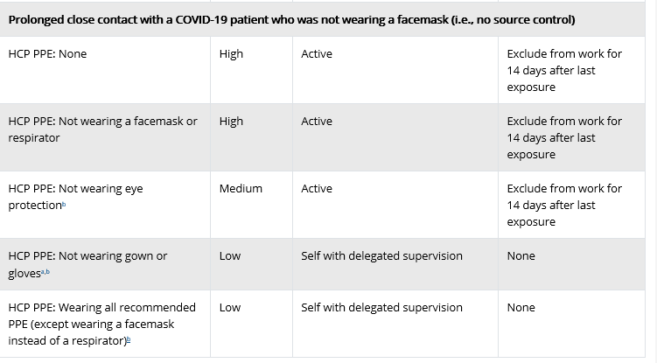
Exposure Risk Assessment
https://www.cdc.gov/coronavirus/2019-ncov/hcp/guidance-risk-assesment-hcp.html

Slide 20
Clinical Diagnosis
Given the consequences of widespread transmission, public health authorities nationally are broadening the range of clinical syndromes warranting self-isolation:
Possible case (not clear definition)
• Temperature ≥100.4°F (HCP-100.0)
• Cough often dry
• Shortness of breath and/or CP
• +/- Sore throat (more prominent in recent cases)
In process of developing definite, probable and suspected case definitions and which ones to report.
To limit potential transmission, if any of these symptoms are present, alone or in combination (in the absence of a known alternative diagnosis): patients should self-isolate.

Slide 21
Precautions when evaluating patients for non COVID 19 issues
If the patient is afebrile (temperature is less than 100.0ºF) and otherwise without even mild symptoms* that might be consistent with COVID-19 (e.g., cough, sore throat, shortness of breath), then precautions specific to COVID-19 are not required. However, until the patient is determined to be without such symptoms, HCP should wear all recommended PPE for the patient encounter.
*Note: In addition to cough and shortness of breath, nonspecific symptoms such as sore throat, myalgia, fatigue, nausea, and diarrhea have been noted as initial symptoms in some cases of COVID-19. These symptoms can have several alternative explanations; however, failure to identify and implement proper precautions in a healthcare setting for persons infected with COVID-19 can contribute to widespread transmission in that facility due to the presence of susceptible patients and close interactions with healthcare personnel. For this reason, a lower temperature of 100.0ºF and the inclusion of mild and non-specific symptoms should be used by healthcare settings evaluating these patients to increase the ability to detect even mild cases of COVID-19.

Slide 22
UPDATED TESTING RECOMMENDATIONS
Evidence suggests >80% of COVID-19 infections are mild (fever is variable with COVID-19 infection and may be absent), might not warrant a healthcare visit or lab test, and do not require hospitalization. Telephone triage and appropriate self-isolation can suffice in most cases.
A simple clinical diagnosis of COVID-19 infection warrants self-isolation, and should be the norm, even in the absence of a positive COVID-19 lab result.
Expanded testing capacity is becoming available:
All hospitalized patients with respiratory symptoms and no other diagnosis
All HCPs including first responders with symptoms or known contact with symptoms
All LTC residents with symptoms
Next priority are
Vulnerable populations who are outpatients
Further specific guidance should be out later today/tomorrow.

Slide 23
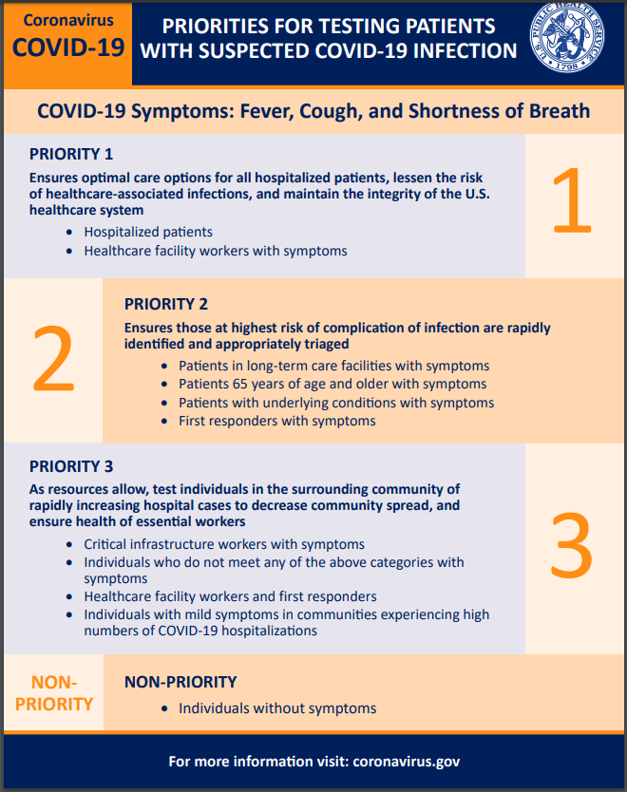
https://www.cdc.gov/coronavirus/2019-ncov/downloads/priority-testing-patients.pdf
Notes:
This is just a new infographic I saw this morning. It is a nice, easy to view summary of the testing priorities.

Slide 24
Pregnancy and Breast Feeding-Prelim Data
Pregnancy-immunocompromising ot some degree-does this cover increased risk for sever disease-no data has shown this yet and di not appear to be the case in China.
No documented vertical transmission documented
Adverse Outcomes-not clearly shown but really unknown
high fevers in first trimester can be associated with some adverse outcomes
severe respiratory infection can be associated with low birth weight
Breast Feeding Not detected in breast milk yet
transmission from close contact

Slide 25
Call In Lines; Facility Screening
1. NM-Info hotline and referral -400-922-0000; Evaluated over the phone
referred one of their outpatient clinics, Can do their own test
2. CHI-CHIhealth.com 8am to 8pm; after hours virtual care (for CB, IMM, Lakeside St. Es, St. Francis and Good Sam )
Virtual Screening referred to MD or ANP; free.
Methodist 402-815-7425 24/7
  Doing testing on main campus
4. Bryan -24/7 hotline-402-481-0500; also website from their Bryan Health homepage
ezVisit-if for coronavirus questions will be provided free of charge
5. Great Plains Health-no hotline-ask people to call their PCP.

Slide 26
Reporting to LHD
Reporting to LHD should primarily be by providers not patients. The LHD staff screening for who to test need the providers to have done some clinical screening/evaluating first (which may all be by phone)
Any general questions by the public can be answered by the general COVID 19 hotlines at various LHDs
Douglas Co Help Line is the following.
Listing of the local health departments and contacts:
http://dhhs.ne.gov/CHPM%20Documents/contacts.pdf

Slide 27
From CDC-Patient Placement
For patients with COVID-19 or other respiratory infections, evaluate need for hospitalization. If hospitalization is not medically necessary, home care is preferable if the individual’s situation allows.
If admitted, place a patient with known or suspected COVID-19 in a single-person room with the door closed. The patient should have a dedicated bathroom.
  Airborne Infection Isolation Rooms (AIIRs) should be reserved for patients who will be undergoing aerosol-generating procedures (intubation, sputum inductionsuctioning, bronchoscopy
  CDC answers to question about nebulizer therapy and negative pressure rooms:
As a measure to limit HCP exposure and conserve PPE, facilities could consider cohorting staff and if possible, designating entire units within the facility, with dedicated HCP, to care for known or suspected COVID-19 patients. Dedicated means that HCP are assigned to care only for these patients during their shift

Slide 28
CDC Recommendations for PPE
Based on local and regional situational analysis of PPE supplies, facemasks are an acceptable alternative when the supply chain of respirators cannot meet the demand. During this time, available respirators should be prioritized for procedures that are likely to generate respiratory aerosols, which would pose the highest exposure risk to HCP.
    Facemasks protect the wearer from splashes and sprays.
    Respirators, which filter inspired air, offer respiratory protection.
    When the supply chain is restored, facilities with a respiratory protection program should return to use of respirators for patients with known or suspected COVID-19Eye protection, gown, and gloves continue to be recommended.
    If there are shortages of gowns, they should be prioritized for aerosol-generating procedures, care activities where splashes and sprays are anticipated, and high-contact patient care activities that provide opportunities for transfer of pathogens

Slide 29
CDC Guidance on Nebulizing Treatments
Yes, nebulization is considered aerosol generating. However, the role it plays in the transmission of SARs-CoV-2 is not absolutely known at this point. In settings like nursing homes, where N95s are not readily available, we have been encouraging the following:
If patient can tolerate, switch to metered-dose inhalers with a dedicated spacer.
  HCW should wear a facemask during the procedure if a respirator is unavailable. Eye protection, gloves, and gowns are also recommended.
  Close patient door when providing nebulizer treatment.
  Upon set-up of nebulizer, have HCW maintain a safe distance (6 feet or greater), possibly outside the door.
  While our guidance does state that AGPs should ideally be conducted in a negative pressure room, given the limit of these rooms conducting all nebs in a negative pressure room is not feasible. would suggest prioritizing negative pressure rooms for other AGPs such as intubation, extubation, open suction, and bronchoscopy.

Slide 30
Air Exchanges per hour | Time (in minutes) required for removal 99% efficiency | Time (in minutes) required for removal 99.9% efficiency
2 | 138 | 207
4 | 69 | 104
6 | 46 | 69
8 | 35 | 52
10 | 28 | 41
Values apply to an empty room with no aerosol-generating source. With a person present and generating aerosol, this table would not apply. Removal times will be longer in rooms or areas with imperfect mixing or air stagnation. Caution should be exercised in using this table in such situations.
https://www.cdc.gov/infectioncontrol/guidelines/environmental/appendix/air.html#tableb1
Notes:
Values apply to an empty room with no aerosol-generating source. With a person present and generating aerosol, this table would not apply. Removal times will be longer in rooms or areas with imperfect mixing or air stagnation.²¹³ Caution should be exercised in using this table in such situations.
Cleaning could occur during this time, as long as respiratory protection is worn. Room would be blocked for appointments until the specified time has elapsed.

Slide 31
Minimizing Spread
The best way to minimize COVID-19 virus introduction/spread in Nebraska is to:
minimize out- of-state travel;
maximize the amount of self-quarantine, social distancing, and non-pharmaceutical interventions among travelers returning to Nebraska.
Maximize the use of social distancing, frequent hand washing or use of hand sanitizer, and covering cough and sneezes
Self isolation of contacts of cases, and family members of those with respiratory illness.
At this time we have clear but limited evidence of local transmission of COVID-19 (i.e., persons with no travel history and no identifiable exposure to a likely source of COVID-19

Slide 32
Strategies for Optimizing the Supply of PPE

Slide 33
PPE Supply
Previous calls have identified the issues with limited supply
Any new PPE gets distributed to LHDs who distribute based on need in theor jurisdictions, aggressive efforts underway to get more PPE
CDC strategies are tier-based and facilities should be utilizing all the listed strategies including:
  Conventional
  Contingency
  Crisis
  https://www.cdc.gov/coronavirus/2019-ncov/hcp/ppe-strategy/index.html
  Regarding use of homemade masks:
  https://www.cdc.gov/coronavirus/2019-ncov/hcp/ppe-strategy/face-masks.html
Notes:
Regarding facemasks- especially- just some caution about the use of homemade masks.
CDC notes regarding the use of homemade masks:
“n settings where facemasks are not available, HCP might use homemade masks (e.g., bandana, scarf) for care of patients with COVID-19 as a last resort. However, homemade masks are not considered PPE, since their capability to protect HCP is unknown. Caution should be exercised when considering this option. Homemade masks should ideally be used in combination with a face shield that covers the entire front (that extends to the chin or below) and sides of the face.”

Slide 34
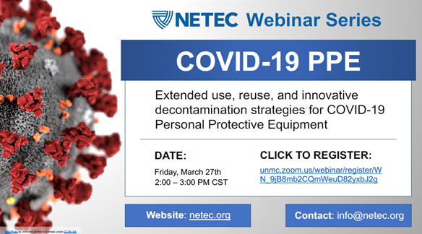
Registration link: https://unmc.zoom.us/webinar/register/WN_9jB8mb2CQmWeuD82yxbJ2g

Slide 35
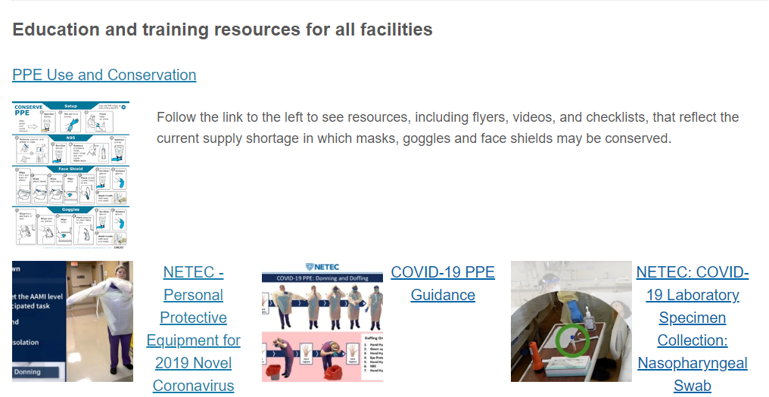
https://repository.netecweb.org/exhibits/show/ncov/ncov
Notes:
NETEC offers excellent training resources on COVID-19 PPE use, as well as conservation

Slide 36
Updates from Interim Guidance for IP in HC
For care other than aerosol generating procedures a face mask can replace an N-95 if an N-95 is not available
If gowns become scarce gowns should be reserved for
Aerosol generating procedures
Care where splashes and sprays anticipated
High contact care activities
In extreme scarcity-
Moving between patients with same confirmed diagnosis and eye protection and mask
not soiled by spray etc
remove only gloves and gowns and perform HH
replace gowns and gloves for next patient

Slide 37
Extended Use versus Re-use
Extended use refers to the practice of wearing the same N95 respirator for repeated encounters with several patients, without removing the respirator between the encounters. Extended use may be implemented when multiple patients are infected and patients are placed together in dedicated waiting rooms, clinics or hospital units. o
Eye protection may be left in place with the N95 respirator for extended use. •
Reuse refers to the practice of using the same N95 respirator for multiple encounters with patients but removing it (‘doffing’) between at least some of the encounters. The respirator is stored in between encounters and reused. o
Re-use of full face shields will be permitted.
Face shields will be dedicated for use by individual healthcare personnel.
Disinfection of the face shield will be required between uses.

Slide 38
Extended Use of N-95s
Discard N95 respirators following use during aerosol generating procedures.
Discard N95 respirators contaminated with blood, respiratory or nasal secretions, or other bodily fluids from patients.
Discard N95 respirators following close contact with, or exit from, the care area of any patient co-infected with an infectious disease requiring contact precautions.
Consider use of a cleanable face shield (preferred³) over an N95 respirator and/or other steps (e.g., masking patients, use of engineering controls) to reduce surface contamination.
Perform hand hygiene with soap and water or an alcohol-based hand sanitizer before and after touching or adjusting the respirator (if necessary for comfort or to maintain fit)

Slide 39
Re-use of N-95s
Discard N95 respirators following use during aerosol generating procedures.
Discard N95 respirators contaminated with blood, resp. or nasal secretions, or other bodily fluids
Discard N95 respirators following close contact with any patient co-infected with an infectious disease requiring contact precautions.
Use a cleanable face shield (preferred) or a surgical mask over an N95 respirator and/or other steps (e.g., masking patients, use of engineering controls), when feasible
Hang used respirators in a designated storage area or keep them in a clean, breathable container such as a paper bag between uses. To minimize potential cross-contamination, store respirators so that they do not touch each other and the person using the respirator is clearly identified.
Clean hands with soap and water or an alcohol-based hand sanitizer before and after touching or adjusting the respirator (r to maintain fit). Avoid touching the inside of the respirator.
Use a pair of clean (non-sterile) gloves when donning a used N95 respirator and performing a user seal check. Discard gloves after the N95 respirator is donned and any adjustments are made to ensure the respirator is sitting comfortably on your face with a good seal.

Slide 40

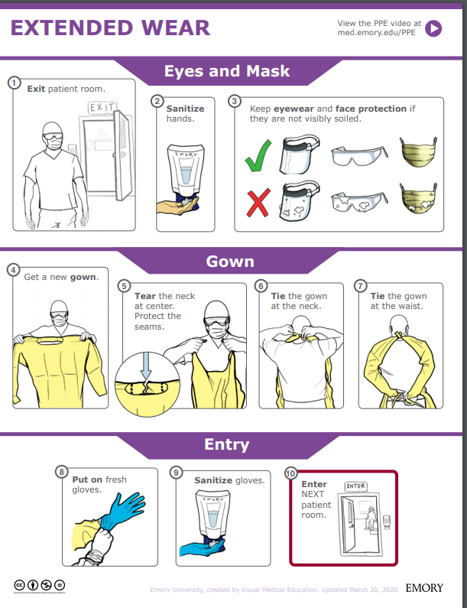
Extended Wear:
Exit room
Sanitize hands
Keep eye wear and face protection if they are not visibly soiled.
Get a new gown
Tear the neck at the center. Protect the seams
Ties the gown at the neck
Ties the gown at the waist
Put on fresh gloves
Sanitize gloves
Enter the next patient room
https://med.emory.edu/departments/medicine/divisions/infectious-diseases/serious-communicable-diseases-program/pdf/extended-wear.pdf
Notes:
This infographic could be posted at the point of PPE Donning. Another infographic is available for doffing, of course.
We think the graphic and the video really need to be paired for clarity- and just want to make you aware of these resources.

Slide 41


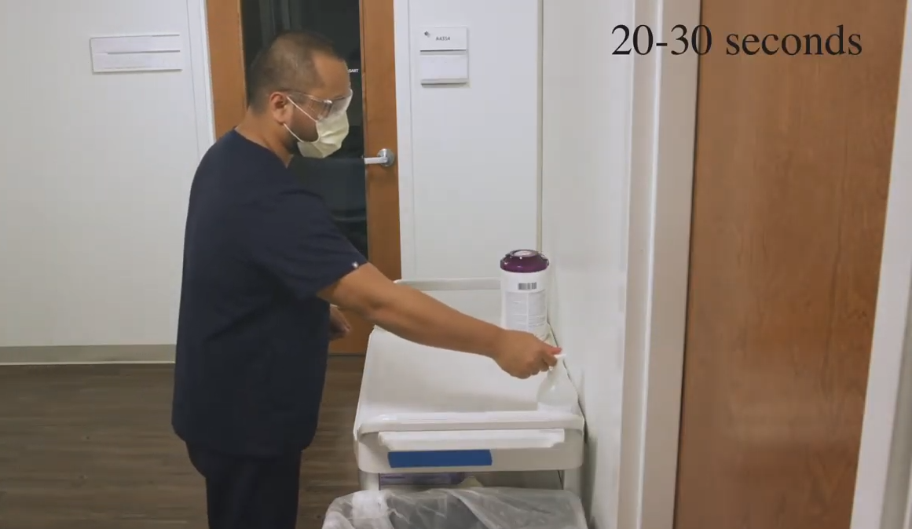
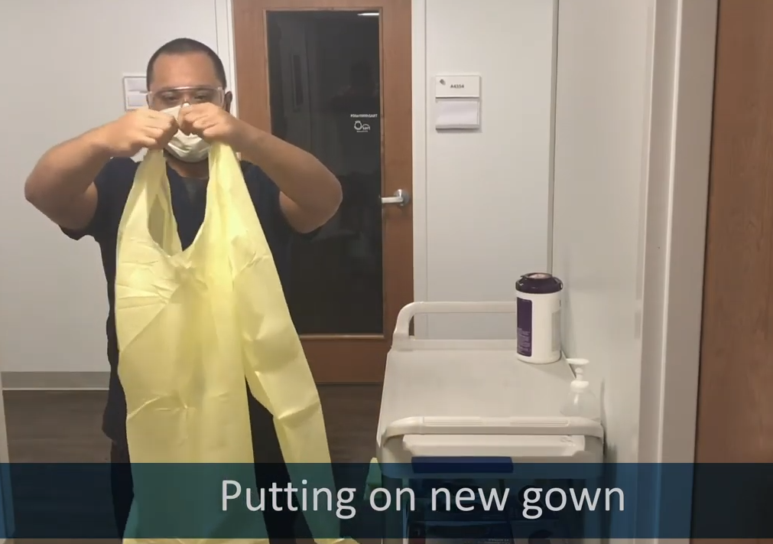
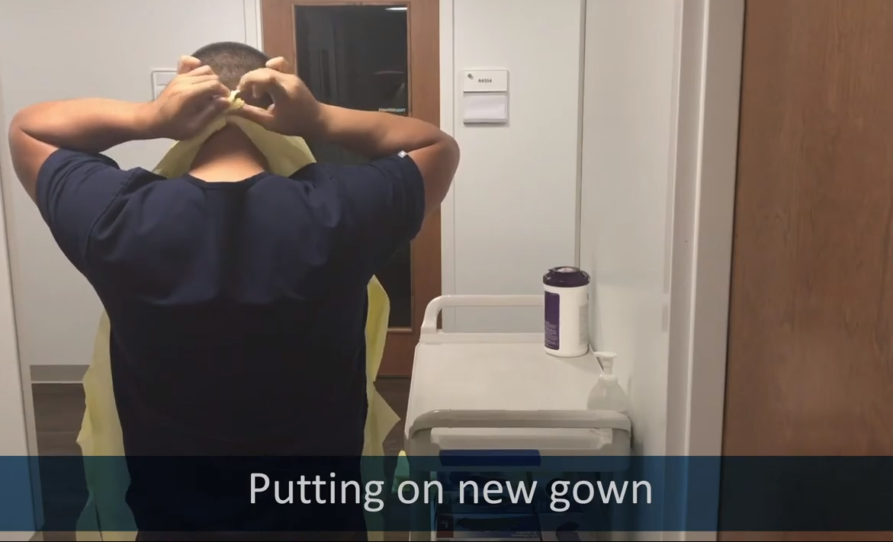
https://med.emory.edu/departments/medicine/divisions/infectious-diseases/serious-communicable-diseases-program/covid-19-resources/conserving-ppe.html
Notes:
The infographics are at the top of this page, but the better place to start is towards the bottom of the page with the instructional video series. In this set clips from the video, you see the HCW donning PPE as part of a conservation strategy to extend the use of eye protection and mask. Highlighted here is the strategy to tear the gown at the neck so that there is no reason to pull the gown over the head/ over the PPE which is still in use.

Slide 42
Re-use of N-95s
Discard N95 respirators following use during aerosol generating procedures.
Discard N95 respirators contaminated with blood, resp. or nasal secretions, or other bodily fluids
Discard N95 respirators following close contact with any patient co-infected with an infectious disease requiring contact precautions.
Use a cleanable face shield (preferred) or a surgical mask over an N95 respirator and/or other steps (e.g., masking patients, use of engineering controls), when feasible
Hang used respirators in a designated storage area or keep them in a clean, breathable container such as a paper bag between uses. To minimize potential cross-contamination, store respirators so that they do not touch each other and the person using the respirator is clearly identified.
Clean hands with soap and water or an alcohol-based hand sanitizer before and after touching or adjusting the respirator (r to maintain fit). Avoid touching the inside of the respirator.
Use a pair of clean (non-sterile) gloves when donning a used N95 respirator and performing a user seal check. Discard gloves after the N95 respirator is donned and any adjustments are made to ensure the respirator is sitting comfortably on your face with a good seal.

Slide 43
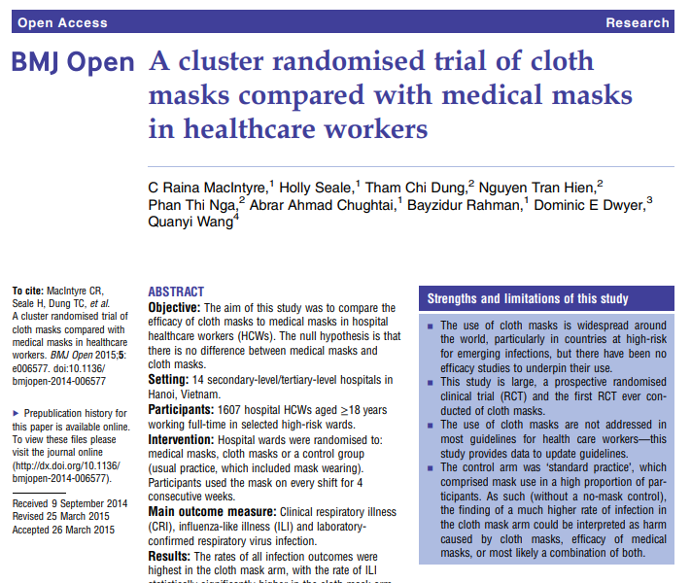
https://bmjopen.bmj.com/content/bmjopen/5/4/e006577.full.pdf
Notes:
This study is from the British Medical Journal, published in 2015.
Conclusion This study is the first RCT of cloth masks, and the results caution against the use of cloth masks… Moisture retention, reuse of cloth masks and poor filtration may result in increased risk of infection. Further research is needed to inform the widespread use of cloth masks globally. However, as a precautionary measure, cloth masks should not be recommended for HCWs, particularly in high-risk situations...
I think we can use this to inform decisions about cloth mask use for HCW- as a stand alone, they are inadequate. Regarding use of cloth masks over N-95, for example, caution should be used to ensure that the wearer can breathe comfortably.

Slide 44
UV Disinfection of PPE
“A team led by John Lowe, PhD, UNMC assistant vice chancellor for inter-professional health security training and education has developed a safe and effective method to decontaminate N95 respirators so they can be used multiple times, instead of just once. It involves using ultraviolet light towers to irradiate high numbers of N95 respirators.
The decontamination of these items works like this: groups of N95s are safely bagged and transported to a room inside Nebraska Medical Center, which is equipped with two ultraviolet light towers. The N95 respirators are hung on wires stretching the length of the room and then decontaminated when the lights are powered on. They are then removed and returned to the original owners for reuse.”
This is public facing now on the NETEC site.
https://repository.netecweb.org/files/original/fe9a813e5643ab774a62b4b1778117e0.pdf

Slide 45
From the CDC –ABHR Shortages
If “severe shortages of ABHR (and have exhausted supply chain access to efficacious products) may consider local production of formulations as described by the FDA Policy for Compounding of Certain Alcohol-Based Hand Sanitizer Productsexternal icon. This policy remains in effect through April 30, 2020. Formulations included in the FDA guidance are consistent with World Health Organization production guidance. These locally produced products are intended for routine healthcare personnel hand cleaning, must not contain active ingredients other than those specified in the FDA guidance, and should not take the place of other regulated skin antiseptics (e.g. surgical hand rub). To avoid contamination with spore-forming organisms, WHO formulations require a 72-hour post-production quarantine. Organizations should revert to the use of commercially produced, FDA-approved product once such supplies again become available.”
Here is the link to The World Health Organization's hand rub directions:https://www.who.int/gpsc/5may/Guide_to_Local_Production.pdf
Here is the FDA one:https://www.fda.gov/news-events/press-announcements/coronavirus-covid-19-update-fda-provides-guidance-production-alcohol-based-hand-sanitizer-help-boost

Slide 46

Infection Prevention and Control
Office Hours
Monday – Friday
7:30 AM – 9:30 AM Central Time
2:00 PM -4:00 PM Central Time
Call 402-552-2881

Slide 47
PPE Examples: Conserving, Donning and Doffing
Repeat slides from Wednesday 3.25.20

Slide 48
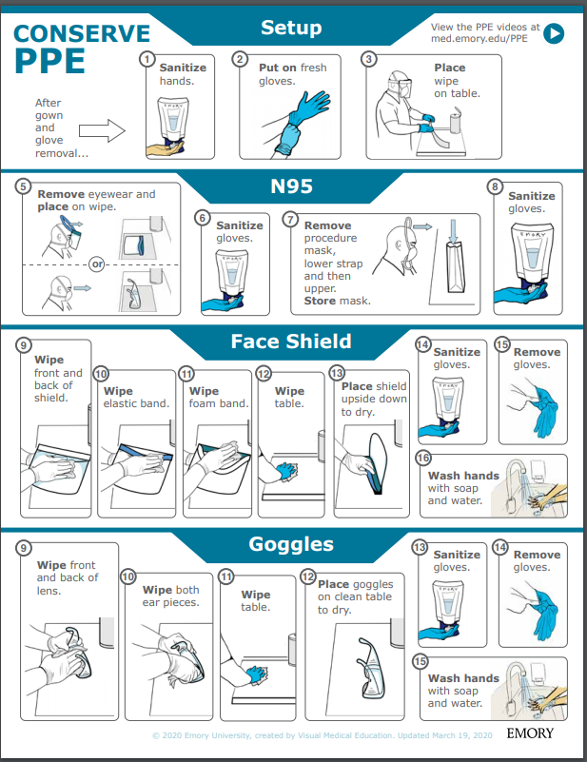
Face shield Re-Use
Sanitize hands
Put on fresh gloves
Place wipe on table
Remove eye wear and place on wipe
Sanitize gloves
Remove procedure mask; Store mask
Sanitize gloves
Wipe front and back of shield
Wipe elastic band
Wipe foam band
Wipe table
Place shield upside down to dry
Sanitize gloves
Remove gloves
Wash hands with soap and water
https://med.emory.edu/departments/medicine/divisions/infectious-diseases/serious-communicable-diseases-program/pdf/ppe-conserve-process-v3.pdf

Slide 49

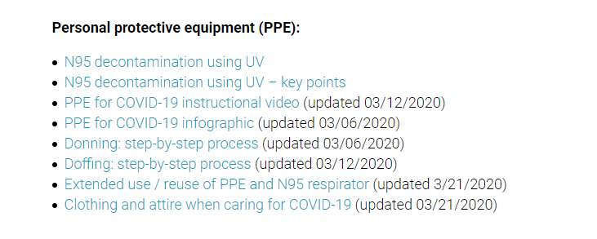
https://www.nebraskamed.com/for-providers/covid19
Notes:
As we’ve noted on previous calls, Nebraska Medicine’s COVID-19 website is public facing, and we encourage users to check out those complete resources and see if those can be implemented or used in conjunction with what your facilities are creating.
Nebraska Medicine has particularly good resources for bagging and processing used PPE.

Slide 50
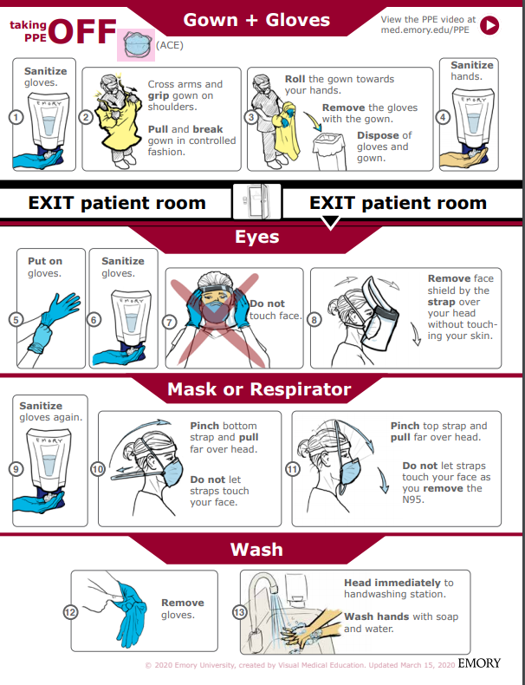
Taking off PPE: Gown
1. Sanitize Gloves
2. Cross arms and grip gown on shoulders. Pull and break gown in a controlled manner
3. Roll the gown towards your hands. Remove the gloves with the gown. Dispose of the gloves and gown.
4. Sanitize hands
https://med.emory.edu/departments/medicine/divisions/infectious-diseases/serious-communicable-diseases-program/pdf/taking-off-ace-conserve-2.pdf
Notes:
We really encourage you to go to the source for both the poster and matching videos. We want to highlight them here. The proper use for your facility, would be to go to the Emory website and use the resources as they have intended. This is just a summary.

Slide 51
Taking off PPE: Eye Protection
  Put on gloves
  Sanitize gloves
  Do NOT touch face
  Rove the face shield by the strap over head without touching our skin
https://med.emory.edu/departments/medicine/divisions/infectious-diseases/serious-communicable-diseases-program/pdf/taking-off-ace-conserve-2.pdf

Slide 52
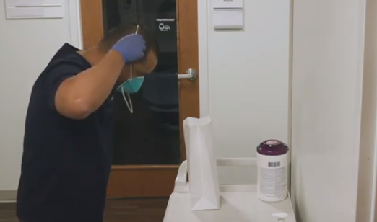
Taking off PPE: Mask
  Sanitize hands
  Pinch loops and pull them back and off your ears.
  Do not let loops touch your face
  Pull loops off without touching your face with them or your hands
  Remove the mask
  WASH
https://med.emory.edu/departments/medicine/divisions/infectious-diseases/serious-communicable-diseases-program/pdf/taking-off-ace-conserve-2.pdf
Notes:
AGAIN, we really encourage you to go to the source for both the poster and matching videos. We want to highlight them here. The proper use for your facility, would be to go to the Emory website and use the resources as they have intended. This is just a summary.

Slide 53
Regarding PPE use
Training must be provided anytime new equipment or new protocols are introduced
Personnel should be required to demonstrate competency: correct technique is observed by a trainer following each training
Posters and educational resources should be readily available; such as posters at the point of PPE donning and doffing
Audits of use with real-time education/feedback are very helpful to ensure proper protection of frontline personnel

Slide 54
https://bmjopen.bmj.com/content/bmjopen/5/4/e006577.full.pdf
Notes:
This study is from the British Medical Journal, published in 2015.
Conclusion This study is the first RCT of cloth masks, and the results caution against the use of cloth masks… Moisture retention, reuse of cloth masks and poor filtration may result in increased risk of infection. Further research is needed to inform the widespread use of cloth masks globally. However, as a precautionary measure, cloth masks should not be recommended for HCWs, particularly in high-risk situations...
I think we can use this to inform decisions about cloth mask use for HCW- as a stand alone, they are inadequate. Regarding use of cloth masks over N-95, for example, caution should be used to ensure that the wearer can breathe comfortably.

Slide 55
Crisis Capacity When N-95s are running low
HCP planned proximity to the case patient during encounter | Facemask or respirator determination
 | Patient masked for entire encounter (i.e., with source control) | Unmasked patient or mask needs to be removed for any period of time during the patient encounter
HCP will remain at greater than 6 feet from symptomatic patient | HCP remaining at this distance from the patient should not need to enter the patient care area; if entry required: no facemask or respirator | HCP remaining at this distance from the patient should not need to enter the patient care area; if entry required: no facemask or respirator
HCP will be within 3 to 6 feet of symptomatic patient | HCP remaining at this distance from the patient should not need to enter the patient care area; if entry required: facemask | HCP remaining at this distance from the patient should not need to enter the patient care area; if entry required: facemask
HCP will be within 3 feet of symptomatic patient, including providing direct patient care | Facemask | N95 respirator/ elastomeric /PAPR, based on availability
HCP will be present in the room during aerosol generating procedures performed on symptomatic persons | N95 respirator/ elastomeric /PAPR, based on availability | N95 respirator/ elastomeric /PAPR, based on availability

Slide 56
PPE Extended and Re-use at NM
Nebraska Medicine has posted how they are extending PPE use on the Nebraska Medicine COVID page- open access.
https://www.nebraskamed.com/sites/default/files/documents/covid-19/COVID-Extended-Use-Reuse-of-PPE-and-N95.pdf?date=03182020

Slide 57

Resources
CDC is updating guidance frequently and should be considered the best authority for most situations
  https://www.cdc.gov/coronavirus/2019-ncov/index.html (main)

Slide 58
Presentation prepared by: Dr. Maureen Tierney and Dr. Tom Safranek; Kate Tyner and Margaret Drake
HAI/AR Epidemiologist
Ishrat.kamal-ahmed@Nebraska.gov
402-471-2937

