Slide 1
FLIPPING THE SCRIPT: TRANSITIONING FROM ACADEMICS TO WORKFORCE
Kamrie Peterson MSN, MBA, RN

Slide 2
Objectives
Identify strategies to successfully transition from academics to the workforce.
Review tools and resources to support becoming a confident and enthusiastic nurse in your organization.
Review tools to assist with managing your time and being a change agent across your organization.

Slide 3
Agenda
Professional Identity
Prioritization
Time Management
Work/Life Balance
Confidence Building
Adaptation to cross-training

Slide 4
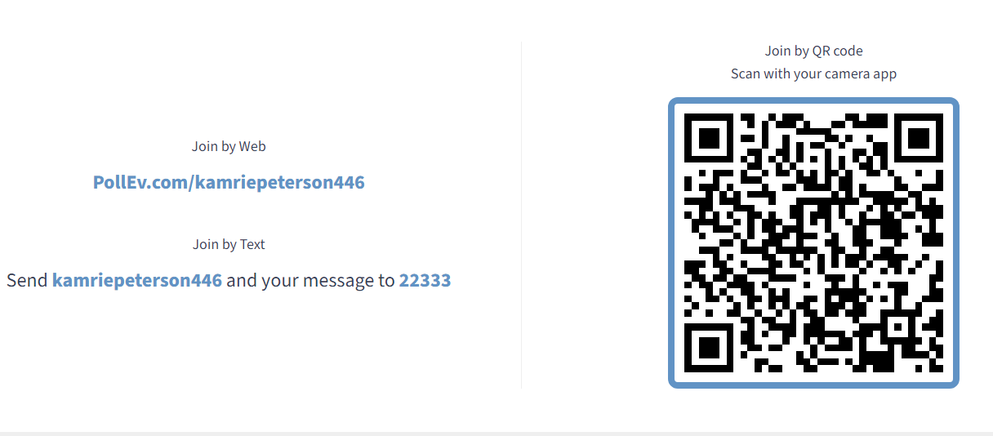
Notes:
We are going to be interactive this sessions. Please take time to get into this session. (3 questions).

Slide 5
Professional Identity
Notes:
Now we are going to move into professional identity. Before we start lets do one more questions.

Slide 6
Professional Identity
“A sense of oneself, and in relation to others, that is influenced by characteristics, norms, and values of the nursing discipline, resulting in an individual thinking, acting, and feeling like a nurse” (University of Kansas)
Notes:
Many things go into your professional identity! By a raise of hands how many of you feel like a nurse?

Slide 7

Notes:
When I think about professional identify I think of: Clinical Competence, ethical practice, effective communication, professional development, collaborative practice, self care, professionalism
Clinical Competence: Keep with your skills. If you don’t use them you lose them.
Ethical Practice: Set aside prejudice. Judgement free zones. Respect for cultural diversity and inclusivity
Effective Communication: Open and honest.
Professional Development: Use your resources, attend education classes.
Collaborative Practice: Team effort. Work with ancillary departments.
Self-Care: Make You a priority for YOU.
Professionalism: Clean, appropriate uniforms. Talk and listen respectively. Dedication to compassionate Care Commitment to patient advocacyEmphasis on EBP
Integrity and ethical decision-making

Slide 8


Slide 9
Prioritization
Notes:
6 questions: It seems easy it pick prioritization if given these examples for patients. But prioritization isn’t an easy it may seem.

Slide 10
Utilize preceptor/Charge Nurse:
Open communication:
Group Cares:
Notes:
We typically thing of triaging when discussion prioritization but there is more to it. Some strategies to think about.
Utilize preceptor: Collaborate with your preceptor to understand the workflow and prioritize tasks effectively.
Open communication: Maintain open communication with your preceptor, Charge Nurse, Care Team
Group Cares: Identify opportunities to cluster care activates to maximize efficiency while ensuring quality patient care.

Slide 11
Time Management
Notes:
4 questions
Complete your assessment the same way each time. This will reduce the amount of times you enter the patients room.
Take notes or have report sheet handy
Are you a list person? If so create a list!
Delegation!

Slide 12
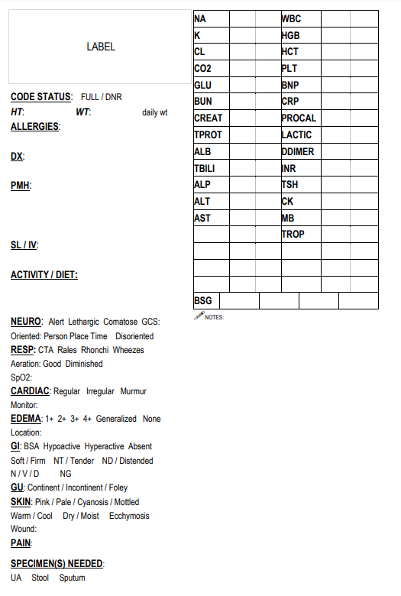
Report Sheets

Slide 13
Work Life Balance

Slide 14
Don’t focus on the money
Boundaries:
It is ok to say NO:
Set Realistic Expectations:
Seek Support:
Notes:
Boundaries: Establish clear boundaries between work and personal life to prevent burnout and maintain well-being
It is ok to say NO: Think about what can you mentally handle
Set Realistic Expectations: Avoid overcommitting and set realistic expectations for both professional and personal responsibilities.
Seek Support: Lean on support Networks including colleagues, friends and family members for emotional support and assistance with balancing responsibilities.

Slide 15
Confidence Building

Slide 16
Game Face:
Book vs life:
Swallowing pride
Ask questions:
SBAR:
Trust in yourself:
Your are not alone:
Notes:
Game Face: Wear your "game face" - exude confidence even when feeling uncertain. Confidence is a skill that can be practiced and developed.
Book vs life: Understand that real-world experiences may differ from textbook scenarios. Embrace challenges as opportunities for growth and learning.
Swallowing pride: Be willing to admit when you don't know something and ask for help. Swallowing pride is a sign of strength, not weakness
Ask questions: Don't hesitate to ask questions. Clarifying doubts demonstrates your commitment to understanding and improving.
SBAR: Utilize the SBAR (Situation, Background, Assessment, Recommendation) communication tool to convey information confidently and effectively.
Trust in yourself: Believe in your abilities and trust yourself to make sound decisions. Confidence comes from knowing that you are capable and prepared.
Your are not alone: You are part of a team that supports and collaborates to achieve common goals.

Slide 17
Cross Training

Slide 18
Embrace Versatility:
Open-mindedness:
Continuous Learning:
Flexibility:
Team Collaboration:
Effective Communication:
Feedback and Reflection:
Notes:
Embrace Versatility: Cross-training enables you to develop skills in multiple areas, fostering versatility and adaptability.
Open-mindedness: Approach cross-training with an open mind, viewing it as an opportunity for personal and professional growth.
Continuous Learning: Embrace the challenge of learning new tasks and processes, recognizing that growth occurs outside of comfort zones.
Flexibility: Be flexible and willing to adapt to changing roles and responsibilities as you transition between different areas of expertise.
Team Collaboration: Collaborate with colleagues across different departments, leveraging each other's strengths to achieve common goals.
Effective Communication: Maintain clear and open communication with supervisors and team members to ensure a smooth transition during cross-training.
Feedback and Reflection: Seek feedback from mentors and peers to identify areas for improvement and reflect on your progress regularly.

Slide 19


Slide 20
