Slide 1
Outreach Education
CHI Health Perinatal Outreach
Dedicated to providing quality perinatal education to healthcare professionals
October 26, 2020

Slide 2
Perinatal Outreach Team
Melissa Wilson, MSN, RNC-NIC
Perinatal Outreach Coordinator & NICU Educator
mwilson1@stez.org
CHI Health St. Elizabeth 402-219-5300
Lincoln, NE
Rachelle Heser, MSN, APRN, C-EFM
Clinical Nurse Specialist – CHI Health Division
Rachelle.heser@alegent.org
402-398-6775
Omaha, NE
Jackie Liess, APRN
Neonatal Nurse Practitioner
Good Samaritan Hospital
jacquelineliess@catholichealth.net
Kearney, NE

Slide 3
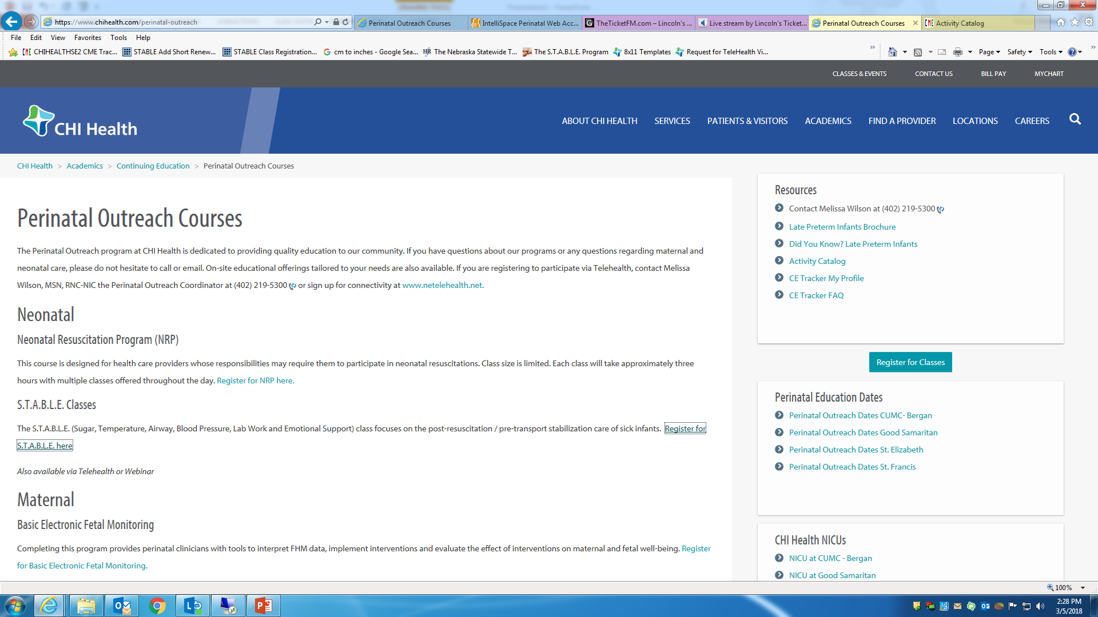
Perinatal outreach website

Slide 4
Perinatal outreach website
https://www.chihealth.com/perinatal-outreach
We offer a variety of opportunities to increase/enhance knowledge about maternity and newborn topics, through classes, telehealth or clinical experiences.
Dates for the 2021 courses will be posted soon. A complete listing of classes and dates can also be distributed for your convenience. Reach out to Melissa.

Slide 5
Menu of options
Neonatal Classes | Maternal Classes | Perinatal Classes
Neonatal Resuscitation Program | Basic Electronic Fetal Monitoring | Emergent Delivery Course
S.T.A.B.L.E Classes | AWHONN Intermediate Fetal Monitoring | Maternal Child Health Conference
 | AWHONN Advanced Fetal Monitoring | Perinatal Grand Rounds
 | EFM Certification Review Course | When A Baby Dies
 | ALSO (Advanced Life Support in Obstetrics)

Slide 6
Neonatal Class Offerings
Neonatal Resuscitation Program (NRP)
This course is designed for health care providers whose
responsibilities may require them to participate in
neonatal resuscitations.
S.T.A.B.L.E. Classes
The S.T.A.B.L.E. (Sugar, Temperature, Airway, Blood
Pressure, Lab Work and Emotional Support) class
focuses on the post-resuscitation / pre-transport
stabilization care of sick infants.

Slide 7
Maternal Class Offerings
Basic Electronic Fetal Monitoring
Completing this program provides perinatal clinicians
with basic tools to interpret FHM data, implement
interventions and evaluate the effect of interventions
on maternal and fetal well-being.
AWHONN Intermediate Fetal Monitoring
Offered in a standardized format, the course may be
used as a competency assessment to validate the
knowledge and skills of experienced nurses and other
clinicians. Participants analyze case scenarios using
key physiologic principles. 2-day course

Slide 8
Maternal Class Offerings
AWHONN Advanced Fetal Monitoring
Building on the skills and knowledge gained in the
Intermediate FHM Course, the Advanced FHM course
conveys the application of advanced fetal heart
monitoring knowledge and skills in intrapartum
clinical practice. Using a case study approach to
focus on the analysis of complicated FHM patterns/
Characteristics and related case information.
EFM Certification Review Course
The purpose of this two-day course is to prepare
experienced labor and delivery nurses and providers
to take the Electronic Fetal Monitoring (EFM)
certification exam by reviewing advanced fetal
monitoring concepts and physiology as it relates
to interpreting FHR tracings.

Slide 9
Maternal Class Offerings
ALSO (Advanced Life Support in Obstetrics)
Advanced Life Support in Obstetrics helps physicians
and other health care providers develop and maintain
the knowledge and skills they need to effectively
manage potential emergencies during the perinatal
period.

Slide 10
Perinatal Class Offerings
Emergent Delivery Course (Target audience is hospitals that do not routinely provide L/D or OB services)
This course is designed to increase a hospital‘s
preparedness related to emergent deliveries and
newborn care after delivery. We provide interactive,
hands on learning for the staff as well as assist in needs
assessments around equipment within the facility.
Maternal Child Health Conference
The Maternal Child Health Conference is provided to
nurses, advanced practice nurses, physician assistants
and physicians. Topics are pertinent to maternal,
neonatal and pediatric issues. Speakers include
physicians and other professionals who are experts in
their specialties.

Slide 11
Perinatal Class Offerings
Perinatal Grand Rounds
Perinatal Grand Rounds are offered the fourth
Wednesday of every month from 12 - 1 p.m. to
providers. Case studies and pertinent topics are
discussed by specialists in their field. Lunch is provided.
Currently offered at CHI Health St. Elizabeth.
When a Baby Dies
This conference is designed to educate health care
professionals on issues related to perinatal loss and
bereavement. The information obtained will guide
participants in developing skills to support patients
and their families through the grieving process.

Slide 12
Emergent Delivery and Newborn Care Education
Our on-site educational offerings can be tailored to your needs
This course is designed to increase a hospital’s preparedness related to emergent deliveries and newborn care after delivery.
  Classroom instruction
  Hands-on education
  Interactive education
  Assist with equipment needs assessment in facility

Slide 13
Emergent Delivery and Newborn Care Education
Labor & Delivery | Newborn Care
OB Triage | Immediate care after delivery
Difference between False Labor & True Labor | Apgar scores, skin to skin
Assessment of OB patient | Elements of newborn resuscitation
Assessment of fetus (Doppler or EFM) | Thermoregulation of newborn
Signs of precipitous delivery | Stabilization for transfer
Cardinal movements | Glucose stabilization
Post delivery care | Incorporate NRP and STABLE principles in an abbreviated fashion
Potential complications

Slide 14
Clinical Experience
CHI Health offers Perinatal Clinical Experiences at St. Elizabeth and CUMC/Bergan Mercy for nurses from our outreach community hospitals
A Clinical Experience Agreement and Checklist is required before nurses can participate in the program
Basic Requirements:
  Completed Clinical Experience Agreement Form
  Proof of adequate liability insurance coverage
  Valid Nebraska nursing license
  Current vaccination record
  BLS & NRP certifications

Slide 15
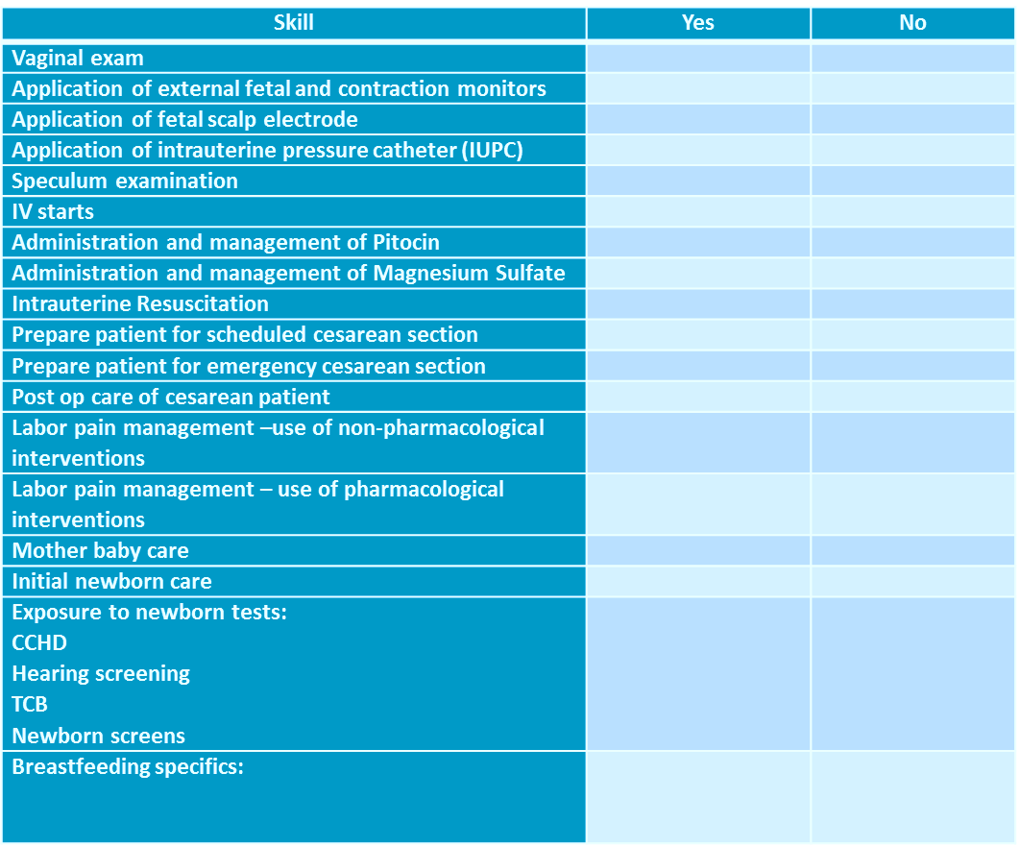
Skills Checklist

