Slide 1
Workforce Generations

Slide 2
Workforce Generations: Five Classifications
Traditional/Silent Generation
Baby Boomers
Generation X’ers/The Lost Generation
Millennials/Generation Y’ers
Generation Z

Slide 3
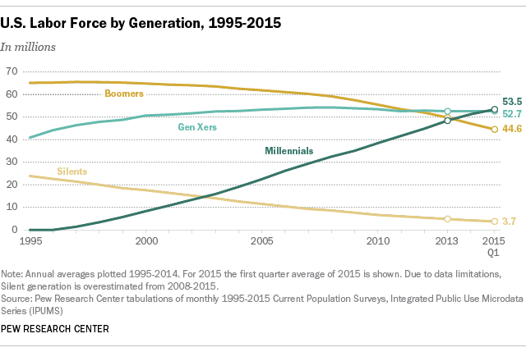
Workforce Generations

Slide 4
Workforce Generations: Five Classifications
Traditional/Silent Generation
Baby Boomers
Generation X’ers/The Lost Generation
Millennials/Generation Y’ers
Generation Z

Slide 5
Workforce Generations
QUIZ TIME!
Notes:
Majority were born before 1945, lived during the Great Depression, World War II
Approximately 2% of the workforce
Values/Ethics: Sacrifice, Collectivism vs. Individualism, Patriotic
Workplace Attributes: Hard working, loyal, often have extensive knowledge and experience to draw from, “punch the timeclock mentality
Workplace preferences: Chain of Command

Slide 6
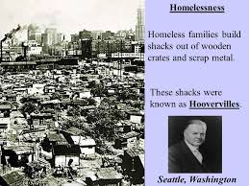
Workforce Generations
Traditional/Silent Generation:
Age: Mid 70’s +
Hard working, loyal
Formal Communication Style
Respect Authority and Rules
Notes:
Majority were born before 1945, lived during the Great Depression, World War II
Approximately 2% of the workforce
Values/Ethics: Sacrifice, Collectivism vs. Individualism, Patriotic
Workplace Attributes: Hard working, loyal, often have extensive knowledge and experience to draw from, “punch the timeclock mentality
Workplace preferences: Chain of Command

Slide 7
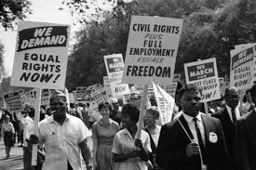
Workforce Generations
Baby Boomers:
Age: Mid 50’s–Early 70’s
Ambitious
Informal Communication Style
Respect Freedom
and Hard Work
Notes:
Majority were born in the mid 1940’s – early 1960’s, approximately 29% of the workforce
Also known as the “me” generation
Events: Time of change = Civil Rights movement, Sexual Revolution/the Pill, 1st man on the moon, Kennedy assassination, Vietnam War, Civil Rights Act of 1964
*Demanded Change and were successful
Values and Work Ethics: Challenge the status quo/authority, equality, politically savvy, personal and professional freedom, ambition, $$/status is important
Workplace attributes: workaholics = success, good team players, strong desire to success
Workplace Preferences: Democratic, friendly/informal environments, “flat” organizations (less red type)

Slide 8
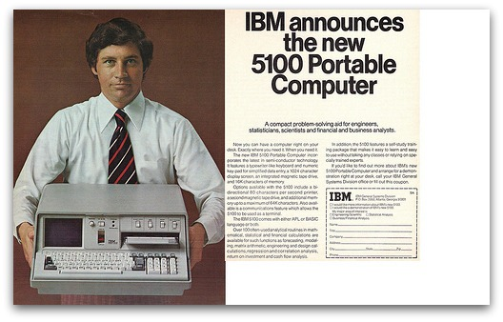
Workforce Generations
Generation X/”The Lost Generation”:
Age: Late 30’s – Mid 50’s
Comfortable with
Technical Communication
Respect Freedom
and Independence
Work Life Balance
Notes:
Majority were born in the mid 1960’s – late 1970’s, also called “MTV Generation”/Misunderstood Generation, approximately 34% of the workforce
While the BB stood for change and equality, this generation didn’t stand for anything
Events: Children of divorce, came from 2 income families, latch key kids, education was increasingly important, rise of technology, personal home computers, space shuttle disaster & downsizing began
Technology + continuing to challenge the status quo and valuing independence & freedom = many entrepreneurs
First generation to value/ask for work/life balance
Values & work ethics: Work life balance over advancement, work smarter/not longer, more results oriented, value diversity, technology, informality & fun, more job switching/less loyalty
Workforce attributes: More adaptable to change, eager to learn, highly educated, independent/self starters, consumer mentality
Workplace preferences: Participative, Informal/flexible and Visionary

Slide 9
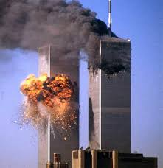
Workforce Generations
Millennials/Generation Y:
Age: Early 20’s - Late 30’s
Very comfortable with Technical
Communication
Respect Relationships/
Autonomy
Work Life Balance
Notes:
Majority of workers were born between 1980’s and mid 1990’s, approximately 34% of the workforce – in 2015 the largest # of workers….53.5 million vs. 52.7 million for Gen X (both at 34%)
Probably can’t remember pre-internet days
Have more of a global perspective and a desire to leave the world a better place than Generation X, this they had more in common with the BB’s, more focus on diversity efforts, instantaneous culture, beginning of the “participation trophy” generation
Events: 9/11 and other terrorist attacks, heavily influenced by technology
Values & work ethics: Strong desire to learn and grow (this could be perceived differently), highly educated, very collaborative, Work life balance over advancement, meaningful work, entrepreneurial, more results oriented, value diversity, technology, informality & fun, more job switching/less loyalty
Workforce attributes: Good at multitasking, technology savvy, optimistic, team/goal oriented, willing to try new things…failure is viewed more as a learning opportunity
Workplace preferences: Collaborative, Achievement Oriented, Highly Creative, Diverse, Flexible, Inspiring

Slide 10
Workforce Generations
Generation Z:
Age: Under 21
“Click” Generation
Notes:
Majority were born between 1990’s – early 2000’s, approximately 1% of the workforce
Age range from 9 – 21, so not in or just entering the workforce
Events: Housing crisis, smart everything, social media influence

Slide 11
Workforce Generations
Traditionalists/
Baby Boomers/
Generation “X” Millennialls
My Paycheck My Purpose
My Satisfaction My Development
My Boss My Coach
My Annual Review My Conversations
My Weaknesses My Strengths
My Job My Life
Source: Gallup Millennials Summit, 2016

Slide 12
Workforce Generations
Millennials – Key Research Findings
As Employees:
Change jobs more often than other generations, 6 in 10 are looking for new jobs
Opportunities to learn and grow is the most important job satisfaction factor
Millennials are the largest generation in the workforce
Least engaged generation
Source: Gallup Millennials Summit, 2016

Slide 13
Workforce Generations
Millennials – Key Research Findings
As People:
- Identify as “politically independent” and are the least likely group to be registered voters
30% do not identify with a particular religion
Highly educated and more heavily in debt than older generations
Racially diverse
Source: Gallup Millennials Summit, 2016

Slide 14
Workforce Generations
Millennials – Key Research Findings
As Consumers:
View economy positively
Tend to disengage from traditional institutions (Financial & Marriage)
Look for fun and entertaining experiences
Not engaged as consumers
Source: Gallup Millennials Summit, 2016

Slide 15
Workforce Generations: How do we manage them?
Baby Boomers:
Status
Compensation
Coaching – Work Life Balance/ Technology

Slide 16
Workforce Generations: How do we manage them?
Generation X’ers:
Feedback
Freedom/Autonomy
Coaching – Respect/Patience

Slide 17
Workforce Generations: How do we manage them?
Generation Y’ers:
Meaningful Work
Fast Paced
Coaching – Respect/Patience

Slide 18
Workforce Generations: Other Considerations
Legal
Organizational Culture
Policies and Procedures

Slide 19
Workforce Generations: Summary
Unique contributions
Unique challenges
Notes:
.

Slide 20
Workforce Generations
Q&A?
Notes:
Majority were born before 1945, lived during the Great Depression, World War II
Approximately 2% of the workforce
Values/Ethics: Sacrifice, Collectivism vs. Individualism, Patriotic
Workplace Attributes: Hard working, loyal, often have extensive knowledge and experience to draw from, “punch the timeclock mentality
Workplace preferences: Chain of Command

Slide 21
References:
http://money.usnews.com/money/blogs/planning-to-retire/2012/05/08/the-new-ideal-retirement-age-67
http://www.businesspundit.com/4-generations-of-workers-can-you-relate/
http://www.metlife.com/assets/cao/mmi/publications/studies/mmi-workbook-generations-workplace.pdf
http://writespeaksell.com/a-company-divided-bridging-the-generation-gap-at-work-through-the-power-of-communication
http://www.valueoptions.com/spotlight_YIW/pdfs/articles/Understanding_and_Managing_Different_Generations.pdf

Slide 22
References:
http://money.usnews.com/money/blogs/planning-to-retire/2012/05/08/the-new-ideal-retirement-age-67
http://www.businesspundit.com/4-generations-of-workers-can-you-relate/
http://www.metlife.com/assets/cao/mmi/publications/studies/mmi-workbook-generations-workplace.pdf
http://writespeaksell.com/a-company-divided-bridging-the-generation-gap-at-work-through-the-power-of-communication
http://www.valueoptions.com/spotlight_YIW/pdfs/articles/Understanding_and_Managing_Different_Generations.pdf

Slide 23
A private, non-profit institution founded in 1966, Bellevue University is accredited by the Higher Learning Commission through the U.S. Department of Education. For general information, please call 800.756.7920.

