Slide 1
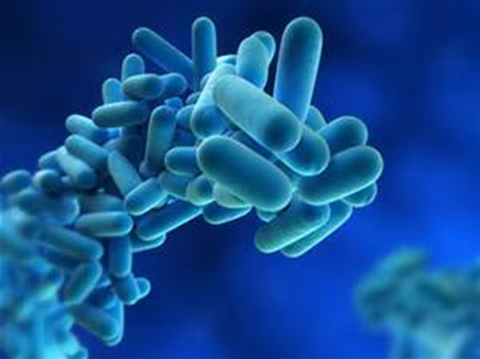
Waterborne Pathogens- Building a water Management Plan 101
Sharon Conroy BSN RN CIC
Rural QI Residency
October 29, 2021

Slide 2
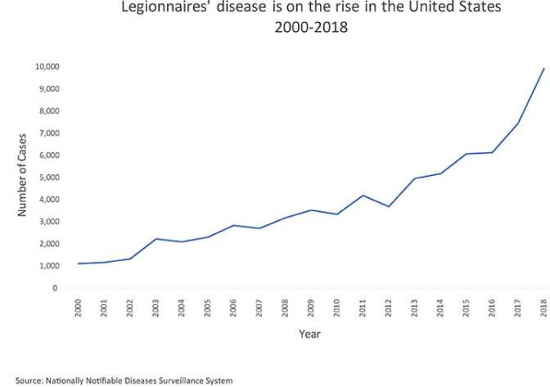
INTRODUCTION
Rate of reporting has grown by nearly 9 times since 2000
76% acquire Legionnaires’
disease from healthcare facility
1 in 4 individuals expire due to
healthcare facility acquired
infection
4 in 5 could have been
prevented
Prevention is not limited to
Infection Prevention
Outbreak with one single event
Notes:
In united States the rate of reported Legionnaires disease infections has grown by nearly 9 times since 2000. Health departments report nearly 10 thousand cases in the united states in 2018. however because Legionnaires is likely under diagnose the numbers by be underestimated related to the true instance of the disease.
Recent studies suggest that the number of actual case may be as much as 2.7 times higher than currently reported
CDC reports that healthcare or facility acquired infections occur 76% locations that report exposures
Legionnaires diseases kills 25 % of individuals who acquire healthcare facility infections
80% of those infections could have been prevented with an affective water management plan
First of all it is required by regulations to have a water management plan
Second Reporting may fall to the infection preventionist efforts to prevent waterborne pathogens does not solely fall on the IP but to a group of different departments and stakeholders within your facility
Third it is Important to know that any single event of legionnaires is considered an outbreak
Hopefully with this presentation you will learn how to put a water management plan together to be able to be proactive in stead reactive within your facility

Slide 3
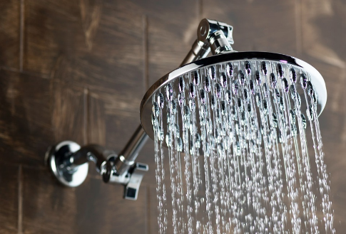
Objectives
Upon completion, participants will be able to understand what opportunistic pathogens are associated with plumbing/potable water systems
Upon completion, participants will be able to identify factors
associated with outbreaks and potential transmission
mechanisms
Upon completion, participants will be able to discuss
recommendations and practices the infection preventionist
should implement to become a stronger partner with risk and
facilities in the development of water safety management plans.
What is Legionnaires Disease?
Notes:
Read bullets
You might at first find it confusing to understand because of terminology we do not frequently use. So we will go over a few terms

Slide 4
Get Down with the Language
ASHRAE: American Society of Heating, Refrigerating and Air Conditioning Engineers
Water management Plan: The risk management plan for the prevention and
control of legionellosis associated with building water systems, including the
documentation of the plan's implementation and operation.
Potable water system: a building water distribution system that provides hot
and cold water intended for human consumption
Dead legs: capped pipes with water but no flow resulting in stagnate water.
Verification: initial and ongoing confirmation that the program is
being implemented as designed.
Validation: initial and ongoing confirmation that the program, when
implemented as designed, effectively controls the hazardous conditions
throughout the building water systems
Notes:
Water management has its own terms to describe the program and actions you will take. Lets break this down with a few key words you may find beneficial
ASHRAE
ASHRAE definition of a water management plan is…….
Next is potable water systems – drink showering bathing, hand washing and food prepping
Dead legs section of pipe that contains water but has no flow or is infrequently used which results in stagnant water – think about these in your facility. We have a portion of the patient wing that we rarely use so the showers and sinks could be somewhat of a dead leg – waste water Wednesdays at out facility.
Read next two bullets--

Slide 5
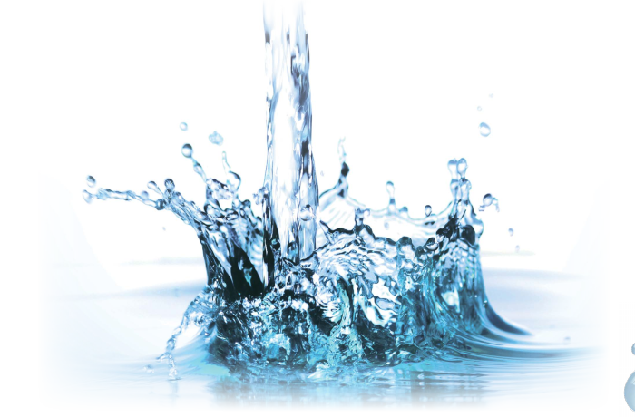
Get Down with the Language
Monitoring: Conducting a planned sequence of observations or
measurements
Control Limit: A maximum value, a minimum value, or a range of values
Corrective Action: Action to be taken to return control values to within established limits when indicated
Sink Aerators: reduce the volume of water thus reduces the splash distance
Cooling Tower: for heating, ventilation, and air conditioning (HVAC)
Notes:
Monitoring: Conducting a planned sequence of observations or measurements of physical or chemical characteristics of control measures this also includes
Control Limit: A maximum value, a minimum value, or a range of values to which a chemical or physical parameter is associated with a specific control measure must be monitored and maintained in order to reduce the occurrence of hazardous
Read Corrective action and
Sink aerators – so for the Infection Preventionist on sinks if you feel at the tip of the faucet a mesh mechanism there – it is in place to reduce the volume of water that is falling out of the faucet. It also reduces the splash or the distance the water falls from the faucet as it hits the sink basin. Because of this mesh mechanism it also can start to hold biofilm, sediment and debris in that mesh – can cause a hazard in that it is a perfect breading for organisms to grow.
Another big item is Cooling Towers. They are structures that contain water with a heat injection device that transfers heat to the atmosphere through an evaporative process though a fan as part of the central air conditioning systems for buildings. And since water management includes all things water …………we have to understand this process

Slide 6
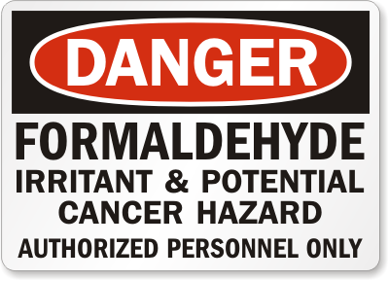
Healthcare-acquired
Legionnaires’ Disease
LEGIONELLA
AHEAD

Slide 7
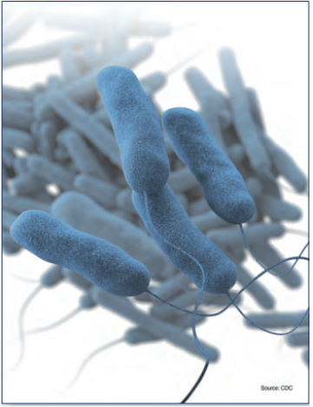
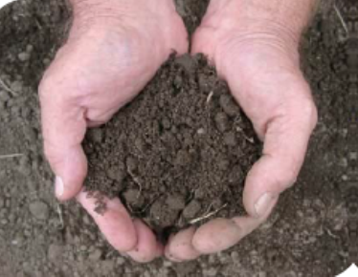
Legionella
Found naturally in freshwater and human-made aquatic
environments​ as well as in soils.
Legionella spends much of their
life cycle in biofilms.
Biofilms allow Legionella to be
protected from environmental stressors such as extreme temperatures and
disinfectants
Notes:
So again you might be asking the question why do we need to have a water management plan
Science is telling us that Legionella cases are on the rise.
Science has shown us we need to protect our building, patients, visitors and staff against water pathogens
Legionella is a gram negative bacteria Found naturally in freshwater environments like lakes and streams ​ and human-made aquatic
environments​ as well as in soils
50+ species, 19 + pathogenic but the one we hear most about is legionella pneumophila
One of the reasons legionella can survive in the environment is because biofilm that surrounds it. This biofilm protects Legionella against temperatures and disinfectants
Biofilms sediment and algae all help to support and protect Legionella
Slime on dog water bowl full of protozoa, yeast, and bacteria – that is where legionellae loves to grow and it is hard to get rid of. And all that other crap the sludge, rust, algae wood and plastic provide a food source for legionella
Bio films and legionella go together

Slide 8
Legionella
Spreads by droplets and people inhale them in.
People can get sick by aspiration of drinking water, less common
Not person to person spread.
Becoming symptomatic post exposure to Legionella can result in two different illnesses
Legionnaires’ Disease which results in pneumonia. cough, SOB, Fever, muscle aches, headaches) and
Pontiac Fever – a milder infection & symptoms: fever and muscle aches, the patient does not develop pneumonia
People at increased risk
People 50 years or older
Chronic lung disease
Immunocompromised –transplant, diabetes etc
Oncology patients or other underlying illness
Notes:
Lets just jump back into to time
Just had graduated a year earlier
Out break of the a strange illness of the Belleview Stratford hotel in Philadelphia in 1976 related to a veterans celebration Legionnaires – every one was scared.
With in days of the conference 34 deaths and around 200 of these Legionnaires who were attending this convention at this hotel got sick. No one knew what it was
Ultimately it was identified as a gram negative bacteria that was to become known as Legionella, it was not contagious and antibiotics helped in treat those infected.
Through the investigation the outbreak of this illness was tied to the cooling tower at the hotel perched on the roof.
Thought they could never prove If the system had been cleaned by the time all of this was discovered. The theory is these powerful fans on these cooling towers emitted a mist of contaminated of contaminated water that fell on pedestrians below and was actually the mist sucked into the lobby through the ground floor vents hence how legionella got its name
Collateral damage - The Belleview Stratford hotel went out of business shortly after this incident – later investigations have surmised that the source was actually the Holiday Inn down
the block , from their cooling tower -due to the ability of the bacteria to travel distances
A milder form called Pontiac fever occurred in 1968 in Pontiac Michigan among people who worked at and visited the health department symptoms : fever and muscle aches, the patient does not develop pneumonia – mainly self limiting and lasted 2 – 5 days, also related to a defective air conditioning system . It wasn’t until the out break in 1976 that PH officials were able to say Legionella cause both diseases
Those at increase risk for Legionella disease

Slide 9
Other Waterborne Pathogens
Pseudomonas species
  This bacteria is commonly found in the environment
  Spread to people when exposed to contaminated water or soil
  Pseudomonas spp cause a wide variety of infections in the
  body
Nontuberculosis Mycobacterium (NTM)
  Environmental organisms found in soil, dust and water
  including natural water sources and municipal water sources.
  Difficult to eliminate due to biofilm.
  NTM can cause a wide variety of infections in the body
  however most commonly focus on the lungs
Notes:
Talk about legionella a lot but not the only thing that we are worried about cryptosporidium, e-coli, salmonella
Legionella is part of a community – it lives synergistically – each bacteria benefiting the other
We are concerned about the health of our water
Go in to combat legionella and create environment for another pathogen to grow
Read first two bullets
Pseudomonas species
This bacteria is commonly found in the environment
Spread to people when exposed to contaminated water or soil
Pseudomonas spp cause a wide variety of infections in the
body
Nontuberculosis Mycobacterium (NTM)
Environmental organisms found in soil, dust and water
including natural water sources and municipal water sources. Similar to Legionella Nontuberculosis Mycobacterium (NTM) also lives in a biofilm
NTM can cause a wide variety of infections in the body
however most commonly focus on the lungs

Slide 10
Sources linked to water systems
Cooling towers
Potable water systems
Evaporative condensers
Spas/whirlpools/hydrotherapy
Respiratory therapy Bronchoscopes
Room air humidifiers
Decorative fountains
Showers
Ice machines
Medical devices – CPAP
Eye washes
Sink faucets
Exposure - Sources
Hospitals
Nursing Homes
Rehab centers
Office build
Apart build
Hotels
Notes:
Are you starting to see how legionella and other bacteria can become a health concern
When these organism grow in human made water systems, cooling towers, decorative fountains, faucets etc., and spread, it is reason to believe at some point in time these organisms get aerosolized and be inhaled into a susceptible host and cause an infection
Laundry list of places where legionella has been linked to water systems
Hospitals are not immune
Home and car air conditioners do not use water to cool the air so they are not at risk for growth
Key here to remember for your water management program is to eliminating legionella uncontrolled growth with in water systems and what type central mechanisms can be implemented to manage that risk
Key point there is no way you will be able to totally eliminate legionella but rather control growth
This why you need the water management program. It does not need to be complex. Biggest thing to know is to understand your building(S) and also understand where your biggest risks are.
So where to start

Slide 11
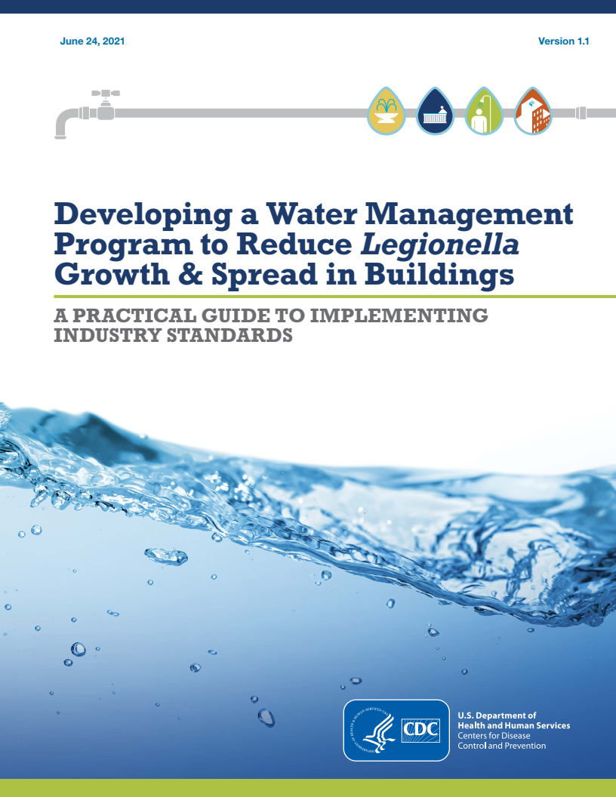
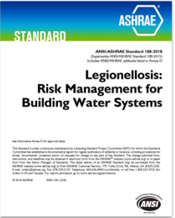
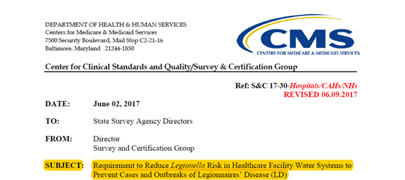

Regulatory Requirements-Industry Guidance
Notes:
You need to understand the principles behind why you need the program before you actually create the program. And yes this means homework. These are the documents you will need in order to start putting together your water management program and maintaining your program.
Remember knowledge is key. CMS is listed as the starting reference. This memo in 2017 sent many Healthcare facilities scrambling to figure out a water management plan. There are also other regulatory standards DNV, the JOINT commission, however for this presentation I am sticking with CMS as the regulating body, but I do encourage you to find out what your surveying body requires as far as a water management plan goes.
The CDC has developed a water management tool kit that I encourage all of you to download free from the CDC website, just recently revised in June 2021 and is a step by step guide for what you need to do for your facility. This document is a must have for the infection Prevention toolkit.
And finally the ASHRAE standards outlines key steps to a successful water management program. These standards are not free.
Some facilities may prefer to have a third party manage the water management program. There are companies that offer this service for a fee. They will create and manage your facilities water management plan. And it will be compliant with CMS requirements for a water management plan
It is still the infection Preventionist responsibility to understand your facilities water management program.
If you are going to write your own water management program use these three documents to guide you in writing your document
Not the sole responsibility of the IP. You are part of a multidisciplinary team used to address a water management program

Slide 12

ASHRAE 188: compliance Good News, Bad News
Standard is not prescriptive
Good news: You get to make lots of decisions
Bad news: You get to make lots of decisions

Slide 13
Water Management Program Team - Partners
Site leadership
Oversee the program
Knowledge of the water systems
Identify control locations and control limits
Identify and take corrective actions
Monitor and document program performance
Communicate regularly
Notes:
The team is not about who gets added to the team but what skill and know does that person have
You need someone to oversee the program – should not be IP
Need someone who has knowledge of the water systems within our building to help us identify control locations and control limits and identify any corrective actions to be taken
We need someone who is going to monitor and document the plan performance
And finally someone to communicate regularly to the team and site leadership
As you can see the leadership is in the center ultimately the buildings water management plan falls to them
Plant operations is usually who oversees the water management plan
You will also want EVS, Risk management and IP on the team
Other ad Hoc members may be added as needed
Designate Multi-Disciplinary team Section A-2
Infection Prevention (CIC or MS Epidemiology)
Engineering
Risk management
Administrator (C-Suite)
Suppliers
Legal

Slide 14
Water Management Program Steps
Create a team
Identify Risks
Develop strategies to mitigate the risks
Map the water system
Source: ASHRAE Standard 188,
https://www.hfmmagazine.com/articles/3771-seven-steps-to-creating-a-water-management-program
Notes:
So lets talk about the step to building a water management program.
These are the first of 7 steps to implement for a successful water management plan we just got done talking about the first step so lets talk about the second step
2. Map the water system
3. Then Identify risks and wrap up with
4 Develop strategies to mitigate the risks

Slide 15
Map Your Water Systems
Create a simple description of your buildings water system and devices.
Describe the water building system using text and flow diagrams.
HINT: Start with the facility plumbing plans and create the document from there.
  Where does the water enter?
  Where is cold water distributed?
  Where is the cold water heated?
  Where is the hot water distributed?
  Where does the hot, cold and tempered wastewater discarded?
Notes:
Step 2 is mapping your water system. This is for some most difficult but this is how we identify our risks
The idea is to create a simple description of your facilities water systems and devices using a process flow diagram
This description should identify where your facility connects to the municipal water supply, how water is distributed, where are pools, water heaters, cooling towers boilers located
Review as-built drawings for potable/non-potable water systems;
Compare drawings with current conditions;
Amend/change as necessary ensuring drawings reflect current conditions; and, Develop accurate facility specific water flow diagrams
Keep in mind descriptions of water sources as it relates to patient care areas, clinical support areas , equipment that could potentially expose patients to contaminated water
Make sure you know who supplies drinking water and are notified of any changes that may impact your water supply

Slide 16
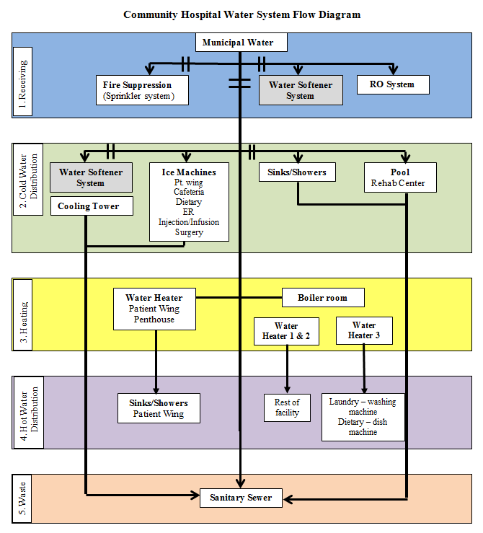
Notes:
You need to know that each water source has its own impact on infection prevention.
This includes municipal water – this may be just a visual inspection – cooling towers checking temperatures, a visual or checking the disinfectant levels – decorative fountains including a visual, checking disinfectant levels – whirlpools visual and checking disinfectant levels – pools visual and disinfectant levels and do they need inspected annually or more often – water heaters a temp check as well as water storage a temperature check and equipment in the kitchen especially temperature of water. And lastly sanitary sewer – need to know if any codes or temperature regulations exist

Slide 17
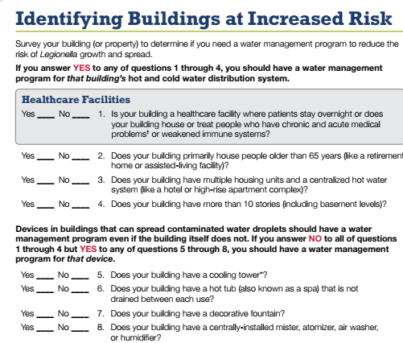
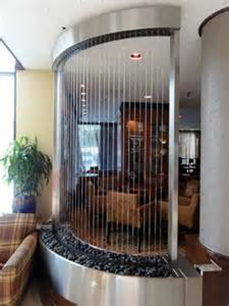
Identify Risks
Individual Risk Factors
Building Risk Factors
• Population served
• Multiple units or floors and
centralized hot water
system
Device Risk Factors
• Cooling Tower(s)
• Hot tub or spa
• Decorative fountain
• Central mister, atomizer, air
washer, or humidifier
Notes:
Step 3 Identifying risks once the water flow diagram is complete you can then identify areas of risk within your facility
So think about the worst case scenario and then what can be done to prevent it – patients most at risk
If you have multiple buildings risks must be identified per site
Is you facility a healthcare facility where your patients stay over night - look at population served – patients with chronic or acute illness or weakened immune systems. Does your building house those over 65, multiple floors
Devices that can potentially spread contaminated water need a water management even if the building does not
Do you have cooling tower, decorative fountains air washers again need a plan
The CDC toolkit in the front of the kit provides a quick assessment to help you decide if you need a plan. If you answered yes to any of the questions you should have a water management plan
Risk Exposure Points
Higher probability of infection based upon:
Intended use of water based processes
Vulnerability of patients
Estimated likelihood of Legionellosis
Aerosolization potential and sources
Areas with greatest risk should get increased scrutiny:
All clinical support areas (dietary, central sterile, etc.)
All patient care areas (including dialysis, respiratory/hydrotherapy)
All water used end points (spas, whirlpools, ice machines, cooling towers, pools, etc.)

Slide 18
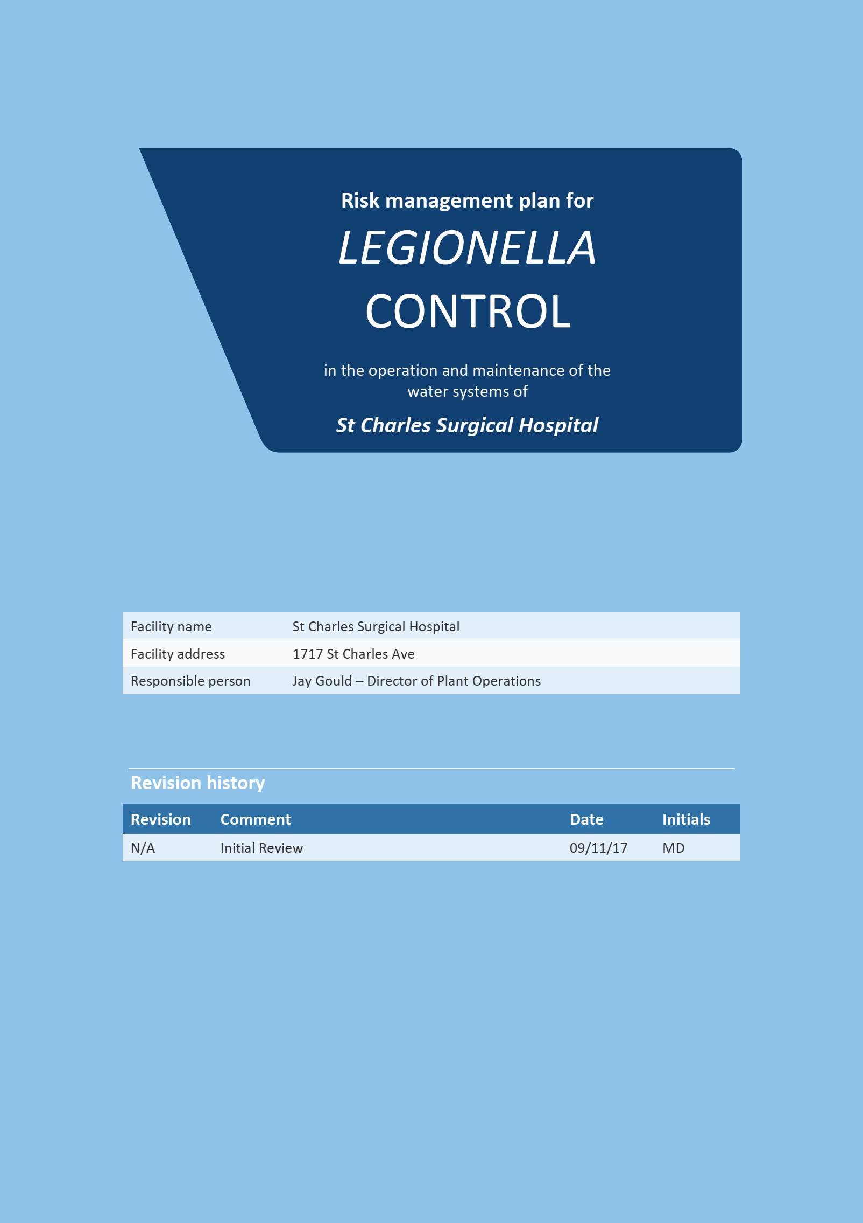
https://www.hindmarshplumbing.com.au/media/enhealth-RMP-Template-Final.pdf

Slide 19
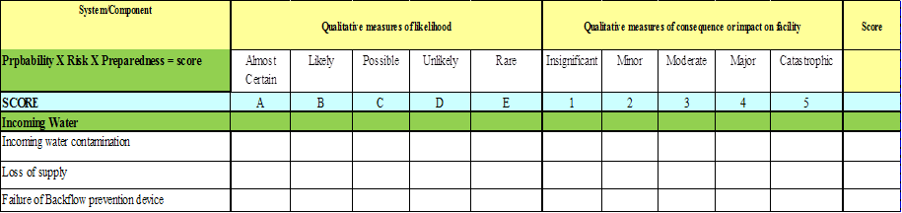
Risk Assessment
https://www.hindmarshplumbing.com.au/media/enhealth-RMP-Template-Final.pdf
Notes:
Can do this concurrently with the water flow diagram.

Slide 20
System/Component | Qualitative measures of likelihood |  |  |  |  | Qualitative measures of consequence or impact on facility |  |  |  |  | Score
Probability X Risk X Preparedness = score | Almost Certain | Likely | Possible | Unlikely | Rare | Insignificant | Minor | Moderate | Major | Catastrophic
SCORE | A | B | C | D | E | 1 | 2 | 3 | 4 | 5
Incoming Water
Incoming water contamination |  |  |  | x |  |  |  |  | x
Loss of supply
Failure of Backflow prevention device
Notes:
How to score risk assessment with the Qualitative risk analysis matrix

Slide 22
Develop Strategies to Mitigate Risks
Determine what strategies you can implement to reduce the risks to your facility.
  Flushing of hot and cold water
  Temperature checks
  Chemical checks
  Competencies of the key players doing these tasks
  Environmental sampling for viable Legionella.
  Monitoring water quality
Notes:
Step 4 is developing strategies to Mitigate risks……think about the what ifs that could happen – an out break brown water on the patient wing to figure out what actin plans need to happen
This is a good time for the team to set down look at the review the water flow diagram and risks that you have identified
This will flow into talking about what strategies are needed to decrease the risk going into the worst case scenario.
The strategies that you draft will verify and validate your program
A few examples include Flushing of hot and cold water
Temperature checks
Chemical checks
Competencies of the key players doing these tasks
Environmental sampling for viable Legionella.
Monitoring water quality
I know this seems like a lot of information , but in order to create a successful water management plan it requires time up front identifying and mitigating the risks
By working out the details now it does help your success in the long run

Slide 23
Table 1 Hazard identification and risk assessment table, including and add rows as required)
System component | Hazard and hazardous event | Risk score | Possible control measures
Incoming water | Incoming water contamination | High | Isolate incoming water - see what the contaminate is and how to treat it, then sanitize whole system with approptiate method
 | Loss of supply | High | Pull up MOUs with other facilities to get water supplies here if an extended outage is anticipated
 | Failure of backflow prevention device | Moderate | Repair/replace back flow preventer - if believe contamination occurred to the water system - would sanitize water system
Hot water system | Water stored below 140 debrees | Moderate | open
 | Heater failure or under capicity | Low | The hot water heating systems has a redundency built into the system. If one water heater was not functioning then would bring another hot water heater on line.
 | Build up of sludge in tank - Physical Therapy | Low | Annual PMs completed - if sludge noted the sludge would be cleaned out

Slide 24
Water Management Program Steps
Monitor and Respond
Review Periodically
Document
Source: ASHRAE Standard 188,
https://www.hfmmagazine.com/articles/3771-seven-steps-to-creating-a-water-management-program
Notes:
So the last three steps are monitor and respond, review periodically and lastly Document

Slide 25
ASHRAE Recommendations
  Ornamental water feature
  Water quality weekly
    pH
    Water Temperature
    Visual Inspection
    Odor
    Heterotrophic plate count (HPC) monthly
Monitor and
Respond
aka Meter/Measure/Manage
  Method
  Frequency
  Control Limit
  Corrective Action
Source: ASHRAE Standard 188,
https://www.hfmmagazine.com/articles/3771-seven-steps-to-creating-a-water-management-program
Notes:
Step 5 Monitor and respond as affectionately referred to Meter/measure/manage
In order to monitor you need to decide what is the method you are going of monitoring – this could include water sampling, temperature monitoring, validating the presence of disinfectant or visual observation
Keep in mind that needs to happen on multiple occasions or scheduled PMs and if you are testing the sites need to be rotated
The frequency of monitoring needs to be determines as well – this is contingent on your building or risk factures you have identified
According to ASHRAE regarding Ornamental water feature quality should be monitored
Water quality weekly using automation when possible and monitoring frequency should be increased as necessary for systems with persistent conditions that favor microbial growth water should be maintained at a less than
> 8.5pH for chlorine biocides and > than 9 for bromine based biocides
Water Temperatures also need to be monitored and be mindful that water temperatures above 77 degrees is favorable legionella growth so systems that operate above 77 degrees many require greater care to reduce the growth of legionella. Heat sources like incandescent lights which are pretty in the water should be avoided as much as possible because they increase the water temperature
Water should be Visibly clear and have no Odor due to microbial contamination
Routine testing microbial testing of bacteria such as with Heterotrophic plate count (HPC) method or a dip slide is an indicator used to estimate the microbial content in the water and should be performed monthly
If any of the values are not within the set parameters then the team should have a corrective action in place to correct the deficit i.e. hyper-chlorination heating, cooling super heating Point of Use Filters
Both the ASHRAE document and the template for pre written water management plans is included in the resource list which help define methods, frequency, control limits and corrective actions

Slide 26
Monitoring
Notes:
Many control measures that manage risk in the water supply are in fact corrective actions to measured parameters at particular frequencies and locations when such parameters exceed a critical limit.
So populate this table with all the operational (i.e. real-time) monitoring undertaken in the facility

Slide 27
Verification monitoring
Notes:
Verification monitoring involves the taking of samples for analysis of a particular parameter. The results of the samples confirm that control measures are effective
All verification monitoring results that are outside quality standards or critical limits, and confirmed cases of Legionellosis, require responses.
This is how you would populate your data fields.
If what you are doing is not working to get you to the parameter you are wanting so if needed add more controls until you are at a level that puts the risk of legionella at a level you feel comfortable with

Slide 28
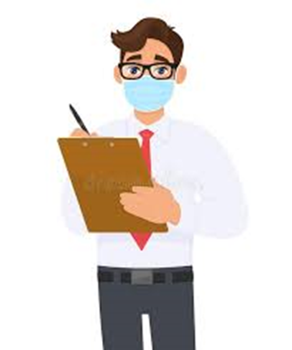
Review
Data review
Response review
Review plans for
updates
Notes:
Step 6 Review
The team should not just create procedures that will confirm the management plan is working but review the data to determine if trends are occurring within the facility
This is the review process. It can be as simple as a spreadsheet with measurements per locations, you can design the spreadsheet to turn green when the levels are as expected, yellow when it is slightly out of range and red when mitigation is necessary. This is a great way to visually catch the fact that maybe a specific location continues to push numbers upwards every month and perhaps after a period of time maybe 6 months that area hits a level that requires intervention.
This is why verification and validation is necessary
Every time an action is needed it should be reviewed and what was done to mitigate the issue needs to be documented with dates– again this could be a simple spread sheet
For example if you have slimy growth noted in a decorative fountain how do you know all corrective actions were taken as stated in your plan - do you have the date it was reported, the date the fountain was drained, the date it was physically scrubbed with a a detergent or other manufactured recommended cleaner or the date of the refill
Review is also needed when there are certain commonly encountered changes with the water supply design or management that might require the extend and frequency of monitoring
Good idea to anticipate additional hazards that might affect water quality – water start up or shut down, water main break or other water service interruptions, connecting water to a newly constructed area etc.
Review plan annually to make sure you are following the most current best practice as a means to update
If an event occurs that causes you to review and update your water management plan be sure to update your process flow diagram, associated control points, control limits and corrective actions

Slide 29
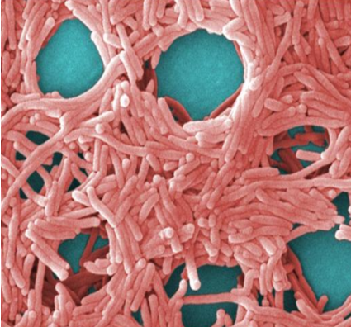
Document and Communicate
Program team
Building description
Water system description and
process flow diagrams
Control measures
Confirmatory procedures
Document collection
Notes:
Step 7 Document Document Document
From the first step to the last all activities need to be documented this includes all parts of the plan and it must be kept current
This includes
Program team
Building description
Water system description and
process flow diagrams
Control measures
Confirmatory procedures
Document collection
Be sure you share your plan, monitoring including any acquired infections and any responses or outcomes with the infection prevention and control committee or your quality assurance improvement program

Slide 30
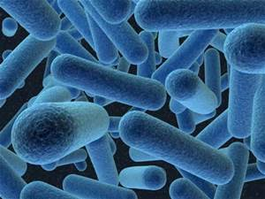
Outbreak Avoidance During Construction, Renovation, or Preventative Maintenance Practices
Consistency between water management plan and facility construction risk assessment
Water intrusion
Prevent frozen pipes
Commission and recommissioning of unused space
Update documents
Construction events
Water shut down
Notes:
Lets put this all together. Need to be aware how everyday activities impact our water
So as an example using a planed or unplanned construction renovations – considerations include the
Consistency between water management plan and facility construction risk assessment also look at
Water interruption or intrusion or
The Prevent freezing pipes
Also Need also to look at the end of the project with the Commissioning and/or recommissioning of unused space and the documented relationship between the existing potable water systems
Construction events
Be sure to document all construction events that impact facility water supply/systems – this includes new construction, plumbing repairs, disruptions to the water system r/t pipe break or shut down, malfunctions with the potable water or water main breaks or repairs
Update documents
Do you have a standard operating procedure for Water shut down, isolating, refilling or flushing water service areas that are impacted and a plan on temporary water will be provided
If water goes down on the patient care area may need to figure out how to get more hand san and bottled water down to those areas and instructing staff if it is yellow let it mellow, if is brown flush it down all as a means to conserve water
Every building is designed to meet the building codes and standards the year it was built. So you need to know what standards were in place the year that area of the facility was built. Need to be aware of the short comings that come with the standards at the time the building was built

Slide 31
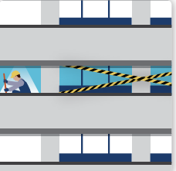
Challenges with newer
buildings
Challenges with older
buildings
Potential for dead legs
increases
Unoccupied floors/space
Water main break or pipes
breaking
Equipment damaged or
broken
Construction/ Renovation
Connecting with municipality
water supply can create
problems
Not enough chlorine comes to
the building
Unoccupied floors/space
Notes:
Potential for dead legs with new construction
increases
Unoccupied floors/space due to downsizing
The age of the pipes can be an issues and the materials can deteriorate and break dramatic changes in weather can cause older pipes to break (Water main break or pipes)
breaking
outdated Equipment that is damaged or broken
Construction/ Renovation
Do not think that because you have a new building you will encounter issues - Connecting with municipality
water supply can create problems- prior to opening the new space you will need to talk about the water management program and determine if the space/building is safe to open
The municipal water supply does Not enough chlorine comes to the building to control water growth – so you may need to add chemicals to you building water supply to keep growth under control
Depending on houw fast you open up the entire build ing you may have unoccupied floors/space that might need attention when those areas do open up

Slide 32
Outcomes
The desired outcome is confirming on a regular basis that
our water management program is being followed.
We verify and validate the program continuously to manage your facilities risks.
A successful WMP:
  Is meeting all verification and validation steps.
  Water quality is within established parameters.
  Environmental testing for Legionella are within limits
  No Legionellosis cases are identified in our patients/clients from a healthcare associated cause.
Notes:
Regardless what problems we may have with the water management program the outcomes are always the same.
The desired outcome is confirming on a regular basis that
our water management program is being followed.
We are verify are we doing what we said we would do and validating is the program actually working continuously to manage your facilities risks. For Example if your plan stated flushing the hot and cold water lines weekly in an unoccupied unit and record and communicate those results have you been doing that?????
If you found a problem did you take the actions described in the plan
Environmental testing for Legionella is useful to validate the effectiveness of the control measures. The water management team should decide if environmental water testing for legionella should be performed and if so how the test will be used to validate the program
If the team decides to do water testing for legionella then the testing protocols need to be specified and documented in advance. You also need to be familiar with and adhere to local and state regulations and accreditation standards for this testing
Legionella cannot be eliminated entirely from the water supply the goal here is to control growth
The last outcome of a successful program is No Legionellosis cases are identified in our patients/clients from a healthcare associated cause.
Some pneumonia order sets test for legionella when pneumonia onset is noted to be 48 hour after admission

Slide 33
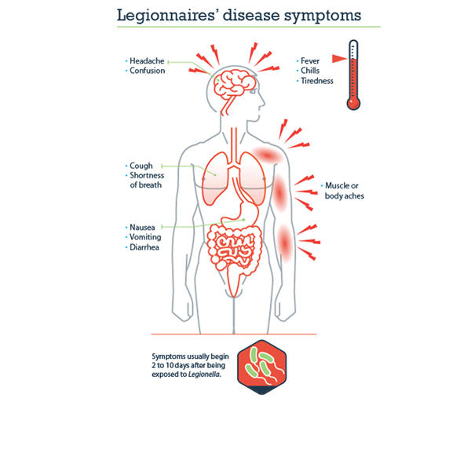
What if I have a legionella case!
Determine if facility-acquired infection
Report to Public Health
Document your determination
If met the definition of potential or FAI, notify medical director and active your water management team and plan
Activate full investigation if:
  1 or more FAI
  2 or more cases of possible FAI
  Activate outbreak plan
Notes:
Nothing gets the heart going better than a call from your microbiology department that you have inpatient with a positive urine antigen test UAT. Sooooooooooooooooooooooo what do you do when you hang up the phone and resigning is not an option
The sudden fear of do I have a problem races though your head
1st take a deep breath
2nd now that you have identified a potential case your water management plan should address how to respond to case of legionnaire disease
A full investigation following a diagnosis of legionnaires disease is needed to determine if the infection was acquired in the facility or out in the community is your first step
The CDC directs us to perform this investigation if just I case of definitive health care acquired legionnaires disease is identified and meets the definition of healthcare infection which is a patient who spent the entire 10 days prior to onset of illness in the facility being identified at any time.
2 or more cases of possible health care related legionnaires disease is possible for patients who spent parts of 10 days before symptoms within the same facility and are identified within twelve months of each other. The interval may be shorter if there were an event like a cooling tower going down
Incubation period for Legionnaires’ disease is typically 2-10 days, but can be longer
Definite case: a patient admitted at least 10 days prior to onset of illness.
Possible/probable Case: admitted for a portion of the incubation period prior to onset, including patients discharged and re-admitted within the incubation period.
Regardless where the case originated the next step is to follow the state requirements for reporting. PH partners may get involved and assist with the investigation
If this is facility acquired you will also need to activate your outbreak investigation plan at this time making sure you look for
potential future cases in the high risk patient population especially for those patients with severe pneumonia OR
If any of the following are identified
+ cases of FAI have been identified in the past 12 months
+ environmental tests for legionella in the past two months
changes in water quality that may lead to legionella growth such as low residual disinfectant levels, temperatures permissive for Legionella growth or near by construction or areas of stagnation
Other patients at risk in your facility, besides FA pneumonia should also be tested for Legionella –preferred diagnostic test are cultures of lower respiratory secretions on selective media and the legionella urinary antigen test
A cheat sheet may be helpful to guide providers on ordering the appropriate tests and where the cultures should be sent if any. This will assure the tests are ordered correctly at the very beginning.

Slide 34
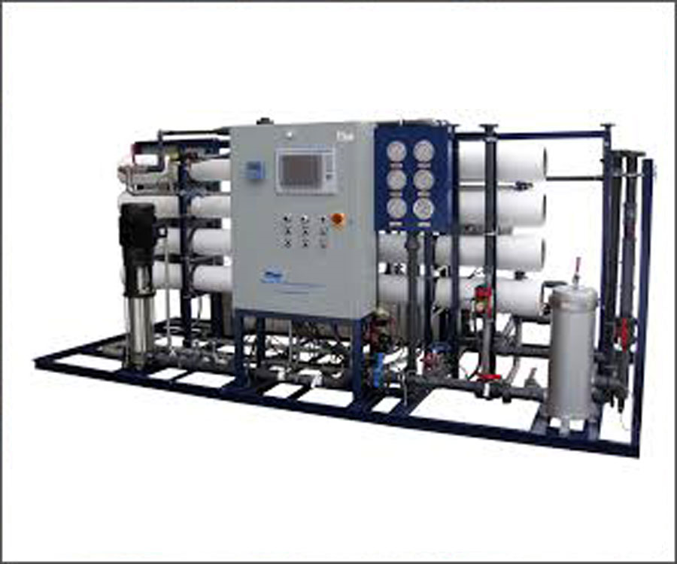
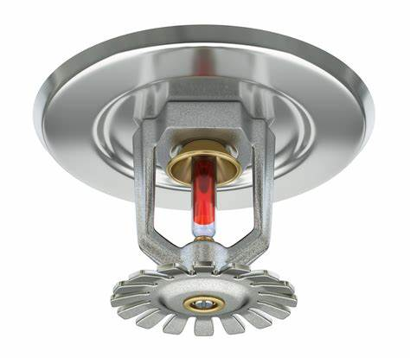
Don’t Forget
Dialysate Water
Sterilization and
Processing
Department
Sprinkler Heads
RO systems
Notes:
Don’t forget your Dialysate water if you have that service in your facility. You need to be looking at the total viable count (TVC). <0.1 CFU/ml
During an average week of hemodialysis the average patient can be exposed to anywhere from 300-600 liters of water, giving way for multiple opportunities for exposure to this high risk population
2004 edition from the Association for Advanced Medical Instrumentation (AMI) is considered the minimum regulatory requirements or the 2014 American National Standards Institute (ANSI) with AMI AND the international Standards of Organizations aka ISO which is the preferred recommendation
Do not forget About your sterile processing department, the concern is just not for microorganisms but need to also be looking water pH, minerals and chemicals that can also impact sterilizers and the outcomes of the process of sterilizing instruments
Finally need to touch on sprinkler heads. Is there a plan if the sprinkler system is activated either due to a fire or an accident. Sprinkler heads can put out 30 – 60 gallons of water of stagnant water per minute, you could be left with a mess of brown or black water and oily like substance that has soaked the entire area until the water main is turned off.
Hopefully you have a water intrusion plan that you can activate to try to dry everything in a matter of 72 hours. So what is not dried or is dried and cannot be cleaned after the 72 hours will need to be removed

Slide 35
Prevention with Equipment Design
Hand Washing Stations
  Faucets
  Location
  Soap
  Drying
  Aerators
  Sink Controls
Whirlpool or Spa Bathing
Facilities
  Manufacture
  recommendations
  Understand operation
  Training on cleaning,
  disinfection, and
  preventative
  maintenance
  Monitor chemical levels
  and water temperature
Notes:
Other items not covered in the 7 steps is design considerations
Hand washing stations are everywhere in our facilities – non touch faucets fittings do have their cons including requiring extra attention to maintain temperature, pressure and frequency of use to avoid stagnation. Or consider electronic eye faucets instead
The position of the sink is important to prevent splashing of supplies and equipment. For those sinks already in place is a splash guard needed. We had a sink in a clean supply room and we were sited because the room was very full and we could not prevent splashing. Mind you this was in new construction. We simply removed the sink and put in a full counter work space instead.
Built in soap dispensers should not be used
Dispenser designs for paper towels again look at a non touch dispenser to dispense paper towels
Removing aerators from faucets continues to be an unresolved issue per the CDC. Accommodations can be used to help with the splash by using a deeper sink bowl or longer spout - decreasing the distance between the spout and the drain can reduce some of the hazards
What a bout whirlpool or tanks that are emptied after each use. Per the CDC cleaning the insider surface with the appropriate disinfectant and rinsing with tap water is necessary. Also at the end of the day after the last patient an additional step includes circulating a chlorine solution at approximately 200 and 300 mg/liter through the agitator of the tank for 15 minutes and then rinsing. DO NOT refill until immediately prior to use
An alternative approach to reduce contamination to this equipment is to place a plastic line to create a whirl pool affect without the agitator.
If it is piped spa type tub, the tub and jets need to be disinfected with specific spa products along with proper draining and flushing sequences.
Much like any equipment, prior to purchasing validation of the manufacture recommendations before purchase – not to just understand the operation – but to know the cleaning, disinfection and required preventative maintenance that goes along with the product Other questions to ask is water recirculated, is air generated to create agitation and finally what is the manufacturer recommendations regarding how to monitor the function of the system including chemicals and water temperature

Slide 36
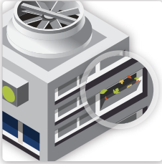
Cooling Tower Prevention
CDC
  Direct drift away from the air-intake
  system
  Minimizing aerosol drift
  EPA-approved biocides
  Routine System Monitoring
  Checklists
  Observe wetted surfaces
  Dosing & control equipment
  Compliance Inspection
Notes:
The reason Cooling towers are always a topic of discussion is because they are the number one culprit of legionella exposure. Take some time make an appointment and as a team member to show you exactly what a cooling tower looks like.
As you can see by this small cartoon picture (found in the CDC tool kit by the way ) of the leaves hanging in the tower
Know that the 2003 CDC environmental infection control guidelines reinforce the older recommendations for cooling towers are to look at when designing new towers that you are directing the tower drift away from the air intake, minimizing the aerosol drift utilizing a drift eliminator as well as utilizing effective EPA approved biocides that are used regularly for operating towers
Routine system monitoring is also required. Work s best is someone is assigned to do this on a scheduled basis and record
Visual observations of cooling towers and associated devices
Observing all wet surfaces
Observing tower basins, drift eliminators and recording the presence of organic materials – this could be biofilms, algae, scale, sediment, silt, dust deposits, oil or grease or an other visible contaminates.
Recording chemical dosing and control equipment
Including sufficient storage and delivery of treatment chemicals and any bleeding off of the system
And finally reporting any systems anomaly's or problems to management or maintenance manager
Last but not least the compliance inspection this inspection can be done quarterly where as routine monitoring needs to be done monthly

Slide 37
Risk Mitigation
Lack of responsible, knowledgeable water risk management team
Failure to maintain any secondary disinfection system
Prior inability to control water temperature fluctuation/stagnation issues/biofilm/sediment
Untreated cooling towers or lack of drift eliminators
Lack of documentation-maintenance logs, remediation, response actions, results
Failure to comply with any state, local regulations
Red Flags
Notes:
Surveyors or lawyers will look at

Slide 38
Conclusion
We have reviewed what opportunistic pathogens are associated with plumbing/potable water systems.
We have reviewed factors associated with outbreaks and potential transmission mechanisms.
Able to discuss recommendations and practices the infection preventionist should implement to become a stronger partner with risk and facilities in the development of water safety management plans.
Notes:
So in conclusion we have covered the 7 steps for developing a water management plan
Need to have the right team members at the table when writing your plan
Need to review and revise at least annually and as needed when systems change ie building taken off line or new construction added
Hopefully the resources listed will be a s beneficial to you as it was out team here at the hospital in writing our plan
The easy thing really is to write the plan the hardest is to monitor and validate your plan on a continuous basis. Failure to use your plan could result in very bad out comes not just for the patient but for your facility as well.

Slide 39

Don’t chase zero
Zero Legionella
Is virtually impossible to
Achieve in complex water systems

Slide 40
Resources
Water Management Program Template, 2019: https://cha.com/wp-content/uploads/2019/03/Water-Management-Program-Template.pdf
CDC Legionella Environmental Assessment Form:
https://www.cdc.gov/legionella/downloads/legionella-environmental-assessment-p.pdf
CDC Developing a Water Management Program to Reduce Legionella Growth & Spread in Buildings -A Practical Guide To Implementing Industry Standards:
https://www.cdc.gov/legionella/downloads/toolkit.pdf
Centers for Medicare & Medicaid Services S&C 17-30 Revised 06.09.2017, https://www.cms.gov/Medicare/Provider-Enrollment-and-Certification/SurveyCertificationGenInfo/Downloads/Survey-and-Cert-Letter-17-30.pdf
Risk management plan for LEGIONELLA CONTROL in the operation and maintenance of the water systems
https://www.hindmarshplumbing.com.au/media/enhealth-RMP-Template-Final.pdf

Slide 41


