Slide 1
Waterborne pathogens-building a water management plan 101
Maxcey Smith, BSN, RN, CPHQ
Director of Quality/Safety Risk Coordinator
Nemaha County Hospital

Slide 2
Disclaimer
This presentation may contain references or links to statues, regulations, or other policy materials. The information provided is only intended to be a general summary. It is not intended to take the place of either the written law or regulations. Please review the specific statues, regulations and other interpretive materials for a full and accurate statement of their contents.

Slide 3
Agenda
Understand what opportunistic pathogens are associated with plumbing/potable water systems.
Identify factors associated with outbreaks and potential transmission mechanisms.
Discuss recommendations and practices you should implement to become a stronger partner with safety/risk and facilities in the development of water safety management plans.

Slide 4
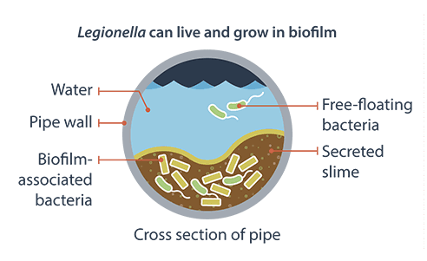
Legionella
The bacterium that causes Legionnaires’ disease.
Occurs naturally in freshwater environments.
Poses a health risk when gets into building water systems.
A variety of internal and external factors can lead to a problem in your building.
Becomes a problem when the bacteria grows and/or spreads through aerosolization or aspiration.

Slide 5
Legionnaires’ disease
Clinical features include cough, fever, muscle aches, sob, headache and radiographic pneumonia.
Pontiac fever-a milder infection and symptoms.
Signs and symptoms are similar to pneumonia caused by other pathogens; only way to diagnose is with a specific diagnostic test.
In the US, reported cases have grown nearly nine times since 2000. Nearly 10,000 cases of Legionnaires’ disease were reported in 2018 but this number is likely underestimated as the illness is thought to be underdiagnosed.

Slide 6
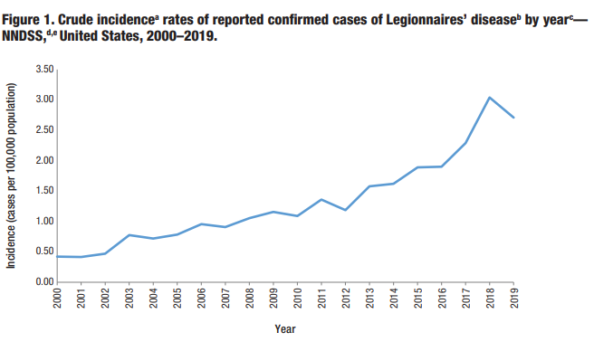
Fast Facts
1 in 10 who gets sick from Legionnaires’ will die.
In general, people do not spread the disease to other people but it is possible in rare circumstances.
Risk factors for developing Legionnaires’ include: age >=50, current or hx of smoking, chronic lung disease such as COPD, immunocompromised, systemic malignancy, underlying illnesses such as DM, renal failure.
More illness occur in the summer and early fall but can happen any time of the year.
This disease is under recognized and underdiagnosed.
Cases need to be detected, allowing rapid investigation by public health officials and prevention of additional cases.

Slide 7
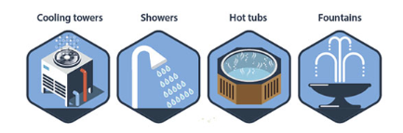
Common sources of infection
Room Air Humidifiers, ice machines, CPAP machines, eye wash stations, sink faucets, bronchoscopes

Slide 8
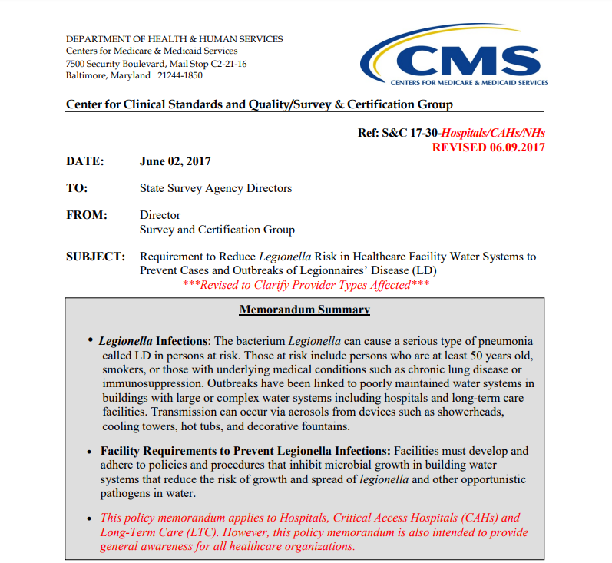
CMS Requirements
42 CFR §482.42 for hospitals: “The hospital must provide a sanitary environment to avoid sources and transmission of infections and communicable diseases. There must be an active program for the prevention, control, and investigation of infections and communicable diseases.”
42 CFR §482.42 for hospitals: “The hospital must provide a sanitary environment to avoid sources and transmission of infections and communicable diseases. There must be an active program for the prevention, control, and investigation of infections and communicable diseases.”
42 CFR §485.635(a)(3)(vi) for critical access hospitals (CAHs): CAH policies must include: “A system for identifying, reporting, investigating and controlling infections and communicable diseases of patients and personnel.”

Slide 9
ASHRAE 188
CMS expects Medicare certified healthcare facilities to have water management policies and procedures to reduce the risk of growth and spread of Legionella and other opportunistic pathogens in building water systems. An industry standard1 calling for the development and implementation of water management programs in large or complex building water systems to reduce the risk of legionellosis was published in 2015 by American Society of Heating, Refrigerating, and Air Conditioning Engineers (ASHRAE).
ASHRAE Standard 188 establishes minimum legionellosis risk management requirements for building water systems.
Toolkit was developed in 2016.
Latest version is June 24th, 2021.

Slide 10
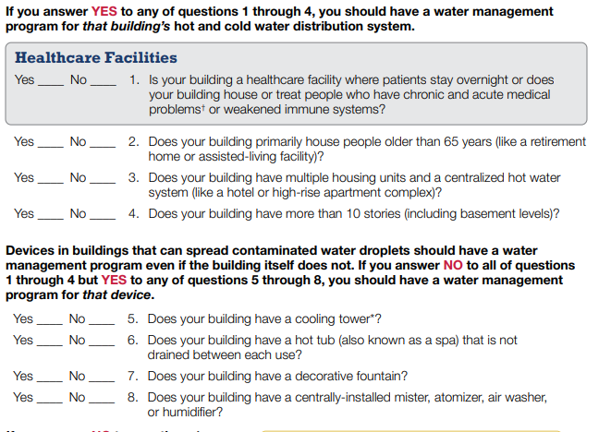
Identify risks
Population served
Multiple units/floors/centralized hot water system
Device Risk Factors-Cooling towers, hot tub/spa, decorative fountains, central mister, atomizer, air washer, humidifier

Slide 11
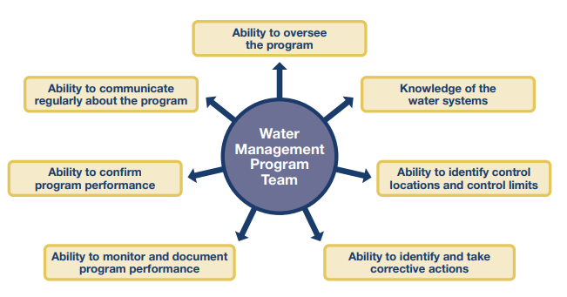
Establish a water management team
Consider someone who understands accreditation standards and licensing requirements.
Someone with expertise in infection prevention.
A clinician with expertise in infectious diseases.
Risk and quality management staff.

Slide 12
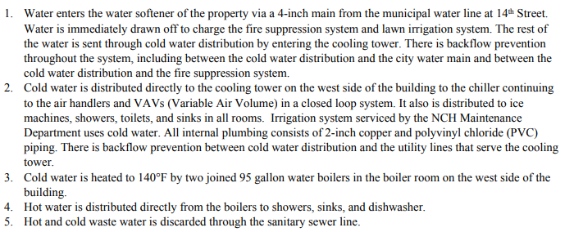
Describe your Building Water Systems Using Text

Slide 13
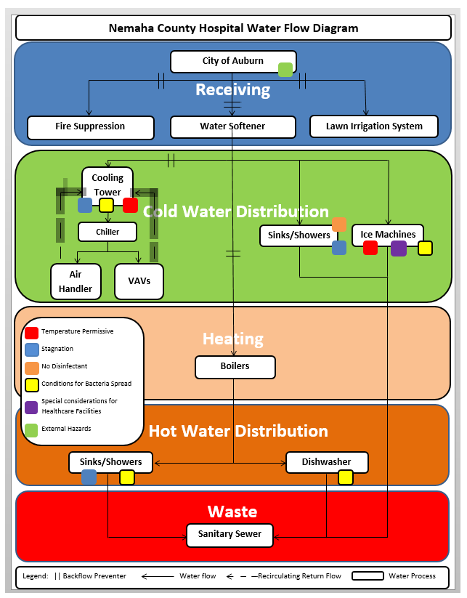
Describe your Building water systems using a flow diagram

Slide 14
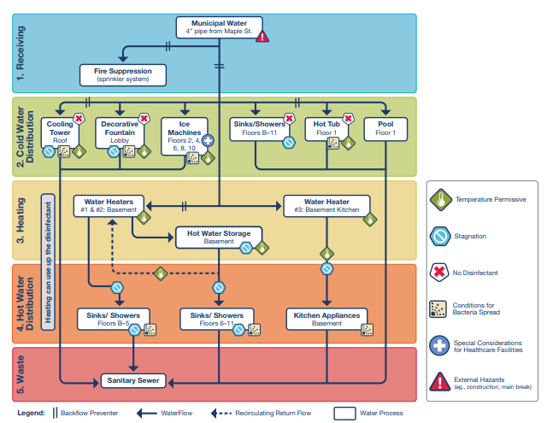
Identify areas Where legionella could grow and spread
Think about where medical procedures may expose patients to water droplets, such as hydrotherapy.
Areas where patient are more vulnerable to infection, such as bone marrow transplant units, oncology floors, or intensive care units.

Slide 15
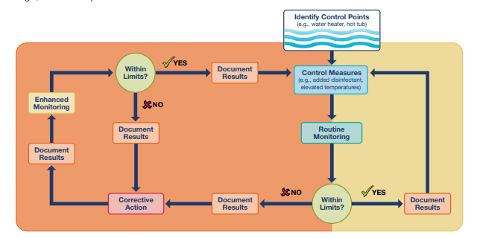
Control Measures and Corrective actions
Make sure the person with expertise in infection prevention on your team is aware.
Report the case to your local and/or state health department; a full investigation may be needed.

Slide 16
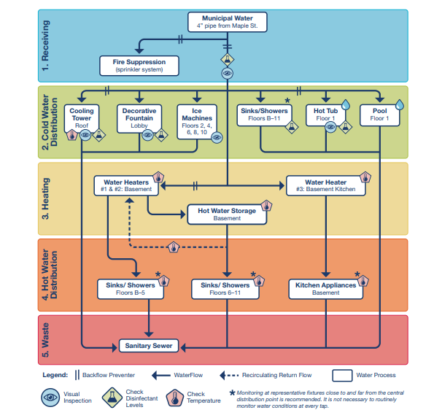
Decide where control measures should be applied
Water quality should be measured throughout the system to ensure that changes may lead to legionella growth (such as a drop in chlorine levels) are not occurring.
Water heaters should be maintained at appropriate temperatures.
Disinfectant and other chemical levels in cooling towers and hot tubs should be continuously maintained and regularly monitored. Surfaces with any visible biofilm (slime) should be cleaned.

Slide 17
Establish ways to intervene when control limits are not met
Plan for your monitoring results to vary over time and be prepared for corrective actions.
Corrective actions are taking in response to systems performing outside of control limits.
Example 1:During weekly inspection of the fountain in front lobby, slimy growth (biofilm) is found. As found in water management program, employee immediately shuts fountain off, drains it to sanitary sewer and scrubs with detergent recommended by manufacturer. Follows program start up procedure checks residual disinfectant level to ensure that are within control limits. Documents observations and informs supervisor.

Slide 18
Make sure the program is running as designed and is effective
Be prepared to RESPOND.
You may need to initiate a customized contingency response to gain control of a building water system.
Verification: Are we doing what we said we would do?
Validation: Is our program actually working? Testing protocol should be specified and documented in advanced. Be familiar with and adhere to local and state regulations and accreditation standards for testing.
Documentation: Program team, Building description, water system description, control measures, confirmatory procedures and document collection and transport methods.
Communication: communicate to your employees and colleagues about your program on a regular basis and train those responsible for implementing and monitoring the program.

Slide 19
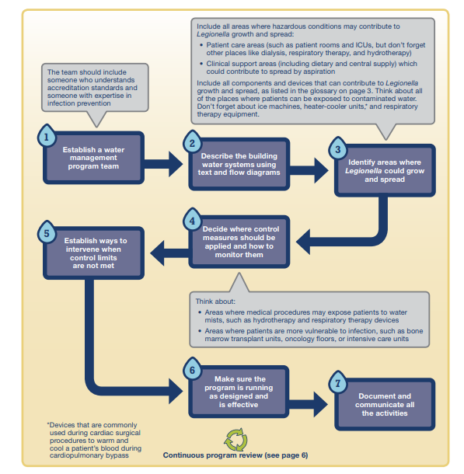

Slide 20
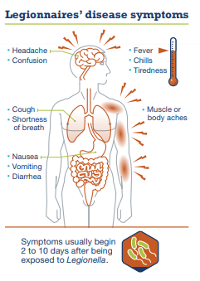
Identifying and investigating legionnaires’ disease cases
A healthcare facility’s water management program to limit Legionella growth and spread should include the actions to take when a patient is diagnosed with Legionnaires’ disease or environmental triggers occur.
Clinicians should test patients with healthcare-associated pneumonia (pneumonia with onset ≥48 hours after admission) for Legionnaires’ disease.
Determining whether the infection was acquired in the facility or the community.
Notifying the public health department.
Other patients with healthcare-associated Legionnaires’ disease diagnosed in the past 12 months
Positive environmental tests for Legionella in the past 2 months
Current changes in water quality that may lead to Legionella growth (such as low chlorine levels)

Slide 21
Conclusion
We have reviewed what opportunistic pathogens are associated with plumbing/potable water systems.
We have reviewed what factors associated with outbreaks and potential transmission mechanisms.
Able to discuss recommendations and practices you should implement to become a stronger partner with risk and facilities in the development of water safety management plans.

Slide 22
Questions??

Slide 23
Resources
What Clinicians Need to Know
Legionella Toolkit
Legionnaires Disease Fact Sheet
CMS Memorandum Summary
ASHRAE 188-2018

