Slide 1
Quality Residency
Capstone Project
nebraskahospitals.org
Jessica Johnson, 10/13/2023 Community Hospital

Slide 2
Introduction to the Organization, Project, Team
Community Hospital is a 25-bed critical access, not-for-profit, DNV-accredited facility in Southwest Nebraska. We provide a full range of acute, obstetrical, surgical, diagnostic, and clinical services.
The hospital has four seeds that aim to help meet their mission and vision. The People Seed’s strategy statement is to achieve a mission-driven workforce with one initiative of improving employees’ perception of teamwork between departments. Poor perception of teamwork can lead to poor patient and employee satisfaction. Communication is a key component of teamwork. Poor communication can lead to medical errors and patient harm.
To improve the score, the hospital commissioned a 90 day team dedicated to the project. Each 90 day team as two facilitators trained in the DMAIC process, a team owner, and an Administrative Council (C-Suite) sponsor. Frontline staff from the highest and lowest scoring departments, both clinical and non-clinical were added to the team. Additional characteristics of honesty, willingness to communicate, optimism, openness to new ideas and availability were considered. One team member left due to availability. Weekly report-outs were given to the Administrative Council during the course of the project.

Slide 3
AIM Statement
The aim of this project is to increase the perception of teamwork by departments by 4.7% from 18.3% excellent responses to the 70th percentile of 23% excellent responses by June 30, 2024.

Slide 4
Measuring Success
Annually, employees are invited to take a survey administered by a third party to measure employee engagement. The survey asks staff to rank teamwork between departments as either excellent, very good, good, fair, or poor.
To monitor this measure on a more frequent basis, the hospital does surveys each month on staff that attend the annual training.
The hospital only calculates the scores based on the number of staff who rate it “excellent.”

Slide 5
Selecting Changes
An anonymous hospital-wide survey was conducted through e-mail to identify potential causes. Questions included:
How would you currently rate the teamwork between departments?
If you were unable to rate the teamwork as excellent, why? (Open-ended)
Which are of the hospital do you currently work? (Clinical, Ancillary, or Non-Patient Care)
Which departments do you work best with? Why?
Which departments can be challenging to work with? Why?
Survey was analyzed:
No common departments identified as challenging.
No difference in scores between clinical, ancillary or non-patient care.

Slide 6
Selecting Changes
Themed responses as to why departments were challenging to work with:
General communication (29 responses)
Rude/disrespectful communication (29 responses)
Individual issues (20 responses)
Lack of/incomplete information sharing (20 responses)
Different goals/Lack of Customer Focus (15 responses)
Inconsistent processes (11 responses)
Time/resources (10 responses)
Other (10 responses)
On-call issues (4 responses)

Slide 7
Selecting Changes
Completed 5-Why on top 2 themes to identify root cause:
Theme: Rude/disrespectful communication
Cause: Lack of training/experience in direct resolution, lack of training in Chain of Command policy
Theme: Lack of/incomplete information sharing
Cause: Lack of defined process, no consistent use of standardized tools to communicate

Slide 8
Selecting Changes
Completed a brainstorming session with team to identify possible solutions.
Researched using scholarly articles
Based on these, the team decided to re-implement TeamSTEPPS with a robust sustainment plan.

Slide 9
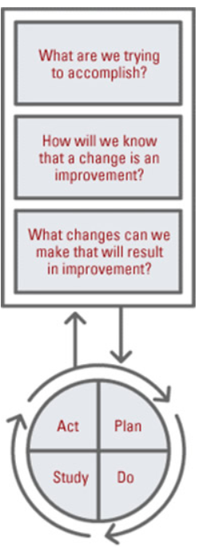
Plan ~ Do ~ Study ~ Act
Plan
I plan to re-implement TeamSTEPPS across the facility.
I hope this produces increases in perception of teamwork by improving communication.
Steps to execute:
Identify personnel to become Master Trainers
Train Master Trainers
Identify and train a team of department champions to encourage the use of TeamSTEPPs tools
Plan full hospital rollout
Create training plan for new hires
Do
We will observe scores monthly.
No data is available at this point.

Slide 10
Plan ~ Do ~ Study ~ Act
Study
Need observation time after completion of training.
Act
Will be creating a sustainment plan for TeamSTEPPS that is more robust the first year.
***Each project will likely require more than 1 PDSA cycle.

Slide 11
Data and Trends
Have assigned contract with the AHA for training.
Goal is to have 30 Master Trainers attend the class.
Currently 29 employees are registered for the class.

Slide 12
Return on Investment (ROI)
Explore the financial implications of the project:
Will costs/expenses be incurred to make noted changes?
Cost of TeamSTEPPS training($30,000)
Staff time in training (16 hrs of training for 30 staff $12,000)
What savings/revenue will be noted?
Decrease in patient harm due to improved communication
Increased staff retention
Improved efficiency and patient satisfaction
Total Savings/Revenue – Total Costs/Expenses = Total ROI
Positive ROI = Dollars Earned ~~ Negative ROI = Dollars Lost

Slide 13
Spreading / Sustaining / Maintaining / Replicating
Current Plan for Sustainment:
Structured training for new employees
1st year: Monthly reminders/training for TeamSTEPPS tools
Quarterly department champion meetings to discuss the use of the tools

Slide 14
THANK YOU/Questions
Jessica Johnson, MHA CHC
jjohnson@chmccook.org
(308) 344-8329
nebraskahospitals.org

