Slide 1
Behavioral Health in Nebraska
Nebraska Hospital Association
August 26, 2021

Slide 3
Thank you, Laura!

Slide 4
National Highlights
Number of U.S. Adults with:
Mental Illness: 44 million
Anxiety Disorders: 42.5 million
Suicidal Thoughts: 9.8 million
Substance Use Disorder in the Past Year: 19 million
Percent of US Adults with Major Depression: 17.3 million
Number of suicide deaths: 47,511
Suicide deaths per 100,000 population: 14.5
Number of visits per year when mental, behavioral, or neurodevelopmental disorder is the primary diagnosis:
Physician offices: 56.8 million
Emergency departments: 4.9 million

Slide 5
Impact of COVID-19 on Mental Health in Nebraska
Over the last year
1,800 new families (74% increase) called the Nebraska Family Helpline
31% of all adults in Nebraska had symptoms of anxiety and/or depression – up from 11% last year
20% reported an unmet need for counseling or therapy
16% of adolescents and 8% of adults in Nebraska reported having a major depressive episode since the start of the pandemic

Slide 6
Behavioral Health Trend for Children and Adolescents
Since 2017 baseline, more adolescents and children have been served by our providers

Slide 7
Impact of Medicaid Funding on Mental Health and Substance Use Disorder Services
*Trending down. Impacted largely by MLTC expansion and COVID-19. Decrease in SUD may be attributed to more men covered by MLTC, rather than DBH. Historically more men have been served in SUD services.
New payer picking up cost

Slide 8
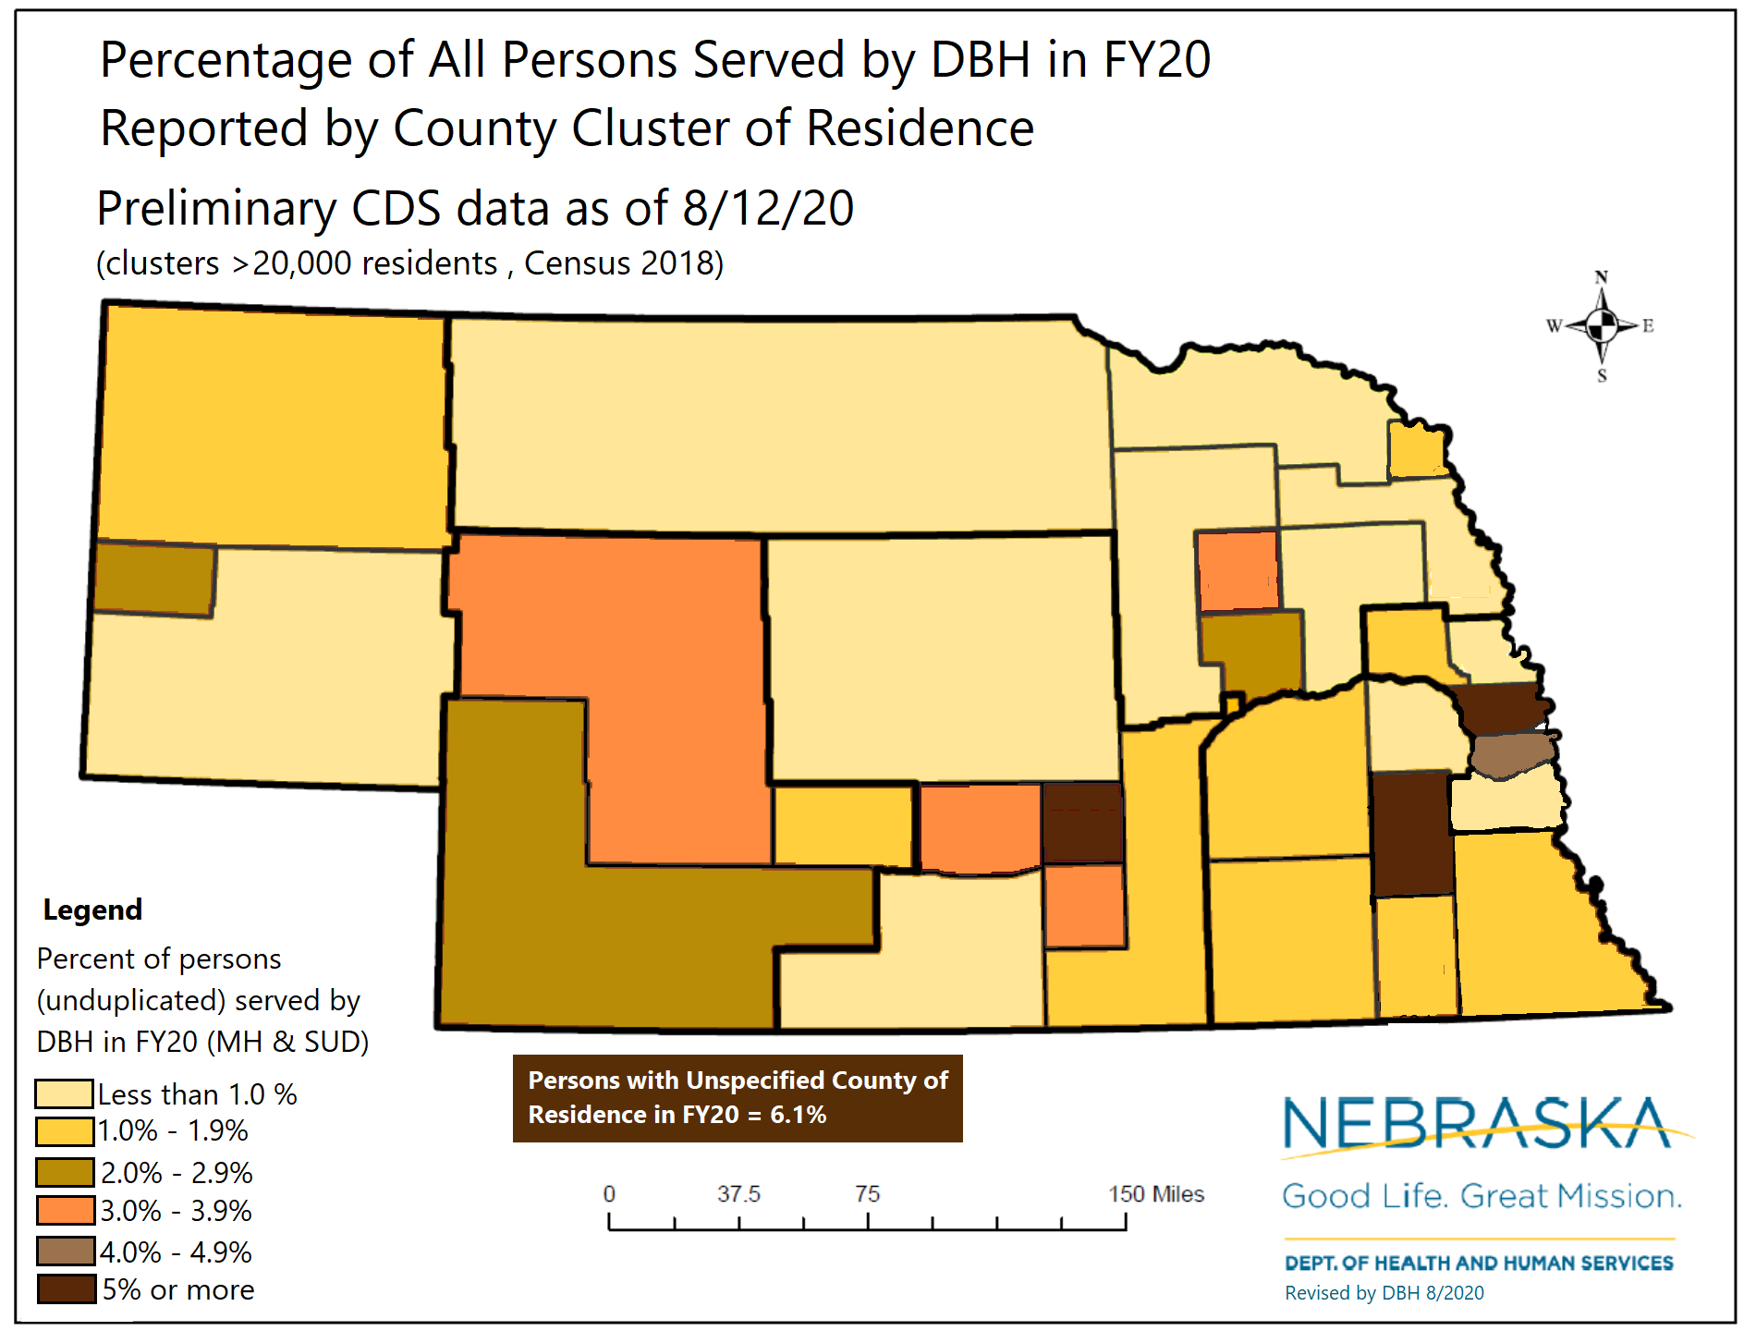
Serving Rural Populations
Rural Nebraskans represent 34% of total population (over 660K). Our goal is to increase availability of mental health services in rural areas.

Slide 9
Mental Health Diagnoses for Nebraska’s Minority Populations
Rates of depression are lower in Black Americans (24.6%) and Hispanic/Latino Americans (19.6%) than in White Americans (34.7%), but
Depression experienced by Black and Hispanic individuals is likely to be more persistent
People who identify as being two or more races (24.9%) have been most likely to report mental illness within the past year than any other race/ethnic group, followed by:
American Indian and Alaska Natives (22.7%)
White (19%)
Black (16.8%)

Slide 10
Mental Health Diagnoses for Nebraska’s Minority Populations
Native Americans and Alaskan Natives report higher rates of posttraumatic stress disorder and alcohol dependence than any other ethnic or racial group
Adults with any mental illness who received mental health services:
48% of whites
31% of Blacks and Hispanics
22% of Asians

Slide 11
Future of Behavioral Health in Nebraska
Guided by Strategic Planning
Pillars of Transformation
Pillar 1: Enhance Behavioral Health Influence
Pillar 2: Implement an Integration Strategy
Pillar 3: Promote Stakeholder Inclusion
Pillar 4: Drive Innovation and Improve Outcomes
Pillar 5: Demonstrate and Drive Value

Slide 12
State Vision for Behavioral Health Division
1. Optimize and strengthen the organization of the Division of Behavioral Health Division to accomplish the new goals of the new strategic plan
2. Increase opportunities for access to rural and vulnerable populations
How can we increase access to Telehealth in rural areas?
How can we strengthen relationships with critical access hospitals?
Could we increase access to mobile services?

Slide 13
State Vision for Behavioral Health Division
3. Develop a Continuum of Care for Children and Youth
Available of 24/7 crisis intervention services
Increase and enhance screening and assessment for community-based mental health services that serve children; inpatient and residential treatment
Explore opportunities to support, participate and leverage funding to enhance community engagement strategies to continue to the development of a children’s continuum.
4. Expand Adult Care Continuum
Maximize the use of all state campuses

Slide 14
Thank You!

