Slide 1
Age Friendly Hospital

Slide 2
Getting Started
4M’s team created
Paper forms
Training
Education with physicians
Created tab in EMR

Slide 3
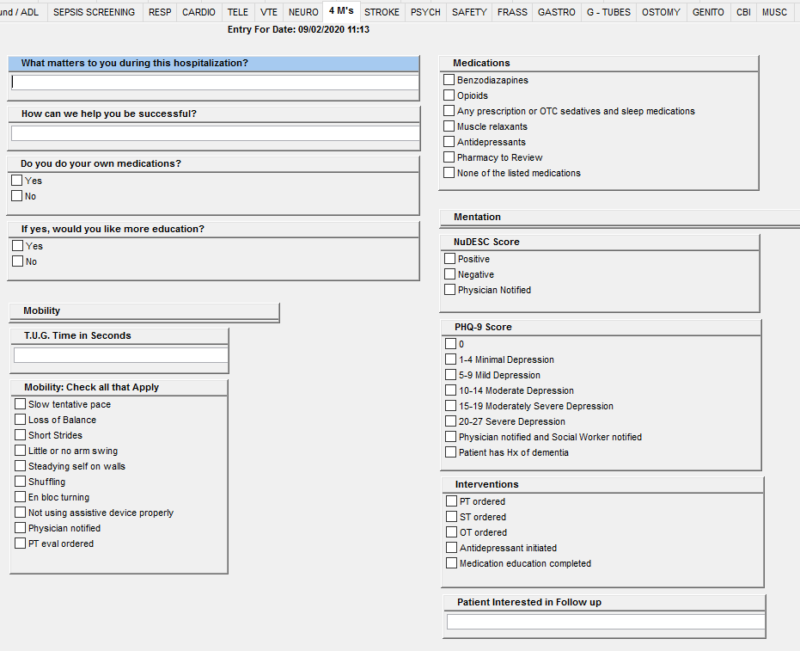

Slide 4
improvements
We got IT involved
Daily reports

Slide 6
Continued improvements
Created What Matters Tree Poster
Involved our Patient and Family Advisory Committee for input

Slide 7
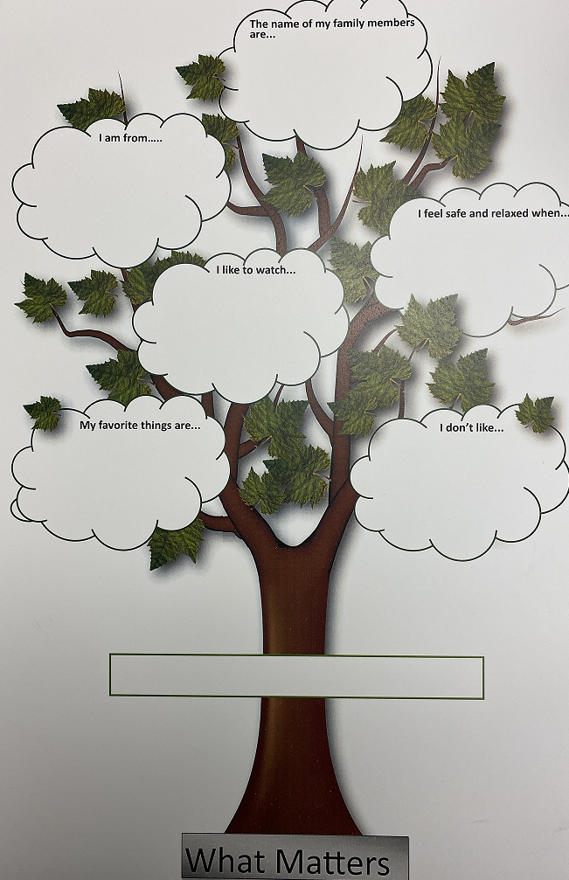

Slide 8
Goals
Closer monitoring of interventions completed related to 4M assessment, i.e. physical therapy, antidepressants, medication reviews.
Would like to start doing some chart review and research to see if our interventions are helping so we can share our wins with staff and they can see they are making an impact by doing the extra work.

