Slide 1
Incorporating Social and Behavioral Determinants of Health in Patient Care
Christopher Henkenius, H4 Technology

Slide 2
Conflict of Interest
Chris Henkenius has no conflict of interest.
Has no real or apparent conflicts of interest to report.
2

Slide 3
Learning Objectives
Describe the importance of social and behavioral determinants of health to patient care
Provide on outline for incorporating social and behavioral determinants of health information into patient care and documentation.
Describe strategies for optimizing health IT systems to capture and use information about social and behavioral determinants of health of individuals
3

Slide 4
What makes us sick? Look Upstream -Dr. Rishi Manchanda
https://youtu.be/dJEwC4wCM70

Slide 5
What are Social Determinants of Health (SDoH)?

Slide 6
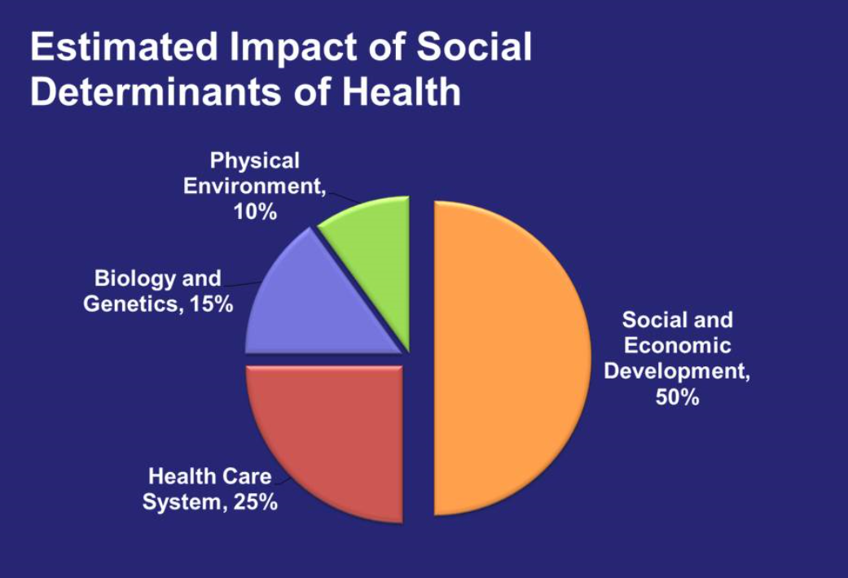
SDoH Impact
Social factors account for 25-60 percent of deaths in the United States in any given year according to various meta-analyses. (Hieman & Artiga, 2015)
Up to 70 percent of a person’s overall health is driven by these social and environmental factors and the behaviors influenced by them. (Schroeder, 2007)

Slide 7
Why Don’t We SDoH?
Patients don’t pay for it
Providers can’t fix it
No time for root cause analysis

Slide 8
Business Implications
HIPAA & 42CFR Part 2
Workflow Impacts (Cost)
Revenue Potential
Cost Avoidance

Slide 9
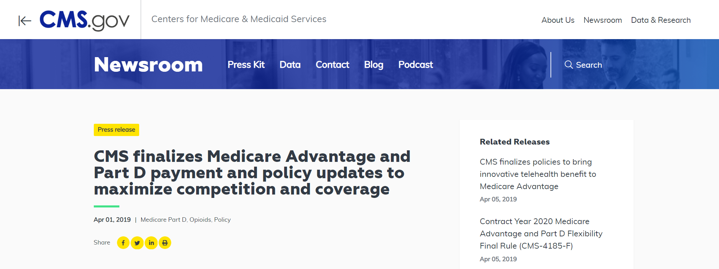
CMS News

Slide 10
What does this mean? Medicare Advantage 2020 Inclusions:
Meal Delivery
Transportation for non medical needs (Grocery)
Home Environment Service
(home/air/carpet cleaning)
Heart Disease – heart healthy food & produce.

Slide 11
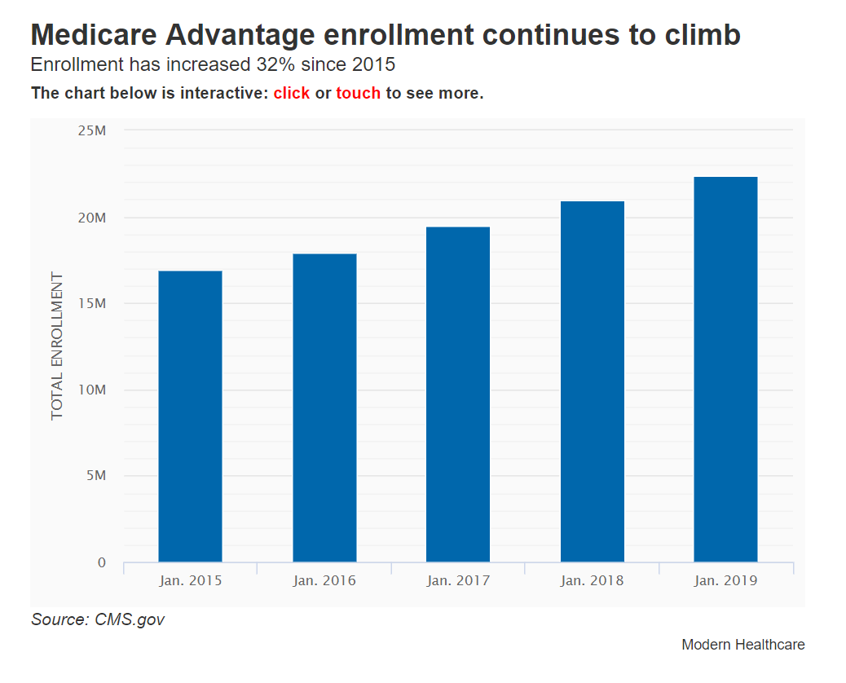
Growth of Medicare Advantage
Medicare enrollment is project to increase to an all time high
20.2 million to 22.6 million
11.5% increase compared to 2018
32% since 2015
https://www.modernhealthcare.com/article/20190116/NEWS/190119927/medicare-advantage-industry-sees-slower-growth-for-2019

Slide 12
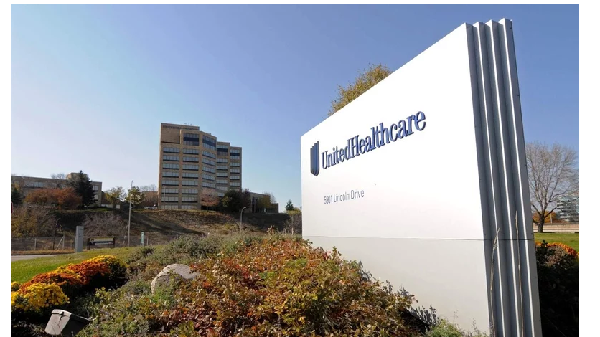
United Healthcare and AMA
United Healthcare and the AMA are advocating for the addition of 23 new codes to capture additional SDoH data, building on existing codes to create a truly whole person approach to care.

Slide 13
Commercial Payer Projects Focus on SDOH
Anthem launched a partnership program — Take Action for Health — with the National Urban League, City of Hope, and Pfizer to improve breast cancer and heart disease care in African American communities nationwide.
Humana launched an initiative to build community trust, establish behavior change, lower costs, and improve health in seven communities. By 2020, the Bold Goal initiative plans to improve health in these communities by 20 percent.
Kaiser Permanente is advancing a “Total Health” framework to address the social determinants of health in neighborhood and school settings that focus on health-promoting policy, system, and environmental changes. To accomplish this, Kaiser Permanente is screening patients for unmet social needs to refer them to relevant resources in their communities. Data shows that 78 percent of those screened have one or more unmet social needs.
Harvard Pilgrim launched a program to reduce racial and ethnic disparities in colorectal screening, reducing the screening gap between low-health literacy groups and their general patient population from 11 to 4 percent in four years.
UnitedHealthcare Community Plan of WI invested $25,000 in four different community programs that were designed to improve financial independence or interpersonal disability care. The payer also used demographic data to improve the distribution of healthy food to local communities by 87 percent in 2016.
Using geospatial data, California-based Health Net reduced postpartum care disparities by 40 percent and increased postpartum visits for African American women in Los Angeles from 17 to 33 percent.
https://www.healthedge.com/blog-social-determinants-health-what-are-payers-doing

Slide 14
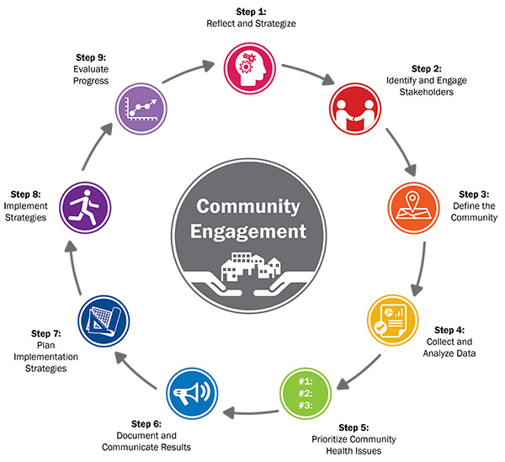
Community Health Needs Assessment to advance Social Determinants of Health
http://www.healthycommunities.org/Resources/toolkit.shtml#.XN8R6chKjic

Slide 15
Sources of SDOH Data
Community level determinants
Individual level determinants

Slide 16
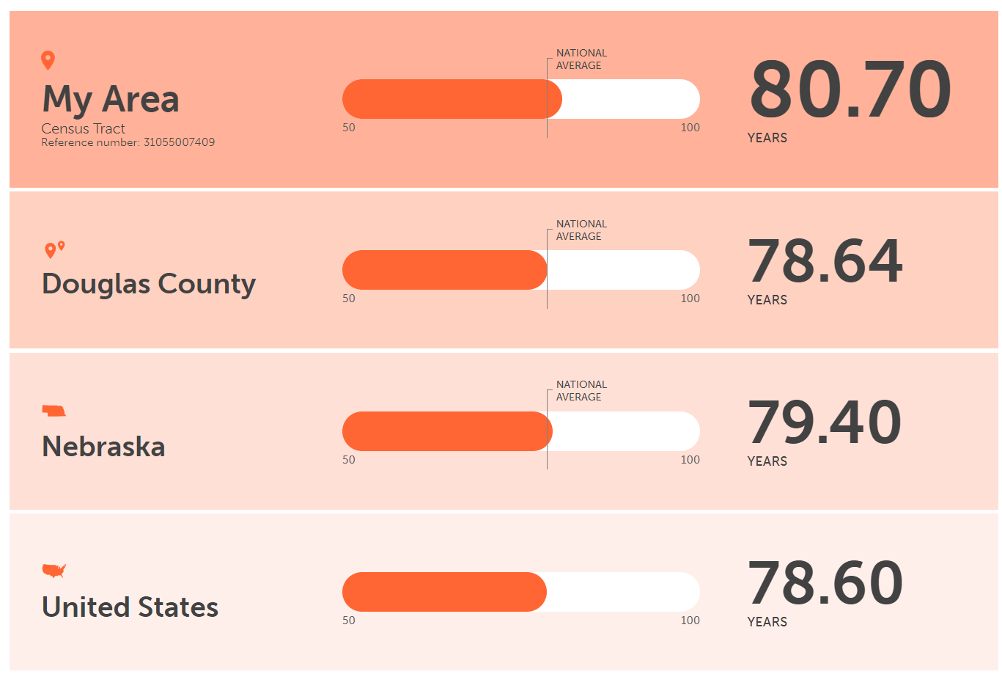
Community Level SDOH Data
Could where you live influence how long you live?
Zip code is more important than genetic code. Robert Wood Johnson Foundation
https://www.rwjf.org/en/library/interactives/whereyouliveaffectshowlongyoulive.html

Slide 17
Community Level SDOH Data
Useful at the system level
Can enhance performance of predictive models
Interest to researchers who want to determine the role of community context in health
Tools for community generated SDOH
City Health Dashboard
https://www.cityhealthdashboard.com
County Health Rankings and Roadmaps http://www.countyhealthrankings.org/explore-health- rankings#county-select-38
CDC Data Set Directory of Social Determinants of Health at the Local Level https://www.cdc.gov/dhdsp/docs/data_set_directory.pdf

Slide 18
Potential Census Bureau Data
Age | Income and Earnings | Race and ethnicity
Ancestry | Labor Force status | School enrollment
Commuting Patterns | Language spoken | Gender
Disability | Marital status | Transportation to work
Educational Attainment | Mobility | Type of work
Employer Type | Nativity | Veterans disability
Fertility | Number of children | Wealth
Food Stamps | Other Income | Well being
Household and Family | Perceived health status | Basic needs, consumer durables
Housing value | Poverty | Crime

Slide 19
Individual Level SDoH Data
Paper
HIT Solutions
Forms, Surveys, Checklists
Embedded Workflow Tools
Electronic Medical Records
Intimate Partner Violence
Social Isolation
Alcohol and Tobacco Use
Depression
Financial Resources
Food, transport and housing insecurity

Slide 20
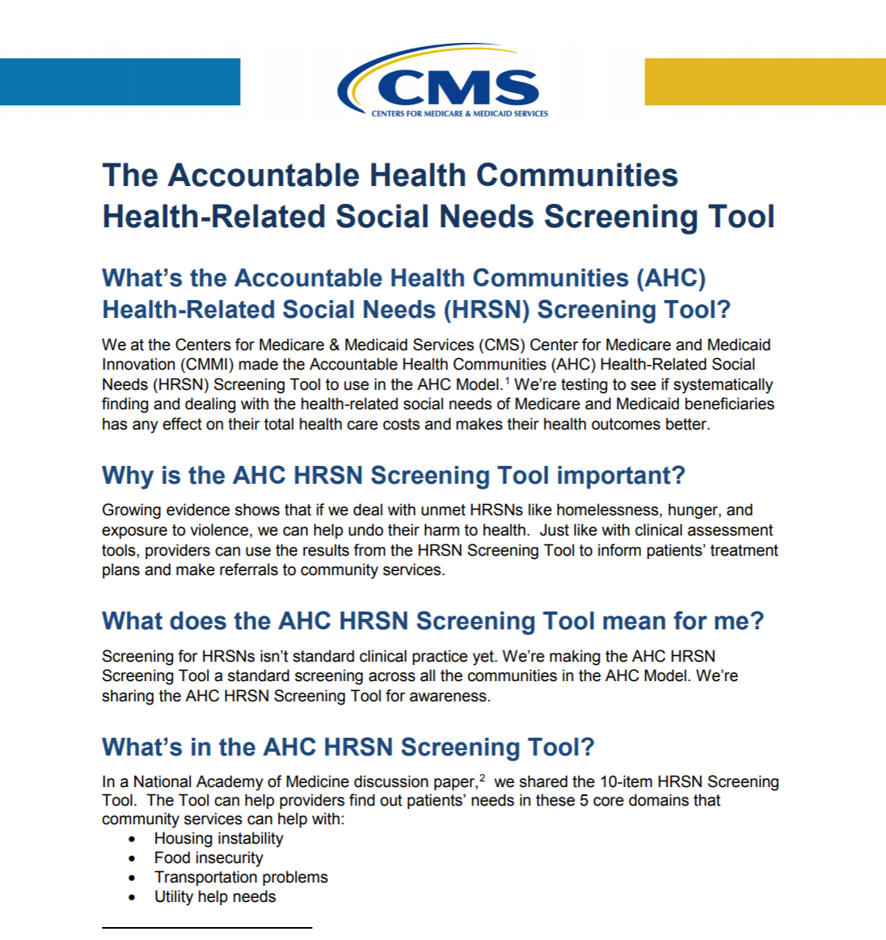
Assessments of Social Determinants of Health
Health-Related Quality of Life
Patient Health Questionnaire – 9 (PHQ9)
ASAM Assessment
Mental Health Assessment
Global Functioning Social & Roles Scales
Lehman’s Quality of Life
Many more service specific

Slide 21
SDoH Use Cases
Direct Patient Care
Value-Based Care Initiatives
Care Management Programs
Mental Health Programs

Slide 22
Technical Implications
Can your EMR meet your needs?
Can your EMR Integrate?
No More Silos
Time to Market
Reporting & Alerts
Resource Planning

Slide 23
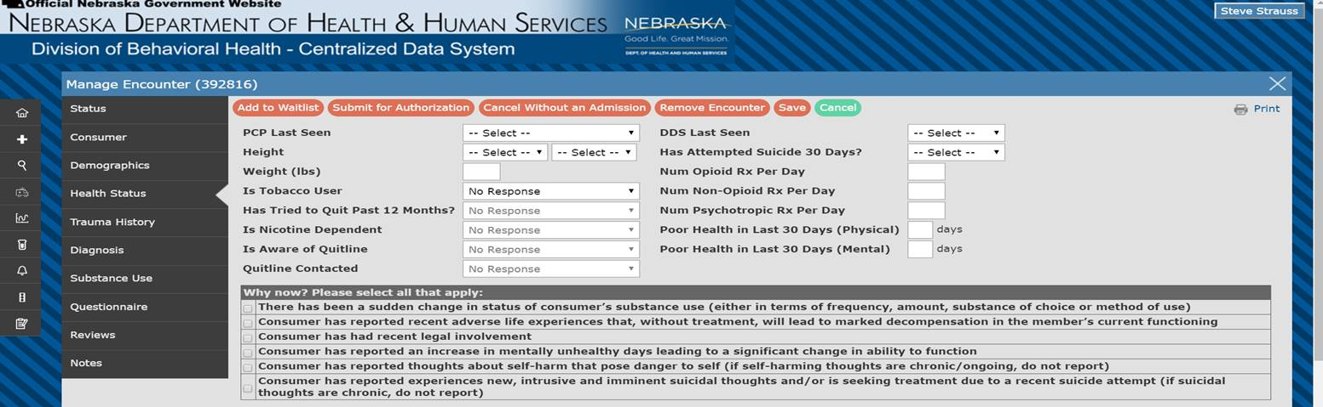
Social Determinants of Health (SDOH) Example

Slide 24
Whole Person Care Solution
Integration Engine
EMR
Data Repository
Business Rules Engine
Business Intelligence
Claims
Financial
SDoH Data
Notes:
I made a couple changes. After the first click and the various systems fly in, you can pause and ask what they use, then talk about the aggregation and “output”. A brief explanation in the box will be helpful

Slide 25
Resources
https://loinc.org/sdh/
https://www.healthit.gov/
https://www.cms.gov/
https://www.patchwiselabs.com/

Slide 26
Let’s Talk
Thank You! H4T is proud to be a Nebraska-based, family owned business.
E
chris@h4-technology.com
W
www.h4-technology.com
C
402-819-4441 x102
Notes:
Pause. Answer questions. Go back to any slides or elaborate? Set up dates and times for follow up…demo, who else needs to be on the next call. Timeframe for a decision.

