Slide 1
How to Stay Positive as a Quality Leader
And Why It is Important

Slide 2
Why is it easy to “get negative”?
It’s human nature!! Our brains are wired to be constantly scanning for threats, this is a survival tool.
Our brains are also wired to remember the threats (negative events and information) while quickly dismissing the positive.
Negative information= Brain like Velcro- it sticks!!
Positive information = Brain like Telflon- it slides off!
In our jobs, we spend a lot of time looking for and studying problems: process problems, workflow problems, communication problems: the list goes on…
Notes:
So- it’s easy to see how easy it is to “get negative” if we aren’t aware and intentional about our attitudes!

Slide 3
BEGIN WITH THE END IN SIGHT!
Notes:
What is YOUR vision as a Quality Leader?

Slide 4
What does positive leadership look like? Take it from Frank P. Saladis, an expert in project management and leadership:
“Positive leadership is about establishing relationships, understanding other points of view, not always having the answer (or pretending to have the right answer), and creating an environment of creativity and innovation. The truly effective and positive leader is an observer, a mentor, a change agent, and someone who enables others to succeed” (2015).
Notes:
I like definitions- and I love this definition of Positive Leadership!

Slide 5
Debbie Downer?
OR
Susie Sunshine?
Who would you rather work with??
If you think you are leading, but no one is following- you are just going for a walk
- Kevin Eikenberry

Slide 6
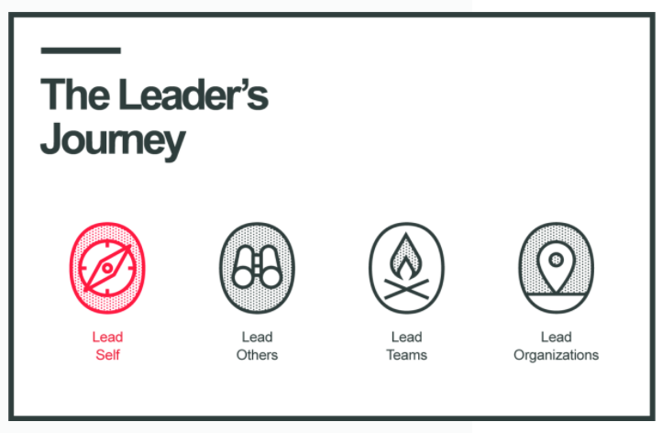
So- Why Is It Important to Stay Positive?
As a Quality Professional, you will be called on to lead groups of your staff through the process of improving: finding problems (opportunities!) and solutions.
Key Point: Before you can lead others, you must first lead yourself.
If you want your team to be positive, YOU need to be positive!
Notes:
I’ve seen many times where someone thinks they can just jump right in to “lead the organization”. But becoming a leader is a journey, not a destination- and it must begin with learning to lead yourself!

Slide 7
Your Attitude Is Contagious!
Positive teams are productive teams
Confident and supportive cultures are more COLLABORATIVE and CREATIVE and ultimately attract hard-working, talented people.
This kind of culture doesn’t just happen- it must be modeled and demonstrated.
COMMIT to a consistent positive attitude! It’s better for YOU and will have a marked influence on your team!
Notes:
Advantages of Positive Leadership

Slide 8
Enthusiasm Is Motivational
It’s true- you CAN drive people through fear and intimidation.
But why would you choose this route? People will only work hard enough to “stay off your radar”!
When you lead with a positive attitude in a supportive climate, people will go above and beyond what you ask. People who feel appreciated become more confident and productive.
POSITIVE ENTHUSIASM IS MOTIVATIONAL-there is no downside!
Notes:
Have you ever worked with someone who managed through fear and intimidation? How did that work for you and your organization?

Slide 9
Attitude Directs Our Relationships
Leaders lead people! So by definition, no leader is successful on their own. Achievements depend on relationships.
You can have all the leadership skills in the world, but if you are demanding and abrasive, you will have to work twice as hard to get half as far. You will have to use so much more of your energy just convincing people to follow you.
Positive people are like magnets. Good natured, confident leaders are not struggling to attract others to their vision. Others are happy to be on their team because they inspire trust and confidence. When you are positive, it is easier to build a network of advocates and champions.

Slide 10
Positivity Creates Resilience
The road to success in any endeavor is full of difficulties, obstacles, and challenges.
When you have an optimistic perspective, you are more likely to view these things as minor setbacks and not overwhelming morale killers.
The better your attitude, the quicker you rebound after a setback.
When your teams see your resilience, they feel braver and hardier themselves!

Slide 11
Optimism Improves Problem Solving
When you run into an obstacle, how do you respond? The answer to that question has a lot to do with your outlook!
Negative people tend to brood and ruminate more, and this draws out the process of dealing with the hurdles.
Positive people tend to roll up their sleeves and start solving the problem!
OPTIMISM ALLOWS YOU TO SEE BEYOND THE PROBLEM AND RECOGNIZE POTENTIAL SOLUTIONS. Hopeful people are less likely to wallow in frustration and discouragement. They want to tackle challenges head-on, regain lost momentum, and move forward!
Notes:
Example: When a staff member calls in at the last minute and you can’t find a replacement- you are “working short”. Is your time better spent complaining about the person who called in, how hard you are going to have to work, etc, etc,- OR saying “if we were great today, what would great look like?- and putting a plan together?

Slide 12
Does being positive mean ignoring problems?
Absolutely not!!
So, what DOES it mean?
Being Positive about yourself and your team
Being Positive about the finding potential solutions
Being Positive about finding the lesson in every problem

Slide 13
YOUR ATTITUDE IS YOUR SUPERPOWER!!
Some people might have a natural disposition toward positivity, but even if you do not, you can still CHOOSE to become more positive.
SO- make a conscious choice to be a positive leader and reinforce your decision with inspiration to keep you motivated. You will be amazed how this can impact the progress you make in any project your team decides to take on!
Notes:
Your second Superpower is networking with your peers! Sometimes just talking to others who are doing the same work and brainstorming on ideas is all it takes to bring your attitude up!

Slide 14
Strategies for Keeping a Positive Outlook:
Be Aware- of your self-talk and of your thoughts. Are they serving you?
Make a Choice- decide in advance that you will keep your outlook positive.
Take Care of Yourself- so basic and yet so often neglected! Stay hydrated, get enough
rest, eat a nutritious diet, move your body. It’s hard to have a positive outlook when
you don’t feel great!
Focus on the things you CAN control: this includes your thoughts and how your respond
to stress.
Develop a practice of gratitude.
Learn to ask GREAT questions and realize that you don’t have all the answers!
Assume positive intent.
Start every day- and every meeting- on a positive note.
Avoid the “energy vampires”! If you must interact with them, don’t “absorb” their vibes!
Notes:
So, we’ve talked about how valuable a positive attitude can be. Now- how do you get and keep a positive attitude?
Example of assuming positive intent?

Slide 15
10. Talk it out with a positive buddy.
Limit your diet of negativity from social media, TV shows, the news, etc.
Train yourself to find the lesson in every failure- and remember that failure is an
essential part of learning and change. If you are not failing, you are not trying!!
13. ALWAYS remember your “Big Why”- why you are doing this work and who is depending
on you to do it.
KEY POINT: It is one thing to KNOW the strategies, it is quite another to IMPLEMENT and USE them CONSISTENTLY!!
Notes:
What are your favorite ways to stay positive????

Slide 16
Do You Want to Learn How to Develop More Positivity??
Good Books to Read!!
1. Mindset- Carol Dweck
2. Learned Optimism- Martin Seligman
3. The Power of Positive Thinking- Dr. Norman Vincent Peale
4. Don’t Sweat the Small Stuff- Richard Carlson
5. The Happiness Advantage- Shawn Achor
6. Positivity- Barbara Erickson
7. Flourish- Martin Seligman

Slide 17
Shari Michl RN, CPHQ
Fillmore County Hospital Geneva, NE
smichl@myfch.org
402-759-3167
Notes:
On behalf of the NHA and all the patients served by Nebraska hospitals, thank you for doing this important work!! Call me anytime if you need some words of encouragement!

