Slide 1
NHA Leadership Institute: Isaacson Session Analyzing Performance Issues
Jonathan P. Titus, MBA, CPLP
jtitus@bellevue.edu

Slide 2
Introductions
Who am I?
Why are we here?
How are you doing?

Slide 3
How does an effective LEADER get employees to perform?

Slide 4
Contingency Model:
Leader-Member Exchange (LMX)
In-Group | Out-Group
More attention | Less attention
Challenging tasks | Redundant or menial tasks
More socialization | Formal reporting
More responsibility | Reliance on formal job structures
More communication | Need to know – and YOU don’t need to know
More satisfaction | More resistance

Slide 5
Contingency Model:
Situational Leadership
Unwilling and Unable | Unwilling and Able | Willing and Unable | Willing and Able
Decisions are made by the leader and announced, so communication is one way. | Decisions remain the leader’s prerogative, but communication is much more two-way. | The leader facilitates the follower’s participation in decisions, but control remains with the leader. | The leader is still involved in decisions and problem-solving, but control is with the follower.
Telling | Coaching | Participating | Delegating
Authoritative |  | Participative
Notes:
Delegate tasks that can be better done by a subordinate.
Delegate tasks that are urgent, but not high priority.
Delegate tasks relevant to a subordinate’s career.
Delegate tasks of appropriate difficulty.
Delegate both pleasant and unpleasant tasks.
Does a leader lose leadership if delegating a task?

Slide 6
Notes:
First Look at YOU – quick Cosmopolitan Magazine-style quiz/self-assessment Whose performance are we really talking about?

Slide 7
Performance Issues
Whose performance is at issue?
Why do I think there’s a problem?
What is the actual performance issue?
What is the desired performance?

Slide 8
Analyzing Performance Issues
What’s the difference between a DISCREPANCY and a DEFICIENCY?

Slide 9
Performance Discrepancy Clues
They don’t know what’s expected of them
They don’t have the tools, space or authority
They don’t get feedback about quality
They’re punished when they do it right
They’re rewarded when they do it wrong
They’re ignored whether they do it right or not
They don’t know how to do it
“Analyzing Problems or You Really Oughta Wanna,” by Mager & Pipe

Slide 10
Performance Discrepancies
They don't know why they should do it
They don't know how to do it
They don't know what they’re supposed to do
They think your way will not work
They think their way is better
They think something else is more important
"Why Employees Don't Do What They're Supposed To Do and What To Do About It," by Ferdinand F. Fournies

Slide 11
Continued
There is no benefit/reward
They think they are doing it
They are rewarded for not doing it
They are punished for doing it
They anticipate a negative consequence
There is no negative consequence
"Why Employees Don't Do What They're Supposed To Do and What To Do About It," by Ferdinand F. Fournies
Notes:
There is no benefit/reward for doing it
They think they are doing it
They are rewarded for not doing it
They are punished for doing it
They anticipate a negative consequence for doing it
There is no negative consequence to them for poor performance

Slide 12
Analyzing Performance
Case Study 1
Review the Analyzing Performance Case Study in your groups and answer the following questions:
What was the performance discrepancy? Was there more than one?
What is a possible solution to the discrepancy?
What’s the cost of the solution?
What’s your action plan for implementing the solution? Who’s involved?
Notes:
Started in …
Origination
Participants
Planning and initial partnerships

Slide 13
Analyzing Performance
Case Study 2
The Case of the Stolen Sales

Slide 14
Leadership Execution
Begin with the end in mind
What are the desired results/outcomes ?
Generate innovative solutions
What is innovation?
Make sound decisions
What happens if you make a bad decision?
Understand business operations
Could you be a leader in another department?
Increase productivity/improve processes
How/what impediments?

Slide 15
Results-Oriented Leadership
Define execution.
•Execution is a discipline integral to strategy
• It’s the major job of the business leader • It must be a core element of culture
Can you identify gaps between performance and execution?

Slide 16
Three Core Processes
Number One: The People Process

Slide 17
Three Core Processes
Number Two: The Strategy Process
- Levels of Strategy:
• corporate
• divisional
• functional
Strategy Video

Slide 18
Three Core Processes
Number Three: The Operations Process
- Where’s the disconnect between
operations and strategy?

Slide 19
…to achieve results.
Clear goals – goal attainment is foremost!
Proaction
Cooperation
Proper priorities
Organizational coordination
Adaptable organization
Accomplishment
High reliability organizations

Slide 20
BREAK

Slide 21
Notes:
Frame of reference/anchor for “Motivation”
What baggage or biases do we need to make explicit before we begin

Slide 22
Group Discussion: Motivating Performance
How do managers motivate employees?
What do managers get in return? What do they want?
A happy employee is a productive employee, right?
Can a leader really motivate an employee?
Does money motivate? We’ll find out.

Slide 25
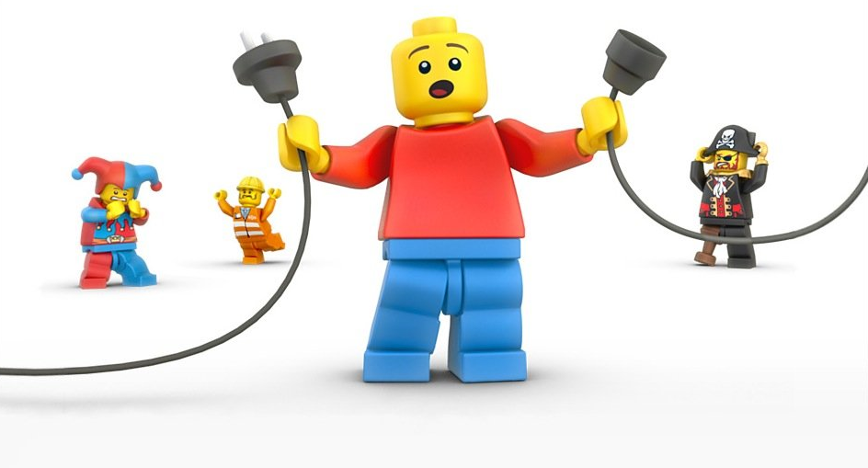
Notes:
We have a disconnect!

Slide 26
PERFORMANCE
OUTCOMES
RESULTS

Slide 28
Motivation Theories
Why do you need to know about motivation theories and research?
Maslow’s Hierarchy of Needs
Herzberg’s 2-Factor Theory
Expectancy Theory
The WRONG motivation discussion!

Slide 29
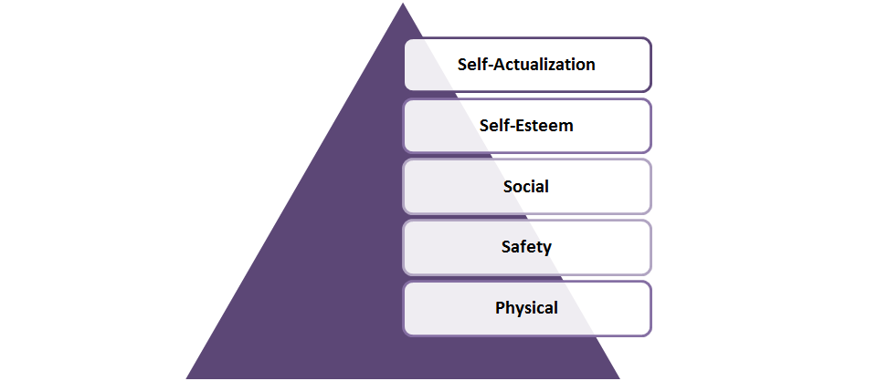
Maslow’s Hierarchy of NEEDS

Slide 30
Maslow’s Hierarchy of NEEDS
Transcendence
WI-FI
BATTERY
Notes:
Added Transcendence: helping others to achieve self-actualization (help others be the best they can be)

Slide 31
Herzberg’s 2-Factor Theory

Slide 32
Job Design
Job Breadth
Job Depth

Slide 33
Expectancy Theory
Desire vs. Likelihood
Managers must recognize that:
Employees work for a variety of reasons.
These reasons, or expected outcomes, may change over time.
It’s necessary to clearly show employees how they can attain the outcomes they desire.

Slide 34
Notes:
A word on “Engagement”

Slide 35
Notes:
Give participants about two minutes to write a brief reflection or two for themselves. This could relate to their professional development goals, one of their actions or behaviors they want to commit to holding themselves accountable for improving at work, or a reminder to focus on what’s really, ULTIMATELY important at work – the patients for example, or ensuring the bills get paid, or keeping the hospital compliant (as well as WHY that thing is SO SO SO important). Say you’re going to play a short video, and then give them about two minutes after the video to journal this reflection.

Slide 36
Notes:
Legacy, purpose

Slide 37
Notes:
Celebrate wins, maximize positive feedback, catch ‘em doing something right

Slide 38
Motivating Performance
How is employee motivation built into annual performance reviews?
Should it be?

Slide 39
Motivating Performance
Now… does money motivate?
$$

Slide 40
The Research About Money
Motivation Video

Slide 42
Motivating Performance
3 Gimme’s of Human Behavior – Feedback Activity
Giving precise and immediate feedback is sometimes all an employee needs to stay motivated to perform. In this exercise, the facilitator will take you though a series of steps that demonstrate how feedback affects motivation and human behavior.
Notes:
Do what you positively reinforce
Stop doing what you castigate
Stop doing what’s ignored

Slide 43
Wrap Up
QUESTIONS

Slide 44
A private, non-profit institution founded in 1966, Bellevue University is accredited by the Higher Learning Commission through the U.S. Department of Education. For general information, please call 800.756.7920. Phone: 402.557.7812 Email: jtitus@bellevue.edu bellevue.edu

