Slide 1
Overview NHSN
Margaret Drake, MT (ASCP), CIC
Nebraska State Infection Preventionist
ICAP- Infection Control Assessment and Promotion Program

Slide 2
Why Should I Use NHSN?
Standardized definitions
National Data Base for comparison
Analysis options
Forms
Support

Slide 3
NHSN Facility Set-Up
Getting Started in NHSN
Adding Users, Locations, Surgeons, and Reporting Plans

Slide 4
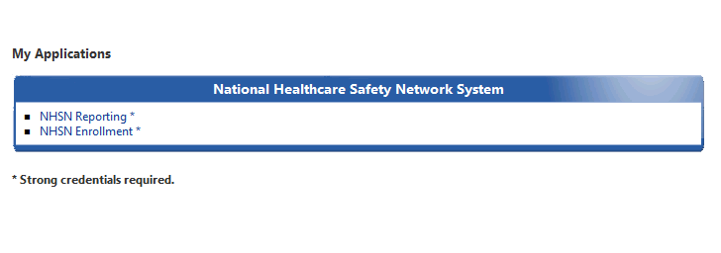
Log in to NHSN
Go to https://sams.cdc.gov
Log in using your SAMS grid card
Select ‘NHSN Reporting’

Slide 5
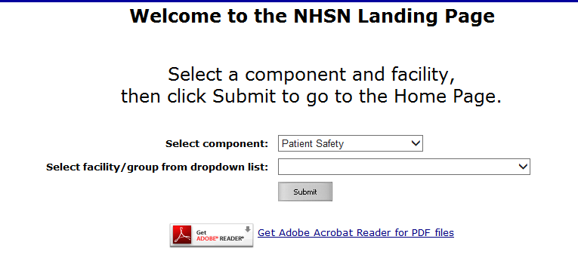
NHSN Landing Page
Select Component from drop down menu
All facilities that you have access to will show up in the second drop down menu
Make selections (if necessary) and click ‘Submit’

Slide 6
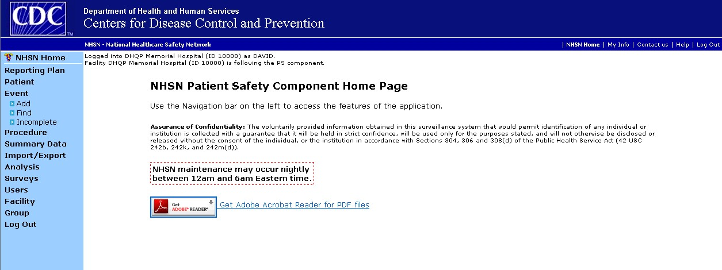
NHSN Patient Safety Home Page
User rights determine which navigation bar options are present
Navigation Bar

Slide 7


Navigating NHSN
Use the navigation bar or NHSN buttons to navigate
Do not use Internet Explorer web browser buttons

Slide 8
Add User
From the NHSN navigation bar: select ‘Users’, then select ‘Add’
Enter user information
  Create a username
  The email address entered must be the same one used to register with SAMS
  Fill in all required fields, marked with an *
Click “Save” button to create the user

Slide 9
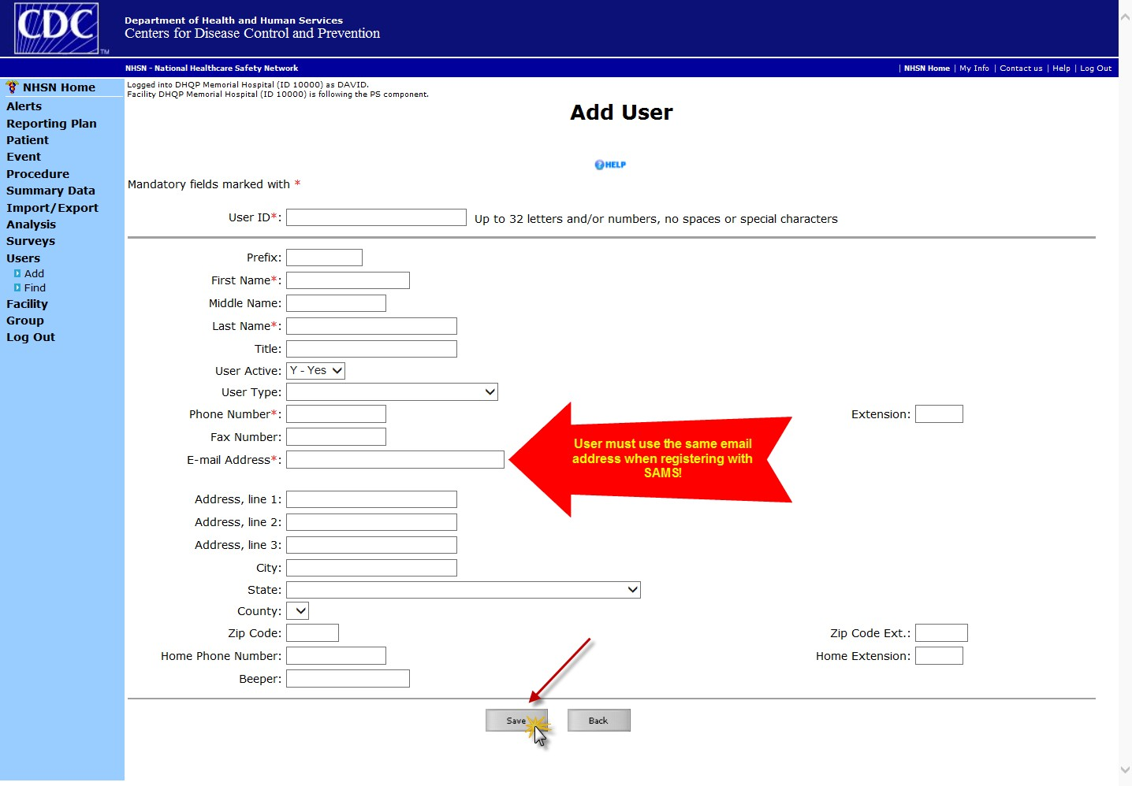
Add User

Slide 10
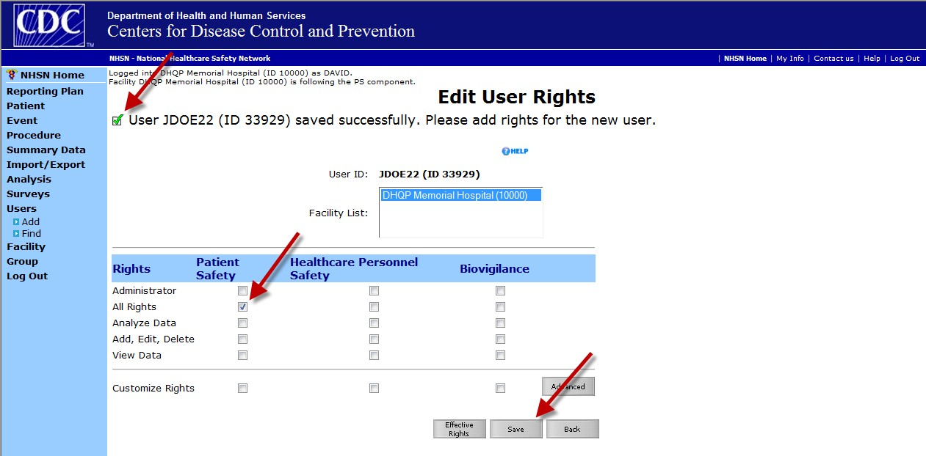
Assign and Save User Rights
Assign rights under Patient Safety, then “Save” rights…
Customizing rights isn’t recommended for most users
Users will not be able to access NHSN without having assigned rights

Slide 11
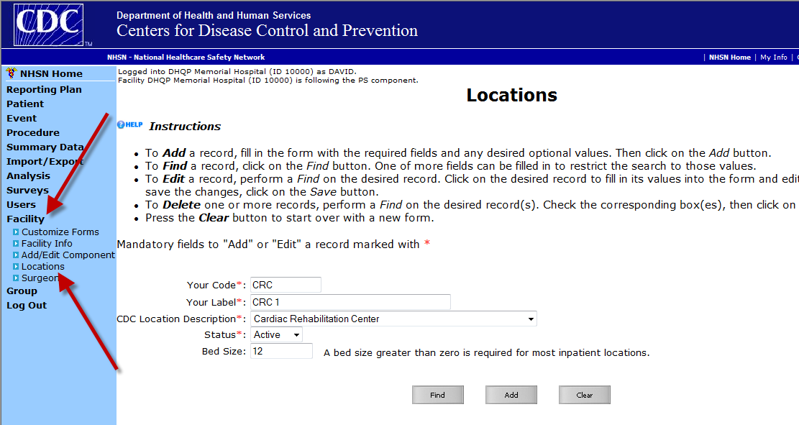
Add Locations

Slide 12
Adding Surgeons
Surgeon codes and surgeon names are not required in NHSN.
Many facilities want to give feedback to their surgeons about their individual SSI rates, because studies have shown that doing so is an important component of risk reduction in the surgical population.

Slide 13
Mapping Locations

Slide 14
Importance of Correct Location Mapping
NHSN location types are developed in order to identify “like populations” within different facilities.
Like populations are believed to have similar risks for healthcare-associated infections (HAIs)
  Similar medical devices
  Similar invasive procedures
  Similar host factors affecting susceptibility
Many NHSN surveillance modules utilize location type as a risk factor, e.g. CLABSI, CAUTI, VAP, MDRO/CDI, etc.

Slide 15
Importance of Correct Location Mapping
NHSN pooled mean rates of infection are calculated for location types and utilized in data analysis, such as the Standardized Infection Ratio.
Incorrectly mapped locations affect the validity of:
  NHSN database data
  Facility-based standardized infection ratios
State validations
Bottom line: Without correctly mapped locations, facilities cannot compare their data to the NHSN data and NHSN data validity is compromised for identifying trends in HAIs.

Slide 16
NHSN Location Terms
NHSN 80% Rule
Virtual Locations
Mixed Acuity Unit

Slide 17
NHSN 80% Rule
Each patient care area in a facility that is monitored in NHSN is “mapped” to one or more CDC locations
The specific CDC location code is determined by the type of patients cared for in that area, over the last full year, according to this rule
If ≥ 80% of patients are of a certain type, then that area is designated as that type of location

Slide 18
Virtual Locations
Created in NHSN when a facility is unable to meet the 80% Rule for location designation in a single physical unit, but would like to report their NHSN surveillance data for each of the major, specific patient types in that unit

Slide 19
Virtual Locations
NOTE: The option of creating virtual locations may be easier for those physical units that are geographically split by patient service or those in which beds are designated by service
For facilities using an electronic source for collecting data, the compatibility of virtual locations in NHSN should be discussed with the EHR contact prior to reporting data for these locations

Slide 20
Mixed Acuity Unit
Intended for units comprised of patients with varying levels of acuity, e.g., CC and Step down; CC and ward
CDC does not have plans to publish national pooled mean rates for this location type
If your facility chooses to use this location designation for reporting, you will not be able to compare your mixed acuity unit rates to an NHSN pooled mean, nor will these data be included in any SIR analyses

Slide 21
Steps for Defining Locations in NHSN
Step 1: Define the acuity level for the location
Step 2: Define the type of service for the location

Slide 22
Decision Tree Step 1: Acuity Level
Is this patient care area comprised of at least 80% of patients that are of the same acuity level?
YES
NO
Proceed to Step 2 and map to a location type of that acuity level using the NHSN 80% Rule for that specific type
Can this patient care area be split into 2 or more locations in NHSN for the purposes of surveillance – also referred to as “virtual locations”?
YES
NO
Proceed to Step 2 and create locations in NHSN for each of the acuity levels, using the NHSN 80% Rule
Map to a CDC Mixed Acuity location

Slide 23
Decision Tree Step 2: Type of Service
Is this patient care area a general medical, surgical, or medical/surgical unit? Or is it comprised of patients from a specific service type (e.g., burn, cardiac)?
General
Specific
If general medical or surgical, are more than 60% of patients either medical or surgical?
If the unit is comprised of patients of a specific service type, does this unit meet the NHSN 80% Rule for locations?
YES
NO
YES
NO
Create a location in NHSN that is mapped to the majority type (i.e., medical or surgical)
The mix of patients should then be a 50/50 to 60/40 mix of medical and surgical patients
Create a location in NHSN that is mapped to that CDC location
Can this single unit be split into 2 or more units in NHSN for the purposes of surveillance – also referred to as “virtual locations”?
Create a location in NHSN that is mapped to a combined medical/surgical CDC location

Slide 24
Decision Tree Step 2: Type of Service
Is this patient care area a general medical, surgical, or medical/surgical unit? Or is it comprised of patients from a specific service type (e.g., burn, cardiac)?
General
Specific
If general medical or surgical, are more than 60% of patients either medical or surgical?
If the unit is comprised of patients of a specific service type, does this unit meet the NHSN 80% Rule for locations?
YES
NO
YES
NO
Create a location in NHSN that is mapped to the majority type (i.e., medical or surgical)
The mix of patients should then be a 50/50 to 60/40 mix of medical and surgical patients
Create a location in NHSN that is mapped to that CDC location
Can this single unit be split into 2 or more units in NHSN for the purposes of surveillance – also referred to as “virtual locations”?
Create a location in NHSN that is mapped to a combined medical/surgical CDC location
(Continued)

Slide 25
ADD MONTHLY REPORTING PLANS

Slide 26
Monthly Reporting Plan
Each facility must enter a Monthly Reporting Plan for every month of the year.
You can enter reporting plans for the entire year.
Events, procedures, and summary data should not be entered for a month until a plan is in place (unless you are reporting off plan).
Plan informs CDC which modules are followed for a given month.

Slide 27
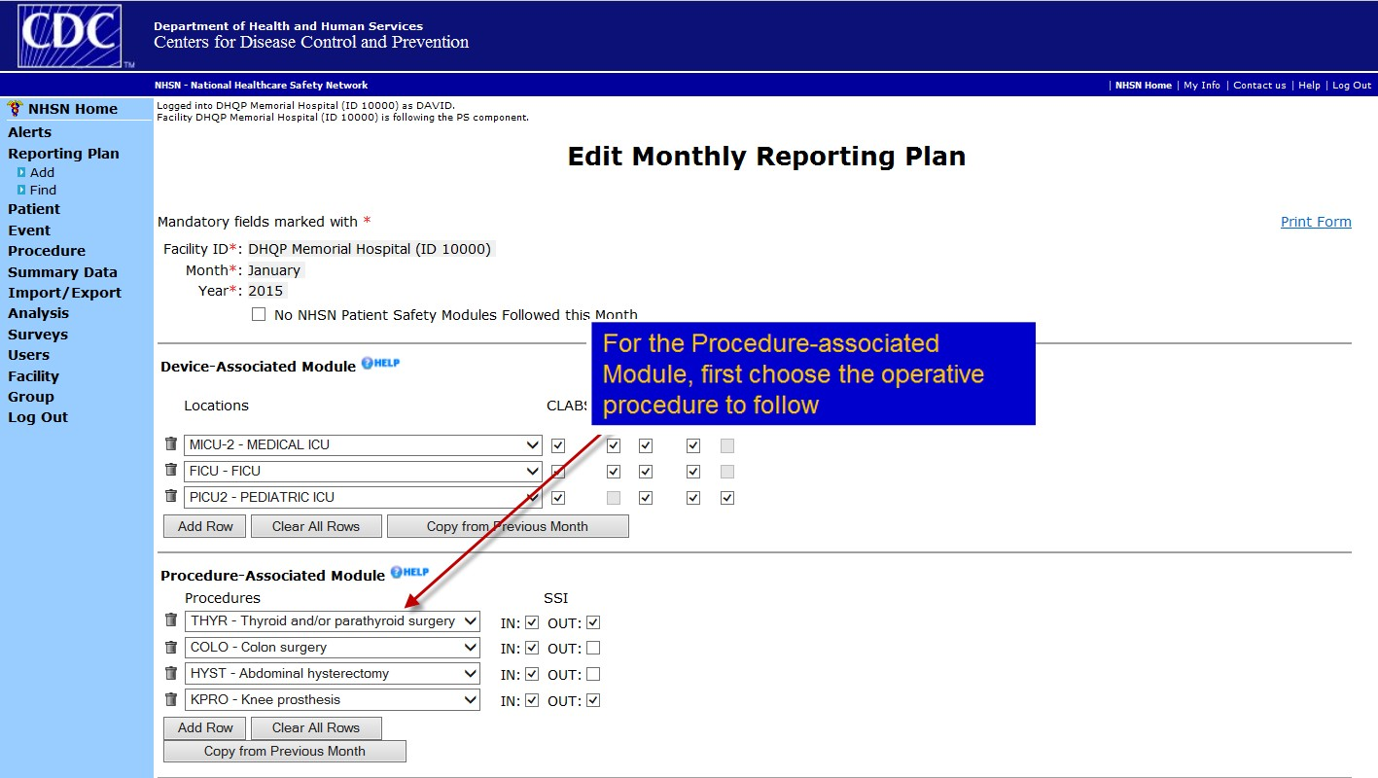
Reporting Plan Options

Slide 28
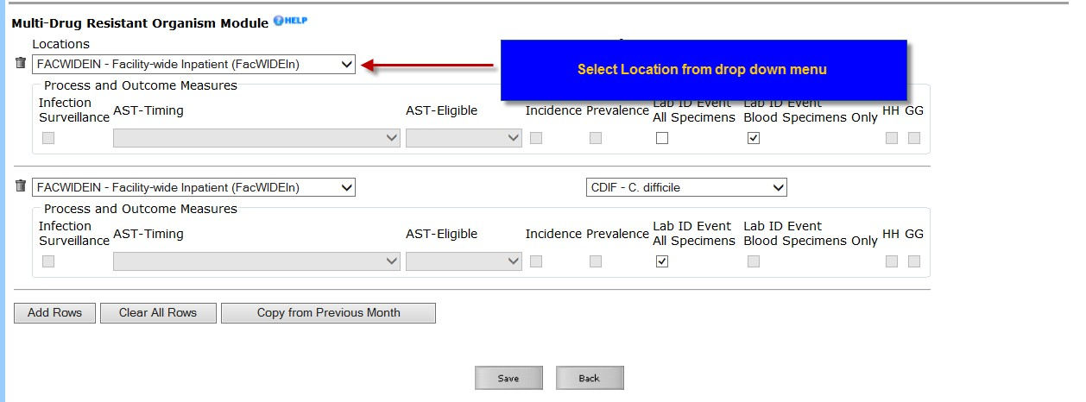
Reporting Plan Options

Slide 29
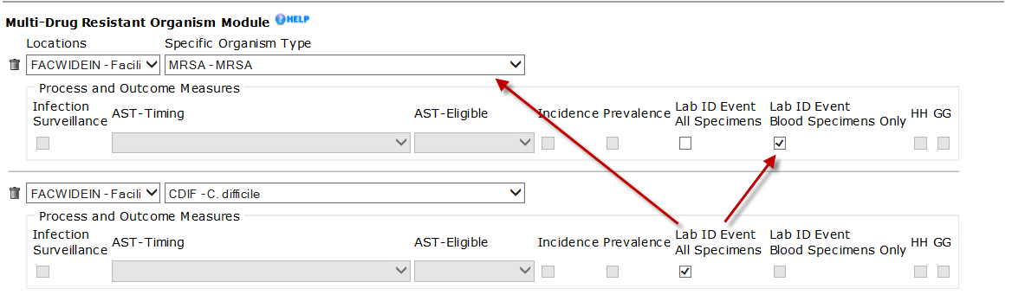
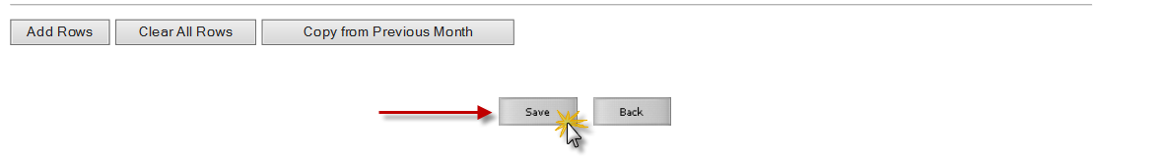
Reporting Plan Options
Select Specific Organism Type and Specimen Type (“All Specimens” or “Blood Specimens Only”)
Be sure to click save when you are finished.

Slide 30
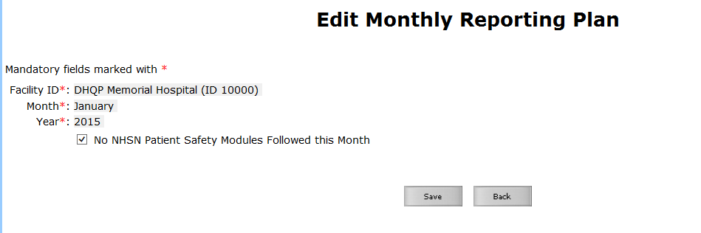
Reporting Plan Options*
…Or choose “No Modules Followed this Month”

Slide 31
Summary
Add NHSN websites to “Favorites”
NHSN Navigation
Add Users and assign user rights
Add Locations
Add or Import surgeon codes
Add Monthly Reporting Plans

Slide 32
References
Power Point for getting started- setting up units and reporting plan
https://www.cdc.gov/nhsn/pdfs/training/enroll/nhsn_getting_started.
Mapping power point
https://www.cdc.gov/nhsn/pdfs/training/analysis/mapping-locations-nhsn
General training and data entry
https://www.cdc.gov/nhsn/pdfs/training/general/PS-Data-Entry.pdf
FAQ for mapping
https://www.cdc.gov/nhsn/faqs/faq-locations.html
Location mapping crosswalk
https://www.cdc.gov/nhsn/PDFs/pscManual/15LocationsDescriptions_current.pdf
n-surveillance-508.pdfpdf

Slide 33
Nebraska State NHSN Group
Method HAI is reported to Nebraska DHHS for Nebraska facilities that have a CMS mandate to report HAIs
Mandated in 2017 for any facility in Nebraska required to report into NHSN for CMS must also report HAIs as part of reportable disease list
Requirement is met by joining the Nebraska group
Voluntary for CAHs
Data used by Public Health to improve health and lives of Nebraskans
Not used for regulatory purposes
Data is reported out in aggregate

Slide 34
Nebraska State HAI Group
Nebraska NHSN user group ID: 44088
Nebraska NHSN Password: NEHAI
Would join under Group on the left hand navigation bar
If interested in being part of the group contact-
Margaret.drake@nebraska.gov
402-580-8955

