Slide 1
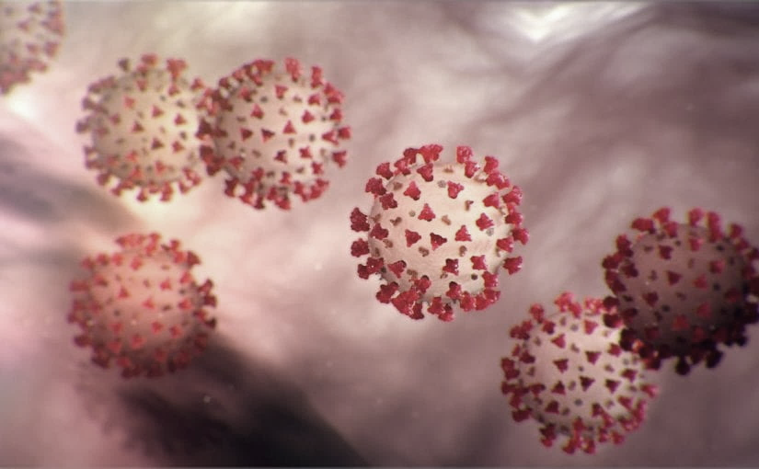
Covid-19 Webex Update
4-10-20
Maureen Tierney, MD, MSc.
Healthcare Associated Infections Medical Director
Tom Safranek, MD, State Epidemiologist

Slide 2
We are one in this fight
Frontline Heroes
Public Health Heroes
First Responder Heroes

Slide 3

Happy Easter from George and Friend

Slide 4
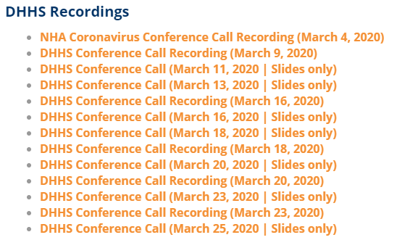
Thank you for joining us!
Slides and recording of today’s presentation will be available at
https://www.nebraskahospitals.org/coronavirus-covid-19-information.html
Scroll to the bottom of the page

Slide 5
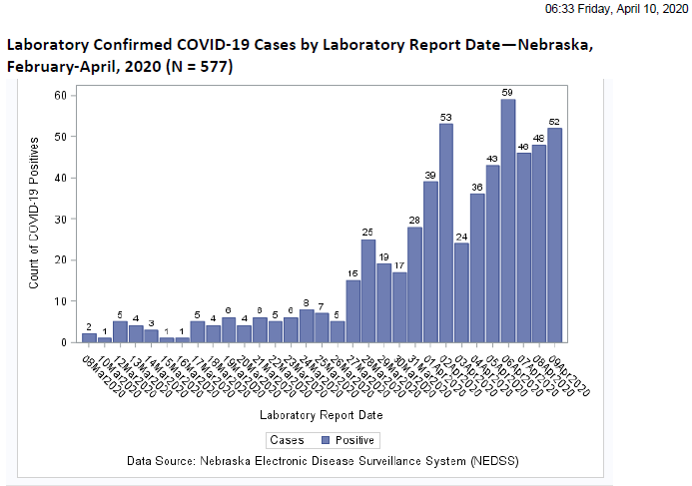

Slide 6
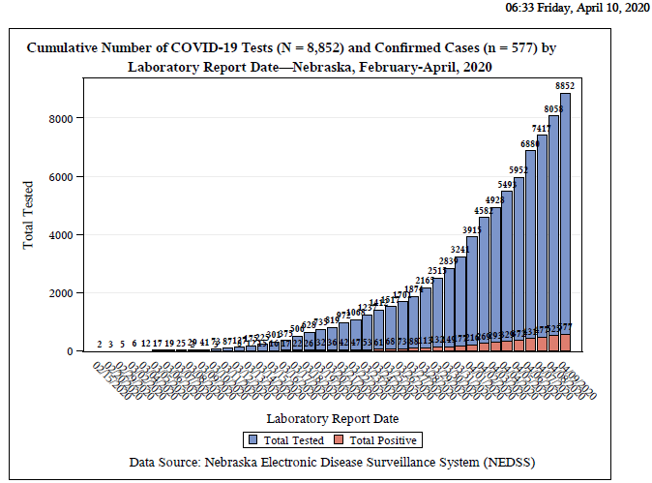

Slide 7
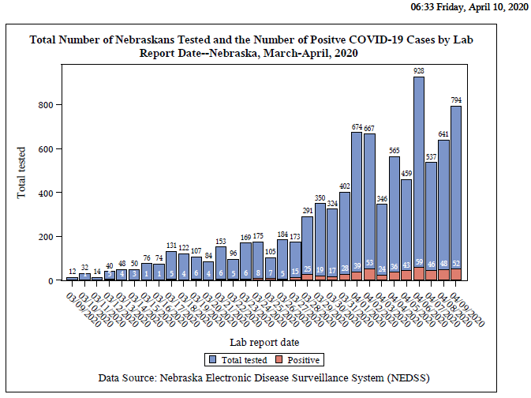

Slide 8
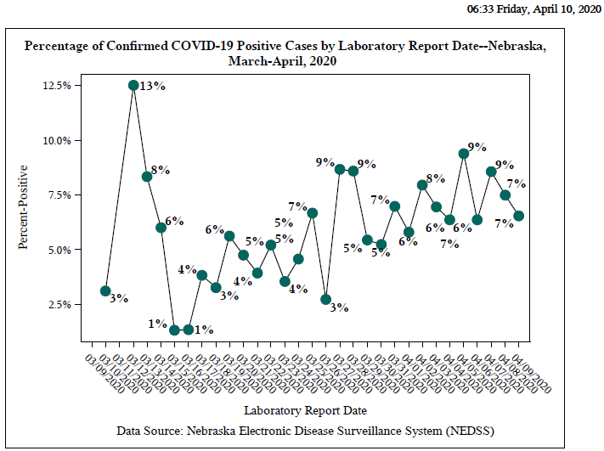

Slide 9
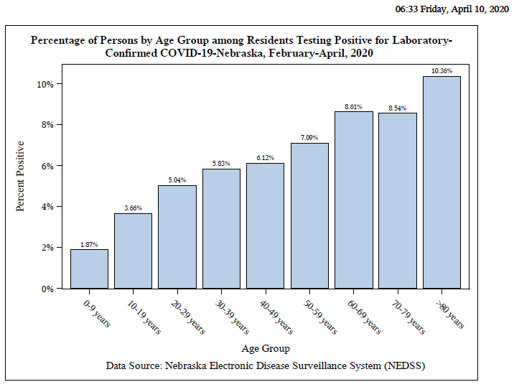

Slide 10
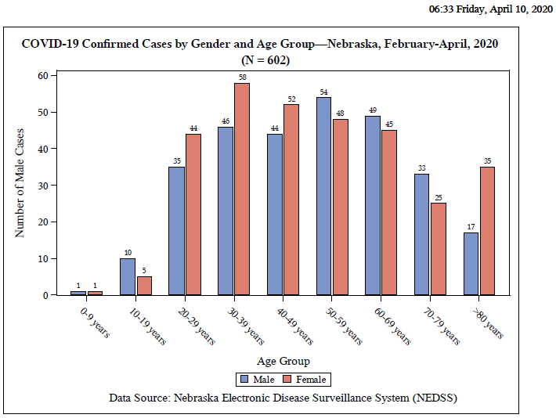

Slide 11
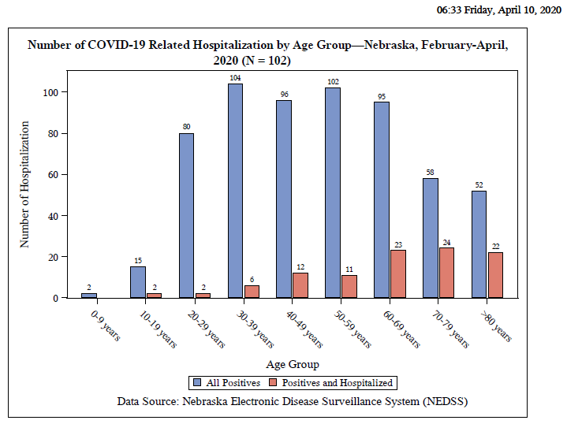

Slide 12
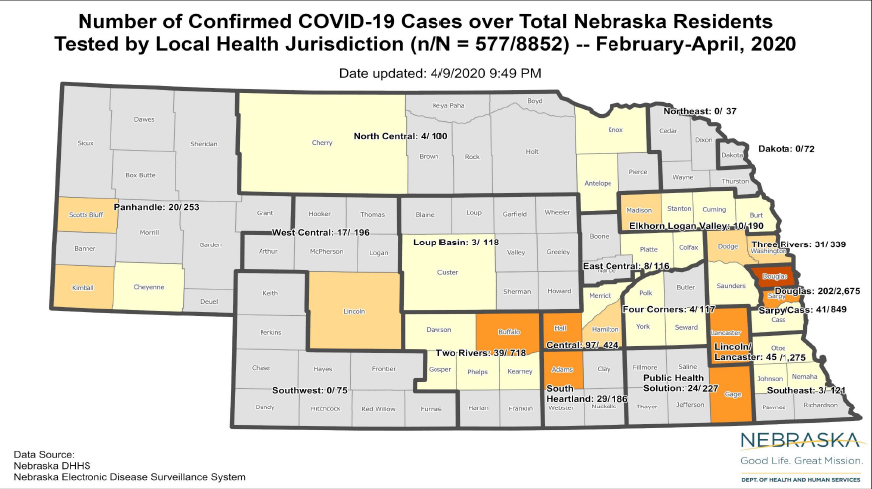

Slide 13
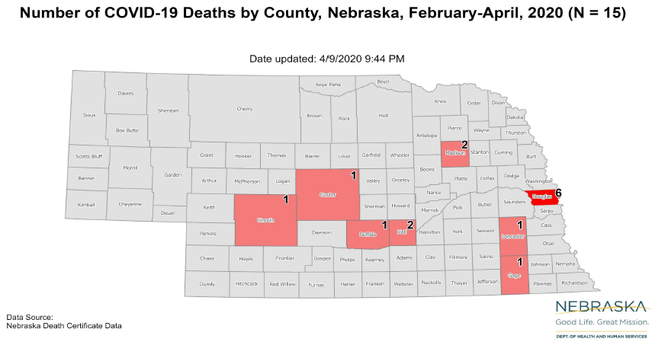

Slide 14
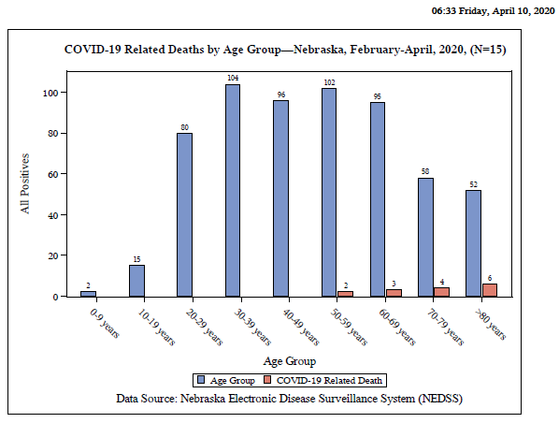

Slide 15

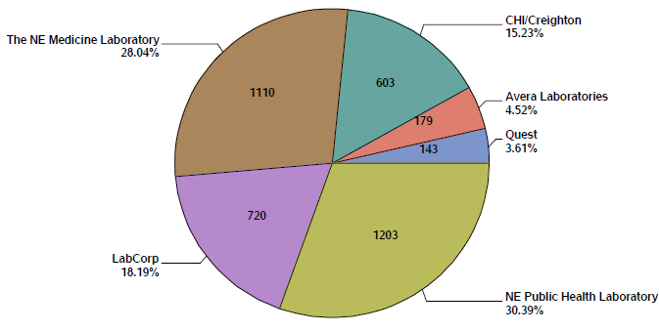

Slide 16
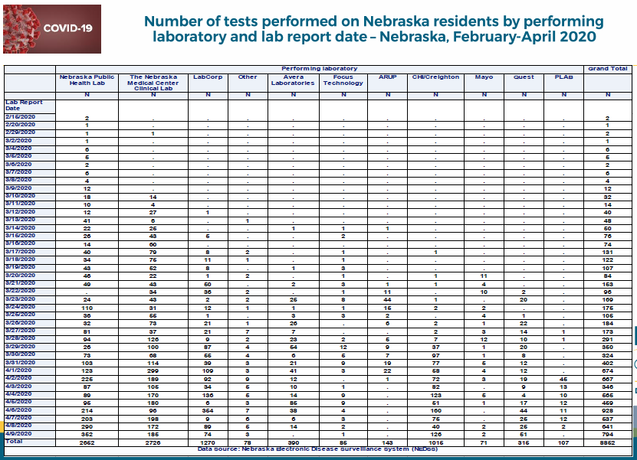

Slide 17
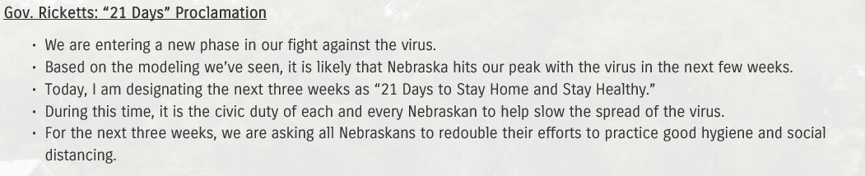
04102020, 1121, www.governor.Nebraska.gov/press

Slide 18
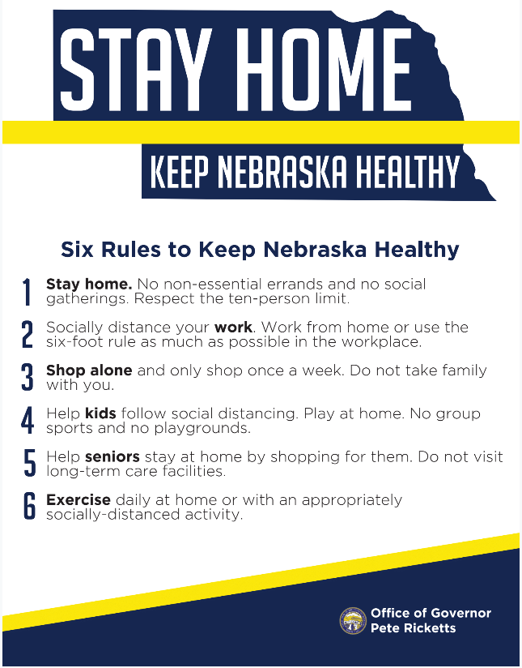

Slide 19
Hospitalization Rate by Age
60-69 16%
70-79 29%
Over 80 30%
Total Cases in LTCF 64

Slide 20
Off Site Quarantine and Convalescence
1. for HCPs and First Responders who wish to Q away from family in hotels-
call 833 220 0018
Information forthcoming on
Quarantine post exposures
Convalescence

Slide 21
CSTE Case Definition Position Statement
https://www.cste.org/news/500750/
Case Classifications
Confirmed: •
Meets confirmatory laboratory evidence.
Probable: •
Meets clinical criteria AND epidemiologic evidence with no confirmatory laboratory testing performed for COVID-19.
• Meets presumptive laboratory evidence AND either clinical criteria OR epidemiologic evidence.
•Meets vital records criteria with no confirmatory laboratory testing performed for COVID19.

Slide 22
Links to Nebraska webinars
Nebraska Acute Care Call every M,W, F at noon
previous calls can be found Nebraska Hospital Association
https://www.nebraskahospitals.org/coronavirus-covid-19-information.html
Nebraska ICAP Long Term Care Webinars every Thursday at noon
previous webinars and questions and answers found on ICAP website
https://icap.nebraskamed.com/
NEW
Nebraska ICAP Combined Critical Access and Outpatient Webinars every Tuesday at non
previous webinars and questions and answers found on ICAP website
https://icap.nebraskamed.com/

Slide 23
Other Resources
Nebraska COVID map - https://universityofne.maps.arcgis.com/apps/MapSeries/index.html?appid=d68aec6490f2457a8f0156d9f150e954
Douglas County COVID tracker - https://dogis.maps.arcgis.com/apps/opsdashboard/index.html#/21bec056a9a6449abcca89a329868fd6

Slide 24
What to Do When Large Numbers of Staff Exposed (Mostly LTC Issue, but also SCAH)
Evaluation including LHD, DHHS Epi, NE CMS, ICAP, to help determine level of exposure, staffing needs, support needed for staff and infection prevention.
When feasible keep HCPs who habe been exposed at home for 4 days if staffing permits.
If cannot do #2, assess level of exposure, if can triage medium risk HCPs back to work but keep out high risk exposures in Q
If #3 not possible, according to CDC and CMS “facilities could consider allowing asymptomatic HCP who have had an exposure to a COVID-19 patient to continue to work after options to improve staffing have been exhausted and in consultation with their occupational health program (or LHD, CMD, DHHS and/or ICAP)
These HCP should still report temperature and absence of symptoms each day prior to starting work. Facilities should have exposed HCP wear a facemask while at work for the 14 days after the exposure.
If HCP develop even mild symptoms consistent with COVID-19, they must cease patient care activities, don a facemask (if not already wearing), and notify their supervisor or occupational health services prior to leaving work.

Slide 25
HCW Masking
Dr. Gary Anthone is recommending that all Healthcare Professionals with Patient Contact
wear a facemask.
Sample Policy
A surgical face mask may be issued at the start of each shift,
Your mask will be used throughout the shift.
In the event that the mask becomes visibly soiled, saturated or damaged, a new mask must be obtained. Stock will be securely stored in each clinical setting.
Should you need a replacement mask, you must request one from supervisory personnel
Nonclinical staff do not need to wear a surgical grade facemask but should consider wearing cloth masks as per the CDC guidelines for the general public.

Slide 26
For Daily Surgical Mask Use
Infection Prevention Guidance on Procedure/Surgical Mask Use and Re-Use
To Doff facemask with intent to reuse
Perform hand hygiene
Remove mask
  Remove procedure mask by holding the ear loops. The front is contaminated, so remove slowly and carefully.
  Remove surgical mask by untying lower ties FIRST. Untie upper ties last. The front is contaminated, so remove slowly and carefully. Ensure ties do not fall into clean interior side of mask.
After removing facemask, visually inspect for contamination, distortion in shape/form. If soiled, torn, or saturated the mask should be discarded.
If the facemask is NOT visibly soiled, torn, or saturated, carefully store on a paper towel exterior side down. Note: units utilizing methods for short term storage and reuse compliant with extended use and reuse can continue to use such system. More information on this method can be found at: https://www.nebraskamed.com/sites/default/files/documents/covid19/COVID-Extended-Use-Reuse-of-PPE-and-N95.pdf?date03212020
Perform Hand Hygiene

Slide 27
One Mask per day Policy Continued
To Re-Don Mask
1. Perform hand hygiene
2. Grasp mask
o Pinch procedure mask at the ear loops or
o Grasp upper ties on surgical mask
3. Place over face
o For procedure mask: Secure ear loops behind the ears. Secure mask.
o For surgical mask: Secure upper ties first, behind head. End by securing lower ties behind head
4. Perform hand hygiene
A disposable facemask can be worn throughout your shift if not visibly soiled, torn or saturated, and NOT touched while delivering patient.
https://www.nebraskamed.com/sites/default/files/documents/covid-19/surgical-mask-policy-and-faq-nebraska-med.pdf

Slide 28
Thanks to NM procedure sharing
https://www.nebraskamed.com/sites/default/files/documents/covid-19/surgical-mask-policy-and-faq-nebraska-med.pdf
For pictures on how to lay out mask on a paper towel go to above website

Slide 29
Cloth Masks for the Public
Nebraskans Protecting Other Nebraskans
In light of this new evidence, CDC recommends wearing cloth face coverings in public settings where other social distancing measures are difficult to maintain (e.g., grocery stores and pharmacies) especially in areas of significant community-based transmission.
It is critical to emphasize that maintaining 6-feet social distancing remains important to slowing the spread of the virus. CDC is additionally advising the use of simple cloth face coverings to slow the spread of the virus and help people who may have the virus and do not know it from transmitting it to others.
NM creating masks for non clinical staff made out of the surgical wrap material that has a high filtration capacity

Slide 30
Older data on cloth masks
International Journal of Infection Control
ISSN 1996-9783
www.ijic.info
doi: 10.3396/IJIC.v9i3.020.13
Use of cloth masks in the practice of infection
control - evidence and policy gaps
1905 Hamilton-Gauze masks to prevent transmission of Streptococcus from staff to OR patients
23.5% to 5.2% in diphtheria and scarlet fever 8% to 0% in nurses
1918 pandemic-masks didn’t seem to help ?? Quality of mass
1920-21-Manchurian outbreak-1/2 inch thick cotton enclosed by 2 layers of gauze more effective
Fine muslin>gauze>gauze padded with cotton-better for larger particles (

Slide 31
Asymptomatic and Presymptomatic Transmission
Pan X, Chen D, Xia Y, et al. Asymptomatic cases in a family cluster with SARS-CoV-2 infection.
The Lancet Infectious diseases. 2020.
Bai Y, Yao L, Wei T, et al. Presumed Asymptomatic Carrier Transmission of COVID-19.
Jama. 2020.
Kimball A HK, Arons M, et al. Asymptomatic and Presymptomatic SARS-CoV-2 Infections in Residents
of a Long-Term Care Skilled Nursing Facility — King County, Washington MMWR ePub: 27 March 2020.
Wei WE LZ, Chiew CJ, Yong SE, Toh MP, Lee VJ. Presymptomatic Transmission of SARS-CoV-2 —
Singapore, January 23–March 16, 2020. MMWR Morbidity and mortality weekly report. 2020;ePub: 1 April 2020.
Li R, Pei S, Chen B, et al. Substantial undocumented infection facilitates the rapid dissemination of
novel coronavirus (SARS-CoV2). Science (New York, NY). 2020.

Slide 32
LTC Accepting Patients
When should a nursing home accept a resident who was diagnosed with COVID-19 from a hospital?
A nursing home can accept a resident diagnosed with COVID-19 and still under Transmission-Based Precautions for COVID-19 as long as the facility can follow CDC guidance for Transmission-Based Precautions. If a nursing home cannot, it must wait until these precautions are discontinued. CDC has released Interim Guidance for Discontinuing Transmission-Based Precautions or In-Home Isolation for Persons with Laboratory-confirmed COVID-19. Information on the duration of infectivity is limited, and the interim guidance has been developed with available information from similar coronaviruses. CDC states that decisions to discontinue Transmission-based Precautions in hospitals will be made on a case-by-case basis in consultation with clinicians, infection prevention and control specialists, and public health officials. Discontinuation will be based on multiple factors (see current CDC guidance for further details).

Slide 33
LTC accepting patients continued
Note: Nursing homes should admit any individuals that they would normally admit to their facility, including individuals from hospitals where a case of COVID-19 was/is present. Also, if possible, dedicate a unit/wing exclusively for any residents coming or returning from the hospital. This can serve as a step-down unit where they remain for 14 days with no symptoms (instead of integrating as usual on short-term rehab floor, or returning to long-stay original room).
If a test is pending state guidance recommends waiting for result before transferring.

Slide 34

Accepting Hospitalized Residents Back to the Nursing Home
Initially admitted for non-COVID-19 illness and Still No COVID concerns:
Can be admitted back to the Nursing Home (consider a transition unit/holding area for 14 days within the facility) with contact/droplet precautions during observation period (AMDA) A COVID test is not required for acceptance back into facility. However, if a COVID test has been performed ,transfer should wait until results are back
Had COVID-19 concerns/ symptoms but now ruled out:
Can be admitted back to the Nursing Home (consider a transition unit/holding area for 14 days within the facility and keep them in
contact/droplet precaution until respiratory symptoms resolves and 14 days have passed)
Was COVID-19 positive and are recovering:
Will either remain in the acute care hospital or be admitted to designated COVID-19 treatment/recovery centers until no longer infectious and then will be transferred back to the nursing home
https://paltc.org/sites/default/files/COVID%2019%20QA%20Community%20Spread%20March%2023.pdf

Slide 35
Managing COVID 19 in LTC
Patient from LTC in ACH ready to go back to LTC
1. Stay in Acute Care (stays lengthened)-until bed utilization goes up
2. Go to a separate convalescent site
3. Transfer to St. Es/ Midlands
Patients in LTC-but cannot be managed or need to protect other patients
1. Decision made on a case by case basis based on # of cases, capacity of staffing, risk to to other residents and bed availability
2. Cohort patients withing the LTCF -creating COVID unit or section
ICAP provides guidance for each LTC that has a case of COVID-19 now.
Some onsite evaluations being done
???Work force to assist in LTC-group working on this /with additional training

Slide 36
Outbreaks in Healthcare
HCW worked when ill-16 residents in an ALF
HCW presymtpomatic; 6 HCP+; 13+ patients in a SNF
Now 11 facilities with COVID+ residents
8 with transmission to others, 3 with several positive staff and residents
Major focus LTC Task Force inc, DHHS, CMS, LHD, ICAP, all major med systems
Any signs or symptoms in a HCP-STAY HOME

Slide 37
Pathways for the Use of Convalescent Plasma
1. Clinical Trials
Investigators wishing to study the use of convalescent plasma in a clinical trial should submit requests to FDA for investigational use under the traditional IND regulatory pathway (21 CFR Part 312). CBER’s Office of Blood Research and Review is committed to engaging with sponsors and reviewing such requests expeditiously.
2. Expanded Access
An IND application for expanded access is an alternative for use of COVID-19 convalescent plasma for patients with serious or immediately life-threatening COVID-19 disease who are not eligible or who are unable to participate in randomized clinical trials (21 CFR 312.305). FDA has worked with multiple federal partners and academia to open an expanded access protocol to facilitate access to COVID-19 convalescent plasma across the nation. For patients with serious or immediately life-threatening COVID-19 who are not eligible for or who are unable to participate in randomized clinical trials, access to this investigational product may be available through participation of acute care facilities in an investigational expanded access protocol under an IND that is already in place.
Currently, the following protocol is in place: National Expanded Access Treatment ProtocolExternal Link Disclaimer .

Slide 38
Convalescent Plasma Continued
3. Single Patient Emergency IND
Although participation in clinical trials or an expanded access program are ways for patients to obtain access to convalescent plasma, for various reasons these may not be readily available to all patients in potential need. Therefore, given the public health emergency that the COVID-19 pandemic presents, while clinical trials are being conducted and an expanded access protocol is available, FDA also is facilitating access to COVID-19 convalescent plasma for use in patients with serious or immediately life-threatening COVID-19 infections through the process of the patient’s physician requesting a single patient emergency IND (eIND) for the individual patient under 21 CFR 312.310. This process allows the use of an investigational drug for the treatment of an individual patient by a licensed physician upon FDA authorization, if the applicable regulatory criteria are met. Note, in such case, a licensed physician seeking to administer COVID-19 convalescent plasma to an individual patient must request the eIND (see 21 CFR 312.310(b)).
To Obtain a Single Patient Emergency IND
For requests between 8am EST and 8pm EST (Mon-Sun), the requesting physician may contact FDA by completing Form FDA 3926 (https://www.fda.gov/media/98616/download) and submitting the form by email to CBER_eIND_Covid-19@FDA.HHS.gov. For eiND requests submitted via email during this time frame, FDA will respond within 4 hours.

Slide 39
How to determine PPE needs
PPE Burn Rate Calculator
Personal Protective Equipment Burn Rate Calculator excel icon[XLS – 39 KB]
This spreadsheet can help healthcare facilities plan and optimize the use of personal protective equipment (PPE) for response to coronavirus disease 2019 (COVID-19). Get the Instructions
PPE Requests need to go to LHD, shipments go out to LHD and then from LHD to facilities as soon as possible. Often don’t know when shipments are arriving.

Slide 40
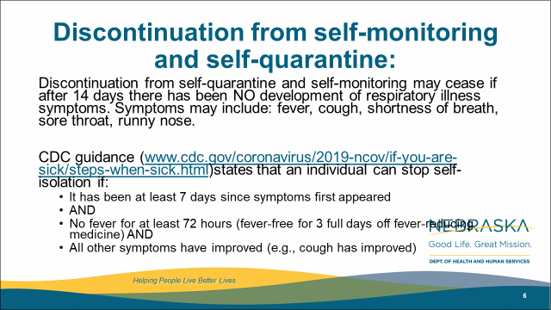
Discontinuation from self-monitoring and self-quarantine:
Discontinuation from self-quarantine and self-monitoring may cease if after 14 days there has been NO development of respiratory illness symptoms. Symptoms may include: fever, cough, shortness of breath, sore throat, runny nose.
CDC guidance (www.cdc.gov/coronavirus/2019-ncov/if-you-are-sick/steps-when-sick.html)states that an individual can stop self-isolation if:
  It has been at least 7 days since symptoms first appeared
  AND
  No fever for at least 72 hours (fever-free for 3 full days off fever-reducing medicine) AND
  All other symptoms have improved (e.g., cough has improved)

Slide 41
Discontinuation of Home Isolation
Time-since-illness-onset and time-since-recovery strategy (non-test-based strategy)*
Persons with COVID-19 who have symptoms and were directed to care for themselves at home may discontinue home isolation under the following conditions:
At least 3 days (72 hours) have passed since recovery defined as resolution of fever without the use of fever-reducing medications and improvement in respiratory symptoms (e.g., cough, shortness of breath); and,
At least 7 days have passed since symptoms first appeared.
(UNMC may recommend longer periods-10/5)
Test based Strategy
Negative results of an FDA Emergency Use Authorized molecular assay for COVID-19 from at least two consecutive nasopharyngeal swab specimens collected ≥24 hours apart** (total of two negative specimens).

Slide 42
Discontinuation of Isolation
Individuals with laboratory-confirmed COVID-19 who have not had any symptoms may discontinue home isolation when at least 7 days have passed since the date of their first positive COVID-19 diagnostic test and have had no subsequent illness.
What about family members quarantined with a COVID-+ family member, when does their quarantine end-7 days from when the loved one would have been eligible to discontinue isolation, then days of self monitoring-asking for CDC clarification
Footnote from CDC
*This recommendation will prevent most, but may not prevent all instances of secondary spread. The risk of transmission after recovery, is likely very substantially less than that during illness.

Slide 43
Strategies for Re-Use of masks
The pathogens on the filter materials of the FFR may be transferred to the wearer upon contact with the FFR during activities such as adjusting the FFR, improper doffing of the FFR, or when performing a user-seal check when redoffing a previously worn FFR. A study evaluating the persistence of SARS-CoV-2 (the virus that causes COVID-19) on plastic, stainless steel, and carboard surfaces showed that the virus is able to survive for up to 72-hours [1]. One strategy to mitigate the contact transfer of pathogens from the FFR to the wearer during reuse is to issue five respirators to each healthcare worker who may care for patients with suspected or confirmed COVID-19.
The healthcare worker will wear one respirator each day and store it in a breathable paper bag at the end of each shift. The order of FFR use should be repeated with a minimum of five days between each FFR use. This will result in each worker requiring a minimum of five FFRs, providing that they put on, take off, care for them and store them properly each day. Healthcare workers should still treat the FFRs as though they are still contaminated and follow the precautions outlined in our reuse recommendations. If supplies are even more constrained and five respirators are not available for each worker who needs them, FFR decontamination may be necessary.

Slide 44
Masking-Options, with Best Alternatives
    N-95 fitted with eye protection is best-goggles or face-shield (especially for aerosol gen procedures inc. NP swab) if available
    N-95 unfitted (seal checked) with eye protection-face-shield might provide protection better than goggles if available
    Face mask with eye protection may be used if no aerosol generating procedures, if possible face-shield might provide more protection than goggles esp if it necessary to get NP swab or give nebulizers, if available
    All HCPs should wear surgical facemasks for patient encounters

Slide 45
CDC Guidance on Nebulizing Treatments
Yes, nebulization is considered aerosol generating. However, the role it plays in the transmission of SARs-CoV-2 is not absolutely known at this point. In settings like nursing homes, where N95s are not readily available, we have been encouraging the following:
If patient can tolerate, switch to metered-dose inhalers with a dedicated spacer.
  HCW should wear a facemask during the procedure if a respirator is unavailable. Eye protection, gloves, and gowns are also recommended.
  Close patient door when providing nebulizer treatment.
  Upon set-up of nebulizer, have HCW maintain a safe distance (6 feet or greater), possibly outside the door.
  While our guidance does state that AGPs should ideally be conducted in a negative pressure room, given the limit of these rooms conducting all nebs in a negative pressure room is not feasible. would suggest prioritizing negative pressure rooms for other AGPs such as intubation, extubation, open suction, and bronchoscopy.

Slide 47

Infection Prevention and Control
Office Hours
Monday – Friday
7:30 AM – 9:30 AM Central Time
2:00 PM -4:00 PM Central Time
Call 402-552-2881

Slide 48
Unique Cleaning Questions
Soft surfaces
For soft surfaces such as carpeted floor, rugs, and drapes
Products for such surfaces
Clean the surface using soap and water or with cleaners appropriate for use on these surfaces.
Fabric Disinfectant
Launder items (if possible) according to the manufacturer’s instructions.Use the warmest appropriate water setting and dry items completely.
OR
Disinfect with an EPA-registered household disinfectant. These disinfectantsexternal icon meet EPA’s criteria for use against COVID-19.

Slide 49
Clinical Diagnosis
Given the consequences of widespread transmission, public health authorities nationally are broadening the range of clinical syndromes warranting self-isolation:
• Temperature ≥100.4°F (HCP, elderly, folks entering hospital for other reasons:100.0)
• Cough often dry
• Shortness of breath and/or CP
• +/- Sore throat (more prominent in recent cases)
Fatigue and myalgias; nausea and diarrhea maybe presenting symptoms
? Loss of smell
To limit potential transmission, if any of these symptoms are present, alone or in combination (in the absence of a known alternative diagnosis): patients should self-isolate.
New COVID ICD-9 code

Slide 50
New Testing Capacity
CHI Health-Creighton Core Lab (Omaha): •
ABBOTT M2000: 94/tests/run; up to three runs/day
Regional Pathology Service (RPS) Laboratory, affiliated with Nebraska Medicine: •
UDT TEST: 100 tests/ day •
ROCHE COBAS 6800: 180 tests/day • TOTAL: 280 tests/day
Nebraska Public Health Laboratory (NPHL) based at UNMC in Omaha: •
CDC-public health test: up to 400 tests/day
Commercial labs (LabCorp, Quest, Mayo Clinic, ARUP, etc.): •
Currently reporting approximately 100 total tests /day; future capacity, unknown. These labs accept orders for COVID-19 tests without restrictions or prescreening.

Slide 51
New HAN on Testing 4-2-10
In-patients: Any in-patient will be tested.
Out-patients: Persons in these groups with a clinical or rule-out diagnosis of COVID-19 can be tested at NPHL. •
Healthcare workers •
Public Safety/First Responders (EMS, law enforcement, firefighters) •
Residents and staff at nursing homes • Residents and staff at group homes, homeless shelters, and daycare facilities • Individuals > 65 years old, and patient with serious underlying conditions
Providers can seek NPHL testing for patients who fail to meet these requirements based on special circumstances that warrant rapid turnaround time.
Contact a state/local public health authority for telephone pre-authorization. For all other patients, order COVID-19 testing through either in-state or national commercial laboratories.
To maximize throughput at NPHL, the lab is group-testing pooled specimens. Pools are created using five individual specimens. If the pool tests negative, all five contributors are considered negative. If the pool tests positive, the individual contributors to the pool are retested separately. This conserves reagents and allows more persons to be tested. To optimize this method, we request that ordering providers indicate on the order form if the provider believes the likelihood of a positive test to be high or low. The low likelihood specimens will be pooled to help save on scarce kits and reagents used to run the test.

Slide 52
Nulirt Ordering
Ordering providers can utilize their existing account or set up a new account, and order COVID-19 tests themselves directly out of their clinic. This entails collecting the specimen, labeling the specimen, submitting the order into NUlirt, printing out the “completed order” and “batch shipping” documents from NUlirt, and arranging for courier delivery of specimens and associated documents via NPHL client services (402-559-2440).
2) Laboratories can place the order into NUlirt on behalf of an ordering provider. Providers must submit the specimen accompanied by a completed COVID-19 NPHL REQUISITION (attached) to the laboratory placing the order into NUlirt. Laboratories cannot place the order into NUlirt without the signed COVID-19 NPHL REQUISITION. Ordering labs are responsible for getting test results back to the ordering provider.
3) Ordering providers can refer patients to designated COVID-19 specimen collection sites, and fax or e-mail a completed COVID-19 NPHL REQUISITION OR have the patient take the completed form with them to the specimen collection site. COVID-19 specimen collection sites must have a completed, signed COVID-19 NPHL REQUISITION to proceed with specimen collection if referring the specimen to NPHL. COVID-19 specimen collection sites can place the order electronically into NUlirt, or reflex to option #4. Specimen collection sites placing electronic orders are responsible for getting test results back to the ordering provider.
4) Ordering providers, laboratories, and designated COVID-19 specimen collection sites can send the COVID-19 NPHL REQUISITION PLUS the N-P specimen via courier to NPHL where the test will be electronically ordered through NUlirt. Please note the importance of specifying the account on the COVID-19 NPHL REQUISITION to insure delivery of the test result via fax or secure e-mail.

Slide 53
Nulirt
Access NUlirt here (https://nulirt.nebraskamed.com) using your existing NUlirt account. If you are a new user, follow the link to register and create a new account. If you are having issues getting access to NUlirt, reach out to the NUlirt support group via email nulirtsupport@nebraskamed.com. There are also client service representatives available to assist with ordering through the NUlirt system at 402-559-2440; or toll free: 1-866-290-1406.
These recommendations are subject to revision depending on COVID-19 lab testing capacity at NPHL and commercial laboratories.
Specimen Collection Requirements: See Collecting and Handling COVID-19 Laboratory Specimens, http://www.nphl.org/. •
Nasopharyngeal Swab (NP): 1 (one) nasopharyngeal swab should be placed in a single tube of viral transport medium (VTM). •
Lower respiratory specimen: sputum if the patient can produce sputum, do not induce sputum

Slide 54
How to Order COVID-19 Different Testing Options
If currently enrolled with the Omaha CHI-Health laboratory: Alegent Core lab)
  order COVID-19 tests through that pathway. All CHI n-patient facilities along with providers, clinics and other entities with an established relationship with the CHI Health Laboratory.
2) If currently enrolled with RPS (Regional Pathology Services) operated out of UNMC, order COVID-19 tests through RPS.
3) If your reference laboratory services are other than these, follow their recommendations for routine and priority COVID-19 testing.
4) NPHL prioritizes testing statewide for ALL in-patients (except above) with possible COVID-19, HCWs (esp. outside of CHI and RPS networks), and suspected COVID-19-infected patients from group settings and other vulnerable populations (e.g., LTC).
5) On March 20, CEO of NM Jim Linder, M.D., e-mailed an invitation offering COVID-19 testing to several other health systems across the state.
WRITE A FOR ASYMPTOMATIC OR S FOR SYMPTOMATIC ON THE TUBE WHEN COLLECTING SPECIMENS (ALLOWS FOR POOLING OF SPECIMENS)

Slide 55
Testing Performance
Over 90% SE/SPEC\(probably over 95 % in good lab hands-which NPHL, UNMC, and CHI labs are.
Rapid 15 min test-60% sensitivity; difficulty with reagents acc. To local lab experts
Serology now FDA approved-not for use in clinical diagnosis-timing of IgM in the acute setting will be past most infectious period
IgG prior infection-able to go back to work???
How long does immunity last??
Can use saline if out of VTM, must be refrigerated , can be frozen

Slide 56
Call In Lines; Facility Screening
1. NM-Info hotline and referral -400-922-0000; Evaluated over the phone
referred one of their outpatient clinics, Can do their own test
2. CHI-CHIhealth.com 8am to 8pm; after hours virtual care (for CB, IMM, Lakeside St. Es, St. Francis and Good Sam ) Virtual Screening referred to MD or ANP; free.
Methodist 402-815-7425 24/7
  Doing testing on main campus; some drive through testing by appt
4. Bryan -24/7 hotline-402-481-0500; also website from their Bryan Health homepage
ezVisit-if for coronavirus questions will be provided free of charge
5. Great Plains Health-no hotline-ask people to call their PCP.
6. Crossroads Urgent Care Clinic near 72/Dodge Omaha 402 715 5272 by appointment only
7. One World and Charles Drew
*. Additional testing sites being set up

Slide 57
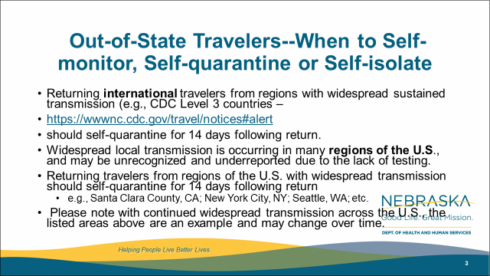
Out-of-State Travelers--When to Self-monitor, Self-quarantine or Self-isolate
Returning international travelers from regions with widespread sustained transmission (e.g., CDC Level 3 countries –
https://wwwnc.cdc.gov/travel/notices#alert
should self-quarantine for 14 days following return.
Widespread local transmission is occurring in many regions of the U.S., and may be unrecognized and underreported due to the lack of testing.
Returning travelers from regions of the U.S. with widespread transmission should self-quarantine for 14 days following return
  e.g., Santa Clara County, CA; New York City, NY; Seattle, WA; etc.
Please note with continued widespread transmission across the U.S., the listed areas above are an example and may change over time.

Slide 58
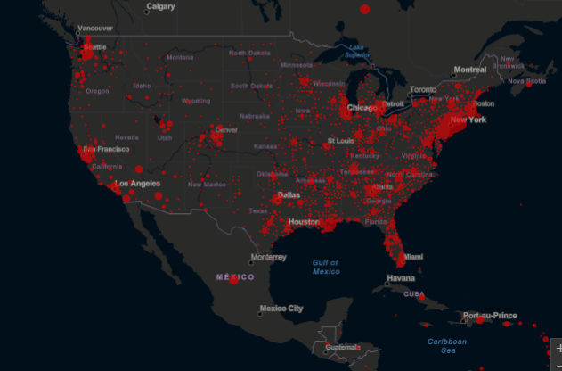
Identifying high risk domestic travel
https://coronavirus.jhu.edu/map.html
Notes:
As of 3/24

Slide 59
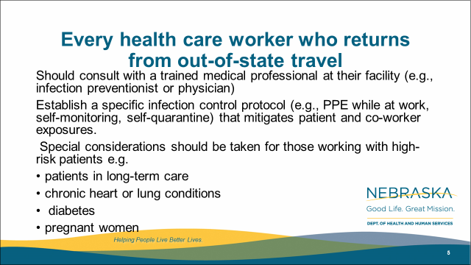
Every health care worker who returns from out-of-state travel
Should consult with a trained medical professional at their facility (e.g., infection preventionist or physician)
Establish a specific infection control protocol (e.g., PPE while at work, self-monitoring, self-quarantine) that mitigates patient and co-worker exposures.
Special considerations should be taken for those working with high-risk patients e.g.
patients in long-term care
chronic heart or lung conditions
diabetes
pregnant women

Slide 60
Updates-When should HCPs Self Quarantine
Travel-to high risk areas self quarantine if at all possible (and upon returning from any travel if possible); if not possible, consult IP or ID/PH/Med Dir.
Any respiratory symptoms, severe fatigue and myalgias, diarrhea, or fever of greater than 99.9F.
If there is a household member who is positive for COVID-19, or highly suspected of having COVID-19.
They have been caring for a person who was documented as having COVID-19
and were not wearing necessary PPE –please see next slide for what to do based on different exposures.

Slide 61
HCP Return to work
Wear a facemask until all symptoms are resolved or 14 days after symptom onset whichever is longer
Be restricted from contact with severely immunocompromised patients
Adhere to HH and respiratory etiquette as recommended for control of COVID-19 in the interim guidance
Self monitor for worsening or recurrence of symptoms and notify employee health/occupational health/supervisor if occurs

Slide 62
Gowns for MRSA and VRE
The use of gowns as part of Contact Precautions in the context of MDROs has been implemented primarily to reduce the risk of transmission to other patients rather than to protect healthcare personnel (HCP). Facilities with shortages could consider suspending the use of gowns for the care of patients with endemic MDROs, such as MRSA, VRE, and ESBL-producing Gram-negative bacilli except as required for Standard Precautions. Facilities should assess their local epidemiology to determine which MDROs are considered endemic. Regardless of the use of gowns, HCP at facilities should continue to wear gloves for contact with these patients and their environment. Hand hygiene should continue to be emphasized. Facilities should also attempt to place patients colonized or infected with an MDRO in a private room, if available.

Slide 63
Other PPE Preserving Strategies
Caring for patients who have highly resistant Gram-negative organisms (e.g., carbapenem-resistant Enterobacteriacae) and other MDROs (e.g., Candida auris) that are not considered endemic: Rather than gowns being donned for every room entry, they should be reserved for use as part of Standard Precautions and also prioritized for high-contact patient care activities that pose highest risk for transfer of pathogens from the patient to HCP. Examples of such high-contact care activities include dressing, bathing/showering, transferring, providing hygiene, changing linens, changing briefs or assisting with toileting, device care or use (central line, urinary catheter, feeding tube, tracheostomy/ventilator), and wound care. To further preserve gowns, HCP are recommended to bundle high-contact care activities as part of individual care encounters. Regardless of the use of gowns, HCP at facilities should continue to wear gloves for contact with these patients and their environment. Hand hygiene should continue to be emphasized. Facilities should also attempt to place patients colonized or infected with an MDRO in a private room, if available.
Caring for patients with Clostridioides difficile infections (CDI): Facilities should continue using Contact Precautions (putting on a gown and gloves upon entry into the patient’s room and placing the patient in a private room) for the care of symptomatic patients with CDI. As part of a supplemental strategy to prevent transmission of CDI,

Slide 64
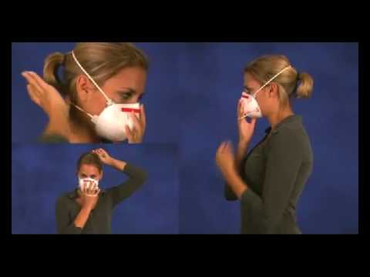
User seal check for N95 respirators
https://www.youtube.com/watch?v=pGXiUyAoEd8.

Slide 65
CDC Updates PPE Optimization Strategies
Alert facilities that updates have been made
Encourage review of guidance at https://www.cdc.gov/coronavirus/2019-ncov/hcp/ppe-strategy/index.html
Highlights:
  Extended use and limited re-use of facemasks
  “When no facemasks are available” guidance
  No resources for Crisis/Alternative Strategies for N95s
  Option for reprocessing eye protection
  Strategies to Allocate Ventilators from Stockpiles to Facilities
  Additional crisis strategies for gowns, including “when no gowns are available”
Notes:
We just want to alert people that the CDC has updated their PPE Optimization Strategies. Some highlights are included here. It is worth reading to see if this gives facilities any new ideas, but frankly catches CDC up to what has been under discussion in Nebraska for awhile- including strategies from NETEC and Nebraska Medicine.

Slide 66
UNMC Study on Contamination of Environment near COVID 19 Patients
https://www.unmc.edu/news.cfm?match=25339
IMPORTANT context about this information: Our findings DO NOT confirm that this virus spreads in an airborne fashion. The identification of genetic material from the virus that causes COVID-19 in air samples found in this study provides limited evidence that some potential for airborne transmission exists. More study is underway to determine if live culturable virus was captured in this study and additional evidence is needed to determine the risk of SARS-CoV-2 transmission via the airborne route.
A study by UNMC/Nebraska Medicine/NSRI researchers recently posted on the open pre-publication site BioRxiv, provides new evidence of SARS-CoV-2 environmental contamination in COVID-19 patient care areas. …The study found high levels of the virus contamination by PCR on commonly used surfaces and in the air of rooms of COVID-19 patients. Air samplers from hallways outside of rooms where staff were moving in and out of doors were also positive.
“Air samples that were positive for viral RNA by RT-PCR were examined for viral propagation in Vero E6 cells. Cytopathic effect was not observed in any sample, to date, and immunofluorescence 15 and western blot analysis have not, so far, indicated the presence of viral antigens suggesting viral replication. However, the low concentrations of virus recovered from these samples makes finding infectious virus in these samples difficult. Further experiments are ongoing to determine viral activity in these samples. “
From https://www.medrxiv.org/content/10.1101/2020.03.23.20039446v2

Slide 67
EVS Cleaning After COVID 19 patient leaves
Terminal cleaning may be performed by EVS personnel.
Delay entry into the room until a sufficient time has elapsed for enough air changes to remove potentially infectious particles. We do not yet know how long SARS-CoV-2 remains infectious in the air.
See next slide for table on air exchanges-time room will be 99% or 99.9% free of particles
After this time has elapsed, EVS personnel may enter the room and should wear a gown and gloves when performing terminal cleaning.
A facemask and eye protection should be added if splashes or sprays during cleaning and disinfection activities are anticipated or otherwise required based on the selected cleaning products.

Slide 68
Air Exchanges per hour | Time (in minutes) required for removal 99% efficiency | Time (in minutes) required for removal 99.9% efficiency
2 | 138 | 207
4 | 69 | 104
6 | 46 | 69
8 | 35 | 52
10 | 28 | 41
Values apply to an empty room with no aerosol-generating source. With a person present and generating aerosol, this table would not apply. Removal times will be longer in rooms or areas with imperfect mixing or air stagnation. Caution should be exercised in using this table in such situations.
https://www.cdc.gov/infectioncontrol/guidelines/environmental/appendix/air.html#tableb1
Notes:
Values apply to an empty room with no aerosol-generating source. With a person present and generating aerosol, this table would not apply. Removal times will be longer in rooms or areas with imperfect mixing or air stagnation.²¹³ Caution should be exercised in using this table in such situations.
Cleaning could occur during this time, as long as respiratory protection is worn. Room would be blocked for appointments until the specified time has elapsed.

Slide 69
Additional Resources on Air Exchanges
https://www.mintie.com/assets/img/resources/ASHRAE_Article-on-VentilationChanges.pdf
https://www.hfmmagazine.com/articles/2671-planning-and-maintaining-hospital-air-isolation-rooms

Slide 70
From CDC-Patient Placement
For patients with COVID-19 or other respiratory infections, evaluate need for hospitalization. If hospitalization is not medically necessary, home care is preferable if the individual’s situation allows.
If admitted, place a patient with known or suspected COVID-19 in a single-person room with the door closed. The patient should have a dedicated bathroom.
  Airborne Infection Isolation Rooms (AIIRs) should be reserved for patients who will be undergoing aerosol-generating procedures (intubation, sputum inductionsuctioning, bronchoscopy
  CDC answers to question about nebulizer therapy and negative pressure rooms:
As a measure to limit HCP exposure and conserve PPE, facilities could consider cohorting staff and if possible, designating entire units within the facility, with dedicated HCP, to care for known or suspected COVID-19 patients. Dedicated means that HCP are assigned to care only for these patients during their shift

Slide 71
Table 2 Summary of the decontamination method and effect on FFR performance
Table 2 provides a summary of the decontamination methods evaluated in the referenced literature and the reported effect of each method on FFR performance.
Method | Treatment level | FFR filtration performance | FFR fit performance | Other observations | References
Vaporous hydrogen peroxide (VHP) | Battelle report: Bioquell Clarus C HPV generator:. Bergman et. al.: Room Bio-Decontamination Service (RBDS™, BIOQUELL UK Ltd, Andover, UK), which utilizes four portable modules | Passed | FFR fit was shown to be unaffected for up to 20 VHP treatments cycles using a head form | Degradation of straps after 30 cycles (Battelle report) | 3, 4
Ultraviolet germicidal irrad. (UVGI) | 0.5–950 J/cm2 | Passed | 90–100% passing rate after 3 cycles depending on model |  | 2, 3, 7, 8, 9, 10
Microwave generated steam | 1100–1250W microwave models (range: 40 sec to 2 min) | All passed filtration eval for 1 or 20 tr. cycles | 95–100% passing rate after 3 and 20 cycles for all models tested |  | 9, 10, 14
Microwave steam bags | 1100 W, 90 sec (bags filled with 60 mL tap water) | Passed | Not evaluated |  | 15
Moist heat incubation | 15 min–30 min (60°C, 80% RH) | 6 of 6 models passed after 3 cycles of contamination | Passed |  | 3, 9, 10
Liquid hydrogen peroxide | 1 sec to 30 min (range: 3–6%) | Passed | Not evaluated |  | 3, 7
Ethylene oxide | 1 hour at 55°C; conc. range: 725–833/L | Passed | Not evaluated |  | 2, 3, 7

Slide 72
UV Disinfection of PPE
“A team led by John Lowe, PhD, UNMC assistant vice chancellor for inter-professional health security training and education has developed a safe and effective method to decontaminate N95 respirators so they can be used multiple times, instead of just once. It involves using ultraviolet light towers to irradiate high numbers of N95 respirators.
The decontamination of these items works like this: groups of N95s are safely bagged and transported to a room inside Nebraska Medical Center, which is equipped with two ultraviolet light towers. The N95 respirators are hung on wires stretching the length of the room and then decontaminated when the lights are powered on. They are then removed and returned to the original owners for reuse.”
This is public facing now on the NETEC site.
https://repository.netecweb.org/files/original/fe9a813e5643ab774a62b4b1778117e0.pdf
UV sights around the state 4-5 places outside the metro-will have more info Wed

Slide 73
Other Decontamination Strategies
On March 28, 2020, FDA issued an Emergency Use Authorization (EUA) permitting the Battelle Decontamination Systemexternal icon at Battelle Memorial Institute to be authorized for use in decontaminating “compatible N95 respirators.”
University of Iowa has shown that possible dropin filtration capacity of 2% post H2O2, so recommend only 2 4 times
Because ultraviolet germicidal irradiation (UVGI), vaporous hydrogen peroxide (VHP), and moist heat showed the most promise as potential methods to decontaminate FFRs, researchers, decontamination companies, healthcare systems, or individual hospitals should focus current efforts on these technologies.

Slide 74
Reporting to LHD
Reporting to LHD should primarily be by providers not patients. The LHD staff screening for who to test need the providers to have done some clinical screening/evaluating first (which may all be by phone)
Do NOT need to report all tests just positives and any probable cast that is pending (epi link)-
Any general questions by the public can be answered by the general COVID 19 hotlines at various LHDs
Listing of the local health departments and contacts:
http://dhhs.ne.gov/CHPM%20Documents/contacts.pdf

Slide 75
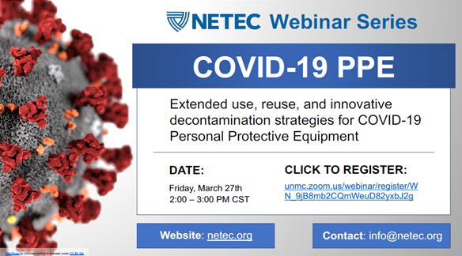
Registration link: https://unmc.zoom.us/webinar/register/WN_9jB8mb2CQmWeuD82yxbJ2g

Slide 76
Cleaning Oxygen tubing
he HAI team in Wisconsin has a position paper on this topic at https://www.dhs.wisconsin.gov/regulations/nh/hai-ltc-oxygen-tubing.pdf
“Current evidence and standards of practice support oxygen tubing replacement to be event related instead of time related. Event related examples requiring oxygen tubing replacement include when visibly soiled, when known contamination occurs and/or between residents. Current evidence and standards of practice do not recommend changing oxygen tubing at regular intervals such as weekly or every five days. When available, manufacturer recommendations should be incorporated into the facility’s policies and procedures.”
Based on the reference documents and from practical perspective, I think this is very reasonable guidance for conservation.
Because nebulizer masks are used with aerosolized medication, they are probably more likely to become contaminated and/or sticky. If the manufacturer recommends a procedure for cleaning and disinfecting them, then perhaps the facility can attempt that. However, long term care facilities rarely have space set-up for proper cleaning and disinfection of these types of devices, so such cleaning should be done with a lot of caution.
.

Slide 77
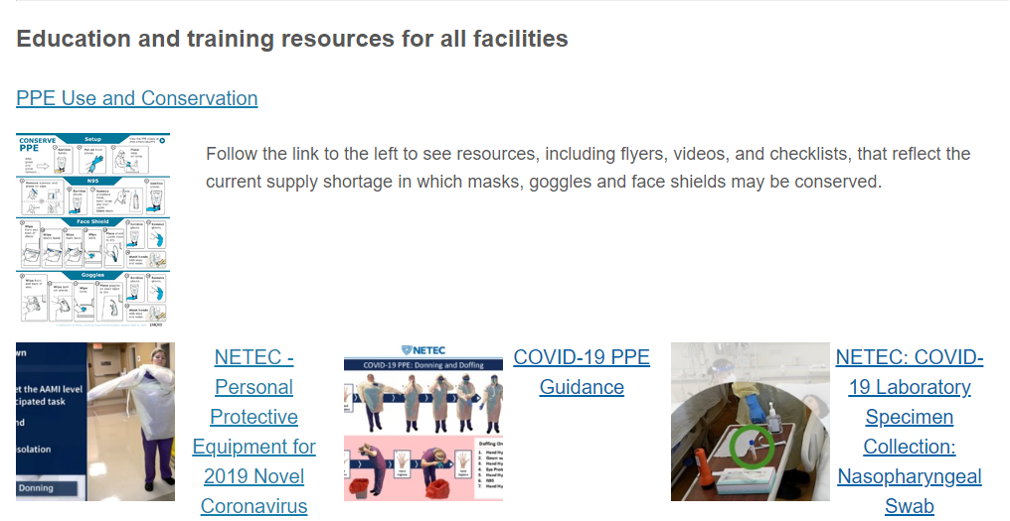
https://repository.netecweb.org/exhibits/show/ncov/ncov
Notes:
NETEC offers excellent training resources on COVID-19 PPE use, as well as conservation

Slide 78
From the CDC –ABHR Shortages
If “severe shortages of ABHR (and have exhausted supply chain access to efficacious products) may consider local production of formulations as described by the FDA Policy for Compounding of Certain Alcohol-Based Hand Sanitizer Productsexternal icon. This policy remains in effect through April 30, 2020. Formulations included in the FDA guidance are consistent with World Health Organization production guidance. These locally produced products are intended for routine healthcare personnel hand cleaning, must not contain active ingredients other than those specified in the FDA guidance, and should not take the place of other regulated skin antiseptics (e.g. surgical hand rub). To avoid contamination with spore-forming organisms, WHO formulations require a 72-hour post-production quarantine. Organizations should revert to the use of commercially produced, FDA-approved product once such supplies again become available.”
Here is the link to The World Health Organization's hand rub directions:https://www.who.int/gpsc/5may/Guide_to_Local_Production.pdf
Here is the FDA one:https://www.fda.gov/news-events/press-announcements/coronavirus-covid-19-update-fda-provides-guidance-production-alcohol-based-hand-sanitizer-help-boost

Slide 79
Unique Cleaning Questions
Soft surfaces
For soft surfaces such as carpeted floor, rugs, and drapes
Products for such surfaces
Clean the surface using soap and water or with cleaners appropriate for use on these surfaces.
Fabric Disinfectant
Launder items (if possible) according to the manufacturer’s instructions.Use the warmest appropriate water setting and dry items completely.
OR
Disinfect with an EPA-registered household disinfectant. These disinfectantsexternal icon meet EPA’s criteria for use against COVID-19.

Slide 80
Resources (as of 8:00am 3/30/20)
Exposure Risk Assessment
https://www.cdc.gov/coronavirus/2019-ncov/hcp/guidance-risk-assesment-hcp.html
Guidance for pregnant and breastfeeding mothers
https://www.cdc.gov/coronavirus/2019-ncov/need-extra-precautions/pregnancy-breastfeeding.htmll
Guidance for PPE
https://www.cdc.gov/coronavirus/2019-ncov/hcp/ppe-strategy/index.html
  Regarding use of homemade masks
  https://www.cdc.gov/coronavirus/2019-ncov/hcp/ppe-strategy/face-masks.html

Slide 81
Presentation prepared by: Dr. Maureen Tierney and Dr. Tom Safranek; Kate Tyner and Margaret Drake
HAI/AR Epidemiologist
Ishrat.kamal-ahmed@Nebraska.gov
402-471-2937

