Slide 1
Covid-19 Webex Update
1-27-2021
Tom Safranek, MD, State Epidemiologist
Louis Safranek, MD, PhD
Board certified specialist, Infectious Disease
E-mail: idmd4u-corona.2020@yahoo.com

Slide 2
Testing
Genome Sequencing of Sewage Detects Regionally Prevalent SARS-CoV-2 Variants
RNA was sequenced directly from sewage collected by municipal utility districts in the San Francisco Bay Area to generate complete and nearly complete SARS-CoV-2 genomes.
The major consensus SARS-CoV-2 genotypes detected in the sewage were identical to clinical genomes from the region.
Observed wastewater variants were more similar to local California patient-derived genotypes than they were to those from other regions within the United States or globally.
Additional variants detected in wastewater have only been identified in genomes from patients sampled outside California, indicating that wastewater sequencing can provide evidence for recent introductions of viral lineages before they are detected by local clinical sequencing.
These results demonstrate that epidemiological surveillance through wastewater sequencing can aid in tracking exact viral strains in an epidemic context.
DOI: 10.1128/mBio.02703-20

Slide 3
Epidemiology
Assessing the age specificity of infection fatality rates for COVID‑19: systematic review, meta‑analysis, and public policy implications
Our analysis finds a exponential relationship between age and IFR for COVID-19. The estimated age-specific infection fatality rate (IFR) is very low for children and younger adults (e.g., 0.002% at age 10 and 0.01% at age 25) but increases progressively to 0.4% at age 55, 1.4% at age 65, 4.6% at age 75, and 15% at age 85.
Moreover, our results indicate that about 90% of the variation in population IFR across geographical locations reflects differences in the age composition of the population and the extent to which relatively vulnerable age groups were exposed to the virus.
These results indicate that COVID-19 is hazardous not only for the elderly but also for middle-aged adults, for whom the infection fatality rate is two orders of magnitude greater than the annualized risk of a fatal automobile accident and far more dangerous than seasonal influenza
https://www.medrxiv.org/content/10.1101/2020.07.23.20160895v3.

Slide 4
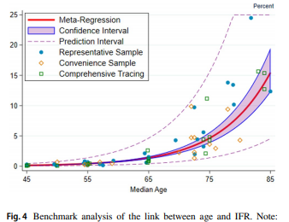
Age related mortality

Slide 5
Epidemiology
Improving Fabric Face Masks: Impact of Design Features on the Protection Offered by Fabric Face Masks
The findings indicate that the protection offered by fabric masks can range significantly based on fit and construction, with the best mask tested providing five times the amount of protection as low-performing masks.
The most protective masks were those with multiple layers with a very tight fit.
Low air-resistance filters can be inserted into fabric masks to improve protection.
Alternatively, a surgical mask can be worn under a tight-fitting fabric mask for significantly improved protection.
While fabric masks do not provide the same level of protection as N95 masks, much can, and should, be done to boost the protection they offer:
https://doi.org/10.1101/2021.01.21.20228569.

Slide 6
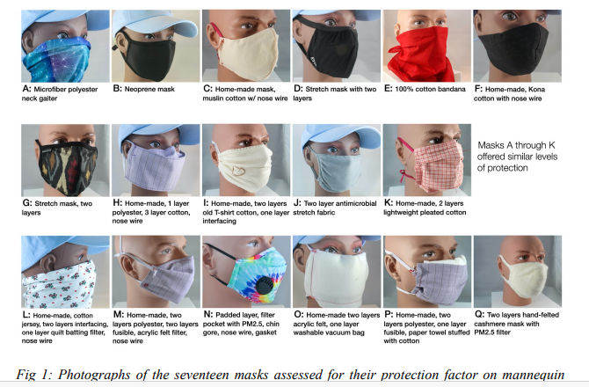
Masks

Slide 7
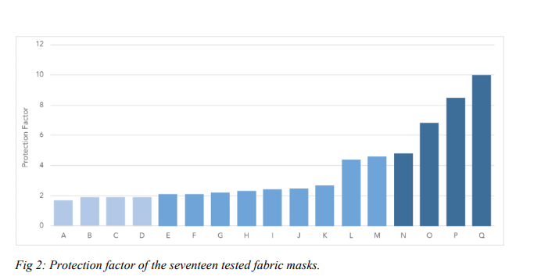
Masks
Notes:
Mask P was highly effective but difficult to breathe through. One participant described it as being suffocated by a scratchy diaper. Mask Q provided the highest protection with a score of 10. It fit tightly but not uncomfortably to the face and was made of two layers of hand-felted cashmere with a PM2.5 filter inserted between.

Slide 8
Masks
What are PM2.5 filters made of?
The filter consists of five layers of activated carbon filter and different kinds of fabric:
Layers 1 and 5: Spun-bound polyester material that filters out larger particles
Layer 3 (middle): activated carbon layer. Traps particulate matter via an adhesion process.
Layers 2 and 4: high-efficiency melt-blown nonwoven polypropylene that can filter small substances.

Slide 9
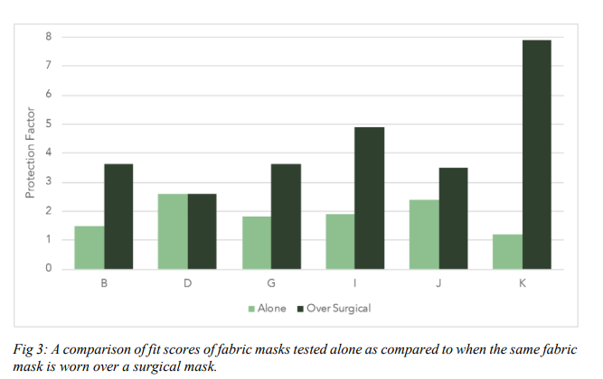
Masks

Slide 10
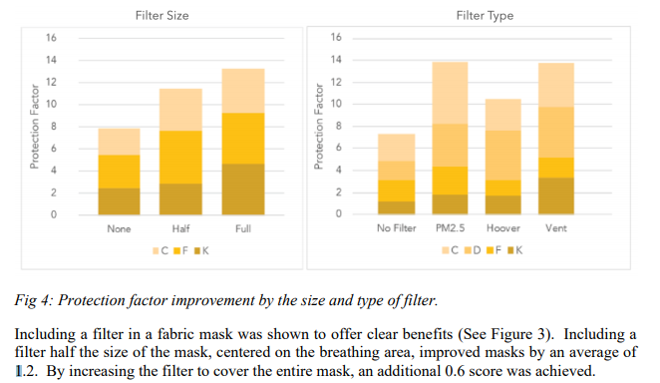
Masks

Slide 11
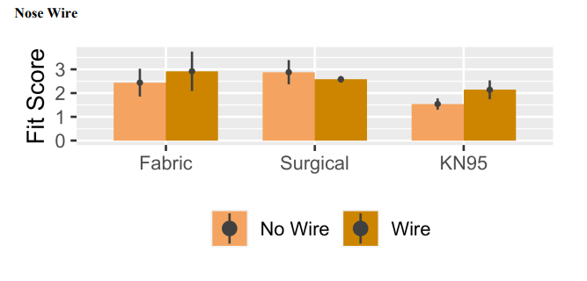
Masks

Slide 12
Masks
Mask adherence and rate of COVID-19 across the United States
Fourteen of the 15 states with no mask-wearing policy for the general public reported a high COVID-19 rate.
Of the 8 states with at least 75% mask adherence, none reported a high COVID-19 rate.
States with the lowest levels of mask adherence were most likely to have high COVID-19 rates in the subsequent month, independent of mask policy or demographic factors.
Our analysis suggests high adherence to mask wearing could be a key factor in reducing the spread of COVID-19.
doi: https://doi.org/10.1101/2021.01.18.21250029

Slide 13
Masks
For mask adherence levels, we utilized the Institute of Health Metrics and Evaluation (IHME) COVID-19 Projections online database (11), and abstracted daily percentages of the population who say they always wear a mask in public.
We classified a state and D.C. as having a high case rate in a given month if a 2-week rate was >200 cases per 100,000 people, per CDC classifications of highest risk of transmission (14).

Slide 14
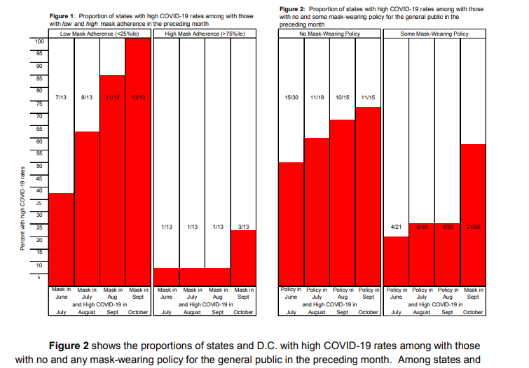
Masks

Slide 15
Epidemiology

Slide 16
Epidemiology
British variant B.1.1.7.

Slide 17
Treatment
Home-based management of COVID-19 by identification of low-risk features
To be observed without treatment, patients could have no more than 1 of the following: CRP > 10 mg/dL, high LDH, ferritin > 500 ng/ml, D-dimer > 1 mg/L, IL-6 > 10 pg/ml, absolute lymphocyte count <1,000, Oxygen saturation <94%, or CT chest evidence of pneumonia.
Primary endpoint was progression to respiratory failure and secondary endpoints was 28-day survival.
Of 208 entered, 132 were low-risk and hence were monitored without therapy. None progressed to respiratory failure or died.
This approach can identify cases who can safely be observed without treatment, thus avoiding expensive, potentially toxic therapies, and circumventing unnecessary, costly hospitalizations.
These results show that 64% of Covid-19 cases can be monitored as outpatients without therapy using these criteria.
doi: https://doi.org/10.1101/2021.01.25.21249684

Slide 18
E-mail
Test often, treat early
Phone: 402-733-8818
idmd4u-corona.2020@yahoo.com

Slide 19
Treatment
Use of non-steroidal anti-inflammatory drugs and risk of death from COVID-19: an OpenSAFELY cohort analysis based on two cohorts
We found no evidence of a harmful effect of routinely prescribed NSAIDs on COVID-19 related deaths. Risks of COVID-19 do not need to influence decisions about the routine therapeutic use of NSAIDs.
http://dx.doi.org/10.1136/annrheumdis-2020-219517

Slide 20
Treatment
Clinical effectiveness of convalescent plasma in hospitalized patients with COVID-19: a systematic review and meta-analysis
This is a systematic review of controlled clinical trials assessing treatment with convalescent plasma for hospitalized patients with a diagnosis of SARS-CoV 2 infection.
The outcomes were mortality, clinical improvement, and ventilation 8requirement.
A total of 50 studies were retrieved from the databases.
The meta-analysis suggests that there is no benefit of convalescent plasma compared to standard care or placebo in the reduction of the overall mortality and in the ventilation requirement; but there could be a benefit for the clinical improvement in patients treated with plasma.
We can conclude that convalescent plasma transfusion cannot reduce the mortality or ventilation requirement in hospitalized patients diagnosed with SARS CoV-2 infection.
https://doi.org/10.1101/2021.01.16.21249956

Slide 21
Treatments
Aspirin
Ivermectin
Minocycline/doxycycline
Famotidine
Hydroxyzine
Hydroxychloroquine
Melatonin
Colchicine, indomethacin
Monoclonal antibodies
Dexamethasone, prednisone
Zinc
Clarithromycin, azithromycin, vitamin D
Remdesivir

