Slide 1
NHSN New User Cohort
May 25, 2021

Slide 2
Line 1 FacWideIN location Patient Days and Admissions
Enter the total number of patient days and admissions for all facility inpatient locations combined for the month.
All of the facility’s inpatient locations must be included, where denominators can be accurately collected and there is the possibility of the MDRO to be present, transmitted, and identified in that specific location.
Total Facility Patient Days should include a single count for individual patients
The Total Facility Patient Days count should be greater than or equal to the Total Facility Admissions count.
Total Facility Admissions reflects an admission from outside of the facility into an inpatient location. Transfers between inpatient locations should not be counted again and included in the total admission count, as this will falsely increase admission count.
The Total Facility Admissions count should be less than or equal to the Total Facility Patient Days count
For further information on counting patient days and admissions, go to
https://www.cdc.gov/nhsn/PDFs/PatientDay_SumData_Guide.pdf
Notes:
This means, patient care units with separate CCNs (inpatient rehabilitation facilities [IRF] and inpatient psychiatric facilities [IPF]) must be included in these counts; however, this excludes outpatient locations and other facility types within the hospital that are enrolled and reporting separately to NHSN (for example LTAC). NOTE: •
Patients should not be counted again or included in this count when transferred between inpatient locations, as this will falsely increase patient day counts.

Slide 3
Line 2: Patient Days and Admissions
Enter the total number of patient days and admissions for all facility inpatient locations,
with the same CMS Certification Number (CCN), combined for the month.
All patient day and admission counts from inpatient rehabilitation facility (IRF) and inpatient psychiatric facility (IPF) locations with separate CCNs must be removed.
This total should not include facilities affiliated with the hospital that are already enrolled separately.
Line 2 Patient Days should be less than or equal to Line 1 Total Facility Patient Days.

Slide 4
Line 3: Patient Days and Admissions
Enter the total number of patient days for all non-baby (see NOTE) facility inpatient locations, with the same CMS Certification Number (CCN), combined for the month.
All patient day and admission counts from inpatient rehabilitation facility (IRF) and inpatient psychiatric facility (IPF) locations with separate CCNs and counts from baby locations must be removed.
These totals should not include facilities affiliated with the hospital that are already enrolled separately in NHSN.
NOTE: Line 3 Patient Days and Line 3 Admissions must exclude any counts from locations that predominantly house infants, including NICU, SCN, or well-baby locations (for example, nurseries, babies in LDRP).

Slide 5
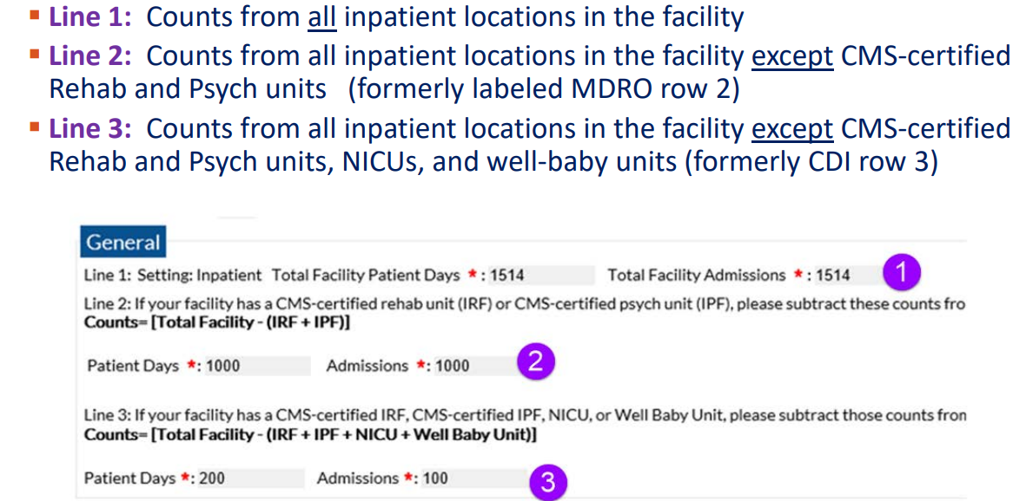
Denominator Facility WideIN

Slide 6
Incorrect Data

Slide 7
ED denominator data
I visit = 1 encounter

Slide 8
Primary testing method for C. difficile used
This is completed in the last month of each calendar-year quarter (March, June, September, and December).
Select from the choices the primary testing method used to perform C. difficile testing by your facility’s laboratory or the outside laboratory where your facility’s testing is done.
If ‘Other’ is selected, please specify. ‘Other’ should not be used to name specific laboratories, reference laboratories, or the brand names of C. difficile tests.
Most methods can be categorized accurately by selecting from the options provided.

Slide 9
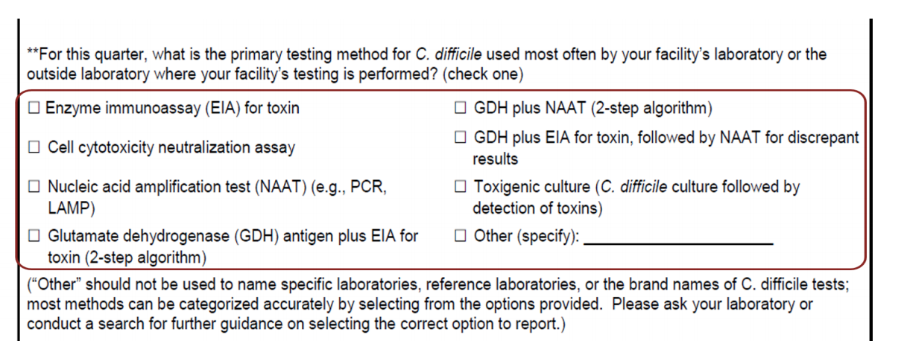
Test Type Entered Quarterly- March,June,September and December

Slide 10
Event Reporting
Event type = LabID
Date Specimen Collected format: MM/DD/YYYY
Specific Organism Type- MRSA or C. difficile
Outpatient yes or no- Select “Yes” if the LabID Event is being reported from an outpatient location where there are no admissions (for example: emergency department or observation unit)
If the patient was an outpatient, Date Admitted to Facility and Date Admitted to Location are not required.
Specimen Source- blood stream = MRSA if reporting MRSA blood specimens only or GI digestive for CDI
Date Admitted to Facility- admission date must reflect the first day spent in the inpatient location regardless of the patients’ status as inpatient or status such as observation
Location- where was the specimen collected
Date Admitted to Location- may be different than date admitted to facility

Slide 11
Last physical overnight location of patient immediately prior to arriving into facility
Optional for specimens collected from the emergency department, observation location(s), or less than four days after admission into an inpatient unit.
Using the available variables, select the location in which the patient spent the night immediately prior to arrival into the facility.
Selections include:
(1) Nursing Home/Skilled Nursing Facility
(2) Other Inpatient Healthcare Setting (for example, acute care hospital, inpatient rehabilitation facility/IRF, long term acute care facility/LTAC, etc.)
(3) Personal Residence/Residential Care (includes personal homes or assisted living environments in which 24/7 care is not provided in a group setting).
Note: If the patient’s personal residence is a nursing home or skilled nursing facility, select Nursing Home/Skilled Nursing Facility.

Slide 12
Has patient been discharged from your facility in the past 4 weeks?
Circle “Yes”
If the patient has been discharged, after an inpatient stay, from your facility in the past 28 days from current positive specimen
Circle “No”.
The 28 day count is a backward count using day of current positive specimen as day 1.

Slide 13
Patient discharged from another facility in the past 4 weeks?
“Yes” if the patient has been discharged, after an inpatient stay, from another facility in the past 28 days. Select
“No” if the patient has not been discharged, after an inpatient stay, from another facility in the past 28 days.
“Unknown” if previous inpatient history is not known.
Last discharging facility Optional. If the patient was discharged from an inpatient stay from another facility in the past 28 days, (previous question is circled “Yes”)
Select all that apply from the provided list, which includes:
(1) Nursing Home/Skilled Nursing Facility
(2) Other Inpatient Healthcare Setting (acute care hospital, inpatient rehabilitation facility/IRF, long term acute care facility/LTAC

Slide 14
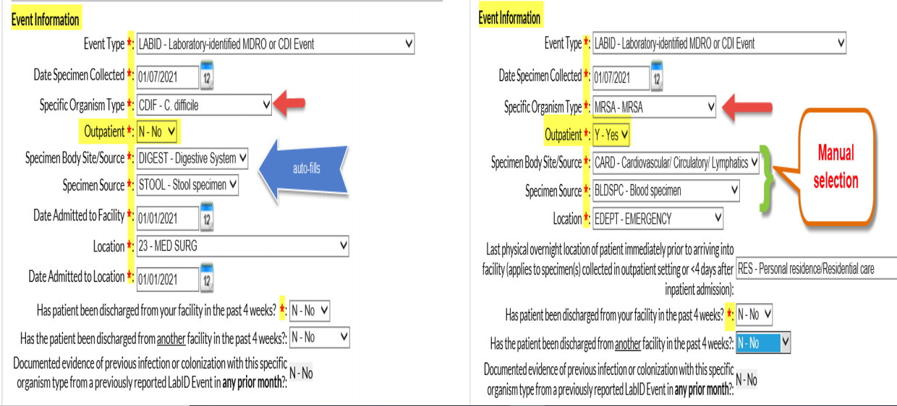
LabID Event Submission

Slide 15
No Events

Slide 16
LabID Event Calculator

Slide 17
Key Concepts to LabID Event Reporting:
LabID Event reporting is based strictly on laboratory testing data without clinical evaluation of the patient, allowing for a much less labor- intensive method of tracking.
Symptoms are NOT used in LabID event reporting.
LabID Event reporting is by single facility; prior positives identified at a different facility will not influence reporting at your facility [reporting resets at new facility].
***the ‘Transfer Rule’ does NOT apply to LabID event reporting.
LabID Events are attributable to the location where the positive specimen is collected.
The ‘LabID 14-day rule’ is location specific.

