Slide 1
High Performing Quality Improvement Teams
Victoria Kennel, PhD
University of Nebraska Medical Center

Slide 2
Learning Objectives
Compose a high performing quality improvement team
Discuss strategies to lead effective teams
Define desired team performance outcomes

Slide 3
Opening Group Discussion
What do quality improvement teams look like in your facility?
What successes do you experience with quality improvement teams?
What challenges do you experience with quality improvement teams?

Slide 4
Why Teams?
QI is complex and the path to improvement isn’t always clear
Processes don’t exist in a vacuum
Multidisciplinary approach allows us to use the knowledge, skills, experiences of many professionals
Efficient use of resources
https://www.hrsa.gov/sites/default/files/quality/toolbox/508pdfs/improvementteams.pdf

Slide 5
High-Performing Teams: Components
Composition
Processes
Performance
Who’s on the team? What are we doing?
How do we interact and combine our resources to achieve our charge?
Were we effective?

Slide 6
Creating the Team
Team Goals
What is our charge? Revisit project aim statement, strategic goals/plans
Clear roles and responsibilities
Who does what? And by when?
Team members
Expertise, knowledge, skills, abilities
Personality and values

Slide 7
QI Team Members
Clinical experts
Technical experts
Team leader
Project sponsor

Slide 8
What to Look for in QI Team Members
Well respected by others
Strong communication skills
Proven problem solvers
Frustrated with the current situation
Creative and willing to offer solutions
Team player
Strong, active listening skills
Flexible, adaptable
Expertise in improvement area
Willing to learn
Assume responsibility for tasks
Committed to success of the project/team
https://www.hrsa.gov/sites/default/files/quality/toolbox/508pdfs/improvementteams.pdf

Slide 9
Leadership Strategies for QI Team Success
Align QI projects with priorities and strategic goals
Create an effective team meeting process to maximize time spent together, and minimize meeting burden
Track progress, outcomes to encourage accountability and allow for replicability
Advocate for programs and resources
Develop relationships with leadership and make the team’s work visible
Ensure fidelity to QI methodologies and be willing to rigorously test and evaluate improvements

Slide 10
Make the Most of Your Meetings
Is the meeting (really) necessary?
Is another communication mechanism more appropriate?
Schedule meeting length appropriate for goals
Leave time for a break to transition to next events
Set clear goals and outcomes
Prepare an agenda
Send it out in advance
Prepare for the meeting accordingly
Does the technology support the meeting goals?
Does everyone have access to the technology?
Does the technology work?
Invite only those whose knowledge, expertise is needed at THAT PARTICULAR meeting
Evidence-based practices for meeting design and preparation
Mroz, J. E., Allen, J. A., Verhoeven, D. C., & Shuffler, M. L. (2018). Do we really need another meeting? The science of workplace meetings. Current Directions in Psychological Science, 27(6), 484-491. https://doi.org/10.1177/0963721418776307

Slide 11
Make the Most of Your Meetings
Start on time
Follow the agenda
Take minutes and document key actions and outcomes
End on time and allow for transition
Commit to completing follow-up activities
Establish accountability structures for follow-through
Mroz, J. E., Allen, J. A., Verhoeven, D. C., & Shuffler, M. L. (2018). Do we really need another meeting? The science of workplace meetings. Current Directions in Psychological Science, 27(6), 484-491. https://doi.org/10.1177/0963721418776307

Slide 12
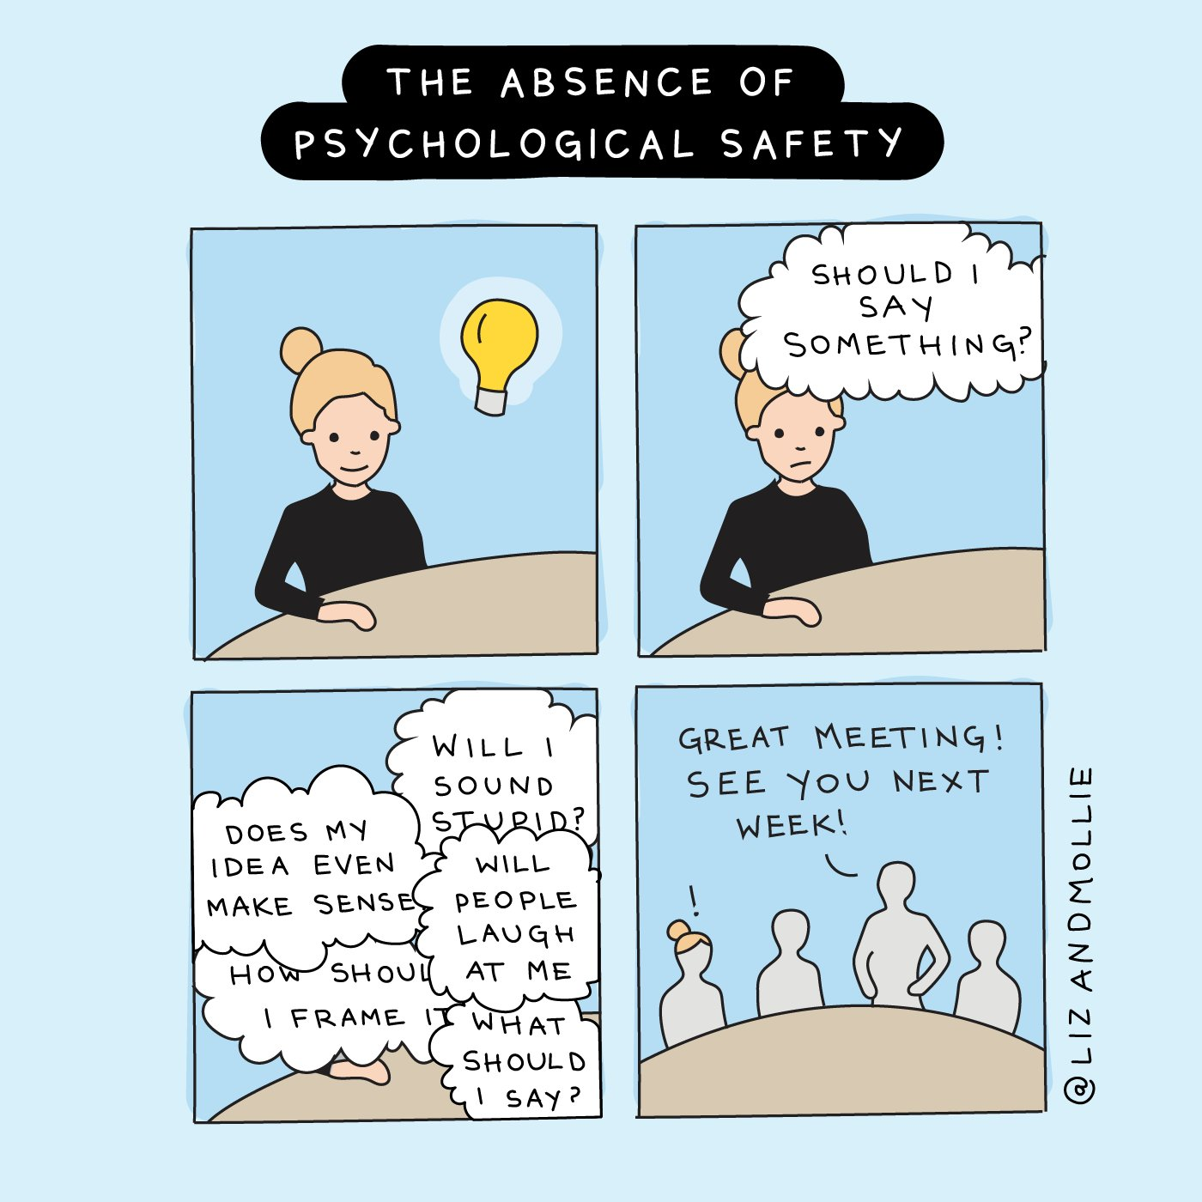
Duffy, M. W., & Fosslien, L. (2020). “The absence of psychological safety.” Cartoon. Retrieved from lizandmollie.com. Permission for use in this presentation received via email on October 13, 2020.

Slide 13
Monitoring Team Performance
Did we achieve our goals?
Did we make high quality decisions? Did we learn?
Are we satisfied with the team? Our work? Our performance?
Did we work together successfully? Are we a viable team moving forward?

Slide 14
Sticky Issues
Not enough personnel to support QI efforts
  Multiple hats are a blessing and a curse
  Be incredibly intentional when crafting roles, responsibilities, and your ask for their expertise and time
Relationships among QI and senior leadership
  Advocate for resources and support
  Establish accountability structures to support forward progress

Slide 15
QI Team Resources
HRSA Improvement Teams
  https://www.hrsa.gov/sites/default/files/quality/toolbox/508pdfs/improvementteams.pdf
IHI Forming the Team
  http://www.ihi.org/resources/Pages/HowtoImprove/ScienceofImprovementFormingtheTeam.aspx

Slide 16
QI Teams Literature
Rowlan P., Lising D., Sinclair L., & Baker G. R. (2018). Team dynamics within quality improvement teams: a scoping review. International Journal for Quality in Health Care, 30(6), 416-422. https://academic.oup.com/intqhc/article/30/6/416/4957970

Slide 17
Wrap Up

