Slide 1
QI Residency Program
Module B - Accreditation & Surveys
morning session

Slide 2
Q & A Day 1 (Module A)
What was the most interesting thing you learned?
What is one thing you will take back to apply in your work?
Other questions?
Notes:
Brief overview of methodologies

Slide 3
The History of Quality Assessment
1910 - Flexner report recognizes the appalling state of U.S. medical schools
1917 - American College of Surgeons establish Hospital Standardization Program and began surveying hospitals- medical staff standards
1952 - Joint commission formed, continued surveying – added physical plant, equipment

Slide 4
The History of Quality Assessment
1965 - Medicare mandates principles of hospital operations , staff credentialing, round the clock nursing, and utilization review
1980’s to current- transitions from quality assurance to performance improvement
2010 – Affordable Care Act, quality is a matter of improving the experience of care, the health of populations and reducing costs
Notes:
Quality is and has been continuously changing, in response to both voluntary and governmental sense. Today we need to be ensuring our quality programs are able to be flexible, adept at changing and meeting needs of patients, communities and the organization
With these changes accrediting agencies have formed to ensure adherence to regulations and safe quality care for patients

Slide 5
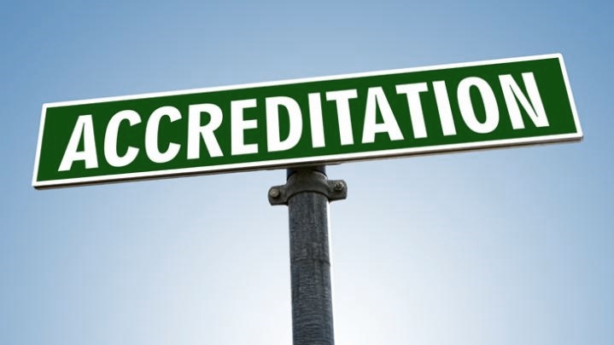
Accreditation
A process of review that allows healthcare organizations to demonstrate their ability to meet regulatory requirements and standards recognized by accreditation organizations.

Slide 6
Accrediting Bodies for Healthcare
The Joint Commission
DNV
NCQA
Others
Notes:
Joint Commission is the largest healthcare accrediting body.
Examples of TJC standards:
Pain management
2. NPSG and RCA’s for improvement
Diagnostic Imaging Compliance checklist

Slide 7
State Survey
Nebraska DHHS survey
CMS State Operations Manual Appendix A or W
Chapter 9 Title 175
Life Safety Codes
Other…
Notes:
Establishes compliance with regulatory requirements for safety, patient care, medical staff, staffing, quality etc… Most CAH’s participate in the DHHS survey. Larger hospitals participate in TJC survey process.

Slide 8
Regulations Review

Slide 9
Conditions of Participation (COP’s)
Organization is evaluated against to establish their level of performance in relation to regulatory requirements
CMS SOM appendix A – hospitals
A tags
CMS SOM appendix W – CAH’s
C tags

Slide 10
COP’s Emergency Services
What tag is emergency services listed under?
Appendix A
Appendix W
How many standards are there under the emergency services tag?
Appendix A
Appendix W
Notes:
Appendix A – A 1100 Standards – (2) a. (Organization & Direction), b. ( Personnel)
Appendix W C 200 Standards = (5) a. (Availability), b.(Equipment, Supplies & Medication), c.(Blood &Blood Products), d.(Personnel), e. (Coordination with Emergency Response)

Slide 11
NE Chapter 9 Title 175
Nebraska state law governing hospitals
Compare COP’s and state law utilize the stricter of the two to guide practices and policy
Compare Emergency Services requirements with CMS SOM COP’s

Slide 12
Life Safety Code & Environmental Care
Appendix I - K tags
Plant operations responsibility
Refer to checklists as a resource
https://www.cms.gov/Medicare/CMS-Forms/CMS-Forms/Downloads/CMS2786R.pdf
Notes:
Be aware of these tags, however plant operations/ maintenance should be responsible for compliance with these tags.

Slide 13
Questions
Notes:
Joint Commission is the largest healthcare accrediting body.

Slide 14
Continuous Survey Readiness (CSR)
Ideal model
Ongoing process, not a ramp up for survey
Leadership commitment
Involves staff at all levels
Variety of approaches
Notes:
Goal is to break crisis management or just in time culture

Slide 15
Continuous Survey Readiness
Understanding of standards, survey requirements
Training for person leading the readiness process
Training for leadership, management and frontline in policies and practices that support standards and survey requirements

Slide 16
Continuous Survey Readiness
Various approaches and learning methods
Face to face interactions
Department rounds with environmental assessment and staff questions
Self assessment tools/ gap analysis
Annual
Ongoing
Resources for updated regulations
Other

Slide 17
CSR example
Leadership prioritizes resources for readiness via information received.
Concern identified in COP’s with emergency services
Quality professional leads CSR process/plan
Self assessment completed
Training plan developed
Story boards
Social Media posts
Self study modules
Re – check self assessment

Slide 18
Let’s practice
Emergency Services self assessment
What types of questions would you ask staff?
What environmental inspections would you look at?
What inventory would you assess?
Notes:
Do self assessment of your organizations emergency services compared to COP’s

Slide 19
The Quality Professional
Responsible to develop and manage survey procedures
Develop multidisciplinary group to anticipate survey and assist with readiness
Develop survey checklist and readiness activities
Notes:
Check list to do items when surveyors present
Readiness activities i.e.
Assign roles such as EMR navigators, Escorts
Review previous surveys to ensure compliance with corrective plans
Sweep areas for outdates items, policies, order sets etc…
Monitor environment for cleanliness, good repair.
Check paper resources are they in date.
Etc…

Slide 20
Activity
Draft survey setup checklist
Continuous survey readiness activities
Notes:
What actions will you do to be ready for survey.

Slide 21
Questions

