Slide 1
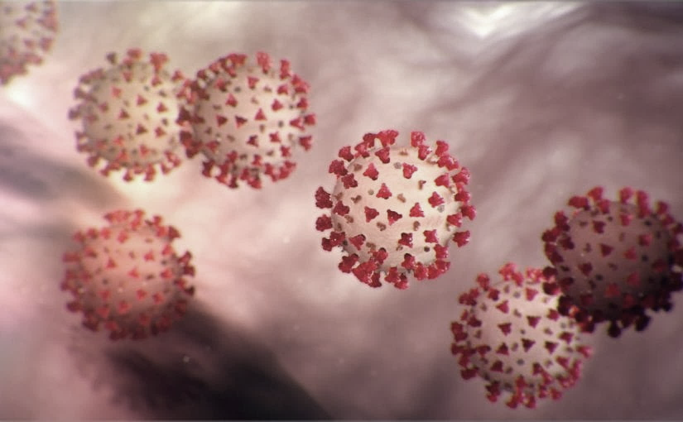
Covid-19 Webinex Update on Testing for COVID-19
Maureen Tierney, MD, MSc.
Healthcare Associated Infections/ Antimicrobial Resistance Medical Director
Tom Safranek, MD
State Epidemiologist

Slide 2
3 Major Issues
1. Supply of Reagents
2. Supply of Appropriate PPE
3. Risk to other patients
These 3 concerns drive the policy of –
1.Prioritized testing based on risk factors above
2. Where the testing is performed

Slide 3
Testing
Availability of Testing-Capacity Expanding
NPHL is performing the CDC-approved test.
  20 specimens per run may be able to expand to about 100/day.
  Approval via LHD through the state DPH is necessary
UNMC - separate test through Regional Pathology Laboratory (RPL),
primarly for providers within the Nebraska Medicine/UNMC system.
May have additional capacity
Because of limitations for non urgent requests send to Commercial labs first
Limiting Factor for NPHL, UNMC, and Commercial labs will be reagent supply

Slide 4
Commercial Lab Testing
Commercial labs listed below have announced the availability of commercial tests through their portals. Published turnaround time is 3-4 days.
Any patient (+) for COVID-19 virus should be immediately reported to their local/state public health office.
All such (+) tests are provisional pending confirmation at NPHL. Request the commercial lab send the specimen to NPHL for all positive tests
LabCorp
Quest
ARUP
Mayo

Slide 5
Call in or Info Lines-Testing Referrals
Nebraska Medicine
Call 800.922.0000 prior to appt or ER-referral to offsite outpatient clinics
CHIhealth.com 8AM to 8PM
Click link on Coronovirus link
You are directed to an MD or ANP
One dedicated clinic
Methodist
Hot Line 24/7 402-815-7425
Referral to NW

Slide 6
Other Testing Sites/Call In lines
Regional West- hoping to use one of the empty health system spaces. We also have a couple of circle drives that would be beneficial for car/curbside testing.
Bryan- hot line should be up tomorrow at 7 am. Kara will let me know what the number is. No triage site at this time, being discussed. Discussing drive up testing.
St. Elizabeth - part of CHI – directing people to the CHI coronavirus website Thinking of re setting up the ED to direct people with respiratory illness to one side and others to another side. St.E’s would be interested in working with the state to do drive up testing. They meet every morning at 730 am to discuss plans and situation.
Great Plains-pending

Slide 7
Other Ideas for Testing Sites
1. Teams to visit LTCF ?
My Vitalz
VNA
Teams from larger heath care affiliated systems
LHD personnel
2. Drive thru in other states
Seattle-for HCWs to allow back to work
Denver, Connecticut-via a doctor’s order
some HDs for contacts

Slide 8
Drive Through Testing Specifics
Makes most sense for contacts. CHI did this for DCHD in their parking lot on Wednesday
For HCWs with a mild respiratory illness to make sure isn’t COVID-19 so they can go back to work when afebrile for 24 hours and relatively symptom free
For patient as ordered by a physician that thinks this is necessary but don’t have N-95s or when we get to the point the system is overwhelmed, also reduces risk to other patients. Model in NE-measles at Children’s
  Can a rapid flu and RPP be done simultaneously
  Could each major healthcare system do this-do 2 in Omaha. 1 in Lincoln than a number of others around the state
  My Vitalz willing to do this as part of their overall monitoring system at Midwest ambulance sights around the state. (11 sites)

Slide 9
Testing Risk Groups:
If you want to test someone potentially fitting the PUI definitions from the CDC that is requested to be tested must call their LHD who will contact one of the team at DHHS who makes the decision about testing.
Major groups of PUIs are travelers returning from China, Italy, S.Korea, Iran, Japan and Hong Kong, Seattle, NYC, California, Taiwan, Thailand who develop symptoms
Contact of a PUI or known case
HCW with exposure (new guidance on levels of risk of HCWs
Patients with severe pneumonia/ARDS without underlying cause after full work-up
New PUI definition –next slide

Slide 10
New CDC Person Under Investigation Definition
Clinicians should use their judgment to determine if a patient has signs and symptoms compatible with COVID-19 and whether the patient should be tested.
Decisions on which patients receive testing should be based on the local epidemiology of COVID-19, as well as the clinical course of illness.
Most patients with confirmed COVID-19 have developed fever¹ and/or symptoms of acute respiratory illness (e.g., cough, difficulty breathing).
Clinicians are strongly encouraged to test for other causes of respiratory illness, including infections such as influenza.

Slide 11
CDC: Criteria to Guide Evaluation and Lab Testing for COVID-19
Additional Criteria to Guide Evaluation and Laboratory Testing for COVID-19.
Priorities for testing may include:
1. Hospitalized patients who have signs and symptoms compatible with COVID-19 in order to inform decisions related to infection control.
2. Other symptomatic individuals such as, older adults (age ≥ 65 years) and individuals with chronic medical conditions and/or an immunocompromised state that may put them at higher risk for poor outcomes (e.g., diabetes, heart disease, receiving immunosuppressive medications, chronic lung disease, chronic kidney disease).

Slide 12
Tips for Testing
Patients with COVID-19 have fever, cough and difficulty breathing.
COVID-19 infection rarely seems to cause a runny nose, sneezing, or sore throat (these symptoms have been observed in only about 5% of patients). Sore throat, sneezing, and stuffy nose are most often signs of a cold.
Note that influenza, strep throat, and other respiratory pathogens (such as the 15 tested for on the respiratory pathogen panel) are circulating and need to be considered.

Slide 13
DHHS HAN 3-11-2020
Specimen Collection Advice for Clinics and EDs Evaluating Patients with Febrile Respiratory Illness
Patients presenting to HCFs for evaluation of any febrile respiratory illness should be fitted with a surgical facemask upon arrival and should be segregated from other patients (e.g., immediately moved to an exam room). This is to prevent transmission of respiratory pathogens including flu and COVID-19.
If the clinical presentation and the epidemiologic risk factors create a HIGH index of suspicion of COVID-19 (this is a clinical judgement-further guidance above) personnel who collect NP (nasopharyngeal) swabs should don full personal protective equipment (PPE) prior to specimen collection. •
N95 respirator, eye protection, disposable gloves, and a gown. •
If N95 respirators or equivalent PPE are not available, the patient should be referred to a location where the person undertaking specimen collection has all CDC-recommended PPE.
A negative pressure room is not essential for testing.

Slide 14
DHHS HAN 3-11-2020
If it is determined that the risk of COVID-19 is low
Facilities lacking a supply of N95 respirators should substitute a surgical mask on persons collecting the specimen.
Eye protection is also essential. If available, a face shield would be preferable to goggles.
At the time of specimen collection, the patient’s surgical facemask should be lowered sufficiently to expose the nares, and a proper swabbing should commence per the instructional video cited below.
The patient’s surgical facemask should be properly repositioned immediately upon completion of specimen collection.

Slide 15
DHHS HAN 3-11-2020
Specimen Collection
It remains CRITICALLY IMPORTANT that staff responsible for collecting nasopharyngeal (NP) swabs be thoroughly trained and strictly compliant with specimen collection protocols. Failure to collect a proper specimen could result in a FALSE NEGATIVE test which could have major consequences for controlling COVID-19. A training video can be found here: https://www.youtube.com/watch?v=hXohAo1d6tk
Use only synthetic fiber swabs with plastic shafts. Do not use calcium alginate swabs or swabs with wooden shafts, as they may contain substances that inactivate some viruses and inhibit PCR testing. Place swabs immediately into sterile tubes containing 2-3 ml of viral transport media. Refrigerate specimen at 2-8°C and ship overnight to CDC on ice pack.
Nasopharyngeal swab: Insert a swab into the nostril parallel to the palate. Leave the swab in place for a few seconds to absorb secretions.

Slide 16

Resources (Testing)
Written instructions from NPHL and CDC on handling samples:
http://www.nphl.org/documents/NPHL%20Alert%20COVID-19%20Collection%20and%20Handling%20in%20NE%20v2020%2002%2012.pdf
https://www.cdc.gov/coronavirus/2019-nCoV/lab/guidelines-clinical-specimens.html
Video for collecting a NP swab:
https://www.youtube.com/watch?v=hXohAo1d6tk
I think this is the best video- also shows proper PPE donning and doffing
https://www.youtube.com/watch?v=c20CfI-Cr8M

Slide 17
Reporting to LHD
Reporting to LHD should primarily be by providers not patients. The LHD staff screening for who to test need the providers to have done some clinical screening/evaluating first (which may all be by phone)
Any general questions by the public can be answered by the general COVID 19 hotlines at various LHDs
Douglas Co Help Line is the following.
Listing of the local health departments and contacts:
http://dhhs.ne.gov/CHPM%20Documents/contacts.pdf

Slide 18
Limited Capacity of N-95s
It is imperative that providers know and practice the strategies for preserving the supply of N95 respirators as outlined by the CDC: https://www.cdc.gov/coronavirus/2019-ncov/hcp/respiratorsstrategy/index.html
During times of limited access to respirators or facemasks, facilities could consider having HCP remove only gloves and gowns (if used) and perform hand hygiene between patients with the same diagnosis (e.g., confirmed COVID-19) while continuing to wear the same eye protection and respirator or facemask (i.e., extended use). Risk of transmission from eye protection and facemasks during extended use is expected to be very low. HCP must take care not to touch their eye protection and respirator or facemask .
Eye protection and the respirator or facemask should be removed, and hand hygiene performed if they become damaged or soiled and when leaving the unit.

Slide 19
Updates from Interim Guidance for IP in HC
For care other than aerosol generating procedures a mask can replace an N-95 if an N-95 is not available
If gowns become scarce gowns should be reserved for
Aerosol generating procedures
Care where splashes and sprays anticipated
High contact care activities
In extreme scarcity-
Moving between patietns with same confirmed diagnosis and eye protection and mask
not soiled by spray etc
remove only gloves and gowns and perform HH
replace gowns and gloves for next patient

Slide 20

Resources
CDC is updating guidance frequently and should be considered the best authority for most situations
  https://www.cdc.gov/coronavirus/2019-ncov/index.html (main)

Slide 21
Presentation prepared by: Dr. Maureen Tierney and Dr. Tom Safranek
HAI/AR Epidemiologist
Ishrat.kamal-ahmed@Nebraska.gov
402-471-2937

