Slide 1
Quality Residency
Capstone Project
nebraskahospitals.org
Tanya Huwaldt, BSN, RN
10.3.2023
Osmond General Hospital

Slide 2
Osmond General Hospital is a 20 bed Critical Access Hospital located in Northeast Nebraska with an average daily census of 2.5 patients (observation, inpatient and skilled).
This project initially started in January 2023. At that time Administration was discussing organizational goals for the new year. In 2021 Osmond General Hospital was listed as a Top 20 CAH hospital. We decided to work on being a Top 20 CAH Hospital for the year 2024. To achieve this goal our first step was to improve HCAHPS scores.
Our team consisted of Tiffany Rice, CNO; Lon Knievel, CEO; Tamarie Vogt, RN; Kelly Henery, RN; Debra Jacobi, Material Management; Jessica Loseke, Radiology Supervisor; Hannah Hasz, Chronic Care Coordinator and Tanya Huwaldt, Regulatory Compliance Coordinator.
Notes:
HCAHPS scores were gathered and shared with the CEO and CNO but not often discussed at meetings or released to staff, unless comments we made.
When we first decided to make a team to increase HCAHPS scores it was first discussed at the nurse’s meeting and the all-staff meeting. Individuals interested were allowed to join the team.

Slide 3
AIM Statement
Increase HCAHPS scores in the following areas
25% by Q1 2024:
quietness at night
education of new medications
education of side effects

Slide 4
Measuring Success
Initial HCAHPS scores are sent to the quality manager monthly, All data is shared with the CEO and CNO.
This data is entered into an heat map which focuses on TOP BOX scores. This is then incorporated into departmental, all-staff and medical staff meetings. The heat map encompassed all the HCAHPS scores, not just the ones this project focused on.
We also evaluated our return rate and how we could improve that. Since we have a low volume, every survey can make a big difference in our scores.
2022 had a 39% return rate.
2023 for Q1 and Q2 we had a 35% return rate.

Slide 5
Selecting Changes
After the HCAHPS team was created we met monthly at first, then quarterly.
We started by evaluating the current admission paperwork. This paperwork was loose and not in a specific organized fashion for the patient, so we implemented admission folders. On the pockets of the folder stickers were created. One sticker had the hospital guest wi-fi and password and another one explaining common sounds they would be hearing at the hospital. It also listed options such as ear plugs and sound machines if they are needed to assist with sleep.
A booklet was created with common medication classifications and side effects.
The pharmacy tech talks with patients about what medication they are receiving and side effects.
A handout was created showing the label that would be on the envelope the survey comes in.

Slide 6
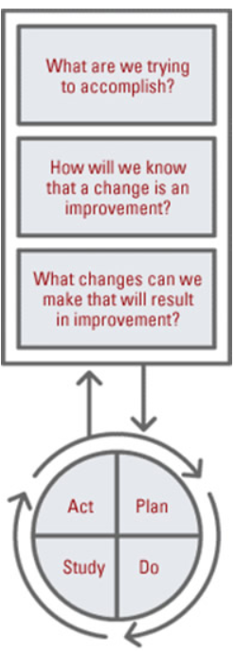
Plan ~ Do ~ Study ~ Act
Plan
Increase HCAHPS scores in patient care experience and medication communication.
Produced better patient care.
Created a team, chose HCAHPS measures to focus on, researched what other facilities did to increase scores.
Implemented new workflows.
Do
On June 1, 2023 the Admission folders went live. Education about the folders and new interventions were discussed at the May nurse’s meeting.
Study
Improving HCAHPS scores is a long process. It takes months to capture and review the data.
Improvement noted.
We need more time to see if this is a real change.
Act
Osmond General Hospital will continue to be innovative on how to increase their return rates. The Chronic Care Coordinator completes follow-up calls on all patients admitted to our facility and ER’s. In addition to follow-up, she also reminds the patient of the satisfaction survey.

Slide 7
Data and Trends
Notes:
This data is from RCCN, and does not represent official HCAHPS results.

Slide 8
Return on Investment (ROI)
Explore the financial implications of the project:
Will costs/expenses be incurred to make noted changes?
Costs:
$200 included admission folders, stickers for the folders, paper for medication education.
What savings/revenue will be noted?
Anticipated outcomes of increased HCAHPS scores:
Increased patient engagement = greater adherence to care plans, follow-ups, and outcomes
Reduced readmissions and ED utilization – approximate cost of a readmission = $7,300
Improved patient volume and/or repeat patient visit
Improved patient trust = better experiences, improved outcomes, good word of mouth throughout community

Slide 9
Spreading / Sustaining / Maintaining / Replicating
HCAHPS measure “rating hospital on a score from 0 to 10” went from 8.94 to 9.80.
Decreased falls.
HCAHPS data has been added as a topic at quarterly All-Staff Meetings. As more meetings have occurred, staff have began to be more vocal about HCAHPS and what they can continue to do and what we can implement as a facility.

Slide 10
THANK YOU/Questions
Tanya Huwaldt, BSN, RN
Regulatory Compliance Coordinator
Osmond General Hospital
nebraskahospitals.org

