Slide 1
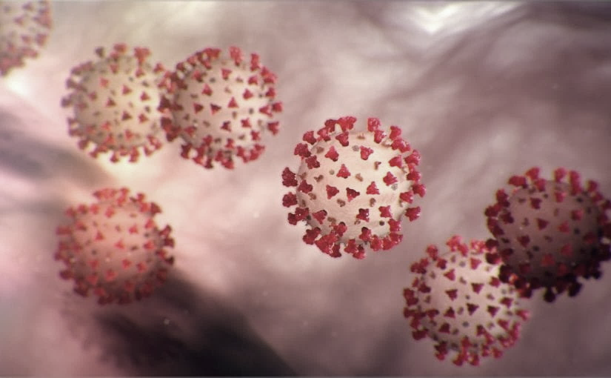
Covid-19 Webex Update
9-22-2020
​​
Tom Safranek, MD, State Epidemiologist
Louis Safranek, MD, PhD
Board certified specialist, Infectious Disease

Slide 2
Risk management
Rapid real-time tracking of non-pharmaceutical interventions and their association with SARS-CoV-2 positivity: The COVID-19 Pandemic Pulse Study
Strict social distancing during most activities can reduce SARS-CoV-2 transmission.
Don’t use public transportation or attend large indoor public gatherings.
https://doi.org/10.1093/cid/ciaa1313

Slide 3
Risk management
Association of Daily Wear of Eyeglasses With Susceptibility to Coronavirus Disease 2019 Infection.
Patients hospitalized with COVID-19 in Suizhou, China, the proportion of inpatients with COVID-19 who wore glasses for extended daily periods (>8 h/d) was smaller than that in the general population.
Daily wearers of eyeglasses may be less susceptible to COVID-19.
DOI: 10.1001/jamaophthalmol.2020.3906

Slide 4
Epidemiology
Seroprevalence of Antibodies to SARS-CoV-2 in US Blood Donors
Unique donors (n=252,882) showed an overall seroprevalence of 1.83% in June (1.37%) and July (2.26%), with the highest prevalence in northern New Jersey (7.3%)
Seroprevalence remains low in US blood donors, with some regional variation.
doi: https://doi.org/10.1101/2020.09.17.20195131

Slide 5
Epidemiology
Measurement of SARS-CoV-2 RNA in wastewater tracks community infection dynamics
Authors examined SARS-CoV-2 RNA concentrations in primary sewage sludge in the New Haven, Connecticut, USA, metropolitan area during the Coronavirus Disease 2019 (COVID-19) outbreak in Spring 2020.
SARS-CoV-2 RNA was detected throughout the more than 10-week study and, when adjusted for time lags, tracked the rise and fall of cases seen in SARS-CoV-2 clinical test results and local COVID-19 hospital admissions.
Relative to these indicators, SARS-CoV-2RNA concentrations in sludge were 0–2 d ahead of SARS-CoV-2 positive test results by date of specimen collection, 0–2 d ahead of the percentage of positive tests by date of specimen collection, 1–4 d ahead of local hospital admissions and 6–8 d ahead of SARS-CoV-2 positive test results by reporting date.
Immediate wastewater results can provide considerable advance notice of infection dynamics.
https://www.nature.com/articles/s41587-020-0684-z

Slide 6
Epidemiology
Sharing a household with children and risk of COVID-19: a study of over 300,000 adults living in healthcare worker households in Scotland
241,266 adults did not share a household with young children; 41,198, 23,783 and 3,850 shared a household with 1, 2 and 3 or more young children respectively.
The risk of hospitalisation with COVID-19 was lower in those with one child and lower still in those with two or more children, adjusting for age the hazard ratio (HR) was 0.83 per child (95% CI 0.70-0.99).
An association of the same magnitude, but more precisely estimated, was obtained for any case of COVID-19.
Conclusion: Increased household exposure to young children was associated with an attenuated risk of testing positive for SARS-CoV-2 and appeared to also be associated with an attenuated risk of COVID-19 disease severe enough to require hospitalisation.
doi: https://doi.org/10.1101/2020.09.21.20196428

Slide 7
Epidemiology
Nasopharyngeal SARS-CoV2 viral loads in young children do not differ significantly from those in older children and adults
https://doi.org/10.1101/2020.09.17.20192245

Slide 8
Immune responses
Immune responses to SARS-CoV-2 infection in hospitalized pediatric and adult patients
Study compared cytokine, humoral, and cellular immune responses in pediatric and adult patients with COVID-19 at a NYC metropolitan hospital.
The pediatric patients had a shorter length of stay, decreased requirement for mechanical ventilation and lower mortality compared to adults.
Adults mounted a more robust T cell response to the viral spike protein compared to pediatric patients. Moreover, serum neutralizing antibody titers and antibody-dependent cellular phagocytosis were higher in adults compared to pediatric COVID-19 patients.
Together these findings demonstrate that the poor outcome in hospitalized adults with COVID-19 compared to children may not be attributable to a failure to generate adaptive immune responses.
DOI: 10.1126/scitranslmed.abd5487

Slide 9
Discoordinated immune responses in the elderly
Antigen-specific adaptive immunity to SARS-CoV-2 in acute COVID-19 and associations with age and disease severity
A combined examination of all three branches of adaptive immunity at the level of SARS-CoV-2-specific CD4+ and CD8+ T cell and neutralizing antibody responses in acute and convalescent subjects.
SARS-CoV-2-specific CD4+ and CD8+ T cells were each associated with milder disease. Coordinated SARS-CoV-2-specific adaptive immune responses were associated with milder disease, suggesting roles for both CD4+ and CD8+ T cells in protective immunity in COVID-19.
Coordination of SARS-CoV-2 antigen-specific responses was disrupted in individuals > 65 years old. Scarcity of naive T cells was also associated with ageing and poor disease outcomes.
A parsimonious explanation is that coordinated CD4+ T cell, CD8+ T cell, and antibody responses are protective, but uncoordinated responses frequently fail to control disease, with a connection between ageing and impaired adaptive immune responses to SARS-CoV-2.
https://doi.org/10.1016/j.cell.2020.09.038

Slide 10
Treatment
Covid-calculator out of the Harvard system
The VICE score predicts risk of needing mechanical ventilation and the DICE score predicts in-hospital mortality.
https://covid-calculator.com/

Slide 11
Treatments
Association between corticosteroids and intubation or death among patients with COVID-19 pneumonia in non-ICU settings.
No association between the use of corticosteroids and intubation or death in the broad population of patients ≤80 years old with COVID-19 hospitalized in non-ICU settings.
However, the treatment was beneficial for patients with ≥ 3L/min oxygen or CRP ≥ 100mg/L at baseline.
These data support use of corticosteroids for certain patients with mild COVID.
doi: https://doi.org/10.1101/2020.09.16.20195750

Slide 12
Treatment
Intravenous methylprednisolone pulse as a treatment for hospitalised severe COVID-19 patients: results from a randomised controlled clinical trial
The early pulmonary phase was defined as the start of the pulmonary involvement including hypoxia (SO2<93%), tachypnea, and based on CT scan findings.
Patients allocated to receive methylprednisolone pulse (intravenous injection, 250mg/day for 3 days), or no glucocorticoids.
The study showed that methylprednisolone pulse administration at the beginning of the early pulmonary phase of illness decreased the mortality rate and improved pulmonary involvement, oxygen saturation, and inflammatory markers in COVID-19 patients.
https://erj.ersjournals.com/content/erj/early/2020/09/09/13993003.02808-2020.full.pdf

Slide 13
Treatment
SAFETY AND EFFICACY OF THE COMBINED USE OF IVERMECTIN, DEXAMETHASONE, ENOXAPARIN AND ASPIRIN AGAINST COVID 19
None of the patients presenting with mild symptoms needed to be hospitalized.
Only one patient died (0.59 % of all included patients vs. 2.1 % overall mortality for the disease in Argentina at time of study; 3.1 % of hospitalized patients vs. 26.8 % mortality in published data).
IDEA protocol may prevent disease progression of COVID-19 when applied to mild cases and decrease mortality in patients at all stages of the disease with a favorable risk-benefit ratio.
https://doi.org/10.1101/2020.09.10.20191619

Slide 14
Treatment
Zinc sulfate in combination with a zinc ionophore may improve outcomes in hospitalized COVID-19 patients.
Zinc sulphate in addition to hydroxychloroquine and azithromycin increased the frequency of patients being discharged home, and decreased the need for ventilation, admission to the ICU and mortality or transfer to hospice for patients who were never admitted to the ICU.
DOI: 10.1099/jmm.0.001250

Slide 15
Treatment
Zinc
Potential Interventions for SARS-CoV-2 Infections: Zinc Showing Promise
https://onlinelibrary.wiley.com/doi/epdf/10.1002/jmv.26523

Slide 16
Treatment
Discovery of SARS-CoV-2 antiviral synergy between remdesivir and approved drugs in human lung cells
Strongest effects were observed with established antivirals, Hepatitis C virus nonstructural protein 5 A (HCV NS5A) inhibitors velpatasvir and elbasvir. Combination with their partner drugs sofosbuvir and grazoprevir further increased efficacy, increasing remdesivir's apparent potency 25-fold.
FDA-approved Hepatitis C therapeutics Epclusa (velpatasvir/sofosbuvir) and Zepatier (elbasvir/grazoprevir) in combination with remdesivir may prove useful.
doi: https://doi.org/10.1101/2020.09.18.302398

Slide 17
COVID-19 and the Path to Immunity
JAMA: September 11, 2020 https://jamanetwork.com/journals/jama/fullarticle/2770758?resultClick=1
1/3 COVID-19 patients: low anti-RBD titers/low viral neutralizing activity; esp in mild or no sx
wide range of clinical disease=variability in the antibody responses
Antigen burden =major driver of the magnitude of the response: highest neutralizing antibody in severe disease
other factors:
models of immunity and reinfection dynamics of the common cold coronaviruses, human coronavirus (HCoV) OC43, HCoV 229E, and HCoV HKU1, limited protective immunity to SARS-CoV-2 has been suggested.
a human challenge to a circulating coronavirus (HCoV 229E), IgG and IgA antibodies waned over the first year after viral nasal challenge: protection lasts only 1 or 2 years
But: following rechallenge with the same HCoV 229E strain at 1 year:
no individuals who had been previously infected developed a cold
all had a shorter duration of detectable virus shedding
strain-specific immunity to clinical coronavirus disease may be preserved despite rapid waning of antibodies
nonhuman primates: SARS-CoV-2 infection protects against reinfection
So far: anecdotal case reports of reinfection (mostly after initial mild COVID-19)
reinfection with SARS-CoV-2 suggests: natural human immune response may not provide sterilizing immunity but may shorten viral shedding, reduce spread, and prevent disease.

Slide 18
COVID-19 and the Path to Immunity
JAMA: September 11, 2020 https://jamanetwork.com/journals/jama/fullarticle/2770758?resultClick=1
seroprevalence data (antibodies to the SARS-CoV-2 spike protein): 10 x more SARS-CoV-2 infections than the number of reported cases.
Est 40 million to 50 million (12% to 15% of the US population)
relying on population-based natural immunity, especially for populations at risk of greater disease severity, is not wise.
need added protection by boosting specific neutralizing antibodies and T_{H}1 immunity to high levels regardless of prior immune status may further protect these individuals.

Slide 19
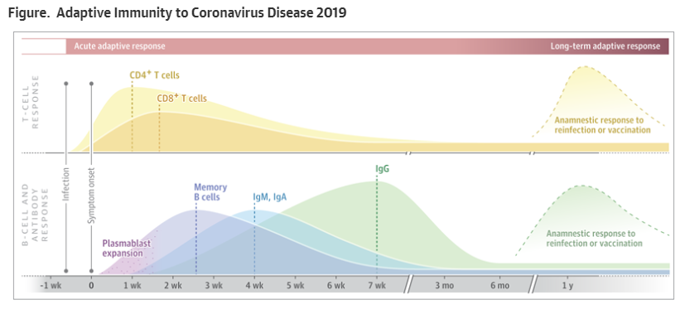

Slide 20
Immune Response to COVID-19
Maturation of the immune response typically takes 40 days with variations
dynamics of the antibody response depends on disease severity and other factors ???
most laboratory-confirmed COVID-19 cases, IgM antibodies detectable around 5–10 days after onset of symptoms and rise rapidly
IgG antibody concentrations follow the IgM response closely
Seroconversion typically occurs within the first 3 weeks ;
Avg. time for seroconversion post symptom onset:
  Total antibody: 9–11 days
  IgM: 10–12 days
  IgG: 12–14 days
COVID-19 antibody response: pathogenic or protective?
Antibodies vs receptor-binding domain of spike protein and nucleocapsid protein show neutralising activity.
Neutralising antibodies to these domains can be detected approximately 7 days after onset of symptoms and rise steeply over the next 2 weeks
can remain RNA-positive despite high concentrations of IgM and IgG antibodies vs nucleocapsid protein and RBD of spike protein
?? presence of neutralising antibodies = protective immunity in patients with COVID-19 is unclear
?? antibodies can enhance infectivity: higher antibody concentrations observed in patients with severe disease vs those with mild disease.
In one study (n=222), a greater proportion of patients with high IgG concentrations had severe disease than did those with low IgG concentrations (52% vs 32%, p=0·008)

Slide 21
