Slide 1
Behavioral Health Integration: Treating the Whole Person
Ann Schumacher, MBA, MSN, RN, FACHE
CHI Health President Mercy Council Bluffs and Immanuel Hospitals
Kenneth McCartney, MHAL
CHI Health Market Director Outpatient Behavioral Services

Slide 2
CommonSpirit Mission
As CommonSpirit Health, we make the healing presence of God known in our world by improving the health of the people we serve, especially those who are vulnerable, while we advance social justice for all.

Slide 3
CHI Health
Creighton University
Behavioral Health Service Line
Medical Group Enterprise
Kearney
Richard Young
Acute Inpatient
Adult /
Adolescent
Assessment Center
OP Clinic
Good Sam Psych Consults
Grand Island
St. Francis
Adult Substance Use Residential OP/ IOP
St. Francis Psych Consults
Lincoln
Integrated
PCP
Oncology Partnership
St. Es and NE Heart Psych Consults
Outpatient
Psych Associates
PCP Integrated Services
School Services in Omaha, GI and NE City
Metro NICU
EAP
Information Referral Line 402-717-HOPE
Omaha Metro Psych Consults
Immanuel
Acute Care
Geriatric /
Adult
Child & Adolescent
Partial Hospitalization
Geriatric /
Adult /
Child & Adolescent
Residential Treatment Center (PRTF)
ECT / TMS
Lasting Hope Recovery Center
Adult Acute Care
Assessment Center
Mercy
Acute Care
Adult /
Child & Adolescent
Partial Program
Child
& Adolescent
Community Support
232 Psychiatric Inpatient Beds in four locations
9 Specialty Clinics with 145,000 Annual Visits
64 Partial Hospitalization Slots in four programs
20 Residential Treatment Beds for Children
23 Adult Residential Substance Abuse beds
130+ Behavioral Clinicians

Slide 4
CHI Health Observations in 2015
What we were seeing?
A no-show rate of 46% to Behavioral Specialty Clinics when referred by a Primary Care Providers
Delays in treatment for a Behavioral Health Clinician
12+ weeks for Medication Management
8+ weeks for Therapy
Inconsistent Coordination of Care between Behavioral Clinicians and other Specialties/Primary Care Providers
Limited access to Behavioral Clinicians in Rural Communities
Increase in ED Visits with a Behavioral Diagnosis
Majority of Mental Health patients are treated and maintained within a Primary Care Physician
Increase in Behavioral Diagnosis in Primary Care
Anxiety (#3), Depression (#7) and Pain (#9) in Top 10 Diagnosis

Slide 5
CHI Health Observations in 2015
National Mental Health Prevalence
Mental illnesses are among the most common health conditions in the United States.
More than 50% will be diagnosed with a mental illness or disorder at some point in their lifetime.1
1 in 5 Americans will experience a mental illness in a given year.2
1 in 5 children, either currently or at some point during their life, have had a seriously debilitating mental illness.3
1 in 25 Americans lives with a serious mental illness, such as schizophrenia, bipolar disorder, or major depression. 4

Slide 6
CHI Health Observations in 2015
National Mental Health Findings
Mental Health Illness Research
Suicide, which is often associated with symptoms of mental illness, is the 10th leading cause of death the U.S. and the 2nd leading cause of death among people aged 15-34.5
Serious mental illness costs in the United States amount to $193.2 billion in lost earnings per year.6
Mood disorders, including major depression, dysthymic disorder, and bipolar disorder, are the third most common cause of hospitalization in the United States. for both youth and adults aged 18 to 44.7
Individuals living with serious mental illness face an increased risk of physical health problems, such as heart disease, diabetes, and HIV (human immunodeficiency virus, the virus that causes AIDS).7
U.S. adults living with serious mental illness die on average 25 years earlier than others, largely due to treatable medical conditions.8
Half of all chronic mental illness begins by age 14 and three-quarters begin by age 24.9

Slide 7
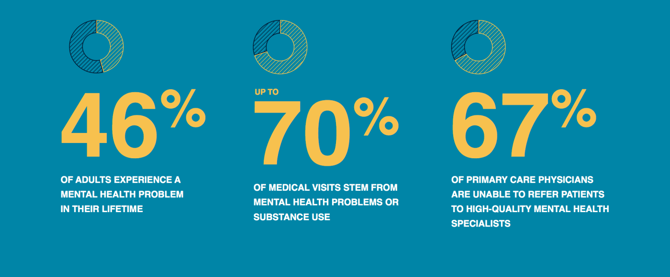
CHI Health Observations in 2015
Mental Health Clinician Crisis
Shortage of Psychiatry Clinicians
Current there are 9 psychiatrists per 100,000 people, short of the nearly 15 per 100,000 that provides good mental health care.10
Sixty percent of US counties have no practicing psychiatrists— front-line medical doctors who evaluate mental health issues and prescribe and manage medications and other treatments.10
The National Council for Mental Health estimates that we may be short by 6,090 to 15,600 psychiatrists by 2025.11
About 45% of psychiatrists don’t accept noncapitated insurance, Medicare, or Medicaid in 2014. 12

Slide 8
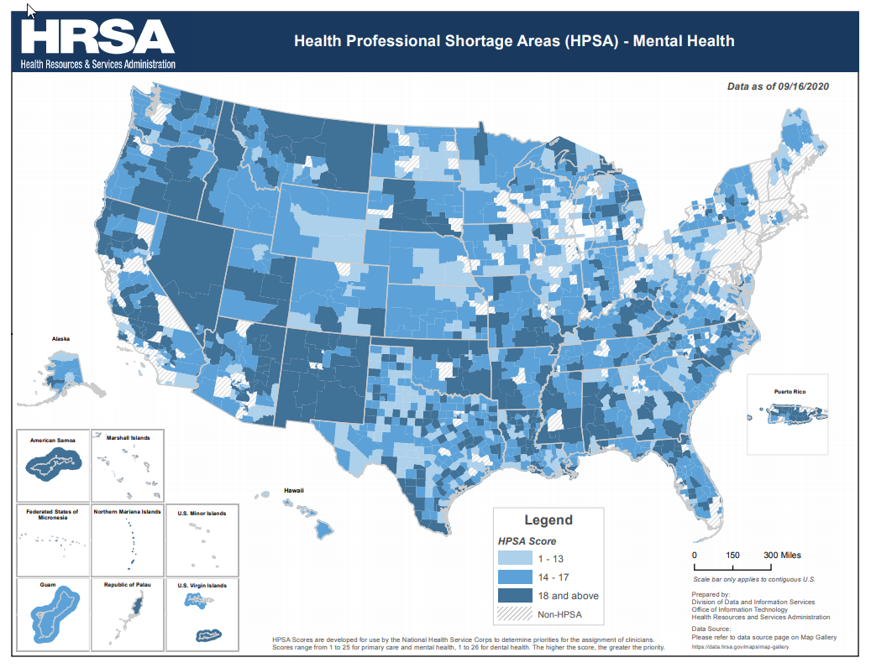

Slide 9
Next Steps… We must Innovate...
What needs to change in our “traditional” model to meet the unmet needs?
How do we best treat the physical, mental and spiritual needs of our consumers where and when they are seeking services?
How do we partner with Primary Care and other Specialties to treat Behavioral Health patients needs?
What can be done to identify patients with mental health needs being seen in other non-behavioral programs?

Slide 10
Literature Search and Site Visits
What are the BEST
programs doing?
What is
EVIDENCE BASED?
What will work in our Market?

Slide 11
Strategies Implemented 2015&16
Psychiatric Immediate Care Clinic Opened
Urgent care model to treat patients who do not meet inpatient criteria but cannot wait for traditional Outpatient Mental Health Treatment
Implemented Walk-in Chemical Dependency Evaluation Clinics
Converted to Centralized Scheduling for all Outpatient Behavioral Clinics
402-717-HOPE to triage, assess and schedule to the patient with the right Behavioral Clinician throughout Nebraska and SW Iowa
Initiated Telehealth to Rural Health Clinics
Behavioral Health established Telehealth services to 9 Critical Access Hospitals/Clinics throughout Nebraska and SW Iowa
Electronic Medical Record
Behavioral Services transitioned to the EPIC Platform creating one comprehensive patient records throughout CHI Health for all Specialties
Behavioral Collaborative Care Model identified and piloted at West Maple PCP Clinic in April 2015
Based upon the University of Washington AIMS Collaborative Care Model
Notes:
Add notes to the why AIMS model

Slide 12
Why Integrate Behavioral Health Into Primary Care?
Timely Access to Behavioral Health Intervention
Community Wait Times for Psychiatric Support for New Outpatient patients ranges from 3-4 Months
Connecting the Patient to the right provider/level of care the first time, thus eliminating delays in treatment
Reduced Stigma with treatment recommendation
Improved Patient Outcomes: Earlier identification and treatment reduces morbidity and mortality
Behavioral Provider not only accepts Referrals but also collaborates with the Treatment Team to identify consumers who could benefit from Behavioral Intervention
Enhanced Physician Experience
Education and Consultation to CHC Clinic
Mutual Consent for Behavioral Interventions to allow all Clinical Staff involved with Patient care to view the entire Medical Records
Improved System Efficiency and Financial Savings
Moves the organization in the direction of Population Based Health

Slide 13
Continuum of Physical and Behavioral Health Care Integration
SAMHSA-HRSA Center for Integrated Health Solutions outlined the above Continuum of Physical and Behavioral Health Care Integration noting that fully integrated care, manifested when behavioral and physical health care providers and other providers function as a true team in a shared practice and with a shared vision, and both providers and patients experience the operation as a single system treating the whole person.
The CHI Health Behavioral Collaborative Care Model represents an Integrated Care program with System-Level Integration.

Slide 14
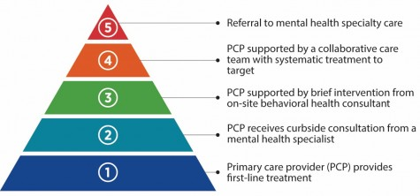
Stepped Model of Integrated Behavioral Health Care

Slide 15
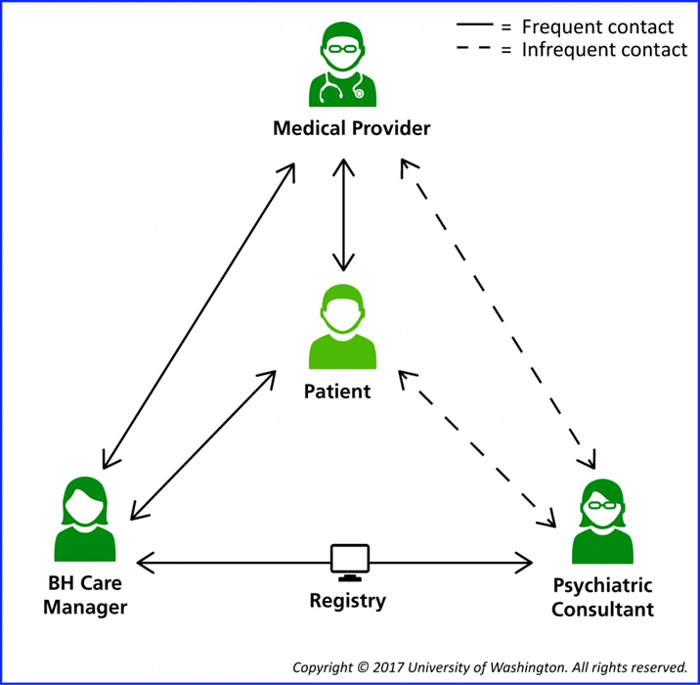
Integrated Behavioral Health Team

Slide 16
Behavioral Health Specialists (BHS) Role
Behavioral Health LCSW with LIMHP Licensure and/or a Psychologists
BHS to work Clinic Registries AND be available for real time behavioral consultations
No traditional patient practice for BHS
BHS to provide Brief Interventions for all identified consumers
Support coordination of care to appropriate level of care
BHS to monitor/track consumers progress
BHS to provide short term problem focused therapy (3-5 sessions)
Ongoing collaboration with clinic Staff - identify non-traditional Behavioral Health Patients
BHS to provider ongoing education and training to Clinic Staff
BHS to support transition for patients needing access to Psychiatric Associates (tradition Behavioral Outpatient Treatment) for long term Therapy and/or Medication Management
Acknowledgement that 12-15% of the population require the need for traditional Psychiatric Outpatient Treatment
In FY20 61% of the BHS Salary was covered via billing for Therapy Services.
Insurance Companies continue to create new CPT Codes to compensate for this work. In FY16 only 43% of the same work was reimbursed.

Slide 17
Psychiatric Provider Role
Behavioral NPs and/or Psychiatrists
Consult with BHS to discuss Clinic registry patients
If Psychiatric Support is needed the following options would be available;
Provide face-to-face or Telehealth 1 time consultation with patients
Provide e-consultations via EMR review directly to “attending” PCP
Provide recommendations for Medication Management as well as a plan for future medication regimen
ALL Medication is prescribed by the PCP – the consulting Psychiatric Support makes recommendations but it is up to the “attending” PCP to determine what/how they want to prescribe
Psychiatric Provider would be available for additional review/consultation with the attending PCP as needed
Face-to-face or Telehealth Consultations with patient are billable. No tradition revenue to Psychiatric Provider for e-consultations or peer-to-peer.

Slide 18
Primary Care Clinician
MDs and/or NPs practicing within CHI Health including Primary Care as well as Specialties
Make referrals to BHS for patients in need
Either “real time” handoff or cc a note to the BHS
Identify the need for the consultation
Collaborate with the BHS and/or Psychiatry Support for ongoing needs
Primary Care Team to identify opportunities for education from Psychiatry to support ongoing training to peers and staff
Review the treatment recommendations from Psychiatry and determine course of treatment
Mutual Acknowledgement implemented to allow the Primary Care Team access to the Behavioral Integrated Documentation
MD and/or NP time reviewing the consultation is billable if completed the same day as a patient encounter

Slide 19
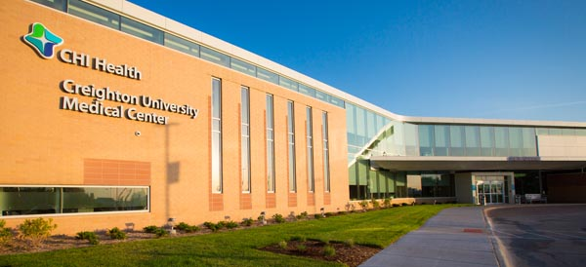
Residents’ Learning Opportunities
Provide training/educational opportunities to Creighton Psychiatric Residents
4th Year Residents provide face-to-face consumer consultation
3rd Year Residents provide, telemedicine, e-consultation via chart/phone or peer to peer review
Child / Adolescent Fellows provide face-to-face consumer consultation
As of 2018 this is now a required rotation for Creighton Psychiatry Residents

Slide 20
Co-located Therapists
Behavioral Health LIMHPs
Co-located at a CHC Clinic
Provide traditional mental health therapy
Carry full patient loads with Productivity Expectations
Timely access may be an issue based on provider availability
Provider “in-house” care for consumers established at the PCP Clinic
Can be utilized to support specific patient populations based upon the need of the CHI Health Clinic
e.g. Refugee population at University Campus
Vital component of the full continuum of Behavioral Integration
Role is self-sustaining based on productivity expectation so no additional resources are needed for sustainability

Slide 21
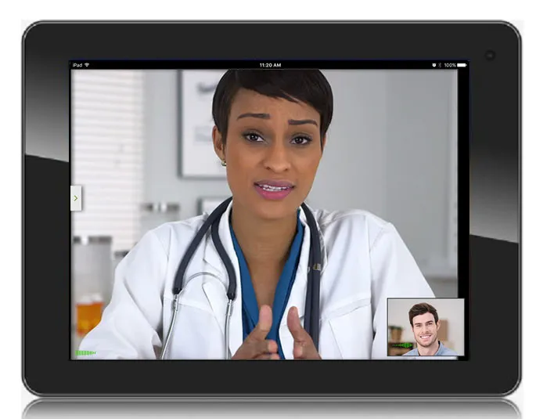
Psych Consult Liaison
Partnership among Behavioral Health Clinicians and Primary Care Providers for ongoing collaboration
Vital to ensure safe, effective and consistent patient care
Provides opportunities to build relationships and enhance provider comfort / experience in treating Mental Health conditions

Slide 22
Right Size Resources Based Upon Needs
Super Clinics – Clinics with annual visits greater than 30,000
Full Time BHS housed within the Clinic (M-F)
3 hours of Psychiatric Provider Support per week
Full Time Co-located Therapist
High Volume Clinics – Clinics with annual visits greater than 20,000 or identified as high need behavioral health populations
Full Time BHS housed within the Clinic (M-F)
2 hours of Psychiatric Provider Support per week
Metro Clinics – Clinics located within the immediate Omaha/Council Bluffs metropolitan area
BHS Support via Telehealth/e-consultation (M-F)
Co-located Therapist support 1 day per week on-site – if needed
Up to 2 hours of Psychiatric Provider Support per week as needed
Rural Clinics – Clinics located beyond the Omaha/Council Bluffs metropolitan area
On-call BHS Support via Telehealth/e-consultation (M-F)
Therapist support via Telehealth
Integrated Psychiatric Provider Support via Telehealth
Up to 1 hour of Psychiatric Provider Support per week as needed

Slide 23
Integrated CHI Health Primary Care Locations July 2021
W Maple PCP – Omaha, NE
W Broadway PCP – Council Bluffs, IA
Immanuel PCP – Omaha, NE
Midlands PCP – Papillion, NE
Bellevue PCP – Bellevue, NE
LaVista PCP – LaVista, NE
42nd and L Street PCP – Omaha, NE
University Campus PCP – Omaha, NE
Valley View PCP – Council Bluffs, IA
Florence Clinic PCP – Omaha, NE
Southwest PCP – Lincoln, NE
Grand Island PCP - Grand Island, NE
Kearney PCP - Kearney, NE

Slide 24
Behavioral Collaborative Care Outcomes
Reference: Asarnow, et al, 2015 “Integrated Medical-Behavioral Care Compared with Usual Primary Care”
Meta-analysis of 31 studies involving 13,129 participants

Slide 25
CHI Health PCP Integrated Clinic Outcomes
Timely access to Behavioral Services
First contact within 2 days of initial referral by Integrated Behavioral Staff
Typically completed realtime via a warm handoff
46% of Referrals from PCP to Psych Associates do not follow-up for Treatment
Over 90% of referrals from a Primary Care Provider to a BHS result in a patient consultation
Enhanced Coordination of Care
Standardized handoffs between specialties and levels of care
Enhanced collaboration between CHI Health Clinics and Behavioral Services
Medical to Behavioral and vice versa
Mutual Consent for Integrated Care
Enhanced Primary Care access and production
LaVista & West Maple Entire Clinics | 12 Months Prior to BH Integration | 12 Months Following BH Integration | % Change
wRVUs per Provider (annualized per 1.0 FTE) – W Maple | 8,862 | 10,032 | 13.20%
Visits per Provider (annualized per 1.0 FTE) - LaVista | 6,237 | 7,069 | 13.34%

Slide 26
CHI Health PCP Integrated Clinic Outcomes Continued...
LaVista & West Maple Entire Clinics | # of BH Integrated Sessions (12 month period) | Clinic Yield Rate | $$ Difference from 99213 ($145) vs 99214 ($215) | Potential Revenue Gain (99213 to a 99214) | $$ Difference from 99213 ($145) vs 99215 ($289) | Potential Revenue Gain (99213 to a 99215)
West Maple (FY18) | 472 | 70.7% | $70 | $23,359 | $144 | $48,053
LaVista (FY18) | 377 | 65.4% | $70 | $17,259 | $144 | $35,504
Clinicians working top-of-scope to support the medical complexity of consumers
Ability to improve E/M Billing to accurately capture collaboration and treatment planning
Utilizing Behavioral Clinicians top of Scope
In CY19 203 face-to-face Consults were performed at Integrated locations by 4th Year Psychiatry Residents.
84% of these patients were effectively treated based off of these recommendations from this one time consultation and were maintained within CHI Health Clinic by their Primary Care for ongoing Medication Management.
16% of these patients (33) were referred to CHI Health Psychiatric Associates for expedited Medication Management appointments.

Slide 27
CHI Health BH Integrated Patient Outcomes
Improved Clinical Outcomes
GLOBAL PROMIS
12.91% Positive Symptom Change Score*
*94 Participants 1/2016-3/2018 with Pre & Post Screenings
Reduced Total Cost of Care to Patients
Patient savings as well as organizational efficiencies
There is a 20.7% reduction in Professional
Billing Charges**
There is a 19.4% reduction in Office Visits**
Reduced ED Visits
Utilizing Outpatient Services first for symptom management of non-urgent services
Collaboration with CHC Social Workers on high ED Utilization Registry
There is a 3.1% reduction in ED Visits**
**Comparing 12 months prior to 12 months post intervention – 715 patients included in study

Slide 28
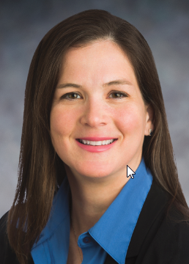
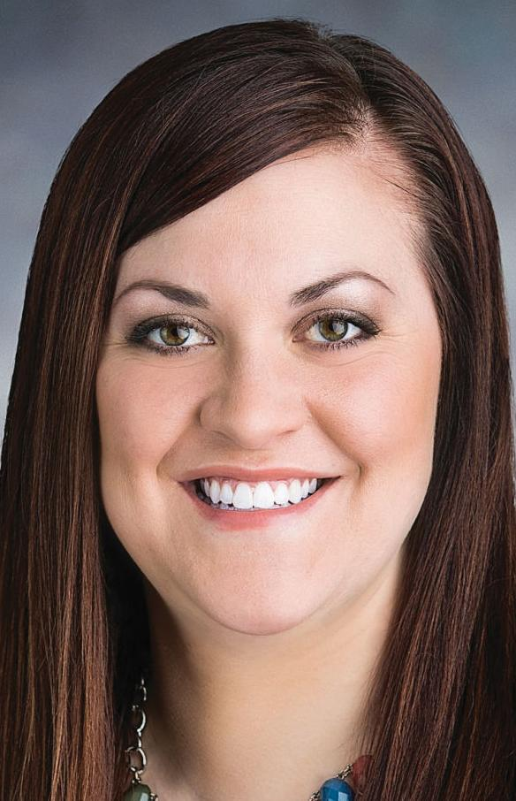
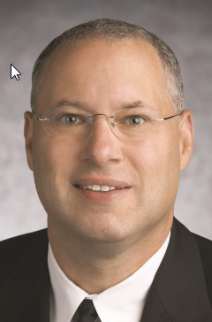
Stakeholder Feedback
“So many of my patients will never seek outside behavioral services, whether it be because of shame or motivation but are willing to see IBH and it becomes a safe way to get the treatment needed. You can take my free coffee at the clinic, take my parking pass, but do not take away the integrated behavioral health services!”
Dr. Amy McGaha
Creighton University
Chair, Department of Family Medicine
“When it comes to behavioral health, there is no time like the present. Being onsite and available in the moment a patient expresses a need or interest is so valuable in getting to the next step toward vital, even lifesaving services. We really focus on putting the patient at ease.”
- Chelsea Hunter, LCSW Behavioral Health Specialist
“I would not have come to counseling if you were not in my doctor’s visit.”
- CHI Health Integrated Patient
“Mental health issues can touch people’s lives in unexpected ways. For example, people diagnosed with diabetes or other chronic illnesses often experience depression. But with short-term counseling, these patients can feel better and take a more active, effective role in their care”
- Dr. Lewis Eirinberg
CHI Health Primary Care Physician
“I wouldn’t have seen a therapists if I hadn’t had a chance to meet them the day of my doctor visit.”
CHI Health Integrated Patient

Slide 29
Primary Care Physician Experience
“Too often we refer patients for behavioral health care - either through a formal referral or by giving them a list of providers or clinics and recommending them contact one to be seen, and either the patient never takes the next step or the provider or clinic has no availability to see a new patient for several months. Being able to see the patient in a timely manner was the first huge success. From there, the specialists were all very skilled in their work and communicated with me often, so we could manage the patient collaboratively, with much better outcomes…Being in the clinic also allowed for great communication and coordination of care between me and the Specialists. We could discuss the patient's situation, progress, etc. and counsel together on recommendations and plans. It is so much easier and more effective to manage a patient's medication when you can actually talk to the counselor they are working with!”
Dr. Michael Schooff
CHI Health Primary Care Medical Director
The Plan… Expansion to all 60+ CHI Health Primary Care Clinics beginning 2020 until...

Slide 30
A GLOBAL PANDEMIC

Slide 31
March 2020 - CHI Health Response
CHI Health Behavioral stood up 130+ Clinicians to provide Telehealth Services
Outpatient and Integrated Behavioral went from < 2% Virtual care to >88% Virtual Care within 2 weeks
Integrated Clinicians tag teaming with Primary Care Virtual Visits to support patient needs
Call volume to the 402-717-HOPE (Crisis Line) went up 31%
Placed Therapists in the Information Referral Line to support the increase in volume and caller acuity
Majority of patients calling with anxiety and depression
New patient referrals up 24% from pre-COVID volumes
No Show rates dropped from 25% down to 11% and patient visits increased significantly
March 2020-June 2021 Outpatient Behavioral Visits were up 14.6% from pre-COVID
Behavioral Integrated Visits were up 15.2% for over the same time period

Slide 32
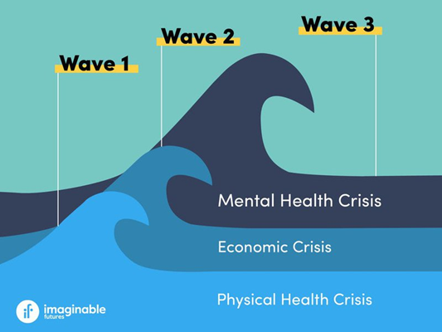
“The Next Pandemic”

Slide 33
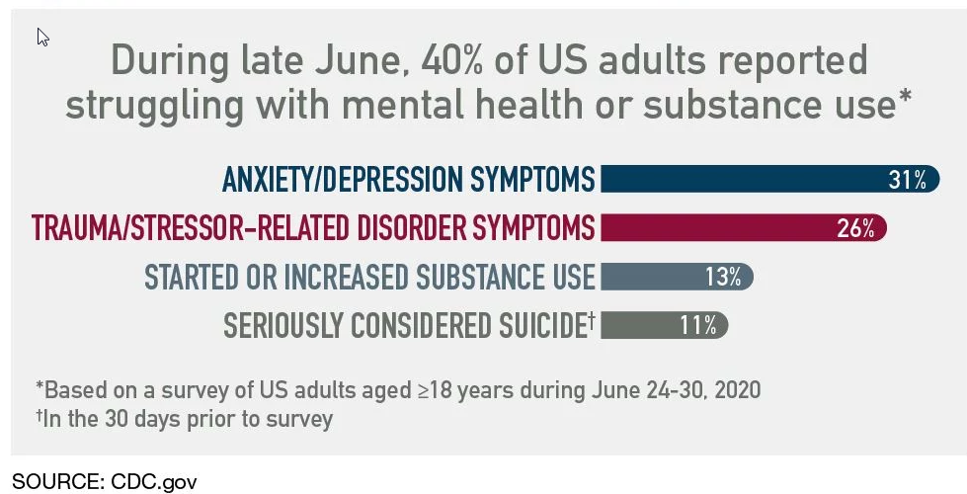
COVID Impact on Mental Health

Slide 34
Innovation Opportunities
Expansion of Telehealth
Studies indicate that there are largely no significant differences between telehealth and in-person care for adults with anxiety, depression, substance use disorder, and post-traumatic stress disorder for the following outcomes: 14
Symptom improvement,
Patient satisfaction,
Quality of life, and
Medication and treatment adherence.
Patients have reported that behavioral health treatment delivered by synchronous telehealth was convenient and reduced barriers to accessing treatment 14
Ability to pair the patient with the “right” provider instead of the “closest” provider
Expanded geographic footprint beyond physical clinic locations
Reduction in Stigma associated with Mental Health Treatment and the recognition of the impact on individual physical health and the well-being of our Communities
Enhanced Integration/Collaboration in non-traditional venues
Partnership with CHI Health Women’s Health
In-person and/or virtual Behavioral Consultation available to all NICU parents in Omaha Metro
Ongoing support and collaboration post discharge in the Women’s Health Clinic by Behavioral Health Specialists
Partnership with CHI Health St. Elizabeth Oncology Department
Providing virtual support post discharge for Oncology Patients throughout the Midwest

Slide 35
Further Innovation
Utilization of Telehealth Technology to provide enhanced Behavioral support to Rural Nebraska and Southwest Iowa
CHI Health awarded a 1.2 Million HRSA Grant in September 2020 to create a Behavioral Health Evaluation and Transfer Service (BHETS)
The goals of the program are to:
Expand access to, coordinate, and improve the quality of behavioral health care services available in rural communities.
Improve and expand tele health training for health care providers.
Expand and improve the quality of health information available to health care providers, and patients and their families, for decision-making
BHETS went live June 28, 2020 supporting five Critical Access Hospitals in Rural Nebraska and Southwest Iowa;
CHI Health Schyler, CHI Health St. Mary’s, CHI Health Plainview, CHI Health Missouri Valley and CHI Health Mercy Corning
Expansion to 12 CHI Health Affiliated Rural Health Clinics in August 2021
Behavioral Integrated Collaborative Care Model is a vital component to identify and support ongoing Mental Health needs within these Markets

Slide 36
Next Steps
Continue to expand Behavioral Integrated Model throughout our Market
Goal for every patient to have timely access to a Behavioral Health Clinician, thus supporting the holistic treatment of our consumers
Tell our Story
“Behavioral Healthcare Now and Post COVID-19” American College of Healthcare Executives, July 2020 featuring Ann Schumacher
Payor investment into Provided Services
Creation of At-Risk Contracts with goals to support clinical outcomes of integration
Negotiate with Payors to reimburse for collaborative care
Partner with Payors to pilot integration efforts
Parity now Law in Nebraska and Iowa effective September 2021
Behavioral Health Integration aligns with the transition to population health by supporting the simultaneous pursuit of the triple aims;
Improving the patient experience of care, Improving the health of populations and Reducing the per capita cost of health care

Slide 37
Questions??

Slide 38
References
1. Kessler RC, Angermeyer M, Anthony JC, et al. Lifetime prevalence and age-of-onset distributions of mental disorders in the World Health Organization’s World Mental Health Survey Initiative. World Psychiatry. 2007;6(3):168-176.
2. Key substance use and mental health indicators in the United States: Results from the 2015 National Survey on Drug Use and Health. Rockville, MD: Center for Behavioral Health Statistics and Quality. Substance Abuse and Mental Health Services Administration. 2016.
3. Merikangas KR, He J, Burstein M, et al. Lifetime Prevalence of Mental Disorders in US Adolescents: Results from the National Comorbidity Study-Adolescent Supplement (NCS-A). Journal of the American Academy of Child and Adolescent Psychiatry. 2010;49(10):980-989. doi:10.1016/j.jaac.2010.05.017.
4.Key substance use and mental health indicators in the United States: Results from the 2015 National Survey on Drug Use and Health. Rockville, MD: Center for Behavioral Health Statistics and Quality. Substance Abuse and Mental Health Services Administration. 2016.
5. Rui P, Hing E, Okeyode T. National Ambulatory Medical Care Survey: 2014 State and National Summary Tables. Atlanta, GA: National Center for Health Statistics. Centers for Disease Control and Prevention. 2014.
6. Insel, T.R. Assessing the Economic Costs of Serious Mental Illness. Am J Psychiatry. 2008 Jun;165(6):663-5. doi: 10.1176/appi.ajp.2008.08030366.
7. Reeves, WC et al. CDC Report: Mental Illness Surveillance Among Adults in the United States. MMWR Morb Mortal Wkly Rep 2011;60(03);1-32.
8. Parks, J., et al. Morbidity and Mortality in People with Serious Mental Illness. Alexandria, VA: National Association of State Mental Health Program Directors Council. 2006.

Slide 39
References
9. Kessler RC, Chiu WT, Demler O, Walters EE. Prevalence, Severity, and Comorbidity of Twelve-month DSM-IV Disorders in the National Comorbidity Survey Replication (NCS-R). Archives of general psychiatry. 2005;62(6):617-627. doi:10.1001/archpsyc.62.6.617.Substance Abuse and Mental Health Services Administration, Center for Behavioral Health Statistics and Quality. (2016). Key substance use and mental health indicators in the United States: Results from the 2015 National Survey on Drug Use and Health. Rockville, MD.
10.“The Silent Shortage: How Immigration Can Address the Large and Growing Psychiatrist Shortage in the United States” New American Economy, October 2017.
11.Blech B, et al Availability of Network Psychiatrists Among the Largest Health Insurance Carriers in Washington, D.C. Psychiatric Services 68:9, September 2017.
12.Bishop TF et al. Acceptance of Insurance by Psychiatrists and the Implications for Access to Mental Health Care. JAMA Psychiatry. 2014 Feb;71(2):176-81. Available at doi: 10.1001/jamapsychiatry.2013.2862.
13.”Mental Health, Substance Use, and Suicideal Idealion During the COVID-19 Panemic - United State, June 24-30, 2020.” Weekly , August 14, 2020.
14. “Telebehavioral Health: An Effective Alternative to In-Person Care.” Milbank Quarterly, October 15, 2020.
15. “Behavioral Healthcare Now and Post COVID-19” American College of Healthcare Executives, July 2020 featuring Ann Schumacher

