Slide 1
High Performing Quality Improvement Teams
Victoria Kennel, PhD
University of Nebraska Medical Center

Slide 2
Learning Objectives
Compose a high performing quality improvement team
Discuss strategies to lead effective teams
Define desired team performance outcomes

Slide 3
QI Teams at Multiple Levels
QI Program Team
Initiative 1 Team
Initiative 2 Team
Initiative 3 Team

Slide 4
Components of a High-Performing Team
Composition
Processes
Performance
Who’s on the team? What are we doing?
How do we interact and combine our resources to achieve our charge?
Were we effective?

Slide 5
Creating the Team
Team goal
  What is our charge?
Team member expertise, knowledge, skills, abilities
  Team members also bring along personality, values
Clear roles and responsibilities
  Who does what? How do these help us achieve our charge?
Size of the team

Slide 6
Improvement Team Members
System leaders
Technical experts
Team leader
Project sponsor

Slide 7
Desirable Characteristics of Improvement Team Members
Well respected by others
Strong communication skills
Proven problem solvers
Frustrated with the current situation
Creative and willing to offer solutions
Team player
Strong, active listening skills
Flexible, adaptable
Expertise in improvement area
https://www.hrsa.gov/sites/default/files/quality/toolbox/508pdfs/improvementteams.pdf

Slide 8
How We Work Together
Leadership, coordination, communication
Trust/psychological safety
  Can I safely speak up and be heard on my team?
Overcoming shared information bias
  Do we only talk about what everyone else already knows about?
Conflict management

Slide 9
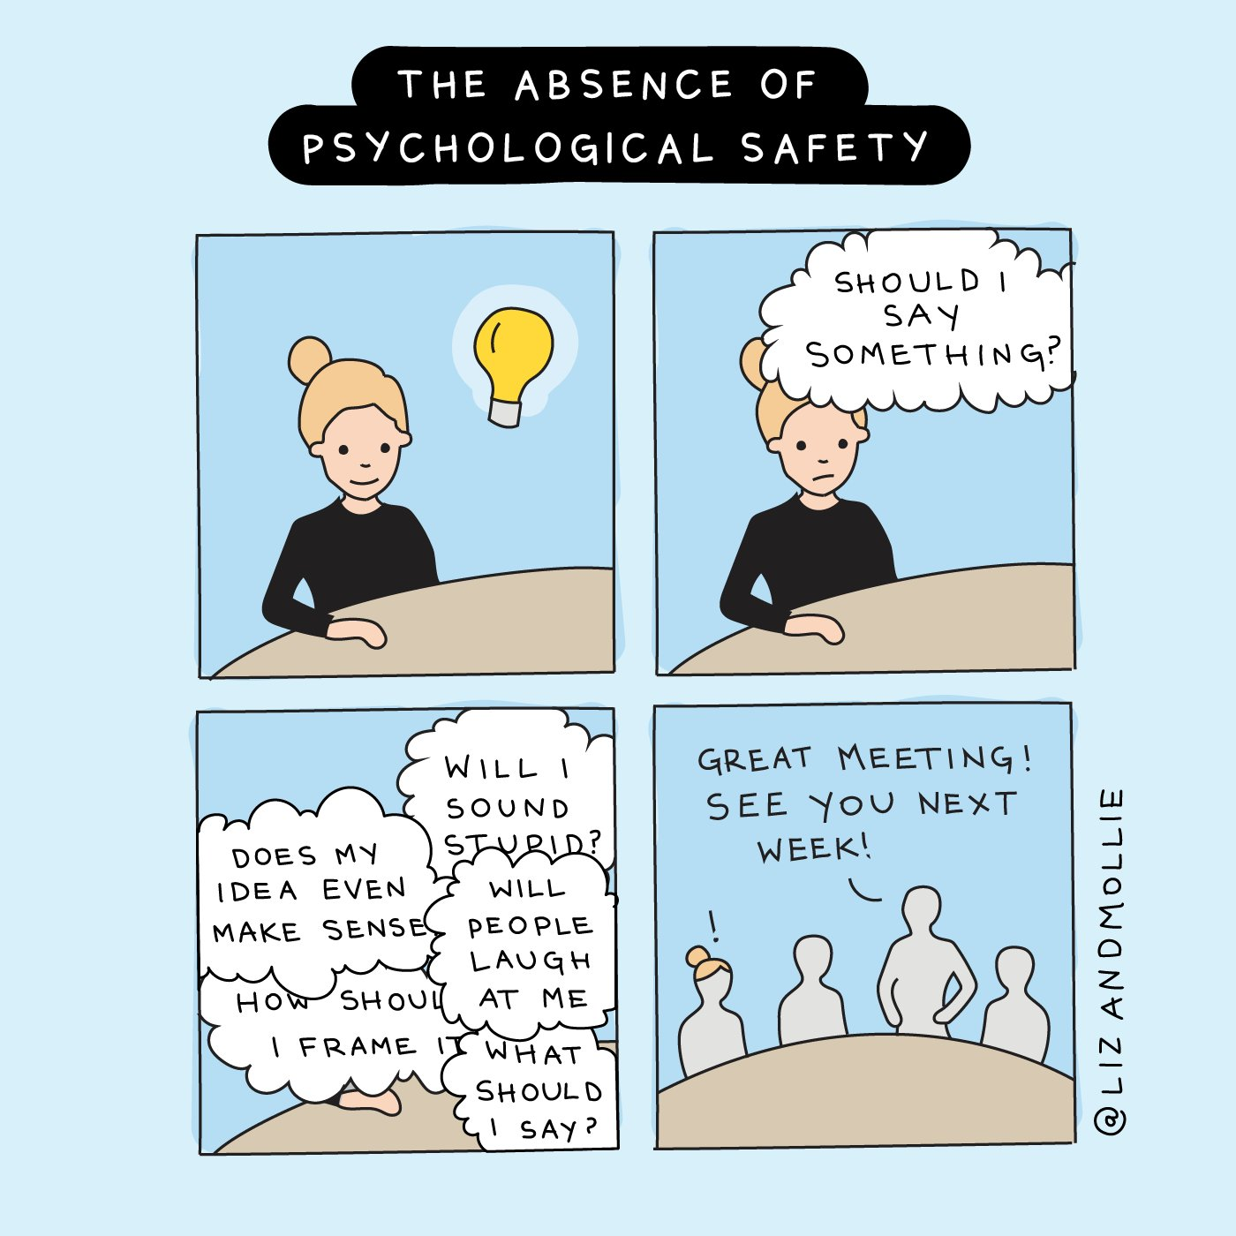
Duffy, M. W., & Fosslien, L. (2020). “The absence of psychological safety.” Cartoon. Retrieved from lizandmollie.com. Permission for use in this presentation received via email on October 13, 2020.

Slide 10
Small Group Discussion
What is the structure of quality improvement teams in your facility?
What successes do you experience with quality improvement teams?
What challenges do you experience with quality improvement teams?

Slide 11
Leadership Strategies for QI Team Success
Address the interpersonal, relational aspects
Create an effective team meeting process
Utilize project management tools to track progress, outcomes

Slide 12
American Society for Quality
Leadership Activities
Navigator
Create shared meaning
Provide direction toward vision, mission, goal, outcomes
Monitor progress
Communicator
Listen and articulate messages
Create shared meaning
Foster environment that supports open honest communication
Mentor
Guide actions of team members
Develop personal relationships
Develop trust, integrity
Learner
Develop personal knowledge, skills, abilities
Encourage reflection and learning from study and experience
Builder
Create structures and processes to support goal and outcome achievement
Ensure resources available
Evaluate processes
Motivator
Influence others to take action
Evaluate actions and performance in relation to mission, goals, and outcomes
Citation: Hirzel RC. Leadership is Personal. http://asq.org/articles/aqc-proceedings/public_proceedings/57_2003/19350.pdf

Slide 13
Make the Most of Your Meetings
Is the meeting (really) necessary?
Is another communication mechanism more appropriate?
Schedule meeting length appropriate for goals
Leave time for a break to transition to next events
Set clear goals and outcomes
Prepare an agenda
Send it out in advance
Prepare for the meeting accordingly
Does the technology support the meeting goals?
Does everyone have access to the technology?
Does the technology work?
Invite only those whose knowledge, expertise is needed at the meeting
Evidence-based practices for meeting design and preparation
Mroz, J. E., Allen, J. A., Verhoeven, D. C., & Shuffler, M. L. (2018). Do we really need another meeting? The science of workplace meetings. Current Directions in Psychological Science, 27(6), 484-491. https://doi.org/10.1177/0963721418776307

Slide 14
Make the Most of Your Meetings
Start on time
Follow the agenda
Take minutes and document key actions and outcomes
End on time and allow for transition

Slide 15
Small Group Discussion
What successes do you experience with leading quality improvement teams?
What challenges do you experience with leading quality improvement teams?

Slide 16
Team Performance
Did we achieve our goals?
Did we make high quality decisions? Did we learn?
Are we satisfied with the team? Our work? Our performance?
Did we work together successfully? Are we a viable team moving forward?

Slide 17
Wrap Up

