Slide 1


Quality Residency
Capstone Project
Renee Lighthall, MLT(ASCP)
Infection Control/Quality Coordinator
Cozad Community Hospital
November 2023

Slide 2
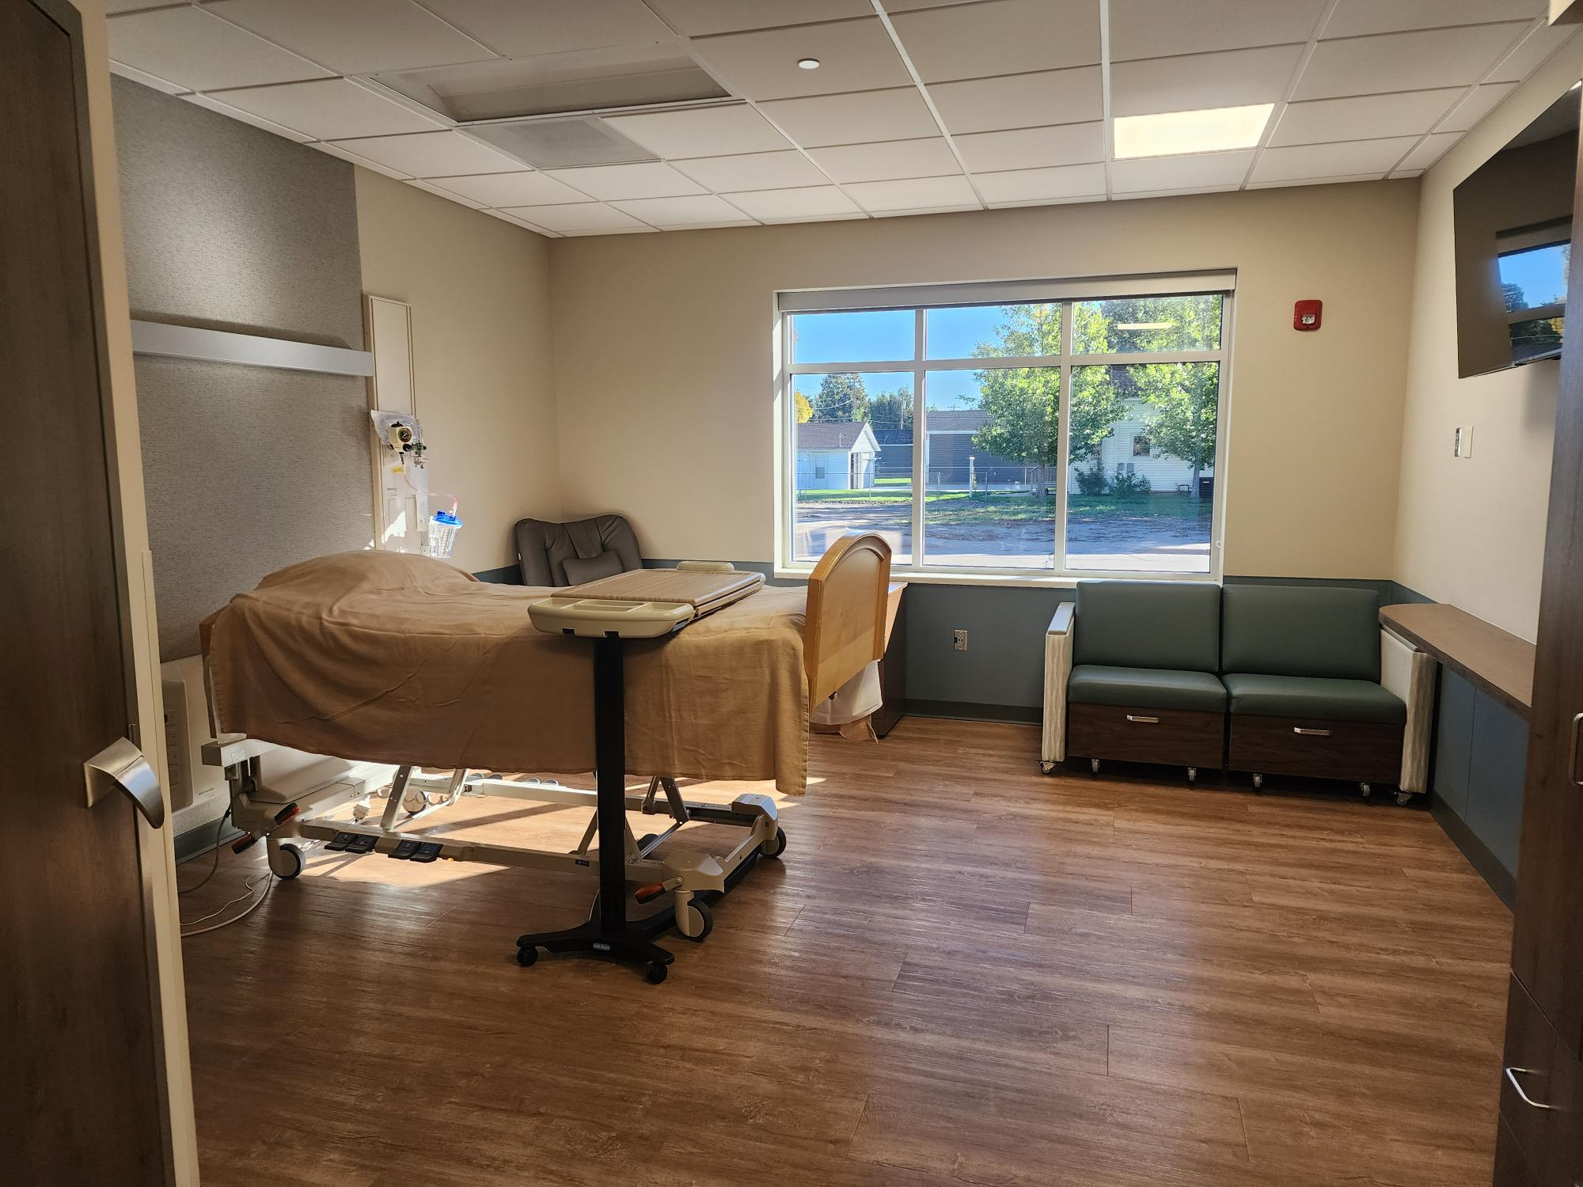
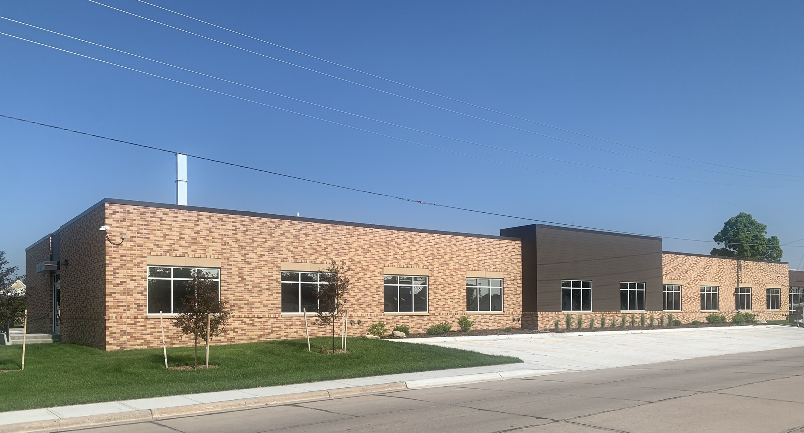
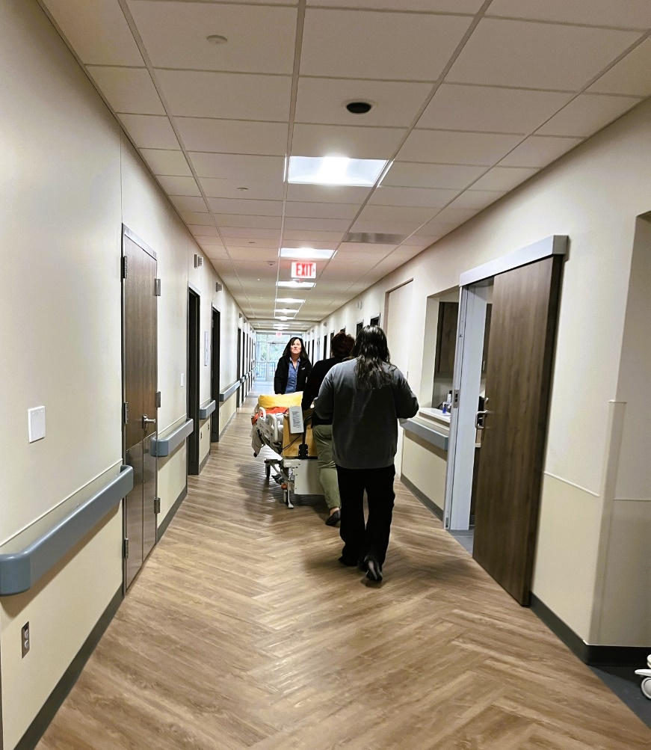
Cozad Community Hospital (CCH) is a nonprofit, 20-bed, Critical Access Hospital (CAH), that serves the Cozad community and the surrounding area.
Swing Bed Program
The swing bed program participates in the Stroudwater Swing Bed Analytics project. The analytics program aids staff in collecting data and objectively scoring patient’s mobility improvement. The swing bed committee will evaluate the data to find strengths and opportunities in improving the patient’s mobility.

Slide 3


Chandra Anderson CNO, Quality and Compliance officer
Renee Lighthall Infection Control/
Quality Coordinator
Brett Kollars
Director of
Physical Therapy
Kate Brummer
Occupational
Therapy
Miranda Pickinpaugh
Utilization Review Coordinator
Dranoel Fleharty
Social Worker/
Swing Bed Coordinator
Tammy McMichael
Director of Nursing

Slide 4


Improvement in Swing Bed Patient Mobility
AIM Statement
The aim of this project is to increase swing bed patients’ mobility scores at Cozad Community Hospital from 11.1% in quarter two of 2022 to the state median of 32% by the end of July 2023.

Slide 5
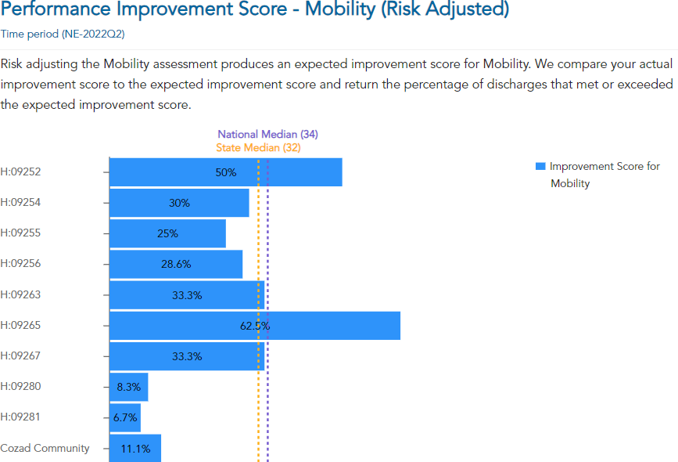
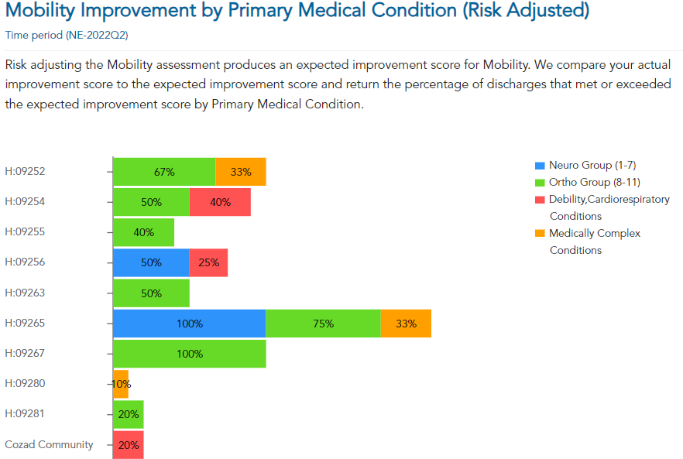
Quarter 2 2022
Comparison to other participating hospitals

Slide 6

Focus Measure | Improvement in Risk-Adjusted Mobility
Baseline Measure Value | 11.1%
Baseline Reporting Quarter | Q2 2022
Measurement Period | Quarter 1 2023-Quarter 3 2023
Issues & Opportunities | No standardized mobility scoring system for therapists. Improve consistency to better reflect patient’s performance.
Target Measure Value | State Median: 32%

Slide 7

Planned Interventions
Specific training on scoring mobility
Modify Physical Therapy evaluation templates
Consistent scoring between therapists for mobility at admission, the goal, and discharge in all applicable categories.

Slide 8
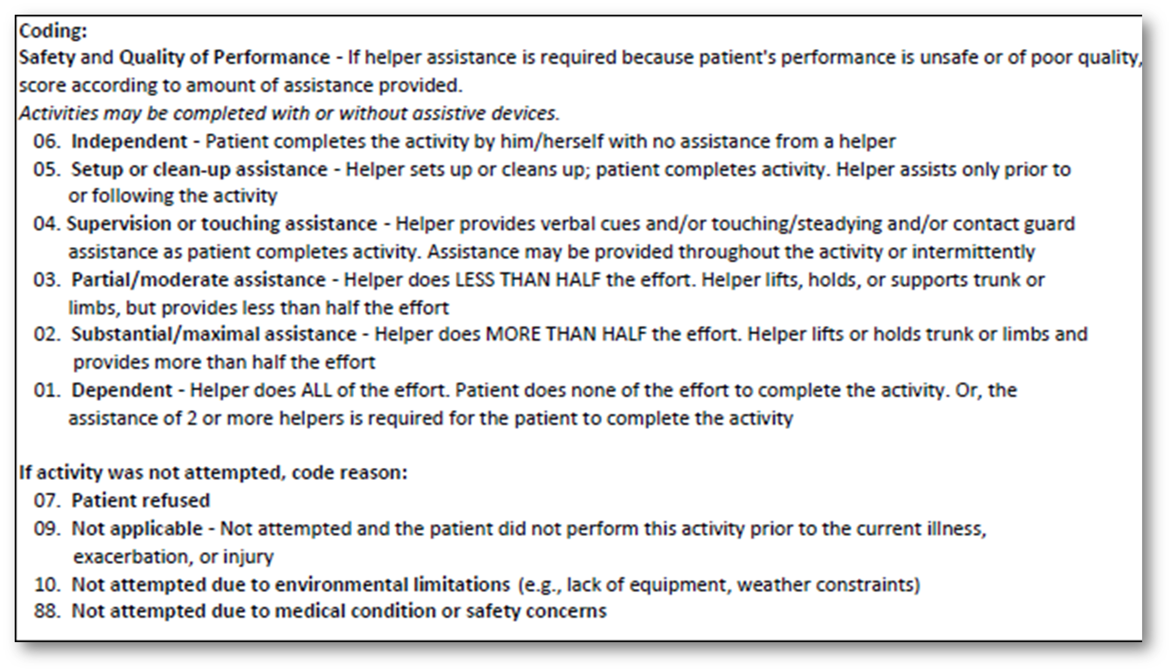

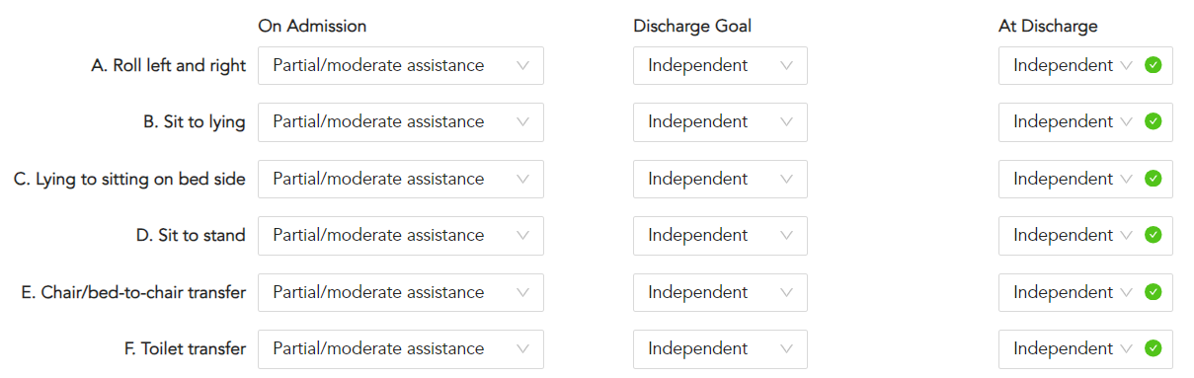
Therapy Coding Criteria and Scoring

Slide 9
PLAN | DO | STUDY |  |  |  | ACT
 | D/C* Month/# of D/C patients | Mobility Score | improve vs. baseline? | Improved from previous month? | What happened? | What changes need to be implemented?
Education for therapists about scoring consistent goals among all therapists. | Dec 4 pts** | 50% | Y | NA | Better standardized method for mobility scoring between therapists. | Reevaluate D/C pt charts and look for gaps in care or documentation. Improve accuracy in the level of mobility at admission, discharge goal, and discharge.
Reevaluate D/C pt charts and look for gaps in care or documentation. | Jan 6 pts | 20% | Y | N | Lower than last month because of specific patients’ level of mobility on admission and ability/willingness to participate in therapies. | Team meeting about how to increase patient participation.
Adjust methods to motivate and encourage patients | Feb 4 pts | 0% | N | N | Scoring was not correct. Code 09/NA was used in error at times. | PT Director will review how to score at admission and discharge Continuous education about mobility scoring.
Validate Scoring at admission and discharge | Mar 4 pts | 50% | Y | Y | Consistent Scoring between therapists. Patients meeting their goals. Exceeded the goal of 32%. | Continue with current practices.
Continue with current practices | Apr 3 pts | 67% | Y | Y | Consistent data entry. | Continue to modify and accurately score according to individual patient’s capability level.
 | May 2 pts | 100% | Y | Y | Continuous improvement each month.
 | June 4 pts |  |  |  | One patient noncompliant with participating in therapy.
*D/C=Discharge ** pts=patients

Slide 10
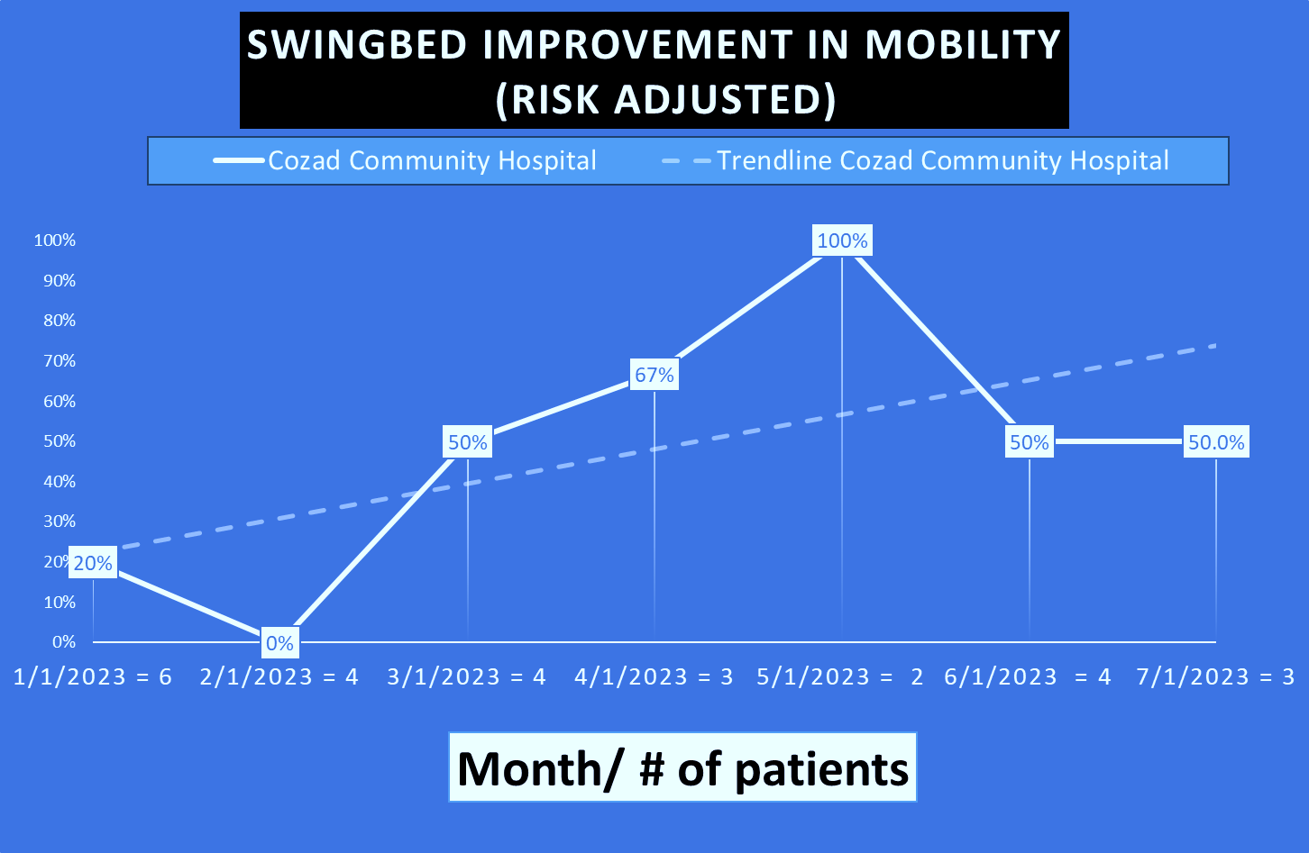
Contributing Factors to Changes in Improvement Percentages
Prior to Tracking:
The Physical Therapy Department updated the swing bed evaluation form to match the recommended scoring system.
The therapy staff completed training with Stroudwater:
To improve the consistency of scoring among the therapists.
Capture a more accurate picture of each patient.
Education on Mobility.
During Tracking:
Re-education for PT staff on scoring if the activity was not attempted. The percentage may be skewed due to this.
Scores dependent on patient participation.
State Median

Slide 11
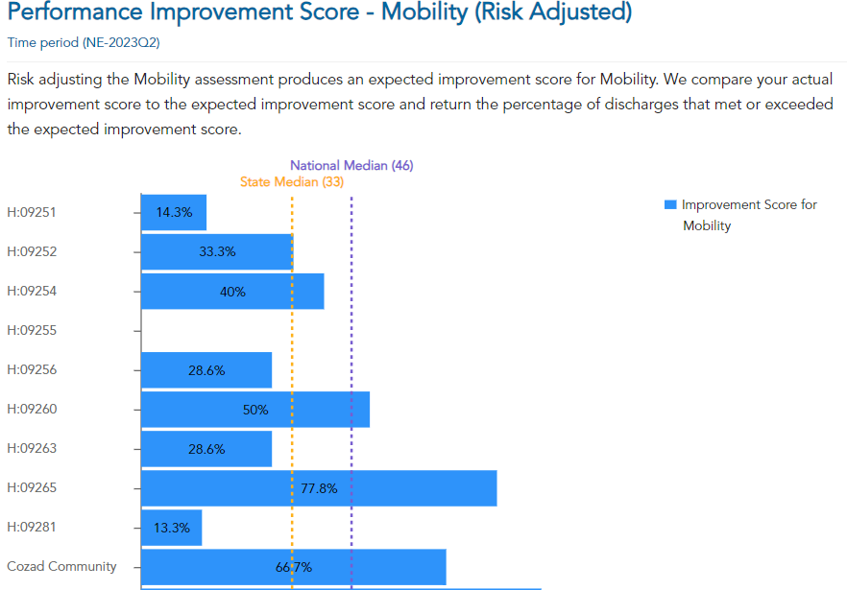
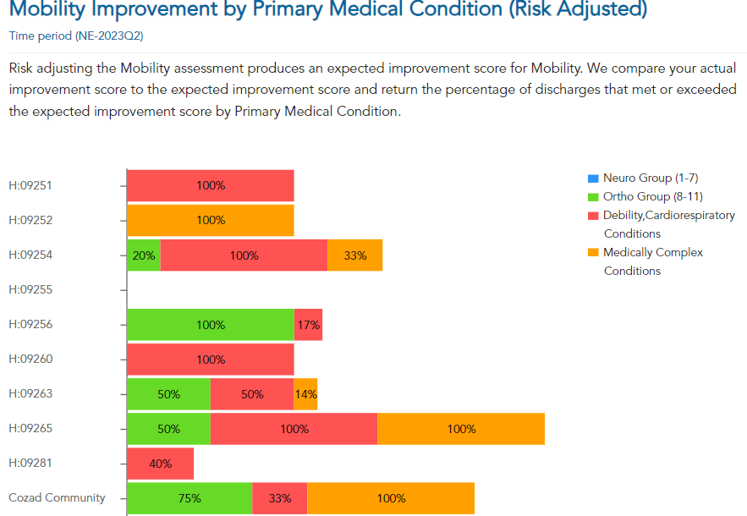
Quarter 2 2023
Comparison to other participating hospitals

Slide 12
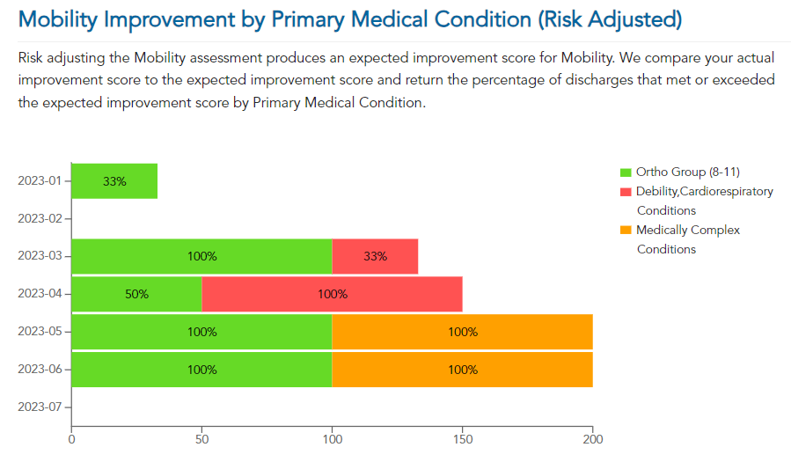
Primary Medical Condition as a % of Discharges

Slide 13


Falls
Average Cost of Harm | $6,694
Number of Incidents 2022 | 5 | $33,470
Number of incidents 2023 to date | 0 | 0
Improvement | 5
Savings | $33,470
Data from NHA Quality Scorecard
This Photo by Unknown Author is licensed under CC BY-SA

Slide 14
Conclusion
End Measure Value | 67%
End Measure Reporting Quarter | Q2 2023
Has the measure improved vs. baseline? | Y
What lessons did we learn? Surprises? Challenges? | The therapy team learned that each therapist interpreted and answered the mobility questions differently during the evaluations, which affected the scoring of the patient’s progress at discharge. The Director of Physical Therapy was surprised by the variations between therapists in how the mobility questions were answered. It was challenging in the beginning to standardize the evaluation process with all staff, but additional education improved that process.
Which interventions will we adopt, adapt, or abandon? | Annual education of the mobility scoring system to ensure consistency among all the therapists.
What modifications will be made going forward? | Periodical review of the data to verify the consistency of scoring and annual review of the scoring system with therapy staff.

Slide 15


nebraskahospitals.org
Renee Lighthall, MLT(ASCP)
Infection Control/Quality Coordinator
Email: reneel@cozadhealthcare.com

