Slide 2
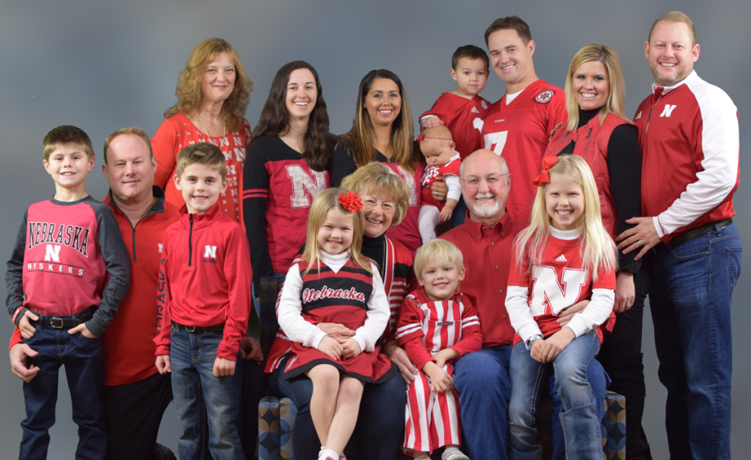
The Kim Foundation
Founded in honor of Larry Courtnage’s Daughter, Kim
We strive to:
Connect people to resources
Provide grants to local non-profits
Increase awareness about mental health and suicide prevention
Break down stigma often associated with seeking mental health care
Larry and Kathy Courtnage Family

Slide 3
Elephant in the Room
Death or other trauma Persistent serious family conflict
Traumatic break-ups of romantic
Why don’t we talk about suicide & mental health?
Are there experiences from your career that have shaped your beliefs on mental illness or suicide?

Slide 4
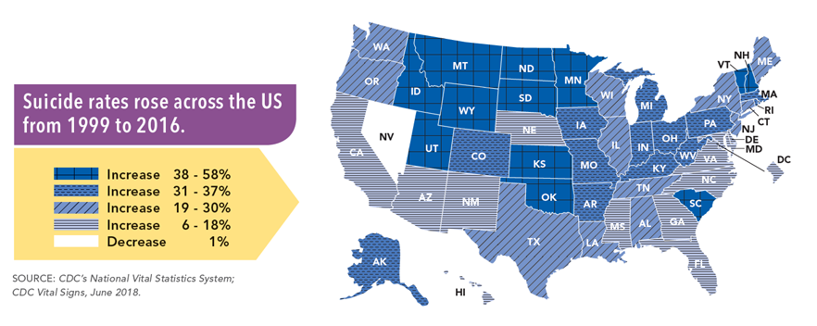
Suicide Rates

Slide 5
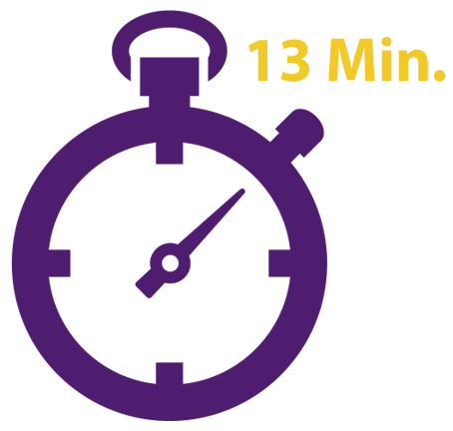
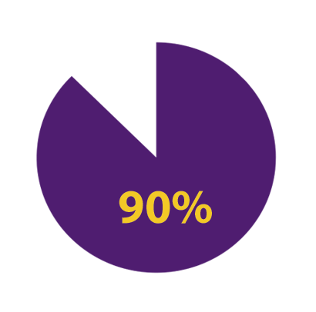
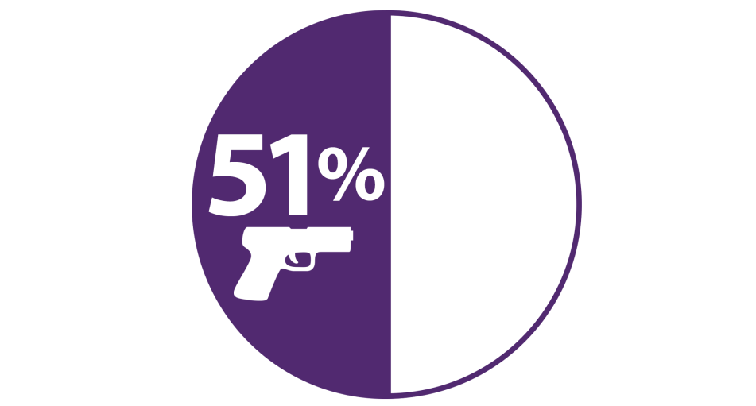
The Facts
Notes:
More than 90% of people who die by suicide have a diagnosable mental disorder.
Suicide is the 2nd leading cause of death for 15-24 year olds.
1 out of 6 students nationwide (grades 9-12) seriously considered suicide in the past year.
As many people die by suicide as car accidents in NE

Slide 6
13Minutes PSA

Slide 7
Suicide Risk Factors
Risk factors are a combination of individual, relationship, community, and societal factors that contribute to the risk of suicide. They are not direct causes of suicide.
Physical & sexual abuse
Death or other trauma in the family
Mental health problems
Physical illness, disability, and pain
Social isolation
Persistent serious family conflict
Traumatic break-ups of romantic relationships
Trouble with the law
Failures, major disappointments
Bullying, harassment, or victimization
Prior suicide attempts

Slide 8
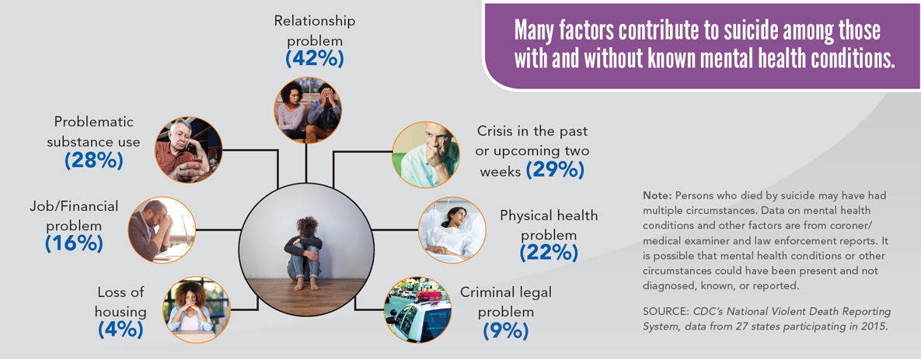
Suicide Risk Factors

Slide 9
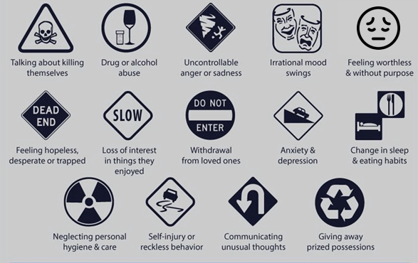
Suicide Warning Signs
Notes:
Anxiety, agitation
Unable to sleep, or sleeping too much
Visiting or calling people to say goodbye
Giving things away or returning borrowed items
Expressing no reason for living or no sense of purpose in life
Dramatic mood changes
Graphic: https://i.pinimg.com/736x/90/89/81/9089814c9e47d8c5d3f45d98ad18a036.jpg

Slide 10
Protective Factors
Protective factors help reduce a person’s chances of having suicidal thoughts or actions.
Having strong problem solving skills
Having a positive self-image
Having a spiritual life or faith
Having close family relationships
Having strong peer support systems
Being involved in hobbies or activities
Being connected to your community
Having access to treatment
Not having access to means
Notes:
-Close relationships- stress the importance of positive relationships, face-to-face “real” interactions vs. online, snapchat, etc.
-Positive self-image- explain the importance of not basing one’s self-worth on “likes”. Important to understand that a lot of what is online and shared is not a true reflection of a person’s life (“highlight reel”).Only way to really know how someone is doing is by having a face-to-face conversation with them.

Slide 11
Trauma’s Role in Suicide
Trauma: A psychological reaction to a harmful or life-threatening occurrence that is outside the range of normal experience and beyond our control.
It’s impact is pervasive, life changing, and enduring. It influences responses to future stressors.
Effects of trauma that may increase suicide risk include: Anxiety, depression, hopelessness, despair, anger, hostility, social isolation, impulsiveness, alcohol or substance abuse, self-destructive behavior, humiliation, shame, guilt, lessened self-esteem, a loss of personal beliefs, and feeling ineffective, distrustful, or threatened.
Those affected by trauma feel less connected or that they are burdens to families and friends. This generates hopelessness and depression, which may produce a desire to die. Trauma weakens resistance to serious self-harm (1).
Source: http://mces.org/PDFs/suicidepolice.pdf
Notes:
http://mces.org/PDFs/suicidepolice.pdf

Slide 12
The Conversation
Follow your gut
Be direct
Help them create a safety plan
Avoid judgment and adding guilt
Avoid telling them they’re being selfish
Assess the severity
Are you thinking of suicide?
Have you thought about how you would take your life?
Do you have access to those means?

Slide 13
Coping Strategies
Positive coping strategies
Restore emotional balance
Help you feel better about yourself
Are respectful of you, others, and property
Help you solve the problem
Negative coping strategies
May be harmful to yourself, others, or property
Do not solve the problem
May create additional problems
Notes:
Discuss with class their positive and negative coping strategies

Slide 14
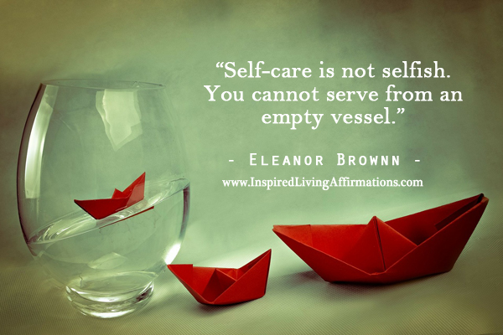
Self-Care
Get some rest
Eat healthy – nourish your body
Exercise your brain – but also allow yourself the time to “turn off”
Respect each other
Notes:
COPING SKILLS WORKSHEET

Slide 15
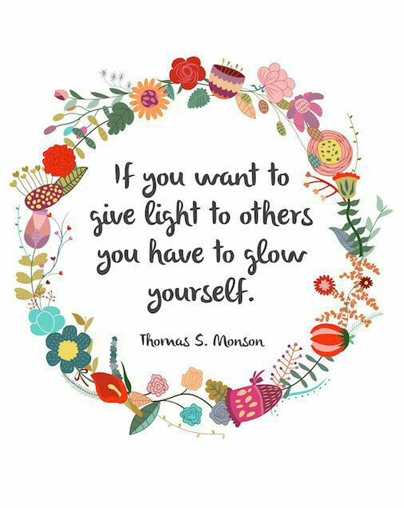
Self-Care
Assess where you are & be honest
You don’t have to do it all
Create an action plan – be specific
Fresh air
Journaling
Communication
Exercise

Slide 16
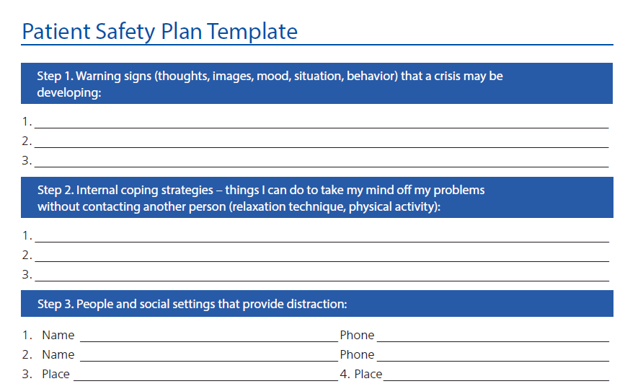
Creating a Safety Plan

Slide 17
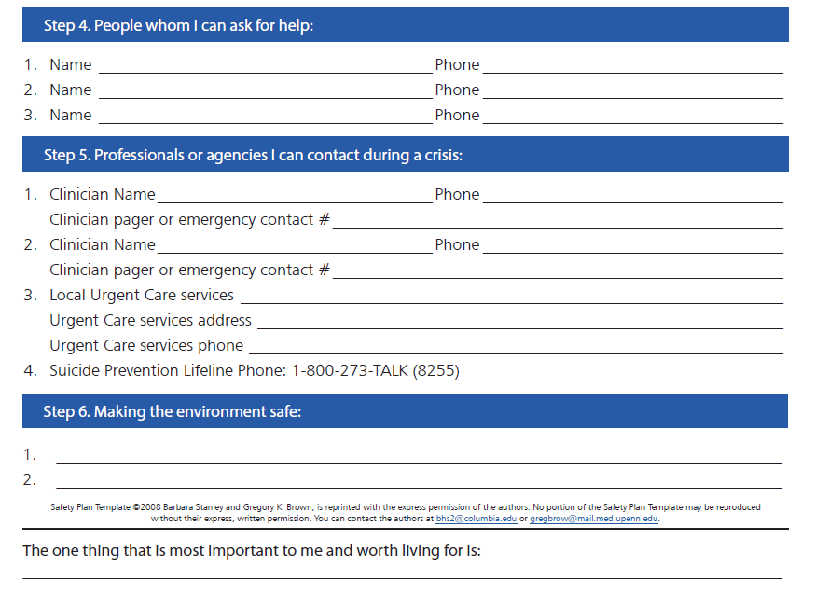
Creating a Safety Plan

Slide 18
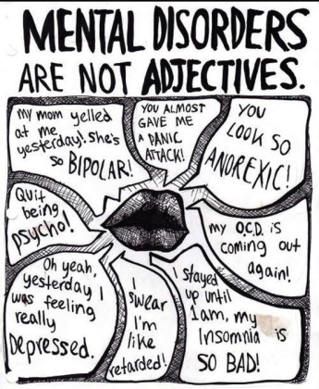
Language
Why does language matter?
Mental Health/Mental Illness/Condition/Disorder
People first language
Slang words to describe mental illness
Non-verbal communication
Committed suicide or died by suicide?
Trauma Informed – What happened to you?

Slide 19
Postvention – LOSS Teams

Slide 20
Postvention – LOSS Teams
Lincoln
Omaha
Norfolk
Kearney
Chadron
Four Corners
Blue River
Southwest
Coming Soon: Panhandle, Grand Island, Columbus

Slide 22
Notes:
In 2018 the youngest death was age 12 (compared to 13 in 2017) and the oldest death was 93 (compared to 90 in 2017).

Slide 23
Notes:
Gunshot wound and asphyxiation are continuing with 2017’s trend of the top two methods used.

Slide 24
Where to Get Help
13minutes.org
Suicide Lifeline 1.800.273.TALK (8255)
Boys Town National Hotline 1.800.448.3000/YourLifeYourVoice.org chat via text, email or online messaging
Nebraska Family Helpline 1.888.866.8660
Crisis Text Line – Text START to 741.741
The Trevor Project – 1.866.4.U.TREVOR (866.488.7386) www.trevorproject.org

Slide 25
Fact vs Fiction
90% of those who die by suicide had an underlying mental health condition
Suicide is the 5th leading cause of death in people age 15-34
There are more suicides in Nebraska than homicides
More females attempt suicide than males
More males die by suicide than females

Slide 26
Questions
Janae Shillito
Community Relations Director
The Kim Foundation
jshillito@thekimfoundation.org
402.891.6964

