Slide 1
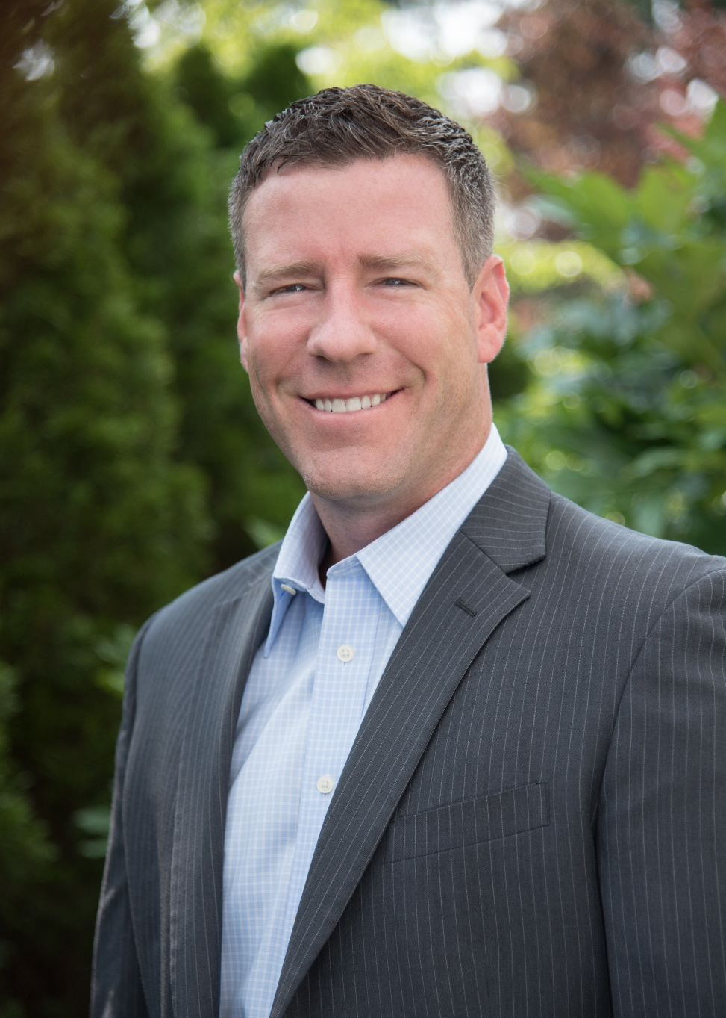
Brent Barnacle
Regional Vice President, Partner
Jackson Physician Search
For the past six years, Brent Barnacle has led Jackson Physician Search's Upper-Midwest Division. Before joining JPS, he worked extensively in organizational business development and training, spanning nearly 20 countries.
Brent applies this experience to build win-win strategic partnerships with Hospital and Physician Group administrators who need to recruit physicians and advanced practice providers. He also consults on healthcare market trends, speaks at local and regional industry events, and is known as a well respected, trusted advisor.
Brent was born and raised in Stillwater, Minnesota and maintains a strong focus on rural physician recruitment. He understands the importance of recruiting for cultural fit, which leads to long-term retention for clients.

Slide 2
Brent Barnacle
Regional Vice President
Jackson Physician Search
Most Rewarding Part of My Job:
Being a trusted advisor and strategic partner means I balance results and relationships to ensure that Jackson Physician Search is the right solution for my client’s physician recruitment needs. I take great pride in having a recruitment team that will go out and find the best physician for my client’s opportunities. To me, it’s all about placing physicians that are a great fit, will succeed, and stay!

Slide 3
Going Country: How to Highlight the Advantages of Practicing Medicine in Rural Communities

Slide 4
LEARNING OBJECTIVES
Demonstrate the advantages – and transparently address the challenges – that are part of practicing in your community, packaged in ways that resonate with millennial physician candidates.
Identify best practices for recruitment into rural communities that can be adapted and implemented to address your unique challenges.

Slide 5
STATE OF THE INDUSTRY
Demographic trends continue to be the primary drivers of increasing demand from 2015 to 2030.
Projected physician shortfall between 37,800 and 124,000 by 2034.
If underserved populations had standard care utilization patterns, demand for physicians would rise substantially.
Physician’s retirement decisions are projected to have the greatest impact on supply.
Medical School Graduates Outnumber Residency Slots
Visa Processing Backlog and Foreign Travel Restrictions
Limits on Treatment Activity by Advanced Practice Providers
Source: “The Complexities of Physician Supply and Demand 2017 Update.” IHS Markit for Association of American Medical Colleges. February 2017

Slide 6
ACUTE SHORTAGE OUTSIDE OF MAJOR CITIES
About 20%
of Americans live in rural areas where many do not have easy access to primary care or specialist services
Less than 11%
of physicians practice in rural areas
Source: Trend Watch, American Hospital Association; Doximity
Notes:
There is a highly disproportionate access to medical care

Slide 7
COMMUNITY IMPACT
Adding one physician to a community of 10,000 people is associated with a 5.3% reduction in average mortality.
Each physician supports 17 jobs and $3.2 million in economic input for a community.
Sources: How is a Shortage of Primary Care Physicians Affecting the Quality and Cost of Medical Care? American College of Physicians White Paper 2008
Nation’s Physicians Support 12.6 Million Jobs, Contribute $2.3 Trillion in Economic Activity, American Medical Association Article 2018

Slide 8
PRIMARY CARE CANDIDATE POOL IN NEBRASKA
Active Primary Care Physicians 1,590
Est. Physicians Under 60
941
Available Due to 7% Turnover 66
Residents 339
93
Estimated 8% of Residents Choose Rural Location
Estimated 8% of Residents Choose Rural Location
Total Annual Candidate Pool in
North and South Dakota
Source: 2021 AAMC State Physician Workforce Data Book
Notes:
We can walk you through these details after the program – but the picture speaks 1000 words
The Primary Care Pool gets smaller with every filter or preference you place on your search.
The Bottom Line:
The pool of actual candidates dwindles to about 8% of what you have at the top of the funnel.
---
Details:
About 30% of physicians are over 60 – so you need to look at physicians under 60 to find those more likely to be willing to make a career change.
Approximately 7% of physicians will make a job change in a given year.
As we look at the number of final-year residents, I should note that this number is inflated because the majority of internal medicine residents go on to do subspecialty training. Recently, I saw that number being as high as 78%.
So immediately, this natural funnel of candidates takes our primary care pool down further still.
Then, when you look at some of the limiting criteria that are sometimes set -- you can see how quickly a pool of actual candidates can reduce to about 8% of what you have at the top of the funnel.

Slide 9
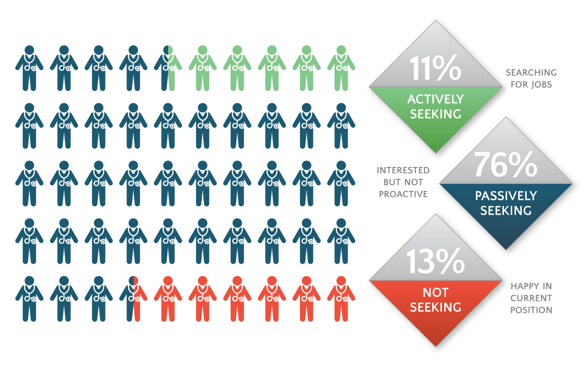
CRITICAL TO REACH PASSIVE CANDIDATES
Notes:
So -- in this fast-changing, complex and highly-competitive recruitment landscape –
You have a big challenge in identifying the RIGHT candidate.
Some candidates are easy to spot. The 11% active seekers . But those are the ones that MOST recruiters will target.
The result is a noisy, highly inefficient landscape that makes it difficult for physicians and organizations to connect in a meaningful way.
More often - you are seeking the type of physician who is NOT LOOKING.
The bulk of the candidate pool lies with the 76% of passive candidates – those interested in a potential job change, but not proactively exploring the market.
Even the 13% who are happy and not looking can have life events that make them receptive – when the time is right.
That means that over 90% of physicians are running below the radar.
BUT they all have something in common:
They are all engaged with social and digital media – It’s a big opportunity if you know WHO they are and HOW to engage them!

Slide 10
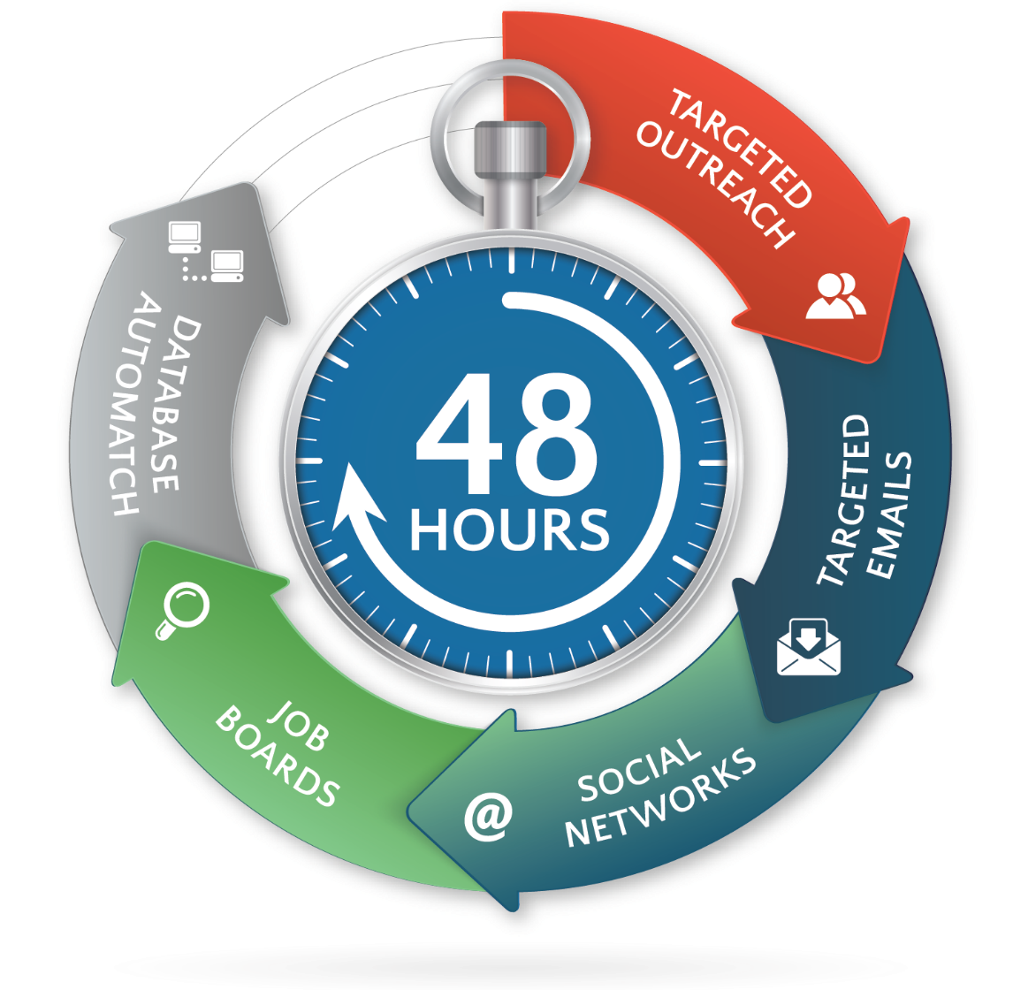
EMERGING STRATEGIES FOR RURAL RECRUITMENT
Use Digital and Social Media to be Fast AND Strategic
Notes:
With all the digital noise we contend with every day, the big question is: HOW do we reach them, engage them and recruit them?
You do it by making digital marketing and social media part of your recruiting strategy from day 1
This infographic shows the cycle of what we at Jackson Physician Search have determined to be best practice for leveraging technology for getting jobs to market – quickly and strategically.
Although digital marketing allows the flexibility to constantly refine and reinvent your ad, the saying holds true that you only get one chance to make a first impression.
Whether you’re working with a firm or managing physician recruitment internally, following this 48-hour plan to get your job to market will ensure the most effective and efficient sweep of prospective candidates who may be a best fit for your position.
From a targeted email campaign to presence on job boards, it is important to sweep the market and ensure your job is everywhere to attract the most significant initial attention.
It is equally important that whomever is responsible for vetting candidate inquiries has a comprehensive understanding of the position and is equipped to answer any questions a prospective candidate may have.
When there are 40,000+ Family Medicine openings to choose from, there is no quicker way to lose a candidate’s interest, than by not knowing your selling points of the opportunity and community, not knowing important details like how call is assigned or compensation schedule, and worst of all, any delay in following up with the candidate is the kiss of death. Know your players, know who is in charge of facilitating next steps, and keep the team on pace.

Slide 11
FIND PASSIVE CANDIDATES ONLINE
Digital Recruitment is a Trend that is Here to Stay
87%
of physicians ages 26-55 use social media
Source: CDW Healthcare 2015 Healthcare Social Media Report – http://www.cdwcommunit.com/resources/infographic/social-media/
Notes:
Social Media is a great way to share information about your facility, your community, and all the benefits of living in rural communities. Most hospitals have LinkedIn and Facebook profiles. Are you using them to promote the advantages of your open positions? We know that most candidates will review online profiles before responding to a job ad, so this is a great opportunity to get started on the right foot with potential recruits.

Slide 12
FIND PASSIVE CANDIDATES ONLINE
Digital Recruitment is a Trend that is Here to Stay
70%
of U.S. physicians are on Doximity – a “Top 5” smartphone app used by the American College of Physicians
Source: Doximity; American College of Physicians
Notes:
We’re seeing more and more physicians utilizing social media for professional networking and job searching – more physician-exclusive sites like Doximity, but as we just saw, also LinkedIn and Facebook.

Slide 13
FIND PASSIVE CANDIDATES ONLINE
Digital Recruitment is a Trend that is Here to Stay
95%
of all physicians prefer to receive info about job opportunities via email, not in their mailbox at home.
Source: MMS Job Opportunity Preferences
Notes:
95% of physicians prefer to receive info about jobs in via email, and 60% of them read their email after 6pm.
This is physician-reported data, but anecdotally, our recruiters hear this all day, every day when speaking with candidates on the phone.
They want to be able to reference the information, they want to vet it with their spouse or significant other, they want to be able to research the organization and community. And they want to do it on their time.

Slide 14
BEWARE...YOU MUST BE RELEVANT
Rise of the Digital Omnivore
55%
of physicians get
weekly
job opportunities
16%
contacted
once
per week
Less than
10%
of recruiter communications are relevant
39%
multiple contacts
per week
Source: Doximity Physician Survey
Notes:
Before you launch your digital recruitment strategy, consider WHAT you’re sending out – and HOW you plan to deliver it. Is the content meaningful and relevant to the candidates?
Remember the earlier statistic that 94% of physicians want job information by email?
That comes with a BIG Challenge as these statistics demonstrate challenge:
On the Left
16% one per week
39% are contacted by recruiters multiple times per WEEK
That means more than HALF are getting weekly contact
But the true problem is shown on the Right
The job opportunities they are hearing about are NOT relevant to their interests
More than half said they get a relevant contact LESS THAN 10% of the time.
So it is clear that many recruiters practice what we call: SPRAY AND PRAY
They are not taking the time to understand the audience, segment and target carefully
The effect is a double-whammy:
Physicians will tune it out completely
There is significant inefficiency – wasted time and money

Slide 15
DIGITAL CANDIDATE SOURCING
EMAIL
Targeted and Specific
Test and Optimize
SOCIAL MEDIA
Follow Industry Leaders
DOXIMITY
Talent Finder Tool
Engaged Database
JOB BOARDS
Resume Search
Job Posting
Join Discussion Groups
Use Targeting Tools
Ultra Targeted DocMails
Notes:
Through these cost-effective and far-reach channels, you can:
Optimize your time and sourcing dollars through TARGETED OUTREACH.
Attract qualified candidates via TARGETED EMAILS, SOCIAL NETWORKS, and NATIONAL JOB BOARDS.
Cast a wide net on job boards while also taking advantage of resume search tools is effective at building a target list of candidates.
Next, make sure your emails are targeted and specific.
Keep your email lists clean through one of the email address scrubbing tools, like Neverbounce. And always test your messages!
Jump on the social media trends by engaging industry leaders, sharing content, and targeting ideal physician candidates.

Slide 16
HIGHLIGHTING THE BENEFITS OF RURAL PRACTICE
Notes:
Next lets discuss how you can highlight the benefits of rural practice

Slide 17
RURAL SURVEY SAYS: WHAT CANDIDATES WANT IN AN OPPORTUNITY
Patient-focused
1
Teamwork
3
Family Friendly Environment
4
Autonomy
2
Participatory Decision Making
5
Source: Rural Recruitment: Results from the JPS 2019 Rural Physician and Administration Survey
Notes:
In our Rural Survey, physicians told us that these 5 things are what they want. Because these are all natural strengths for rural organizations, use that to your benefit when marketing vacancies.

Slide 18
RURAL SURVEY SAYS: TOP 3 FACTORS FOR CHOOSING A RURAL PRACTICE LOCATION
Physicians:
Administrators Said:
Community Culture
Proximity to Family/Friends/Colleagues
Compensation
Compensation
Offer of Loan Repayment
Preference/needs of Spouse/Partner
Source: Rural Recruitment: Results from the JPS 2019 Rural Physician and Administration Survey

Slide 19
Tailor the Interview Team to the Candidate
Remember: CEO Sells the Vision
1
Assign Topics & Ensure Consistent Message
3
Explore the Candidate's Priorities and Motivations
4
Have Your Best Facility and Community Advocates Conduct Candidate Tours
2
Tailor the Community Tour to the Entire Family
5
Leave No Questions Unanswered: Most Physicians Accept or Decline an Offer After the First Interview
6
THE INTERVIEW: WINDOW TO YOUR CULTURE
Source: Rural Recruitment: Results from the JPS 2019 Rural Physician and Administration Survey
Notes:
Once you have a candidate, the interview becomes critical to success. It’s a window to your culture.
And recruiting for cultural fit is just as important to achieving long-term physician retention as recruiting the right skill sets.
The key is to ensure that before any search, all of the individuals who have a say in the hiring process are already on-board and recognize the urgency of the situation. Things to include are ensuring that presented candidates are acted upon quickly, in most cases, the first contact should be within 24 to 48 hours.
Build momentum by quickly setting up interviews and prepare a winning site visit. Another way to feed that momentum is by having the basics of a contract already laid out and approved by key decision-makers. The most disappointing aspect of any physician search is missing out on the perfect candidate because of an avoidable bottleneck.

Slide 20
Interview-to-Hire Ratio
Reduce Interview-to-Hire Ratio from 5:1 to 3:1 for a Cost Savings of $18,000
Acceptance Rate
Improve Acceptance Rate by 20% for a Cost Savings of $24,000
Shorten Vacancy
Shorten Vacancy Time by 60 days for Revenue Gain of $138,000
* Estimating $6,000 per Interview in travel and team hours
* Estimating $24,000 to restart search and resume interviews for declined offer
* Given $828,000 average revenue per primary care physician per year (specialists will be more)
KEY TAKEAWAY: IMPROVE RECRUITMENT ROI AND MAXIMIZE REVENUE
Notes:
Recruiting top physicians can be an expensive and time-consuming process -- which is even more reason to streamline efficiency.
Each day you are recruiting equates to thousands of dollars in lost revenue. Hiring more quickly will benefit your hospital’s bottom line, as well as productivity, morale, and patient loyalty.
Improving these three outcomes, even minimally, can result in a huge impact on your bottom line.
On the right, you can see that improving your interview to hire ratio from 5:1 to 3:1, results in a cost savings of $18,000.
And on the left, if you shorten a vacancy by just 60 days, you can expect an average revenue gain of $138,000.
The key to improving these outcomes all comes back to leveraging technology to recruit efficiently - and - being strategic to recruit for fit.

Slide 21
Questions?

Slide 22
Brent Barnacle
Regional Vice President, Partner
Jackson Physician Search
bbarnacle@jacksonphysiciansearch.com
314-788-6861

