Slide 1
Jennifer Moffett, Board Chair, AFSP Nebraska
Notes:
The American Foundation for Suicide Prevention is dedicated to saving lives and bringing hope to those affected by suicide. With chapters across all 50 states, AFSP creates a culture that’s smart about mental health through education and community programs, furthers suicide prevention through research and advocacy, and provides support for those affected by suicide. My name is [NAME] and I am the [ROLE] for [CHAPTER] Chapter of AFSP. I am so glad you’ve joined us today to learn about our bold goal.

Slide 2
Notes:
Here are the areas we will be reviewing during our conversation today.

Slide 3
Notes:
Let’s talk about why there’s such a need for this project.

Slide 4
Notes:
Suicide remains a leading cause of death in the United States.
The graph on the screen shows the rates of suicide in the U.S per 100,000 between 1995 and 2018. Between 1999 and 2018, the national rate of suicide increased 35%. We saw a decrease in the rate in 2019 and 2020. The preliminary data for 2021 does show that suicide rates did increase, but they were still lower than the rates in 2018.

Slide 5
Notes:
Suicide is complex and it can often be prevented. This insight was gained through suicide prevention research. In fact, AFSP is the largest private funder of suicide prevention research. The research studies AFSP funds also help set the tone of the national research agenda.
We know there are actions we can take that are proven to lower the rates of suicide in communities, such as providing suicide prevention education for more people, including front line professionals, and temporarily reducing access to lethal means when someone is in a state of crisis.
In recent Harris Polls show that the majority of people in the United States believe that suicide can be prevented, and that it’s time to make suicide prevention a national priority, and that is what AFSP is doing through Project 2025.

Slide 6
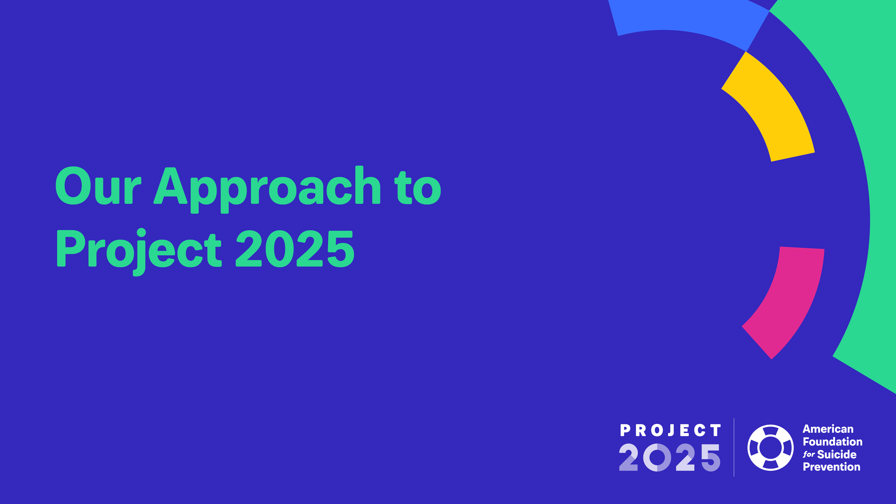
Notes:
So, what is Project 2025?

Slide 7
Notes:
Project 2025 is a nationwide, collaborative initiative, developed by AFSP, to reduce the annual rate of suicide in the U.S. 20 percent by 2025. It is the bold goal at the center of AFSP’s mission.

Slide 8
Notes:
To initiate Project 2025, AFSP convened an advisory panel of the foremost experts in suicide prevention to help set the strategies for Project 2025. Together with their input, we commissioned a dynamic systems modeling exercise.
Dynamic systems modeling is used to describe and predict the interactions over time between multiple components of a phenomenon that are viewed as a system.
So what did our advisory panel use dynamic systems modeling to determine?

Slide 9
Notes:
We examined number one, who we are losing to suicide, how we are losing them, where we are losing them, and finally, what actions we can take to save the most lives in the shortest amount of time.
The results of the expert analysis determined our approach for Project 2025. We can sum this approach up in four steps.

Slide 10
Notes:
The first step was to review the data and scientific research to identify the settings and best, evidence-informed strategies for preventing suicide within those settings with the goal of saving the most lives the fastest.
The next step was to start developing key partnerships within these settings, and to invest in the development of the tools and resources to support the delivery of suicide prevention programs in these settings. AFSP knows we can’t do this alone. We need the help of leaders in each of the four areas to support our project 2025 in communities across the country.
Once we identified the critical areas through which we could make the most impact; and identified partners within those areas; we knew we would need to work with them to deliver resources and programs in each of those areas, at both a national, and a local level.
Then finally, we are using what we learn, measuring outcomes and working to grow partnerships and develop more tools and resources.
With these four steps in place, our goal is to save the most lives in the shortest amount of time. Now let's take a closer look at our four focus areas.

Slide 11
Notes:
Now we want to shift gears and talk about the four focus areas of Project 2025 and highlight some of the work being done in those focus areas.

Slide 12
Notes:
The focus areas represent settings, rather than subgroups of people, because our expert panel determined we can reach the most at-risk individuals by focusing on these four settings.
The four critical areas we identified are:
Firearms
Healthcare Systems
Emergency Departments
and Corrections Systems

Slide 13
Notes:
The first critical area is Firearms.
Nearly 23,000 people are lost each year to suicide by firearm. 51% of all suicides in the U.S. are by firearm, and about two-thirds of all firearms deaths are suicides.
It was estimated that if half the people who purchase firearms were exposed to suicide prevention education, and if even just a minority of those took action based on the education, we could expect an estimated 9,500 lives saved through 2025.

Slide 14
Notes:
The next critical area is Healthcare Systems.
Up to 45% of people who die by suicide visit their primary care physician in the month prior to their death.
Our modeling estimated that if even just one out of every five at-risk people in large healthcare systems were identified through screening– such as during primary care and behavioral health visits – and if they were provided with short-term interventions and better follow-up care, we would be able to save 9,200 lives by 2025

Slide 15
Notes:
Another critical area is Emergency Departments.
39% of people who die by suicide make an Emergency Department visit in the year prior to their death. Emergency Departments therefore present another key setting with a tremendous opportunity to save lives.
Our modeling estimated that if even just one out of five people seen in Emergency Departments received screening, and was provided short-term interventions such as Safety Planning and follow-up care, we could expect an estimated 1,100 lives saved through 2025

Slide 16
Notes:
The fourth critical area is Corrections Systems.
Suicide is the leading cause of death in jails, and has increased 30% in prisons in recent years. Incarcerated people are particularly vulnerable to suicide, for a variety of complex reasons.
It was estimated that by screening for suicide risk, even if only 50% of at-risk individuals were identified at key points within the corrections system, such as at times of entry and exit – and by delivering comprehensive care that addresses both physical and mental health – we could expect an estimated 1,100 lives saved through 2025.

Slide 17
Notes:
In short, AFSP’s Project 2025 is an unprecedented commitment to positively impact our culture surrounding mental health and suicide prevention. The results of the analysis by our expert advisory committee based on what we know from research, and using dynamic systems modeling, reveal how we CAN save lives. But we cannot do it alone.
In order to achieve the goals of Project 2025, we must mobilize institutions, associations and individuals across these four settings. Together, we can make enormous change. But it will take a collective effort.

Slide 18
Notes:
Project 2025 is a “real-time” effort translating what we know about suicide prevention into practical, real-world solutions. We are guided by the following principles:
To be nimble and innovative as new solutions arise. We are not afraid to shift direction if and when a better approach comes along.
To act as a catalyst for change by enlisting others within the four areas, at both the national and local levels. Unless we establish key partnerships to put what we know into action, AFSP’s reach may be limited.
To leverage monetary and infrastructure investments made by others. We must build on the great work already being done in suicide prevention and expand its reach.
Finally, we must monitor impact to improve results and build on progress. We will continue to evaluate our impact over time so we can double down on what is working and refine our approach.

Slide 19
Notes:
We know that healthcare and corrections systems are not broken but are operating as they were designed. These systems were designed to perpetuate inequity and have often harmed those with mental health conditions or those in suicidal crisis, and especially those from minoritized communities. In particular, the use of the criminal justice and juvenile justice systems to intervene with those experiencing suicide crises disproportionately impacts people of color, Indigenous communities, LGBTQ+ individuals, those who are socioeconomically disadvantaged, and those living at the intersections of these identities. Such disparities warrant targeted initiatives that are not only feasible, effective, and sustainable, but also equitable.
These systems were designed this way. That means, however, that we can redesign and change these systems to equitably serve those in need, but we cannot do it alone. Collaboration and equitable partnerships are major keys to systems change. To that end, our work is helping to identify the organizations that are led by and engaging with BIPOC, LGBTQIA+, and other minoritized communities and endeavoring to elevate their work and support its implementation. Our role is as a catalyst–helping those on the ground implement evidence-based solutions for all those impacted by suicide.

Slide 20
Notes:
We’ll now talk a little bit about dynamic modeling—what it is and how we used it to identify our strategies in the four focus areas. Dynamic systems modeling describes the aspects of the system, including interactions, related to time and sequencing of the operations. It is used to specify and implement the control aspect of the system.

Slide 21
Notes:
So why did we choose to do dynamic modeling? First, it supported our approach I mentioned earlier—focusing on settings and systems rather than groups of people. It also supports a public health approach to suicide prevention, which I’ll discuss in a moment. Second, it helps to inform data- and evidence-driven decision making related to our strategies in each of the four areas. It also allows us to measure progress along the way, and offers the flexibility necessary to capture the complexities and nuances of these systems. Relatedly, it allows us to adjust to variables in real time, including changing these as we implement and learn new things, the efficacy and new evidence related to our strategies, and changes in population.

Slide 22
Notes:
As I mentioned, dynamic modeling also supports a public health approach. We often view suicide prevention as individual and interpersonal—identifying warning signs, having honest conversations, and supporting those who are struggling. This is incredibly important and valuable work that is included in the models, but we also know that we need to intervene at the community and societal levels to make change happen. That’s where our work in healthcare and corrections systems, our advocacy and policy work, and our goal of changing the culture around mental health come in. Change at all of these levels is necessary, and our goal is to be a catalyst for that change.

Slide 23
Notes:
Our modeling and public health approach also accounts for a holistic prevention model. The tripartite model of prevention, often used by the CDC and others, helps illustrate the various levels of prevention efforts. Universal efforts are broad scale interventions intended to minimize risk across a population, such as gatekeeper trainings and awareness campaigns. Selective efforts are those designed to decrease risk for those who might be at risk—this might include suicide risk screening or crisis line support. Indicated efforts are those targeted at the most high-risk people, such as safety planning and extreme risk protection orders.

Slide 24
Notes:
This slide provides a different perspective on the demographics data and out thinking behind the numbers. The blue circle represents our overall population of interest while the yellow circle represents the high-risk population—most of whom are unscreened in healthcare settings. On the upper right, we see the total number of firearm owners compared to the fraction of all suicide deaths from firearm owners—a key population to provide resources to. Finally, on the lower right, we see the total number of suicide deaths in the U.S. compared to the fraction of those deaths that come from the high-risk population I mentioned earlier.

Slide 25
Notes:
In this slide, we see the output from our dynamic modeling for safety planning. The top line is total annual suicide deaths, the bottom line is lives saved per year, and the dark blue line in the middle is what we’re primarily interested in—the cumulative number of potential lives saved over time. If we implement safety planning in 20% of emergency departments and primary care sites assuming 3% effectiveness, we could potentially save 3,500 lives by 2025.

Slide 26
Notes:
In this example, we estimate that if 50% of those who purchase a firearm are exposed to suicide prevention and secure storage education, assuming it is 20% effective, we could potentially save 9,500 lives by 2025.

Slide 27
Notes:
In this example, we graph out a comprehensive approach—if we implement screening, safety planning, lethal means counseling, follow-up care, and expand the mental health workforce, we could potentially see over 38,000 lives saved by 2025. This is why a public health approach is important—it takes all of these strategies, along with buy-in and support across all of these systems, to make a change.

Slide 28
Notes:
Now that we’ve given you an overview of what Project 2025 is, what the four critical areas are that have been identified, and how our dynamic modeling works, I’m going to go over some specific examples within each of those areas of how we’re making a difference within each.
Hopefully, this will give you an idea of how you can help us expand on Project 2025 in your own community.

Slide 29
Notes:
We know through research that educating firearm owners on suicide prevention, and how they can practice safe handling, and secure storage, we can save lives.
We have therefore partnered with firearms retailers and range owners to provide suicide prevention education in communities across the country.
Through Project 2025, we show the firearms owning community how to spot signs of suicide risk in themselves and others; implement safe storage practices; and promote help-seeking at times of distress.

Slide 30
Notes:
We have collaborated with the National Shooting Sports Foundation (NSSF), the leading trade organization for firearms ranges and retailers. Through this partnership, we are delivering an education and awareness campaign which includes content on suicide prevention, safe firearms storage, and seeking help for mental health to the NSSF’s more than 8,000 members, which is comprised of firearms retailers, ranges, and instructors across the U.S.
The NSSF conducted a survey off its members in 2017 and 2019, and 91% said they see suicide as preventable. While exposure to suicide prevention education grew 5% between 2017 and 2019, Project 2025 seeks to provide more educational materials and awareness to the firearm industry in the coming years.
You can see samples of the co-branded materials on the screen. These materials are currently available for free, so if you want to learn more, please reach out and we can help you get them.

Slide 31
Notes:
Part of this this collaboration, we have also developed a presentation called Talk Saves Lives: An Introduction to Suicide Prevention for Firearms Owners, which is a special module of AFSP’s signature suicide prevention presentation, Talk Saves Lives.
The presentation is available for free, either in person or virtually. So we encourage you to connect with our chapter to learn more. We’ll be providing details on how you can connect with our chapter at the end of this presentation!

Slide 32
Notes:
The second focus area is Healthcare Systems. The key strategy in this area is to work with healthcare systems and accrediting organizations to accelerate the acceptance and adoption of suicide prevention practices across healthcare settings, including primary care.
Through Project 2025, we will ensure that healthcare providers are empowered with the training, tools, resources, and institutional support necessary to identify signs of risk, and make the right assessments, treatments and interventions to save lives.

Slide 33
Notes:
AFSP has partnered with SafeSide Prevention to implement innovative and scalable suicide prevention intervention training to primary care physicians at practices across the country. The SafeSide Primary CARE training program is designed to enhance physicians’ comfort-level with conducting suicide risk assessments during primary care appointments, including well-visits, as well as to deliver basic interventions and/or refer patients to the appropriate care. This primary care training is fully compatible with the Zero Suicide model for suicide prevention across healthcare systems, and provides a readily-available training option for Zero Suicide partners.
If this is something you are interested in the AFSP Nebraska Chapter has budgeted to help support the launch of this training for clinics in Nebraska and we can work with you to get more details and work to implement.

Slide 34
Notes:
In addition to the SafeSide partnership, AFSP is a member organization of the National Action Alliance for Suicide Prevention, which has published the Recommended Standard Care for Suicide Prevention in Healthcare.
This resource provides guidelines for suicide prevention best-practices in various healthcare settings, including primary care, behavioral health, and emergency departments. You can download a copy of these recommendations by visiting the Project 2025 website at project2025.afsp.org. Look for the resources section of healthcare systems.

Slide 35
Notes:
We recently launched a partnership with the American Academy of Pediatrics to deliver a series of Project ECHO collaboratives geared toward improving suicide prevention in pediatric healthcare.

Slide 36
Notes:
Our Project ECHO collaboratives will feature two strands. The first are clinical quality improvement ECHOs with pediatric providers and clinics focused on enhancing best practices for suicide prevention care and improving outcomes as a result. This will help pediatricians and pediatric health providers build knowledge and change practices and procedures to better support youth who may be struggling.
The second strand is community ambassadors ECHOs wherein we establish clinical-community partnerships geared toward advocacy and influencing community and systems change. We know both are necessary to make change happen.

Slide 37
Notes:
Each year, AFSP’s Public Policy team mobilizes energetic volunteer Field Advocates across the country to urge public officials to prioritize suicide prevention and mental health. Together, we make bold strides at the federal, state, and local level to pass suicide prevention policies that can save lives.
Because primary care providers are in a unique position to identify those at risk of suicide and enact appropriate intervention methods – and without proper training they may miss warning signs and risk factors in their patients that indicate high suicide risk – AFSP is focused on supporting state-level legislation and regulatory efforts to make such training required in all 50 states and the District of Columbia.

Slide 38
Notes:
The next focus area of Project 2025 is Emergency Departments. Remember what we said earlier: 39% of people who die by suicide make an Emergency Department visit in the year prior to their death. So ERs present another key setting with a tremendous opportunity to save lives.
By working with Emergency Departments, we can provide a safety net by educating and equipping emergency physicians and staff with the suicide prevention tools they need to screen and care for at-risk patients in emergency departments and other acute care settings.

Slide 39
Notes:
One of the biggest challenges to suicide prevention in ERs is the absence of a quick, easy-to-follow procedure for emergency physicians to assess for suicide risk and provide immediate care.
So, AFSP partnered with the American College of Emergency Physicians (ACEP) to develop and deliver a brief suicide risk assessment and suicide prevention intervention tool called “I Care Too” (ICAR²E).The tool is freely available online for use by any emergency physician, nurse, or medical student.
Our partnership enabled us to reach ACEP’s more than 40,000 members of emergency physicians and professionals who all have access to the ICAR²E tool.

Slide 40
Notes:
Later this fall, we will formally launch our partnership with the Institute for Healthcare Improvement, our largest initiative yet, and one design to enact change across large healthcare systems by innovating, testing, and implementing evidence-based improvement strategies to reduce suicide at scale.

Slide 41
Notes:
Our IHI initiative will involve strategic partners across the country developing strategy to implement these practices, pilot test them, and refine them in order to create a holistic strategy that we know works.

Slide 42
Notes:
Suicide is the leading cause of death in jails, and has increased 30% in prisons in recent years. We believe that jails and prisons represent settings where we can have an immediate impact on saving lives.
By working with key partners in the corrections environment, we can bridge the gaps in suicide screening, improve correctional healthcare training, and increase suicide prevention education in the correctional environment.
By doing these things, we can change the culture of suicide prevention across the continuum of the correctional system, and help save lives.

Slide 43
Notes:
AFSP has partnered with the National Commission on Correctional Healthcare (NCCHC), one of the nation’s largest correctional healthcare accrediting organizations.
Through this partnership, we have co- developed and published the Suicide Prevention Resource Guide to improve the standard of suicide prevention care in jails and prisons.
The guide includes case studies, insight into assessing suicide risk, best practices for treating at-risk individuals in a corrections environment, how to develop a training curriculum, and more.
Anyone interested can download the guide for free in the Tools section of our Project 2025 website, at: project2025.afsp.org.

Slide 44
Notes:
AFSP also created a specialized module of our Talk Saves Lives presentation that is focused on corrections.
Talk Saves Lives: An Introduction to Suicide Prevention in the Correctional Environment was launched in fall of 2021. It provides corrections staff with information about what can be done to create a safer environment for people in custody, such as how to recognize risks and warning signs, offer support to those in custody who may be struggling, and access crisis services.
It also offers self-care strategies and guidance for correctional staff to take care of their own mental health, given the unique challenges of their roll.

Slide 45
Notes:
We need the help of leaders in each of the four areas to support our project 2025 in communities across the country. On the screen now you see some of the organizations that we are working with to achieve the goals of Project 2025.
To achieve our Project 2025 goal, we must partner with others to put suicide prevention efforts, programs, policies, and interventions into practice that will reach more people and help save lives.

Slide 46
Notes:
So to wrap up…let’s take one more look at our ultimate goal, and what we know we can accomplish if different stakeholders and systems across the four key areas meet this challenge, and do their part in making suicide prevention a priority.

Slide 47
Notes:
With your help, if we can establish more of these key collaborations and partnerships in each of the four critical areas, it has been estimated that by 2025, the U.S. suicide rate will have dropped to its lowest in 30 years, and more than 20,000 lives will have been saved.

Slide 48
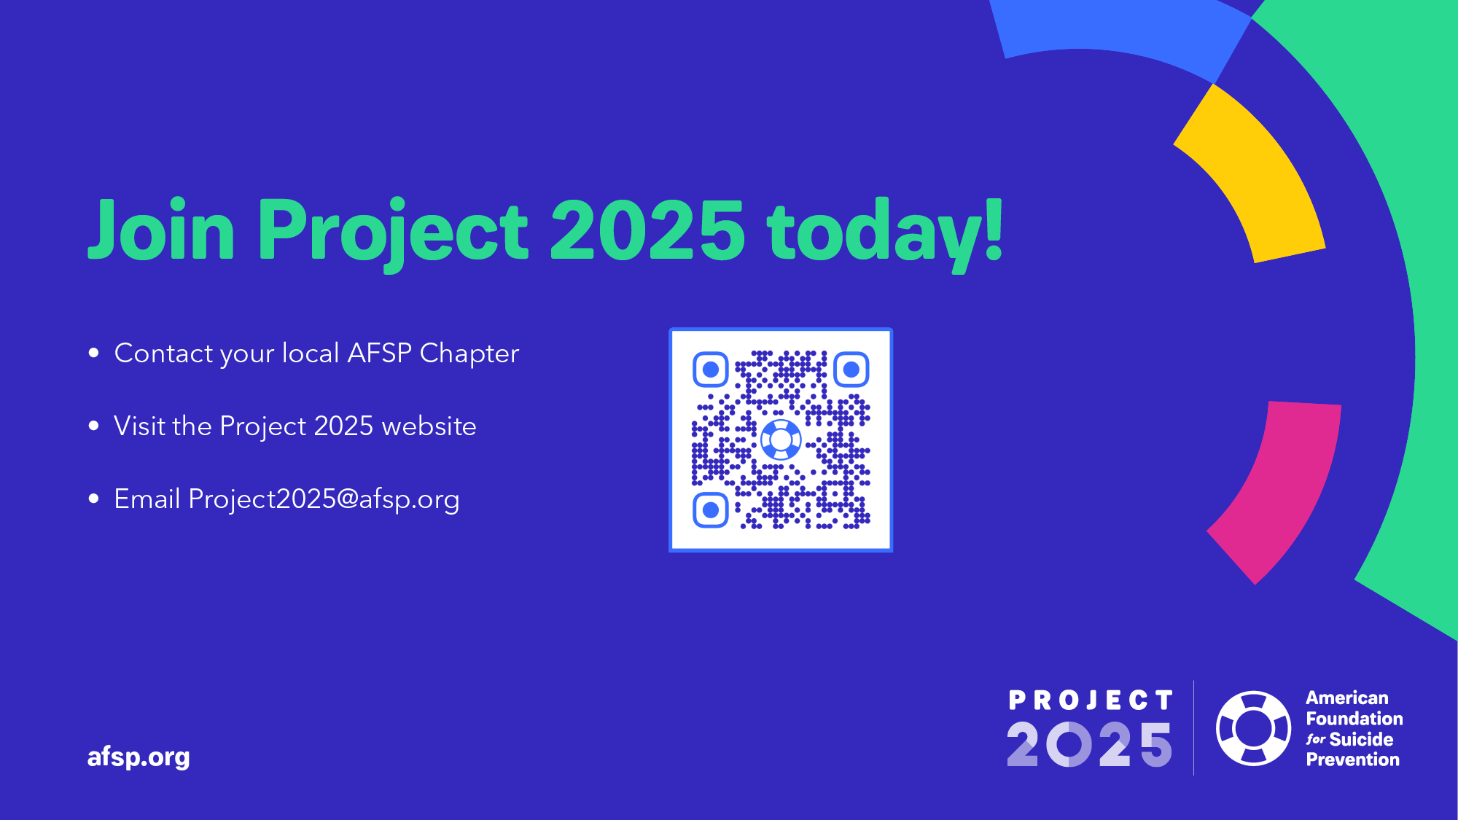
Notes:
Thank you so much for your time! To learn more about the American Foundation for Suicide Prevention’s Project 2025 initiative, you can scan this code to take you to the Project 2025 website.
You can also find it at: Project2025 dot AFSP dot org.

Slide 49
Notes:
Thank you!

