Slide 1
MACRA/MIPS

Slide 2
MACRA
Medicare Access and CHIP Reauthorization Act, landmark legislation that changed Medicare payments to physicians.
Rewards a higher quality of care provided to patients (replaces volume threshold).
Notes:
MACRA (Medicare Access and CHIP Reauthorization Act of 2015): The law intended to steer our healthcare system towards CMS’ three goals of better care, smarter spending, and healthier people by focusing on incentives, care delivery, and information sharing.

Slide 3
MIPS (Merit-based incentive payment system)
Tries to improve the quality of the act by moving Medicare Part B providers to a performance-based payment system.
4 MIPS categories include 1) quality, 2) promoting interoperability (PI), 3) cost, and 4) improvement
Notes:
MIPS was designed to tie payments to quality and cost efficient care, drive improvement in care processes and health outcomes, increase the use of healthcare information, and reduce the cost of care.
MIPS consolidates and sunsets the previous quality programs by CMS, including (VM) Value-based payment modifier, (EHR) Electronic Health Record Reporting system (Meaningful use), and the Physician Quality Reporting System (PQRS).

Slide 4
2021 MIPS Eligible Clinicians (EC)
Physicians (including doctors of medicine, osteopathy, dental surgery, dental medicine, podiatric medicine, and optometry)
Osteopathic practitioners
Chiropractors
Physician assistants
Nurse practitioners
Clinical nurse specialists
Certified registered nurse anesthetists
Physical therapists
Occupational therapists
Clinical psychologists
Qualified speech-language pathologists
Qualified audiologists
Registered dietitians or nutrition professionals

Slide 5
Included in MIPS if …
Bill more than $90,000 a year in allowed charges for covered professional services under the Medicare Physician Fee Schedule (PFS) AND
Excluded from MIPS if…
DO NOT bill more than $90,000 a year in allowed charges for covered professional services under the Medicare Physician Fee Schedule (PFS) OR
Furnish covered professional services to more than 200 Medicare Part B beneficiaries AND
Provide more than 200 covered professional services under the PFS
DO NOT furnish covered professional services to more than 200 Medicare beneficiaries OR
DO NOT provide more than 200 covered professional services under the PFS
Notes:
The Quality Payment Program (QPP) consists of 2 major tracks: MIPS (Merit-based Incentive Payment System AND the Alternative Payment Models (APMs), which Anne Hansen will discuss later.

Slide 6
QPP Participation Status
Determine eligibility (including whether you exceed the low-volume threshold)
Assign special statuses
Non-patient facing: 100 or fewer Medicare Part B patient-facing encounters (including telehealth services)
Small practice: 15 or fewer clinicians (NPIs) billing under the practice (TIN)
Rural: in a zip code designated as rural
Health Professional Shortage Areas (HPSA): in an area designated as a HPSA
Hospital-based: furnishes 75 percent or more of covered professional services in a hospital setting
Ambulatory surgical center (ASC)-based: 75 percent or more of covered professional services in sites of service identified by code 24
MIPS Determination Periods: October 1, 2019 – September 30, 2020 and October 1, 2020 – September 30, 2021
5
Notes:
MIPS Determination Periods
Your eligibility will be reviewed twice during Performance Year. Reviews will analyze CMS Medicare Part B Claims data and PECOS data from two 12-month time periods:

Slide 7
MIPS Payment Adjustment
Payment Adjustment
PLUS bonus money for top performers
2021 MIPS Score Threshold
To avoid a -9% penalty, you must score at least 60 points
To be eligible for bonus money you must score at least 85 points (Exceptional Performance Bonus)
+/- 9% of EC’s 2021 Medicare fee reimbursement payments
Notes:
This is a significant increase from the 45 point threshold in 2020.

Slide 8
2021 MIPS Category Scoring Requirements
Quality
40% of score
365 day performance period
Promoting Interoperability (PI)
25% of score
90 days (minimum) performance period
Improvement Activities (IA)
15% of score
90 days (minimum) performance period
Cost
20% of score
365 day performance period
Notes:
The Quality category
The Improvement Activity has only 1 component and that is to complete one or more improvement activities.
The cost category, there is no requirement for data submission. CMS uses administrative claims data to measure performance.

Slide 9
2021 Quality Reporting
There are 6 collection types for MIPS quality measures:
  Electronic Clinical Quality Measures (eCQMs)
  MIPS Clinical Quality Measures (CQMs)
  Qualified Clinical Data Registry (QCDR) Measures
  Medicare Part B claims measures
  CMS Web Interface measures
  The Consumer Assessment of Healthcare Providers and Systems (CAHPS) for MIPS Survey.
Notes:
Hospital-wide 30 day, all-cause unplanned readmission rate for the MIPS eligible groups will be automatically calculated for those in individual, groups and virtual groups. The same will be done with the Risk-standardized complication rate following elective primary total hip arthroplasty and/or the total knee arthroplasty.

Slide 10
2021 MIPS Reporting Options
Individual
A single National Provider Identifier (NPI) tied to a single Tax Identification Number (TIN)
Group
A set of clinicians (identified by their NPIs) sharing a common TIN. You must report group-level data for each MIPS category
Large Practice
Practice with >25 providers using CMS Web Interface
Must report on all CMS Web Interface measures with a full year’s worth of data
Virtual Group
Individual clinicians and small groups that form one virtual group
Groups must be 10 or less ECs and exceed the low-volume group threshold
Must notify CMS prior to December 31, 2020
Notes:
Clinicians participating in MIPS may participate as individuals or as a member of a group.
Individual
If you report MIPS data in as an individual, your payment adjustment will be based only on your performance. An individual is defined as a single NPI tied to a single TIN.
Group
If you report MIPS data with a group, your payment adjustment is based on the group’s performance. A group is defined as a set of clinicians (at least 2)- identified by their National Provider Identifier (NPI) - sharing a common Taxpayer Identification Number (TIN), no matter the specialty or practice site.
Virtual Group
A Virtual Group is a combination of two or more Taxpayer Identification Numbers (TINs) made up of solo practitioners and groups of 10 or fewer eligible clinicians who come together “virtually” (no matter specialty or location) to participate in MIPS for a performance period of a year.

Slide 11
2021 MIPS PI Objectives
e-Prescribing
e-prescribing (10 points)
Query of Prescription Drug Monitoring Program (PDMP) (10 bonus points)
Health Information Exchange
Support electronic referral loops by sending health information (20 points)
Support electronic referral loops by receiving and reconciling health information (20 points)
Provider to Patient Exchange
Provide patients electronic access to their health information (40 points)
Public Health and Clinical Data Exchange (choose 2 for a total of 10 points)
Immunization Registry Reporting
Electronic Case Reporting
Public Health Registry Reporting
Clinical Data Registry Reporting
Syndromic Surveillance Reporting
11
Notes:
Bonus of 10 points in the electronic prescribing that a query is done in the PDMP

Slide 12
2021 MIPS PI Category
Requirements
Report on 4 measures
Must use 2015 CEHRT
Must submit collected data (unless an exclusion is claimed) for 90 continuous days
Automatic for NP, PA, CRNA, CNS, PT, OT, Speech Pathologist, Audiologist, Clinical Psychologist, Registered Dietitian, Non-Patient Facing, Hospital-based, Ambulatory Surgical Center-based
Can submit data if you choose to be scored based on performance
Must submit a “yes” to:
Reweighting PI Category
Prevention of Information Blocking Attestation
ONC Direct Review Attestation
Security risk analysis measure

Slide 13
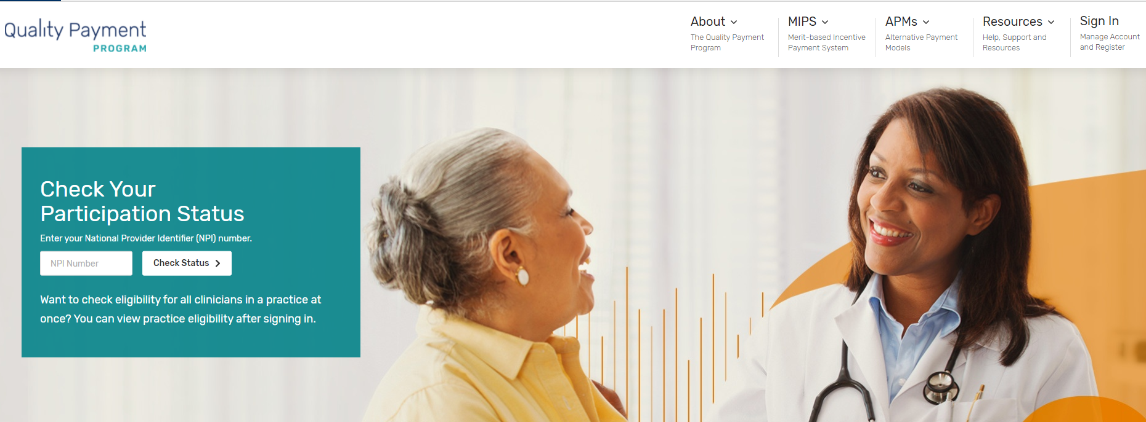
Quality Payment Program (QPP)
https://qpp.cms.gov/
Notes:
Review
Check Participation Status
Explore Measures and Activities
Resource Library

Slide 14
Multi-year MIPS Success Plan
Review current state
Educating leaders
Educate clinicians
Align MIPS program with other quality improvement initiatives
Ensure accurate documentation and coding
Notes:
Understanding where you stand today with MIPS and how changes in 2021 will impact your scores
Educating leaders about the evolution of MIPS over the next 2 years and the resource changes required to position the organization for success
Managing MIPS PI category performance to ensure clinicians are on track for the mandated measures that are now available
Relating the MIPS program to your other VBC or quality improvement initiatives to gain efficiencies, improve overall performance and maximize financial impact
Making informed programmatic decisions about MIPS submission by understanding the impact to your scores and financial reimbursement
Strengthening or establishing a continuous performance improvement discipline among clinicians catalyzed by MIPS, and extensible to other value-based programs
Creating a multi-year QPP roadmap that includes your participation in MIPS and APMs and that is relevant to your organizational goals

Slide 15
Moving Forward
Leadership and Organization-wide Commitment
Set Meaningful Goals
Accurately Manage Data
Create Relevant Scorecards
Notes:
Leadership and organization-wide commitment toward continuous performance improvement is critical to success in MIPS and in the transition to value-based care
As the financial stakes increase, the program gets harder, and scores become public, healthcare organizations will need to have effective insights to set meaningful goals, relevant scorecards to engage clinicians, and accurate data to manage performance

Slide 16
Real-World Strategies
Planning
Select measures that align with current internal priorities
Use resources on the QPP website to create a tracking spreadsheet for selected quality measures and improvement activities
Include providers in selection of quality measures and improvement activities
Monitoring
Track performance on quality measures and improvement activities
Create and share dashboards or reports to keep providers apprised of their progress
Reporting
Understand the ramifications of the various submission mechanisms and how they affect your score
Audit Preparedness
Consult the 2021 Improvement Activities Criteria to understand the documentation to support attestation of Improvement Activities
Create a MIPS Audit Binder/Folder to keep all documentation that supports progress and work on MIPS measures
Notes:
Contact me for advanced consulting help

Slide 18
Contact Information
Erin Starr, RN, BSN, CPHQ
Chief Nursing Officer/Quality, Jefferson Community Health and Life
402.729-6889
erin.starr@jchealthandlife.org

Slide 19
Resources
Quality Payment Program
  https://qpp.cms.gov/
Quality Payment Program Resource Library
  https://qpp.cms.gov/about/resource-library
MIPS 101 - https://qpp-cm-prod-content.s3.amazonaws.com/uploads/607/2019%20MIPS%20101%20Guide.pdf
CMS Presentation “QUALITY PAYMENT PROGRAM YEAR 3 (2019) FINAL RULE OVERVIEW”
  https://www.cms.gov/Medicare/Quality-Initiatives-Patient-Assessment-Instruments/Value-Based-Programs/MACRA-MIPS-and-APMs/QPP-Year-3-Final-Rule-Overview-webinar-slides.pdf

