Slide 1
Leading Change Management
Victoria Kennel, PhD
University of Nebraska Medical Center

Slide 2
Learning Objectives
Prepare your approach for leading change in your organization

Slide 3
What is change management?
The Working Environment
The “Event”
The Psychological Response

Slide 4
This is not easy…

Slide 5
What is the change?
What is the problem, and your need?
What is the desired change?
Does your change address the problem/need?
Are you truly ‘solving’ the problem?
What needs to change about the change itself to best fit the people and the environment?
What needs to change about the people and the environment to best fit the change?

Slide 6
ADKAR Change Model
Awareness
Aware of the change and the reasons for it
Desire
Desire to participate and support the change
Knowledge
Knowledge of the change and its desired outcomes
Ability
Reinforcement
Ability to implement/perform the change at the desired level of performance
Reinforce the change to sustain it until it becomes the norm
Nature of the change. What’s in it for me? Personal situation. Motivational factors.
View of current state. Perception of a problem. Acceptance of change messaging and credibility of sender. Solid reasons for change.
Current knowledge base. Capability to gain new knowledge. Resources for and access to training/education.
Psychological, physical, intellectual capabilities. Time and resources to develop new skills
Incentives/rewards meaningful to the person impacted by the change, is associated with actual progress/accomplishment. No negative consequences. System reinforces change.
Citation: Hiatt JM. ADKAR: A Model for Change in Business, Government, and Our Community. Prosci Research: Loveland, CO. 2006.

Slide 7
Small Group Discussion
What challenges do you experience leading change in your facility?
How might you use aspects of the ADKAR change model to address these challenges?

Slide 8
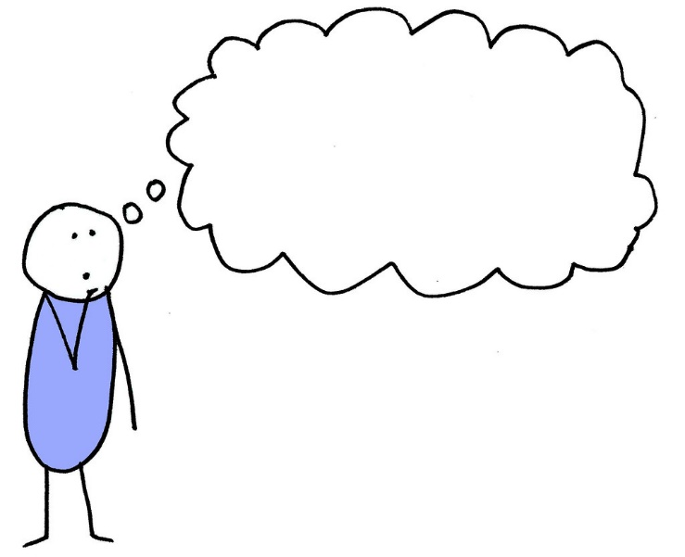
What do they know?
"When did we learn about this?"
"I didn't know I was supposed to do this."
"Why are we doing this?"
Understand the challenge
What do staff know?
Action to encourage behavior change
Match the education method to the type of knowledge
Do staff know that they should be doing this?
Do staff know why they should be doing this?
Evaluate what was (and wasn't) learned (e.g., post-test, pre-post test)
Is the knowledge used on an infrequent or irregular basis? Consider use of reference guides, alerts/reminders, cognitive aids, etc.
Michie et al. (2005)

Slide 9
What can they do?
"I know I'm supposed to do this, but I don't know how."
"I can't do this the way we were told, so I did it another way."
Understand the challenge
Action to encourage behavior change
Offer opportunities for staff to practice or demonstrate the skill, and receive feedback
How easy/difficult is it for staff to do this so that their action meets the desired standards?
Identify the workarounds used, and remove barriers to encourage action consistent with desired protocols
Do staff know how to do this?
Michie et al. (2005)

Slide 10
What do they believe about their capabilities?
"I know how to do it, and can do it, but I just don't feel confident in my ability to do it well in this situation."
Understand the challenge
Do staff believe that they can do this?
Action to encourage behavior change
Provide ample opportunities to practice under different circumstances
How confident are staff in doing this in this specific situation?
Pair staff with role models who can assist and demonstrate successful completion of the activity
Offer positive verbal feedback and encouragement
Encourage staff to visualize themselves performing this activity successfully
Michie et al. (2005)

Slide 11
What are their professional roles and identities?
"This isn't my responsibility"
or “This isn't my job"​
“[My profession] doesn't do this"
Understand the challenge
How does doing this align (or create conflict) with staff professional identity?
Action to encourage behavior change
Reinforce the importance of ‘task assistance,’ ‘mutual support,’ and 'back-up behavior' as key aspects of team-based care
Revisit job descriptions and task responsibilities
Do staff perceive this activity as ‘beyond’ or ‘beneath’ their role?
Identify opportunities for cross-training
Michie et al. (2005)

Slide 12
What do they see others do?
“Other staff members do (don't do) it this way."
"Provider X does (doesn't) do this, so neither do we."
Understand the challenge
Do staff see others doing this? Do others like them do this?
Action to encourage behavior change
Have well-respected role models, champions share information in support of the desired behavior, against the undesired behavior
Are social norms encouraging or discouraging staff from doing this?
Show staff how their performance compares against others
Offer verbal/non-verbal rewards for effort and/or progress
Michie et al., 2005; Tang et al., 2021

Slide 13
What are their goals and motivations?
"I can't do this and this at the same time."
"I know this will keep the patient safe, but the patient will be really upset with me."
Understand the challenge
Do staff feel like they need to do this?
Action to encourage behavior change
Help staff with goal prioritization
Do staff understand the goal of this action?
What competing goals influence staff behavior?
What incentives exist to motivate staff to act?
Ensure goals are clearly defined, explained, and understood
Identify areas where goals are in competition, in conflict with one another
Revisit how you recognize, reward new behavior
Michie et al. (2005)

Slide 14
What do they think will (or won’t) happen if they do (or don’t) act?
“I've done this many times, nothing bad has happened."
"Is adding one more intervention really going to help reduce risk?
Understand the challenge
What will happen if staff do this?
Action to encourage behavior change
Help staff draw connections between their actions and outcomes
What are the perceived costs of doing this? What are the perceived costs of the consequences of doing this?
Do the benefits outweigh the costs?
What will staff feel like if they do, or don't do, this?
Understand staff perceptions of costs vs. benefits of the action
Understand staff perceptions of risk and the why behind them; educate accordingly to ensure perceptions of risk reflect reality
Michie et al. (2005)

Slide 15
Small Group Discussion
Which of these challenges are most prominent in your facility?
How might you adopt some of the proposed strategies to overcome these challenges?

Slide 16
Wrap-Up

