Slide 1
Incorporating 4Ms into Discharge Planning

Slide 2
Objectives
Describe what the 4M’S framework entails for a Critical Access Hospital.
Strategies to align patient goals with their plan of care to improve outcomes, safety, and quality of care
Explore approaches to collaborate with inter-personal teams to ensure patients have expert care while meeting individual needs
Incorporating the 4M’s into the discharge planning process

Slide 3
SAUNDERS MEDICAL CENTER
Notes:
<enter presenter>
Facts/statistics about SMC
Context of CAH within Nebraska

Slide 4
Leadership/Planning
Our Mission
To improve the health of the people of Saunders County and beyond by providing convenient and timely access to high quality comprehensive care with exceptional service and compassion.
Our Vision
We are the Board, Medical Staff, and Employees of Saunders Medical Center, which includes a hospital, long-term care facility, and outpatient clinics.
Saunders Medical Center stays committed to a tradition of excellence through leadership in the provision of quality medical services and health education for the people of Saunders County.
Our Strategic Plan Pillar Quality
Quality work, safety and improvement is our focus in all the work that we do.

Slide 5
SBAR
S-Chart review Age Friendly not documented
B-We changed EMR 2022 to Cerner, COVID
A-Processes are broke
R- Revamp Age Friendly

Slide 6
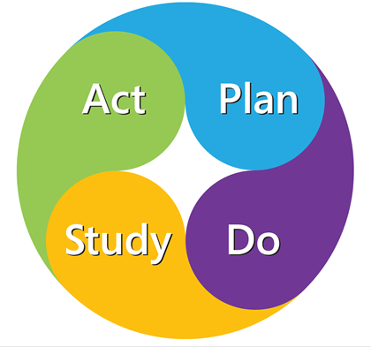
Process Improvement Methods
Multi-Disciplinary Team
Leadership Team
Providers
Pharmacy
Hospital Nursing
Quality
Therapy
Social Work
.
Goal: To improve our Age Friendly Processes, Documentation will be 100% of audited charts

Slide 7
Process Improvement Methods
INTERVENTIONS
TOOLS
Data Collection
Education to Providers and Nursing
Updated Procedure
Worked with EMR vendor and IT for templates
Patient Education
Worked with therapy and pharmacy
Template created
Communication board in patient room
Patient handouts

Slide 8
Results
Showed Improvement
Coaching staff
Collaborating with other departments

Slide 9
Patient Stories

Slide 10
Next Steps
Lessons learned
replicability
sustainability
Buy in is important
Showing the data to all staff at the beginning
Many competing priorities
Respect what matters to the patient even if it is different than clinical goal
Work with other department at SMC Age Friendly through out SMC
Support for continual learning
Provide clear definitions for all staff
Continue work with Vendor
Share results
Share patient stories
Celebrate success
Continued data collection and monitoring
Monitor HCAHPS questions
Monitor and Improve Readmissions
Improve falls

Slide 11
Conclusion
GOAL: To improve our Age Friendly Processes, Documentation will be 100% of audited charts
We are on the journey for improving patient care and are always learning

