Slide 1
NHSN New User Cohort
May 4, 2021

Slide 2
https://www.cdc.gov/nhsn/psc/uti/index.html

Slide 3
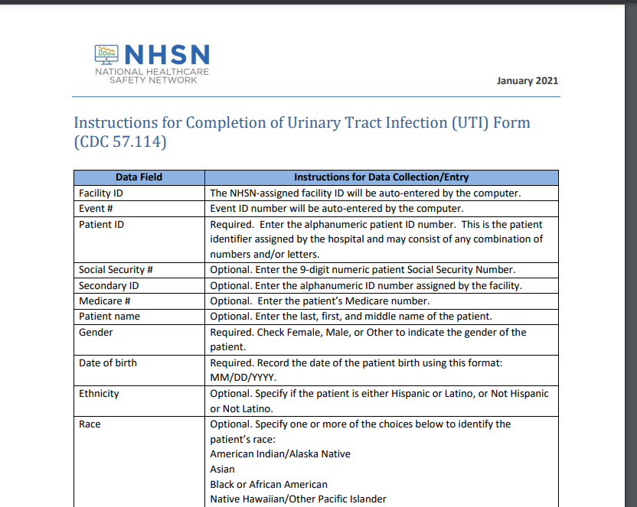
Table of Instructions for UTI Events
https://www.cdc.gov/nhsn/forms/instr/57_114.pdf

Slide 4
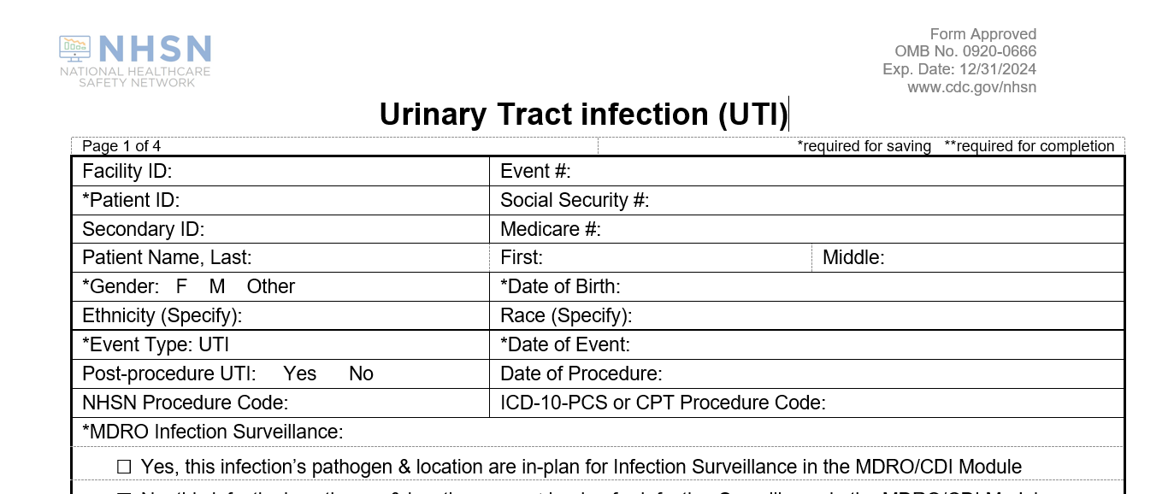
UTI Form
https://www.cdc.gov/nhsn/psc/uti/index.html

Slide 5
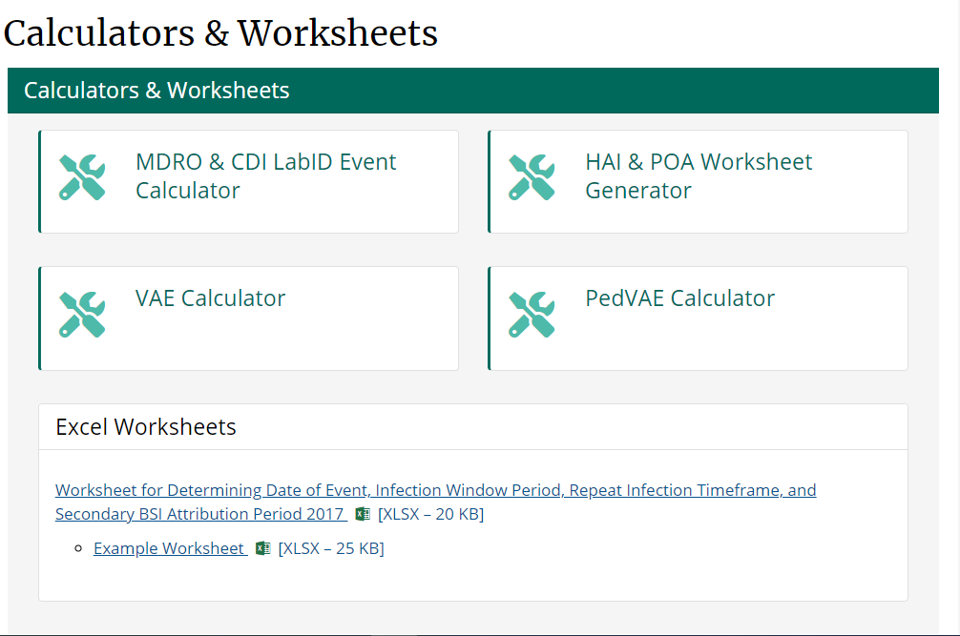
Calculators & Worksheets
https://www.cdc.gov/nhsn/psc/calculators.html

Slide 6
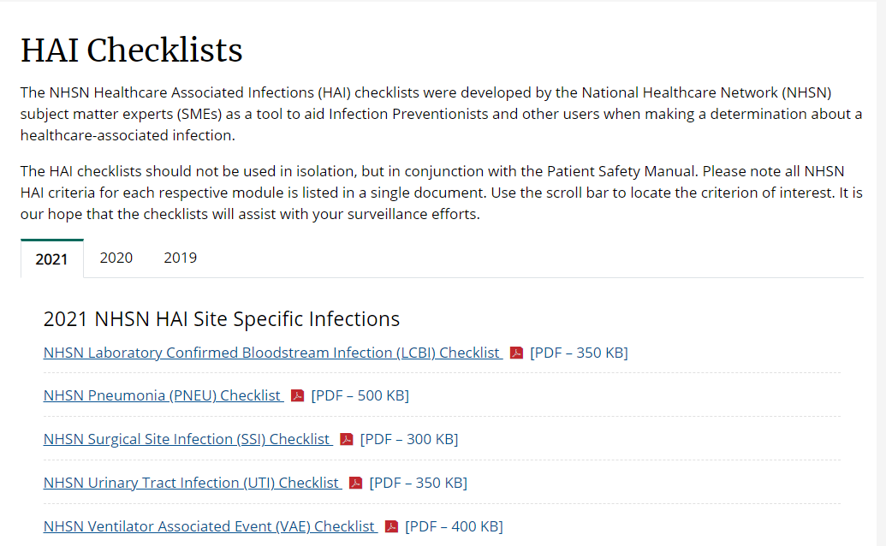
HAI CHECKLISTS
https://www.cdc.gov/nhsn/hai-checklists/index.html

Slide 7
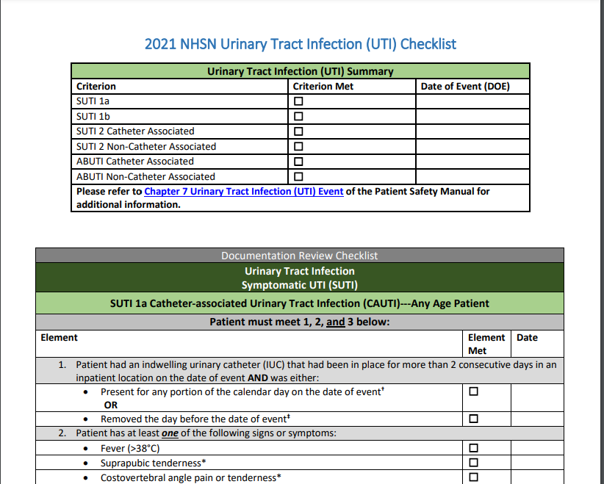
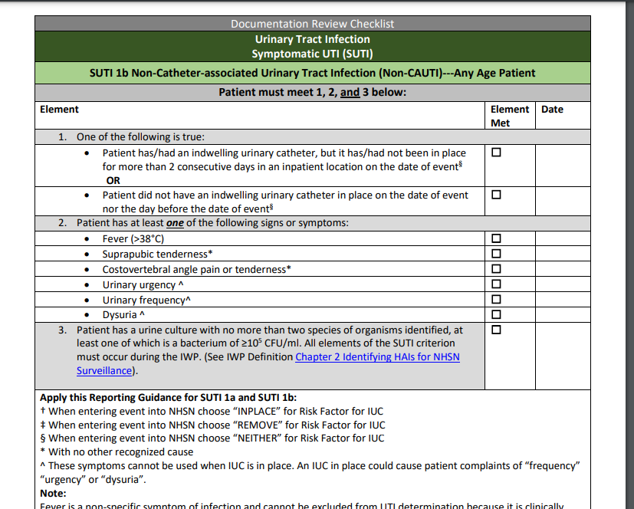
Example of the UTI checklist
https://www.cdc.gov/nhsn/pdfs/checklists/uti-checklist-508.pdf

