Slide 1
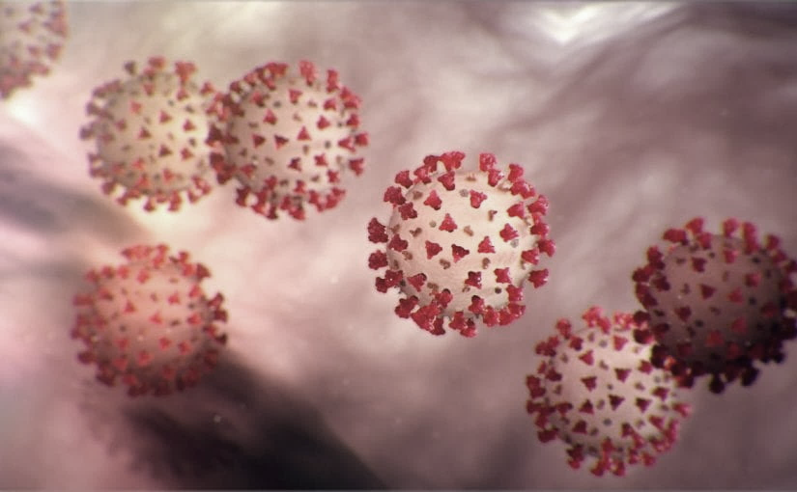
Covid-19 Webex Update 5-11-20
Maureen Tierney, MD, MSc.
Healthcare Associated Infections Medical Director
Tom Safranek, MD, State Epidemiologist

Slide 2
We are one in this fight
Frontline Heroes
Public Health Heroes
First Responder Heroes

Slide 3
NYM George

Slide 4
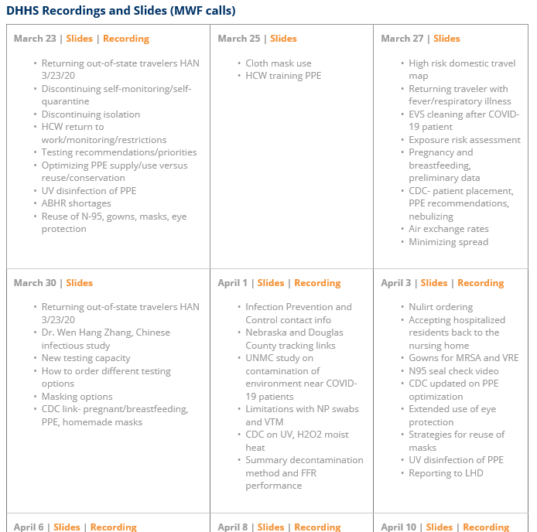
Thank you for joining us!
Slides and recording of today’s presentation will be available at
https://www.nebraskahospitals.org/coronavirus-covid-19-information.html
Scroll to the bottom of the page

Slide 5
Links to Nebraska webinars
Nebraska Acute Care Call every M,W, F at noon
previous calls can be found Nebraska Hospital Association
https://www.nebraskahospitals.org/coronavirus-covid-19-information.html
Nebraska ICAP Long Term Care Webinars every Thursday at noon
previous webinars and questions and answers found on ICAP website
NEW
https://icap.nebraskamed.com/
Nebraska ICAP Combined Critical Access and Outpatient Webinars every Tuesday at non
previous webinars and questions and answers found on ICAP website
https://icap.nebraskamed.com/

Slide 6
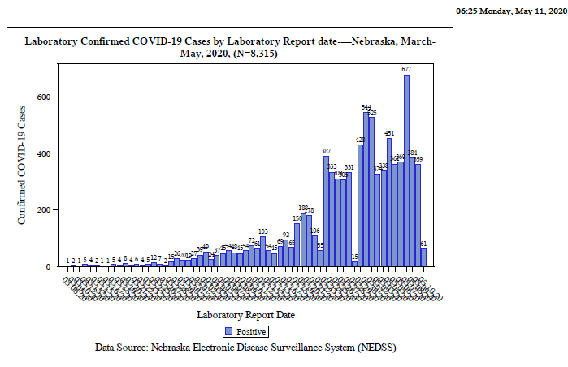

Slide 8
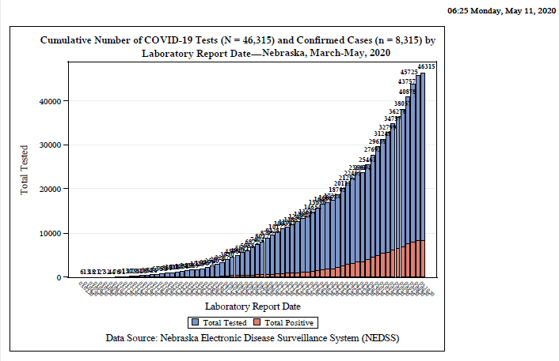

Slide 9
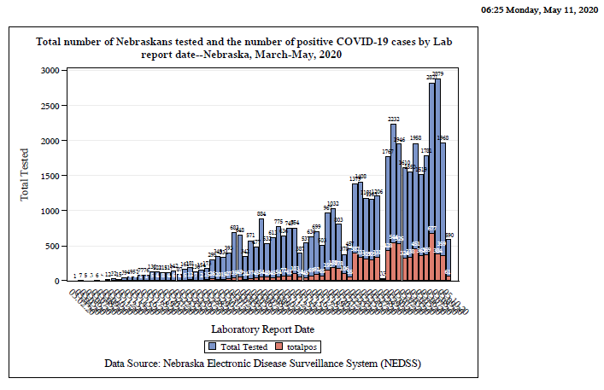

Slide 10
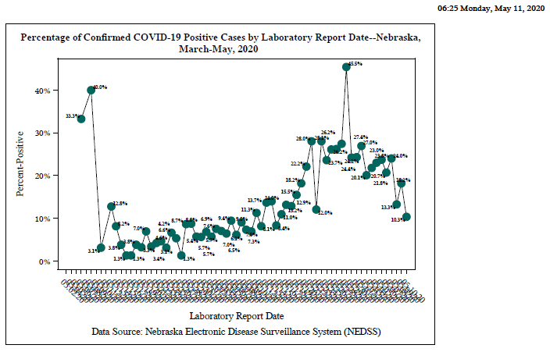

Slide 11
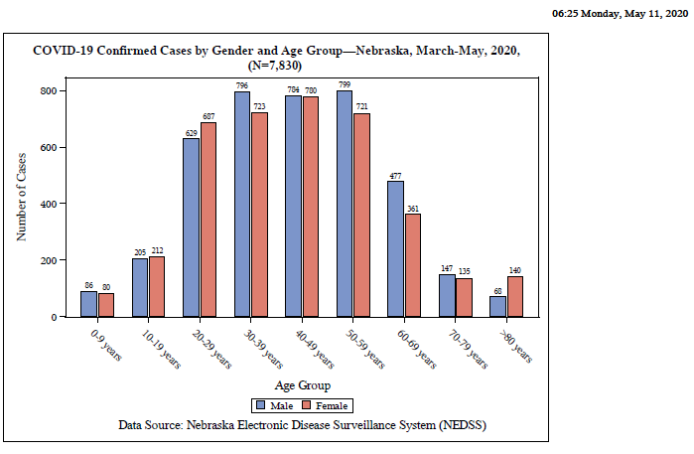

Slide 12
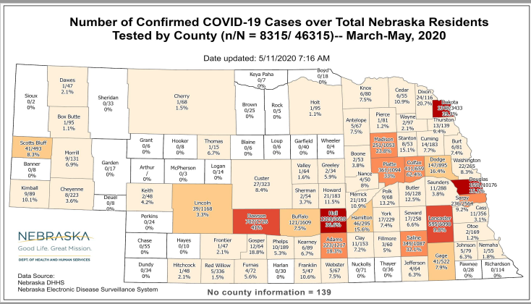

Slide 13
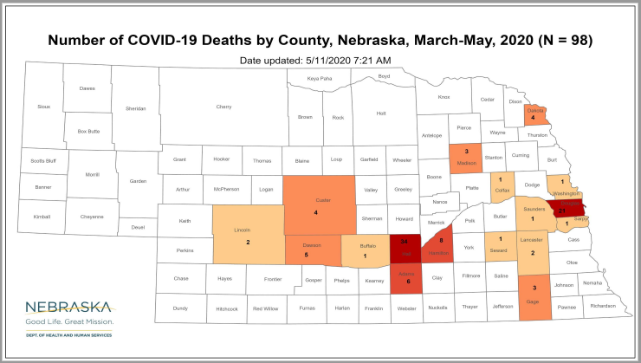

Slide 14
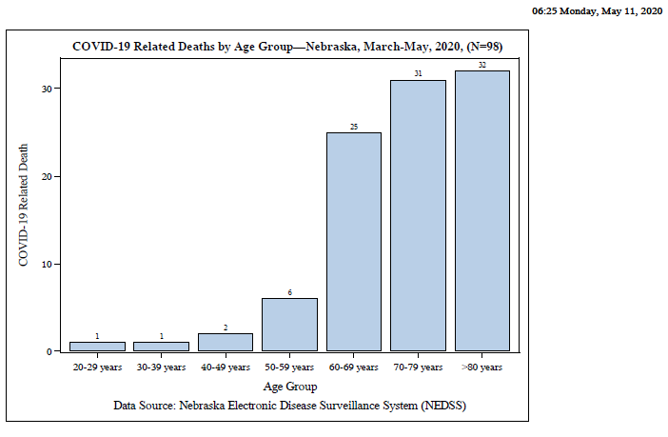

Slide 15
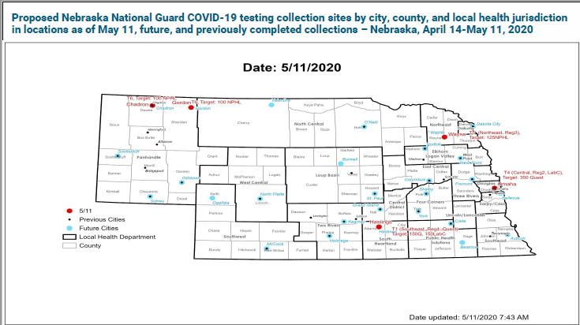

Slide 16
Bed and Vent Availability as of 5-8-20
https://nebraska.maps.arcgis.com/apps/opsdashboard/index.html#/4213f719a45647bc873ffb58783ffef3
47% hospital beds available
43% ICU beds available
75% ventilators available
Transfer Center supported by CHI-not just to/from CHI hospitals

Slide 17
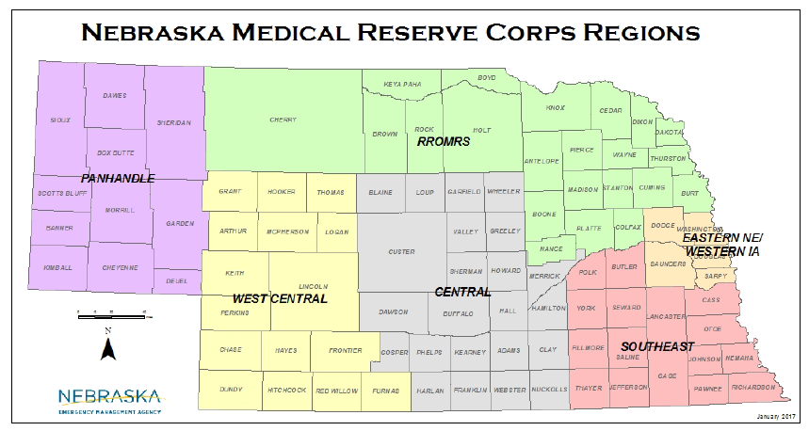

Slide 18
Meat Packing Plants; Shelters
Hall County, Dakota County, Dawson over 1000 cases in NE
In some counties over ¼ of cases; Hall CO drop in cases, Dougls increasing
Shelly Schwedhelm, Dr. Lawler and team -have visited 15 Meat Packing Plants so far
Continuing multiple a week
Closures as necessary to close outbreaks made on case by case basis
Recommendations on Best Practices, a Checklist and A Survey
http://dhhs.ne.gov/Pages/Post-acute-and-Other-Facilities.aspx
More attention and visits to shelters to occur-first was to Open Door Mission
Second being visited this week

Slide 19
LTC COVID 19 Data (as of 5.6.20)
73 Facilities with at least one resident or staff positive for COVID-19
29 LTCF have at least one resident positive
Over 250 positive residents
LHD and ICAP available for help
Every facility with a positive resident and most with a positive staff member have a virtual ICAP visit
NETEC- over 24 onsite visits
Over 40 CDC Tele ICAR visits

Slide 20
Report of Placental Infection
A pregnant woman in Switzerland delivered a stillborn infant at 19 weeks' gestation after testing positive for COVID-19, reported David Baud, MD, PhD, of the Lausanne University Hospital in Switzerland, and colleagues.
"This case of miscarriage during the second trimester of pregnancy in a woman with COVID-19 appears related to placental infection with SARS-CoV-2, supported by virological findings in the placenta," Baud's group wrote in a research letter in JAMA.
After delivery, swabs and biopsies of the placenta tested negative for bacterial infection, but positive for SARS-CoV-2. The placenta remained positive at 24 hours after delivery. No other causes of fetal demise were found.
Baud and colleagues noted that placental infection resulting in miscarriage or fetal growth abnormalities were observed in 40% of maternal infections with SARS and MERS coronaviruses..

Slide 21
Evidence of Maternal Death
Another case series indicated mothers are at risk, too: seven pregnant women testing positive for COVID-19 died of cardiopulmonary complications, reported Kjersti Aagaard, MD, PhD, of the Baylor College of Medicine in Houston, and colleagues in The American Journal of Obstetrics and Gynecology.
Nine women in the series endured a range of cardiopulmonary complications including acute hypotension, persistent hypoxia, organ failure, acute respiratory distress syndrome, and cardiac arrest. Seven… died. This report was the first to document maternal deaths related to COVID-19. Aagaard said this case series does not establish risk; rather, documenting these cases cautions against assuming a low risk before solid data become available.
"The maternal mortality rate is unknown," Aagaard said in an interview with MedPage Today. “… what this report tells us is the mortality rate among pregnant women due to COVID-19 disease is not zero."
Initial reports on more than 150 pregnant women from China indicated only one case of severe cardiopulmonary morbidity but they experienced higher hospitalization and fatality rates during the 2002-2003 SARS epidemic …the SARS mortality rate in the general population was 10.5%, for pregnant women it was 25%..

Slide 22
ORs Positive Pressure vs Negative Pressure
From an onboard ID discussion
We are keeping all ORs positive pressure. We do have an anteroom in one OR that is negative to both the OR and the corridor for high-risk procedures. However, even without an anteroom, the 20 air exchanges per hour are highly protective.
Majority favoring keeping Positive pressure in OR
What are folks doing here?

Slide 23
Pediatric Hyper-Inflammatory Syndrome Possible Related to COVID-19
85 cases, 3 deaths
64 in NY
Others Britain, Italy, Spain, LA
Fever, Rash, conjunctivitis, vessel involvement
More abdominal pain, vomiting, and diarrhea than typical Kawasaki
Shock
Lancet 8 cases from UK 2 SARS CoV2 isolate, 4 epi link. 1 adeno
Rough data ~40-50 +PCR, ~80% + serology (lay press)
Kawasaki like but not all s/s

Slide 24
Asthma and COVID-19
The presence of type 2 inflammation in asthma or allergies, which is associated with lower expression of ACE2, thought to be the entry receptor for SARS-CoV-2 in host cells.
A study in the Journal of Allergy and Clinical Immunology showed "respiratory allergy and controlled allergen exposures are each associated with significant reductions in ACE2 expression,“
Asthma in 5% Chinese population but 1% of Chinese COVID patients
Asthma not in top ten comorbidities in NYC patients despite 10% prevalence in pop.
Role on inhaled steroids unknown

Slide 25
Remdesivir Availability
Gilead Sciences, the drug’s manufacturer, has committed to donating 607,000 vials of remdesivir to treat roughly 78,000 patients in the next six weeks, the department said.
The latest round of remdesivir distributions will send 5,600 vials of remdesivir to Illinois, 4,400 to New Jersey, 1,600 to Michigan, 1,200 to Connecticut and Maryland, and 400 to Iowa.
HHS finally clarified those numbers on Saturday, reporting the delivery of nearly 23,000 vials to New York, nearly 5,000 to Massachusetts, 4,000 to New Jersey, and smaller allotments to Indiana, Virginia, Rhode Island, and Tennessee.
All 50 states will eventually receive doses of Remdesivir

Slide 26
Moderna Vaccine into Phase 2
The U.S. Food and Drug Administration (FDA) completed its review of the Company’s Investigational New Drug (IND) application for its novel coronavirus (SARS-CoV-2 or COVID-19) vaccine candidate (mRNA-1273) allowing it to proceed to Phase 2 study, expected to begin shortly; finalizing protocol for Phase 3 study of mRNA-1273, expected to begin in early summer of 2020

Slide 27
Improvement with Anticoagulation
Anticoagulation was associated with better survival for certain COVID-19 patients in a large observational study from New York City.
Among 2,773 hospitalized COVID-19 patients treated early in the outbreak, the 28% who received systemic anticoagulation saw a similar in-hospital mortality rate as those who went without (22.5% vs 22.8%). Median survival was 21 versus 14 days.
However, among the 395 mechanically ventilated patients, in-hospital mortality was substantially lower with the therapeutic-dose anticoagulation used in that setting -- 29.1% versus 62.7% -- with a median survival of 21 versus 9 days.
Journal of the American College of Cardiology.

Slide 28
NEJM May 7,2020
Observational Study of Hydroxychloroquine in Hospitalized Patients with Covid-19
List of authors.Joshua Geleris, M.D., et al.
CONCLUSIONS
In this observational study involving patients with Covid-19 who had been admitted to the hospital, hydroxychloroquine administration was not associated with either a greatly lowered or an increased risk of the composite end point of intubation or death. Randomized, controlled trials of hydroxychloroquine in patients with Covid-19 are needed. (Funded by the National Institutes of Health.)

Slide 29
Three-Drug Cocktail Appears To Help Patients With Mild To Moderate COVID-19 In Hong Kong Study
Researchers at the University of Hong Kong and six public hospitals in Hong Kong found “patients with mild to moderate” COVID-19, “appeared to improve more quickly if they were treated with a three-drug cocktail, compared with a group receiving just a two-drug combination.” The findings were published in The Lancet.
The three-drug cocktail was made of HIV drug Kaletra (lopinavir-ritonavir), general antiviral
drug ribavirin, and multiple sclerosis drug beta-interferon, while the control group was only
given lopinavir-ritonavir.

Slide 30
SARS-CoV-2 Found in Semen
Semen Of Patients With COVID-19 May Contain SARS-CoV-2, Study Indicates
Reuters (5/7, Kelland) reports that “Chinese researchers who tested sperm of men infected with COVID-19 found that a minority of them had the new coronavirus in their semen, opening up a small chance the disease could be transmitted sexually, scientists said on Thursday.” In the study, 16 percent of men hospitalized with the disease “tested positive for SARS-CoV-2 in their semen.” The study findings were published in JAMA Network Open.

Slide 31
Researchers Say ADT Might Reduce Coronavirus Infection Risk In Men
HealthDay (5/7, Reinberg) reports researchers found that “Italian men with prostate cancer on androgen-deprivation therapy (ADT) were less likely to get infected with” coronavirus “and had less severe cases if they were infected,” suggesting that blocking testosterone might help prevent coronavirus infection in men. Dr. Andrea Alimonti, a Swiss oncologist, said, “This could give us a therapeutic window to treat patients that have been infected and haven’t gotten better, to see whether this therapy would lead them to recover faster or to decrease the severity of their symptoms.” The findings were published in the Annals of Oncology.

Slide 32
New Type of Antigen Test
WASHINGTON -- The FDA gave emergency use authorization (EUA) late Friday to the first SARS-CoV-2 antigen test, which provides results indicating active infection in 15 minutes.
It's less sensitive than the current PCR-based molecular tests, however, and comes with important limits on its use. https://www.fda.gov/media/137884/download
Quidel's Sofia 2 SARS Antigen FIA is a lateral flow immunofluorescent assay that directly detects SARS-CoV-2 viral proteins. It's to be used with nasopharyngeal swabs collected as for PCR.
The EUA allows it to be performed at point-of-care (in locations with a so-called CLIA waiver) as well as in clinical labs. But can run only on Quidel's benchtop Sofia 2 analyzer.
And because Quidel's evaluation indicated it has sensitivity of only 80% relative to PCR tests, "negative results do not rule out infection," the FDA cautioned in announcing the EUA.

Slide 33
FDA Approves EUA for at Home Saliva Test
The decision is part of the FDA’s efforts to expand testing capabilities for the fast-spreading virus, which has caused over 70,000 deaths in the United States.
The saliva test kit was developed by RUCDR Infinite Biologics, a unit of Rutgers’ Human Genetics Institute of New Jersey, and its collaborators, Spectrum Solutions and Accurate Diagnostic Labs.
The test will cost $150 and needs to be fully supervised by a practitioner via telemedicine to ensure proper sample collection, a spokeswoman for RUCDR Infinite Biologics’ partner, Vault Health, told Reuters.
Last week FDA gave an EUA LabCop at home NP swab test

Slide 34
Testing in Nebraska
Average of 1900 tests per day over past week
Goal-10,000 tests per week
List of all the drive thru sites inc. present sites, NG sites, Test NE coming soon
Test Nebraska.com-in partnership with private corporations
Risk assessment questionnaire
Started in GI, Kearney and Omaha Monday
Adding a Lincoln site last Friday
Reporting results underway
Almost All major hospital systems have own drive thru testing

Slide 35
Timing of Development of antibodies
The study, which was published in the Nature Medicine journal by researchers at Chongquin Medical University, “brings much-needed clarity, along with renewed enthusiasm” to efforts to develop and implement widescale antibody testing, National Institutes of Health Director Francis Collins wrote Thursday in a blog post.
Revealed most patient had begun to develop antibody within 2-3 weeks
“Although more follow-up work is needed to determine just how protective these antibodies are and for how long, these findings suggest that the immune systems of people who survive COVID-19 have been primed to recognize SARS-CoV-2 and possibly thwart a second infection,” he wrote, using the technical name for the specific coronavirus causing the disease.

Slide 36
COVID-19 Serology Tests EUAs
EUA Date | Company | Type of Test
5/5 | EuroImmune US | IgG
5/2 | Roche | Total Ab
4/30 | Wadsworth NYSDPH | Total Ab
4/29 | Biorad | Total Ab
4/26 | Abbott | IgG only
4/24 | DiaSorin | IgG only
4/24 | Ortho-Clin | IgG only
4/24 | Autobio | IgM+IgG
4/15 | Mt.Sinai Lab NYC | ElISA IgG
4/14 | Chembio | IgM/IgG
4/14 | Ortho Clin | Total Ab
4/1 | Celley, Inc | IgG/IgM rapid

Slide 37
Viral kinetics of SARS-CoV-2 in asymptomatic carriers and pre-symptomatic patients
Seong Eun Kim et al
Open AccessPublished:May 03, 2020DOI:https://doi.org/10.1016/j.ijid.2020.04.083
High pre-symptomatic titers
Asymptomatic titers-
time to first negative RT-PCR-average 4.5 days (2-9 days)
All negative by 14 days ( supports 14 day Q period)

Slide 38
Donating Plasma and Convalescent Plasma
Donating Plasma
People who have fully recovered from COVID-19 for at least two wks are encouraged to consider donating plasma, which may help save the lives of other patients. COVID-19 convalescent plasma must only be collected from recovered individuals if they are eligible to donate blood. Individuals must have had a prior diagnosis of COVID-19 documented by a lab test and meet other donor criteria. Individuals must have complete resolution of symptoms for at least 28 days before they donate, or alternatively have no symptoms for at least 14 days prior to donation and have a neg lab test for active COVID-19 disease.
~American Red Cross
~Innovative Blood resources (IBR) which is based out of the twin cities (MN) in con partnership with Nebraska Community Blood Bank NPCC
Convalescent Plasma
CHI facilities involved in Mayo Clinic Protocol-convalescent plasma

Slide 39
Infection Prevention and Control Office Hours
Monday – Friday
7:30 AM – 9:30 AM Central Time
2:00 PM -4:00 PM Central Time
Call 402-552-2881

Slide 40
STOP HERE

Slide 41
Off Site Quarantine and Convalescence
HCPs and First Responders who wish to Q away from family in hotels- call 833 220 0018
(NEDHHS) will be expanding its pilot program to provide temporary accommodations to residents exposed to coronavirus disease (COVID-19) who need to quarantine or isolate. The program, coined NAP the Nebraska Accommodation Project, (on NE DHHS COVID 19 website)
The goal of this program is to offer temporary housing to Nebraskans that have been exposed to COVID-19 or are positive for COVID-19 and do not need any assistance with ADL and can mange their own health issues and are in need of a quarantine and/or isolation location outside of the normally defined household due to a high-risk household member. These accommodations will be available in a dormitory room setting and are open to anyone that meets the application criteria. Applications must be completed online at http://dhhs.ne.gov/Pages/Coronavirus look for the Nebraska Accommodation Project (NAP) header.
All ER heads given a number to call to expedite such transfer
Initially, the University of Nebraska Omaha (UNO) will be used for NAP. UNL, UNK, and other campuses may come onboard later.
6. Accommodations for Meat Packing Employees

Slide 42
When Home Quarantine can be discontinued
Discontinuation of self-monitoring and self-quarantine:
Self-quarantine and self monitoring may stop if after 14 days from most recent exposure, there has been NO development of respiratory illness symptoms. Symptoms may include: cough, shortness of breath, fever, sore throat, and fatigue, myalgias, diarrhea.
Discontinuation of quarantine for household members of a person with COVID-19 who is under self-isolation:
Individuals who are at home with someone that has (or is suspected of having) COVID-19 should continue self-quarantine for 7 days after patient has been released from isolation AND then continue 7 more days with self-monitoring (total of 14 days).
These guidelines may not always pertain decisions regarding admission/discharge and transfer to/from healthcare facilities.

Slide 43
Changes in CDC Guidance regarding Isolation
Extended the home isolation period from 7 to 10 days since symptoms first appeared for the symptom-based strategy in persons with COVID-19 who have symptoms and from 7 to 10 days after the date of their first positive test for the time-based strategy in asymptomatic persons with laboratory-confirmed COVID-19. This update was made based on evidence suggesting a longer duration of viral shedding and will be revised as additional evidence becomes available. This time period will capture a greater proportion of contagious patients; however, it will not capture everyone.
Also extended the transmission-based precaution in healthcare settings based on a symptom or time based approach to be 10 days from symptom onset or test results in an asymptomatic person

Slide 44
When home isolation is over
• Discontinuation from self-isolation for a symptomatic case (confirmed or probable):
CDC guidance (https://www.cdc.gov/coronavirus/2019-ncov/hcp/disposition-in-homepatients.html) states that an individual can stop self-isolation if it has been at least 10 days since symptoms first appeared AND No fever for at least 72 hours (fever-free for 3 full days off fever-reducing medicine) AND All other symptoms have improved (e.g., cough has improved).
• Discontinuation from self-isolation for an asymptomatic laboratory-confirmed case.
•Persons with laboratory-confirmed COVID-19 who have not had any symptoms may discontinue isolation when at least 10 days have passed since the date of their first positive COVID-19 diagnostic test and have had no subsequent illness provided they remain asymptomatic. For 3 days following discontinuation of isolation, these persons should continue to limit contact (stay 6 feet away from others) and limit potential of dispersal of respiratory secretions by wearing a covering for their nose and mouth whenever they are in settings where other persons are present. In community settings, this covering may be a barrier mask, such as a bandana, scarf, or cloth mask. The covering does not refer to a medical mask or respirator.

Slide 45
Discontinuation of Transmission-Based Precautions for patients with COVID-19:
Symptomatic patients with COVID-19 should remain in Transmission-Based Precautions until either:
Symptom-based strategy
At least 3 days (72 hours) have passed since recovery defined as resolution of fever without the use of fever-reducing medications and improvement in respiratory symptoms (e.g., cough, shortness of breath); and,
At least 10 days have passed since symptoms first appeared
Test-based strategy
Resolution of fever without the use of fever-reducing medications and
Improvement in respiratory symptoms (e.g., cough, shortness of breath), and
Negative results of an FDA Emergency Use Authorized COVID-19 molecular assay for detection of SARS-CoV-2 RNA from at least two consecutive respiratory specimens collected ≥24 hours apart (total of two negative specimens) [1]. See Interim Guidelines for Collecting, Handling, and Testing Clinical Specimens for 2019 Novel Coronavirus (2019-nCoV). Of note, there have been reports of prolonged detection of RNA without direct correlation to viral culture.

Slide 46
Asymptomatic Patients
Patients with laboratory-confirmed COVID-19 who have not had any symptoms should remain in Transmission-Based Precautions until either:
Time-based strategy
10 days have passed since the date of their first positive COVID-19 diagnostic test, assuming they have not subsequently developed symptoms since their positive test. Note, because symptoms cannot be used to gauge where these individuals are in the course of their illness, it is possible that the duration of viral shedding could be longer or shorter than 10 days after their first positive test.
Test-based strategy
Negative results of an FDA Emergency Use Authorized COVID-19 molecular assay for detection of SARS-CoV-2 RNA from at least two consecutive respiratory specimens collected ≥24 hours apart (total of two negative specimens). Note, because of the absence of symptoms, it is not possible to gauge where these individuals are in the course of their illness. There have been reports of prolonged detection of RNA without direct correlation to viral culture.
Note that detecting viral RNA via PCR does not necessarily mean that infectious virus is present.

Slide 47
Return to Work Criteria for HCP with Confirmed or Suspected COVID-19
Symptomatic HCP with suspected or confirmed COVID-19:
Symptom-based strategy. Exclude from work until:
At least 3 days (72 hours) have passed since recovery defined as resolution of fever without the use of fever-reducing medications and improvement in respiratory symptoms (e.g., cough, shortness of breath); and,
At least 10 days have passed since symptoms first appeared
Test-based strategy. Exclude from work until:
Resolution of fever without the use of fever-reducing medications and
Improvement in respiratory symptoms (e.g., cough, shortness of breath), and
Negative results of an FDA Emergency Use Authorized COVID-19 molecular assay for detection of SARS-CoV-2 RNA from at least two consecutive nasopharyngeal swab specimens collected ≥24 hours apart (total of two negative specimens

Slide 48
Return to Work Criteria for HCP with Confirmed or Suspected COVID-19 (Continued)
HCP with laboratory-confirmed COVID-19 who have not had any symptoms:
Time-based strategy. Exclude from work until:
10 days have passed since the date of their first positive COVID-19 diagnostic test assuming they have not subsequently developed symptoms since their positive test. If they develop symptoms, then the symptom-based or test-based strategy should be used. Note, because symptoms cannot be used to gauge where these individuals are in the course of their illness, it is possible that the duration of viral shedding could be longer or shorter than 10 days after their first positive test.
Test-based strategy. Exclude from work until:
Negative results of an FDA Emergency Use Authorized COVID-19 molecular assay for detection of SARS-CoV-2 RNA from at least two consecutive nasopharyngeal swab specimens collected ≥24 hours apart (total of two negative specimens). Note, because of the absence of symptoms, it is not possible to gauge where these individual are in the course of their illness. There have been reports of prolonged detection of RNA without direct correlation to viral culture.
Note that detecting viral RNA via PCR does not necessarily mean that infectious virus is present.Consider consulting with local infectious disease experts when making decisions about discontinuing Transmission-Based Precautions for individuals who might remain infectious longer than 10 days (e.g., severely immunocompromised).
If HCP had COVID-19 ruled out and have an alternate diagnosis (e.g., tested positive for influenza), criteria for return to work should be based on that diagnosis.

Slide 49
Return to Work Practices and Work Restrictions
After returning to work, HCP should:
Wear a facemask for source control at all times while in the healthcare facility until all symptoms are completely resolved or at baseline. A facemask instead of a cloth face covering should be used by these HCP for source control during this time period while in the facility. After this time period, these HCP should revert to their facility policy regarding universal source control during the pandemic.
A facemask for source control does not replace the need to wear an N95 or higher-level respirator (or other recommended PPE) when indicated, including when caring for patients with suspected or confirmed COVID-19.
Of note, N95 or other respirators with an exhaust valve might not provide source control.
Self-monitor for symptoms, and seek re-evaluation from occupational health if respiratory symptoms recur or worsen
https://www.cdc.gov/coronavirus/2019-ncov/hcp/return-to-work.html

Slide 50
Testing Exposed HCWs
Overall Recommendation is not to do so
ICSA, SHEA do not routinely recommend
Understand individual situations may require a different approach
Outbreaks in LTC

Slide 51
When a Testing-Based Strategy is Preferred
Hospitalized patients may have longer periods of SARS-CoV-2 RNA detection compared to patients with mild or moderate disease. Severely immunocompromised patients (e.g., medical treatment with immunosuppressive drugs, bone marrow or solid organ transplant recipients, inherited immunodeficiency, poorly controlled HIV) may also have longer periods of SARS-CoV-2 RNA detection and prolonged shedding of infectious recovery. These groups may be contagious for longer than others. In addition, placing a patient in a setting where they will have close contact with individuals at risk for severe disease warrants a conservative approach.
Hence, a test-based strategy is preferred for discontinuation of transmission-based precautions for patients who are
Hospitalized or
Severely immunocompromised or
Being transferred to a long-term care or assisted living facility
If testing is not readily available, facilities should use the non-test-based strategy for discontinuation of Transmission-Based Precautions or extend the period of isolation beyond the non-test-based-strategy duration, on a case by case basis in consultation with local and state public health authorities.
From CDC updated IP Guidance 4/15/20

Slide 52
New CDC LTC COVID Resources
Webinar Series: Sparkling Surfaces Clean Hands Closely Monitor Residents Keep COVID-19 Out! PPE Lessons

Slide 53
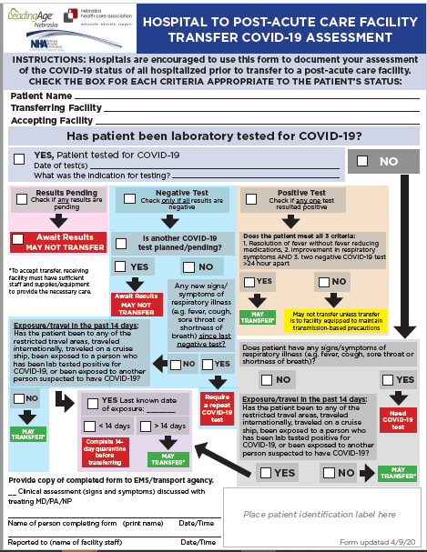

Slide 54
LTCF Support by DHHS HAI/ICAP
Collecting LTC epi data by facility and LHD
Continuing 1:1mentoring and support for each LTCF with a COVID-19+ resident or staff
thru ICAP office 402-582-4881 M-F 7:30 to 4 pm
after hours through LHD or Dr. Kamal-Ahmed Ishrat.kamal-ahmed@Nebraska.com
Tele-ICAR by CDC
Developing our own preemptive Tele-Icar to expand on CDC efforts
Weekly webinars on Thursdays at noon-ICAP site
Creating guidances and resources on Nebraska ICAP site.
NETEC teams doing onsite visits
Expanding testing with NG and CDC.

Slide 55
Figure: Cohorting Residents in the Long-Term Care Facilities
Red Zone (Isolation zone) | Dark Red | Residents with Positive COVID-19 test
 | Light Red | Symptomatic residents suspected of having COVID-19
Yellow Zone (Quarantine zone) |  | Asymptomatic residents who may have been exposed to COVID-19
Green Zone (COVID-19 free zone) |  | Asymptomatic residents without any exposure to COVID-19
Gray Zone (Transitional zone) |  | Residents who are being transferred from the hospital/outside facilities (but have no known exposure to COVID-19) are usually kept in this zone for 14 days and if remains asymptomatic at the end of 14 day will be moved to Green zone
https://icap.nebraskamed.com/wp-content/uploads/sites/2/2020/04/Cohorting-Plan-for-LTCF-4.16.20.pdf.

Slide 56
FEMA Supplies to LTC
White House Coronavirus Task Force, FEMA will coordinate two shipments totaling a 14-day supply of personal protective equipment (PPE) to more than 15,400 Medicare and Medicaid-certified nursing homes across the Nation, including all 50 states, the District of Columbia, Puerto Rico and Guam.
By the beginning of July, each facility will receive two, separate packages containing a seven-day supply of eye protection, surgical masks, gowns, and gloves. Each package will be individualized for each nursing home based upon their level of staffing.

Slide 57
Interim Infection Prevention and Control Recommendations for Patients with Suspected or Confirmed Coronavirus Disease 2019 (COVID-19) in Healthcare Settings: https://www.cdc.gov/coronavirus/2019-ncov/hcp/infection-control-recommendations.html
Additional Guidance for Nursing Homes and Long-Term Care Settings: https://www.cdc.gov/coronavirus/2019-ncov/hcp/long-term-care.html
Key Strategies to Prepare for COVID-19 in Long-term Care Facilities (LTCFs): https://www.cdc.gov/coronavirus/2019-ncov/hcp/long-term-care-strategies.html
Preparedness Checklist for Nursing Homes and Other Long-Term Care Settings: https://www.cdc.gov/coronavirus/2019-ncov/hcp/long-term-care-checklist.html

Slide 58
PPE Request Form
https://form.jotform.com/NebraskaDHHS/PPERequestForm

Slide 59
How to determine PPE needs
PPE Burn Rate Calculator
Personal Protective Equipment Burn Rate Calculator excel icon[XLS – 39 KB]
This spreadsheet can help healthcare facilities plan and optimize the use of personal protective equipment (PPE) for response to coronavirus disease 2019 (COVID-19). Get the Instructions
PPE Requests need to go to LHD, shipments go out to LHD and then from LHD to facilities as soon as possible. Often don’t know when shipments are arriving.

Slide 60
Home Healthcare Guidances
https://www.nahc.org/resources-services/coronavirus-resources/

Slide 61
LTC Accepting Patients
When should a nursing home accept a resident who was diagnosed with COVID-19 from a hospital?
A nursing home can accept a resident diagnosed with COVID-19 and still under Transmission-Based Precautions for COVID-19 as long as the facility can follow CDC guidance for Transmission-Based Precautions. If a nursing home cannot, it must wait until these precautions are discontinued. CDC has released Interim Guidance for Discontinuing Transmission-Based Precautions or In-Home Isolation for Persons with Laboratory-confirmed COVID-19. Information on the duration of infectivity is limited, and the interim guidance has been developed with available information from similar coronaviruses. CDC states that decisions to discontinue Transmission-based Precautions in hospitals will be made on a case-by-case basis in consultation with clinicians, infection prevention and control specialists, and public health officials. Discontinuation will be based on multiple factors (see current CDC guidance for further details).

Slide 62
Post Mortem Guidance
Https://www.cdc.gov/coronavirus/2019-ncov/hcp/guidance-postmortem-specimens.html
Guidance for post-mortem specimens (NP swabs)
Guidance for Funeral Directors

Slide 63
Strategies to Mitigate Healthcare Personnel Staffing Shortages
Maintaining appropriate staffing in healthcare facilities is essential to providing a safe work environment for HCP and safe patient care. As the COVID-19 pandemic progresses, staffing shortages will likely occur due to HCP exposures, illness, or need to care for family members at home. Healthcare facilities must be prepared for potential staffing shortages and have plans and processes in place to mitigate them, including considerations for permitting HCP to return to work without meeting all return to work criteria above. Refer to the Strategies to Mitigate Healthcare Personnel Staffing Shortages document for information. As part of this, asymptomatic HCP with a recognized COVID-19 exposure might be permitted to work as a crisis capacity strategy to address staffing shortages if they wear a facemask for source control for 14 days after the exposure. This time period is based on the current incubation period for COVID-19 which is 14 days.
From CDC 4.30.20

Slide 64
Staffing Needs
NE DHHS COVID Staffing Support Program
Caryn N Vincent, MPH | Interim Deputy Director, Public Health | Nebraska Department of Health and Human Services
Email: Caryn.Vincent@nebraska.gov
Phone: 402-471-1595 or 402-613-2377
Please provide facility name, type of professional support needed, and contact information. Someone will contact you regarding your request within 24 hours.

Slide 65
CDC'S CURRENT LIST OF CORONAVIRUS SYMPTOMS
Fever
Cough
Shortness of Breath
Chills
Repeated shaking with chills
Muscle pain
Headache
Sore throat
New loss of taste or smell
In US more GI-25% diarrhea, 10% vomiting
New info about neurologic effects, including stroke, GB

Slide 66
What to Do When Large Numbers of Staff Exposed (Mostly LTC Issue, but also SCAH)
Evaluation including LHD, DHHS Epi, NE CMS, ICAP, to help determine level of exposure, staffing needs, support needed for staff and infection prevention.
When feasible keep HCPs who have been exposed at home for 14 days if staffing permits.
If cannot do #2, assess level of exposure, if can triage medium risk HCPs back to work but keep out high risk exposures in Q do so;
If #3 not possible, according to CDC and CMS “facilities could consider allowing asymptomatic HCP who have had an exposure to a COVID-19 patient to continue to work after options to improve staffing have been exhausted and in consultation with their occupational health program (or LHD, CMD, DHHS and/or ICAP)
These HCP should still report temperature and absence of symptoms each day prior to starting work. Facilities should have exposed HCP wear a facemask while at work for the 14 days after the exposure.
If HCP develop even mild symptoms consistent with COVID-19, they must cease patient care activities, don a facemask (if not already wearing), and notify their supervisor or occupational health services prior to leaving work.

Slide 67
Registration link: https://unmc.zoom.us/webinar/register/WN_9jB8mb2CQmWeuD82yxbJ2g

Slide 68
Thanks to NM procedure sharing
https://www.nebraskamed.com/sites/default/files/documents/covid-19/surgical-mask-policy-and-faq-nebraska-med.pdf
For how to use one mask per staff per day
For pictures on how to lay out mask on a paper towel go to above website

Slide 69
Resources (as of 8:00am 3/30/20)
Exposure Risk Assessment
https://www.cdc.gov/coronavirus/2019-ncov/hcp/guidance-risk-assesment-hcp.html
Guidance for pregnant and breastfeeding mothers
https://www.cdc.gov/coronavirus/2019-ncov/need-extra-precautions/pregnancy-breastfeeding.htmll
Guidance for PPE
https://www.cdc.gov/coronavirus/2019-ncov/hcp/ppe-strategy/index.html
Regarding use of homemade masks
https://www.cdc.gov/coronavirus/2019-ncov/hcp/ppe-strategy/face-masks.html

Slide 70
Presentation prepared by: Dr. Maureen Tierney and Dr. Tom Safranek
HAI/AR Epidemiologist
Ishrat.kamal-ahmed@Nebraska.gov
402-471-2937

